Slide 1
Surrender
American Battlefield Trust

Slide 2
Inquiry Question: Does Lee’s surrender at Appomattox effectively end the conflict known as the American Civil War?
Notes:
Ask students to create a hypothesis of the answer to this question. Have students either discuss in groups their ideas or as a class. Ask students how they produced those hypothesis.

Slide 3
Vocabulary
Surrender – To admit defeat and give up in the face of overwhelming odds. Most defeated generals were able to negotiate surrender terms. These might include items like parole instead of prison for the soldiers or letting officers keep their sidearms.
Siege (pronounced seej) – Blocking the supply lines and escape routes of a city to force it to surrender. A siege usually meant one army trapped in a city, slowly running out of food and fresh water, with the opposing army camped outside. Famous sieges were held at Petersburg, Vicksburg, and Port Hudson.
Siege lines – Lines of works and fortifications that are built by both armies during a siege. The defenders build earthworks to strengthen their position inside a fort or city against assault while the besieging army constructs fortifications to protect siege guns and soldiers from sharpshooters inside the city.
Notes:
More terms and definitions can be found on the “Glossary of Civil War Terms” page: https://www.battlefields.org/glossary-civil-war-terms

Slide 4
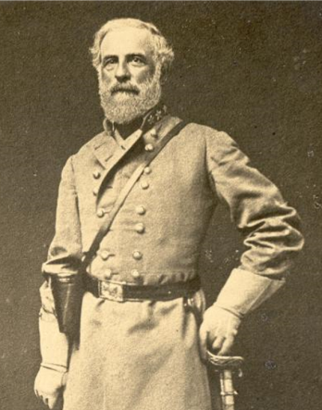
End of 1863
With success at Gettysburg and Vicksburg the war is going in favor of the Union forces, but three years of war has taken its toll on the nation.
Ulysses S. Grant, defeats the Confederate defenses of Vicksburg in July 1863.
November 1863, Lincoln gives the Gettysburg Address.
Robert E. Lee, retreats from Gettysburg, PA in July 1863 and returned to Virginia.
Notes:
Discussion Questions:
How do you think the Civil War changed with Lee left Pennsylvania (the North) and retreated to the South? Do you agree with historians that say that Gettysburg was the high-water mark of the Confederacy?

Slide 5
The Entire Civil War Animated Map
Watch from 21:12-24:40
Notes:
Watch for an overview of the War in 1864 and 1865. This will include battles mentioned later in the PowerPoint
https://www.battlefields.org/learn/maps/entire-civil-war-animated-map

Slide 6
March 1864
Abraham Lincoln appoints General Ulysses S. Grant as commander of ALL U.S. forces - for the first time one commander will oversee the entire Union Army.

Slide 7
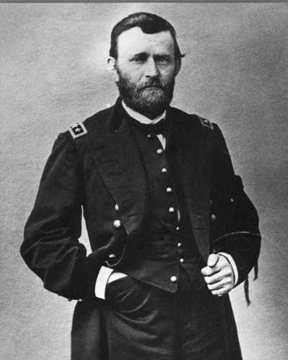
Bringing the War to an End
General Grant moves himself to the Eastern front to move on the Confederate capital, Richmond, Virginia.
Union General William T. Sherman will move towards the capture of Atlanta. Atlanta is a railroad hub and a city that manufactures numerous goods for the Confederacy.
Notes:
Discussion Question:
Why do you think Grant and Sherman targeted these cities?
Both generals are trying to force a Union victory:
Grant is focusing on taking over the Confederacy’s political center
Sherman is focusing on taking over the Confederacy’s economic center

Slide 8
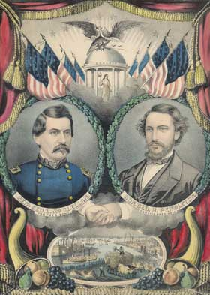
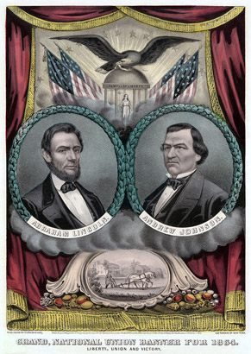
Election of 1864
Abraham Lincoln runs for re-election in his campaign against his former General, George B. McClellan.
A poster of the Democrat ticket.
A poster of the Republican ticket.
Notes:
While the campaigns are underway, Lincoln is up for reelection.
Lincoln wants to remain in the war and retain the Union
McClellan wants to start peace talks immediately even if that means letting the Confederate States secede
Lincoln wins the election
Discussion Question:
Why would voters vote for McClellan? Why would they vote for Lincoln?

Slide 9
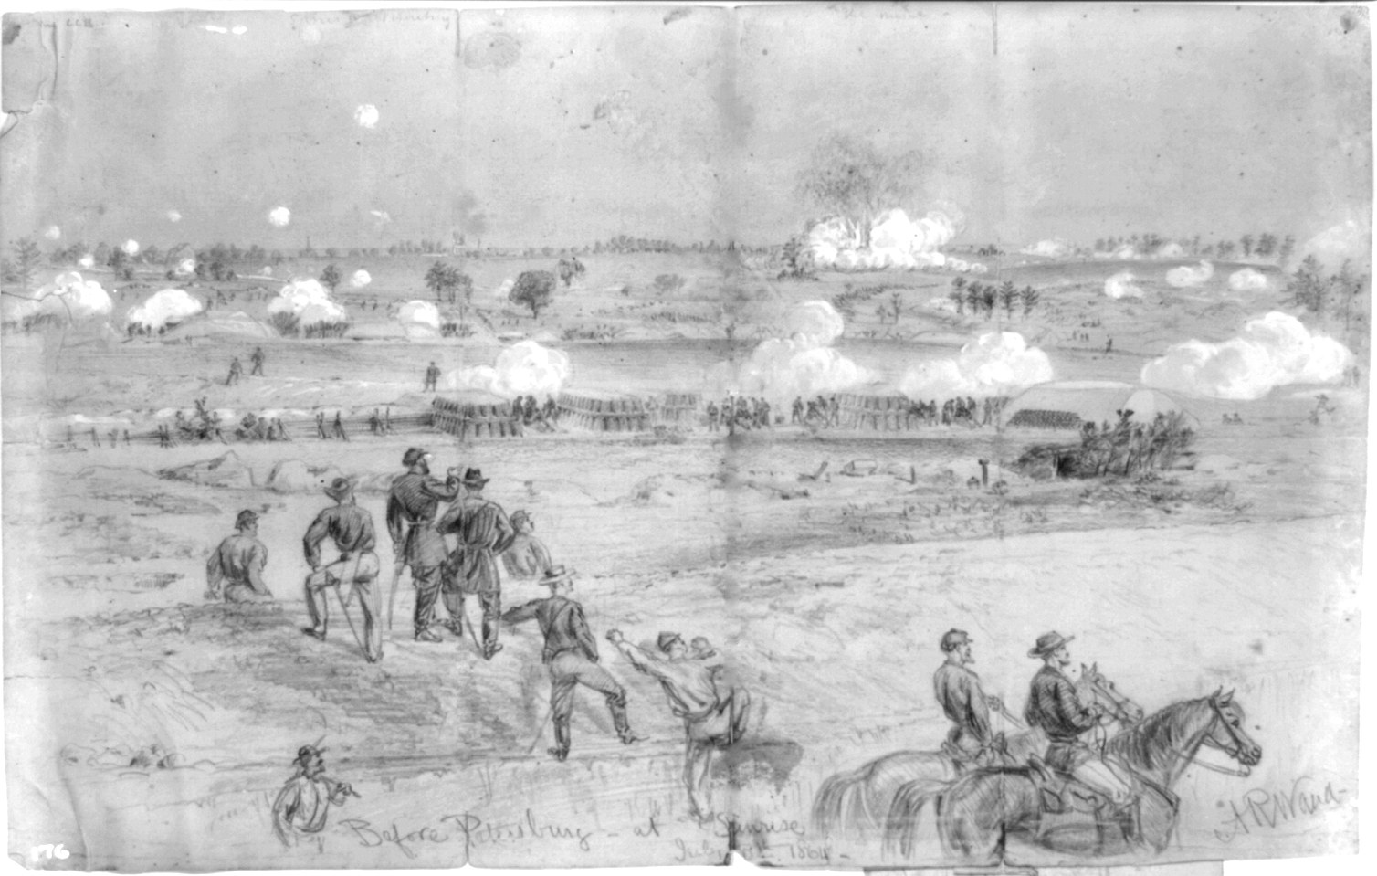
Siege of Petersburg: June 15, 1864 – April 2, 1865
Petersburg, VA was a main supply hub for the Confederate Army and for Richmond, the capital of the Confederacy
Battle of Petersburg: June 15 – 18, 1864
Confederate Victory
Grant responds by “laying siege” on Petersburg
Notes:
Battle of Petersburg – June 15-18, 1864:
Grant attempted to attack and take over Petersburg to cut off supply lines
Siege of Petersburg – June 15, 1864 – April 2, 1865:
The “siege” of Petersburg was not a traditional siege.
Siege= military operation which enemy forces surround a town or building, cutting off essential supplies, with the aim of compelling the surrender of those inside.
Siege of Petersburg= Union army creating fortification east of the city (not surrounding it) and started destroying supply lines (not completely cutting them off until April 2, 1865)
Battles continued such at the Battle of the Crater and Chaffin’s Farm
Battle of Five Forks – April 1, 1865:
Confederates retreated into Virginia attempting to get more supplies and meet with General Joseph E. Johnston’s army

Slide 10
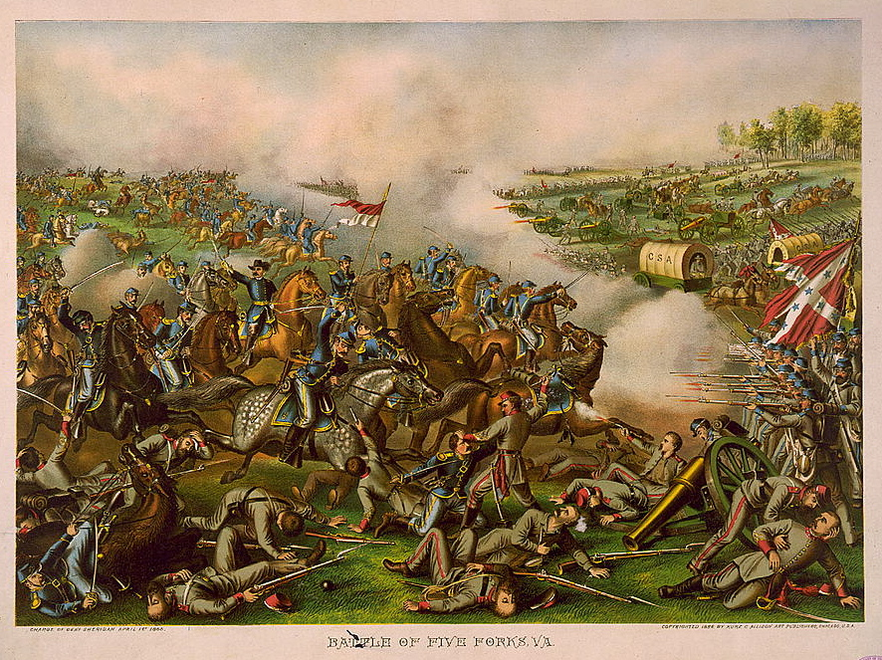
Siege of Petersburg: June 15, 1864 – April 2, 1865
Battle of Five Forks: April 1, 1865
Union Victory – Confederate retreat
Led to General Lee informing President Davis that Petersburg and Richmond should be evacuated
Notes:
Battle of Five Forks: April 1, 1864:
Confederates retreated into Virginia attempting to get more supplies and meet with General Joseph E. Johnston’s army

Slide 11
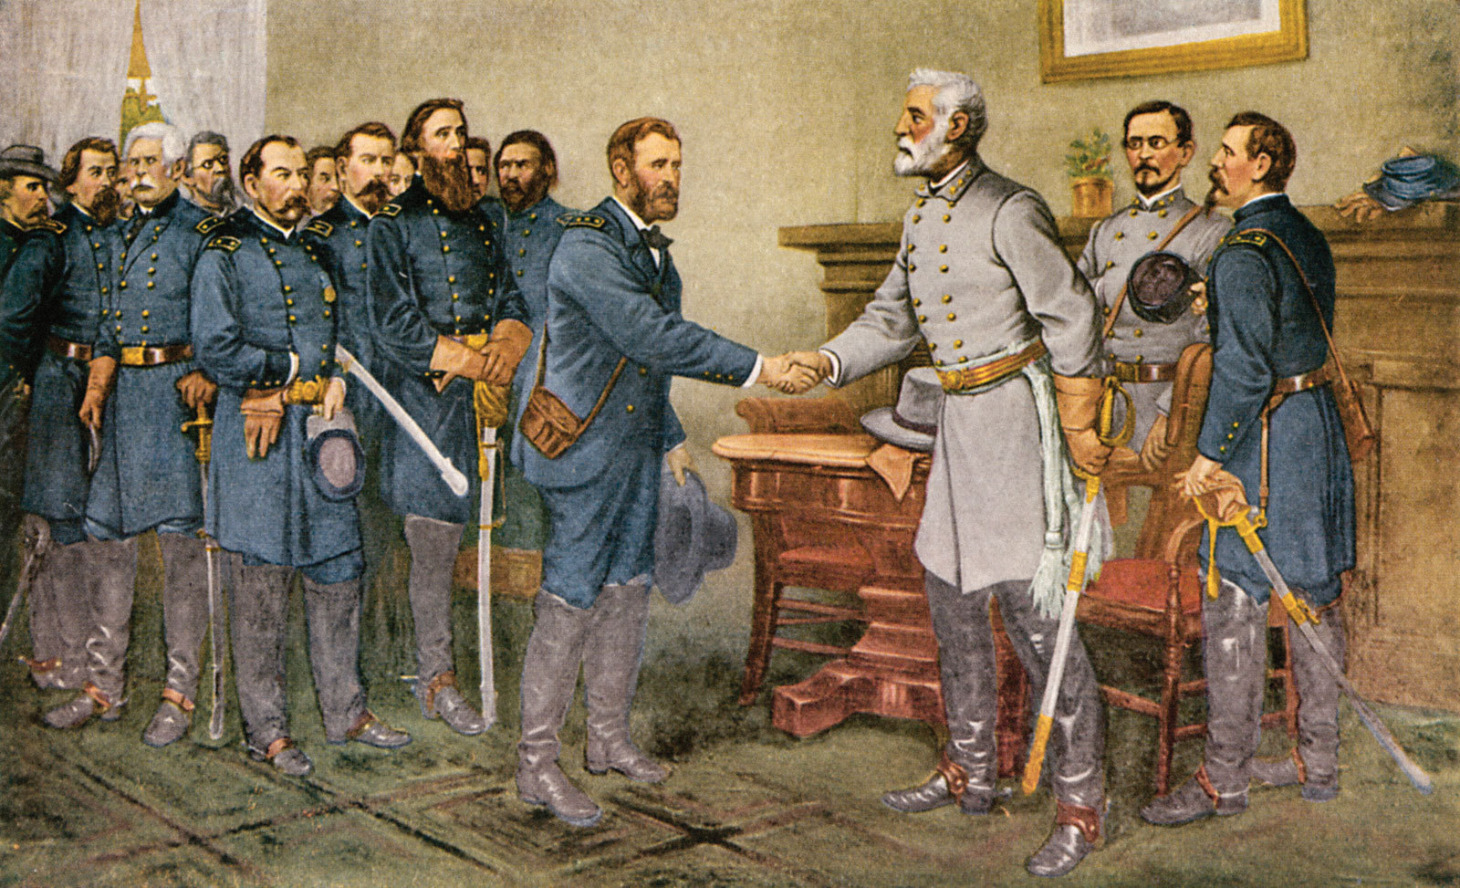
Confederate Surrender
April 2, 1865
Union breaks through the defenses of Petersburg
April 3, 1865
Union troops take over Richmond, the Confederate Capital
April 9, 1865
Confederate General, Robert E. Lee surrenders at Appomattox, Virginia.
Later in April, on the western front, Confederate General, Joseph Johnston will surrender to General William T. Sherman.

Slide 12
Appomattox Courthouse: The Surrender Meeting
Notes:
Discussion Questions:
Why did President Lincoln want Grant to “go easy” on the Army of Virginia?
What do you think the Confederate soldiers’ reactions were to this surrender?
Link for video: https://www.battlefields.org/learn/videos/appomattox-surrender

Slide 13
Inquiry Question: Does Lee’s surrender at Appomattox effectively end the conflict known as the American Civil War?
Notes:
Discuss with the students on whether their hypothesis were correct or not. Discuss what the students learned from their primary and secondary sources.

