Slide 1
Post 1865: Effects of the War
American Battlefield Trust

Slide 2
Reconstruction
What will be done when the war is over?
Reconstruction - The period following the Civil War in which Congress passed laws designed to rebuild the country and bring the Southern states back into the Union.

Slide 3
President Abraham Lincoln
Lincoln wanted the country to come back together peacefully.
Lincoln’s plan was created in 1863, about two years before the end of the war.
At the time of his death, the war was just ending and he was not able to put his ideas into practice.
The Ten Percent Plan
10% of voters in the seceded states must swear loyalty under oath to the Union.
The seceded states must abolish slavery.

Slide 4
Republicans in Congress
Wanted to be more strict with the States that had rebelled.
Wanted a State to re-enter through a slower admission process.
Wade-Davis Bill
The majority of white men from formerly Confederate states must swear loyalty to the United States.
The seceded states must abolish slavery.
Former Confederate soldiers or volunteers cannot hold office or vote.

Slide 5
President Andrew Johnson
Wanted to be strict with the States that had rebelled, but ended up making it relatively easy for them.
Allowed for segregation of the races.
Johnson Plan
The majority of white men from formerly Confederate states must swear loyalty to the United States.
Formerly Confederate states must ratify the 13th Amendment.
Former Confederate officials may hold office and vote.

Slide 6
Radical Republicans
Radical republicans, often abolitionists, represented a large part of Congress.
These Congressmen wanted to be strict with the States that had rebelled.
Reconstruction Act
Formerly Confederate states must disband their state governments.
Formerly Confederate states must write new state constitutions.
Formerly Confederate states must ratify the 14th Amendment
Formerly Confederate states must allow African Americans to vote.

Slide 7
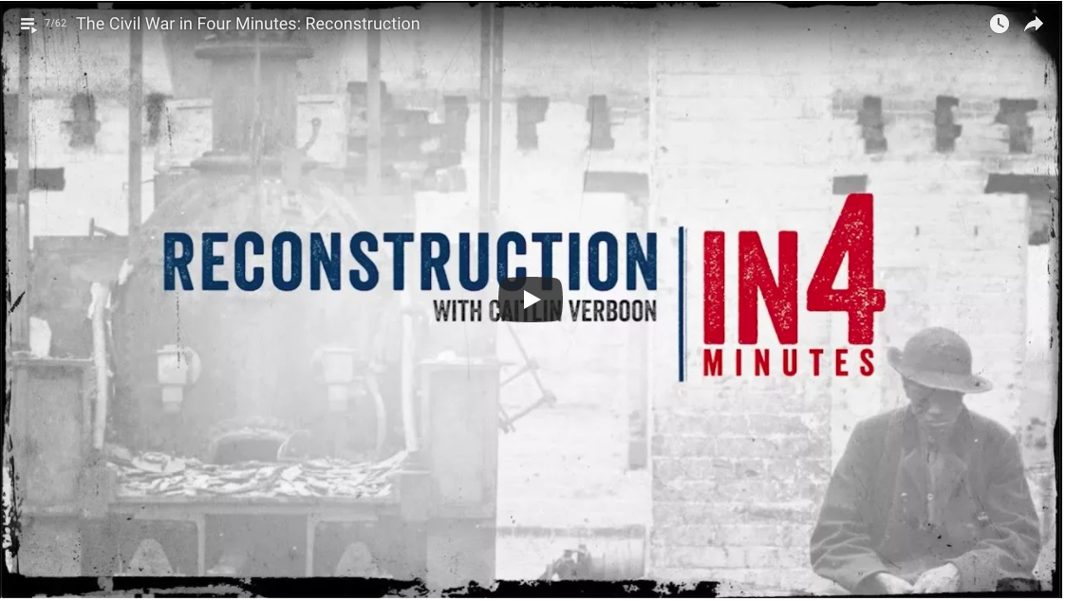
Reconstruction
Notes:
After completing the Reconstruction Cards have students watch the 4 minute video, summarizing Reconstruction. https://www.civilwar.org/learn/videos/reconstruction-after-civil-war

