Slide 1
1861: The Country Goes to War
The American Battlefield Trust

Slide 2
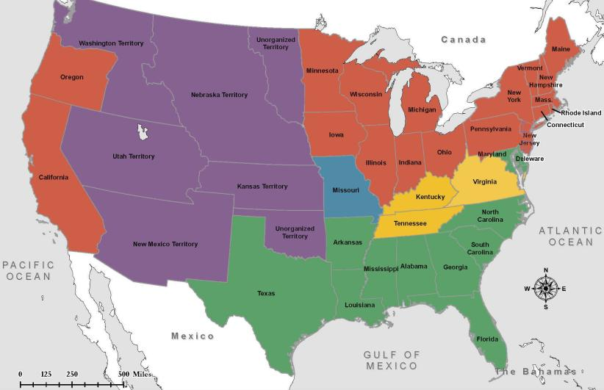
Lincoln Elected President November 6, 1860
Red – Lincoln
Yellow – Bell
Blue – Douglas
Green – Breckinridge
Purple – Non-Voting Territories

Slide 3
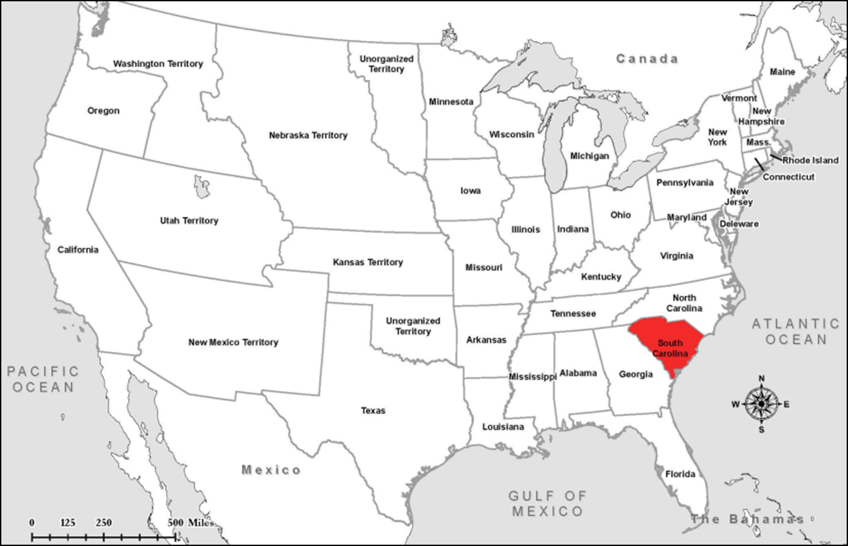
South Carolina Secedes December 20, 1860

Slide 4
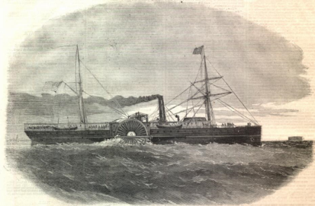
Shots Fired January 9, 1861
Shots were fired at daybreak at the steamship Star of the West.
The 250 United States troops on board were attempting to enter the harbor of Charleston for the purpose of communicating with Fort Sumter.
The Star of the West returned to sea after South Carolina troops fired on her.

Slide 5
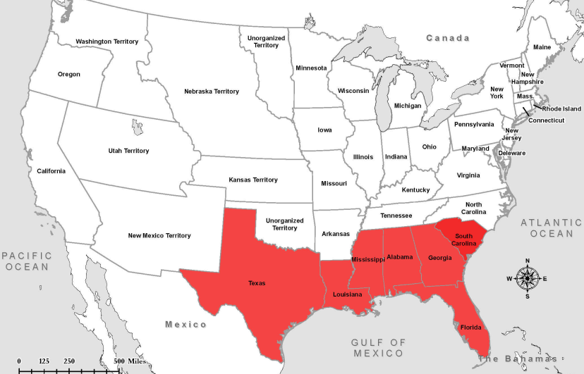
Secession January and February 1861

Slide 6
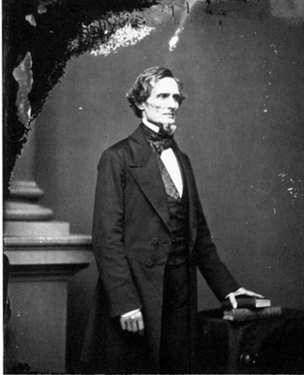
A President for the Confederacy February 9, 1861
Jefferson Davis is chosen as the President of the Confederate States of America.
He will be elected that November.

Slide 7
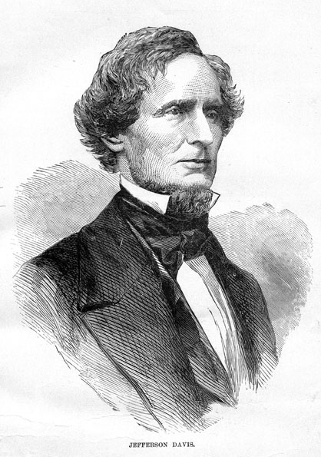
Except from the Inaugural Address Jefferson Davis, President of the Confederate States of America February 18, 1861
“I enter upon the duties of the office to which I have been chosen with the hope that the beginning of our career as a Confederacy may not be obstructed by hostile opposition to our enjoyment of the separate existence and independence which we have asserted, and, with the blessing of Providence, intend to maintain. Our present condition, achieved in a manner unprecedented in the history of nations, illustrates the American idea that governments rest upon the consent of the governed, and that it is the right of the people to alter or abolish governments whenever they become destructive of the ends for which they were established.”

Slide 8
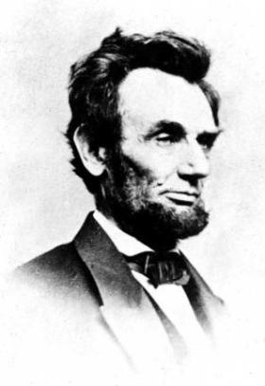
Except from the Inaugural Address Abraham Lincoln, President of the United States of America March 4, 1861
“In your hands, my dissatisfied fellow-countrymen, and not in mine, is the momentous issue of civil war. The Government will not assail you. You can have no conflict without being yourselves the aggressors. You have no oath registered in heaven to destroy the Government, while I shall have the most solemn one to ‘preserve, protect, and defend it.’”

Slide 9
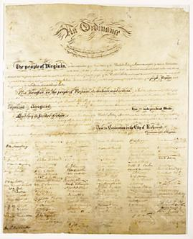
Constitution of the Confederate States of America March 11, 1861
Preamble
“We, the people of the Confederate States, each State acting in its sovereign and independent character, in order to form a permanent federal government, establish justice, insure domestic tranquility, and secure the blessings of liberty to ourselves and our posterity invoking the favor and guidance of Almighty God do ordain and establish this Constitution for the Confederate States of America.”

Slide 10
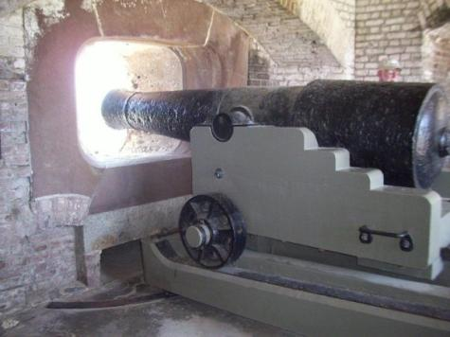
Fort Sumter April 12, 1861
Confederate forces fired on the fort, which was unable to effectively fight back. The United States surrendered Fort Sumter, Union forces left the following day.
The firing upon Fort Sumter was the opening engagement of the American Civil War.

Slide 11
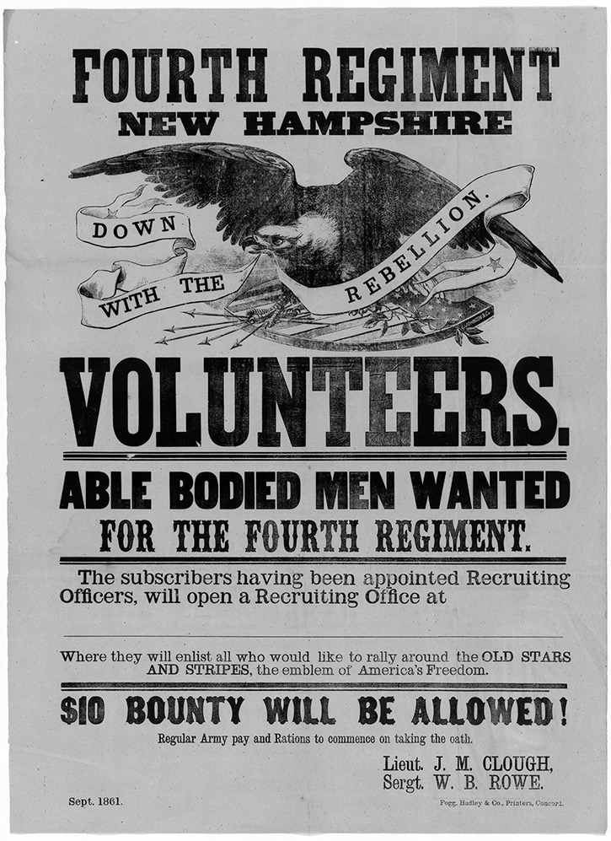
C A L L T O A R M S ! ! 75,000 VOLUNTEERS WANTED Washington, April 15. Under the act of Congress for calling out the militia to execute the laws of the Union to suppress insurrection…. - Simon Cameron, Secretary of War

Slide 12
April 17, 1861
Notes:
Confederate call to arms printed in Lexington, Kentucky, asking for volunteers to go to war in Virginia. April 17, 1861. State Library, Richmond, Virginia.
New York State Archives. New York (State). Department of Education. Division of Visual Instruction. Instructional glass lantern slides, ca. 1856-1939. Series A3045-78, No. 3659
http://digitalcollections.archives.nysed.gov/index.php/Detail/Object/Show/object_id/1110

Slide 13
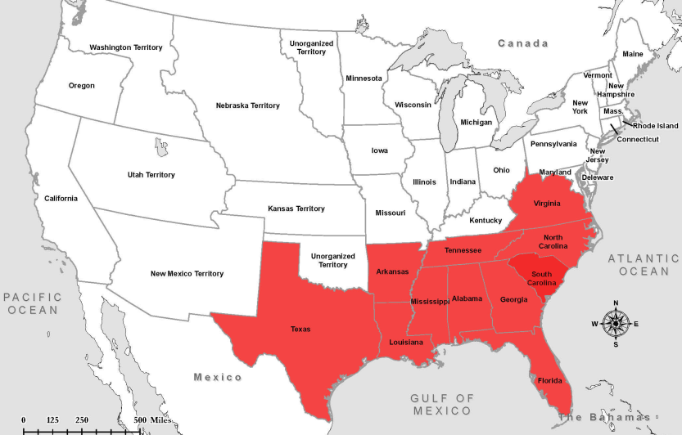
Secession April to June 1861

Slide 14
Virginia Joins the Confederacy April 17, 1861
Virginia joins the Confederate States of America.
Richmond becomes the Capital of the Confederacy

