Slide 1
1863
American Battlefield Trust

Slide 2
Inquiry Question
Why is July 1863 a major turning point of the American Civil War?
Notes:
Ask students to create a hypothesis of the answer to this question. Have students either discuss in groups their ideas or as a class. Ask students how they produced those hypothesis.

Slide 3
Vocabulary
Siege – When a location is surrounded by the enemy or trapped. No one can get supplies such as food, water, or medicine in.
Campaign – Military actions that include multiple battles with a certain goal (examples of goals might include capturing a certain city or stretch of land).
General – The person who is the commander of an army.
Blockade – Can be done by land or sea, but either way it blocks the sale or trade of goods from one country to another.
Notes:
More terms and definitions can be found on the “Glossary of Civil War Terms” page: https://www.battlefields.org/glossary-civil-war-terms

Slide 4
The Entire Civil War Animated Map
Activity Watch “The Entire Civil War Animated Map” beginning at 11:03 and ending at 16:40.
What does the victory at Vicksburg essentially do to the Confederate territory?
Where is Gettysburg located? In which state? Why is this important?
Who can now fight for the Union Army? Why is this important to this group of people? Why might this be important to the Union?

Slide 5
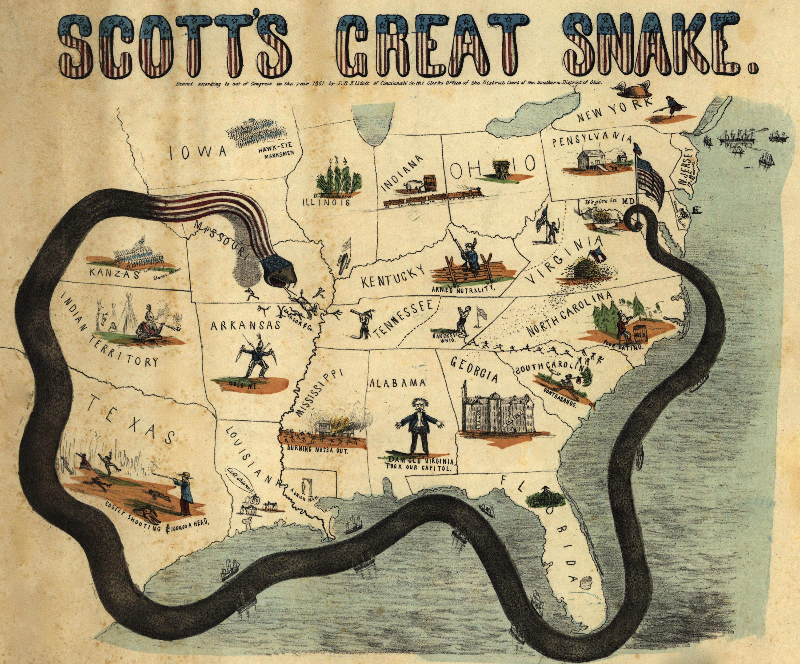
The “Anaconda Plan”
Proposed by General-in-Chief Winfield Scott
Union would Blockade Southern Ports from receiving or sending supplies to civilians, soldiers, or from foreign markets
Command the Mississippi River and cut the Southern States in two different parts
Notes:
Reference for Image: Elliott, , J. B. . "Scott's great snake. Entered according to Act of Congress in the year 1861 by J.B. Elliott of Cincinnati.." Library of Congress. Library of Congress Geography and Map Division Washington, n.d. Web. 22 May 2013. <http://memory.loc.gov/cgi-bin/query/h?ammem/gmd:@field(NUMBER @band(g3701s cw0011000))>.

Slide 6
The Gettysburg Address
What did Lincoln do following the battle of Gettysburg?
Why do you think he did this?
How was this part of the turning point of 1863?
Why does this hold importance today?
Activity Watch “The Gettysburg Address”

Slide 7
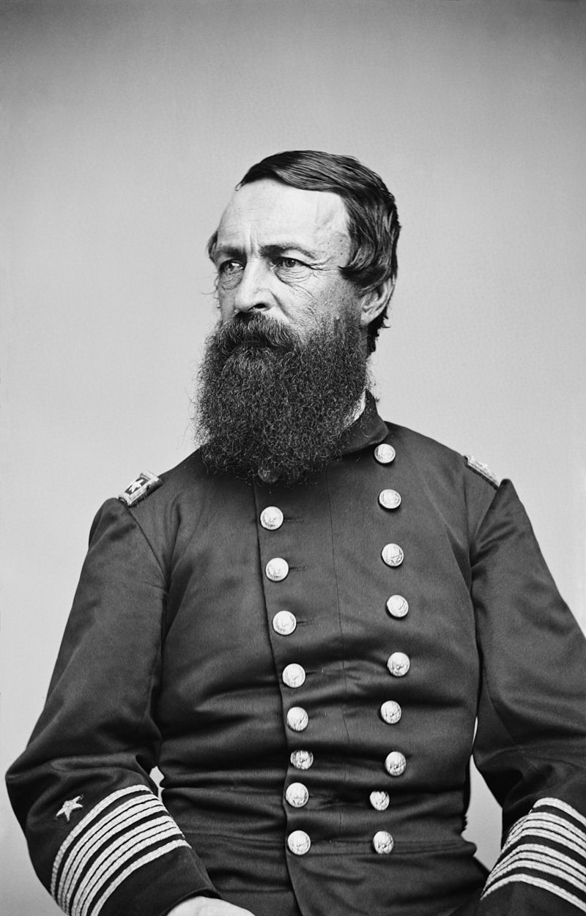
Meet the Primary Sources: David Dixon Porter
Published Incidents and Anecdotes of the Civil War was in 1885 as a memoir of his Civil War experience
Present during the capture of New Orleans, during the Red River Campaign, and at Fort Fisher
2nd person to become United States Navy Admiral (highest position in Navy)
Porter accompanied Lincoln as he toured Richmond in April 1865

Slide 8
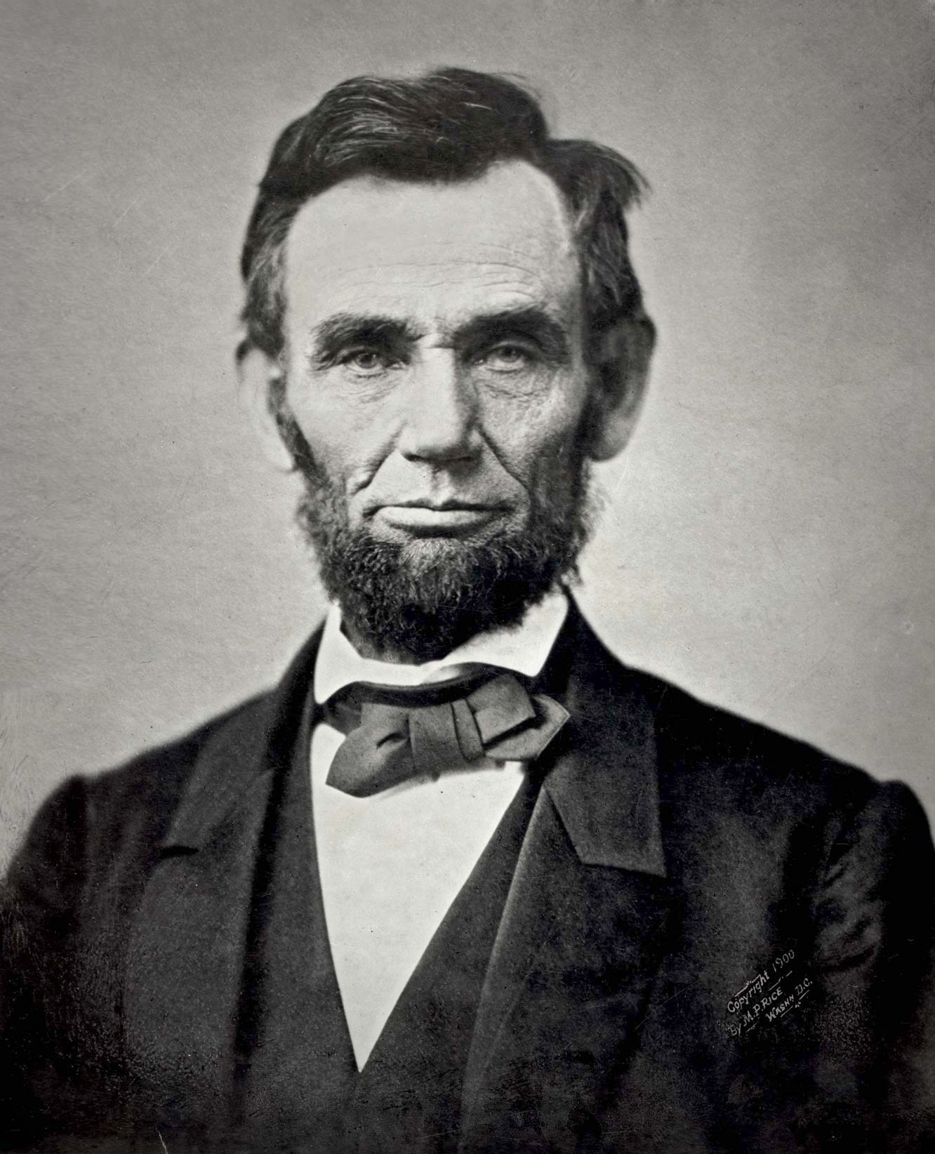
Meet the Primary Sources: Abraham Lincoln
Self-taught military strategist
Used military operations to achieve the political end of preserving the United States one nation, indivisible, and as a republic based on majority rule.
Executive control of the army as Commander-in-Chief and changed his military cabinet several times during the war

Slide 9
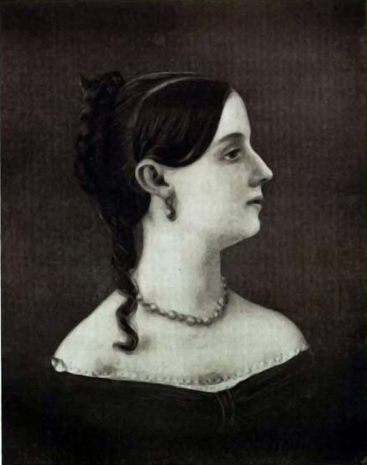
Meet the Primary Sources: Sara Agnes Rice Pryor
Published Reminiscence of Peace and War in 1905 as a memoir of her Civil War experience
Accompanied her husband, Confederate Brigadier General Roger Atkinson Pryor, to the war front from 1861-1863 as an Army Nurse
Returned to Petersburg, Virginia in 1863 to care for her children until the end of war

Slide 10
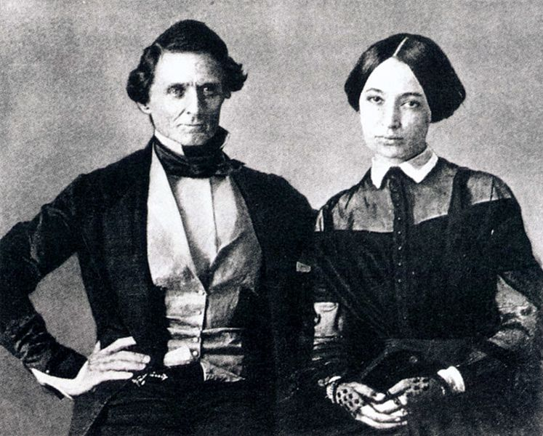
Meet the Primary Sources: Varina Davis
Wife of Confederate President Jefferson Davis and 1st Lady of the Confederacy
Published Jefferson Davis, A Memoir in 1890 after Davis’s death in order to make an income
Moved to New York City to become a full-time newspaper columnist in 1891

Slide 11
Inquiry Question
Why is July 1863 a major turning point of the American Civil War?
Notes:
Discuss with the students on whether their hypothesis were correct or not. Discuss what the students learned from their primary sources.

