Slide 1
Little House on the Prairie:
Post-Civil War West Lesson Plan
The American Battlefield Trust

Slide 2
Reconstruction Era West
The American Civil War ended on May 26, 1865.
Rapid technological developments and societal shifts after the Civil War led to a new period in American life.
Outcome: Mass Migration and Settlement of Territory West of the Mississippi River

Slide 3
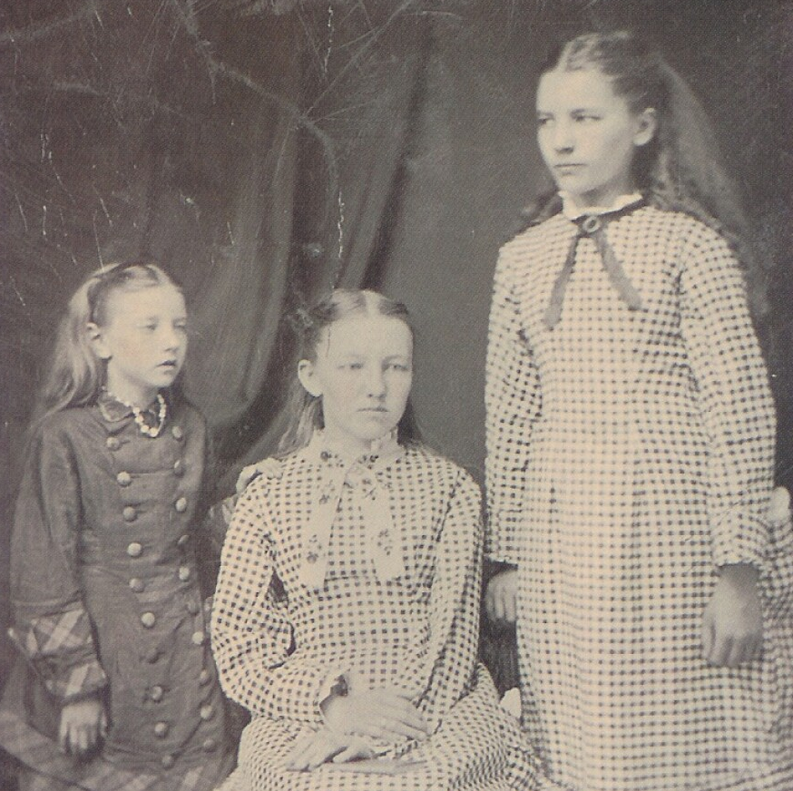
Who was Laura Ingalls Wilder?
Laura (right) with sisters Mary and Carrie, ca. late 1870s
Laura Ingalls Wilder was born near Pepin, Wisconsin on February 7, 1867, two years after the end of the Civil War.
Laura lived in Wisconsin, Kansas, Minnesota, Iowa, South Dakota, Missouri, and Florida during the height of Westward Expansion.
In 1932 she published her first book, Little House in the Big Woods, detailing her early years in Pepin. Nine books were written in total for the Little House series, capturing her semi-fictionalized account of the Post-Civil War West.
Notes:
Extra Resources:
Laura Ingalls Wilder | American Battlefield Trust
1881: "The Day Seemed Really Fourth of July" | American Battlefield Trust

Slide 4
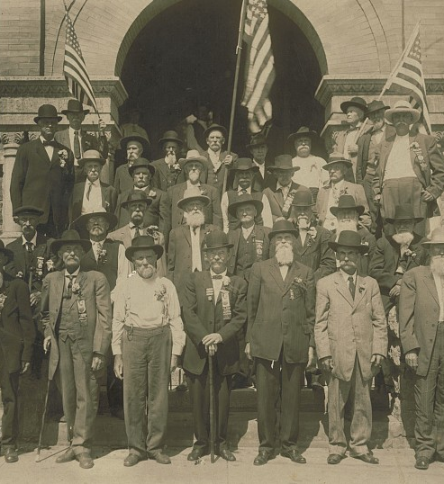
Civil War Veterans
The Grand Army of the Republic was founded on April 6, 1866, by Union veterans of the Civil War. A southern counterpart, The United Confederate Veterans, was established in 1889.
Veterans were at the forefront of Westward Expansion, leading the construction of railroads, opening businesses and participating in local government.
Daniel Freeman, a Union veteran, was widely considered the first American to utilize the Homestead Act, staking his claim ten minutes after midnight on January 1, 1863.
Union and Confederate veterans set aside differences and reconciled with the common goal of settling the American West.
Notes:
Extra Resources:
Veterans of the Civil War | American Battlefield Trust
1885: "Good Agricultural Land" | American Battlefield Trust

Slide 5
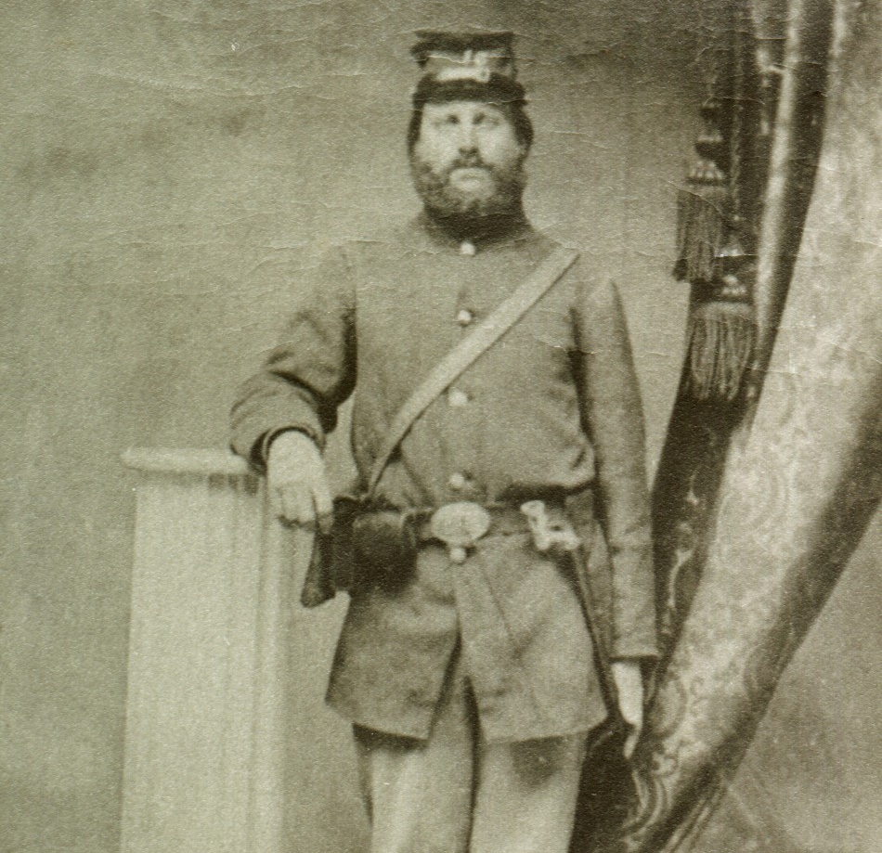
Civil War Figures in Laura's Life
Joseph Quiner
Lansford James Ingalls
Hiram Ingalls
Elias Bedal
Reverend Leonard Moses
Reverend Edward Brown
Notes:
Extra Resources:
Laura Ingalls Wilder and the Civil War | American Battlefield Trust
Joseph C. Quiner | American Battlefield Trust

Slide 6
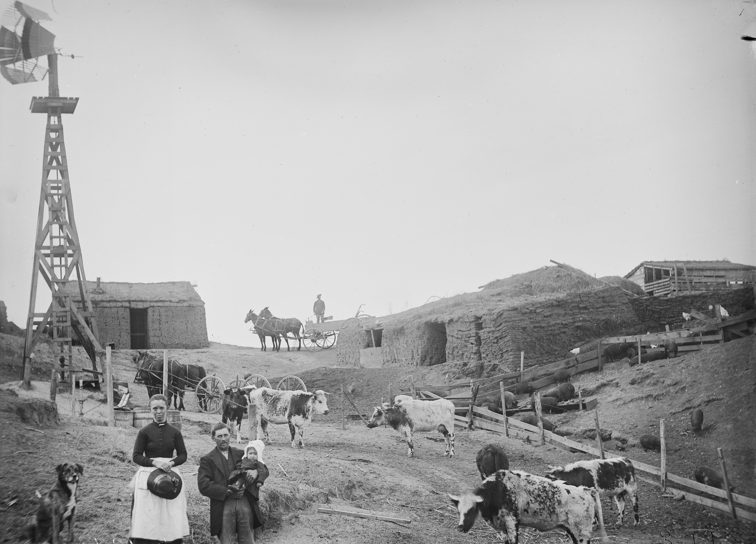
Homestead Act of 1862
On May 20, 1862, President Abraham Lincoln signed the Homestead Act which went into effect on January 1, 1863.
Up to 160 acres, for purchase at a $1.25 per acre. Required settlers to be 21 years or older, a head of a household, a citizen or an immigrant declaring to become a citizen, and a resident on that land for at least 6 months.
After five years of permanent residence, the government granted the property to settlers for free.
Those who bore "arms against the United States Government" or gave "aid and comfort to its enemies" were ineligible from homesteading.
Notes:
Extra Resources:
The Homestead Act of 1862 | American Battlefield Trust
The Homestead Act | American Battlefield Trust
The Homestead Act Primary Source Questions | American Battlefield Trust

Slide 7
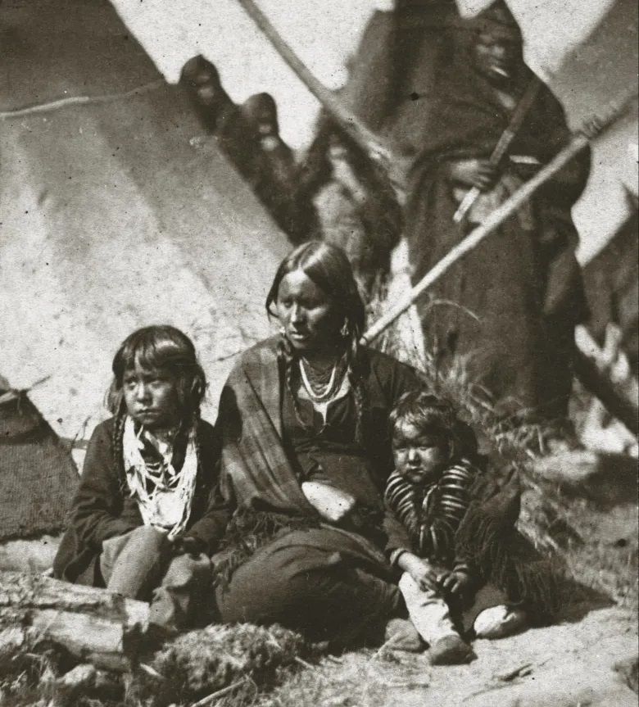
Displacement of Native Americans
US-Dakota War of 1862: Late annuities lead to violence between Dakota and white settlers. The Dakota are expelled from Minnesota.
Great Sioux War of 1876: Discovery of gold in the Black Hills leads to encroachment and war between Sioux and U.S.
Dawes Act of 1887: Contributed to the loss of roughly 100 million acres of reservation land.
Notes:
Extra Resources:
US-Dakota War of 1862 | American Battlefield Trust
1874: "The Indians did not want to leave here" | American Battlefield Trust

Slide 8
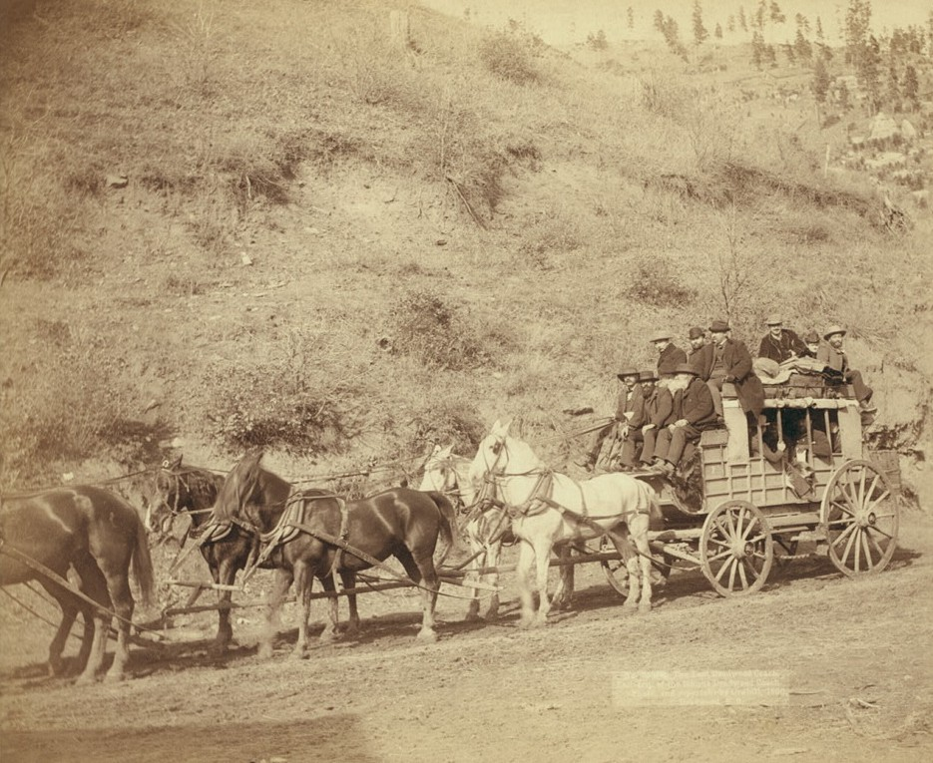
Means of
Transportation
Prairie Schooners were best suited for the rough terrain of the frontier but could only cover 7-12 miles in a day.
Stagecoaches carried mail and passengers and could be protected by armed guards.
When accessible, steamboats could cover ten times as much distance as wagons on the overland trail.
By the 1880s and 1890s, railroads became the dominant mode of travel across the West.
Notes:
Extra Resources:
Transportation in the Post-Civil War West | American Battlefield Trust

Slide 9
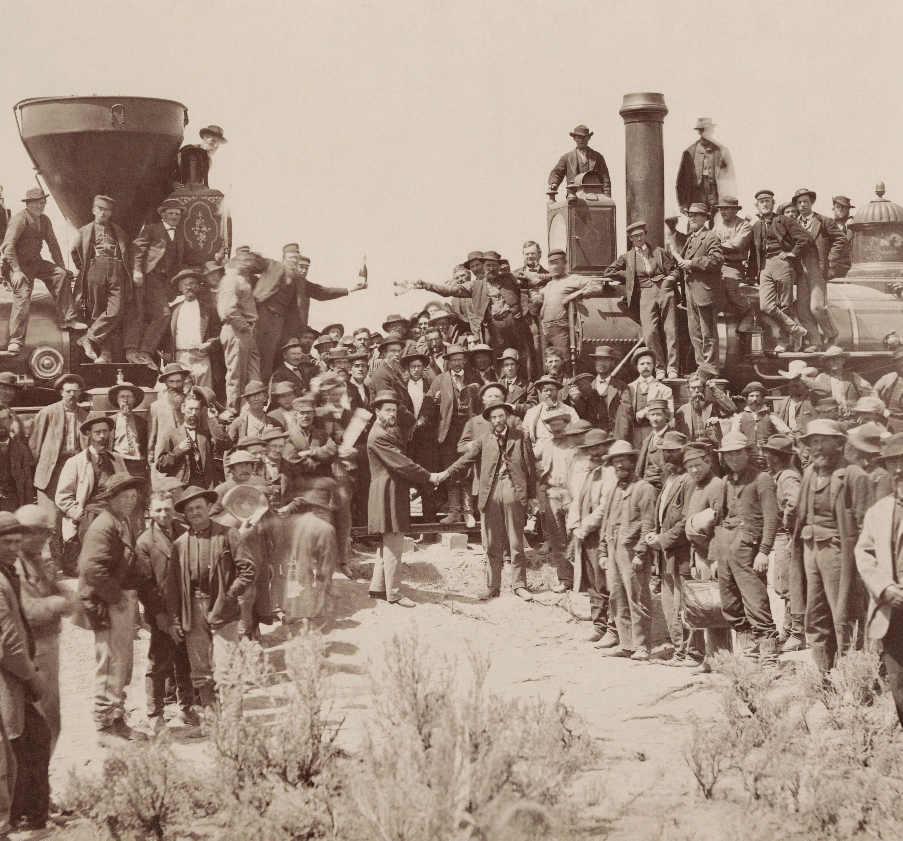
Transcontinental Railroad
President Abraham Lincoln signed the Pacific Railway Act on July 1, 1862.
The first Transcontinental Railroad was completed on May 10, 1869. Thousands of more miles would be laid in the next several decades.
Around 15,000 Chinese laborers participated in the construction of the railroad.
By 1900 the United States would lay over 170,000 miles of railroad track across the continent.
Notes:
Extra Resources:
The Transcontinental Railroad | American Battlefield Trust
1862: Pacific Railway Act | American Battlefield Trust
1881: "Surveys in the Land of the Lost Buffaloes" | American Battlefield Trust

Slide 10
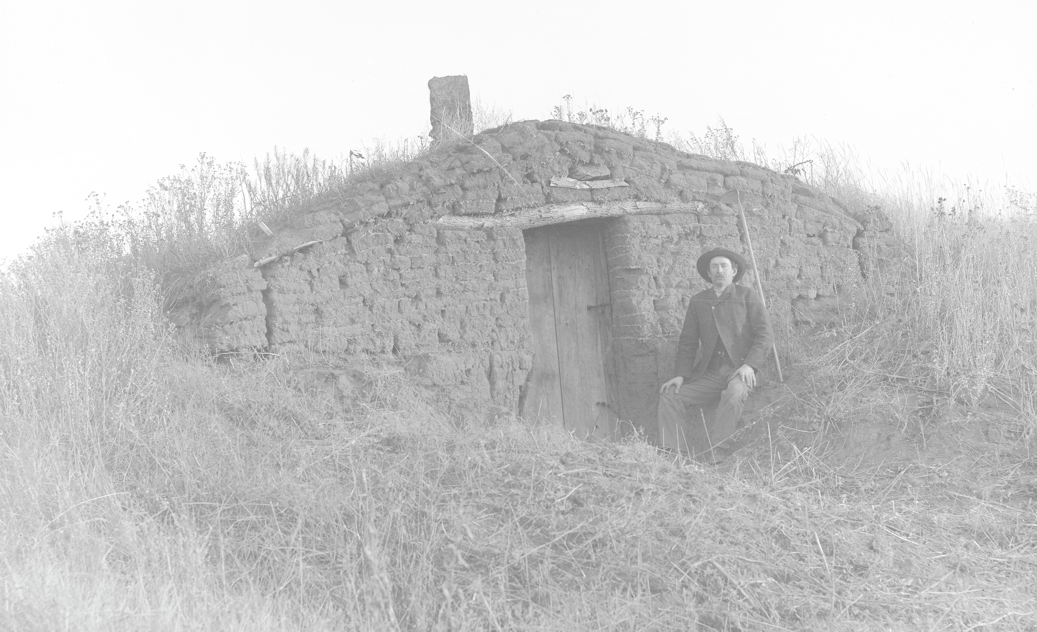
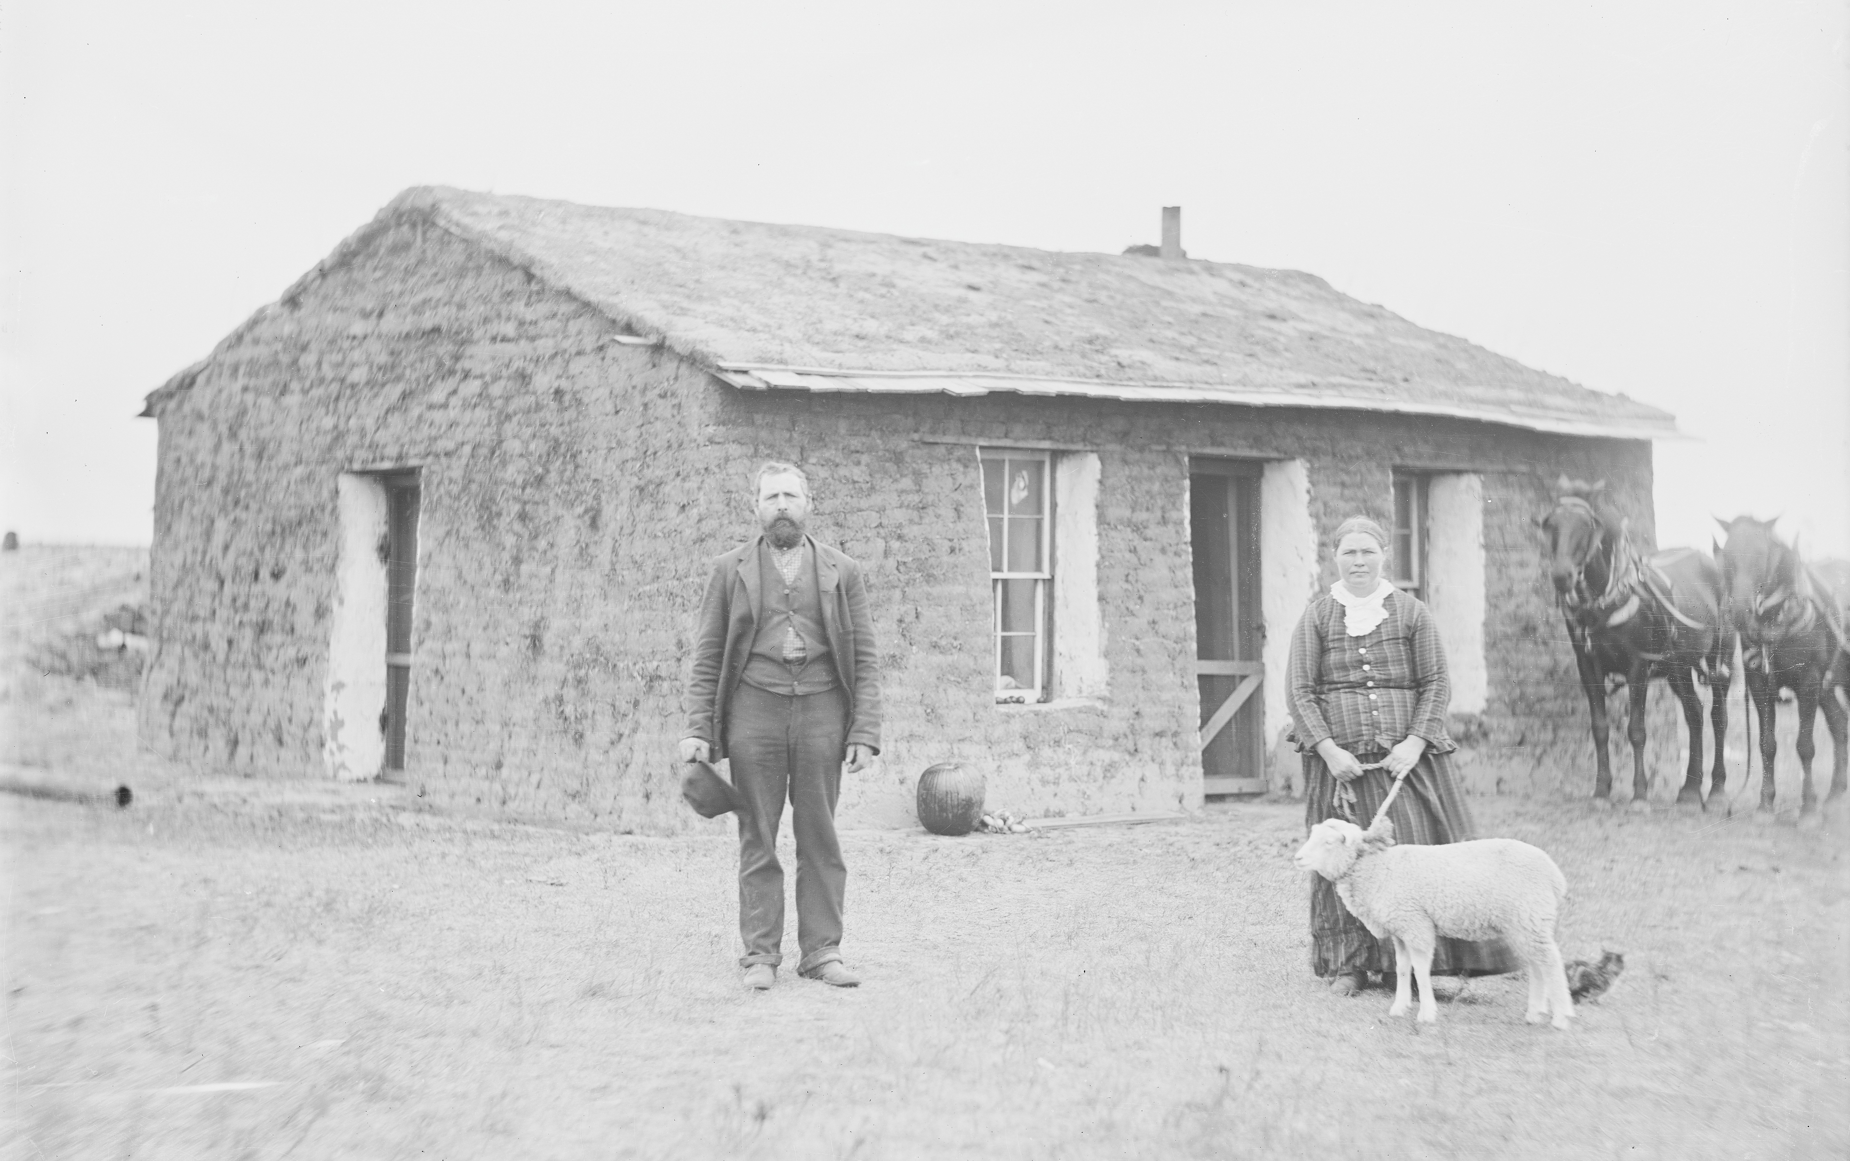
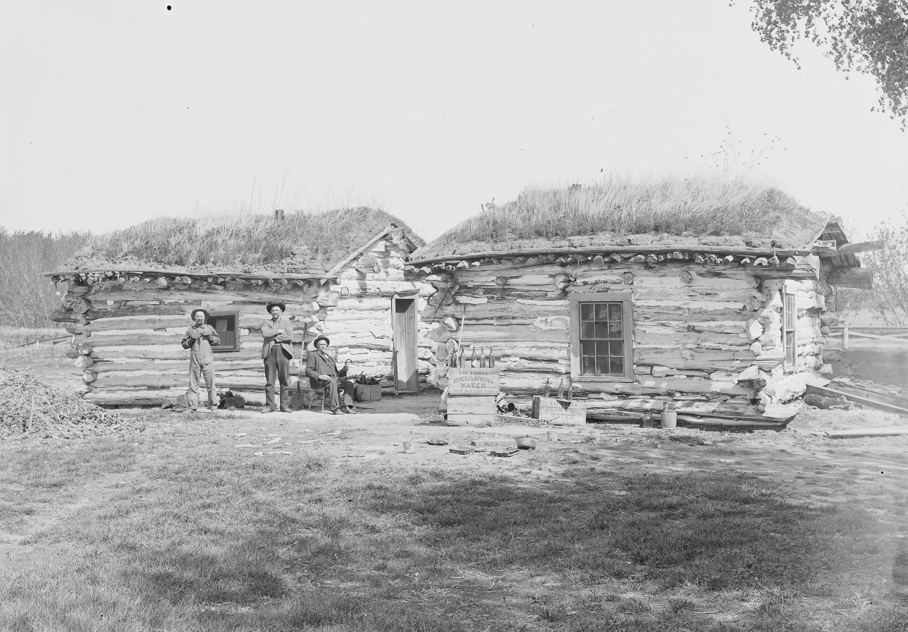
Pioneer Shelters
Dugouts were built by digging into hillsides or banks and reinforced with sod and branches, providing effective year-round insulation while serving as a temporary residence until a permanent home could be constructed. Sod houses, or “soddies,” were homes built from strips of sod on flat plains that provided insulation similar to dugouts but could be constructed larger, with multiple rooms and occasionally multiple stories. Log cabins were frontier homes built by stacking notched logs and sealing gaps with materials such as clay, mud, grass, or hair using a technique called chinking.
Dugouts
Sod Houses
Log Cabins
Notes:
Extra Resources:
Shelters in the American West | American Battlefield Trust

Slide 11
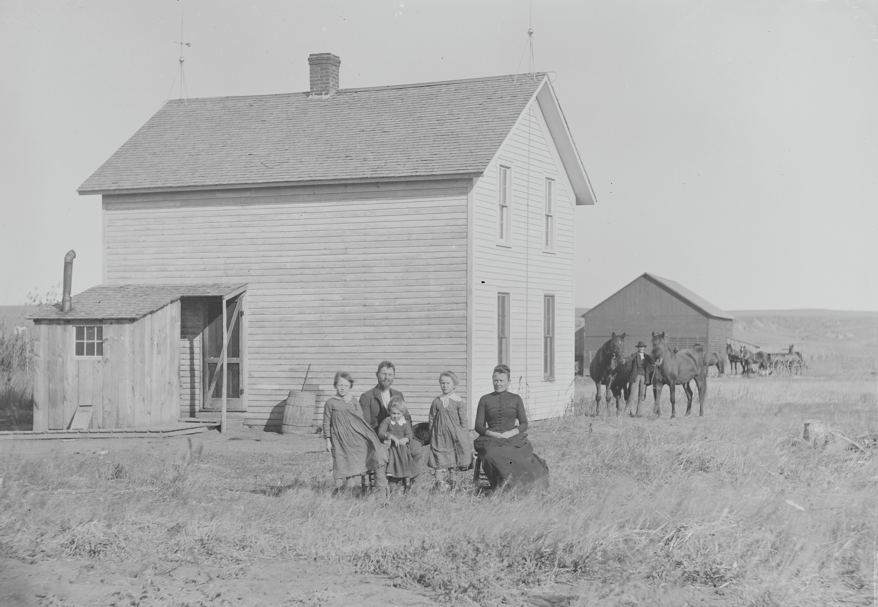
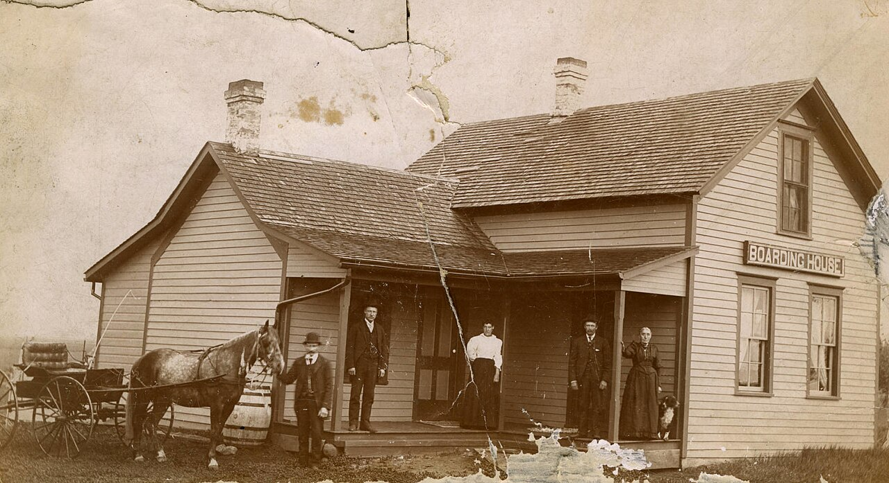
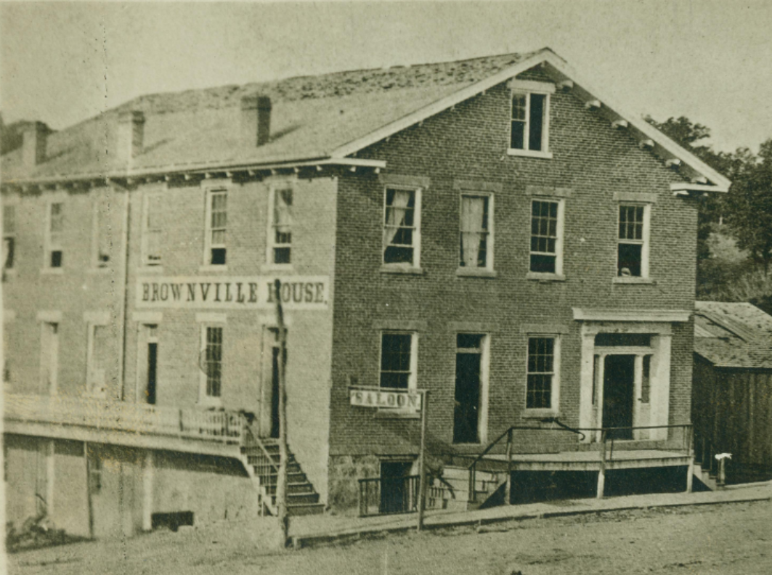
Pioneer Shelters
As railroads expanded across the West in the late 1800s, settlers gained access to better building materials and tools, leading to larger, more sophisticated frame houses that eventually could be ordered from catalogs and assembled on-site. As migration to the frontier increased, boarding houses and hotels were built to provide temporary lodging, with boarding houses offering longer stays and meals while hotels mainly served travelers and workers.
Frame Houses
Boarding Houses
Hotels
Notes:
Extra Resources:

Slide 12
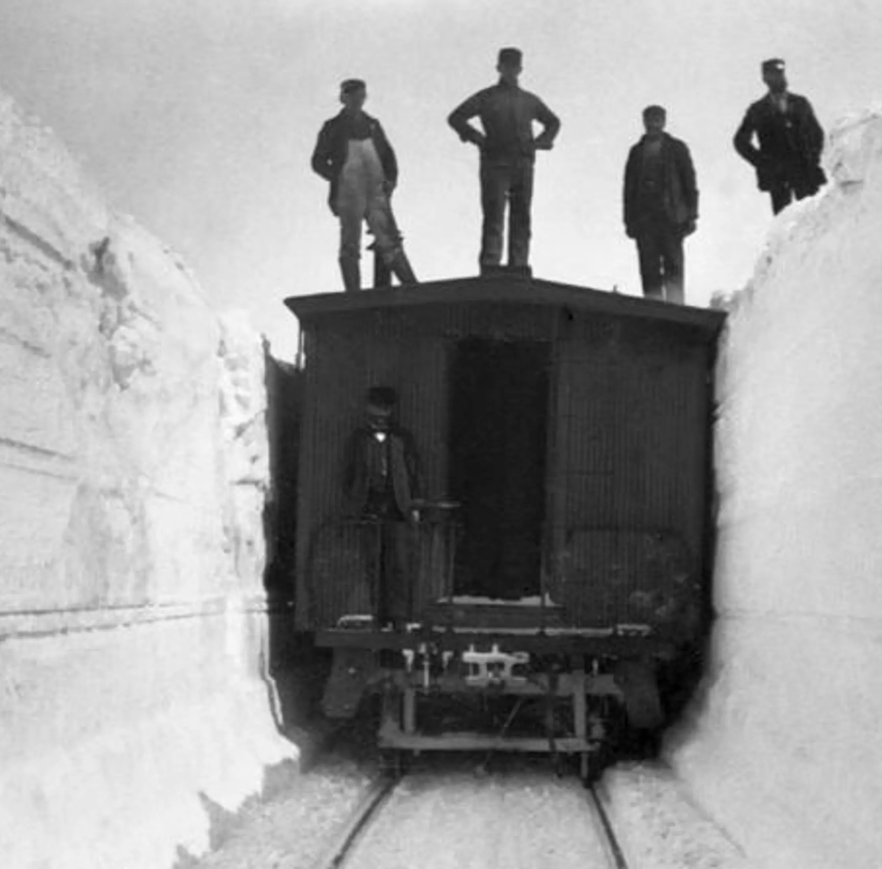
Frontier Life
Locust Plague of 1874: Swarms of Rocky Mountain Locusts destroyed entire crop yields across 2 million acres of the Great Plains and Midwest.
The Long Winter of 1880–81: Record snowfall and frigid temperatures blocked rail lines, which brought vital supplies and food to the frontier.
The 1888 Children's Blizzard: The surprise blizzard struck on January 12th and led to 235 deaths, many of whom were children stranded at their rural schools.
Prairie fires, which could stretch unimpeded for miles, were a perpetual threat to homesteads and communities.
Diseases such as Diphtheria, Measles, Smallpox, Typhus, Typhoid, Cholera and Tuberculosis were constant dangers in pioneer camps.
Notes:
Extra Resources:
1873: "Settled On A Piece Of Unsurveyed Land" | American Battlefield Trust
1874: "The Grasshopper Invasion" | American Battlefield Trust

Slide 13
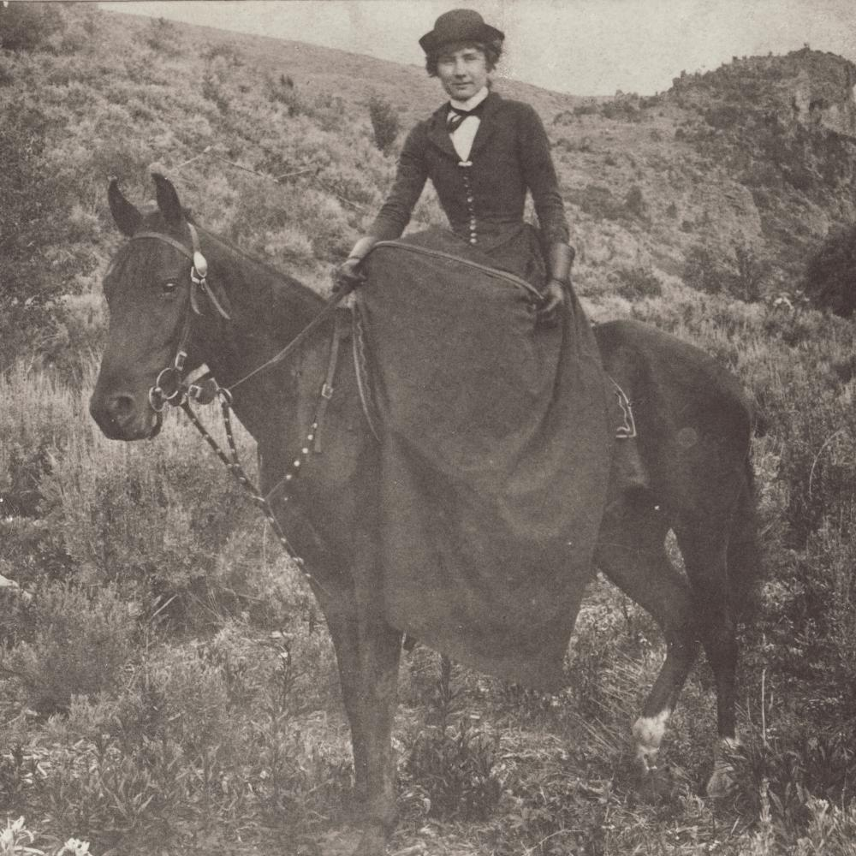
Opportunities for Women
Married and single women were eligible to apply for homesteads.
Women began to gain meaningful employment as schoolteachers, business owners, and laborers.
Ladies Aid Societies, Woman's Christian Temperance Union, and the Woman Suffrage Associations became popular community activism groups.
Wyoming granted women the right to vote in 1869, making it the first in the nation.
Notes:
Extra Resources:
Frontier Feminists | American Battlefield Trust
1869: "Every Woman Residing In This Territory May Cast Her Vote" | American Battlefield Trust
Memories of a Pioneer School Teacher | American Battlefield Trust

Slide 14
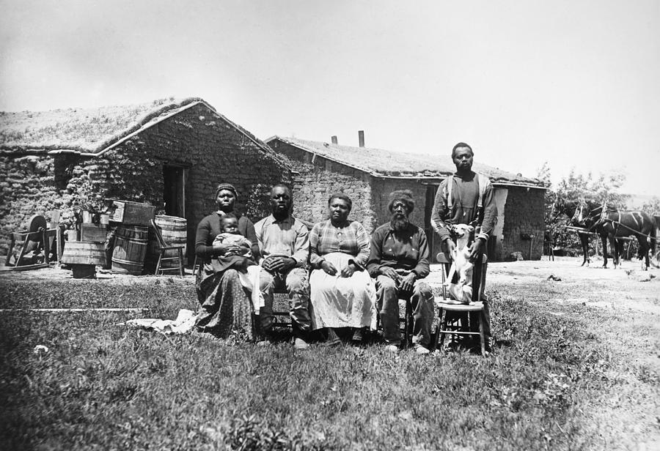
Freedom and Black Migration
The 13th and 14th Amendments established freedom and citizenship for formerly enslaved African Americans.
The Exoduster Movement, led by Benjamin "Pap" Singleton, promoted black migration to Kansas.
Around 3,500 African Americans claimed roughly 650,000 acres of land during the lifespan of homesteading.
Following the Civil War, Congress authorized new colored regiments. These black soldiers came to be known as Buffalo Soldiers.
Notes:
Extra Resources:
Black Pioneers of the West | American Battlefield Trust
1870: "What Might Have Happened if Dr. Tan[n] Hadn't Found Them" | American Battlefield Trust
1878: "Ho For Kansas!" | American Battlefield Trust
Mary Fields | American Battlefield Trust

Slide 15
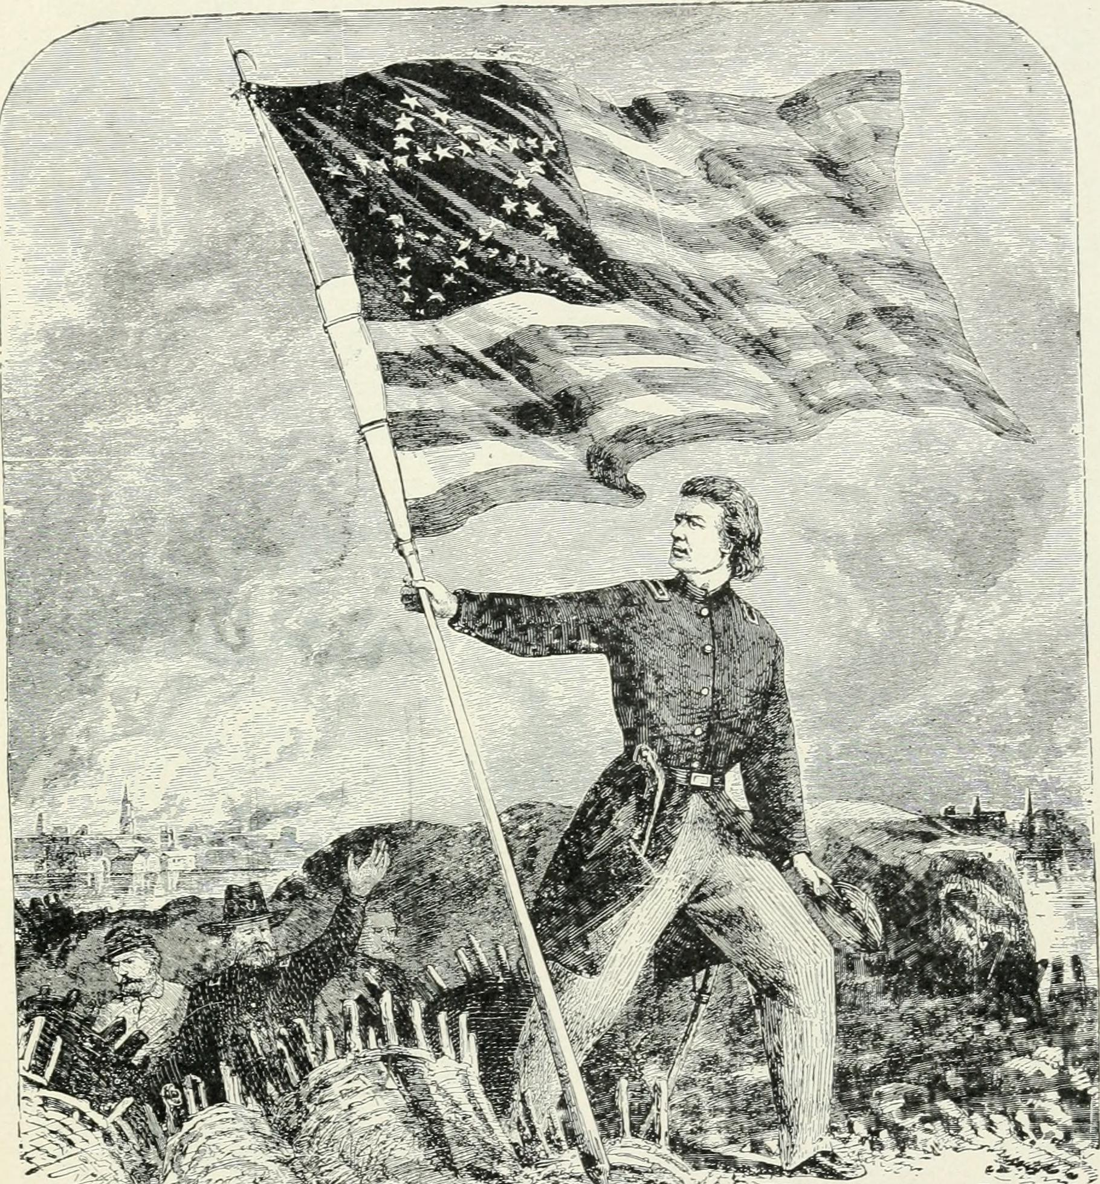
Impact
From 1865 to 1900, 9 new states were admitted into the United States.
Around 93,000,000 Americans are estimated to have descended from homesteaders.
The establishment of nationwide railroad networks allowed people, supplies and news to travel at a revolutionary pace.
The last known Civil War veteran, Albert Henry Woolson, passed away on August 2, 1956. Laura Ingalls Wilder died just six months later, on February 10, 1957.
Over 73 million copies of Laura Ingalls Wilder's books have been sold in more than 100 countries.
Notes:
Extra Resources:

