Slide 1
1863: Shifting Tides
The Civil War Curriculum

Slide 2
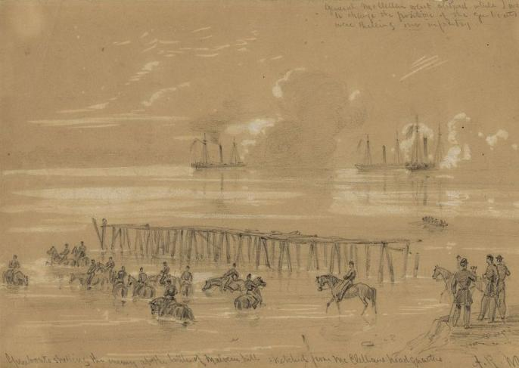
Shifting Tides
While the Union won some important battles and was holding a successful blockade, the Confederacy was more successful on the battlefield.
Notes:
While the Union won some important battles the Confederacy was more successful on the battlefield.
Image:
Union gunboats firing upon the Confederates during the battle of Malvern Hill.

Slide 3
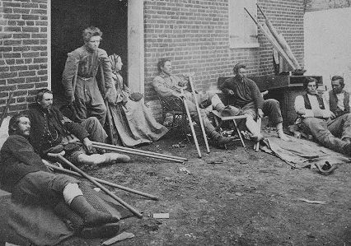
Shifting Tides
Confederate success on the battlefield led to high morale among its citizens, whereas in the Union, morale was low.

Slide 4
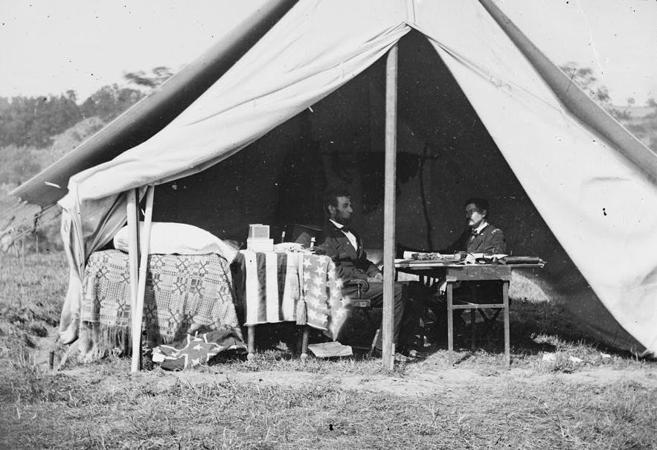
Shifting Tides
The Battle of Antietam and the Emancipation Proclamation, which followed, changed the war, but the citizens of the North began to wonder if the war effort was worth the incredibly high death toll.
Notes:
The battle of Antietam and the Emancipation Proclamation were used to alter the meaning of the war, but the citizens of the North were asking if it was worth the high death toll after Antietam. Let’s look at some of the most important battles, who won, and the casualties.

Slide 5
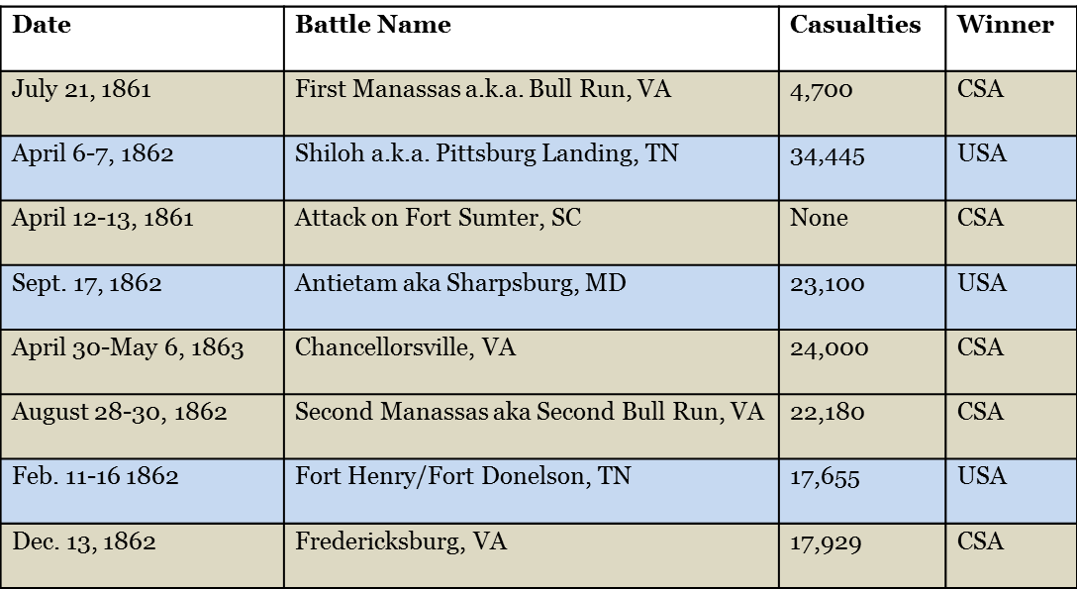
Shifting Tides
Some of the major battle casualties (people killed, wounded, or lost) leading up to the summer of 1863.

Slide 6
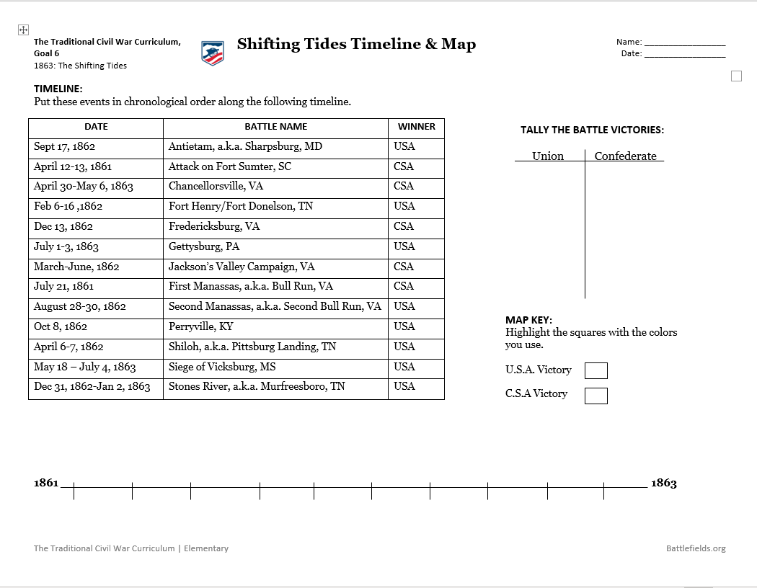

Shifting Tides
Activity:
On your paper is a list of battles, write the battles in chronological order on your timeline.

Slide 7
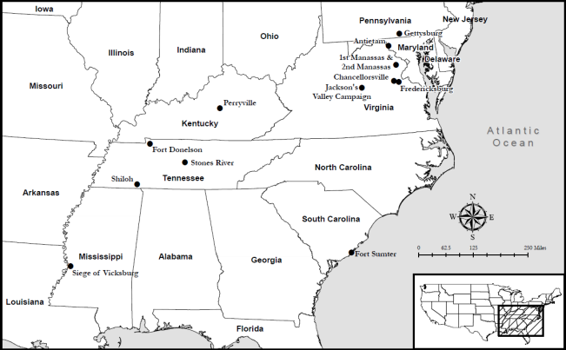
Shifting Tides Map
Activity:
As we discuss each battle you will
Highlight the battle on your map indicating which side won.
Tally the winners for each battle.

Slide 8
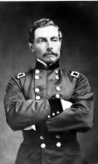
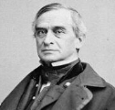
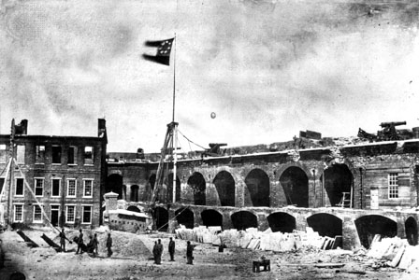
Fort Sumter April 12, 1861
On April 12, 1861, the Confederate army fired upon Fort Sumter, which guarded the port of Charleston SC. At 2:30 pm the next day, Union forces surrendered the fort. After this attack President Lincoln called for 75,000 volunteers.
Make a tally mark under the Confederate Victory column. Find Fort Sumter on your map and highlight it as a Confederate victory.
Notes:
Image information:
Bottom Right – Fort Sumter
Left – P.G.T. Beauregard
Top Right – Robert Anderson

Slide 9
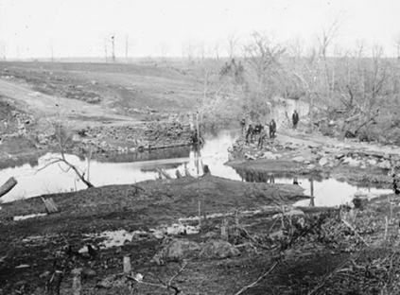
First Manassas (Bull Run) July 21, 1861
The first major battle of the Civil War occurred North of Manassas Junction about 20 miles west of Washington, DC.
With 4,700 casualties everyone realized that the war was not going to be short or easy.
Tally and highlight Manassas as a Confederate victory.
Notes:
Image information:
The ruins of Cub Run bridge after the battle,
July 21, 1861.

Slide 10
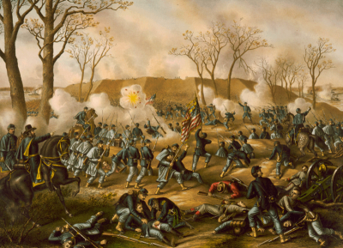
Forts Henry and Donelson February 1862
Ulysses S. Grant gained control of Forts Henry and Donelson in February 1862. A major victory for the Union, the fall of Forts Henry and Donelson opened up Tennessee and Alabama to Union advances. There were 17,655 casualties in these battles.
Tally and highlight both forts on your map as Union victories.
Notes:
Image information:
Battle of Fort Donelson

Slide 11
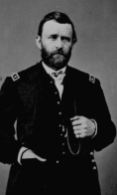
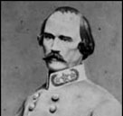
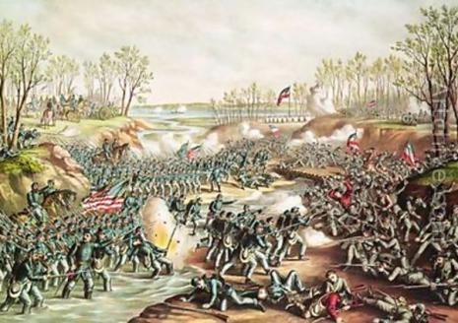
Battle of Shiloh April 6-7, 1862
Camped at Pittsburg Landing along the Tennessee River, the Union Army, under Maj. Gen. Grant was attacked by Confederate forces under General Albert Sidney Johnston. Ultimately, Johnston was killed and the Confederates were forced to retreat from the bloodiest American battle up to that time with 23,716 casualties. Shiloh ended Confederate hopes of blocking the Union advance into northern Mississippi.
Tally and highlight Shiloh as a Union victory on your map.
Notes:
Image information:
Left– Ulysses S. Grant
Top Right – Albert Sidney Johnston
Bottom Right – Battle of Shiloh Illustration

Slide 12
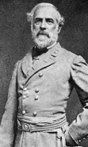
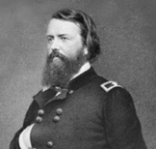
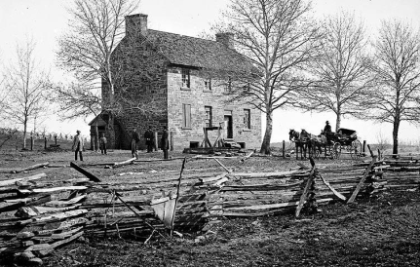
Second Manassas (Second Bull Run) August 28-30, 1862
At the Second Battle of Manassas, Robert E. Lee led Stonewall Jackson and James Longstreet as they outmaneuvered Union General John Pope, driving the Union Army back to Washington DC. There were 22,180 casualties in this battle.
Make a tally mark for the Confederacy. Find Manassas on your map and highlight it as a Confederate victory.
Notes:
Image Information:
Left – Robert E Lee
Top Right – John Pope
Bottom Right – Stone House at Manassas

Slide 13
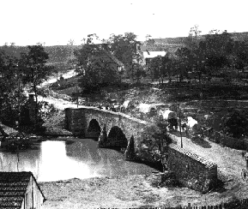
Antietam September 17, 1862
The battle of Antietam technically ended in a draw, but is considered a strategic win for the Union because the Confederacy withdrew. Following the battle, Abraham Lincoln issued the Emancipation Proclamation. Antietam saw 23,100 casualties, making it the single bloodiest day in American history.
Make a tally mark for the Union. Find Antietam on your map, and highlight it as a Union victory.
Notes:
Image information:
Bridge at Antietam

Slide 14
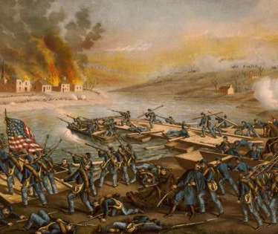
Fredericksburg December 13, 1862
Following Antietam, the Union sought another victory at Fredericksburg, 60 miles from Richmond. Arriving at the banks of the Rappahannock River, the Union army faced a smaller Confederate army. However, pontoon bridges were needed to cross the river. By the time the bridges arrived, the Confederates had been reinforced and entrenched on high ground. The Union attempted a bloody uphill attack, but was forced back, at a total cost of 17,929 casualties.
Make a tally mark for the Confederate victory. Find Fredericksburg on your map and highlight it as a Confederate victory.
Notes:
Image information:
River crossing at Fredericksburg

Slide 15
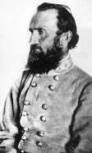
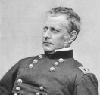
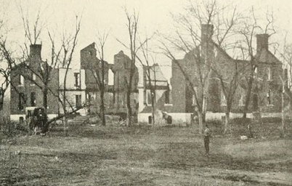
Chancellorsville April 30-May 6, 1863
At Chancellorsville, Robert E. Lee outmaneuvered Union leader Joseph Hooker. Lee took a great risk and divided his army against the much larger Union force. This is considered Lee’s greatest victory, but it cost him his greatest general, Stonewall Jackson. Total casualties are estimated at 24,000.
Make a tally mark for the Confederate victory. Find Chancellorsville on your map, and highlight it as a Confederate victory.
Notes:
Image Information
Left: Stonewall Jackson
Top Right: Joseph Hooker
Bottom Right: Ruins of the Chancellor House

Slide 16
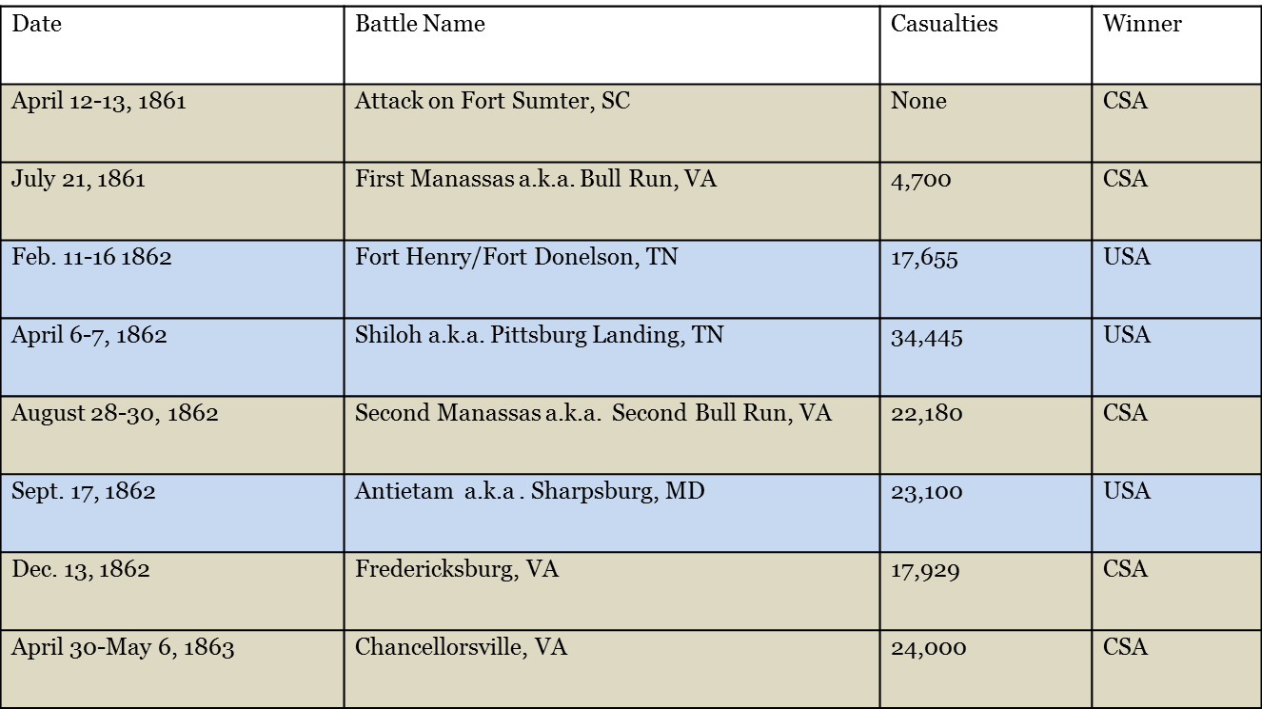
The situation as the summer of 1863 arrives:

Slide 17
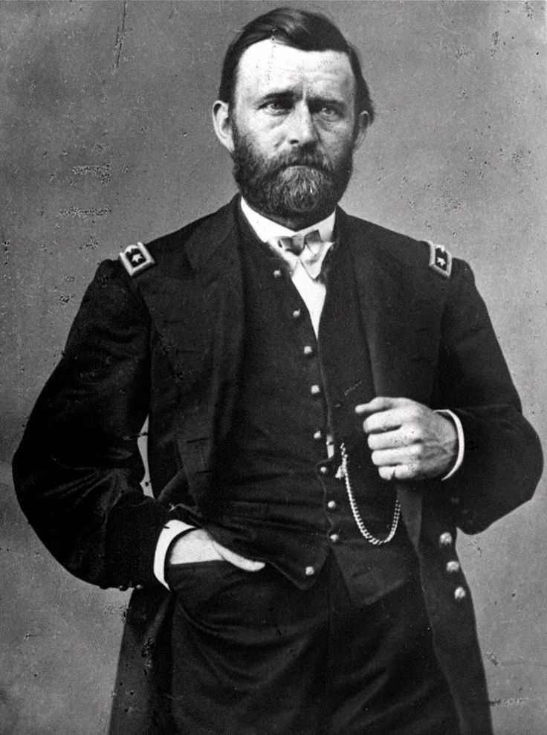
Vicksburg May 18 - July 4, 1863
In the west, United States military forces under Ulysses S. Grant surround Vicksburg, Mississippi, located at a significant point on the Mississippi River.
On your map locate and circle Vicksburg, Mississippi
Notes:
Image information:
Ulysses S. Grant

Slide 18
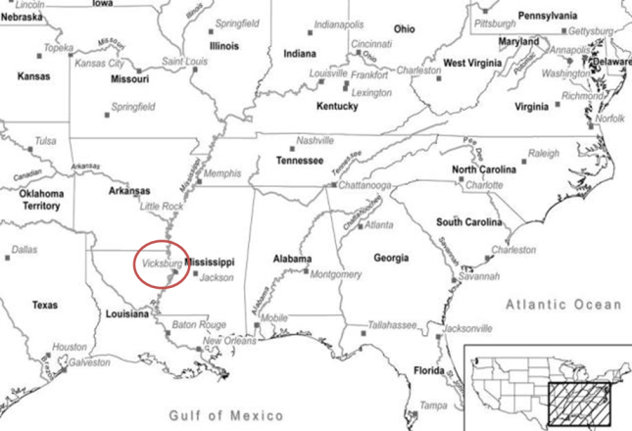
Vicksburg
A loss at Vicksburg would mean that the Confederate territory would be cut in half.
Notes:
A Confederate loss of Vicksburg would make it very difficult for Confederate states west of the Mississippi River to send supplies and communicate to Confederate states east of the Mississippi River.

Slide 19
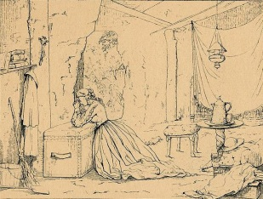
Vicksburg
After 47 days of siege Lt. Gen. John C. Pemberton surrenders Vicksburg to Grant on July 4, 1863.
Etching titled, “Cave life in Vicksburg during the siege”
Notes:
Image information:
Etching titled, “Cave life in Vicksburg during the siege”

Slide 20
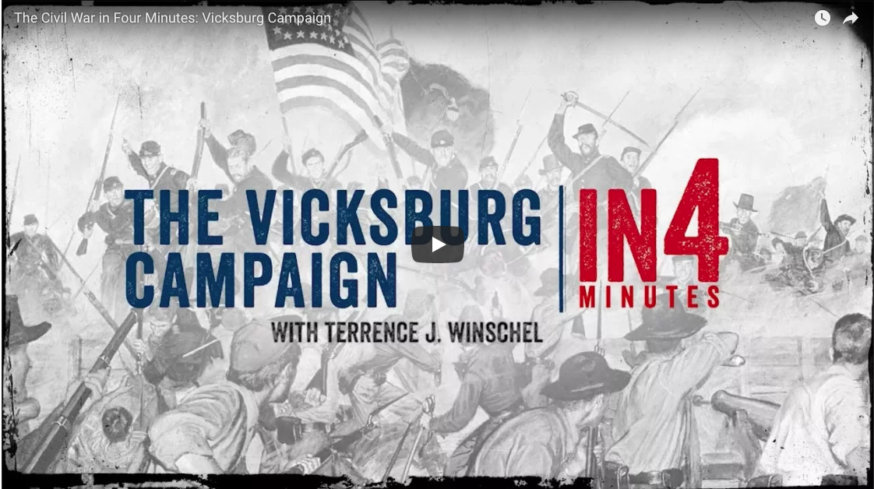
The Vicksburg Campaign
Activity:
Watch In4: The Vicksburg Campaign
Notes:
Watch The Vicksburg Campaign In4
https://www.battlefields.org/learn/videos/vicksburg-campaign

Slide 21
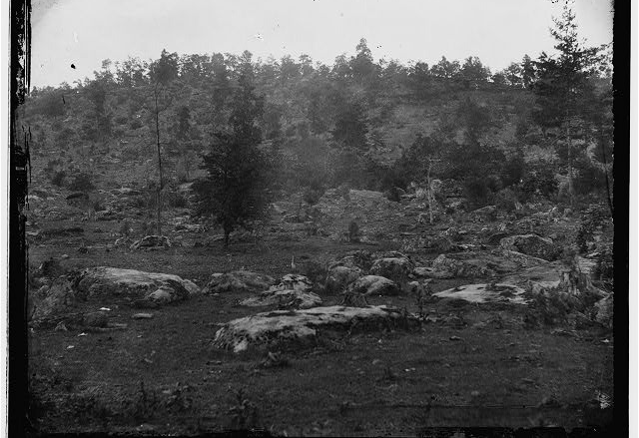
Gettysburg July 1-3, 1863
In the east, Confederate forces under General Robert E. Lee invade the Northern state of Pennsylvania
On your map locate and circle Gettysburg, Pennsylvania
Notes:
Image information:
View of Little Round Top, Gettysburg

Slide 22
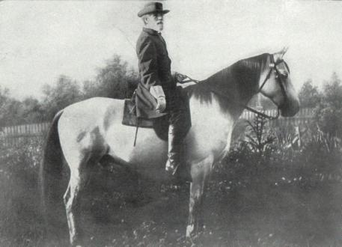
Gettysburg
At this point in the war, the Confederate Army of Northern Virginia has a winning record. And Confederate General, Robert E. Lee has a plan to move his army north.
Notes:
Image information:
Robert E. Lee on Traveller

Slide 23
Gettysburg
5 Reasons Lee invaded Pennsylvania :
to disrupt the Union’s ability to attack the Confederate capital at Richmond, Virginia
to draw the United States Army away from the safety of the defenses of Washington, D.C. and fight them in the “open”
to take the war away from the farmers in Virginia who were having problems planting and harvesting crops, as both armies had been camping or fighting on their land for the previous two summers
to “live off the land” and collect supplies to take back to Virginia
to win a decisive victory on Northern soil in the hopes of bringing the Civil War to a close

Slide 24
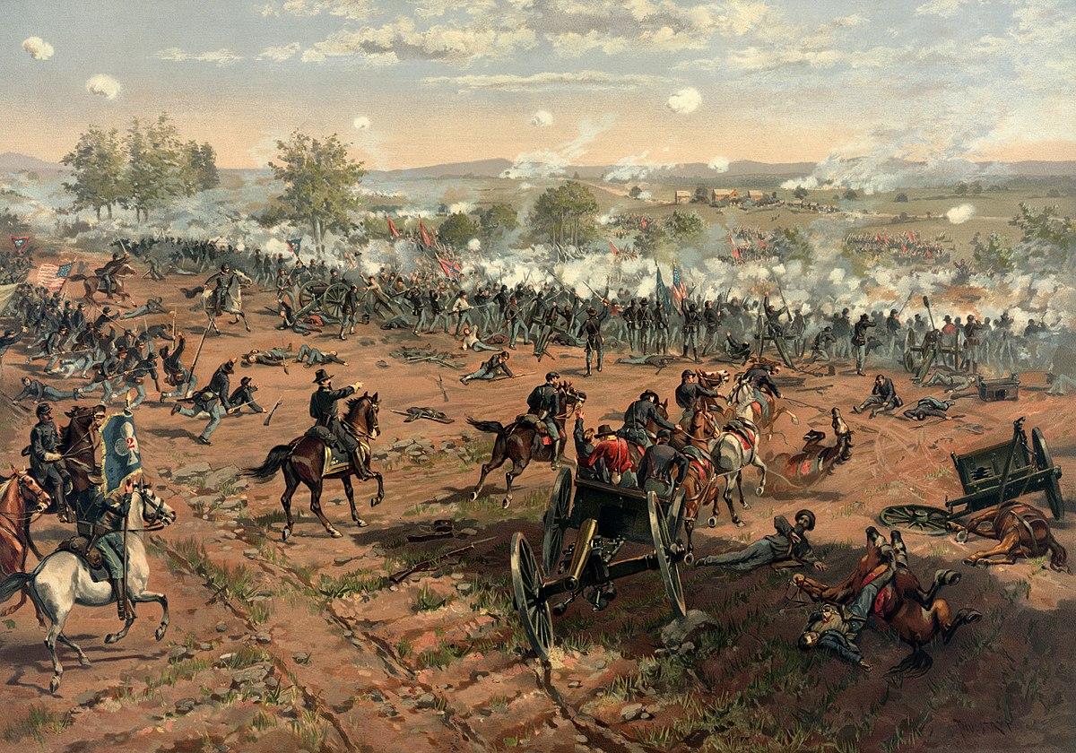
Gettysburg On July 1st, 1863 Union forces clash with Lee’s Army

Slide 25
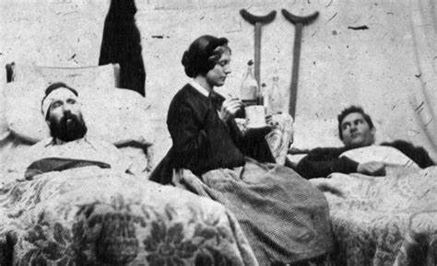
After three days of fighting and 51,000 casualties killed, wounded, or missing…

Slide 26
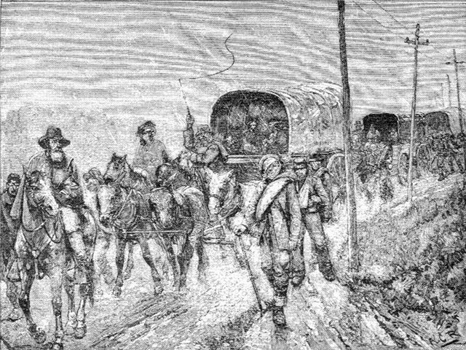
Gettysburg
The Confederate Army of Northern Virginia is defeated
Lee and his army leave Pennsylvania and retreat to Virginia.
Never again would the Confederates invade a Northern state in large numbers.

Slide 27
After Vicksburg and Gettysburg:
Date | Battle Name | Causalities | Winner
April 12-13, 1861 | Attack on Fort Sumter, SC | None | CSA
July 21, 1861 | First Manassas a.k.a. Bull Run, VA | 4,700 | CSA
Feb. 11-16 1862 | Fort Henry/Fort Donelson, TN | 17,655 | USA
April 6-7, 1862 | Shiloh a.k.a. Pittsburg Landing, TN | 34,445 | USA
August 28-30, 1862 | Second Manassas aka Second Bull Run, VA | 22,180 | CSA
Sept. 17, 1862 | Antietam a.k.a. Sharpsburg, MD | 23,100 | USA
Dec. 13, 1862 | Fredericksburg, VA | 17,929 | CSA
April 30-May 6, 1863 | Chancellorsville, VA | 24,000 | CSA
July 1-3, 1863 | Gettysburg, PA | 51,000 | USA
May 18 – July 4 1863 | Siege of Vicksburg, MS | 19,233 | USA

Slide 28
The Aftermath
In the United States
The victories at Gettysburg and Vicksburg increased the morale of the United States and its armies. Many people now feel that the war can be won.
In the Confederate States
The losses at Vicksburg and Gettysburg decrease the morale of the Confederate States and its armies.
For most of the remainder of the war the Confederates will fight on the defensive.

Slide 29
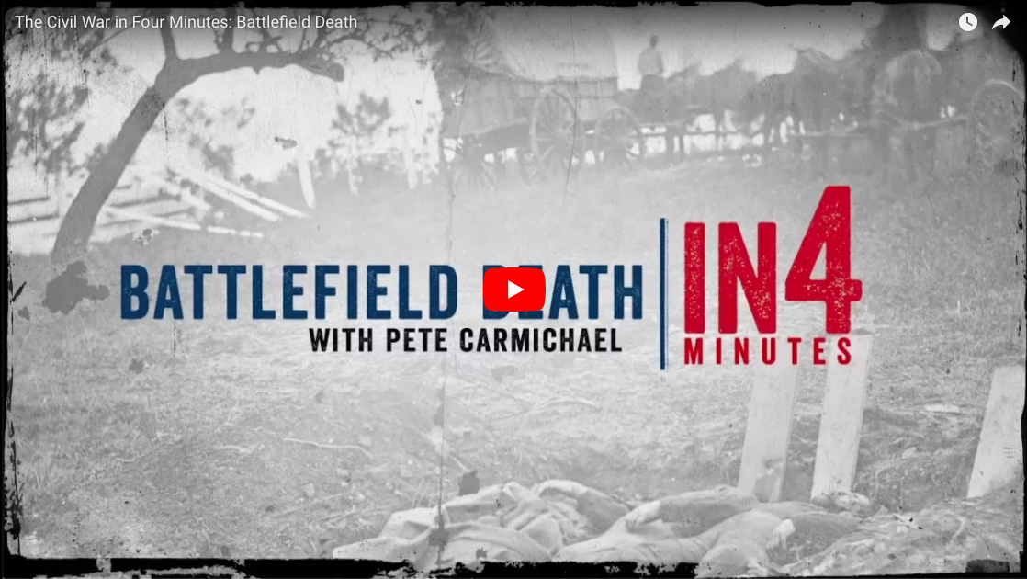
The Aftermath
Activity:
Watch In4: Battlefield Death
Notes:
CAUTION GRAPHIC IMAGES
https://www.battlefields.org/learn/videos/battlefield-death-civil-war

Slide 30
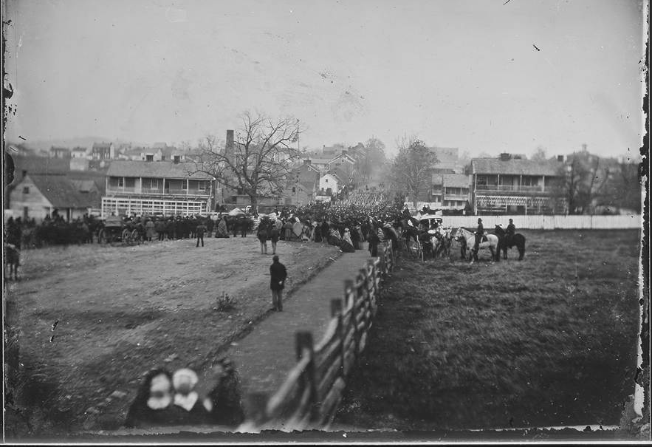
The Aftermath
On November 19, 1863, a Soldiers’ National Cemetery was established at Gettysburg for the Union dead.
Music played and speeches were made, but the most significant speech, lasting approximately two minutes, was made by President Abraham Lincoln.

Slide 31
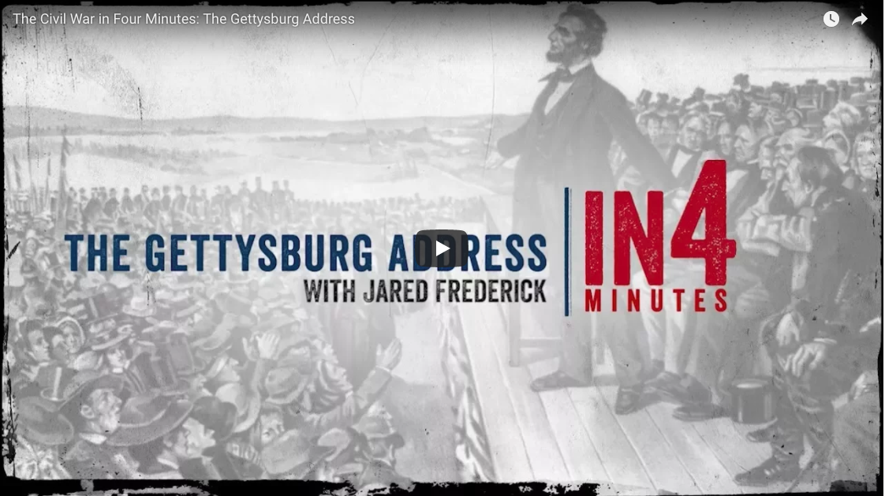
Gettysburg Address
Activity:
Watch In4: The Gettysburg Address
Notes:
https://www.battlefields.org/learn/videos/gettysburg-address

Slide 32
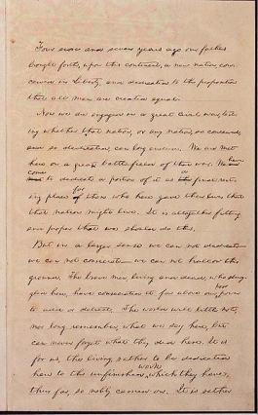
The Aftermath
Activity
Let’s read the Gettysburg Address together.
Complete the Gettysburg Address questions

Slide 33
Why do you think Americans feel that the Gettysburg Address still speaks to them today? Do you think this is an eternal document? Why?

