Slide 1
1775 Perspectives: The Continental Army
A Revolutionary War Lesson Plan

Slide 2
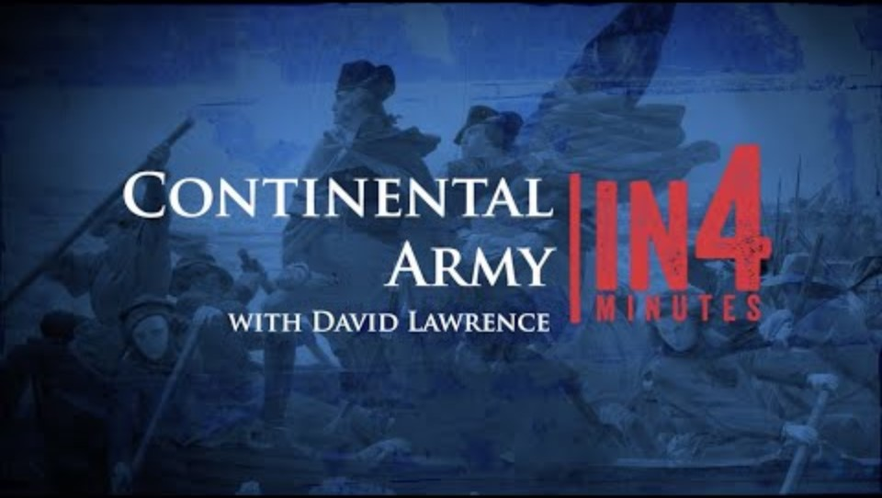
Continental Army In4Minutes
Notes:
The video is embedded, but can also be viewed here: https://www.battlefields.org/learn/videos/continental-army-revolutionary-war

Slide 3
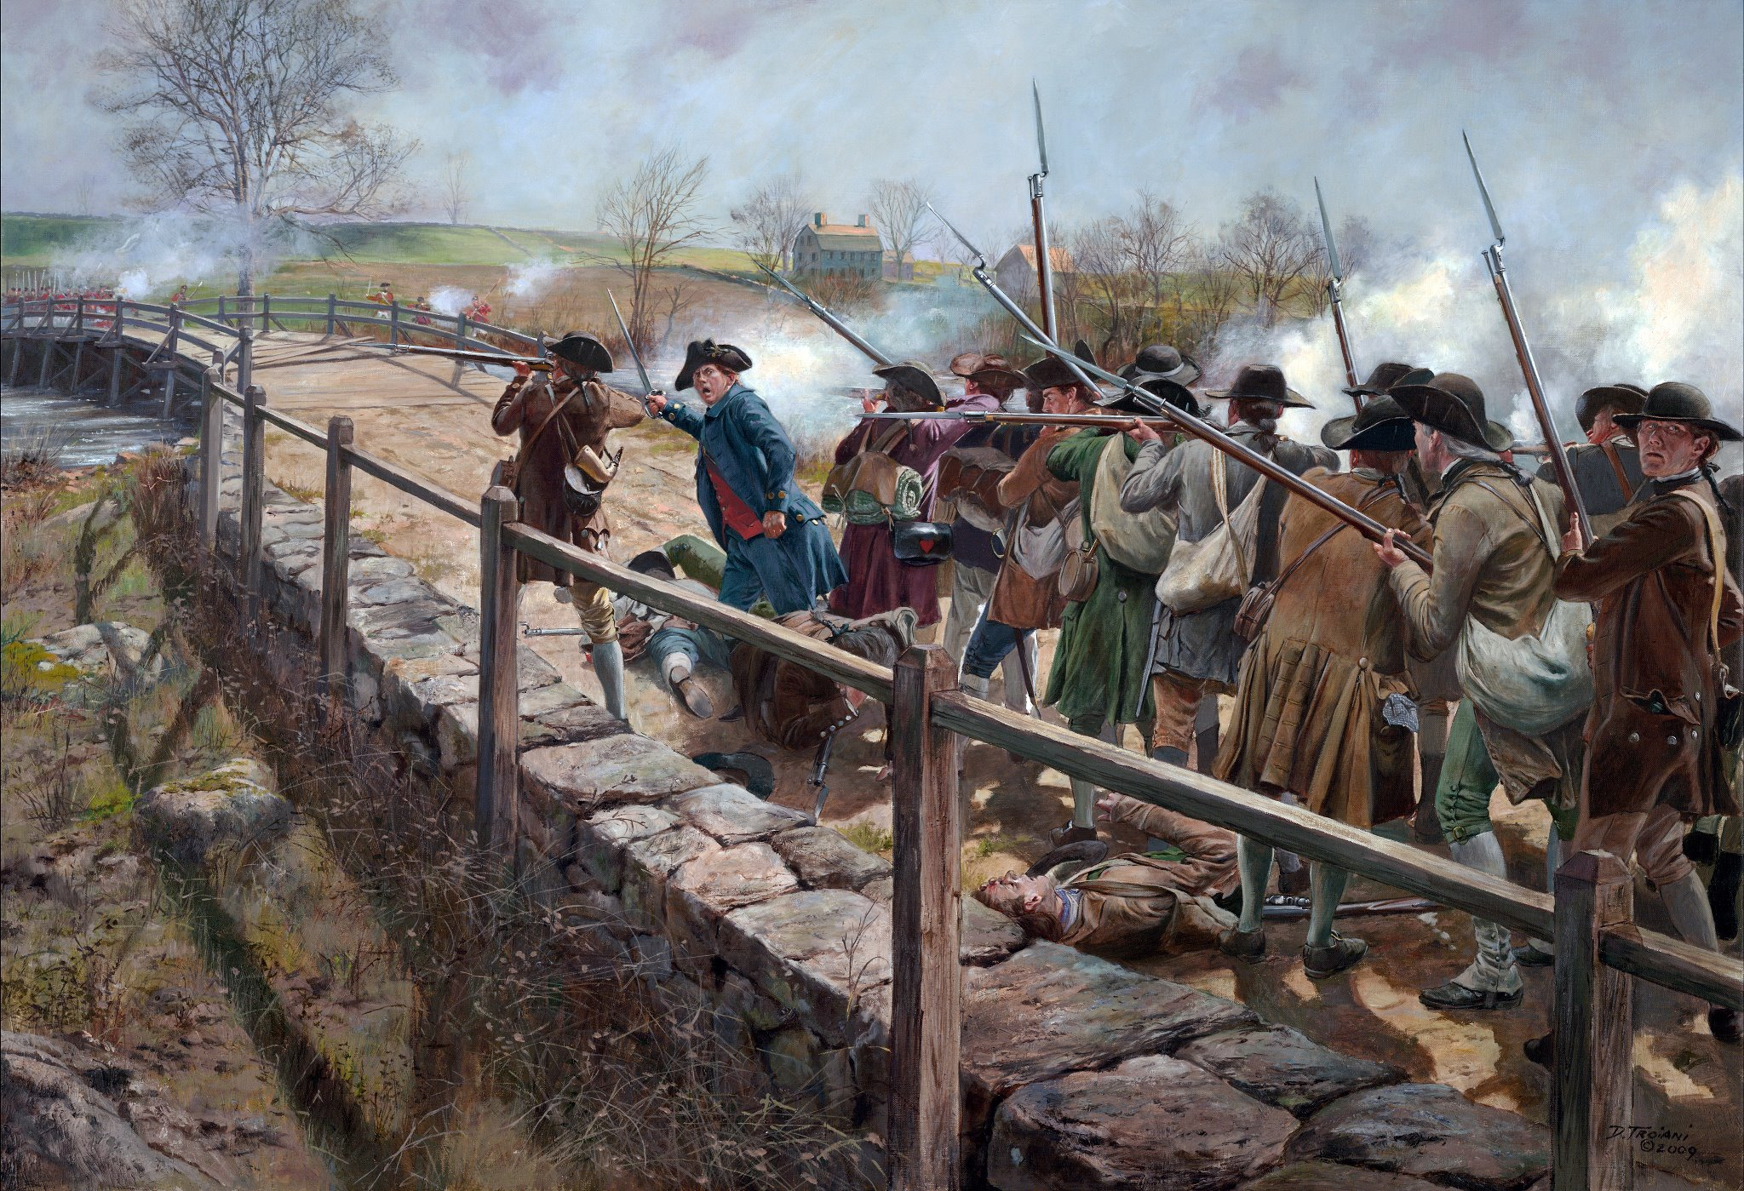
Militia Origins
The Continental Army did not spontaneously. Local military groups, called “militia”, existed to defend the colonies long before the Revolutionary War.
Local militia defended colonists against attacks by native tribes and played a key role in defeating French forces during the French and Indian War.
When Congress authorized the formation of the Continental Army on June 14, 1775, these militia units formed its core.
Don Troiani
Notes:
The Continental Army did not appear from nothing. Local military groups, called “militia”, existed to defend the colonies long before the Revolutionary War. Local militia defended colonists against attacks by native tribes and played a key role in defeating French forces during the French and Indian War. It was these same militia units who defeated the British at Concord and besieged Boston. When Congress authorized the formation of the Continental Army in 1775, these militia units formed its core. George Washington was sent by congress to organize these various militia units into a larger, unified, fighting force.
Learn more: https://www.battlefields.org/learn/articles/militia-minutemen-and-continentals-american-military-force-american-revolution

Slide 4
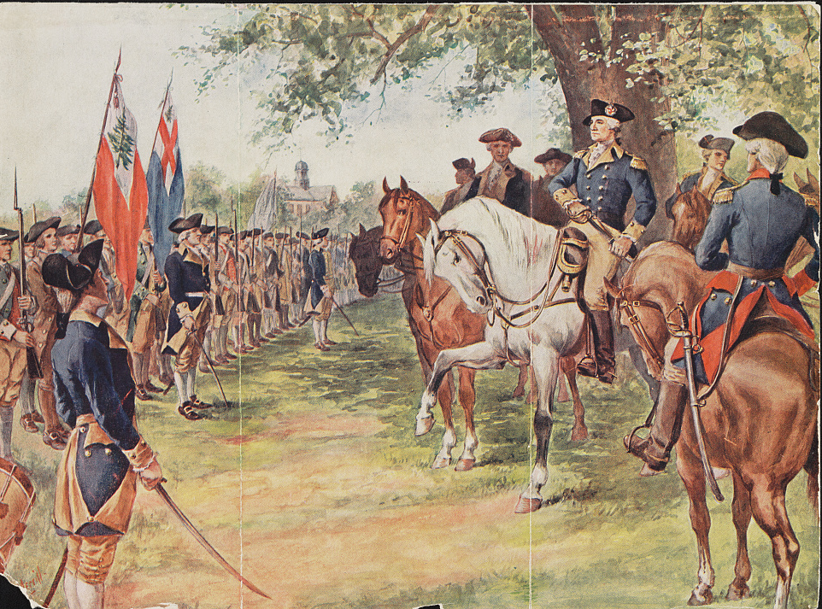
Washington Takes Command
George Washington was appointed by Congress in 1775 to lead the new army.
His first task was to organize the many different militias into a cohesive fighting force. Troops from every colony and of all backgrounds had to learn to fight together.
Washington established a strict chain of command, appointing promising officers to command groups of militias.
The militias from each colony were initially grouped together.
Notes:
George Washington was appointed by Congress to lead the new army. His first task was to organize the many different militias into a cohesive fighting force. Troops from every colony and of all backgrounds had to learn to fight together. Washington established a strict chain of command, appointing promising officers to command groups of militias.
Learn more: https://www.battlefields.org/learn/articles/george-washingtons-military-leadership

Slide 5
The Continental Army’s Structure
Regiment
Brigade
Division
Continental Army
38 militia regiments, divided into…
Six brigades, divided into…
Three divisions, formed…
One army.
Each regiment was roughly 700 troops.
Each brigade was roughly 2500 troops.
Each division was roughly 5000 troops.
In 1775 the army numbered roughly 16,000 troops.
Notes:
Learn more: https://www.battlefields.org/learn/articles/militia-minutemen-and-continentals-american-military-force-american-revolution

Slide 6
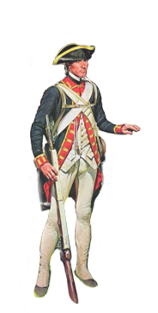
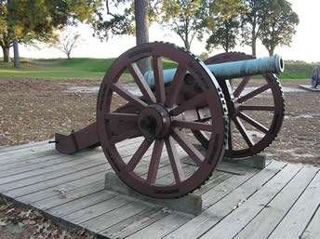
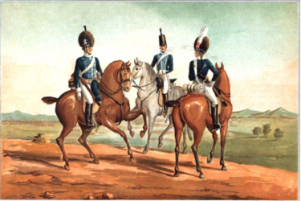
The Three Branches of the Army
Infantry, Artillery, & Cavalry
This is an infantryman.
Infantry fought on foot and were armed with muskets.
Their muskets also came with a bayonet, for use in hand-to-hand combat.
A musket could hit enemy targets effectively at ranges of around 100 yards or less.
Because muskets weren’t very accurate, infantry fought in formations and fired in massed volleys to maximize their chance of hitting the enemy.
This is a cannon.
A cannon is crewed by a group of artillerists.
Cannons, referred to collectively as “artillery”, were rare, and therefore a valuable prize if they could be captured.
Cannons had a much longer range and fired larger projectiles than muskets.
Cannons were used to destroy fortifications (defenses) and to break up formations of infantry or cavalry.
This is a group of cavalrymen.
Cavalry units were made of troops on horseback.
Their primary job was to gather intelligence by observing the enemy army. They could also be used in a charge to break through an enemy line.
They were typically armed with a saber (a type of sword), and one or more pistols.
Notes:
The continental army was divided into three branches: the infantry, the artillery, and the cavalry. Each served an essential role. The majority of the troops were infantry, who fought on foot with muskets. They formed a battle line, which was the main fighting arm of the army in battles. Artillery supported this line by firing at enemy battle lines from long range, breaking them up and disorganizing them. Cavalry, with their superior mobility, helped by scouting and gathering intelligence on the enemy army, as well as by making decisive “charges” designed to break through the enemy line, causing it to break and flee. Infantry, even in large groups, often broke and ran in the face of a well-executed cavalry charge. Imagine a hundred men on horseback galloping toward you at full speed. Would you stand there or would you try to get out of the way?
Learn more:
https://www.battlefields.org/learn/articles/10-facts-continental-army
https://www.battlefields.org/learn/articles/cavalry-american-revolution
https://www.battlefields.org/learn/articles/artillery-across-three-wars
https://www.battlefields.org/learn/articles/fighting-man-continental-army

Slide 7
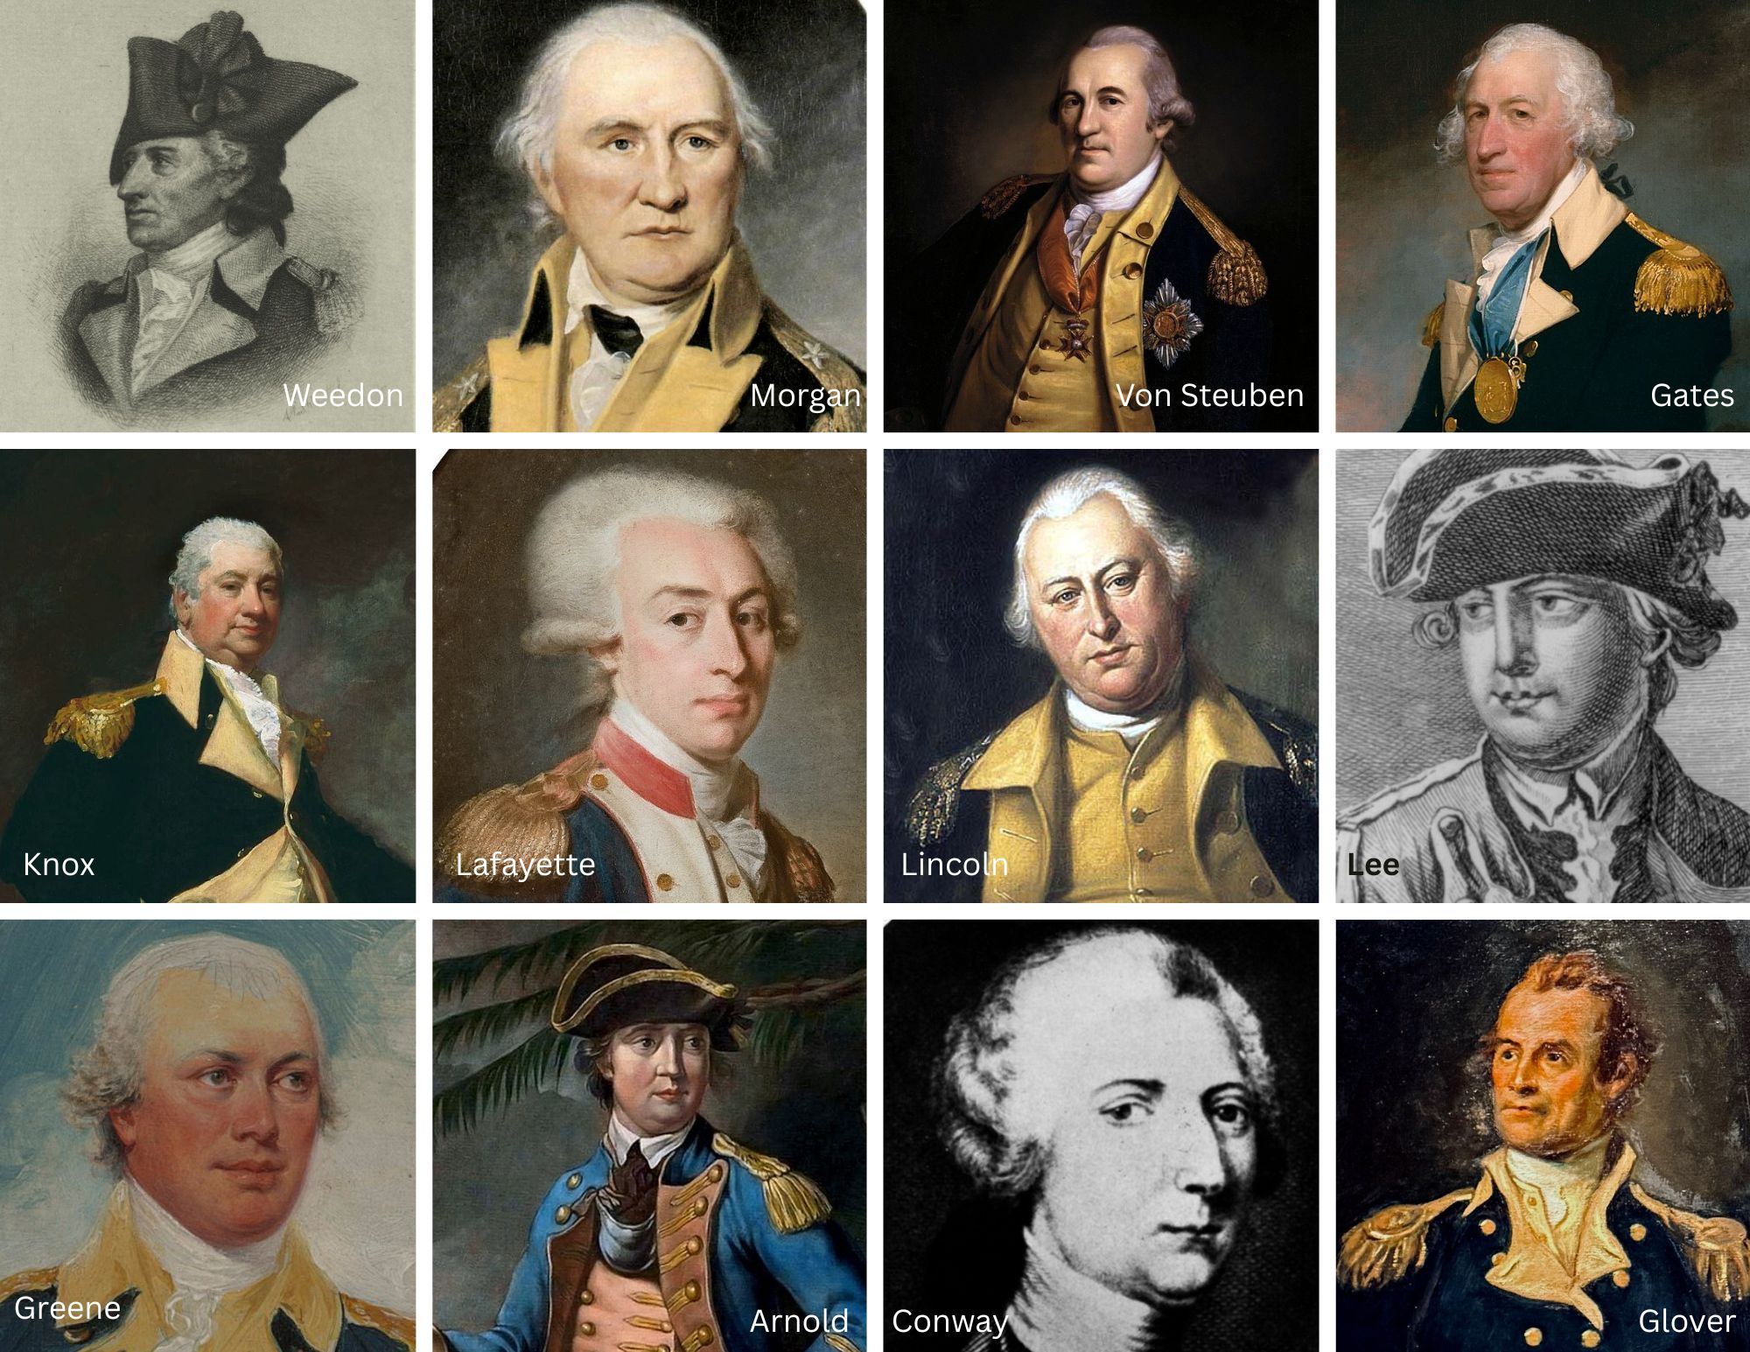
Notable
Leaders
George Washington commanded the whole Continental Army, but there were many other generals leading brigades and divisions.
These are a few of the generals in the Continental Army.
Some of the generals were from Europe and chose to journey to the United States to fight in the war.
Notes:
Learn more:
Foreign Fighters in the American Revolution: https://www.battlefields.org/learn/articles/foreign-fighters-american-cause-independence
George Washington’s Military Leadership: https://www.battlefields.org/learn/articles/george-washingtons-military-leadership
(Pictured generals in last name alphabetical order)
Benedict Arnold (turned traitor to the United States in 1780): https://www.battlefields.org/learn/biographies/benedict-arnold
Thomas Conway: https://www.battlefields.org/learn/biographies/thomas-conway
Horatio Gates: https://www.battlefields.org/learn/biographies/horatio-gates
John Glover: https://www.battlefields.org/learn/biographies/john-glover
Nathanael Greene: https://www.battlefields.org/learn/biographies/nathanael-greene
Henry Knox: https://www.battlefields.org/learn/biographies/henry-knox
Marquis de Lafayette: https://www.battlefields.org/learn/biographies/marquis-de-lafayette
Charles Lee: https://www.battlefields.org/learn/biographies/charles-lee
Benjamin Lincoln: https://www.battlefields.org/learn/biographies/benjamin-lincoln
Daniel Morgan: https://www.battlefields.org/learn/biographies/daniel-morgan
Fredrich Von Steuben: https://www.battlefields.org/learn/biographies/baron-von-steuben
George Weedon: https://www.battlefields.org/learn/biographies/george-weedon

Slide 8
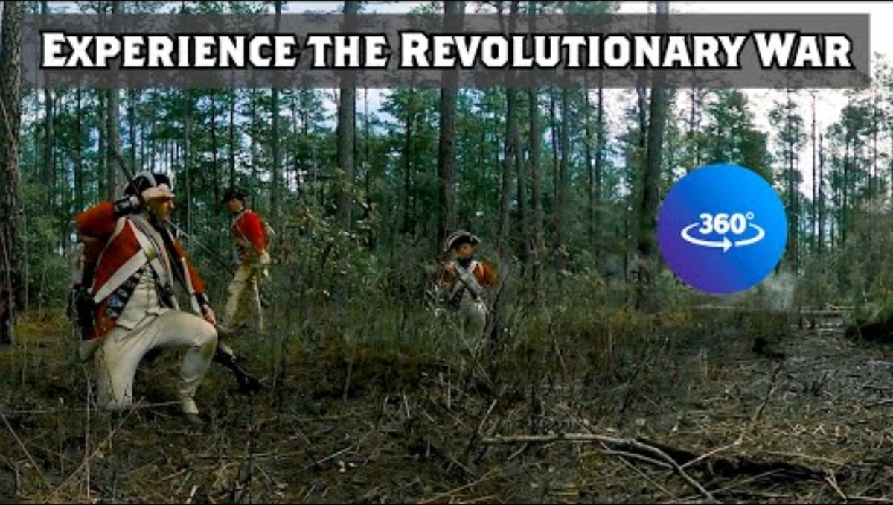
Soldier Life in the Revolution (In VR!)
Notes:
This VR video shows what life was like for Patriot soldiers during the Revolutionary War. If you don’t have a VR headset, don’t worry! You can look around in all directions by clicking and dragging with your mouse.
Link to VR: https://www.battlefields.org/learn/revolutionary-war/soldier-life-american-revolution-virtual-reality-experience

Slide 9
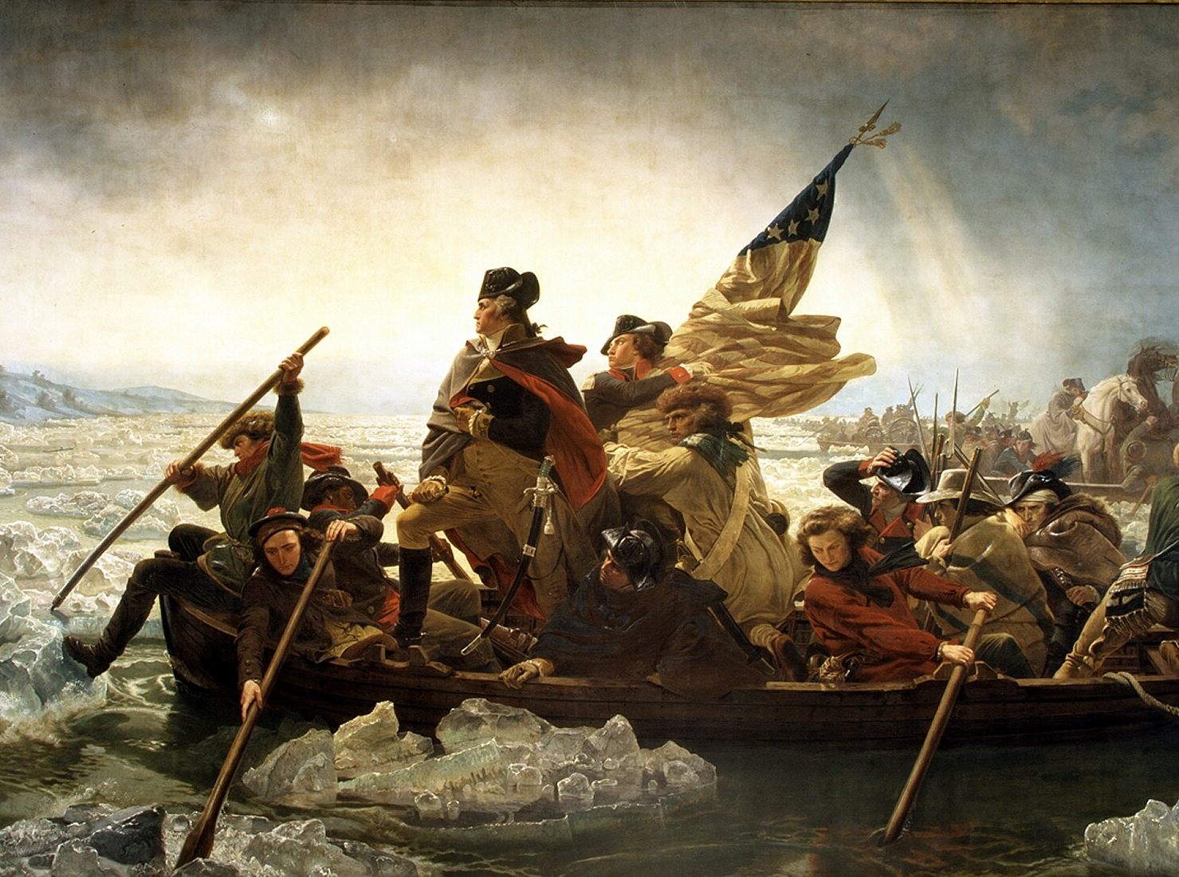
Early Successes and Failures
The first year and a half of the Continental Army saw both great success and great failure.
In early 1776, the army drove British troops out of Boston, inspiring Congress to declare independence that summer.
Weeks later, in the Battle of Long Island, the army suffered one of its greatest defeats. After a series of battles, the British captured New York City.
By wintertime, British troops were on the outskirts of Philadelphia, the new nation’s capital.
1776 ended and 1777 started well, though, when the army defeated British troops at Trenton and Princeton, in New Jersey.
Notes:
The first year and a half of the Continental Army saw both great success and great failure. In early 1776 the army drove British troops out of Boston, inspiring Congress to declare independence that summer. Weeks later, in the battle of Long Island, the army suffered one of its greatest defeats. After a series of battles the British captured New York City. By wintertime British troops were on the outskirts of Philadelphia, the new nation’s capital. The year ended on a high note, though, when the army defeated British troops at Trenton and Princeton, in New Jersey.
Learn more:
Siege of Boston: https://www.battlefields.org/learn/revolutionary-war/battles/boston
Battle of Long Island: https://www.battlefields.org/learn/revolutionary-war/battles/brooklyn
Ten Crucial Days (Trenton and Princeton): https://www.battlefields.org/learn/topics/ten-crucial-days-campaign

Slide 10
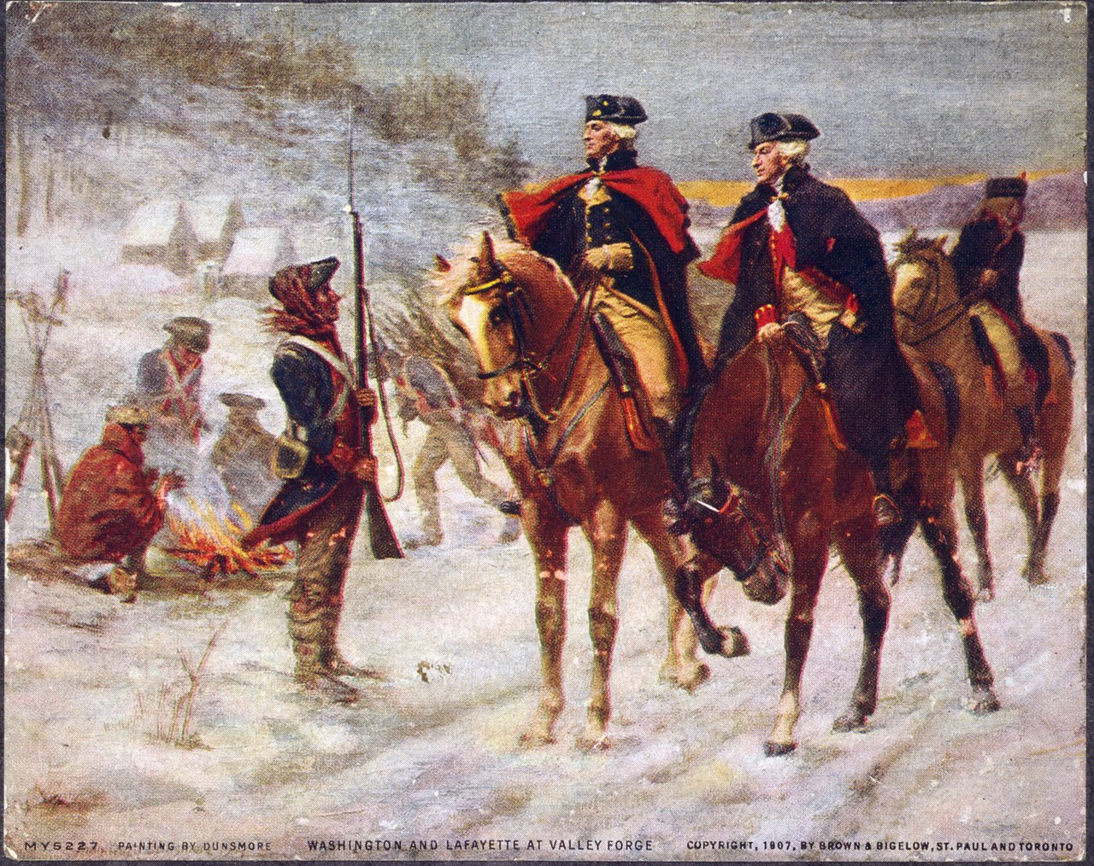
Surviving Harsh Winters
While the armies moved regularly during the spring, summer, and fall, winter conditions made campaigning impossible.
Instead, the army hunkered down, building solid structures to keep out the cold.
Some of the locations of winter encampments were Valley Forge, Morristown and Newburgh.
Even with the protection of log cabins and the warmth of fires, soldiers struggled to keep warm and dry, which led to many illnesses and deaths.
Notes:
After the victories at Trenton and Princeton, Washington and the army camped for the winter at Morristown, New Jersey. Located between New York and Philadelphia, Pennsylvania, Morristown, New Jersey provided a strategic location for Washington's army to make camp. Conditions in the camp were brutal, and many soldiers came down with diseases in the frigid and wet conditions. Washington did his best to keep the troops safe, going so far as to inoculate the men for disease, an early form of vaccination. Even still, many troops attempted to desert – leave the army without permission – and return home. George Washington and other patriot officers spent a great deal of time and energy convincing the men to stay and keep fighting.
Learn more:
Morristown: https://www.battlefields.org/learn/articles/morristown-winter-encampment
Valley Forge: https://www.battlefields.org/learn/articles/valley-forge-encampment
Newburgh: https://www.battlefields.org/learn/articles/newburgh-conspiracy

Slide 11
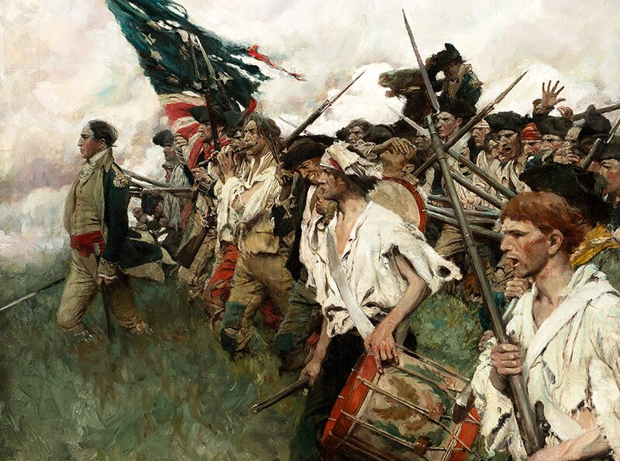
Critical Campaigns - 1777
As the war grew, so did the army. For the first time, it was divided into independent units.
Horatio Gates took command of a force which defeated Sir John Burgoyne's British troops at Saratoga, New York. This victory secured French intervention on behalf of the Patriots.
George Washington continued to command the main army defending Philadelphia.
This army was defeated at the Battle of Brandywine in September, and Philadelphia fell to the British shortly after.
In both cases one thing was clear: Patriot troops needed better training to beat British troops consistently.
Notes:
As the war grew in size, so did the army. For the first time it was divided into smaller, independent units.
Horatio Gates took command of an army which defeated British Forces at Saratoga, New York. This victory secured French intervention on behalf of the Patriots.
George Washington continued to command the main army defending Philadelphia.
This army was defeated at the Battle of Brandywine in September, and Philadelphia fell to the British shortly after.
In both cases one thing was clear: Patriot troops needed better training in order to beat British troops consistently in battle.
Learn more:
Saratoga: https://www.battlefields.org/learn/revolutionary-war/battles/saratoga
Brandywine: https://www.battlefields.org/learn/revolutionary-war/battles/brandywine

Slide 12
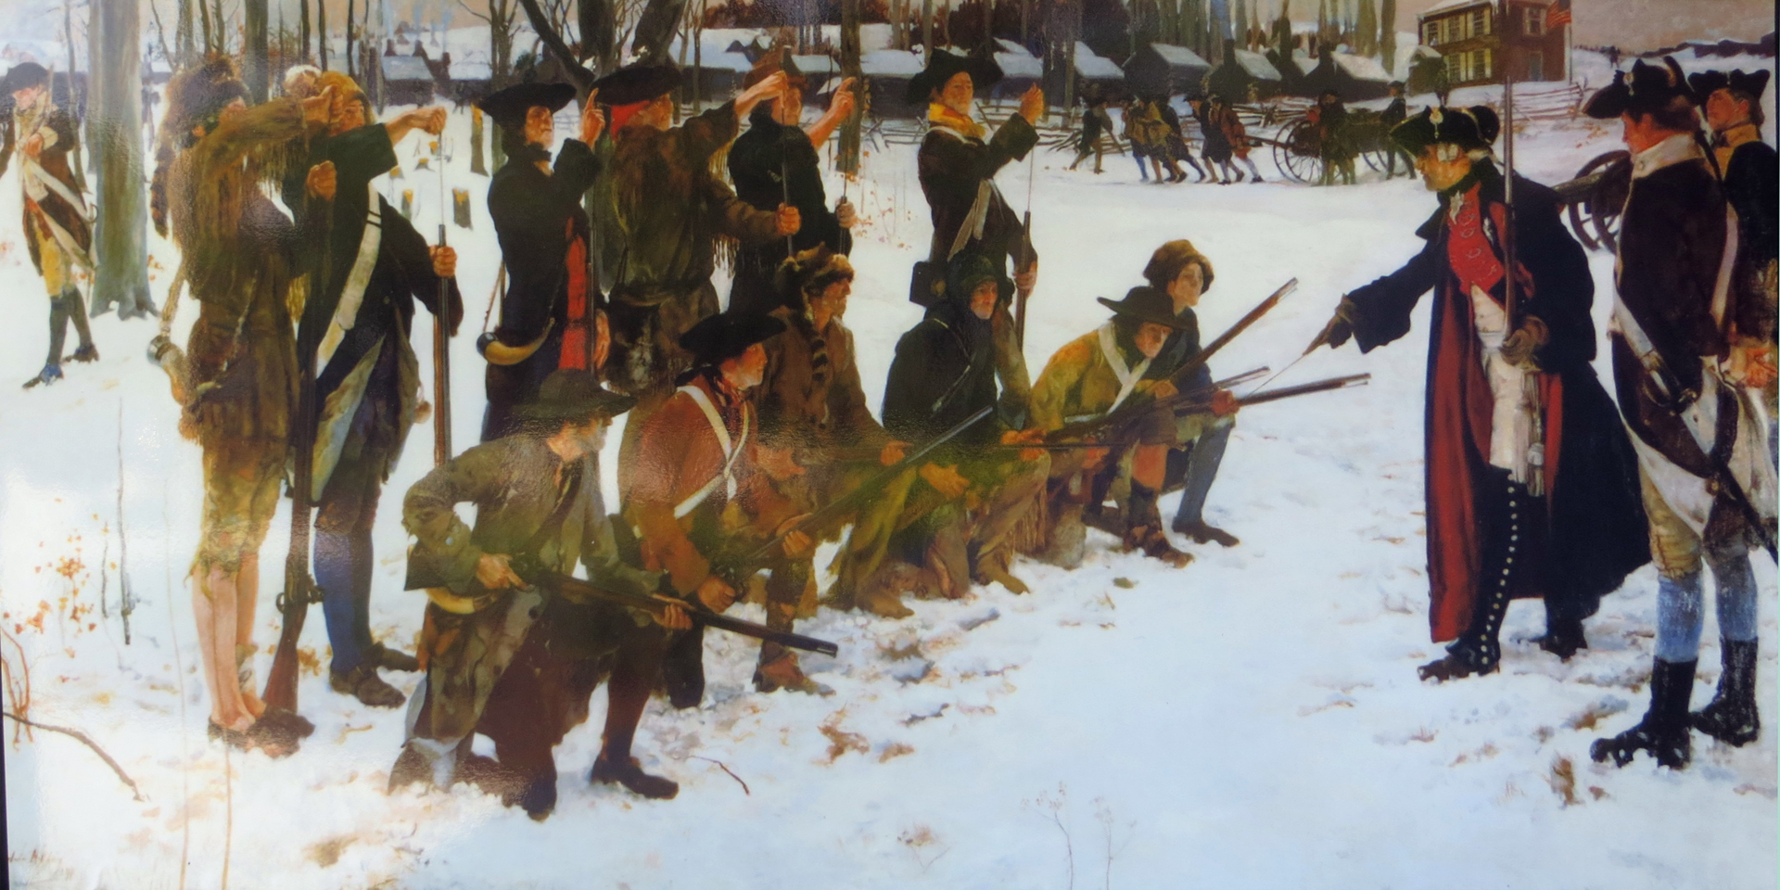
Training at Valley Forge
After the Battle of Brandywine (1777), the Continental Army with George Washington encamped at Valley Forge, Pennsylvania.
Baron von Steuben, a Prussian military officer who barely spoke any English, trained the army while it spent the winter at Valley Forge.
While the soldiers initially resisted the training, Steuben’s angry rants, which he forced interpreters to translate into English, soon became a source of entertainment and learning, and the army gradually became more proficient in its drill and tactics.
Notes:
Despite brutal conditions, Valley Forge marked a milestone in the army's military experience. In February, 1778, Baron Friedrich von Steuben arrived at Valley Forge, where Washington appointed him unofficial Inspector General of the camp shortly thereafter. Baron von Steuben worked to bring uniformity to the continental soldiers, who had seen combat, but lacked the martial training to pose an effective threat to the British. He developed a system of drill for the entire army and taught the men combat maneuvers that equipped them to rival the well-trained British regulars. Steuben’s previous experience in the Prussian army during the Seven Years' War prepared him to oversee the military training Washington’s men so desperately needed, and by the end of the encampment at Valley Forge, the army had undergone a significant transformation, from ragtag and wearied recruits to an ordered and disciplined fighting force.
Learn more:
Winter at Valley Forge: https://www.battlefields.org/learn/articles/winter-valley-forge
Baron Von Steuben: https://www.battlefields.org/learn/biographies/baron-von-steuben

Slide 13
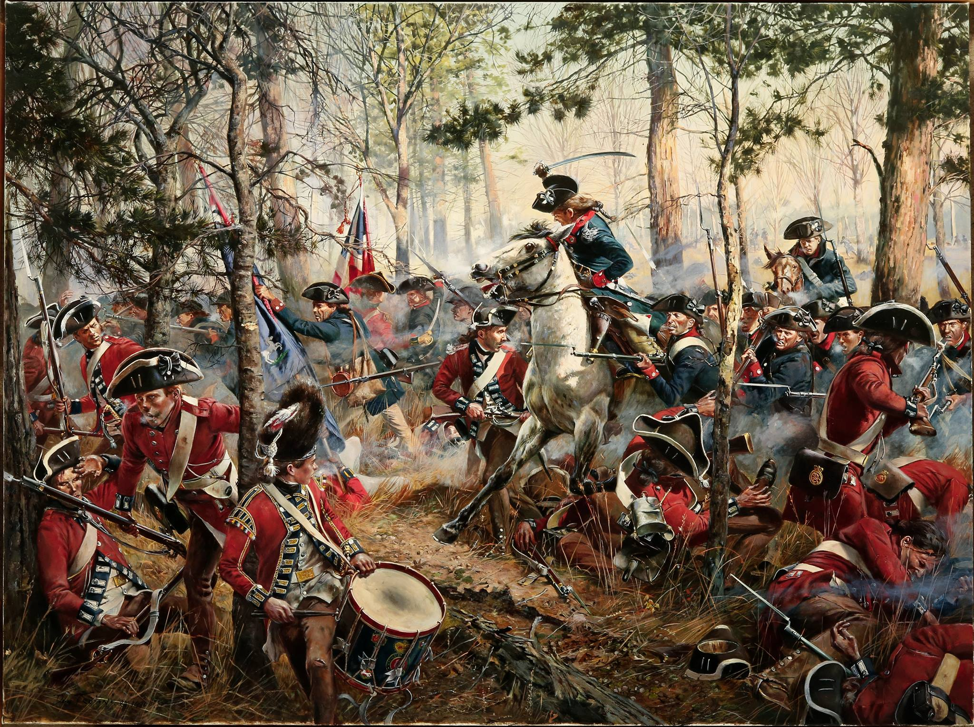
The Continental Line Regiments
George Washington saw the need to create a professional core within the Continental Army.
Congress authorized Washington to raise regiments of “Continentals”, units with soldiers drawn from across the states, rather than all hailing from one.
These units were better trained and more disciplined than the militia units that dominated the army and formed the elite core of Washington’s army through its later campaigns.
Don Troiani
Notes:
Early on George Washington saw the need to create a professional core within the Continental Army. Congress authorized Washington to raise regiments of “Continentals”, units with soldiers drawn from across the states, rather than all hailing from one. These units were better trained and more disciplined than the militia units that dominated the army, and formed the elite core of Washington’s army through its later campaigns.
Learn more: https://www.battlefields.org/learn/articles/george-washingtons-military-leadership

Slide 14
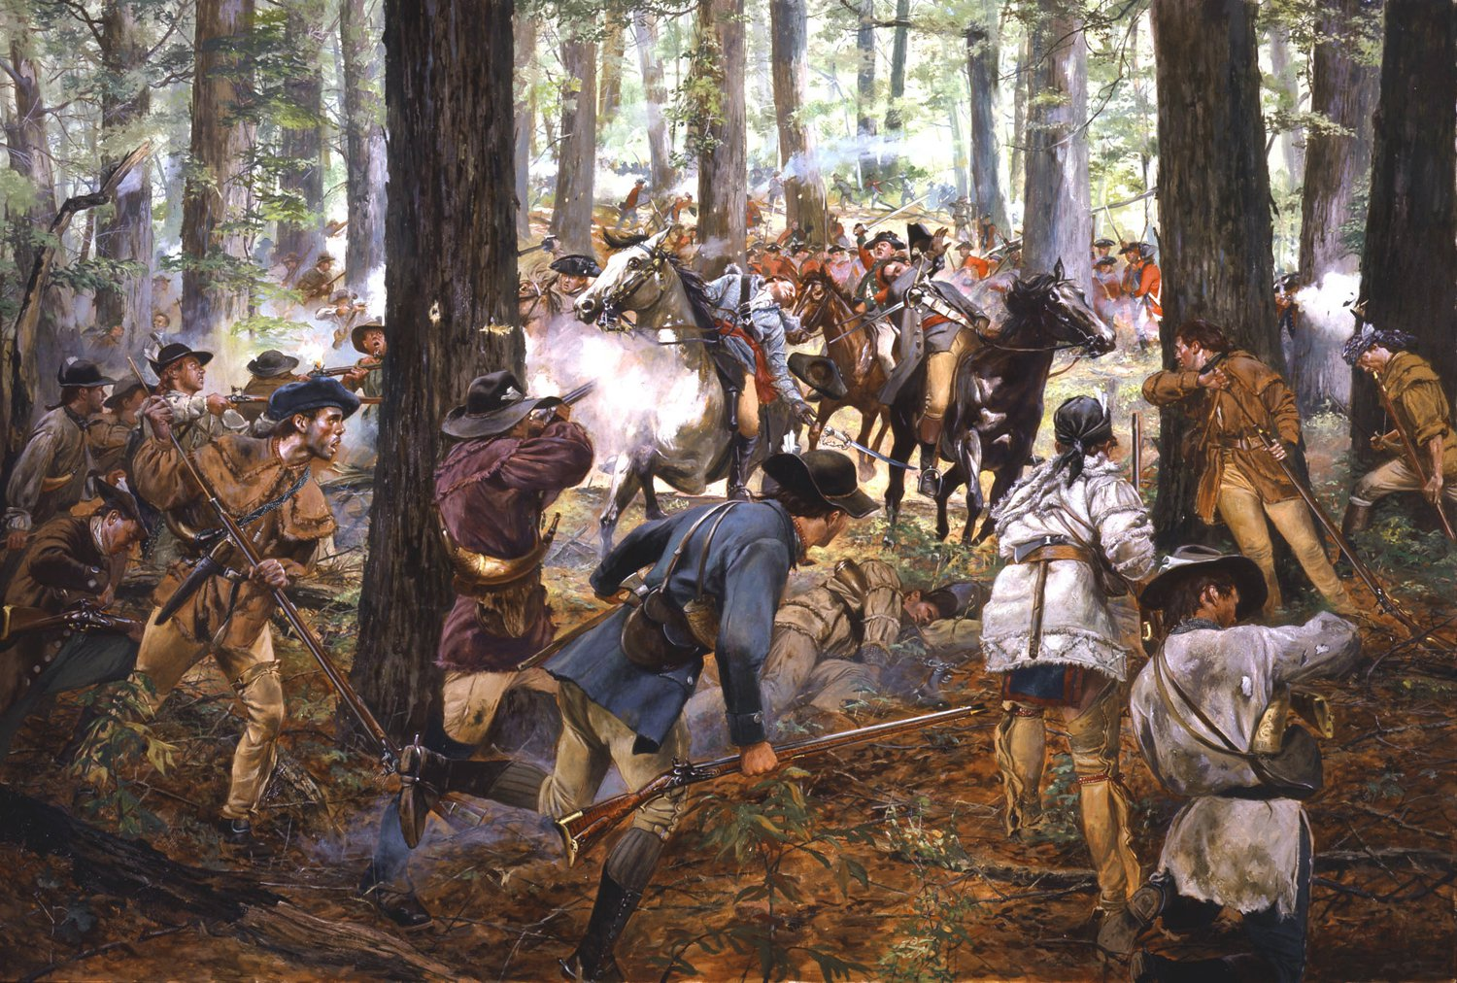
Success in the South
After 1777, Washington’s main army did not see heavy combat, as Washington knew he did not have enough troops to directly attack the main British army in New York.
Instead, both sides sent smaller army detachments to the southern states to turn the tide in that area.
Washington sent experienced troops and Continentals from his army to aid local militia in the Carolinas against British troops.
Battles at Cowpens and Guilford Courthouse challenged British efforts to end Patriot resistance in the southern states.
Don Troiani
Notes:
After 1777 Washington’s main army did not see heavy combat, as Washington knew he did not have enough troops to directly attack the main British army in New York. Instead, both sides sent smaller units, detachments, to the southern states to turn the tide in that area. Washington sent experienced troops and Continentals from his army to aid local militia in the Carolinas against British troops. Victories at King’s Mountain and Cowpens (South Carolina) along with a close loss at Guilford Courthouse (near modern-day Greensboro, North Carolina), stymied British efforts to defeat Patriot forces in the southern states.
Learn more:
https://www.battlefields.org/learn/videos/southern-campaign
https://www.battlefields.org/learn/articles/10-facts-southern-campaign

Slide 15
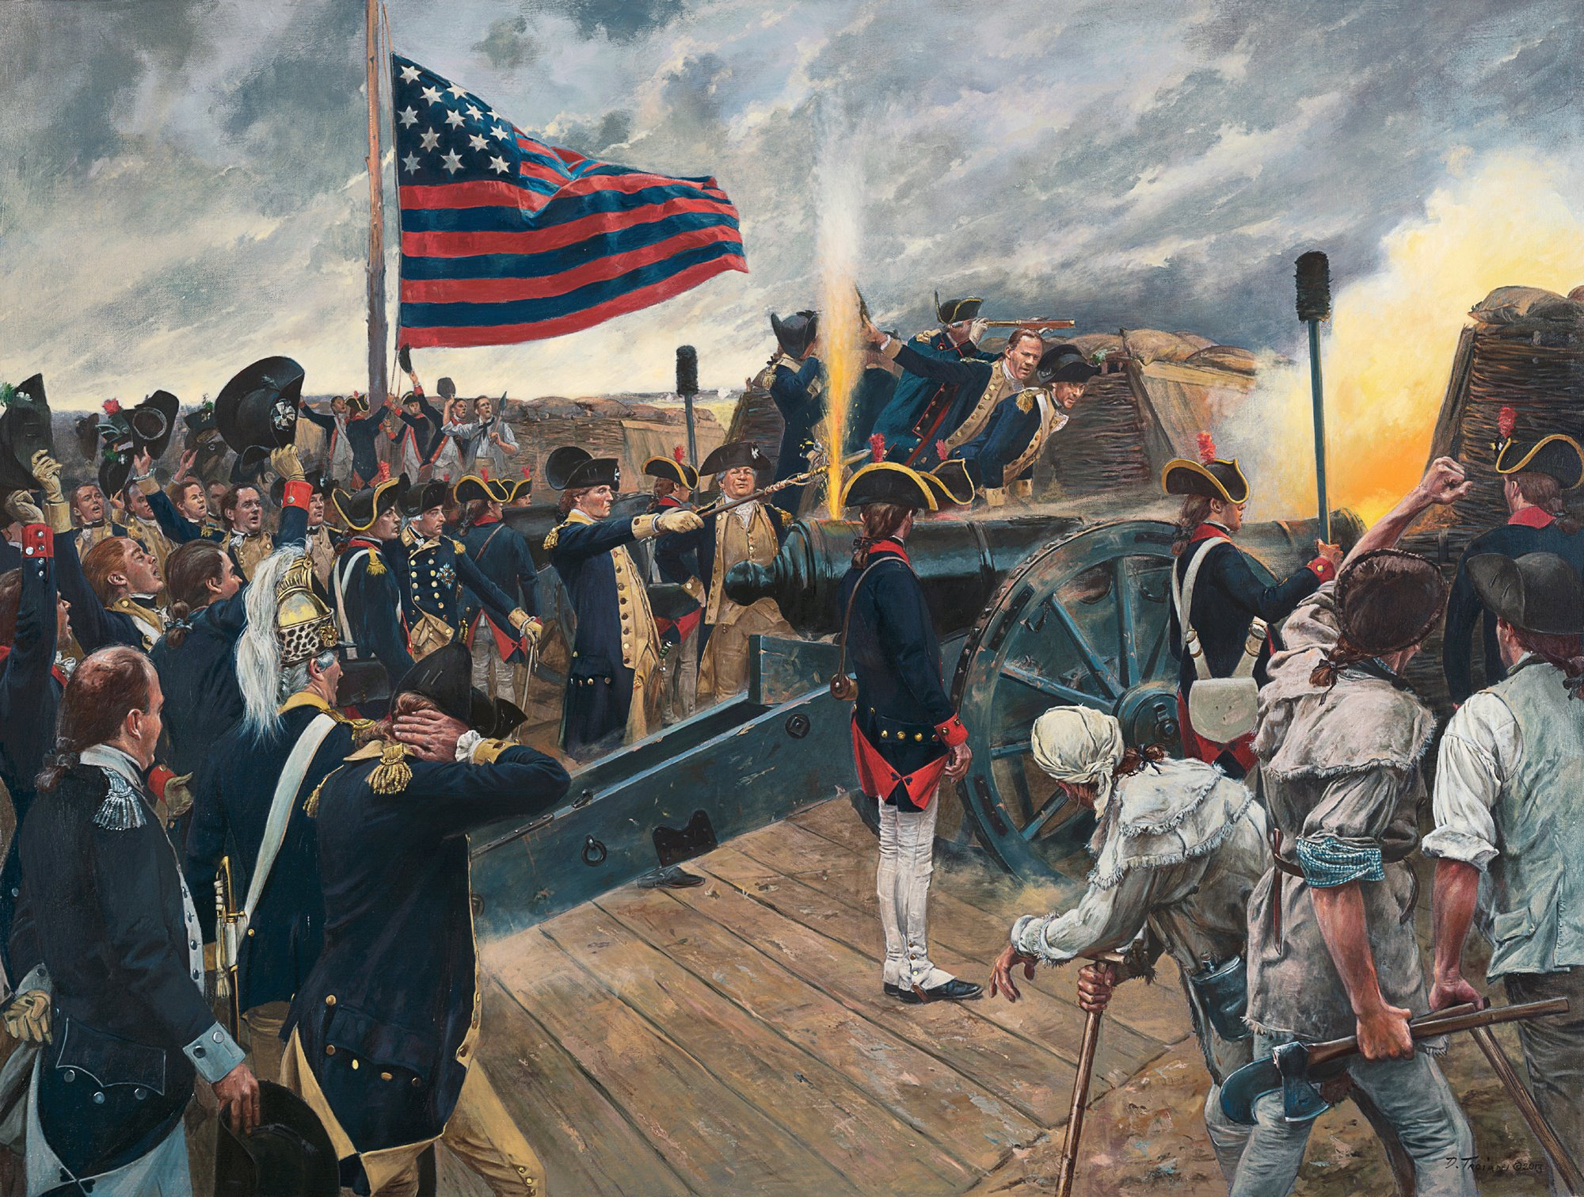
Yorktown and Victory
After a series of setbacks, Lord Cornwallis’ British army in the Carolinas was forced to retreat to the coast to resupply and recover.
Washington departed New Jersey in secret with his army to trap Cornwallis.
Washington, and a force of Allied French troops, trapped Cornwallis’ army at Yorktown, Virginia. After a siege, the British force surrendered.
This victory effectively put an end to the fighting in the Revolutionary War, and led to a peace treaty signed in Paris, France, in 1783.
Don Troiani
Notes:
After a series of setbacks, Lord Cornwallis’ British army in the Carolinas was forced to retreat to the coast to resupply and recover. Washington departed New Jersey in secret with his army to trap Cornwallis. Washington, along with Greene and a force of Allied French troops, found and trapped Cornwallis’ army at Yorktown, Virginia. After a protracted siege, the British force surrendered. This victory effectively put an end to the fighting in the Revolutionary War, and led to a peace treaty signed in Paris, France, in 1783.
Learn more:
https://www.battlefields.org/learn/revolutionary-war/battles/yorktown

Slide 16
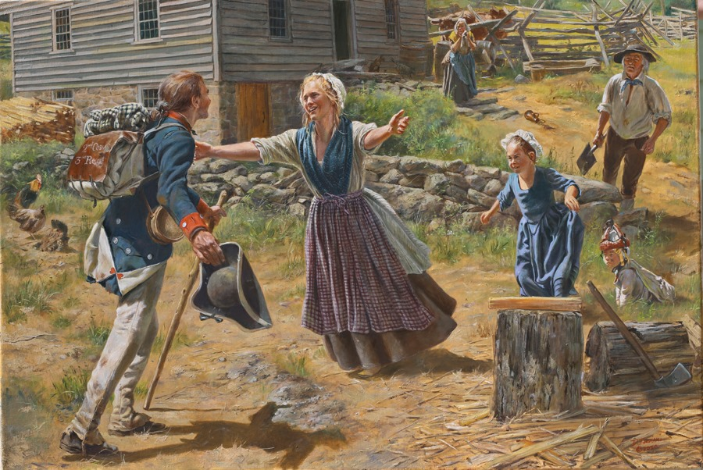
Aftermath
At the end of the war, its job done, Congress disbanded the Continental Army. George Washington and his soldiers returned home.
Each state, under the Articles of Confederation, was responsible for its own defense. State militias remained in place.
Some Continentals stayed, however, forming the nucleus of a very small United States Army.
The men, knowledge, and practices passed down from the Continental Army became the blueprint for every American fighting force thereafter, a tradition the United States Army still relies upon to this day.
Don Troiani
Notes:
At the end of the war, its job done, Congress disbanded the Continental Army. George Washington and all of his soldiers returned home. Each state, under the Articles of Confederation, was responsible for its own defense. State militias remained in place. Some continentals stayed, however, forming the nucleus of a very small United States Army. The men, knowledge, and practices passed down from the Continental Army became the blueprint for every American fighting force thereafter, a tradition the United States Army still relies upon to this day.

Slide 17
Primary Sources
1775 (Specific)
Washington’s Commission
General Orders: July 4, 1775
Continental Army Soldiers’ Experiences
1776: “Our Orders are to Take Possession of Dorchester Hill”
1776: “For the Cause of Freedom & Love”
George Washington Describes the Continental Army’s Needs
1778: “Setting for a March”
“She Served as a Private Soldier”
“A Slave for Five Years Fighting for Liberty”
Newburgh Address
Notes:
View the Lesson Plan Teaching Guide for links to these Primary Sources, worksheets, and discussion suggestions.

