Slide 1
1775 Perspectives: Battle of Bunker Hill
A Revolutionary War Lesson Plan

Slide 2
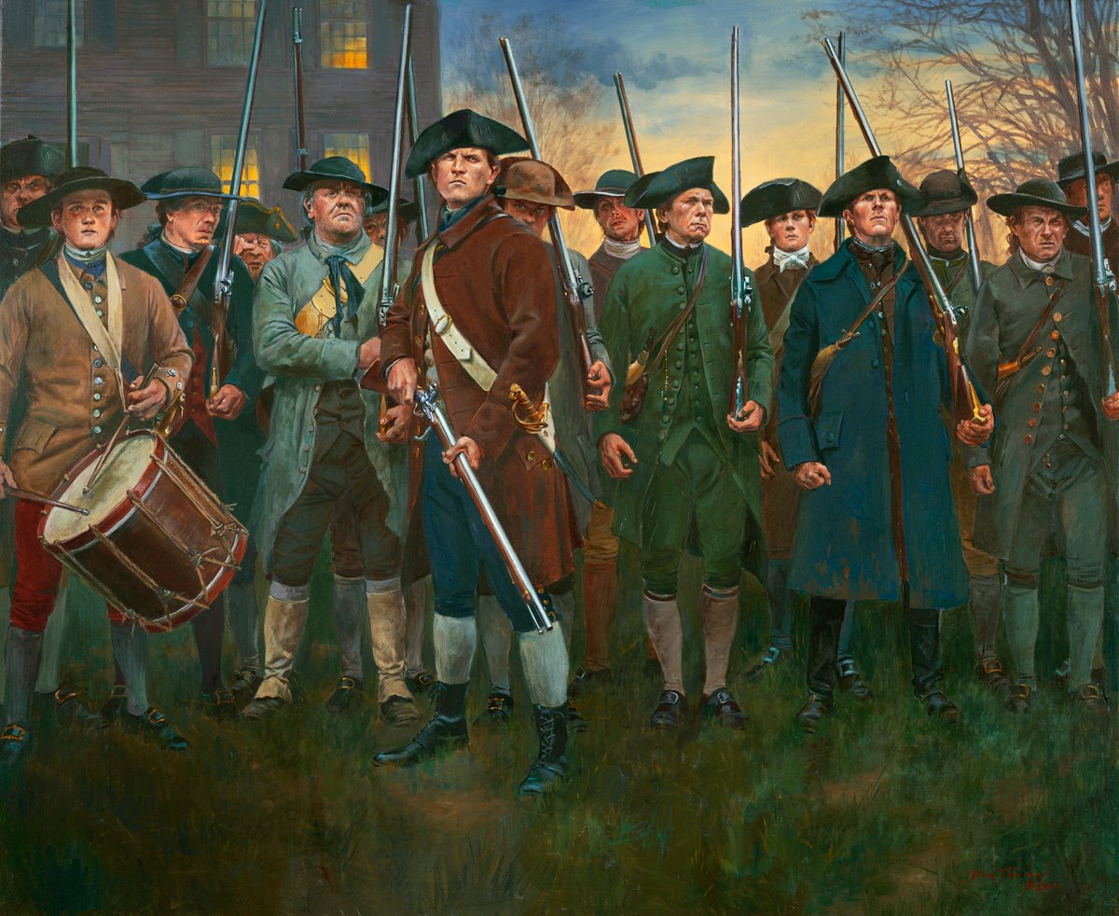
The Revolution Begins
On April 19, 1775, British soldiers marched to Concord, Massachusetts, hoping to seize guns and gunpowder from the local militia.
Patriot militiamen, warned about the British advance, gathered at Lexington. Shots were fired.
The British continued to Concord and more fighting occurred.
Don Troiani
Notes:
The British marched into Lexington and Concord intending to suppress the possibility of rebellion by seizing weapons from the colonists. Instead, their actions sparked the first battle of the Revolutionary War. The colonists’ intricate alarm system summoned local militia companies, enabling them to successfully counter the British threat. Learn more: https://www.battlefields.org/learn/revolutionary-war/battles/lexington-and-concord

Slide 3
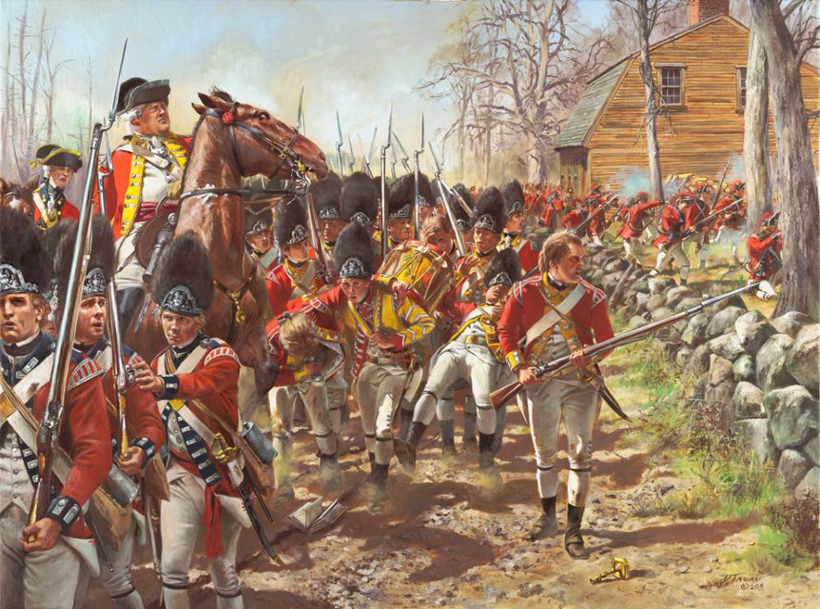
A Bloody Retreat
The British retreated from Concord on April 19, 1775.
Massachusetts militia ambushed the British, hiding behind stone walls and trees.
After meeting reinforcements, the British returned to Boston, following by hundreds of militiamen.
Word of the British defeat spread across New England, and militia companies from many of the colonies marched to Massachusetts.
Don Troiani
Notes:
The British conduct a running fight until they can reach the cover of British guns on ships anchored in the waterways surrounding Boston. The Patriots chase them but, having no clear orders, ultimately let them escape.
In the wake of Lexington and Concord, Governor Gage finds Boston faced by a huge militia of men who have arrived from throughout New England to fight for liberty. Numbering 20,000, this resolute force will become part of the Continental Army.

Slide 4
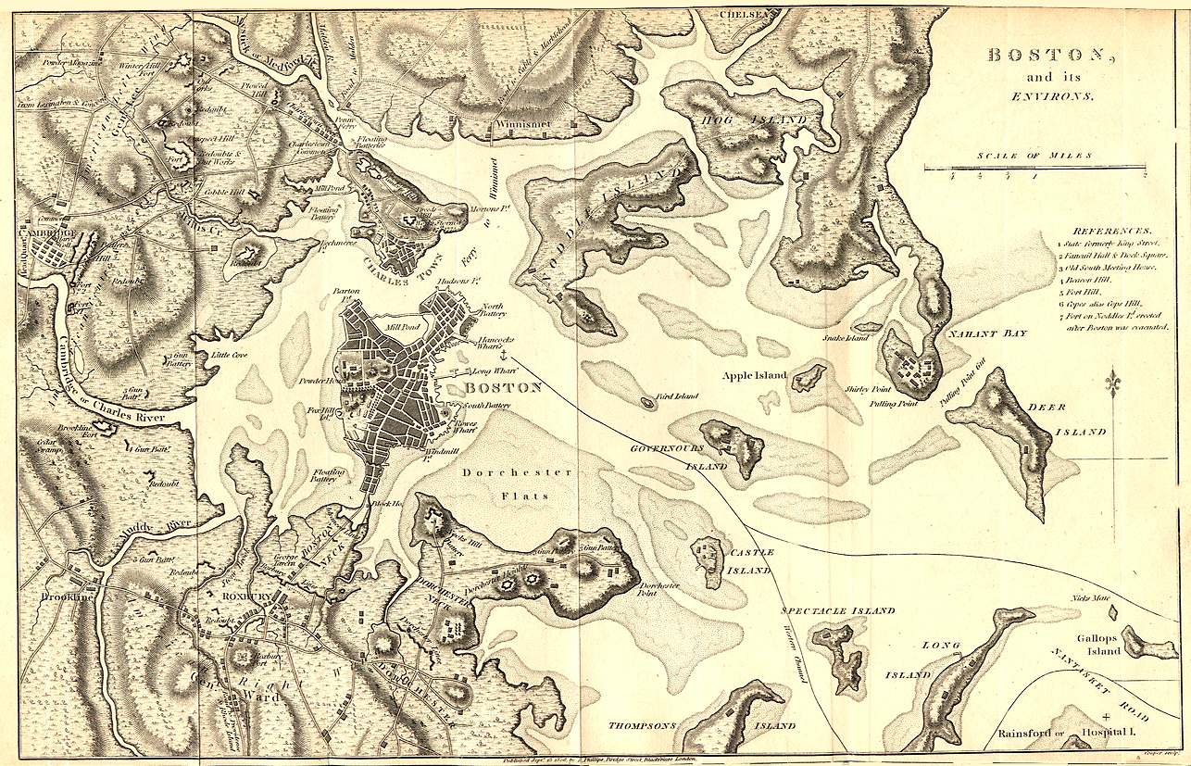
Boston Under Siege
After Lexington and Concord, militia units encircled Boston.
British troops defended the narrow “neck” of the Boston peninsula. The other three sides of the town were protected by water.
Because of Boston’s natural defenses and the large British army there, the militia settled into a “siege”, keeping the British troops trapped inside Boston.
The British sent reinforcements and supplies by ship to Boston Harbor. The standoff became a stalemate.
Notes:
The city of Boston lies on a peninsula. Today much of Boston harbor has been filled in with sediment to create new land, but in 1775 the “neck” of Boston connecting it to the mainland was extremely narrow. This meant that even with superior numbers the Patriots could not attack the city without taking heavy casualties. The roughly 16,000 Patriots outnumbered the 6,000 British Regulars in the city but instead of attacking encircle the town and begin a siege, cutting Boston off from supplies by land. The British fleet, however, continued to sail supplies and reinforcements into Boston Harbor, keeping the city fed and armed. The siege became a stalemate. Learn more: https://www.battlefields.org/learn/articles/ten-facts-boston-during-american-revolution

Slide 5
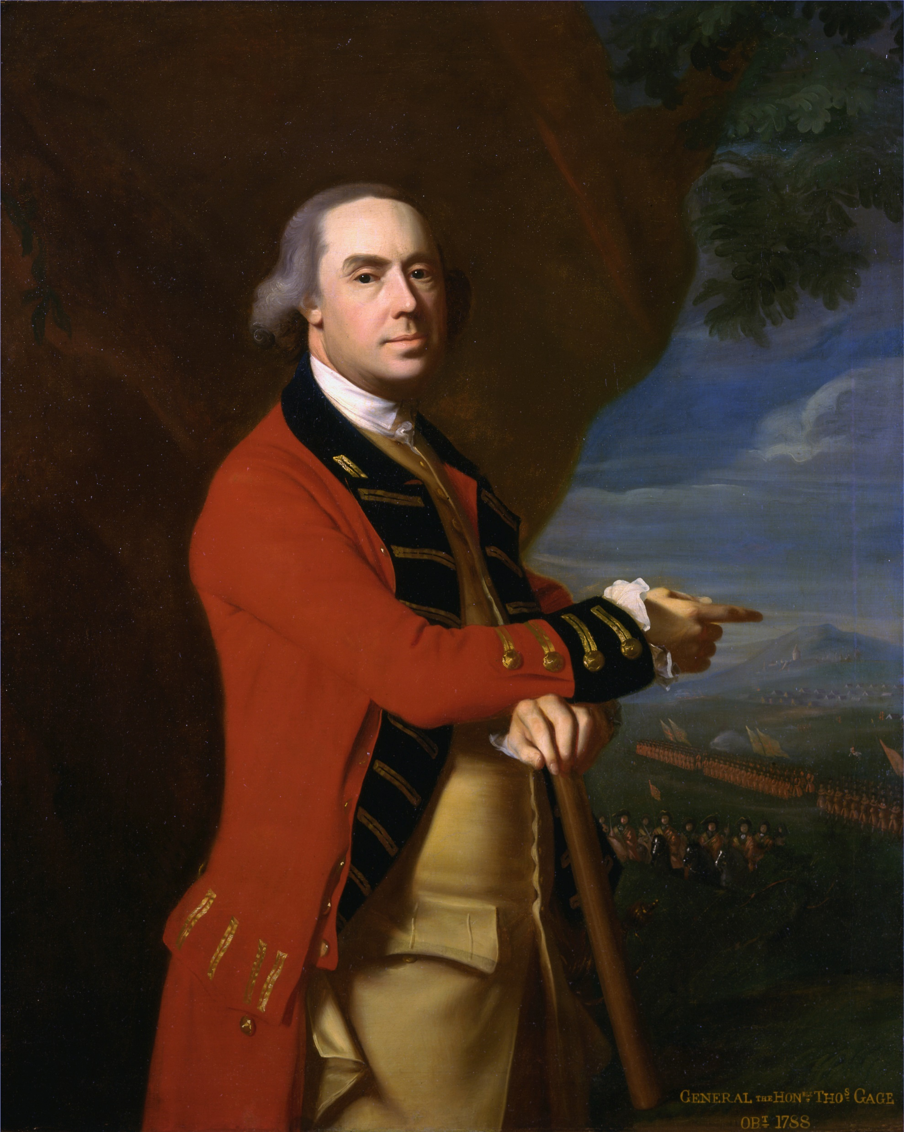
General Thomas Gage
The British commander, Sir Thomas Gage, worried about how many militia troops encamped outside Boston.
“The rebels are not the despicable rabble too many have supposed them to be.... In all their wars against the French they never showed such conduct, attention, and perseverance as they do now.”
Outnumbered, Gage gave up defenses at Charlestown, a village separated from Boston by the Charles River.
The British retreat left Breed’s Hill and Bunker Hill undefended.
Notes:
Learn more:
Thomas Gage: https://www.battlefields.org/learn/biographies/thomas-gage

Slide 6
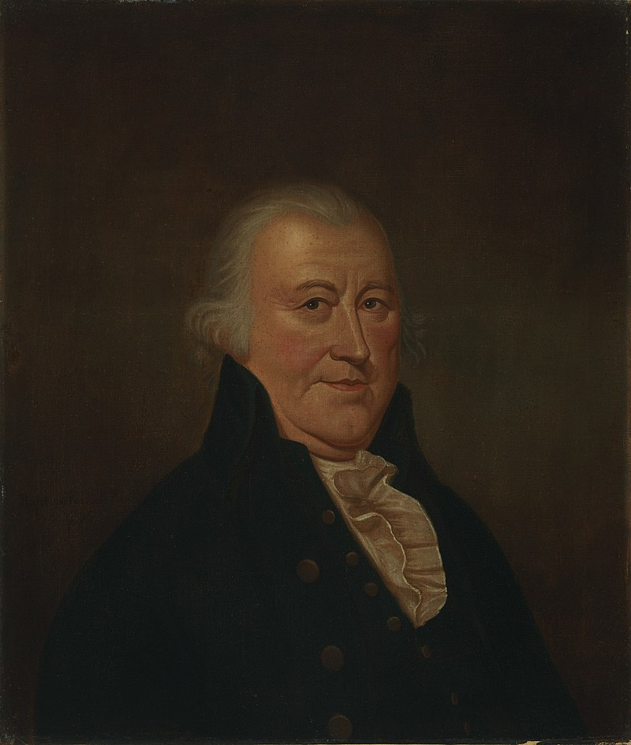
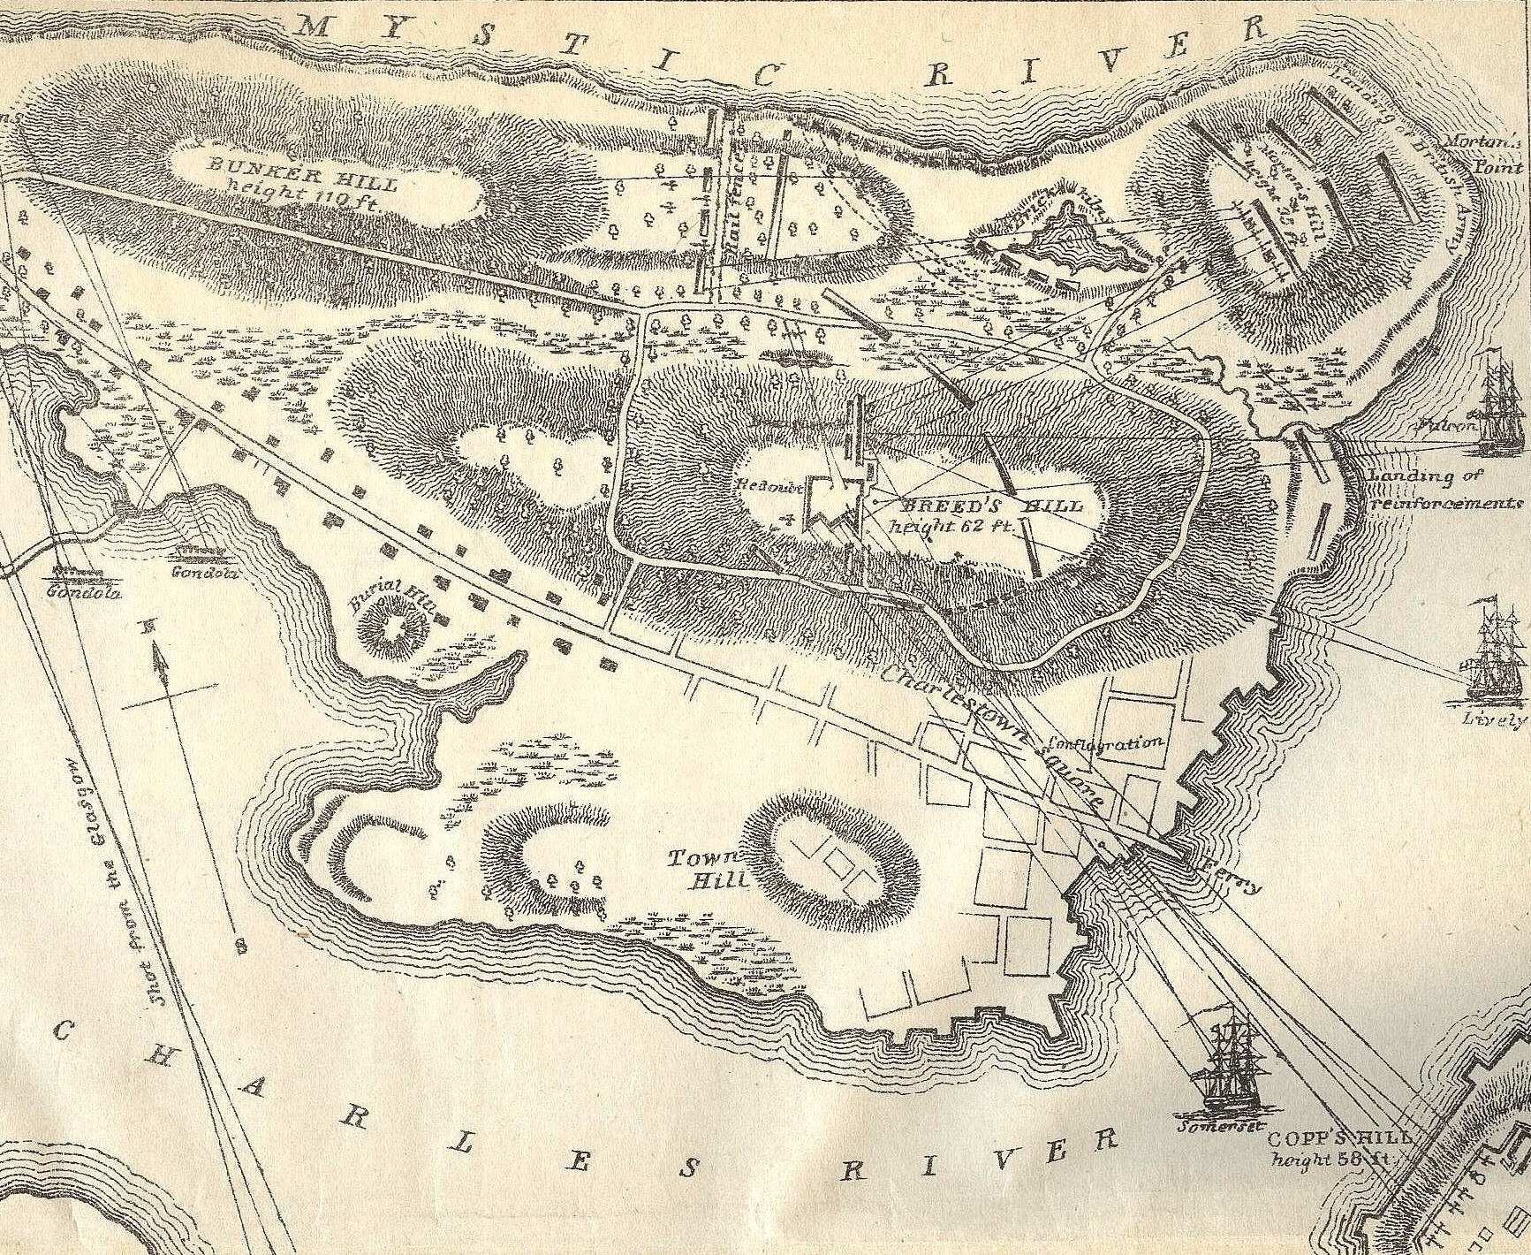
The Patriot Strategy
Artemas Ward commanded the militia troops around Boston.
He wanted to force the British to leave Boston. To do this, he needed to stop British ships from delivering supplies. Cannons and a good position of high ground might help.
Benedict Arnold planned to capture Fort Ticonderoga and its cannons—nearly 200 miles away from Boston.
However, Bunker Hill could be a perfect spot to place these cannons to shoot at British ships.
Notes:
Artemas Ward, a native of Massachusetts, commanded the growing force of militia gathering around Boston. He recognized that the only way to end the siege was to prevent British ships from entering Boston Harbor. Without cannons, however, he had no way of accomplishing this. The Continental Congress in Philadelphia thus instructs Benedict Arnold, a patriot leader, to gather a force of troops to attack Fort Ticonderoga, in upstate New York, to capture its cannons so Ward can use them at Boston. Learn more: https://www.battlefields.org/learn/articles/siege-boston

Slide 7
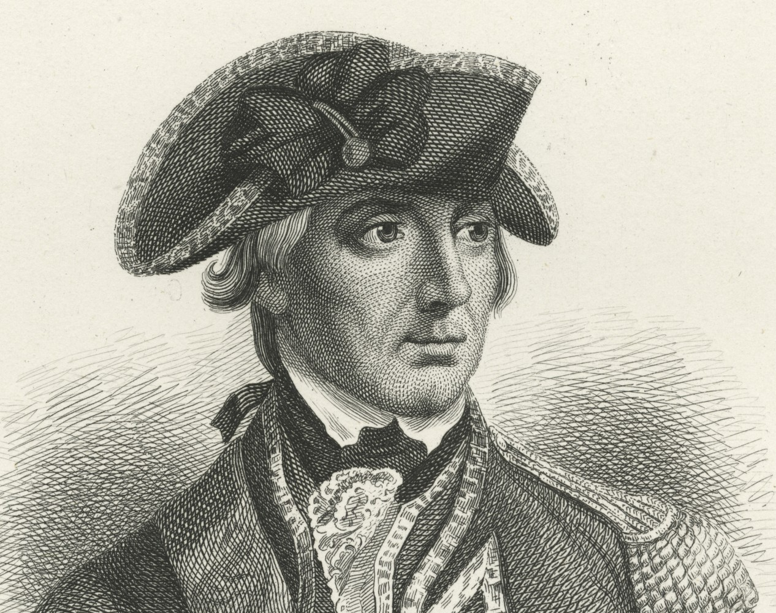
The British Response
General Sir William Howe and General John Burgoyne arrived in Boston on May 19, 1775—joining General Gage.
Howe inspected the city’s defenses and was shocked that Bunker Hill, overlooking Boston, was left undefended.
Howe began preparations to land British troops in Charlestown to reoccupy Bunker Hill.
Militia sympathizers living in Boston heard rumors of the plan and alerted American leaders.
Notes:
The sheer number of militiamen gathered on the hills outside of Boston deeply troubles Gen. Thomas Gage and his newly arrived subordinates, Gens. William Howe, Henry Clinton, and John Burgoyne. On June 15 and June 16, the Patriots move forward to Breed’s Hill on the Charlestown peninsula, where they prepare a fortified position that all but invites a British response. General John Stark from New Hampshire recognizes that the left flank of the fortified position is exposed along the south bank of the Mystic River. He and his men assemble a makeshift split rail barricade to blunt any flanking action employed by the British. When the British officers look out at what has been erected in the short span of one evening they are stunned. Gage knows he has to take action.

Slide 8
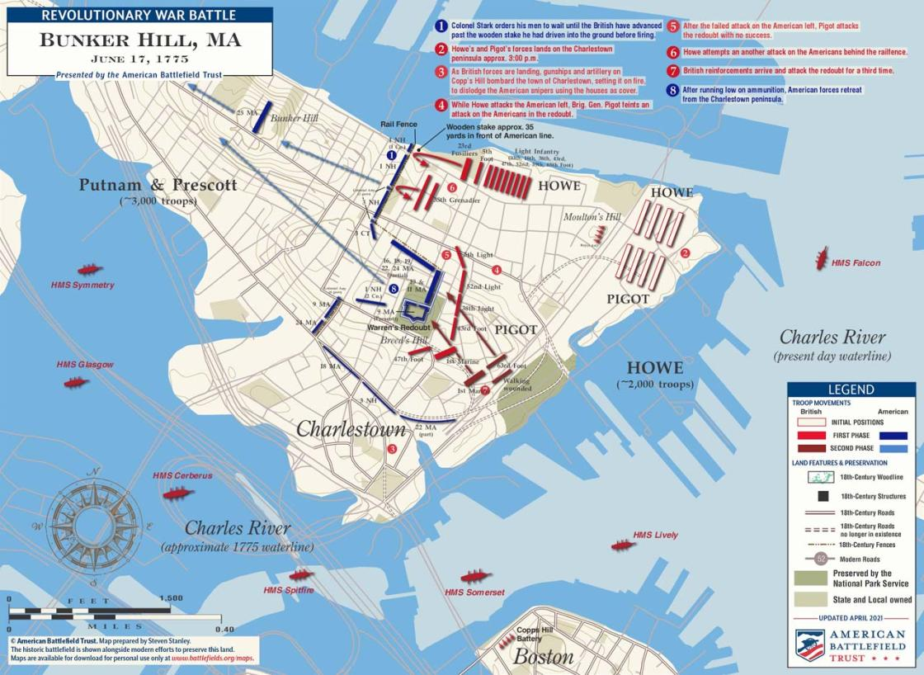
A Bold Move
Informed of Howe’s plan, General Ward ordered 1,200 militia troops, led by Colonel William Prescott, to occupy and fortify the high ground
Prescott and his men march to Bunker Hill after dark on June 16 and worked quickly to build fortifications.
The next morning the British were surprised to see a redoubt (fortifications) on the high ground.
General Howe ordered an attack on the redoubt.
The Battle of Bunker Hill was fought on June 17, 1775.
Bunker Hill or Breed’s Hill? Breed’s Hill was the location of most of the fighting but is part of the slope toward Bunker Hill; generally, it has been referred to as the Battle of Bunker Hill.
Notes:
The British Army planned to launch an attack against the Americans on the heights north and south of Boston. Details of the attack were leaked, however, and a detachment of 1,000 Massachusetts and Connecticut soldiers—more of an armed mob than a military unit—gathered to defend a hill in Charlestown. Among the defenders were several enslaved and free African Americans as well. The violent clash of these forces on what is mistakenly known as “Bunker Hill” signaled that the colonial revolt would not be easily extinguished.
Learn more: https://www.battlefields.org/learn/articles/battle-bunker-hill-success-too-dearly-bought

Slide 9
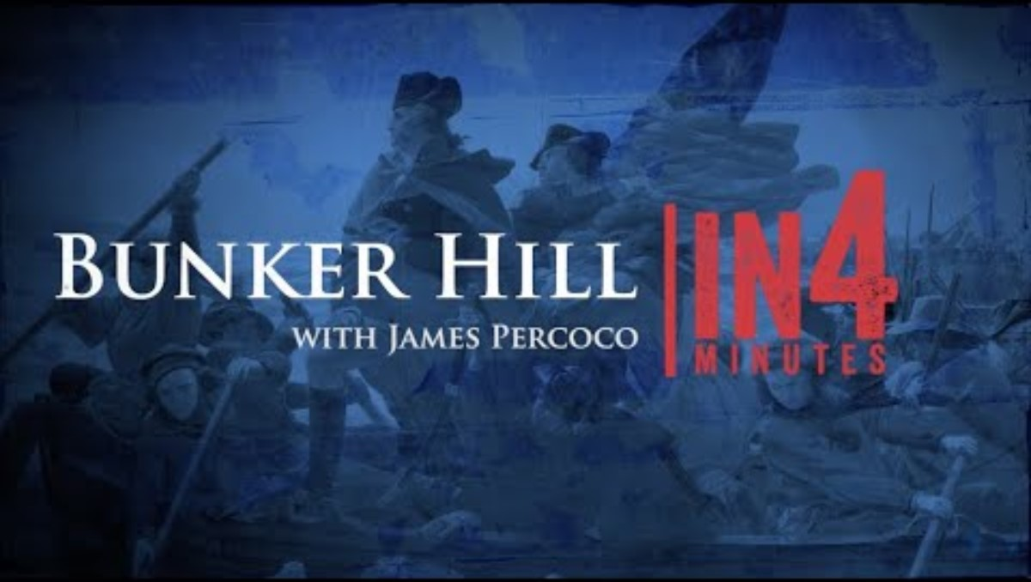
The Battle Begins
Notes:
The video is embedded in the slide, but here is the link: https://www.battlefields.org/learn/videos/bunker-hill

Slide 10
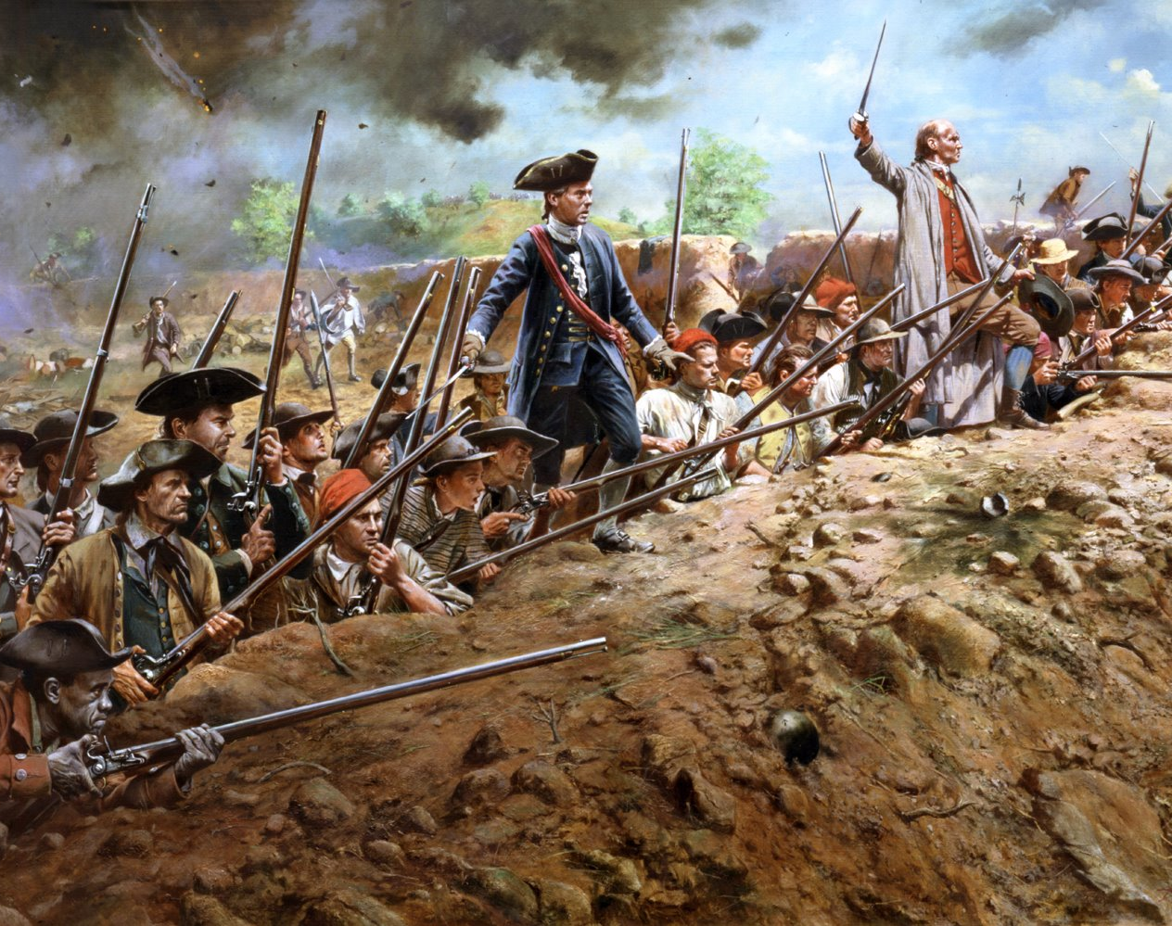
The American Plan
The British typically attacked in tightly-packed formations, relying on their numbers to give victory as they rushed in for hand-to-hand combat.
The New England Militia hoped to counter the British tactics by waiting to shoot until the British were within close range, maximizing the British casualties.
One militia leader legendarily said: “don’t fire until you see the whites of their eyes.”
Don Troiani
Notes:
On this sultry afternoon, Gage and his commanders order British regulars and grenadiers to move across Boston Harbor and disembark in lower Charlestown, where Gage will force the rabble’s hand with an assault. As the British move into position, the fatigued but spirited defenders are on the alert inside their hastily built fortifications.
Led by Gen. William Howe, King George’s troops climb Breed’s Hill in perfect battle formation. Legend has it that as they advance, American officer William Prescott cautions his men not to waste their powder, exclaiming “don’t fire until you see the whites of their eyes.” When British troops near the redoubt, the patriots unleash a withering volley, creating an absolute slaughter. One patriot remarks afterward, “They advanced toward us in order to swallow us up, but they found a choaky[sic] mouthful of us.” It is a veritable bloodbath as the British retreat back to their lines.

Slide 11
The Charge
The British marched toward Bunker Hill and up the slopes. The Americans held their fire until the last moment, then unleashed a devastating volley.
Militia soldiers were told to aim at British officers. Many were killed in the first charge, leaving many British soldiers leaderless.
The British charged the hill three times. The Americans beat them back twice. On the third charge, the Redcoats broke into the defenses.
Notes:
Drums sounded around 3:30 p.m., and British forces launched themselves toward the hill and the rail fence running perpendicular to the Mystic River and on the left of the American line. What ensued was a two-hour engagement that ended with American withdrawal and a short-lived pursuit by the weary British soldiery. On the hillside of Breed’s Hill and along the stretch of sandy soil on the bank of the Mystic River laid more than 1,000 dead and wounded British soldiers. Approximately 450 colonials were killed and wounded, including the great Patriot Dr. Joseph Warren, so instrumental in the build-up of Massachusetts and the burgeoning revolutionary movement. He had risen from his bed, where he had been laid-low with a migraine, to rush to Breed’s Hill, where he was one of the last to fall as the redoubt itself fell to the British.

Slide 12
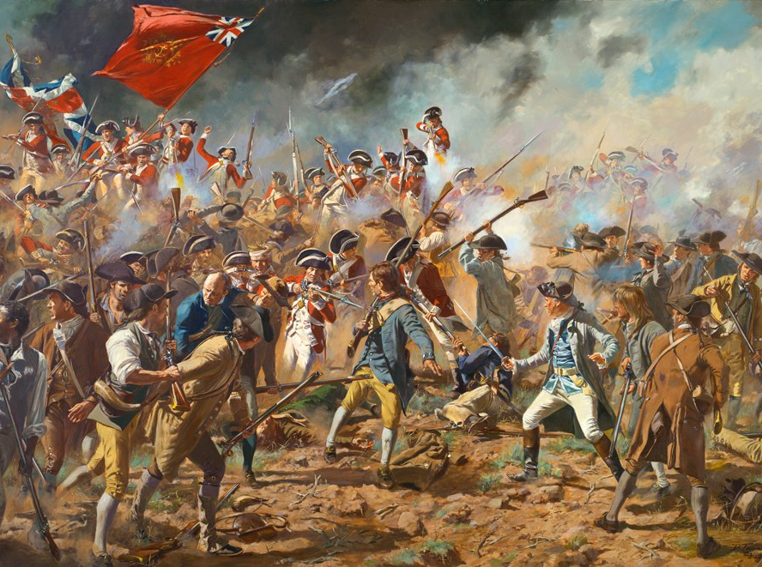
Close Combat
When the British finally broke into the American defenses, they put their bayonets to use.
Bayonets were blades attached to the end of muskets and used for stabbing and hand-to-hand combat.
British soldiers, well trained on bayonet tactics, pushed back the untrained Patriot militia.
Dr. Joseph Warren, a notable Boston patriot, fell in the intense fighting.
The British captured Bunker Hill, forcing the militia to leave the high ground and the Charlestown Peninsula.
Don Troiani
Notes:
Once more the British push up the hill, stepping over the bodies of their dead and wounded comrades who lay “as thick as sheep in a fold,” and again they receive another patriot volley. Finally, on the third try –and just when the patriots run out of powder and shot—the British succeed in breaking through the patriot works. Intense hand-to-hand fighting occurs inside the fortification. The British are victorious but at a cost. At some point in the struggle, a “black soldier named Salem” is credited with killing British Maj. John Pitcairn, the officer despised for allegedly ordering his men to fire on patriots during the battle of Lexington and Concord weeks earlier.

Slide 13
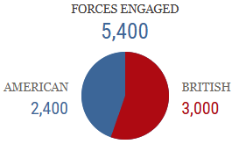
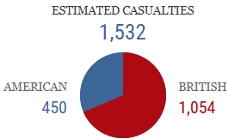
Bunker Hill by the Numbers
Notes:
“Our three generals,” a British officer wrote of his commanders in Boston, “expected rather to punish a mob than fight with troops that would look them in the face.” The King’s troops count 282 dead and another 800 wounded. Patriot casualties are less than half of the British total. British General Sir Henry Clinton is appalled at the carnage, calling it “a dear bought victory.” Badly depleted, the British abandon plans to seize another high point near the city and ultimately evacuate Boston.

Slide 14
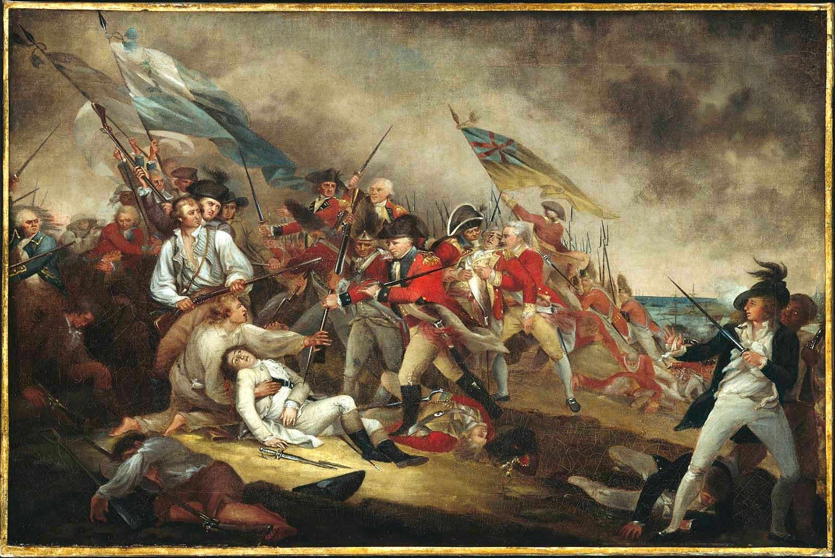
Aftermath
The British suffered heavy casualties. One in three British soldiers who attacked at Bunker Hill were killed or wounded.
Although the British captured the hill, the Americans proved they could stand up to British soldiers in combat.
News of the battle boosted the American cause, convincing many to join the fight to enlist in the Continental Army and local militias.
General Howe, wishing to avoid further loss, decided not to launch any more attacks on American positions, cementing the stalemate at Boston, to Patriot advantage.
Notes:
Though defeated, the Patriots are not demoralized. Those who choose to stay and keep the British bottled up in Boston become the nucleus of the Continental Army. The task of transforming the mob into a fighting force falls on the shoulders of Virginian George Washington, who assumes command in Cambridge, Massachusetts, within two weeks of the Battle of Bunker Hill.

Slide 15
Primary Sources
British
1775: “In His Majesty’s Name, Offer and Promise, His Most Gracious Pardon”
Bunker Hill: “Very Fatal to the 1st Battalion of Marines”
Bunker Hill: "To Acquaint Your Lordship of an Action on the 17th"
American
Bunker Hill: “We Entrench’d & Made a Fort”
Bunker Hill: “My Brother was Missing”
1775: “Dr. Warren…Fell Gloriously Fighting For His Country”
1775: The Committee of Safety’s Account of The Battle of Bunker Hill
Dedication Speech for the Unveiling of the Bunker Hill Monument
Notes:
View the Lesson Plan Teaching Guide for links to these Primary Sources, worksheets, and discussion suggestions.

