Slide 1
Women’s Experiences During the Revolutionary War
The American Battlefield Trust

Slide 2
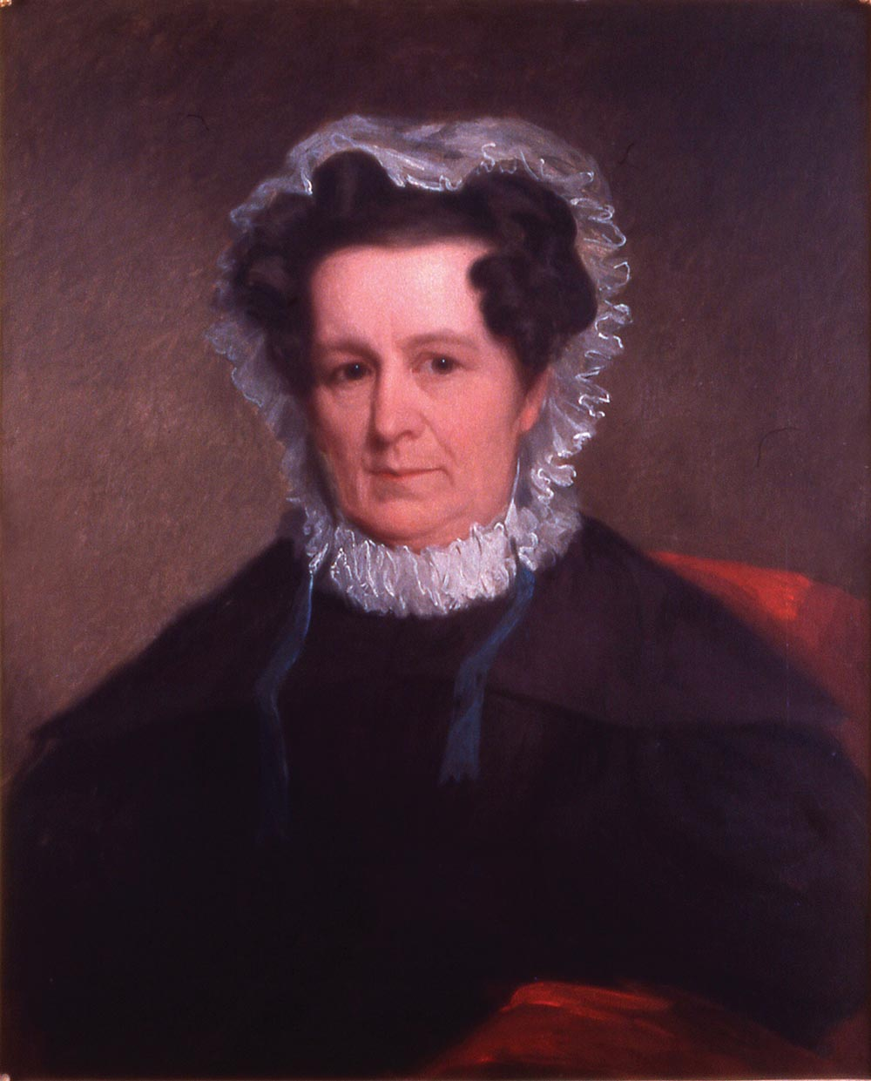
Divided Opinions – Loyalist or Whig on the Homefront
During the American Revolution, battles were fought on the field but division between civilians occurred as well
Loyalist and Patriot/Whig beliefs often clashed on the home front
The Southern campaigns in the Carolinas (1779-82) was particularly violent in this area
Neighbors would quarrel over the idea of independence, even families were split
African American women – both free and enslaved – also faced the choice of loyalties
It wasn’t easy for anyone to choose a side, unknown dangers loomed on who to trust
Some women left their Loyalist families to be win their Patriot husbands – Lucy Flucker Knox, wife of Patriot General Henry Knox, is such an example
Lucy Knox in 1834, Knox Museum
Notes:
The Revolutionary War affected everyone in some way. While armies fought on the battlefields, civilians on the homefront sometimes came in conflict with each other over their Loyalist beliefs or desire for independence. This strife was particularly bad during the Southern Campaigns in the Carolinas (1779-1782). Women’s roles and the homefront efforts are sometimes forgotten, but they were part of the struggle for liberty and the founding of the United States of America.
Sometimes, it wasn’t just neighbors who viewed the question of independence differently. Sometimes, families split. The people of that era — including the women — had to make decisions about where their loyalties lay, and their education, circumstances, economic status, and even location were just a few of the factors that could influence their choices.
African American women — enslaved or free — also faced complicated choices. For example, in Virginia, the British governor Lord Dunmore issued a proclamation offering freedom to enslaved men who would enlist and fight for him. How would a wife feel about her husband accepting Dunmore’s offer? The British also offered freedom to enslaved men and women who ran away to their side, especially if they brought information. Questions about who to trust and if the chance for freedom might be worth the unknown dangers loomed. In the later war period and early Federalist era, some northern states included provisions for freedom for enslaved people who lived within that state for a certain period. New paths to freedom opened and new opportunities for those who chose to take them.

Slide 3
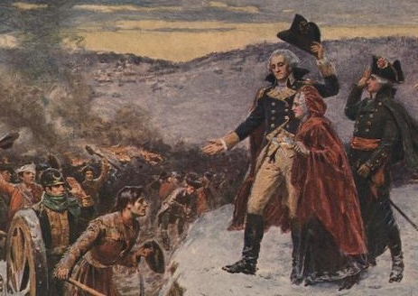
Influencing Morale
During the war, women wielded significant power to influence morale
Loyalist and Patriot women of all classes could raise spirits of officers and soldiers
It was much more common for Officer’s wives to join the army, though an enlisted man’s family could join as well
Martha Washington, wife of General George Washington, often joined her husband and the Continental Army at their winter quarters; most notably Valley Forge in 1777-78
She ran the household of Washington’s quarters, organized meals for staff and entertained officers and kept their spirits high
Freedoms Foundation at Valley Forge
Notes:
Women wielding significant power to influence morale for their side during the Revolutionary War. Loyalist women and women supporting the Continental Army of all social classes could raise the spirits of officers and soldiers by their presence, their sacrifices and contributions to the cause.

Slide 4
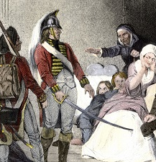
An Occupied Homefront
It wasn’t uncommon for 18th Century soldiers to be quartered with civilians in their homes
The Quartering Act of 1765
Passed by British Parliament, it required colonial communities to provide British military forces with food, drink, lodgings and transportation
This continued through the war, often British & Hessian soldiers would march into a town and take over private residences
Some soldiers harmed those in the residence. Quartering did take place in the countryside, but it was more common in large cities such as Boston, New York, Philadelphia and Charleston
The Continental Army had many interactions with civilians, but generally, they did not quarter in homes without permission
Army arrivals often put a strain on community resources. Many commanders often tried to winter near a community or region with abundance of resources that could be bought or requisitioned
ushistory.org
Notes:
The Quartering Act of 1765 — passed by British Parliament — required colonial communities to provide food, drink, lodgings (quarters), and transportation to British military forces posted in those cities, towns, or villages. This continued through the Revolutionary War period. Often during the war, British and Hessian soldiers would march upon a town or a single farm and quarter themselves for a short period of time. Residents were forced to give up their bedrooms and the best they had to offer to the occupying forces. Some soldiers physically harmed women and girls during the occupations of the homes. Though the British forces could quarter in small communities, some of the most notable occupations took place in large cities: Boston, New York, Philadelphia, and Charleston.
The Continental Army had plenty of interactions with friendly or hostile civilians as well, but generally, they did not quarter in homes without permission. The arrival of any army put a strain on the resources of civilian communities, and military commanders like George Washington often tried to choose winter quarters near a community or region that had an abundance of food that could be requisitioned (taken) or purchased from the local farmers.

Slide 5
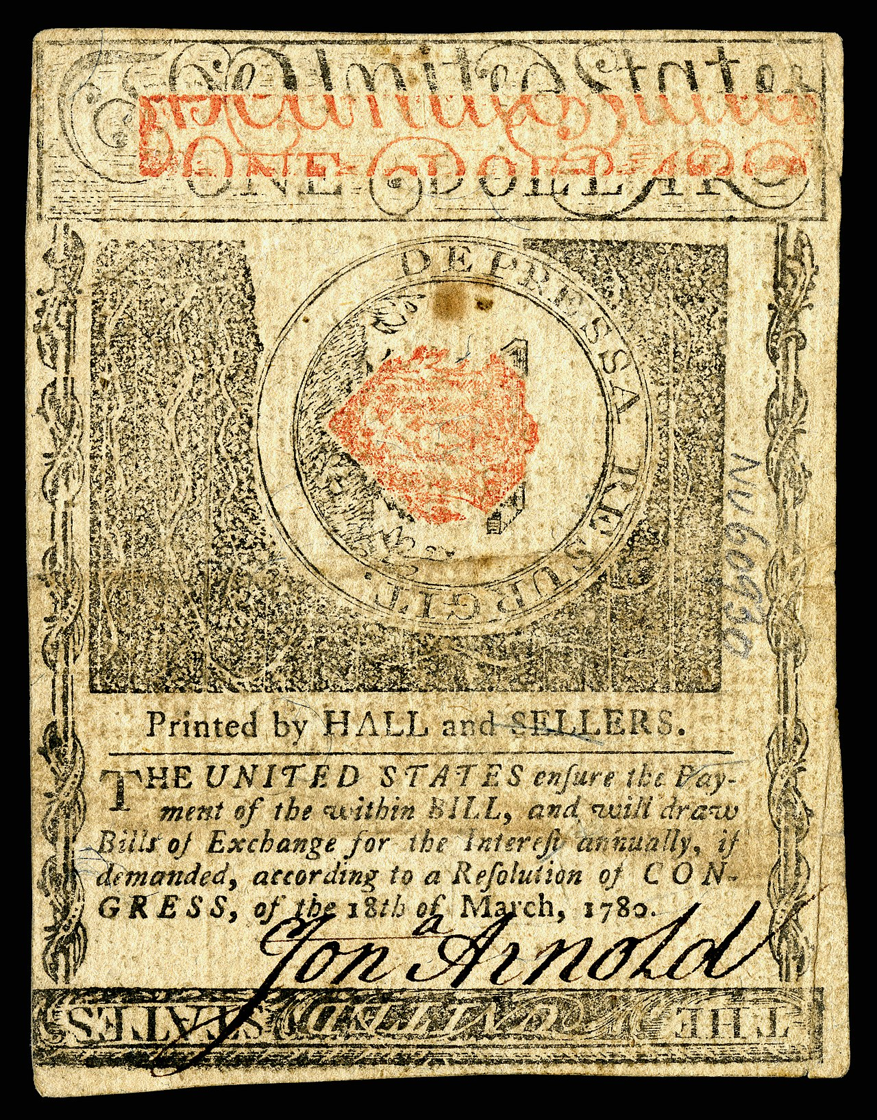
Homefront Hardships: Economy
Hardships on the homefront came in many forms – the economy, lack of food, illness and lack of male protection for example
Continental money had very little value, meaning women had lost purchasing power
Women sometimes had to sell a business or land in order get enough money to survive, especially if her husband was away or she was widowed
Wives also had to step into the role of managing the family’s business or land
This required taking on new skills that she most likely didn’t consider before the war
Both Patriot and Loyalist women found themselves making decisions in finance, business and property
Rhode Island currency, Smithsonian Institution
Notes:
The homefront in America during the Revolutionary War experienced many difficulties, even if the military did not come directly to their community. Particularly with men absent with the military, imprisoned for political beliefs or advocating on the political scene, women had to find their own solutions to the difficulties of the day which forced them into new roles.
The money issued by states or Continental Congress had very little backing or credit, meaning that the money lacked value or was highly inflated. This reduced the purchasing power of any money that a woman had, received, or managed to earn. A woman might face the difficult decisions of selling a business or land to get enough money to survive if her husband was away or she was widowed. She also might step into an active role of managing the family’s business or farm, taking on new skills that perhaps she had never considered in the pre-war years. Both American and Loyalist women suddenly found themselves making decisions about finances, business, and property that they probably never imagined they would make.

Slide 6
Homefront Hardships: Food
Civilian food supply could be reduced if men were away and not able to assist with planting and harvesting crops
Armies could also take or destroy food
Rural families had little way of protecting themselves from foraging parties. Soldiers would show up, under arms, and threaten property owners until their demands were met
This was often done by British and Hessian troops, who were viewed by many as foreign occupiers
Washington was desperate to keep civilian and soldier morale high, he sometimes ordered troops to forage and steal food supplies and horses when needed; payment for these thefts did occur occasionally but it was often empty promises of “Congress would reimburse” at a later time
Notes:
The civilian's food supply could be reduced if the men were away from home and not able to help with the planting and harvesting; also the armies could take or destroy the food. Often, rural families had little way of protecting themselves from foraging parties. Soldiers would show up, often under arms, and threaten the property owners until their demands were met. Much of this was conducted by the British and Hessian troops, who were viewed by many as foreign occupiers. As desperate as he was to keep morale between citizen and soldier high, Washington himself ordered troops to forage and steal food supplies and horses when necessary. Payment for such theft did occur on occasion, but was often a series an unkept assurances and promises that ‘Congress would reimburse” at a later time.

Slide 7
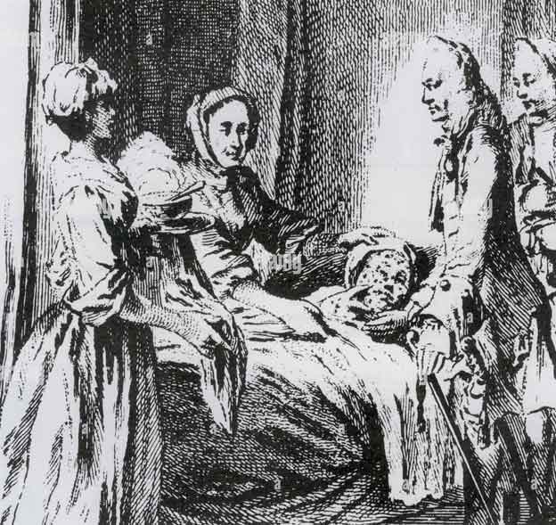
Homefront Hardships: Disease
Disease and illness was common in the 18th century, and this could be more devastating to an army than even the fiercest battlefield foe
During the war, a smallpox endemic swept through the armies and the homefront, killing many
Women had to decide for themselves and their children whether to get inoculated against smallpox, sometimes going against their husbands wishes (or simply not telling him it was done)
It was a difficult choice to be knowingly exposed to one of the deadliest diseases of the era that women had to make
Notes:
Disease and severe illnesses were very common in the 18th Century, and a smallpox endemic swept through the armies and the homefronts, killing many. Women made decisions to be inoculated against smallpox, sometimes going against their husbands’ wishes or simply not informing him until it was completed. The choice to be knowingly exposed to one of the deadliest diseases of the era was a significant decision that many women made alone for themselves and their young children during the Revolutionary War period.

Slide 8
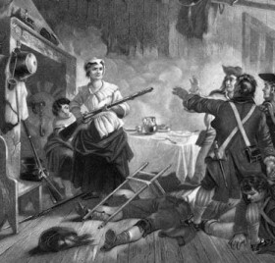
Homefront Hardships: Male Protection & Communities Divided
When men joined the army or a military force, they often left their families on the homefront relatively unguarded
Alone, some women faced cruelties, theft, or general annoyances from neighbors and or enemy soldiers
There were several methods that women had for surviving and coping; Take up weapons to defend themselves, follow their male relatives in the army, or relocating
Widows faced the harsh realities of widowhood, had to marry again or find some other way(s) to protect and support themselves
Communities could often be divided between patriot and loyalist
Added uncertainty to family life
In some regions, civil war broke out as neighbors chose sides
This was more common in the Southern region of the American colonies
Notes:
When men joined the military forces, they often left their families relatively unguarded on the homefront. Without male protection, some women faced cruelties, theft, or general annoyances from their neighbors or enemy soldiers. Women had a variety of methods for surviving and coping, including deciding to take up weapons to defend themselves, following their male relatives in the army, or relocating to a more friendly area. As soldiers died in battle or from disease, some women faced the harsh realities of widowhood and had to marry again or find other ways to protect and support themselves.
Communities divided over patriot and loyalist causes, adding uncertainty to family life. In some regions, civil war broke out as neighbors chose sides and bothered (or outright attacked) each other, particularly in the Southern region.

Slide 9
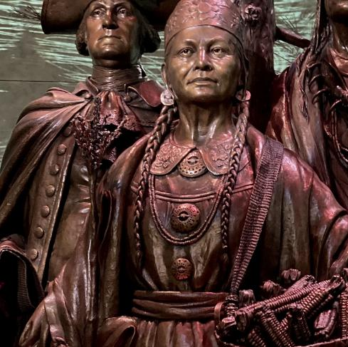
Supplying the Army
Supplying an army is never easy; it takes time, money and logistics to bring soldiers what they need
During the American Revolution, woman took a significant role in supplying armies
Women often managed large farms, plantations or businesses
The Continental Army was clothed, fed, and supplied from the homefront
Sometimes women directly brought or sent supplies to military camps
Polly Cooper (right) of the Oneida Indian Nation brought over 600 bushels of corn to the Continentals at Valley Forge (1777-78)
Oneida Chief Skenandoah sent 40 warriors and Polly to Valley Forge to help the starving army
They traveled hundred of miles from Central New York in the cold and snow
American Battlefield Trust
Notes:
The homefront in America during the Revolutionary War experienced many difficulties, even if the military did not come directly to their community. Particularly with men absent with the military, imprisoned for political beliefs or advocating on the political scene, women had to find their own solutions to the difficulties of the day which forced them into new roles.
The money issued by states or Continental Congress had very little backing or credit, meaning that the money lacked value or was highly inflated. This reduced the purchasing power of any money that a woman had, received, or managed to earn. A woman might face the difficult decisions of selling a business or land to get enough money to survive if her husband was away or she was widowed. She also might step into an active role of managing the family’s business or farm, taking on new skills that perhaps she had never considered in the pre-war years. Both American and Loyalist women suddenly found themselves making decisions about finances, business, and property that they probably never imagined they would make.

Slide 10
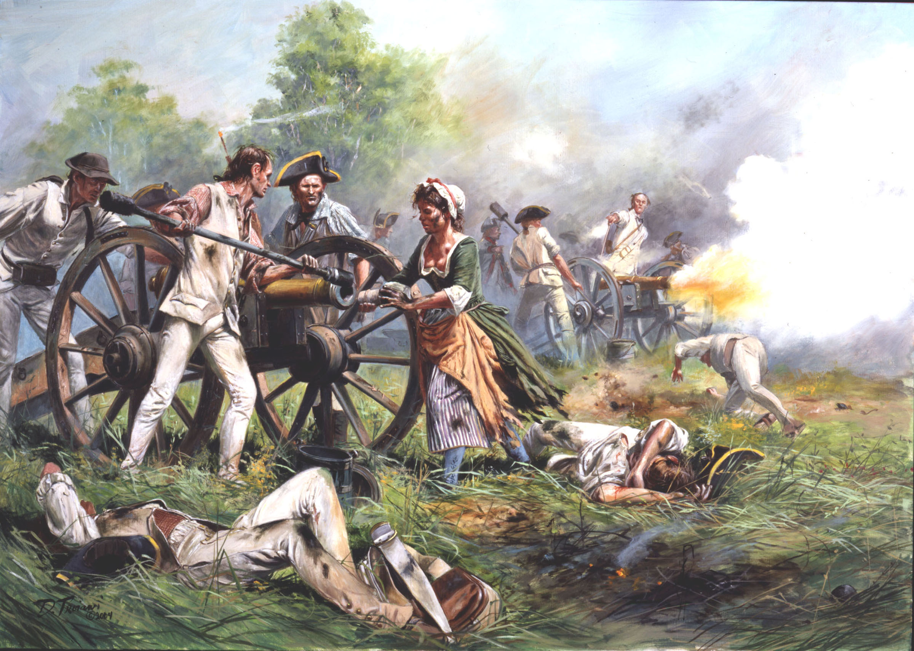
Camp Followers
When men marched off to war in the Continental Army or Colonial militias, their wives would often follow
These women took care of the domestic side of army organization, but were sometimes flung into the vortex of battle
The story of “Molly Pitcher” at the Battle of Monmouth, June 1778 is one such example
The women that followed the army were also relatives of soldiers or militiamen and were respected and protected
Some came temporarily or long term, perhaps feeling unsafe in their homes or wanting to endure the hardship with their loved ones and show their devotion to the cause
Historian Robert Dunkerly points out, “Women attached themselves to the armies, and the armies had to deal with their refusal to stay behind....” The women became essential to the survival of the armies since they “performed support services and functions for armies that did not have large infrastructures or logistical support services.” Much of this support came through practical tasks that were generally viewed as “women’s work” — like sewing, mending, washing, cooking, and tending to the sick. (Women of the Revolution by Robert M. Dunkerly)
Don Troiani
Notes:
Women often followed their husbands in the Continental Army or Colonia militias. These women, known as camp followers, often tended to the domestic side of army organization. Sometimes they were flung into the vortex of battle.
Historian Robert Dunkerly points out, “Women attached themselves to the armies, and the armies had to deal with their refusal to stay behind....” The women became essential to the survival of the armies since they “performed support services and functions for armies that did not have large infrastructures or logistical support services.” Much of this support came through practical tasks that were generally viewed as “women’s work” — like sewing, mending, washing, cooking, and tending to the sick. (Women of the Revolution by Robert M. Dunkerly)
The majority of women who followed or visited the army were relatives of the soldiers or militiamen and were respected and protected. Some came temporarily while others stayed long-term, perhaps feeling unsafe in their homes or preferring to endure the hardships near their loved ones in uniform. Life in a camp, trailing the army, or quartering in a military would have had additional challenges and uncertainty for women, but for those who came it was often preferable to the difficulties at home or a way to show their devotion to their cause.

Slide 11
Civilians on the Battlefield
National Park Service
Many women didn’t have battlefield experience during the American Revolution
Some women did witness battles, whether it was in the countryside, across farms, or in the streets of cities
Regardless of where these battles occurred, they directly impacted civilians and the homefront
Sometimes the fight came right to their doorstep, and in Sally Kellog of Vermont’s case, she experienced the horrors first-hand in 1776
Benedict Arnold’s make-shift fleet and the British navy clashed on Lake Champlain during the Battle of Valcour Island
Her family escaped via the water and “fell in between Arnold’s fleet and the British fleet” as she recalled
A year later when her family relocated to Bennington, Vermont they were caught in the horrors again. Sally claimed the results were “a sight to behold. There was not a house [in Bennington’s vicinity] but was stowed full of wounded.”
Notes:
Most women did not have a battlefield experience during the American Revolution simply because the war never came to their homes. However, some women had witnessed battles were fought in the countryside, across civilian property or farms, or conflict in the streets of their cities. Whether in the cities or countryside, the battles of the Revolutionary War directly impacted civilians and the homefront.
Ordinary women endured the horrors of the battlefield when those fights came to their doorstep. Sally Kellogg of Vermont and her family escaped the gods of War in 1776 when the War for Independence found its way into the northern reaches of upstate New York and Benedict Arnold’s makeshift fleet and the British Navy clashed on Lake Champlain during the Battle of Valcour Island. As the Kellogg family made good its escape by water, Sally’s family “fell in between Arnold’s fleet and the British fleet,” she later recalled. As the family rowed to safety at Fort Ticonderoga, the exchange of gunfire between ships could be seen and heard Sally recalled, “but happy for us the balls went over us. We heard them whis.” Nevertheless, the war continued to follow the Kellogg family. A year later, after having relocated to Bennington, Vermont the Kelloggs were once more forced to be witnesses to carnage and once again upon recollection Sally claimed the results were, “a sight to behold. There was not a house [in Bennington’s vicinity] but was stowed full of wounded. (From https://www.battlefields.org/learn/articles/women-american-revolution)
Other women who were camp followers found themselves on battlefields with a chance to make a difference and even raise the military morale.

Slide 12
Female Soldiers
Women who disguised themselves as men and joined the army was extremely rare during the American Revolution
There are a few known women who served in the 18th century British Army, but none have been identified in North America
At least one has been identified in the Continental Army
Deborah Sampson (left) enlisted under the alias Robert Shurtliff in 1782, fought briefly in New York and was wounded
A physician only discovered who she truly was when she fell ill with fever; she was later honorably discharged from service
She spent the remainder of her life petitioning Congress for a service pension and formal recognition of her service
American Battlefield Trust
Notes:
Women who disguised themselves as men and joined the army were extremely rare during the Revolutionary War. While there are a couple of known women who served in the ranks of the 18th Century British Army, none have been identified with service in North America.
In the Continental Army at least one disguised female soldier has been identified. Deborah Sampson enlisted under the alias “Robert Shurtliff” in 1782, fought briefly in New York, and was wounded. A physician discovered her identity the following year when she fell ill with fever; she was later honorably discharged from service and spent the rest of her life petitioning Congress for a service pension and formal recognition for her service.

Slide 13
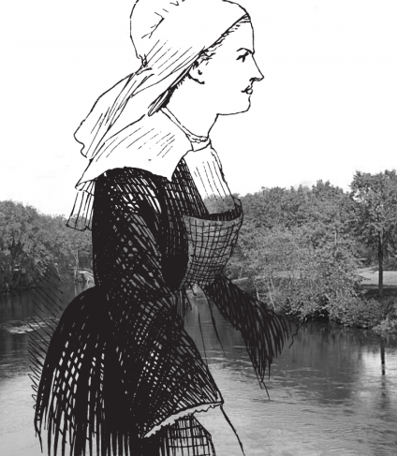
Taking up Arms to Defend Homes
On some occasions, civilian women took up arms to defend their homes
Because the men were not home, women had to used weapons to defend their homes or communities from hostile neighbors or even enemy soldiers
These women tended to be from the middle or lower classes and having knowledge of muskets or other weapons from hunting or previous self-defense
Prudence Wright
During the battles of Lexington and Concord, she created a women’s militia, came to be known as “Prudence Wright Guard”
About 40 women dressed as men, shoulders muskets and other weapons and planned to intimidate the Redcoats in the area; they even captured several soldiers
Notes:
On some occasions, civilian women took up arms (weapons) to defend their homes or communities from hostile neighbors or enemy soldiers. These women tended to be middle or lower class with knowledge of muskets from hunting or previous self-defense.

Slide 14
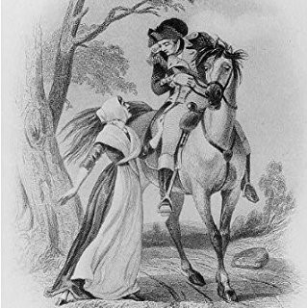
Spies
Spies were a key part of the American Revolution
Spies were used by both British and Patriot armies to gather information about their enemy
Troop strength, morale, access to munitions and supplies, intended plans, or (for British commanders) info on loyalist sympathizers as well as geography and terrain details unfamiliar to the British
Some spies served for long periods or even the duration of the war, while others performed singular acts when duty called or opportunity presented itself
Women acted as spies on both sides during the Revolutionary War, though many remain unacknowledged or unknown
Notes:
During the American Revolution, both the British and patriot armies employed spies to gather information about the enemy. Both armies relied on spies to gather information on troop strength and morale, access to and availability of munitions and supplies and intended plans to march or attack. British commanders found intelligence gathered by loyalist sympathizers useful, which often included details about geography and terrain unfamiliar to the British army. Some spies served for long periods or even the duration of the war, while others performed only singular acts of espionage when duty called, or when opportunities presented themselves. Women acted as spies for both sides during the Revolutionary War, but many remain unknown and unacknowledged in the pages of history.

Slide 15
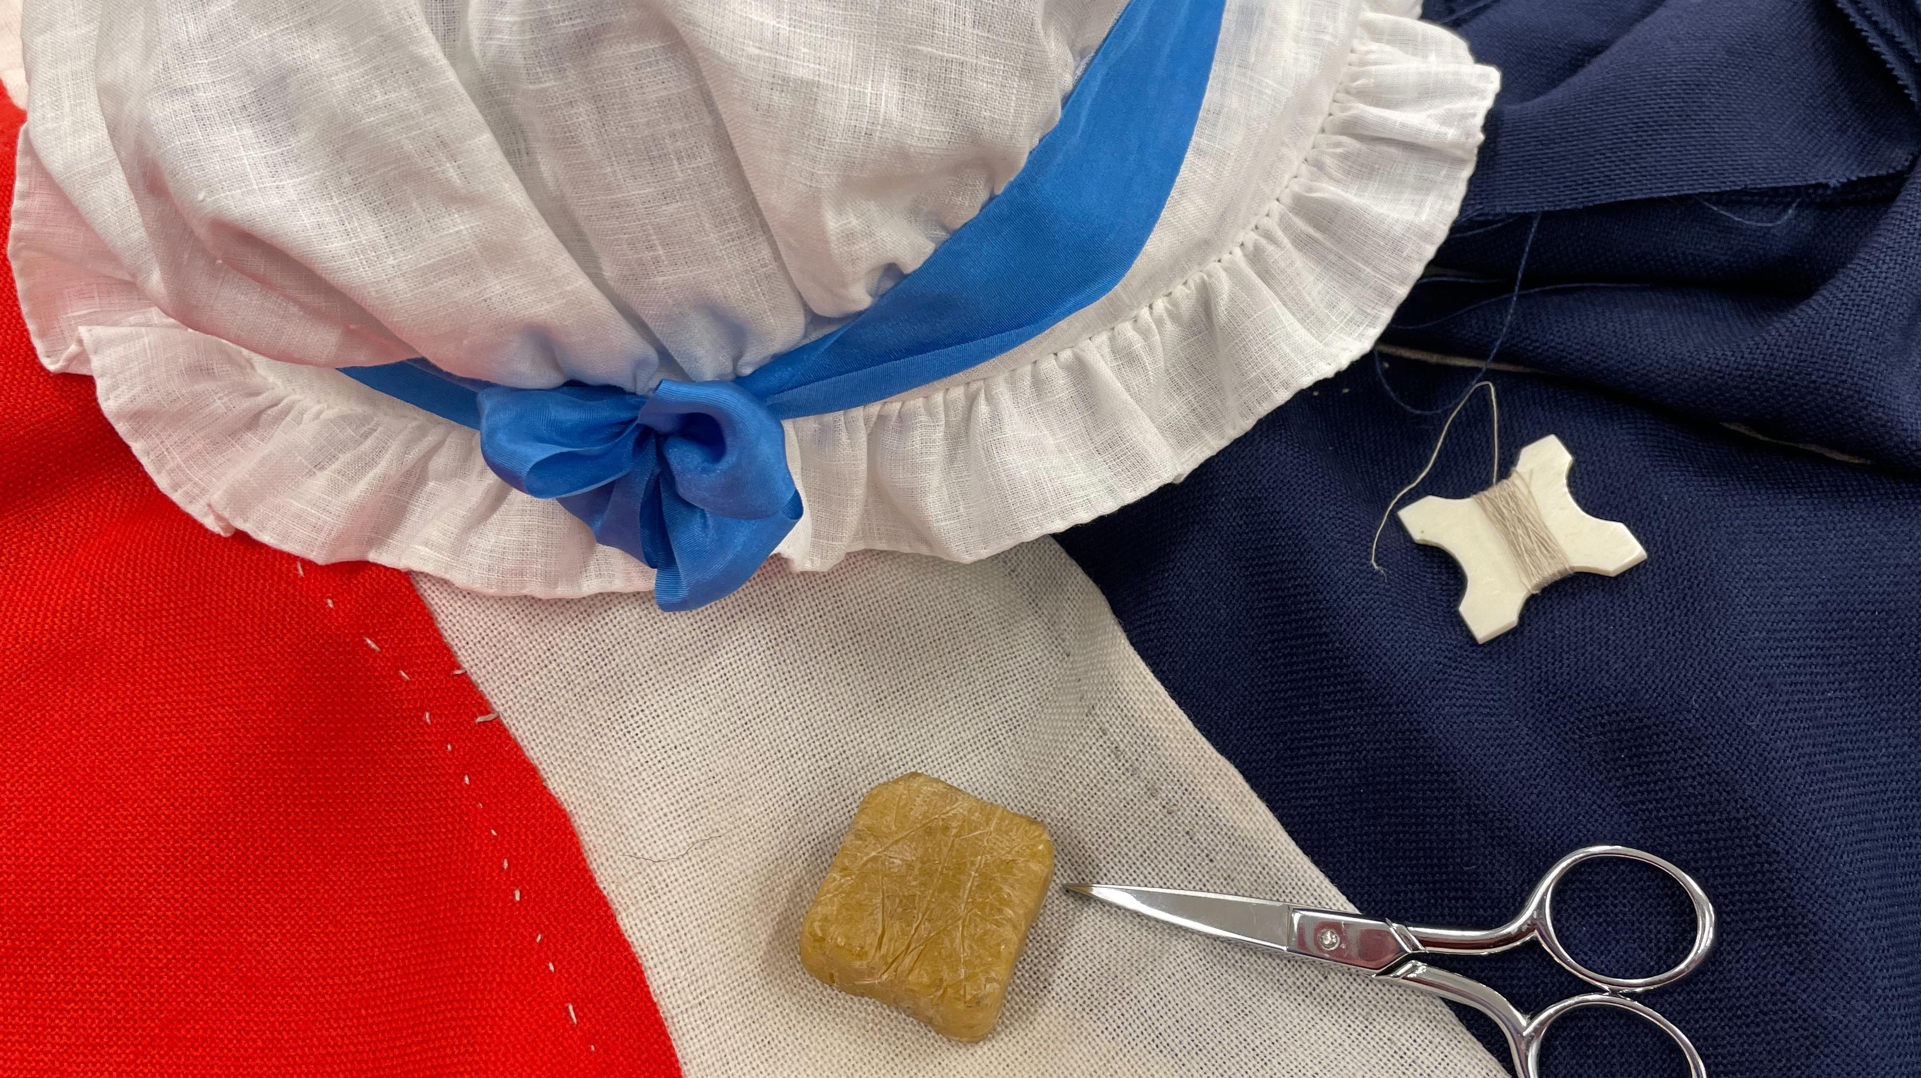
Legendary Women
During and after the American Revolution, many stories emerged involving women’s roles and acts of heroism
This generally came from writings by the women themselves, male writings about women or from family lore and legend
Especially in the 19th Century stories about these women took on new meanings as they were held up as heroines
Parts of their story were often picked and chose to create an ideal woman thus obscuring the real history
It’s important to remember who is writing the history, when they wrote it and why
“Most of the women themselves did not (or could not) write about their experiences. They may have told their stories to friends and neighbors and they may have been local celebrities, but often their true stories were lost as that generation passed on, and later descendents romanticized and distorted, intentionally and unintentionally, what had been passed down.” (Women of the Revolution, page 24)
Notes:
During the Revolutionary War itself and certainly in the following decades and centuries, many stories emerged involving women’s roles and moments of heroism. Generally, what historians know about women of this era comes from writings by the women themselves, male writing about the women, or from family lore and legend.
Historian Robert Dunkerly explains it this way: “Most of the women themselves did not (or could not) write about their experiences. They may have told their stories to friends and neighbors and they may have been local celebrities, but often their true stories were lost as that generation passed on, and later descendents romanticized and distorted, intentionally and unintentionally, what had been passed down.” (Women of the Revolution, page 24)
Especially in the 19th Century stories about Revolutionary War women took on new meanings as they were upheld as heroines according to the ideals of the later era. By picking and choosing parts of the stories to create an ideal woman by another era’s standards, the real history of what these women decided, endured, or accomplished was often obscured.
It is important to consider where stories of Revolutionary War women originated. Is there written documentation about her life and actions? Does the story come from family traditions? Was it a creation of a later generation? Being aware of the layers of history — especially in women’s studies — is important to help honestly evaluate the who, what, where, how, and why of some of the popular stories from America’s past.

