Slide 1
Women and Revolutionary Politics
The American Battlefield Trust

Slide 2
Essential Questions
How did women achieve more social and political agency during the American Revolution?
How did the Revolution elevate women’s role in society?

Slide 3
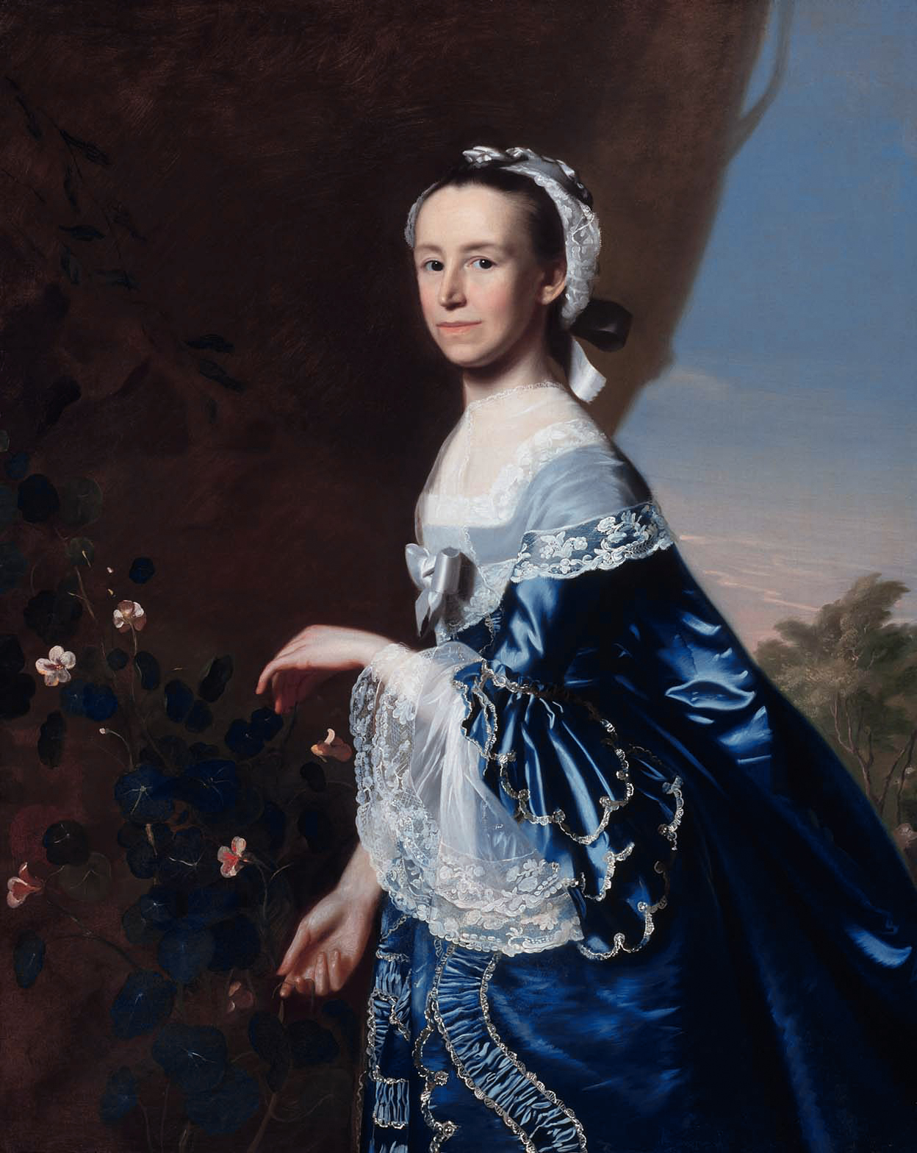
Enlightenment View of Women
The Enlightenment produced new philosophies about women’s roles in society.
Women were thought to influence men to live with stronger virtues...or they could be easily blamed for men’s poor choices.
Though equality was an emerging idea, it did not mean that ALL citizens were equal in the political sense. But once “all men are created equal” became enshrined in the Declaration of Independence, many women began questioning to what extent that phrase meant.
Notes:
The Age of Enlightenment spanned the 17th and 18th centuries in Europe and produced new philosophies about sciences and many aspects of life, including women’s roles in society. Enlightenment ideas influenced American thought about politics and society, and unsurprisingly, affected men’s ideals about women and how women viewed themselves.
Virtue, one of the tenants of the Enlightenment, gave women a new mode to advance themselves and society. American Revolutionaries particularly instilled a belief that virtue was a necessity in public and private life. Women were thought to influence men to live with stronger virtues...or they could be easily blamed for men’s poor choices. Some Founding Fathers such as Benjamin Rush insisted the Republic could only thrive if women became virtuous and ‘educated’ their sons and daughters in order to grow up to become civic-minded citizens.
Equality was an emerging idea within the circles of the eighteenth century. Equality, however, did not mean that ALL citizens were equal in the political sense. What Thomas Jefferson and others were referring to was equality in that the government would not recognize special rights for those born from powerful families or titled individuals. It did not mean equality among men and women, or equality among black and white individuals. It did not mean equality among white men; property owners were favored in society over non-property owners, which is why many of the earliest American laws specifically reinforced property rights, including owning slaves (a form of legal property). Despite the intention, once ‘all men are created equal’ became enshrined in the Declaration of Independence, many elite white women began openly questioning to what extension that phrase meant for women, and more so, to what extension did the American experiment offer the social contract of liberty.

Slide 4
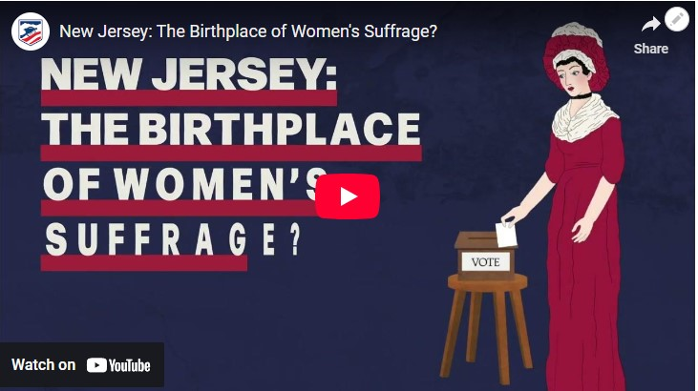
Rights that women had in Colonial America (perceived and reality)
White women’s rights and legal status in Colonial America varied by colony.
Some colonies allowed more property rights for women, especially if they were widowed.
In general, women could not vote, could not hold political or religious office, and had little judicial recourse.
Notes:
Link for video: https://www.battlefields.org/learn/videos/untold/new-jersey-birthplace-womens-suffrage
White women’s rights and legal status in Colonial America varied by colony. Some colonies allowed more property rights for women, especially if they were widowed.
In general, women could not vote, could not hold political or religious office, and had little judicial recourse.
However, one political experiment during the post-Revolution years involved voting rights. In New Jersey, an ambiguous passage in the 1776 constitution was recognized to allow women to vote. A modification in 1790, now specifically stating “he or she,” further granted the right to vote to free black Americans. Records show women took advantage of this opportunity and voted in every election through 1807, when a voting controversy prompted state leaders to rescind the clauses from 1790. But as many historians note, no other state followed New Jersey in providing voting access to women. Records show that many women likely organized within their church communities prior to voting at the ballot box.

Slide 5
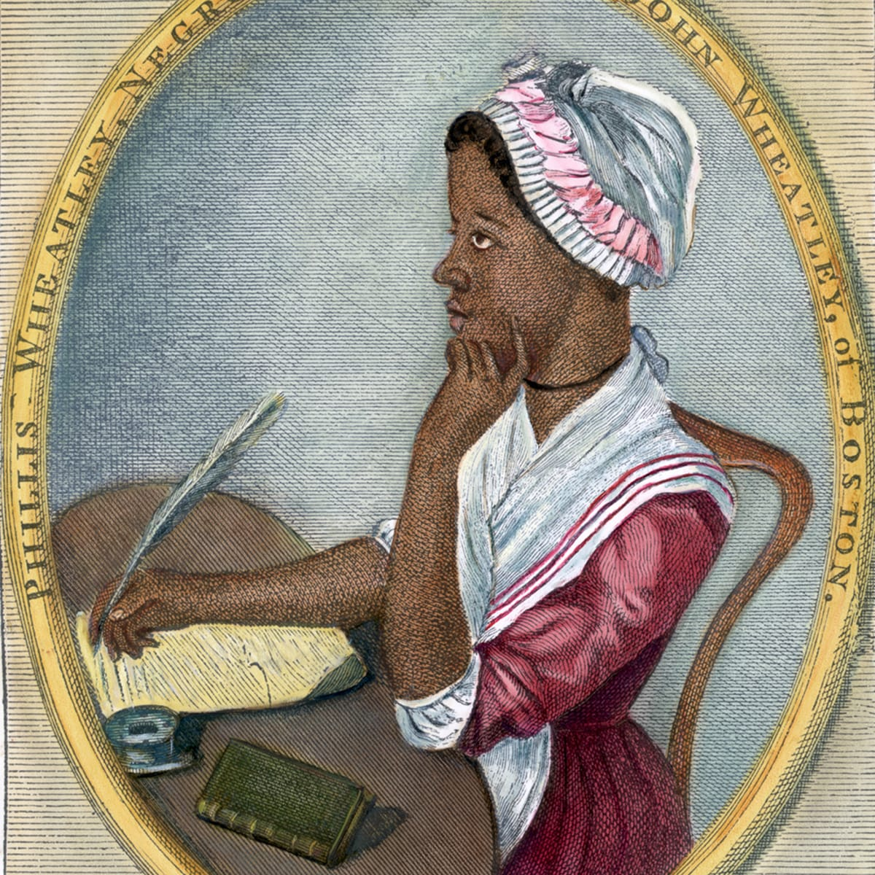
Free Communities/Abolition
Black men fought on both sides during the conflict, and Black women also chose sides to support from the homefront.
With the rise of abolitionist groups in the 1780s/90s, there came a push to create institutions that provided educate for black women.
Though not always aligned, the suffragist and abolitionist movements occasionally found common cause.
Articles for more on slavery in Colonial America and African Americans in the American Revolution
Notes:
Free communities of African Americans existed on the outskirts of white communities, a trend that continued for decades following the Revolutionary War. These communities faced similar decisions of rebellion or loyalty to British rule. Black men fought on both sides during the conflict, and Black women also chose sides to support from the homefront.
The rise of abolitionist groups in the 1780s/90s, particularly in Philadelphia, opened new doors and opportunities for women of color. For the first time there was a push to create institutions that would provide educate for black women. New schools in Philadelphia became popular in the 1790s which coincided with the republican motherhood movement that shaped new attitudes towards educating middle class white women.
Pennsylvania was one of the earliest states to create manumission laws for enslaved people. Any person who remained in the state for longer than six months would automatically become legally freed from bondage. This became a problem for southern politicians when Philadelphia served as the federal seat of government until 1800. President George Washington rotated the few enslaved people among his household servants in order to prevent this from happening. Nonetheless, escapes occurred, including Oney Judge, Martha Washington’s personal servant, and Hercules, the president’s personal chef.
Though not always aligned, the suffragist and abolitionist movements occasionally found common cause in their perceptions of the American political and social structures being designed to keep them out. This became more common in the early 19th Century but had some foundations in the Colonial and Revolutionary War Eras.

Slide 6
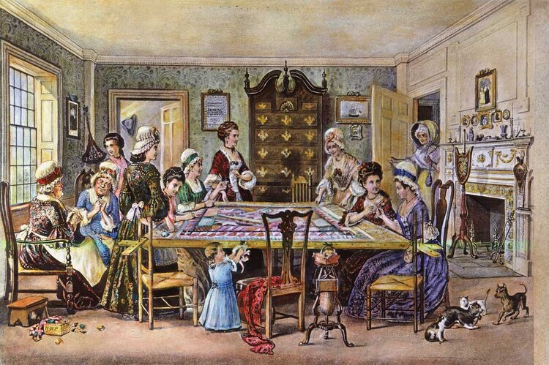
Pamphlets and Advocacy
Women wrote newspaper editorials and songs advocating protests of British tea and taxation, while others - confided within their diaries the zealous atmosphere sweeping through the colonies.
Pamphlets and newspaper editorials promoting advocacy became more common in the 1780s, while public meetings at coffee houses were conducted.
The 1790s witnessed a continuation of this trend with numerous poems and pro-American editorials, indicating a permanent tolerance for women’s voices in the public sphere under certain conditions.
Notes:
The protests over taxation and the themes of the Revolutionary War offered new opportunities for writers to make their opinions heard. Women wrote newspaper editorials and songs advocating protests of British tea and taxation. Still, others began confiding within their diaries the zealous atmosphere sweeping through the colonies. As both examples explain, the distinct separation of ‘public and private’ roles of women was being tested.
One song partially read, “Let the Daughters of Liberty, nobly arise, And tho’ we’ve no Voice, but a negative here, The use of the Taxables[sic], let us forbear.” (pp. 159-160, Norton, Liberty’s Daughters)
The 1780s saw an increase in vocal proponents for women’s rights. Pamphlets and newspaper editorials promoting advocacy became more common while public meetings at coffee houses were conducted. The 1790s witnessed a continuation of this trend with numerous poems and pro-American editorials, indicating a permanent tolerance for women’s voices in the public sphere under certain conditions.

Slide 7
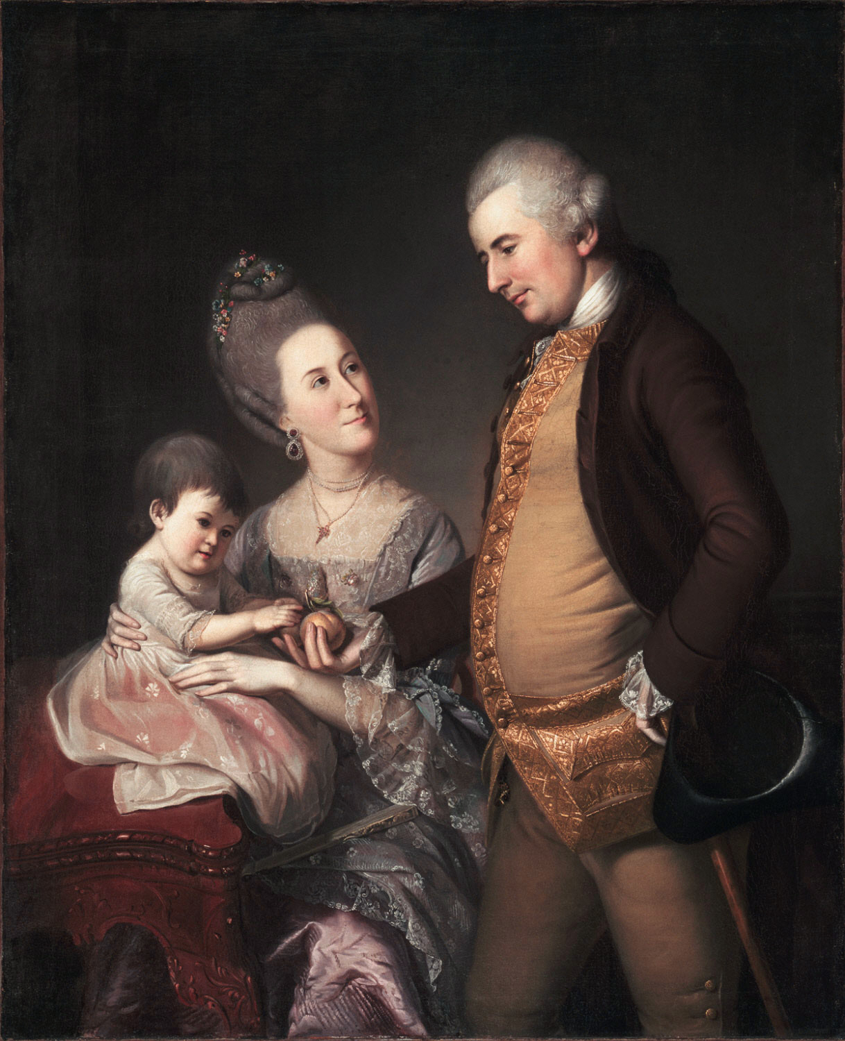
Were they really challenging norms?
An increase in published writings and an increased interest in political movements marked changes.
But women still held their traditional place at home in the private sphere.
Women were widely seen to have shared the burden during the war years, facing hardships and sacrificing equal to their husbands and men.
This “shared struggle” gave way to the Republican Motherhood movement which officially brought women into a more public view while admiring and valuing their traditional roles in a new way.
Notes:
How far were women challenging social norms during the Revolutionary War era? An increase in published writings and an increased interest in political movements marked changes. Also, the tax protestations and need to make decisions and run businesses or farm while the men were at war certainly moved more women into active roles in areas that had previously been male controlled.
However, most of these changes and challenges still happened within the private sphere. Women were commenting on and even influencing the public sphere, but generally they were still less visible in the process. Their thoughts and opinions were respected, but women still held their traditional place at home. However, their influence from the proverbial doorstep should not be underrated.
Women were widely seen to have shared the burden during the war years, facing hardships and sacrificing equal to their husbands and men. The perception and relation of “shared struggle” laid the groundwork for the concepts of Republican Motherhood during the founding years of the United States and the Federalist era which officially brought women into a more public view while admiring and valuing their traditional roles in a new way.

Slide 8
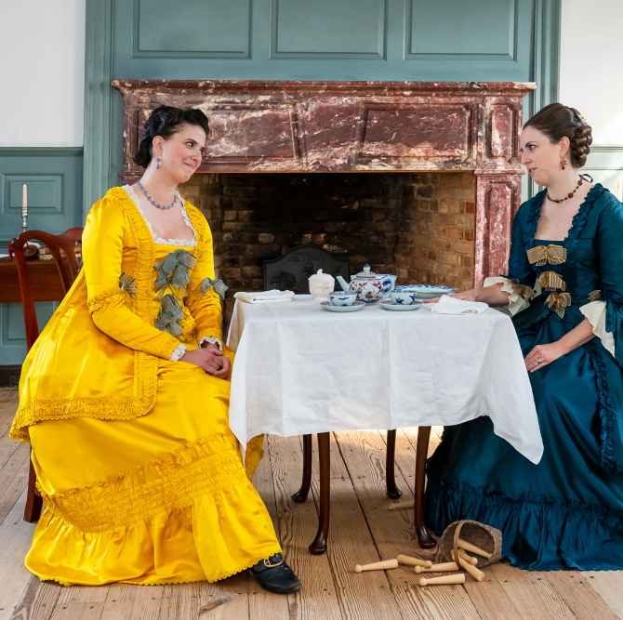
Whigs vs. Tories
Whigs (Patriots) opposed the British “taxation without representation” and advocated for independence.
Tories (Loyalists) upheld the British monarchy’s views.
Women who sided with American independence benefitted from winning the war, and retaining community connections, property, and employment.
Loyalists were ‘marked’ within communities for their outspoken allegiance to the Crown and were often forced out of their communities when the war ended.
Notes:
Whig and Tory referred to members of two opposing political parties or factions in England, particularly during the 18th century and were used for political purposes in America as well. In the American colonies, Whigs (Patriots) generally opposed the British “taxation without representation” and eventually advocated for independence while the Tories (Loyalists) upheld the British monarchy’s views.
Women who sided with American independence during the Revolution had the benefit of winning the war, and retaining what community connections — and by extension, property and employment, after the war’s conclusion. The same cannot be said for the wives of Loyalists. From the outset of the war, loyalists were ‘marked’ within communities for their outspoken allegiance to the Crown. And when the war ended, most loyalists were forced out of their communities through seizure of their property. And when claims were filed to retrieve seized land and property, most went unanswered.

Slide 9
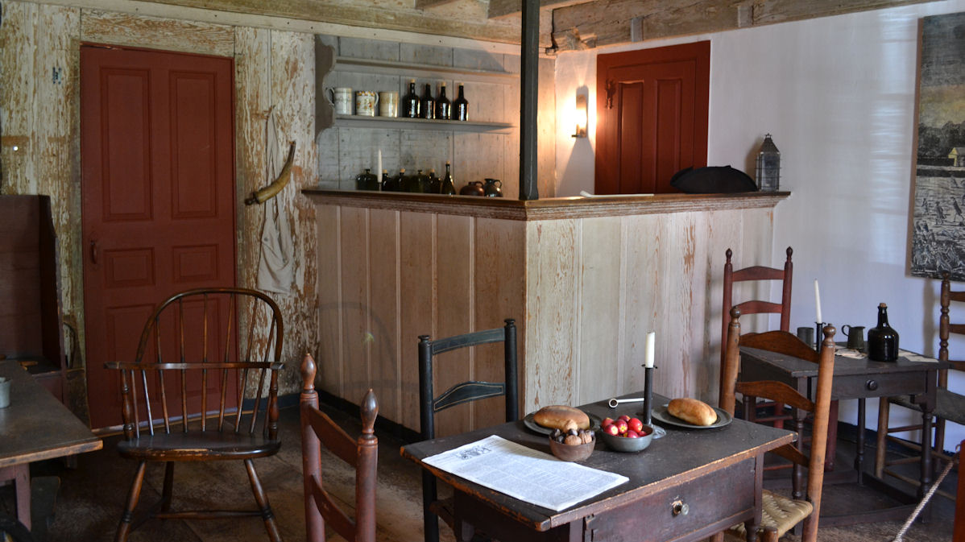
Protesting
Protests against British taxation elevated women’s public role and purpose in orchestrating social change.
The Boston Tea Party in 1773 is the first real example of women becoming involved in ‘American politics.’
To combat the textile shortage, women began homespun operations to provide clothing for the Continental Army and local community..
Many women served as tavern keepers in the eighteenth century, where some of the first protests against British taxation in the 1760s were formed.
This put the role of tavern ownership in a uniquely ‘frontal’ position during the American Revolution.
Notes:
One way that colonial women became engrossed in politics during the 1760s/70s came with the rising protest movements directed at British taxation. Prior to these events, women served no public role or purpose in organizing and raising awareness of social issues. This changed following the Boston Tea Party in 1773 and the Boston Port Act, effectively cutting off shipping to Massachusetts. In response, patriotic pamphleteers and religious sermons called on women to perform their “duty” in seeing to it that tea was boycotted. A large portion of colonial women responded enthusiastically to the tea boycott. This is the first real example of women becoming involved in ‘American politics,’ something that would continue to evolve into the 1780s.
Another boycott that took place up to and during the American Revolution was the refusal of imported textiles or fabrics by British shipping. To combat this shortage, women began homespun operations that saw the first rise in ‘American clothing.’ Seamstresses and quilters took on new lives as professions, serving both as a commodity for a household but also as one that could provide clothing for the Continental Army and local community. On plantations, many enslaved women were tasked with making clothing, changing some of the economic practices of the plantation owners who could now rely on homespun materials rather than purchasing new clothing for their laborers.
A large number of women served as tavern keepers in the eighteenth century; taverns were typically the meeting place of white men discussing business or politics. It is known that many of the first protests against British taxation in the 1760s were formed at taverns in Boston and in other colonies. This put the role and presence of ownership of tavern keepers in a uniquely ‘frontal’ position during the American Revolution. (The fictionalized character of Anna Strong in AMC’s television series, “Turn: Washington’s Spies.” Mrs. Strong remains the standard-bearer of her husband’s tavern upon his imprisonment, putting her in close contact with British and American soldiers, and at great risk.)

Slide 10
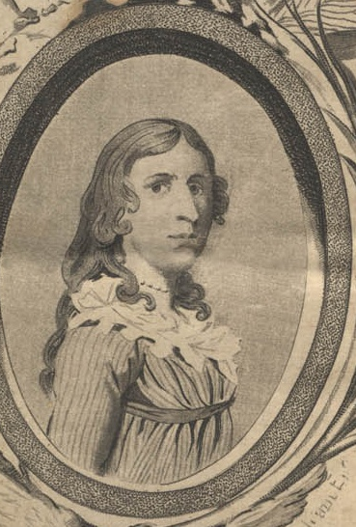
Daughters of Liberty
The Daughters of Liberty assisted the Sons of Liberty in organizing protests to non-importation.
After the Tea Act, Daughters of Liberty began drinking “liberty tea” as a substitute.
Some even aided the war effort by melting metal for bullets and sewing uniforms.
Deborah Sampson, Martha Washington, and Sarah Franklin Bach were among the Daughters of Liberty.

Slide 11
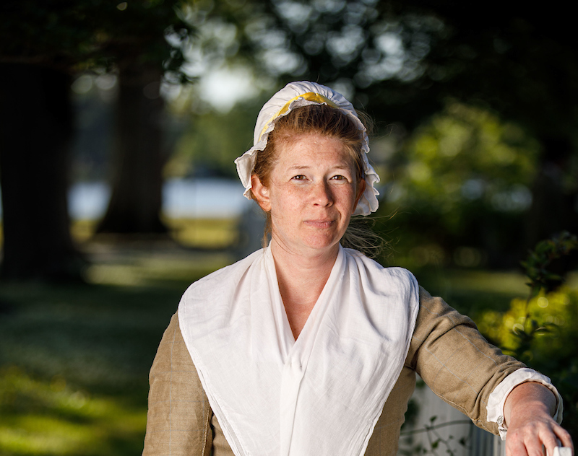
Legacy of the Revolution
Some women continued to pursue the expansion of married women’s rights, along with political representation.
The roles that women had taken from the homefront during the Revolutionary War challenged some of the cultural norms.
Their sacrifices and duty to raise children to be good citizens opened the door for more active roles in public society in the 19th Century.
Notes:
Despite a general sense of opportunity regarding the future, the Revolution did not see widespread support for expanding rights to women. Early advocates targeted the expansion of married women’s rights, along with political representation. Though these were discussed in the elite social circles among wives and widows, they rarely spilled over into the halls of Congress or state governments. This was largely to do with the separation of public and private roles for both men and especially women.
The roles that women had taken from the homefront during the Revolutionary War challenged some of the cultural norms. Their acknowledged sacrifices, combined with the ideals of virtual and civic duty to raise children to be good citizens, opened the door for more active roles in public society in the 19th Century.

