Slide 1
Women in Colonial & Revolutionary Era Society
The American Battlefield Trust

Slide 2
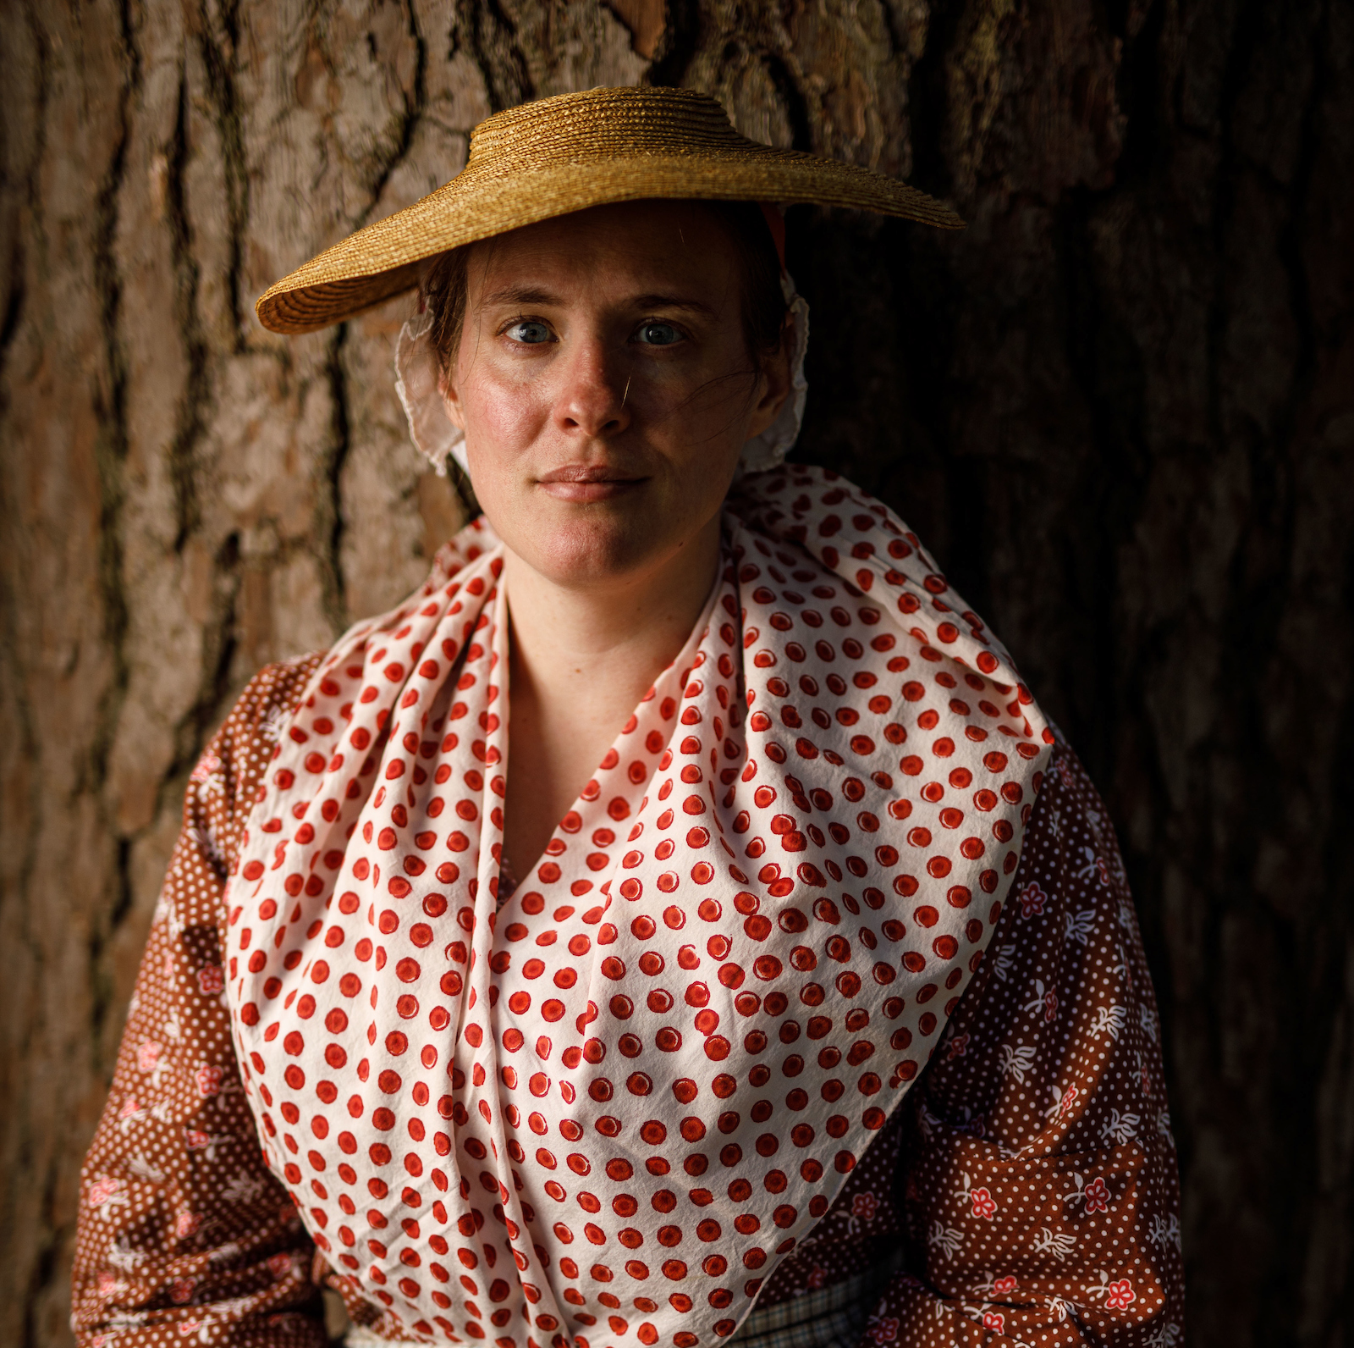
Gender Roles
In the 18th century, women had specific roles: primarily the household and child-rearing
Women did not take a prominent role in public affairs or politics, were seen as benefactors of male success
Sometimes they would take a more active role (i.e. the Daughters of Liberty)
Women that were influential at the time were usually wives, widows or daughters of influential men
Class took a huge role; it was very rare for women of lower-class status to be published or give a speech
Notes:
In Colonial Era and Revolutionary War Era, women had specific roles — primarily maintaining the household and child-rearing. Society’s structures were based on class and gender roles which were largely supported by the concept of family. A family’s name and success secured a social place, and families were usually large for a greater chance of carrying on the male lineage and expanding their influence or wealth in the local communities.
Though most women did not take a prominent role in public affairs or public settings, women were seen as the confidants and benefactors of male success in politics and business. Women did not participate in politics by holding office or voting, but many were self-informed of the political issues of the era and had strong opinions which sometimes influenced the men in their lives or social circles.
Some of the most influential women in mid-late 18th Century American were the wives or widows of influential men in politics and power. Among these women were the spouses of political leaders, as well as the leading business and merchant class of the main coastal port cities of Boston, New York, Philadelphia and Charleston. Widows, usually through their inheritance of their deceased husband’s property and possessions, held sway within social circles as well as the daughters of powerful leaders. It was rare for a woman of lower-class status to be published in a newspaper, give a speech before a gathered group of the elite, or produce an opinion that influenced how the broader, secular colonial society thought.

Slide 3
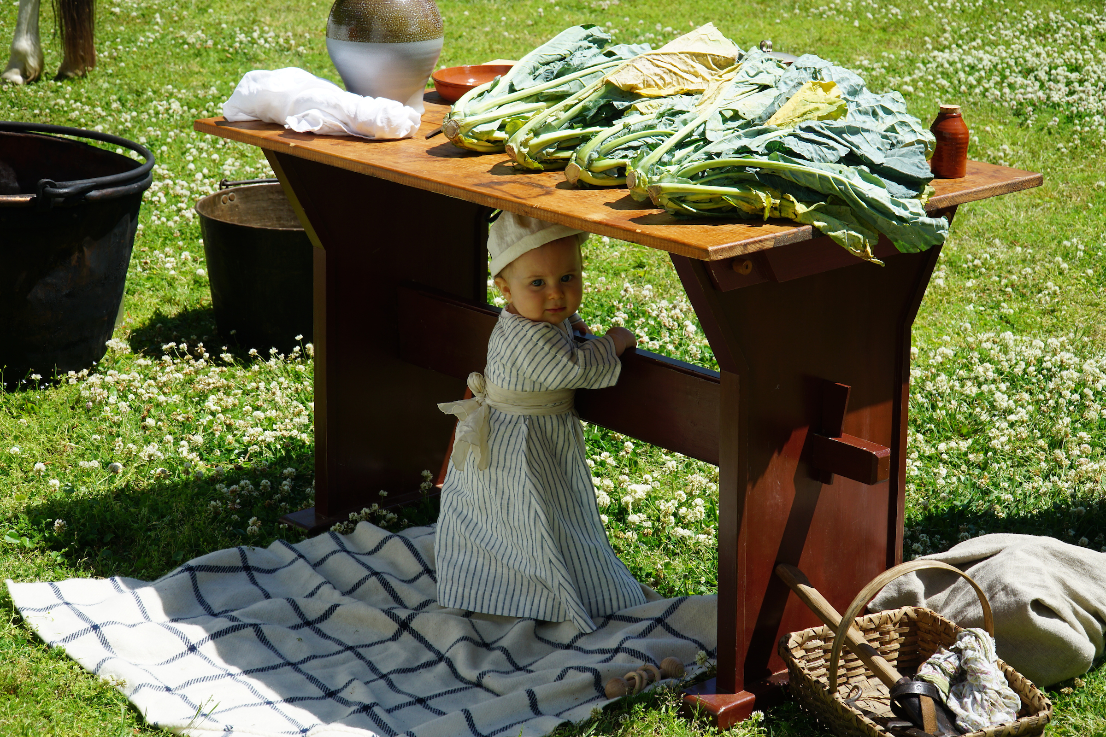
Urban and Rural Differences
Urban and rural white women had shared similarities, but their roles in the home varied
Urban women could rely on city and town markets for food sources
Meanwhile, rural women did much more to immediate interests of the household, preparing food, ironing & washing clothes, and sewing all while caring for children
More of a difference between Northern and Southern white women
White women raised on plantations had a workforce of slaves
White women of southern plantations and wealthy northern urban families both had more “free time”
During their unmarried years, these women received an education and later questioned or improved women’s roles in American society
Notes:
Class structures differentiated women, particularly white women, in colonial and Revolutionary America. As historian Mary Beth Norton writes in Liberty’s Daughters, rural and urban white women shared similarities, but varied in their roles in the household. Rural wives acted in the immediate interests of the household, preparing food, ironing and washing clothing, sewing and maintaining clothing, and cleaning the homestead, all while rearing children. Urban wives could rely on city and town markets for food sources, while indentured and enslaved servants did the bulk of housework.
The true difference, as noted by Norton, was between northern and southern white women. Whereas similarities existed among poor and ‘middling’ classes, white women raised on plantations had a workforce in enslaved people unparalleled with their class equals in the North. While southern wives oversaw the management of their plantations, they generally were hands-off in the physical duties and labor because of the prominence and use of slaves to perform these duties.
White women of plantation families and those of wealthy Northern urban white families shared similarities in having more “free time.” During their unmarried years, girls and women of these social classes received an education and later questioned or improved women’s roles in American society.

Slide 4
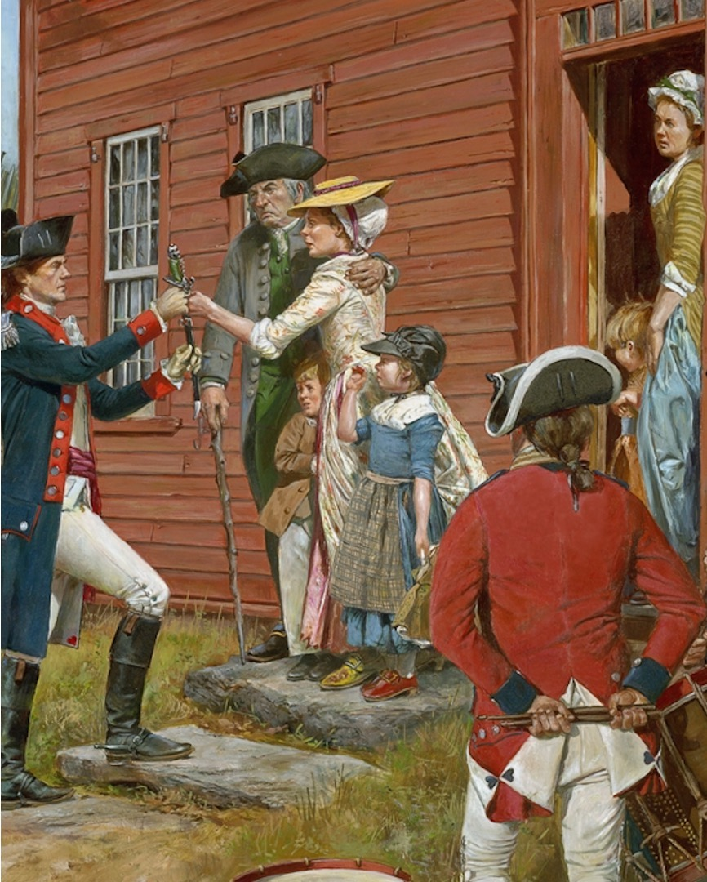
The Separation of Public and Private Life
Nearly all families of the 18th century, whether wealthy or not, followed the notion of women remaining in the boundaries of “private” life
Husbands were the face of the family in “public” life, making women detached from business duties
Held nearly all legal rights, including those purchased or inherited through his family, and those through his wife
Some women that were unmarried or widowed were able to bridge this gap if they did not have male relatives to assist them
“Will it be said that the judgment of a male of two years old, is more sage than that of a female of the same age? But…as their years increased, the sister must be wholly domesticated, while the brother is led by the hand through all the flowering paths of science.” - Judith Sergeant Murray, (p. 197, Berkin, First Generations: Women in Colonial America)
Don Troiani
Notes:
White women were expected to remain within the boundaries of “private” life and nearly all families of the 18th Century American practiced this. Private life and public life were separate: wives were expected to be capable and ready to bear and raise children, provide domestic securities for the household (preparing food, cooking, cleaning, ironing, sewing), and usually remaining detached from the business duties of their husbands. Husbands were the face of the family in ‘public’ life, holding nearly all legal rights, including those purchased or inherited through his family, and those inherited through his wife. However, some unmarried women or widows were forced to learn to bridge the gap between public and private life to manage a small business or control property if they did not have male relatives to assist them.
Quote: Will it be said that the judgment of a male of two years old, is more sage than that of a female of the same age? But…as their years increased, the sister must be wholly domesticated, while the brother is led by the hand through all the flowering paths of science.” - Judith Sergeant Murray, (p. 197, Berkin, First Generations: Women in Colonial America)

Slide 5
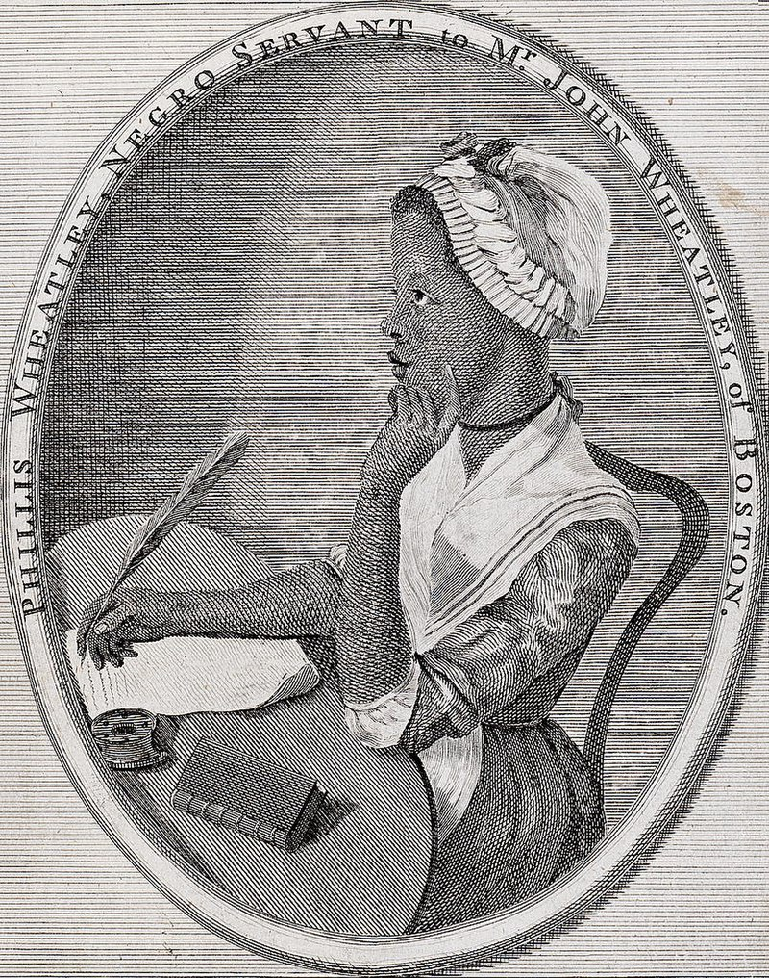
What about African American Women?
Enslaved African laborers were purchased and considered property
At the time of the American Revolution, slavery was practiced in all thirteen colonies but slowly decreasing in areas of the north
By the end of the 18th century, enslaved women outnumbered men on the fields performing manual labor
Some enslaved women had more domestic duties such as cooking, cleaning or childcare
Free African American communities existed during this time, on the outskirts of white communities
Free African women could find paid work within these circumstances
They didn’t have civil rights or legal representation
Kidnapping of free African Americans did happen in the colonies but was much more common decades later
Notes:
In contrast to indentured servants who served contractually for a designated period, enslaved African laborers were purchased and considered legal property. The need for help to keep a farm or plantation afloat under-guarded the acceptance of both indentured servitude and slavery beyond the rich and large tobacco and rice plantations of the South. At the time of the Revolutionary War, slavery was legal and practiced in all thirteen colonies, though decreasing in some areas of the north.
By the end of the eighteenth century, enslaved women outnumbered men on the fields performing manual labor. Part of the reason for this was men were allowed to learn a trade and become artisans to the benefit of the plantation. To compensate, women who did not work within the main household were forced to perform extensive labor duties with crops and farming. Some enslaved women had more domestic tasks, like cooking, cleaning, or using skills of midwifery or childcare.
Free African American communities existing during this period could be found on the outskirts of white communities. Among free black women, paid positions for these services could be found in newspaper ads in cities like Philadelphia. Like their white counterparts, free black women had some autonomy to choose their employment within these circumstances. Though not as prevalent as in later decades, kidnapping of free African Americans and selling them into slavery did happen. Without legal representation and denied civil rights, Black Americans had few ways to defend themselves against kidnapping or other crimes in this era.

Slide 6
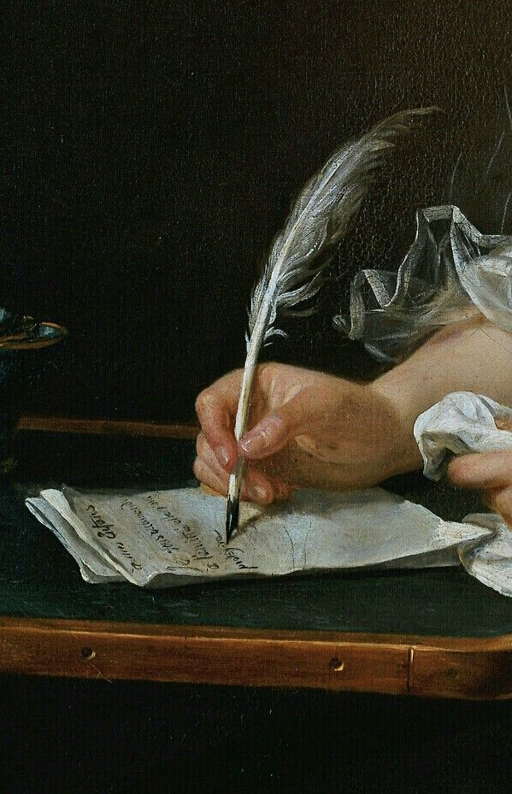
18th Century Education
Public schools as we know it did not exist in the 18th century
Schools were either religious based or instructing law
Girls who did receive education got it through private instruction or tutors
As more women became literate, wealthy social circles began to press for more women’s rights
Their role in the household was challenged
Phillis Wheatley, a former slave, received schooling from her former masters and would go on to publish poetry during the American Revolution
Notes:
Public schooling as we know it in the modern era did not exist in the 18th Century. Schools were either religious-based or mainly instructing law. Girls who received an education studied with private instruction or tutors.
As more women became literate, advocacy arose among some wealthy social circles to push for more women’s rights. In addition, as education improved for women, the belief that their main role lay within the household began to be challenged.
This was not limited to just white women. Phillis Wheatley, a former enslaved woman, is a notable exception for having received an education from her former masters. She would go on to publish poetry in support of the American Revolution.

Slide 7
Indentured Servants
An agreed individual would have a formal contract to work for a certain number of years in exchange for transportation, food, clothing, shelter, or perhaps skills training
Unlike slavery, indentured servitude had an agreed ending and provided legal rights
Some would serve long terms for years, others for months
Women could often pick and choose their position due to the abundance of open jobs in wealthy households
Examples show numerous white women in Philadelphia rotating through wealthy households
Means these women were not bound by legal doctrine, such as slaves would be
These choices were usually made for personal or financial reasons, showing how indentured servitude change decades immediately following the American Revolution
Notes:
Indentured servitude was a formal contract which agreed that an individual would work for a certain number of years in exchange for transportation, food, clothing, shelter, or perhaps skills training. (This was different than slavery which had no agreed ending and no legal rights for the enslaved.) White women who were indentured servants, particularly in urban areas, seem to have only held their jobs for short periods of time. As indentured service decreased in the latter half of the eighteenth century, white house servants were less bound to long-term service (years), and left households after only serving a few months at a time. It appears one reason for this was the abundance of positions available in wealthier households, offering plentiful job opportunities, allowing women to pick and choose to whom they would serve.
Some examples show numerous white servants rotating through the households of Philadelphia’s wealthiest citizens in a single year, indicating these servant women were not bound to their service by legal doctrine (as most indentured servitude had been) or through legal property (such as enslaved women). These women had choices and often made them for personal or financial reasons, offering a change in how servitude evolved among the non-enslaved population in the decades immediately after the American Revolution.

Slide 8
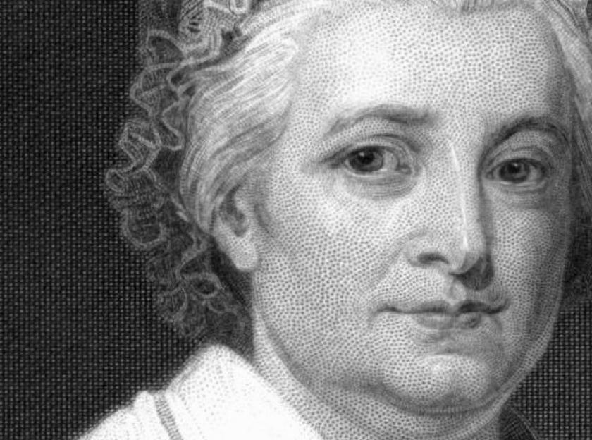
Property Rights
Property rights for women varied depending on what colony they lived in
Some colonies afforded widows considerable property rights, if land was deeded by their deceased spouse
More than likely a widow would hold onto property rights only until their oldest male child could legally inherit it, this included slaves
For example, Martha Washington inherited slaves from her first husband
When she married George Washington in 1759, George had no legal authority over these slaves, other than ensuring they remained in the family’s possession
These were called “dower slaves” and George could only oversee them, not sell or prevent Martha from selling them
Legally they were bound to pass onto her children or other descendants upon her death
Notes:
Rights of women depended on which colony they lived in. For instance, some colonies afforded widows considerable property rights if deeded land by their deceased spouse. Others were allowed to challenge men in court.
One of the few rights women obtained in colonial British America was over their deceased husbands’ property. Some widows became the beneficiaries of thousands of acres. However, more than likely, the widow was only holding the property rights until their oldest male child could legally inherit it. Similarly, enslaved people considered property could be dowered or held for a period by women until they died. Martha Washington is one example of inheriting dower slaves from her first husband and holding them until her death. George Washington, her second husband, had no legal authority over these people other than ensuring they remained in the family’s possession.
One of the sole rights retained by married women were dower rights, or the inheritance of property through her first marriage. As a widow, women did retain privileges awarded to them by their deceased husbands’ estates in the sum of 1/3 of the total property. Martha Washington received 1/3 of her deceased husband’s slaves upon his death, which she brought with her into her marriage to George Washington in 1759. Washington, a slave owner himself, held no legal authority over these enslaved peoples at Mount Vernon, aside from being their overseer. As dower slaves, he could not sell them or prevent Martha from selling them as they were legally bound to pass onto her children upon her death.

Slide 9
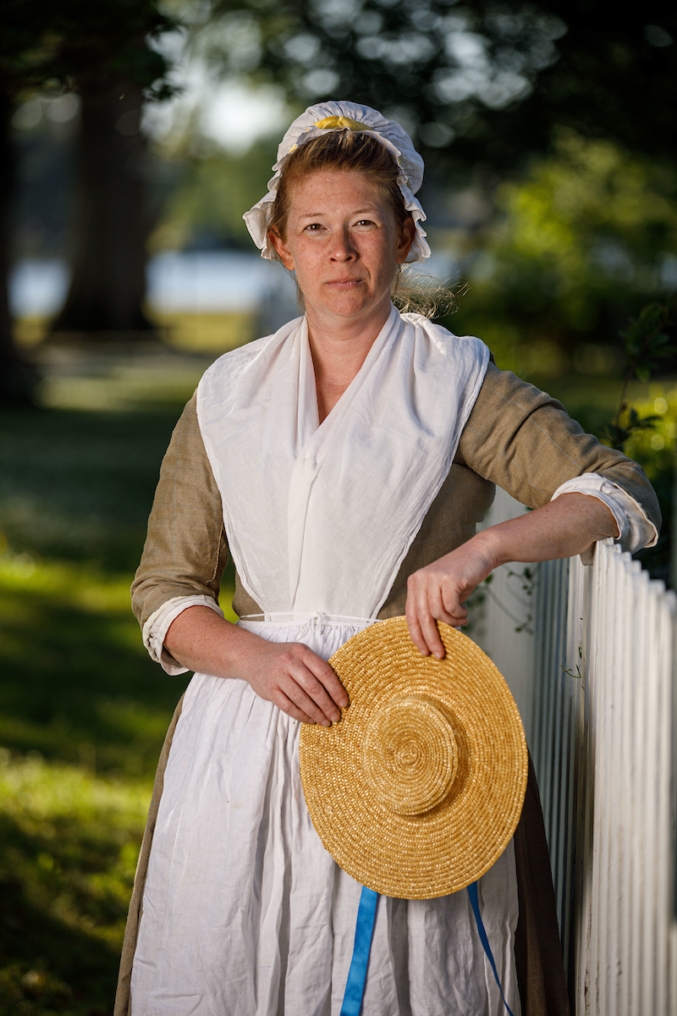
Operating a Business or land
Women had little to no experience handling a business, so if her husband died, she could have a difficult time doing so
Could be targets of scammers looking to take advantage of their ignorance
Some women and widows acquired business knowledge while their husbands were alive or through legal counsel
Many women demanded antenuptial agreements from their fiancés
This ensured they were left with control over the deceased husband’s estate and property, rather than forfeiting it to a potential new husband
Laws such as this existed at the time and some knowledgeable women took advantage, most either did not know about the laws or chose not to pursue them
Notes:
Married women faced the uncertainty of handling their husband’s business affairs in the instance of his death. While most widows became executrixes of her deceased husband’s estate, very few of them had any knowledge or knowhow of the legal processes that went into settling debts or managing account books. Because of this, widows could be targets of scammers looking to take advantage of their ignorance. Other widows were capable accountants and managers and did so either through acquiring knowledge while their husbands were alive or through paying for legal counsel.
A large percentage of women demanded antenuptial agreements from their fiancés to ensure they were left with control over their deceased husband’s estate and property rather than forfeiting these rights to a potential new husband upon remarrying. While such laws did exist and knowledgeable women did take advantage of them to their benefit, most women were either ignorant of these rights or chose not to pursue them for various reasons.

Slide 10
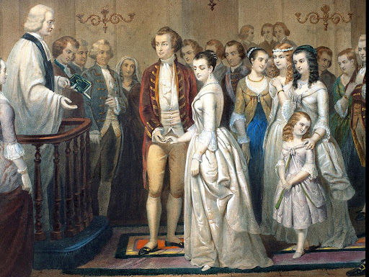
Marriage
Most women assumed they would marry, but there was no guarantee of courtship or a ‘good match’
In colonial times, many marriages were conducted for the sake of business, particularly among wealthy families to preserve accumulated wealth
Once married, women were expected to be submissive to their husbands, following religious, legal and social norms. If a wife was unhappy, women had little hope or legal means to improve their situation
Many women wrote in journals about loneliness or a monotonous routine of housework, food preparation and child rearing
During the Revolutionary period, some women called to create legal rights for married women
Notes:
Most women assumed they would marry, but there was no guarantee a courtship would lead to a ‘good match’ in a marital partner. In the early colonial period, many matches were conducted as business transactions, particularly among wealthy families seeking to pair their sons and daughters together, preserving their accumulated equitable wealth. While fathers held considerable sway over the matching and approval of their daughters’ marriages, women themselves did retain some autonomy in approving or disapproving of the proposed match. During the later Colonial Era and into the Revolutionary War, the concept of “romantic love” allowed young people to “choose” their marriage partner with less interference from their parents.
Once married, women were expected to be submissive to their husbands, following religious, legal, and social norms. A sense of duty governed the lives of many married women and gave them motivation and purpose through joys and difficulties. Evidence from journals and letters by married women points to varying degrees of happiness and misery in marriage; however, if the marriage was unhappy or their husband was unfaithful, the women had little hope or legal precedents to improve their situation.
Some married women wrote about loneliness or a monotonous routine of housework, food preparation, and child rearing — especially if their husbands worked away from home or journeyed to pursue their professions.
One of the most profound developments that came about during the Revolutionary period was the call by some women to create legal rights or representation as married women. At the time, all legal rights of married wives were retained by their husbands, including inherited property, financial endowments, and earned wages. Advocating for legal representation among women constituted a call to end this complete control of women through marriage.

Slide 11
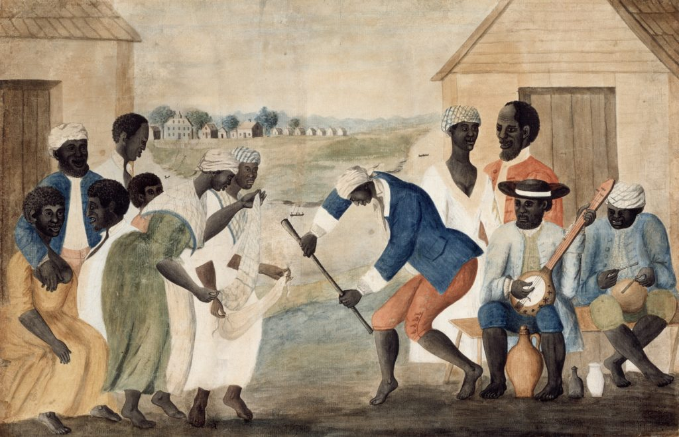
What about Slaves and Marriages or Families?
Most enslaved people could marry by choice in the 18th century, with “permission” of their enslavers
Many slaves intermarried within populations of neighboring plantations, hoping to keep families intact
Family was important in enslaved communities as traditions, stories from Africa, accounts of resistance and truths were passed on to be remembered
Threat of breaking up families by way of moving or selling slaves hung over every enslaved marriage
By law at the time, a child’s status (enslaved or free) was determined by the mother’s status
Even if a free man, whether black or white, married an enslaved woman and had children, the children would be enslaved
Relationships between enslaved women and white men did exist, but there are many reasons to believe many were NOT consensual
Notes:
Because of their legal status, enslaved black men held no power over their wives. However, most enslaved people could marry by choice in the eighteenth century, though often with the “permission” of their enslavers. It seems many intermarried within the populations of neighboring plantations or within their communities, hoping to keep their families intact. Family was important in enslaved communities, and many traditions were passed from generation to generation, including stories from Africa, accounts of resistance to slavery, and truths to be remembered. The threat of breaking up a family if an enslaver chose to move or chose to sell individuals hung over every marriage, bringing emotions, fears, and strengths that were unknown in white marriages.
By law, a child’s status (enslaved or free) was determined by the mother’s status. Thus, even if a free Black man married an enslaved woman, their children would be enslaved. This also held true if a father was white. Mixed race children born to enslaved mothers were proof of relationships between enslaved women and white men, and there is reason to believe many of the relationships were not consensual.

Slide 12
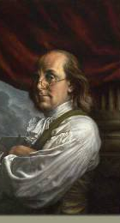
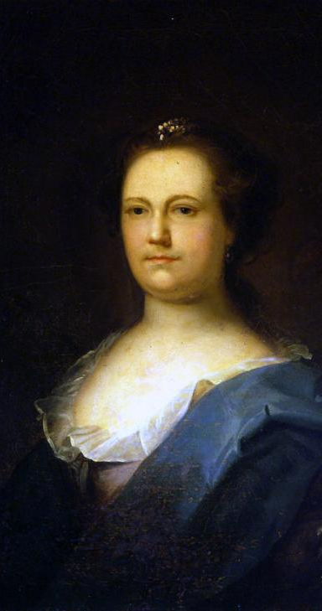
Common Law Marriage: A Different Kind of Marriage
Legally different than a civil-recognized marriage
Though different, they were recognized as legitimate partnerships in the 18th century
Benjamin Franklin and Deborah Reed
Reed had been legally married to another man who disappeared in the Caribbean
Franklin and Reed married in 1730 under Common Law
British legal system did not see them as husband and wife, but rather living in a “mutual agreement”
Stayed this way until Reed’s death in 1774
Notes:
Some women chose common law marriages or arrangements instead of civil-recognized marriages to their husbands or partners. While these were legally different in many ways, they were recognized as legitimate partnerships in the eighteenth century.
Benjamin Franklin and his wife Deborah Reed lived in a common law relationship for the tenure of their marriage until her death in 1774. Deborah had been legally married to another man who had disappeared in the Caribbean; Franklin and Reed married in 1730 under common law whereas the British legal system did not formally recognize them as husband and wife; rather they were cohabitants living within a ‘mutual agreement.’

Slide 13
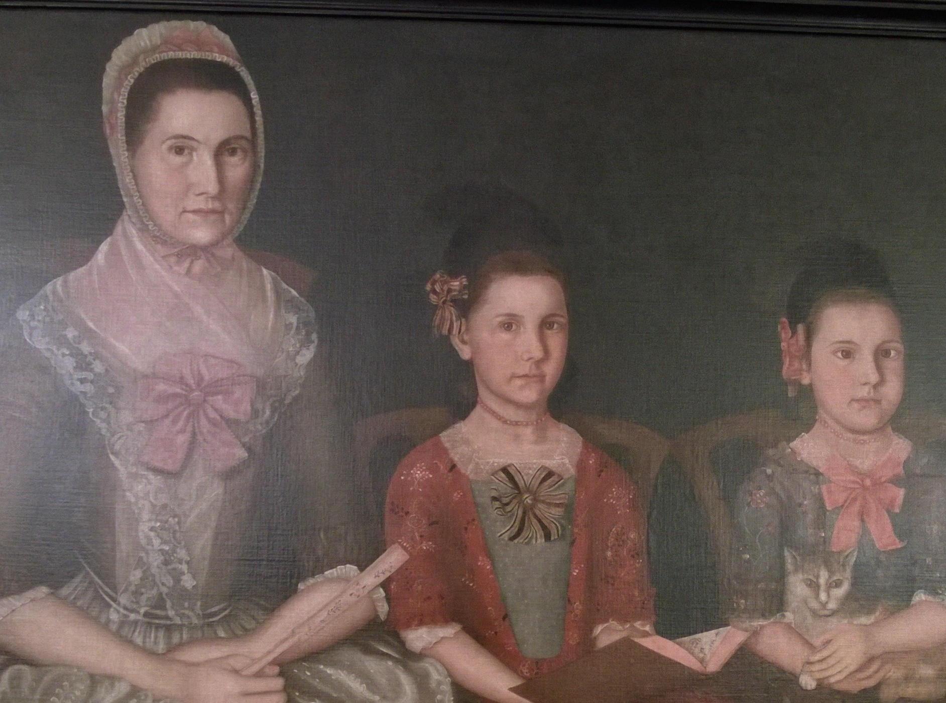
Children
Colonial and Revolutionary War era families were typically large
Many infants and children died of illness or tragic accidents
Those who survived quickly entered roles, training and learning based on their gender
Mothers oversaw discipline and daily routines of both genders, but around age six daughters came under the wing of their mothers while sons gravitated towards the male and public world
In poor or middling white lineage, daughters by age ten had been taught to farm, wash clothing and prepare food
By age ten boys of the same class had some form of education, mild literacy and were about to begin an apprenticeship of some kind
Adult daughters, especially in affluent families, retained a close relationship with their mothers and letters show the close bonds
Notes:
Colonial and Revolutionary War Eras typically saw large families. Many infants and children died of illnesses or tragic accidents. The children who survived quickly entered roles, training, and learning based on their gender.
Mothers oversaw the discipline and daily routines of their children regardless of sex, but around age six, daughters came under the wing of their mothers while boys gravitated into the male and public world. Roles were assigned to each whereas by the age of ten a daughter of middling or poor white lineage had been taught to farm or wash clothing and prepare food. By the age of ten boys within the same class structures had some form of education, perhaps mild literacy, and were about to begin an apprenticeship in some trade or profession.
Adult daughters, particularly from affluent families, often retained a close relationship with their mothers. Letters show affectionate bonds between mother and daughter. The opposite is typical of adult sons and their fathers; most notably among affluent families, the adult sons were ‘expected’ to perform a certain degree of capability by their fathers. This created a cool and distant relationship that began during a son’s teenage years. (pp. 102-107, Norton, Liberty’s Daughters)

Slide 14
Divorce and Separations
Divorce in 18th Century America was extremely difficult to obtain; thus it was virtually nonexistent
Special circumstances could reward legal separation, such as an affliction carried into the legal contract
If agreed upon by both husband and wife, mutual separations did occur
Property rights laws remained solely in the court of the husband
Because many women were not versed in equity law, they chose to remain in abusive or loveless marriages
Specific state laws could aid women in marital trouble
Notes:
Divorce in eighteenth century America was extremely difficult to obtain; thus, it was virtually nonexistent in the modern sense. Special circumstances could reward a legal separation of husband and wife, usually if the asking party could prove that the reason for divorce existed prior to their marriage, i.e., the affliction was carried into the legal contract. As such, separations did occur with both husband and wife agreeing to mutually split up. However, property rights laws remained solely in the court of the husband, meaning a husband was under no legal obligation to surrender any property, including what his wife might have brought into the marriage, back to her upon separation. The exceptions came with women who understood equity laws that allowed them narrow control over what assets they brought to the marriage; however, historians dispute how many women took advantage of these laws. (pp. 46-47, Norton, Liberty’s Daughters). Thus, many women chose to remain married to abusive or unloved husbands because of the legal predicament they were in.
Despite the cultural stigma attached to divorce, specific state laws could aid women in marital trouble. The case of Abigail Bailey of New Hampshire is one extreme example, whereas she discovered her husband having an incestuous affair with their teenage daughter, and promptly threatened to have their daughter testify against him in court (a capital crime in New Hampshire) unless he agreed to divide their property evenly. Mr. Bailey, using the law to his advantage, attempted to abandon her in rural New York state; Mrs. Bailey quickly returned and had him arrested. Only from jail did Mr. Bailey agree to the property settlement so long as she dropped the charge of incest. pp. 49-50, Norton, Liberty’s Daughters.

