Slide 1
The Constitutional Convention
The American Battlefield Trust

Slide 2
The Need to Revise
The Articles of Confederation made it difficult for states to work together for commerce, opportunity and foreign policy.
The states agreed to send delegates to a convention in Philadelphia in May 1787 to try to revise or reform the Articles of Confederation.
Philadelphia was one of the largest cities in the United States and had been the capital for years of the Revolutionary War.
55 delegates from all states except Rhode Island attended the Philadelphia Convention which is now called the Constitutional Convention.
Philadelphia, Pennsylvania
Notes:
Four years after the United States and Britain signed the Treaty of Paris, the United States was in trouble. In 1781, the budding United States government had created the Articles of Confederation to rule their new nation. These Articles purposefully gave more power to the states than a centralized government to counter the authoritarian nature of the British monarchy. However, because of the weak central government, the United States had trouble negotiating with foreign powers, raising money to support the pensions of Continental Army soldiers, and regulating commerce. Now these shortcomings were coming to a head, and the prominent political leaders of the United States worried that these shortcomings could mean an end to the United States. On May 25, 1787, fifty-five delegates met in the old Pennsylvania State House, now known as Independence Hall, in Philadelphia, Pennsylvania. The purpose of this Convention was to revise the Articles of Confederation and compensate for its shortcomings. However, the Convention ended with the United States Constitution, a new system of government, and this Convention became known as the Constitutional Convention.
Read more:
From Declaration to Constitution: https://www.battlefields.org/learn/articles/declaration-constitution
The Constitutional Convention: https://www.battlefields.org/learn/articles/constitutional-convention
Philadelphia in 1787: https://www.battlefields.org/learn/articles/philadelphia-1787
The Articles of Confederation: https://www.battlefields.org/learn/articles/articles-confederation

Slide 3
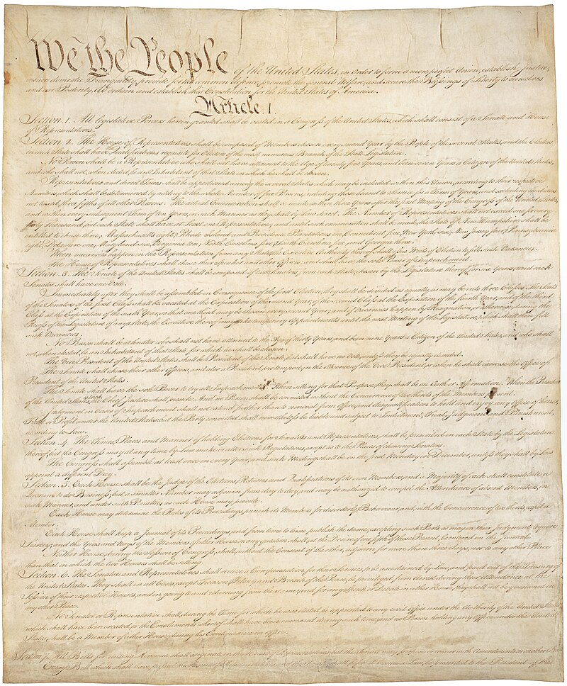
Inquiry Question:
Preamble of the Constitution begins with the phrase “We The People.”
How did the events and debates of the Constitutional Convention reflect or challenge this phrase?
Notes:
An inquiry question to use in this lesson plan.

Slide 4
The Origins of the Constitution of the United States
Notes:
The video is embedded in the slide, but here's a link: https://www.battlefields.org/learn/videos/untold/united-states-constitution

Slide 5
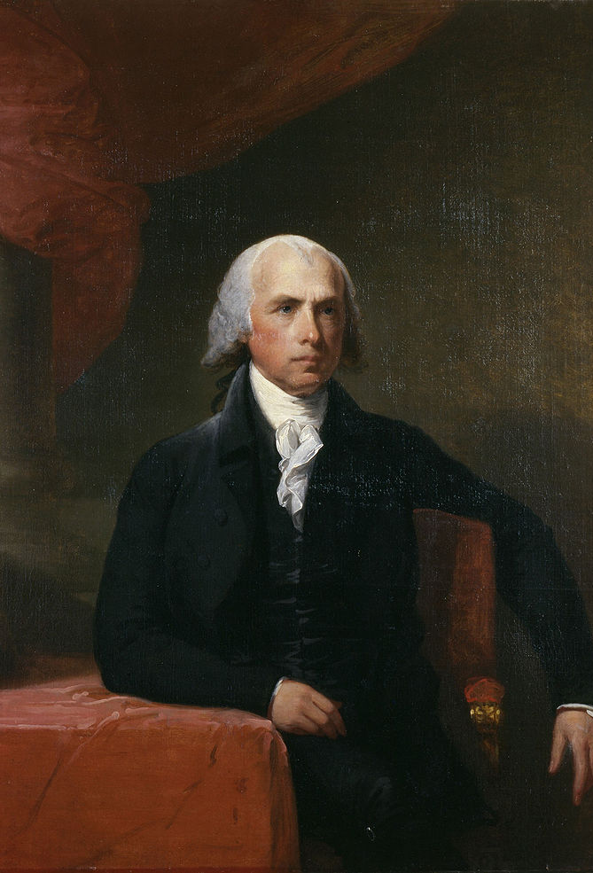
A New Government?
After fighting the Revolutionary War and leaving Britain's monarch and parliament, there were certain types of government that did not appeal to Americans. Also, memories of religious or political persecution that had prompted ancestors to journey to colonial North America made other options unsavory.
Delegates at the Philadelphia Convention thought they assembled to revise the Articles of Confederation, but James Madison led a proposal to draft a new form of government and a new document. He suggested a form of a federal democratic-republic form of government outlined in a constitution.
Notes:
Forms of Government: https://www.battlefields.org/learn/articles/forms-government
James Madison: https://www.battlefields.org/learn/biographies/james-madison
Under the Articles of Confederation, most of the power rested with the states and the people. Essentially, the states of the confederation dictated to the central government what they would and would not do, a typical hallmark of confederations throughout history. While this may seem beneficial and protective of democracy at first glance, it often lacks staying power, and—as had already been experienced under the Articles of Confederation—lacks a central power to unite the states for the good, protection and prosperity of the country.
Most of the delegates at the Philadelphia Convention (Constitutional Convention) in 1787 wanted a democratic form of government but debated how to balance the power needed for an effective federal government. Some also worried about the weaknesses of direct democracy, while still acknowledging that the voice of the people was important. With a stronger central government than a confederacy but with limits to that centralized power outlined by a governing document, the United States adopted the form of a federal democratic-republic form of government outlined in a constitution.

Slide 6
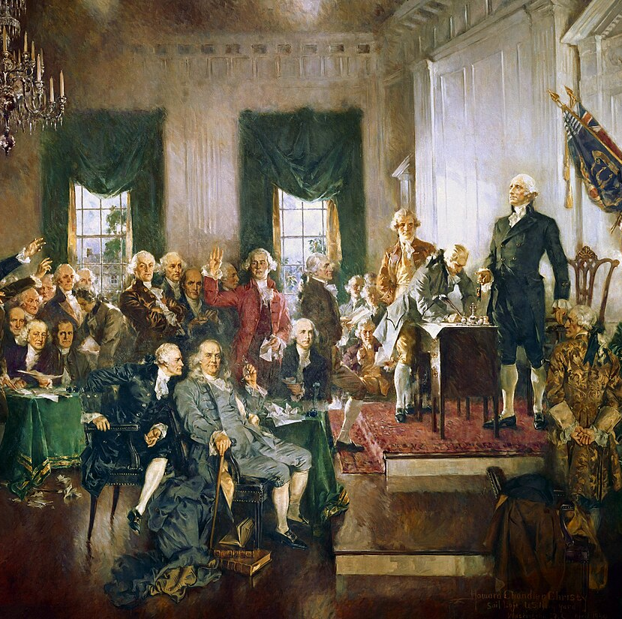
Who’s Who?
George Washington
Benjamin Franklin
James Madison
Gouverneur Morris
Roger Sherman
Charles Pinckney
Alexander Hamilton
In total, 55 delegates attended the Constitutional Convention, though most were not all there at the same time.
Notes:
Who Signed and Who Did Not Sign The Constitution? https://www.battlefields.org/learn/articles/who-signed-and-who-did-not-sign-us-constitution
George Washington: https://www.battlefields.org/learn/biographies/george-Washington
Benjamin Franklin: https://www.battlefields.org/learn/biographies/benjamin-franklin
James Madison: https://www.battlefields.org/learn/biographies/james-madison
Gouverneur Morris: https://www.battlefields.org/learn/biographies/gouverneur-morris
Roger Sherman: https://www.battlefields.org/learn/biographies/roger-sherman
Charles Pinckney: https://www.battlefields.org/learn/biographies/charles-pinckney
Alexander Hamilton: https://www.battlefields.org/learn/biographies/alexander-Hamilton

Slide 7
Plans for the Legislature
The Virginia Plan | The New Jersey Plan | The Connecticut Compromise
Presented by Edmund Randolph 3 Branches of Government: Legislative, Executive, Judicial Bicameral Legislature: Senate and House both based on population representation | Presented by William Paterson 3 Branches of Government: Legislative, Executive, Judicial One House Legislature with one representative for each state, regardless of population. | Presented by Roger Sherman 3 Branches of Government: Legislative, Executive, Judicial Bicameral Legislature: House representation based on population, Senate has two elected senators, regardless of state size or population.
Notes:
Once the Convention decided on drafting a new governmental system, arguments began. The Virginia Plan, proposed by James Madison and presented by Edmund Randolph, included three branches of government: the Legislative Branch, the Executive Branch, and the Judicial Branch. The Legislative Branch was to be comprised of a Senate and a House of Representatives. Representatives of both were determined by the population of each state. William Paterson, a delegate of New Jersey, noted that the Legislative Branch favored states with higher populations, such as Virginia, as opposed to states with lower populations, such as New Jersey. In the New Jersey Plan, Patterson proposed that there was to be only one house in the Legislative Branch and that each state get only one representative. This revision made representation an even playing field against the states. Arguments ensued until the Connecticut Compromise was proposed. This compromise retained the three branches of government from the Virginia Plan. However, the Senate in the Legislative Branch was to be comprised of two representatives per state, and the House of Representatives was to be comprised of representatives proportional to the state’s population.
Edmund Randolph: https://www.battlefields.org/learn/biographies/edmund-randolph
Roger Sherman: https://www.battlefields.org/learn/biographies/roger-sherman
Forms of Government: https://www.battlefields.org/learn/articles/forms-government
Constitutional Convention: https://www.battlefields.org/learn/articles/constitutional-convention

Slide 8
All Men Are Created Equal?
This video gives background of how the Founding Fathers viewed slavery.
Notes:
The video is embedded in the slide, but here's a link: https://www.battlefields.org/learn/videos/untold/all-men-created-equal

Slide 9
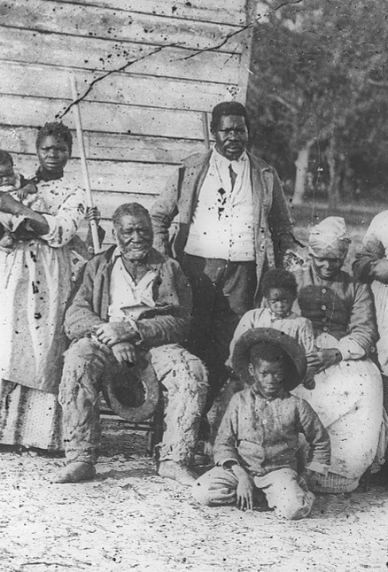
Slavery and The Constitution
Representation in Congress based on population sparked the debate over slavery during the Constitutional Convention. Southern states argued that enslaved people should be included in the population count toward that state’s number of delegates in the House of Representatives. Smaller states and northern states realized this would distort the number of representatives and protested on political and moral grounds.
Eventually, the convention adopted the Three-Fifths Compromise which counted three-fifths of a state’s slave population for representation. This still gave southern states with large slave populations an advantage with more representatives and more electoral votes.
The Transatlantic Slave Trade, Fugitive Slave Laws, and suppression of enslaved people’s revolts were also addressed in the Constitution.
Many of the delegates denounced the immorality of slavery but decided to find compromises instead of outlawing the practice.
The Thirteenth Amendment to the Constitution, ratified in 1865, ended slavery in the United States.
Notes:
Read more: https://www.battlefields.org/learn/articles/slavery-and-constitution
Representation in Congress based on population sparked the debate. Enslaved people were part of a state’s population, but should they be represented? Enslaved people were considered property without rights or privileges, but southern states argued that enslaved people should be included in the population count toward that state’s number of delegates in the House of Representatives. Smaller states and northern states realized this would distort the number of representatives that southern states sent to congress and protested on political and moral grounds.
Eventually, the convention adopted the Three-Fifths Compromise which counted three-fifths of a state’s slave population for representation. This still gave southern states with large slave populations an advantage with more representatives and more electoral votes. The three-fifths number did not come from a belief that enslaved people were part human; rather, the number was derived from an approximation of measuring wealth that an enslaved person contributed to that state’s economy. The Three-Fifths concept predated the Constitutional Convention had had been debated in the Confederation Congress, but for the first time it was added to a national government document in 1787. The additional seats in Congress that southern states gained with the Three-Fifths Compromise created the “Slave Power” in the legislature and allowed bills favorable to the southern region to pass more easily in congress. The frustration over imbalances of regional political power led to future compromises like The Missouri Compromise (1820), the Compromise of 1850 and the Kansas-Nebraska Act. More electoral votes from slave-holding states also meant the greater likelihood of their preferred candidate for president, and in time, meant Supreme Court justices favorable to slavery.
Other aspects of slavery in the United States came under debate and were addressed in the Constitution, including the slave trade, fugitive slave laws and suppression of slave revolts.

Slide 10
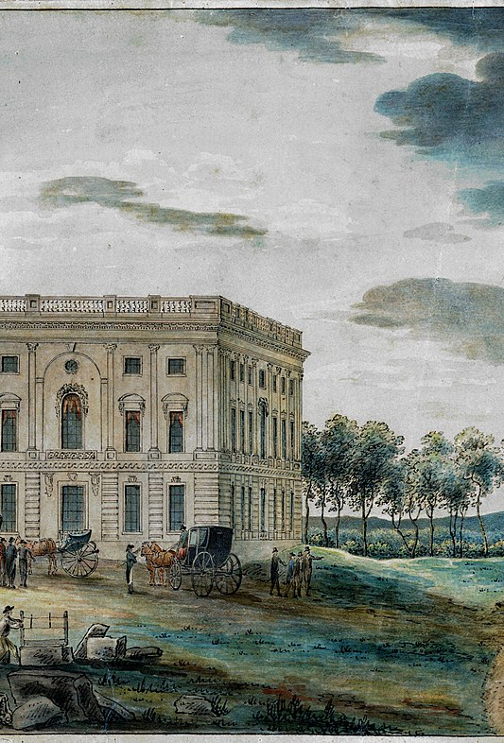
The Executive & Judicial Branches
The Executive Branch of government would be the President and Vice President and implied that other officers (a cabinet) could be established.
An Electoral College System would elect the President and Vice President.
The Judicial Branch would be the Supreme Court, and Congress (legislative) could establish lower courts.
The powers given to the Legislative, Executive and Judicial branches of government where to “check and balance” each other.
Notes:
Other discussions emerged in this Convention, such as: In the Executive Branch, should there be one leader, known as the president, or should there be a group of leaders? If there is one president, how should that president be elected, and how long should their terms in office be? Should there be a way to impeach if the president is not fulfilling their duties and what offense should be impeachable? Which branch should be responsible for electing judges for the Judicial Branch of government? What type of systems was in place to check and balance the three branches of government?

Slide 11
The Constitution’s Articles
Article I – Legislature
Article II – Executive
Article III – Judicial
Article IV – States and Federal Government
Article V – Amending the Constitution
Article VI – Laws/Treaties, No Religious Tests To Hold Government office, New Government Responsible For Debts Incurred Under The Articles of Confederation.
Article VII – Ratification of the Constitution
Notes:
The Constitution of the United States: https://www.battlefields.org/learn/primary-sources/constitution-united-states

Slide 12
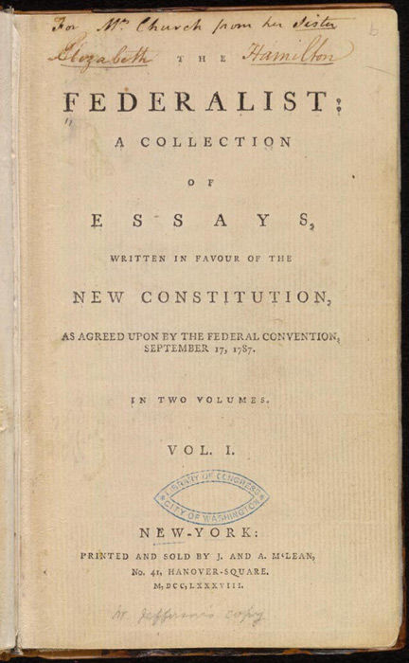
Ratifying the Constitution
Signing the Constitution at the Convention did not put it into effect.
Instead, Article VII required 9 of the 13 states to ratify the Constitution. (Eventually all 13 did.)
Delegates and supporters of the Constitution wrote to explain and defend the new document and encourage ratification.
James Madison, Alexander Hamilton and John Jay wrote “The Federalist Papers”, explaining details of the Constitution.
Opponents made arguments, too – particularly advocating for a Bill of Rights to be added to safeguard freedoms and liberties.
By 1788, enough states had ratified, and preparations were made for the new government to be elected and to be seated in 1789.
Notes:
Who Signed and Who Did Not Sign the Constitution? https://www.battlefields.org/learn/articles/who-signed-and-who-did-not-sign-us-constitution
Ratifying the Constitution: https://www.battlefields.org/learn/articles/ratifying-constitution
The Federalist Papers: https://www.battlefields.org/learn/articles/federalist-papers
Most of the concerns rose from the lack of specific statements of rights protected and upheld through the Constitution. Freedom of speech, freedom of religion, freedom of press, freedom to assemble, the right to petition, safety from unlawful seizure, and a general guarantee of rights not outlined remaining in the hands of the people or the states numbered among top concerns. While delegates tried to assure the concerned parties that it was implied that anything not outlined in the Constitution remained protected and in the hands of the states or the people, many wanted it in writing. Before the convention adjourned, there were already plans to add amendments—a Bill of Rights—to specifically outline and protect these and other freedoms. Still, some delegates at the Constitutional Convention decided not to sign the document to signal their concerns about its power without a Bill of Rights.

