Slide 1
Governing: The Constitution of the United States
The American Battlefield Trust

Slide 2
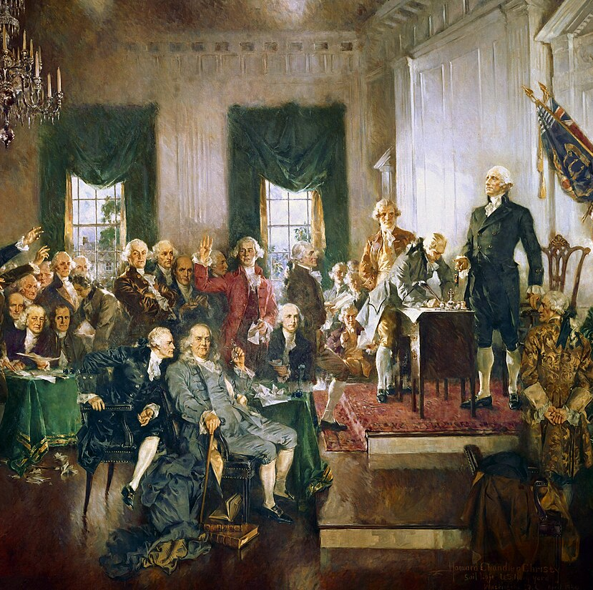
The Constitutional Convention
May 25-September 17, 1787
Philadelphia, Pennsylvania
55 Delegates – including George Washington, Benjamin Franklin, James Madison, and Alexander Hamilton
9 of the 13 states had to ratify the Constitution for it to become the law of the land which occurred in 1788.
In 1789, George Washington became the first president, and the elected congressmen and appointed judges took their seats.
Notes:
Constitutional Convention: https://www.battlefields.org/learn/articles/constitutional-convention
Who Signed and Who Did Not Sign The Constitution? https://www.battlefields.org/learn/articles/who-signed-and-who-did-not-sign-us-constitution
George Washington: https://www.battlefields.org/learn/biographies/george-Washington
Benjamin Franklin: https://www.battlefields.org/learn/biographies/benjamin-franklin
James Madison: https://www.battlefields.org/learn/biographies/james-madison
Alexander Hamilton: https://www.battlefields.org/learn/biographies/alexander-Hamilton

Slide 3
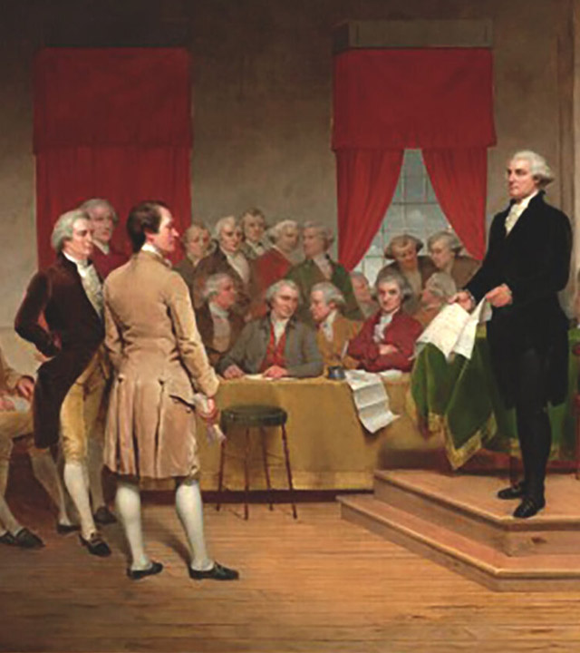
Inquiry Question:
In your opinion, what are the two most significant amendments to the Constitution of the United States?
Why? (Support your answer)
Notes:
An inquiry question to use in this lesson plan.

Slide 4
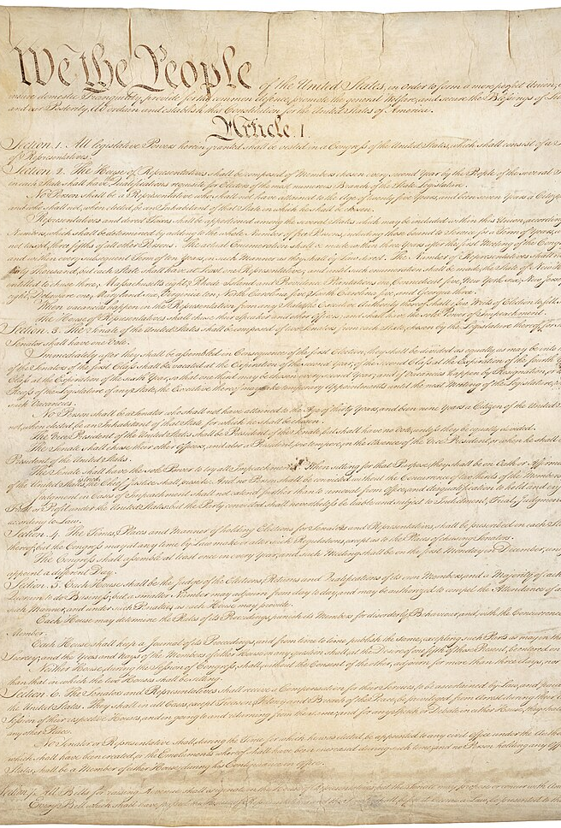
The Constitution’s Articles
Article I – Legislature
Article II – Executive
Article III – Judicial
Article IV – States and Federal Government
Article V – Amending the Constitution
Article VI – Laws/Treaties, No Religious Tests To Hold Government office, New Government Responsible For Debts Incurred Under The Articles of Confederation.
Article VII – Ratification of the Constitution
Notes:
The Constitution of the United States: https://www.battlefields.org/learn/primary-sources/constitution-united-states

Slide 5
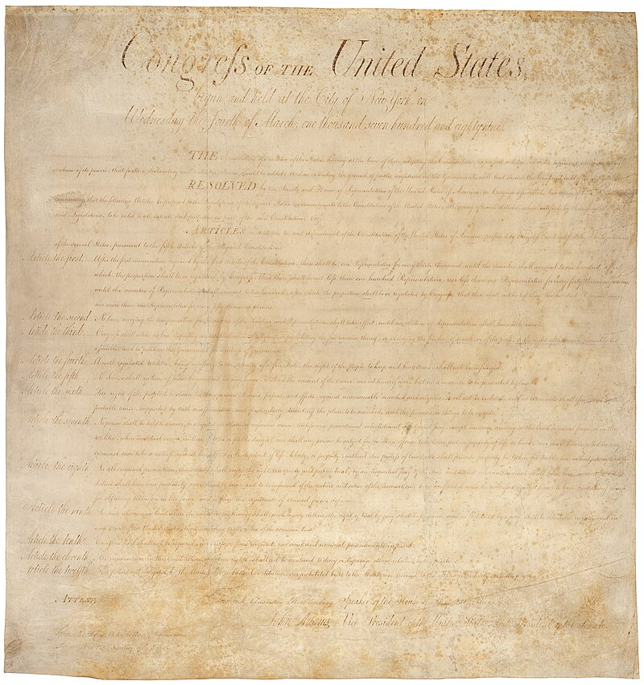
The Bill of Rights: Proposal to Ratification
Many delegates at the Constitutional Convention worried that the Constitution did not sufficiently protect the freedoms of individuals in the United States.
Amendments began to be proposed and the idea of a national “Bill of Rights” formed.
During the ratification process, some states agreed to ratify the Constitution ONLY if a Bill of Rights was added to protect the liberties and rights of individuals; two states refused to ratify until after a Bill of Rights was added.
James Madison created the first drafts of the first amendments to the Constitution, which became the Bill of Rights.
The newly-seated Congress revised and debated the Constitutional amendments, eventually settling on 10 which became the Bill of Rights.
By 1791, enough states had ratified these amendments, and they were added to the Constitution.
Notes:
Learn more: https://www.battlefields.org/learn/articles/bill-rights
Madison’s amendments were given to a committee on June 8, 1789 to discuss and edit before they were presented to Congress as a whole. In that committee, Madison’s original list was heavily edited. The preamble was largely scratched and his changes were edited until they encompassed seventeen amendments that the committee recommended being affixed to the end of the document. On July 21, 1789, these changes were presented to Congress to be examined, discussed, and edited. After months of discussion, and rewriting, Congress sent twelve amendments to be ratified by the States. Two years later, ten of the twelve amendments had enough states to be ratified nationally.

Slide 6
The Bill of Rights
Notes:
The video is embedded in the slide, but here's a link: https://www.battlefields.org/learn/videos/untold/bill-rights

Slide 7
The Bill of Rights
First Amendment: Protects freedom of religion, freedom of speech, freedom of the press, the right to peaceably assemble and the right to petition the Government.
Second Amendment: Protects the right to “keep and bear Arms.”
Third Amendment: No soldiers quartered in private homes without the consent of the home’s owner.
Fourth Amendment: Protects against unreasonable searches and seizures.
Fifth Amendment: Protects against double-jeopardy and self-incrimination and guarantees rights to due process, a grand jury, and compensation for seizure of private property.
Sixth Amendment: Establishes and protects numerous rights of the defendant in a criminal trial.
Seventh Amendment: Guarantees jury trials in federal civil cases
Eighth Amendment: Protects from excessive bail and fines and from “cruel and unusual punishments.”
Ninth Amendment: Protects fundamental rights, even if they are not listed in the Constitution or Bill or Rights.
Tenth Amendment: Reinforces the separation of power between the states and the federal government, stating that powers not granted to the federal government in the Constitution are reserved for the states or the people.

Slide 8
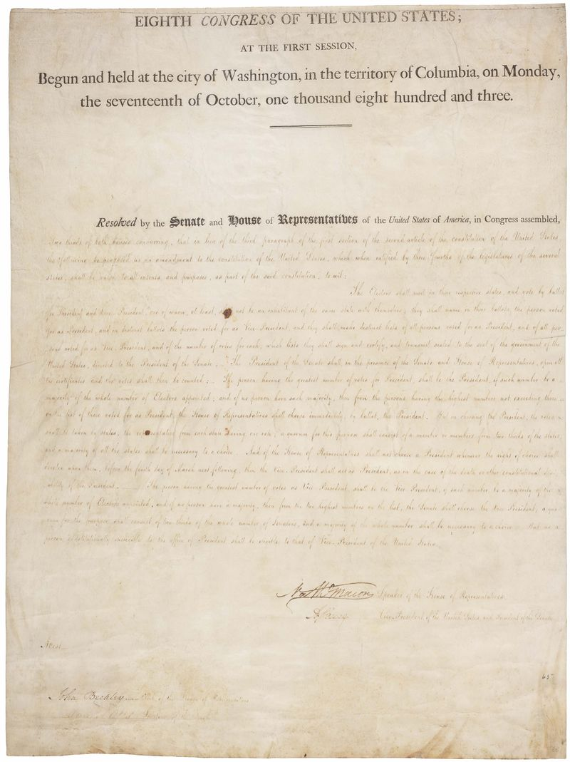
“The Forgotten Amendments”
What about the 11th and 12th Amendments? They sometimes get forgotten between the Bill of Rights and the Reconstruction Amendments!
11th Amendment: (1795) Limits the ability of individuals to bring a lawsuit in federal court against states that they are not residents/citizens of.
12th Amendment: (1804) Revised the operations of the Electoral College and how the President and Vice President are elected; it was added to the Constitution to prevent the president and vice president being elected from different parties which had caused previous political turmoil in the Elections of 1796 and 1800.
Notes:
Learn more: https://www.battlefields.org/learn/articles/forgotten-amendments
The 11th and 12th Amendments—while overshadowed by the Bill of Rights which preceded them and the Reconstruction Amendments that came afterward—still play a vital role in America’s constitutional order. Neither amendment made any sweeping changes. Instead, they made minor adjustments. These changes helped make the Constitution “more perfect,” in the same way that its original signers hoped to create a “more perfect” union.

Slide 9
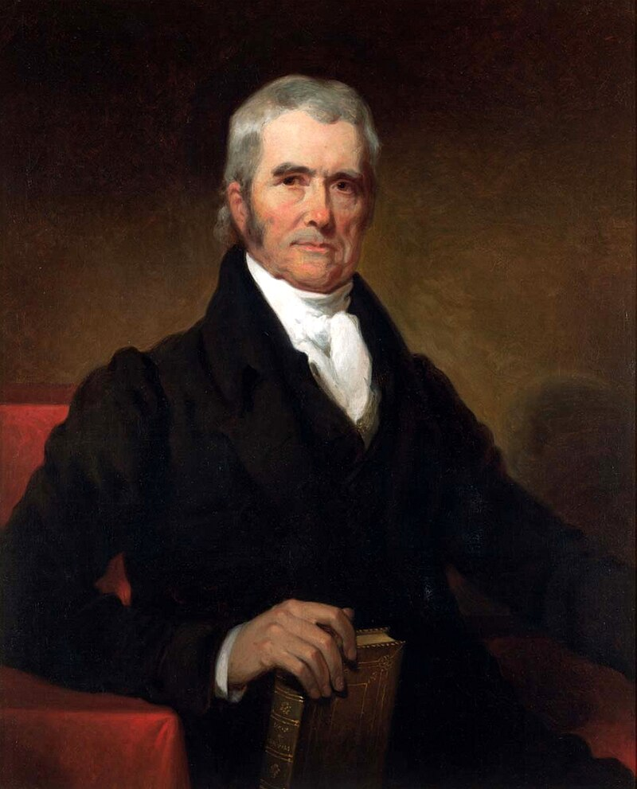
Interpreting the Constitution
The case Marbury v. Madison set a precedent for the Supreme Court to declare a law unconstitutional and established precedent for judicial review.
John Marshall, the 4th Chief Justice of the Supreme Court, expanded the court’s influence and power by interpreting the Constitution.
Marshall expansion of the Supreme Court’s power allowed the court to be a more significant part of the “checks and balances” of the federal government, but his precedent received both criticisms and praise in the early 19th Century.
Marshall’s precedents for judicial review and the Supreme Court’s role in interpreting the Constitution continues to be debated to this day.
Notes:
(Image is a painting of John Marshall)
Learn more:
John Marshall: https://www.battlefields.org/learn/biographies/john-marshall
Marbury v. Madison: https://www.battlefields.org/learn/articles/marbury-v-madison
The Marshall Court: https://www.battlefields.org/learn/articles/marshall-court

Slide 10
The Supreme Court: Gatekeeper of the Constitution
Notes:
The video is embedded in the slide, but here's a link: https://www.battlefields.org/learn/videos/untold/supreme-court-gatekeeper-constitution

Slide 11
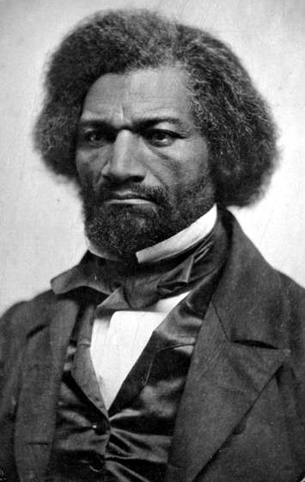
Slavery and The Constitution
When the Constitution was ratified in 1788, slavery existed in the United States.
Delegates at the Constitutional Convention declined to abolish slavery at that time, though some spoke out against it. They made compromises about population representation (Three-Fifths Compromise), the continuation of the Transatlantic Slave Trade into the United States until 1808, Fugitive Slave Laws and suppression of enslaved peoples’ revolts.
During the early 19th Century, the Abolition Movement grew in the United States—even supported by some of the Founding Fathers.
In 1818, Arthur Livermore introduced a proposal to House of Representatives to abolish slavery by a new Constitutional amendment; John Quincy Adams brought the same proposal in 1839, but both efforts failed to gain congressional support.
Among the abolitionists, Frederick Douglass, who had been formerly enslaved, spoke boldly, challenging whether the Constitution—as it was written—protected slavery and advocating for an amendment to the Constitution that would end the practice.
Notes:
(Image: 1850s photograph of Frederick Douglass)
Read more:
Slavery and the Constitution: https://www.battlefields.org/learn/articles/slavery-and-constitution
Frederick Douglass: https://www.battlefields.org/learn/biographies/frederick-douglass
Even as they compromised on issues surrounding slavery and declined to outlaw the practice during the Constitutional Convention, delegates recognized that they were not dealing with slavery and letting the moral issue fester and grow. George Mason, who enslaved people on his Virginia land, denounced slavery at the convention, saying, "Every master of slaves is born a petty tyrant. They bring the judgment of heaven on a country." Decades of suffering for enslaved men, women and children and decades of political power struggles among white politicians would culminate in a bloody Civil War. When the Civil War ended, a new amendment was ratified and added to the Constitution of the United States: "Neither slavery nor involuntary servitude, except as a punishment for crime whereof the party shall have been duly convicted, shall exist within the United States, or any place subject to their jurisdiction." But in 1787, that was still 78 years in the future.

Slide 12
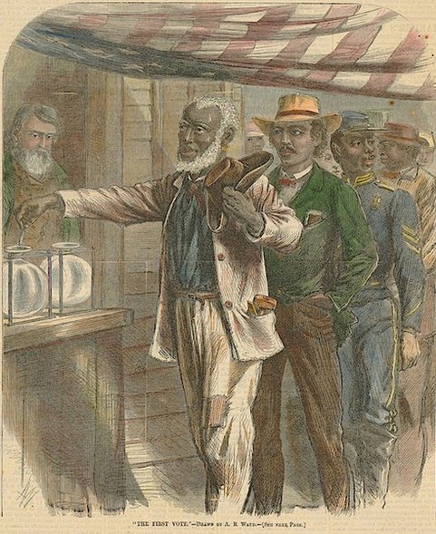
The Reconstruction Amendments
After the American Civil War and during the Reconstruction Era, three amendments to the Constitution were ratified.
13th Amendment: (1865) Abolished slavery within the United States.
14th Amendment: (1868) Addresses and protects citizenship rights and equal protection under the law.
15th Amendment: (1870) Guaranteed African American men the right to vote.

Slide 13
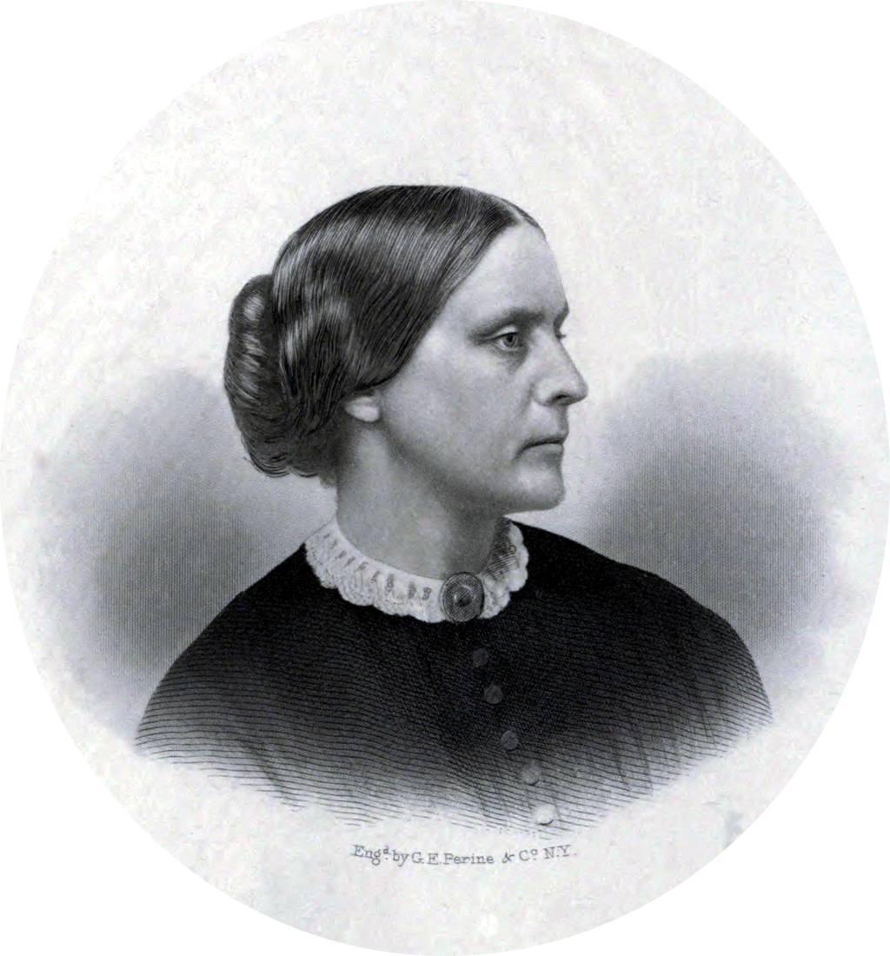
Women’s Suffrage
While aspect of the Constitution and Bill of Rights protected women, their rights were still limited, and voting was not allowed.
During the 19th Century, the women’s suffrage movement grew, advocating for the right to vote.
Susan B. Anthony and Elizabeth Cady Stanton were among the national leaders of the Women’s Suffrage movement in the 19th Century.
In 1920, the 19th Amendment to the Constitution gave women the right to vote.
Notes:
(Image: Susan B. Anthony)
Learn more:
Women and the Constitutional Convention: https://www.battlefields.org/learn/articles/women-and-constitutional-convention
Susan B. Anthony: https://www.battlefields.org/learn/biographies/susan-b-anthony
Elizabeth Cady Stanton: https://www.battlefields.org/learn/biographies/elizabeth-cady-Stanton
With the brief exception in New Jersey—from 1776 to 1807—women were not allowed to vote. The concept of household voting allowed for the men to vote and “represent” the views of his family. This system of voting stemmed from English political theory and the laws of Coverture which “denied a married woman a separate legal status from her husband, thereby preventing her from voting.”
In the late 19th Century, some states allowed women to vote in state elections. It was not until the ratification of the 19th Amendment to the U.S. Constitution in 1920 that women could cast ballots in all elections.
During 1787, some women had hopes that they would be directly included in the United States new government either immediately or in the near future. Instead, it would take decades for women to gain the right to vote. Still, women influenced the framing of the Constitution and language was included in the final document that—while it did not allow them to actively participate—did not shut women out of citizenship and future discussions of what they should, could and would look like.

Slide 14
Other Amendments
16th Amendment: (1913) Allows Congress to levy an income tax.
17th Amendment: (1913) Allows Senators to be directly elected, instead of being elected by state legislatures.
18th Amendment: (1919) Prohibited alcohol in the United States.
20th Amendment: (1933) Clarifies the inauguration timing of a president and reduced the “lame duck” period.
21st Amendment: (1933) Repealed the 18th Amendment.
22nd Amendment: (1951) Limits a president to two terms in office.
23rd Amendment: (1961) Allows the District of Columbia to vote in the Electoral College.
24th Amendment: (1964) Abolished poll taxes.
25th Amendment: (1967) Clarifies presidential succession in case of death or disability.
26th Amendment: (1971) Established a national standard minimum age of 18 for voting in state and federal elections.
27th Amendment: (1992) Regulates that any new law to increase or decrease the salaries of Congressional members will only take effect after the next election of the House of Representatives.
Notes:
Since the Bill of Rights was ratified, seventeen more amendments have been approved and added to the Constitution. Such as the Reconstruction Amendments that were added following the American Civil War that granted African-Americans citizenship and the right to vote. These Bill of Rights, and the discussions surrounding, gave Americans innate individual rights established by Congress and the ability to codify more as the United States changes and grows over time.

