Slide 1
Expanding The Nation
The American Battlefield Trust

Slide 2
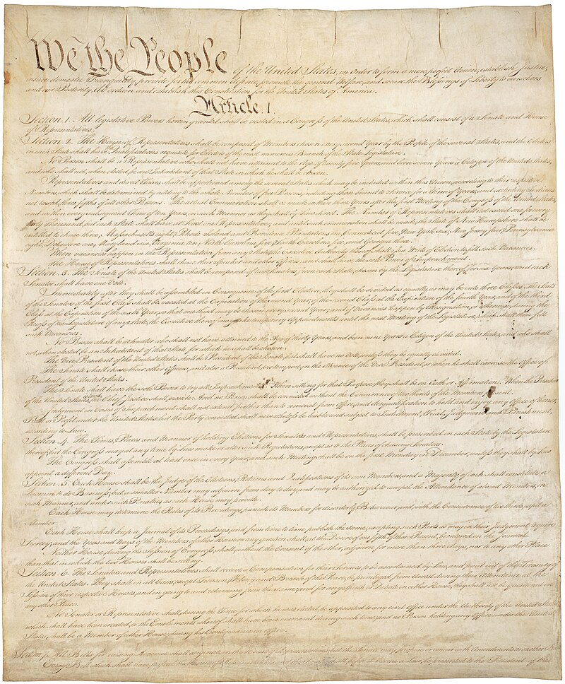
The First 12 Years
Constitutional Convention (1787)
Constitution Ratified (1788)
George Washington’s Presidency (1789-1797)
John Adams’ Presidency (1797-1801)
Notes:
The Constitution of the United States: https://www.battlefields.org/learn/primary-sources/constitution-united-states

Slide 3
Inquiry Question:
Preamble of the Constitution begins with the phrase “We The People.”
How the did the events and debates of the Constitutional Convention reflect or challenge this phrase?
Notes:
An inquiry question to use in this lesson plan.

Slide 4
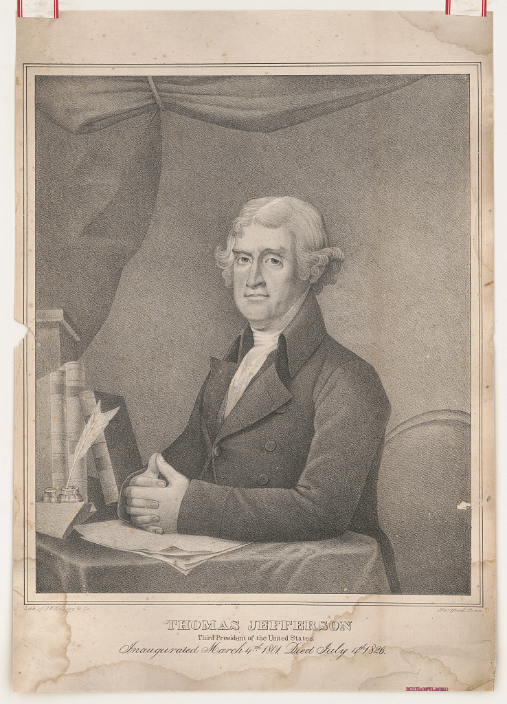
The Democratic-Republican Party
Tracing its roots to the Anti-Federalists from the debates over ratifying the Constitution, the Democratic-Republican Party formed in the early 1790s under the leadership of Thomas Jefferson and James Madison.
Supporters of the Democratic-Republican Party’s preferences and policies were mostly farmers—people from the South and those settling lands to the west.
The party advocated for individual liberties, separation of church and state, freedom of religion, free markets and free trade, agrarian society, and republicanism and decentralization in government.
Democratic-Republicans had strong stances on foreign policy, especially in the party’s early years; they sympathized with the French Revolution and were consistently hostile toward Great Britian.
Notes:
Learn more:
The Jeffersonian Party: https://www.battlefields.org/learn/articles/jeffersonian-party
The Rise of Political Parties: https://www.battlefields.org/learn/articles/rise-political-parties
Furthermore, Jeffersonians were innately skeptical at the government’s ability to protect individual freedoms. Members of this party called upon the citizenry to openly act as a ‘check’ on the national government. Thomas Jefferson, specifically, believed one of these ‘checks’ to be voting. Thus, Jefferson and his party advocated voting to the masses and invented new ways of increasing voter mobilization which increased turnout. Additionally, Jeffersonians saw the Federalists as corrupt and called on the American people to resist corruption of the government by any means necessary as part of their duty as American citizens. The possibility of corruption worried the Jeffersonians so much that the party objected to a national religion and wanted increased separation between church and state in order to prevent governmental manipulation in religion.

Slide 5
Decline of the Federalist Party

Slide 6
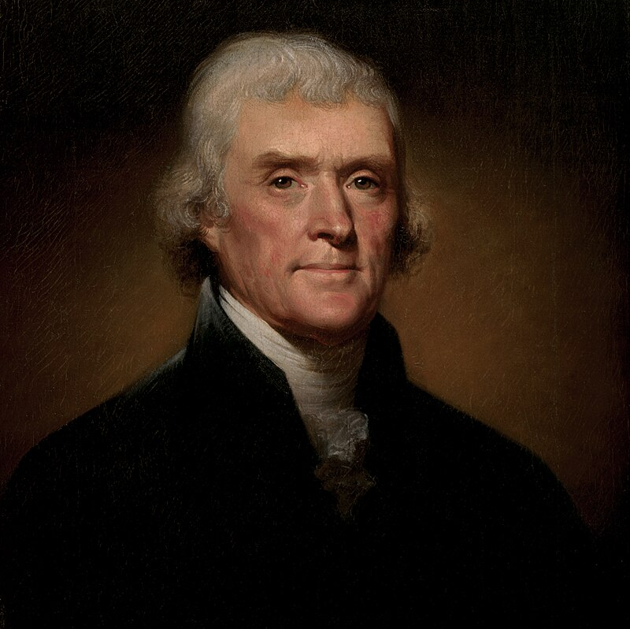
Thomas Jefferson
Born 1743, Died 1826
Third President of the United States
Prior to presidency, Jefferson had drafted the Declaration of Independence, served as a diplomat to France, held office of Secretary of State in Washington’s Administration and was Vice President in Adams’ Administration.
A leader of the Anti-Federalists/Democratic-Republican Party
The first president elected from the Democratic-Republican Party.
Notes:
Thomas Jefferson: https://www.battlefields.org/learn/biographies/thomas-Jefferson
During the election of 1800 Jefferson again ran for president. However, the public discourse was much different in this election. Federalists attacked Jefferson's character—explicitly targeting Jefferson's religion. Federalists argued that Jefferson's support for religious freedom came from a lack of faith within Jefferson. Republicans argued the opposite, that Jefferson knew that "coercion never will be of service to Christianity." Jefferson's support of religious freedom also garnered him the votes of Catholics, Baptists, Jews, and other religious minorities. Vice President Jefferson won the presidential election of 1800 73 electoral votes to 65 electoral votes. After twelve years of Federalist governance, the United States had its first democratic “revolution,” peacefully shifting power to the Democratic-Republicans.

Slide 7
Jefferson’s Administration
1 Term as President (1797-1801)
XYZ Affair
Established the Department of the Navy
Alien and Sedition Acts
Response to the unpopular Alien and Sedition Acts included the Virginia and Kentucky Resolutions
Quasi-War
Splintering of the Federalist Party
Moving the federal capital to Washington City (Washington D.C.)
Lost the Election of 1800
Notes:
Thomas Jefferson: https://www.battlefields.org/learn/biographies/thomas-Jefferson
Jefferson’s eight years as president saw successes but often at the cost of his Republican ideology. During Jefferson's first term he promised a Republican government, ensuring a free and democratic society. A major way Jefferson sought to impose his vision of policy on the United States was by lowering the national debt while also repealing excise taxes greatly. Jefferson described his budget as, “rigorously frugal and simple.” Through this rigorously frugal and simple budget, Jefferson shrunk the federal debt from 83 million dollars in 1801 to 57 million dollars in 1809.
However, Jefferson's actions did not always align with his ideology. In 1803 Jefferson sent James Monroe to purchase the Louisiana Territory from Napoleon. Monroe’s mission succeeded with the Louisiana purchase, purchasing 828,000 square miles for only 15 million dollars. Jefferson realized this move would be hypocritical—there was no provision in the constitution for land acquisition. Jefferson attempted to make an amendment to the constitution allowing the purchase, however, Napoleon threatened to pull out of the deal if not done expeditiously. Jefferson made the deal immediately and without clear Constitutional authority to do so. Jefferson long criticized the Federalists for their loose interpretation of the constitution, but for the largest success of his presidency, Jefferson had to stray from his strict interpretation of the constitution. Jefferson would send explorers Meriweather Lewis and William Clark to map and explore the new territory in 1804.

Slide 8
The Louisiana Purchase
The Judicial Branch expands power to check and balance

Slide 9
The Election of 1808

Slide 10
Notes:
Learn more at www.battlefields.org

