Slide 1
1775 Perspectives: Riding on the Eve of Revolution
A Revolutionary War Lesson Plan

Slide 2
Paul Revere’s Ride in 4 Minutes
Notes:
YouTube Video Link: https://youtu.be/h7ug7Zny_yo?si=i2JroCqNEBztMkY_
Website Video Link: https://www.battlefields.org/learn/videos/paul-reveres-ride

Slide 3
Map of the Revere, Dawes and Prescott’s Routes
Notes:
Print copies and examine this map: https://www.battlefields.org/media/document/38397

Slide 4
Night: April 18, 1775
700 British soldiers left Boston, Massachusetts with orders to march to Concord and capture weapons stored there.
2 American messengers left Boston to alert the militia and minutemen along the road to Concord; their news sent other messengers to other villages to rally more distant communities.
Notes:
Extra Resources:
The Sons of Liberty in Boston believed when British General Thomas Gage ordered the Regulars out towards Lexington that their mission was the capture of Samuel Adams and John Hancock. Adams and Hancock were seen as the leaders of Massachusetts colonial resistance. Adams, the passionate orator, and Hancock the financier worked together for a common goal. Many believed the King wanted both men captured and ordered Gage to capture them. Both men were in staying in Lexington on April 19, 1775, at the Hancock-Clarke House (Hancock himself had lived here briefly as a child). Gage’s mission for his Regulars was not the capture of the two Patriot leaders, but the weapons, supplies and cannons being stored in Concord by the Massachusetts Provincial Congress. The fact the road to Concord from Boston that Regulars took went through Lexington had nothing to do with the presence of Adams or Hancock.

Slide 5
Boston
1630 – Boston founded
The city was nearly surrounded by water and building projects had not yet added to the land which allowed the city to expand.
By the mid-1700’s Boston was one of the most prosperous and busy seaports in the British colonies in North America.
Boston became a center of resistance to British taxes, leading to confrontations like the Boston Massacre (1770) and Boston Tea Party (1773).
The Sons of Liberty advocated and protested for “no taxation without representation,” and British authorities considered this group the ringleaders of trouble in Boston.
Following the Boston Tea Party, the port was closed to commerce, and more British soldiers arrived to try to keep order.
Notes:
Learn more:
Boston Massacre: https://www.battlefields.org/learn/articles/boston-massacre
Boston Tea Party: https://www.battlefields.org/learn/topics/boston-tea-party
The British Army in Boston: https://www.battlefields.org/learn/articles/british-army-boston
Who were the Sons of Liberty?: https://www.battlefields.org/learn/articles/who-were-sons-liberty

Slide 6
The British
General Thomas Gage commanded British troops in North America in spring 1775, and he gave orders for the expedition to Concord to seize weapons.
Colonel Francis Smith (pictured) commanded the 700 British soldiers who left Boston and headed for Concord.
British Patrols watched the roads to Concord, trying to catch messengers and keep the road open for Smith’s column of soldiers.
Notes:
Extra Resources:
Thomas Gage: https://www.battlefields.org/learn/biographies/thomas-gage
Francis Smith: https://www.battlefields.org/learn/biographies/francis-smith
The British Army during the American Revolution: https://www.battlefields.org/learn/articles/british-army-american-revolution
The events of April 19, 1775 were a culmination of many altercations between local militia and British Regular soldiers. On December 14 and 15, 1774, militia from Portsmouth, New Hampshire attacked Fort William and Mary. The British fort was undermanned (less than ten soldiers) but would not surrender to the militia force of nearly 300 men. Fighting ensued and one British soldier was wounded, the garrison surrendered and over the two days gunpowder, firearms and 16 cannon were captured. Though shots were exchanged from colonial militia and British Regulars, it did not lead to war.

Slide 7
Militia & Minutemen
Militia units served as the backbone of protection in the colonies. They created a community bond that connected many far-flung neighbors. Most militias would muster and train in town and county centers, usually on court days. The events tended to have the air of a county festival, where entire communities came out to witness the drill and then host festivities afterward. Militias were the main colonial military organization for defense, but they were only part-time.
Minuteman companies were officially created by the Massachusetts Provincial Congress in October 1774 to be the best soldiers of each militia company. They regularly trained, and some were paid. They were to respond, “at a minute’s notice.”
The messengers on April 18, 1775, were getting the news to community leaders and militia officers and thousands of militiamen to respond to the British expedition.
Notes:
Extra Resources:
Militia, Minutemen, and Continentals: The American Military Force in the American Revolution: https://www.battlefields.org/learn/articles/militia-minutemen-and-continentals-american-military-force-american-revolution
Captain John Parker: https://www.battlefields.org/learn/biographies/john-parker
Colonel James Barrett: https://www.battlefields.org/learn/biographies/james-barrett
As events around Boston became more tense, many communities in Massachusetts began to create more elite companies of minutemen. Militias mostly trained on a seasonal basis, but minutemen companies were established to provide more regular training (sometimes weekly) of the best men in the militia. They were expected to respond quickly to danger at a “minute’s notice.” Some of the first minutemen companies were created in Worcester, Massachusetts, in September 1774. Soon, the Massachusetts Provincial Congress adopted this organizational structure for all Massachusetts militia units in October that same year. Other New England colonies began to do the same. Some of these units were in action on April 19, 1775, but contrary to popular thought, most of the colonial units that responded that day were not minutemen companies, but regular militia.

Slide 8
Spies & Information
Both British and Americans had spies and a network of communication in Boston and the surrounding countryside.
On April 18, 1775, Dr. Joseph Warren (pictured) confirmed that British soldiers were expected to march to Concord. He instructed Paul Revere and William Dawes (both Sons of Liberty) to take the news to Concord and alert the villages along the way.
Notes:
Extra Resources:
Joseph Warren: https://www.battlefields.org/learn/biographies/joseph-warren

Slide 9
Old North Church
A signal had been arranged to be shown from the steeple of Christ Church (Old North Church) in Boston to alert Charlestown.
One light would be shown if the British were leaving Boston by land and two lights if leaving crossing the Charles River.
This signal ensured that if Revere and Dawes could not leave British-guarded Boston the news of the British movements would still be known.
In the early evening of April 18, 1775, Paul Revere told Robert Newman to show two lanterns from the window of Old North Church.
A historic print depicting Old North’s first steeple. (Boston Public Library, Print Department)
Notes:
Extra Resources:
Robert Newman: https://www.battlefields.org/learn/biographies/robert-newman
Old North Church: https://www.battlefields.org/learn/articles/old-north-church
In the tallest church steeple in Boston, on the night of April 18, 1775, the sexton, Robert Newman, and Captain John Pulling, Jr. each carried a lantern up to the belltower. “One if by land, and two if by sea” reads the famous poem “Paul Revere’s Ride” penned by Henry Wadsworth Longfellow in 1860, and indeed two lanterns hung from the steeple that night to signal that the British had crossed the Charles River and began moving on the Massachusetts countryside by "sea". This alerted lookouts in Charlestown to the British approach, but both lanterns hung for less than a minute combined. Nevertheless, the warning paid off, and with the ensuing rides of Paul Revere and William Dawes patriot militia and minutemen across the countryside knew that British infantry and marines were rowing across the Charles River to begin their early morning foray.

Slide 10
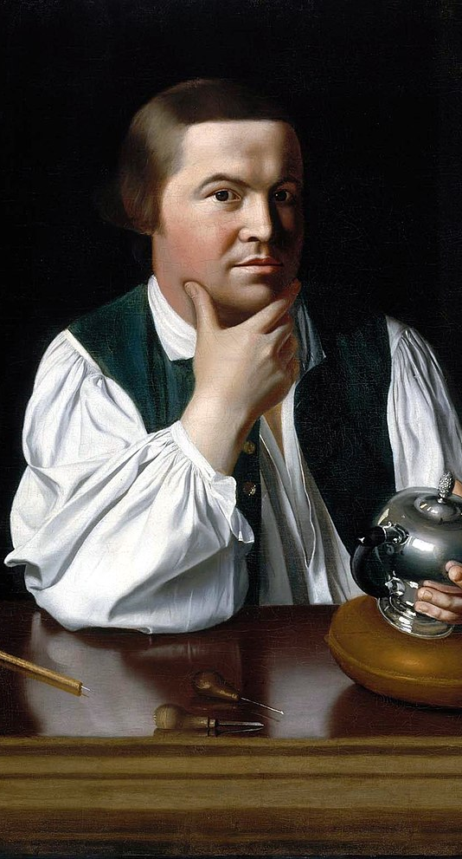
Paul Revere & William Dawes
Paul Revere (left) was a silversmith and active member and messenger of the Sons of Liberty. He had previously carried messages and news into the countryside and even to the First Continental Congress in Philadelphia.
William Dawes was a tanner and militia officer, also active in the Sons of Liberty. He had previously used disguises and talented acting to get past British guards.
Notes:
Learn more:
Paul Revere: https://www.battlefields.org/learn/biographies/paul-revere
William Dawes: https://www.battlefields.org/learn/biographies/william-dawes

Slide 11
News to Lexington!
Revere left Boston by crossing the Charles River where friends met him with a horse for his ride to Concord.
Dawes left Boston by land, passing British sentries at the Boston Neck. He rode through Roxbury and Cambridge, heading for Concord.
Revere and Dawes arrived in the village of Lexington about the same time, waking the militia leaders and telling Sons of Liberty Samuel Adams and John Hancock to seek another place of safety.
Notes:
Upon reaching the Charlestown shore, Revere mounted and began his ride to Lexington. Passing through the towns of Somerville, Medford, and Menotomy (Arlington), Revere did not yell “the British are coming!”, instead accounts show that Revere passed the message of “the Regulars are coming out.”
Revere and Dawes met at the town of Menotomy and continued to Lexington to warn Adams and Hancock. After bundling Hancock and Adams out of Lexington, and narrowly missing the vanguard of the British column and its rendezvous with destiny on Lexington Green, Revere and Dawes decided to ride on to Concord. On their way they encountered a young doctor, Samuel Prescott, on his way home to Concord.

Slide 12
Heading to Concord
Since the British were heading to Concord, Revere and Dawes left Lexington and continued west, continuing to stop at roadside farmhouses with the news.
Did you know??? The riders called “the Regulars are coming out,” referring to the British soldiers.
A third rider—Dr. Samuel Prescott—joined Revere and Dawes beyond Lexington. He offered to go with them since the militia officers knew him and would not doubt his word.
Notes:
Learn more:
Samuel Prescott: https://www.battlefields.org/learn/biographies/samuel-prescott
The phrase “the British are coming,” would have been confusing to locals, who still considered themselves British. Everyone knew what “the Regulars are coming out” meant, and as Revere passed through, more alarm riders rode out, signal guns fired, church bells rang, all alerting the countryside to the coming threat. As the alarm spread, Minutemen grabbed their weapons and headed for town greens, followed by the rest of the Militia.

Slide 13
Captured! Escaped! Ride On!
British soldiers patrolling the road ordered the trio of horsemen to halt.
Paul Revere was captured.
William Dawes escaped but lost his horse.
Samuel Prescott escaped, riding cross-country to get to Concord.
Notes:
Revere and Dawes met at the town of Menotomy and continued to Lexington to warn Adams and Hancock. After bundling Hancock and Adams out of Lexington, and narrowly missing the vanguard of the British column and its rendezvous with destiny on Lexington Green, Revere and Dawes decided to ride on to Concord. On their way they encountered a young doctor, Samuel Prescott, on his way home to Concord.
Revere’s famous ride ended on the outskirts of Lincoln when he, Dawes, and Prescott ran into a British patrol. While Dawes and Prescott escaped, Revere was captured, playing no further role in the events of April 19. Prescott managed to make it home to Concord, however, and alerted the town. When the British arrived, the men of Concord, Acton, Bedford, and Lincoln were waiting.

Slide 14
Ready…Revolution!
Paul Revere, William Dawes and Samuel Prescott carried the news of the British advance to Concord.
Other messengers took the news to other villages, rallying more militia units.
The midnight messengers completed their mission. The militia had been summoned to meet the British Regulars.
At Lexington, Captain Parker’s militia waited.
At Concord, Colonel Barrett gathered his troops.
Later on April 19, 1775, the first shots of the American Revolution would be fired—probably by accident—at Lexington and Concord.
Notes:
Learn More:
When he arrived in Concord, Prescott ordered the church bell to be rung to awaken and gather the local militia more quickly. He also sent other riders—including his brother—to further communities, ensuring that hundreds of militiamen would gather and take part in the fighting later that day.
The Lexington militiamen that filed onto the Lexington Green the morning of April 19, 1775, were there as a show of force, to remind British authorities that the colonists were armed and ready to defend themselves. Much like other militia units had shadowed other British Regular excursions (most notably at Salem, Massachusetts on February 26, 1775), the Lexington militia had no intention in getting into a firefight with the Regulars. Captain John Parker proved to be a steady leader of the militia that morning, he knew it would be suicide for his 80 men to take on the 400 well-trained British Regulars. The position of Parker’s men to the side of the road to Concord show that Parker had no intention of blocking their route to Concord. Post war accounts of Parkers words that morning have been exaggerated, but his actions and primary accounts of those who were there prove that Parker had no intention of getting into a battle that morning.
One of the biggest mysteries of April 19, 1775, is who fired the first shot at Lexington. Both sides claimed the other side shot first, thus placing blame on their enemy for the bloodshed that ensued. It seems everyone interviewed after the events of April 19th had a varied answer to this question. It is obvious confusion and chaos infringed on everyone’s view of the events. There is evidence that points to either a quick trigger by one of the men on the Lexington green or a spectator firing from behind a stone wall near Buckman’s Tavern. We will never know who fired the first shot, but it was a spark that lit a world war.

Slide 15
Historical Memory
Paul Revere is one of the most iconic heroes of the American Revolution, immortalized by Henry Wadsworth Longfellow in his 1860 poem, Paul Revere’s Ride.
Longfellow was writing in a time of growing national crisis, with war clouds forming between North and South, and wrote a poem more about national unity than the true story of Paul Revere.
While Longfellow helped immortalize Revere, he also perpetuated some of the most common myths of the famous “Midnight Ride.”
Notes:
Extra Resources:
Paul Revere’s Ride: Legends, Myths and Realties: https://www.battlefields.org/learn/articles/paul-reveres-ride-legends-myths-and-realities
While Longfellow mixes myth and reality, his immortal words are still hauntingly accurate:
You know the rest. In the books you have read,
How the British Regulars fired and fled,--
How the farmers gave them ball for ball,
From behind each fence and farmyard-wall,
Chasing the red-coats down the lane,
Then crossing the fields to emerge again
Under the trees at the turn of the road,
And only pausing to fire and load.

Slide 16
Primary Sources
The Ride
Paul Revere’s Deposition, 1775
"Describing the Events that Took Place at Lexington and Concord"
Revere’s Letters
Rachel Revere’s Captured Letter
Paul Revere’s Letters to his wife and son
Memory
"Story of the Battle of Concord and Lexington and Revear’s ride Twenty Years Ago"
Notes:
View the Lesson Plan Teaching Guide for links to these Primary Sources, worksheets, and discussion suggestions.

Slide 17
Notes:
Always more FREE resources at www.battlefields.org

