Slide 1
Civil War 1864: A Virtual Reality Experience
American Battlefield Trust

Slide 2
The Civil War in 1864 New Leadership, Stalemate and Siege, the Changing Nature of Warfare, and an Election at Stake

Slide 3
The Last Three Years
Battle of Fredericksburg – December 13, 1862
Emancipation Proclamation – January 1, 1863
Battle of Chancellorsville – May 1-4, 1863
Siege of Vicksburg – May 18-July 4, 1863
Battle of Gettysburg – July 1-3, 1863
Fort Sumter – April 12, 1861
First Bull Run – July 21, 1861
Battle of Shiloh – April 5-6, 1862
Peninsula Campaign – May-June 1862
Battle of Antietam – September 17, 1862
Notes:
See Civil War: Animated Map until 16:45 for more explanation. https://www.youtube.com/watch?v=LObskCXyHK0&t=1s
Fort Sumter: https://www.battlefields.org/learn/civil-war/battles/fort-sumter
First Bull Run: https://www.battlefields.org/learn/civil-war/battles/bull-run
Battle of Shiloh: https://www.battlefields.org/learn/civil-war/battles/shiloh
Peninsula Campaign: https://www.battlefields.org/learn/articles/peninsula-campaign-0
Battle of Antietam: https://www.battlefields.org/learn/civil-war/battles/antietam
Battle of Fredericksburg: https://www.battlefields.org/learn/civil-war/battles/fredericksburg
Emancipation Proclamation: https://www.battlefields.org/learn/topics/emancipation-proclamation
Battle of Chancellorsville: https://www.battlefields.org/learn/civil-war/battles/chancellorsville
Siege of Vicksburg: https://www.battlefields.org/learn/civil-war/battles/vicksburg
Gettysburg: https://www.battlefields.org/learn/civil-war/battles/gettysburg

Slide 4
New Leadership
Lieutenant General Ulysses S. Grant
Successful in the Western Theater: Fort Donelson, Shiloh, Vicksburg, Chattanooga
Appointed commander-in-chief of all Union operations in 1864
Directly led Army of the Potomac in the field instead of from DC
More aggressive and active style of command than predecessors
Bloody but relentless Overland Campaign proved he would destroy the Confederate Army even if it "took all summer"
Notes:
The Overland Campaign: https://www.battlefields.org/learn/articles/overland-campaign
Ulysses S. Grant: https://www.battlefields.org/learn/biographies/ulysses-s-grant

Slide 5
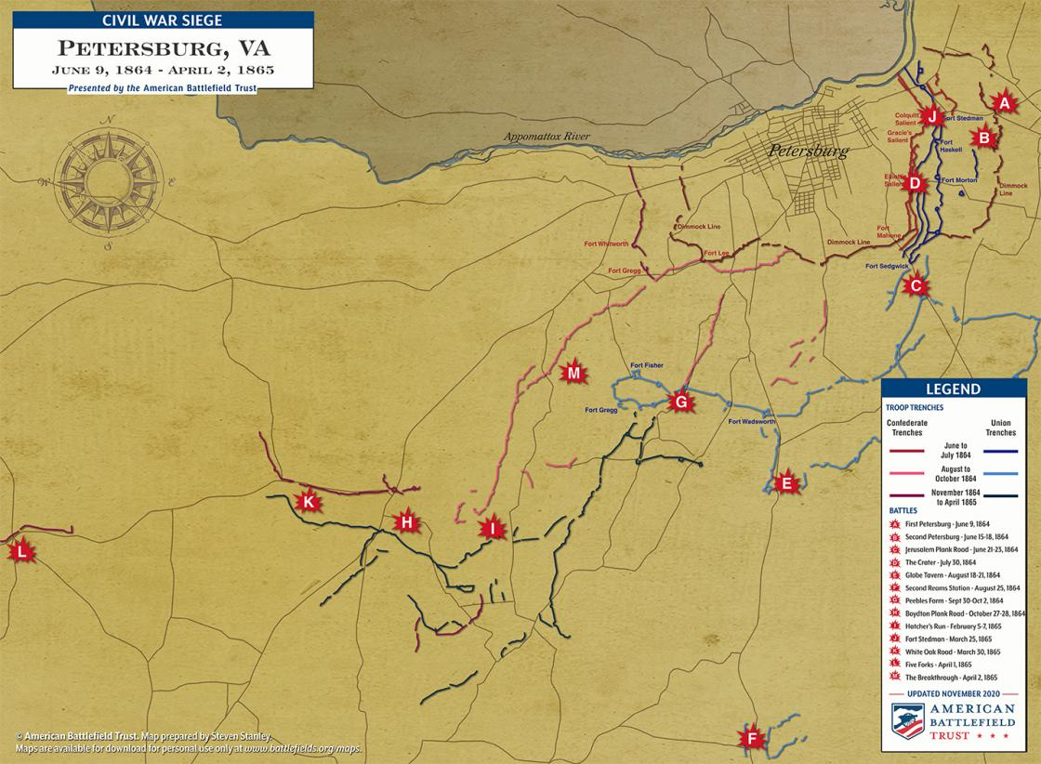
Stalemate and Siege
Petersburg
Petersburg is an important supply and communications hub.
The fall of Petersburg will lead to the fall of Richmond - the Confederate capital and seat of govt.
Assault on Petersburg (June 15-18, 1864) fails; Grant settles in for a siege.
A siege is a offensive tool used to defeat a location by surrounding, isolating, and restricting supplies.
292 day-long siege
A ring of Confederate and Union trenches form around the city, as seen on the map.
Siege: Blocking the supply lines and escape routes of a city to force it to surrender. A siege usually meant one army trapped in a city, slowly running out of food and fresh water, with the opposing army camped outside.
Notes:
General Ulysses S. Grant’s inability to capture Richmond or destroy the Confederate Army of Northern Virginia during the Overland Campaign (May 4–June 12, 1864) caused him to cast his glance toward the critical southern city of Petersburg. His strategic goals shifted from the defeat of Robert E. Lee's army in the field to eliminating the supply and communication routes to the Confederate capital at Richmond.
The city of Petersburg, 24 miles south of Richmond, was the junction point of five railroads that supplied the entire upper James River region. Capturing this important transportation hub would isolate the Confederate capital and force Gen. Robert E. Lee to either evacuate Richmond or fight the numerically superior Grant on open ground.
From June 15–18, 1864, Confederate general Beauregard and his troops, though outnumbered by the Federals, saved Petersburg from Union capture. The late appearance of Lee’s men ended the Federals’ hopes of taking the city by storm and ensured a lengthy siege. For the next nine months, Grant focused on severing Petersburg’s many wagon and rail connections to the south and west. He eventually attacked and crippled Lee’s forces, forcing the South to surrender at Appomattox on April 9, 1865.

Slide 6
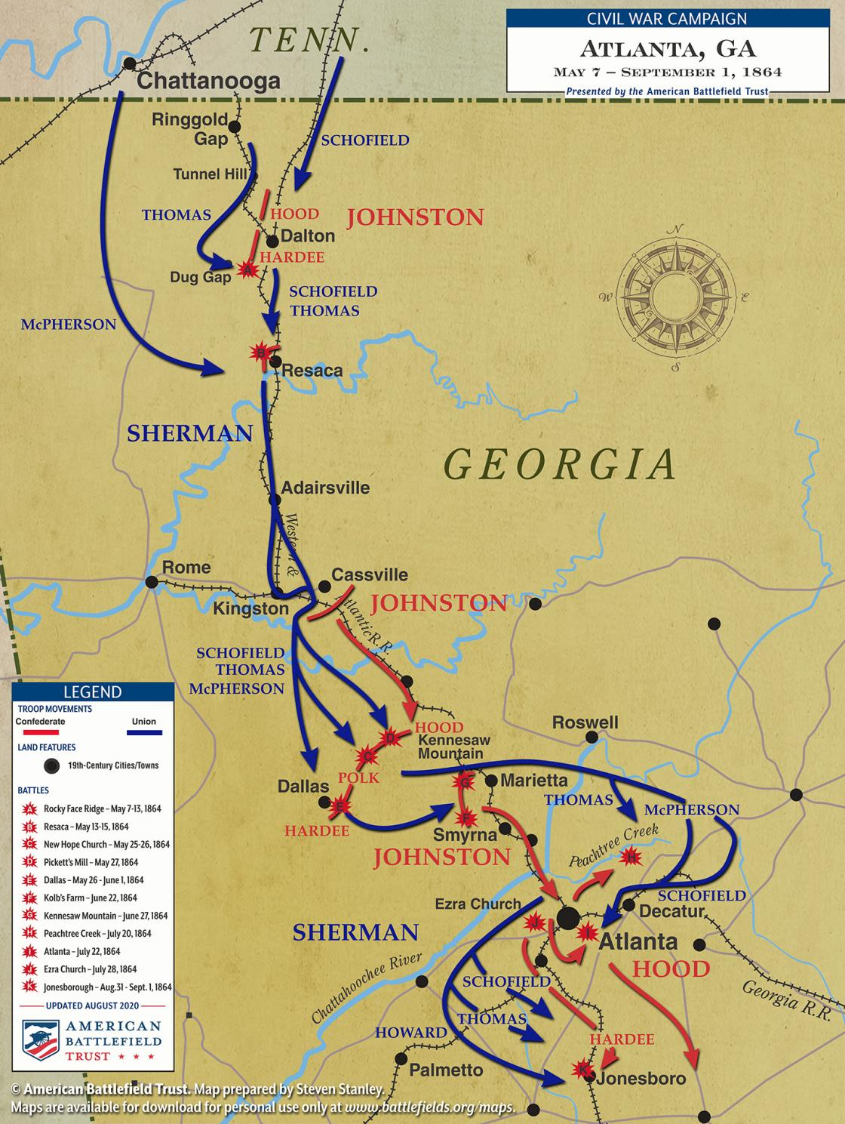
Stalemate and Siege
Atlanta
Major General William T. Sherman sent by Grant to 1. destroy Confederate General Joseph E. Johnston's army and 2. capture Atlanta in 1864
Importance - Atlanta is a huge industrial, commercial and supply center.
Sherman drives Johnston back to the outskirts
Johnston replaced by John Bell Hood, who leads more aggressive frontal assaults against Sherman that also fail
Sherman unsuccessful at directly taking the city
Siege of Atlanta throughout August
Notes:
In the spring of 1864, Lt. Gen. Ulysses S. Grant, general-in-chief of all U.S. armies, ordered five, simultaneous offensives to press Confederates all along their frontier. Grant recognized that the Confederates could not win a war of attrition, and he instilled in his commanders the need to exhaust the resources of the Rebels by destroying their armies.
Grant assigned his friend Maj. Gen. William T. Sherman to command the fifth advance against Gen. Joseph E. Johnston’s army. Johnston was charged with defending Atlanta, the largest industrial, logistical, and administrative center outside of Richmond. Atlanta was at the junction of four railroads that connected all remaining Confederate-held territory east of the Mississippi River.
By early July, Johnston had fallen back into the defenses of Atlanta. Frustrated by Johnston’s lack of aggressiveness, President Jefferson Davis replaced him with Lt. Gen. John B. Hood on July 18. Within days, Hood launched two attacks on Sherman—one at Peach Tree Creek on July 20 and the other along the Georgia Railroad (known as the Battle of Atlanta) on July 22. Both ended in defeat and led to the fall of Atlanta in September. The capture of such a valuable Confederate stronghold boosted Northern morale, helped ensure the reelection of President Abraham Lincoln in November, and precipitated the downfall of the Confederacy.

Slide 7
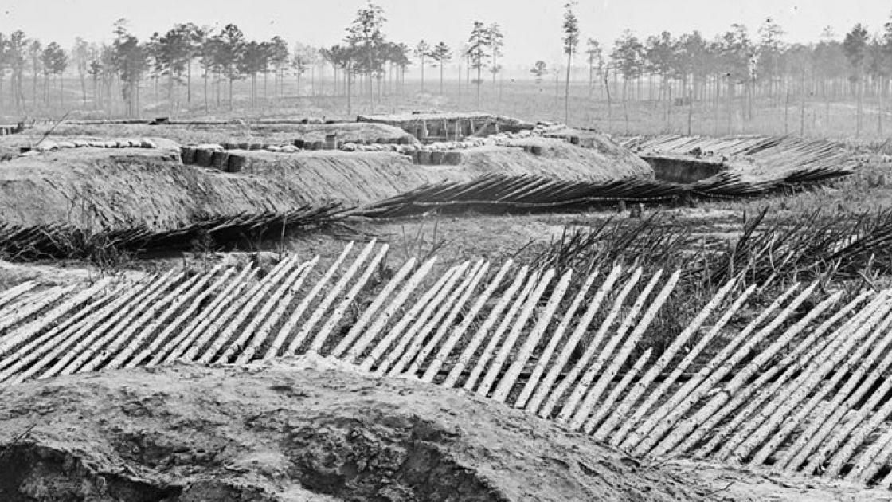
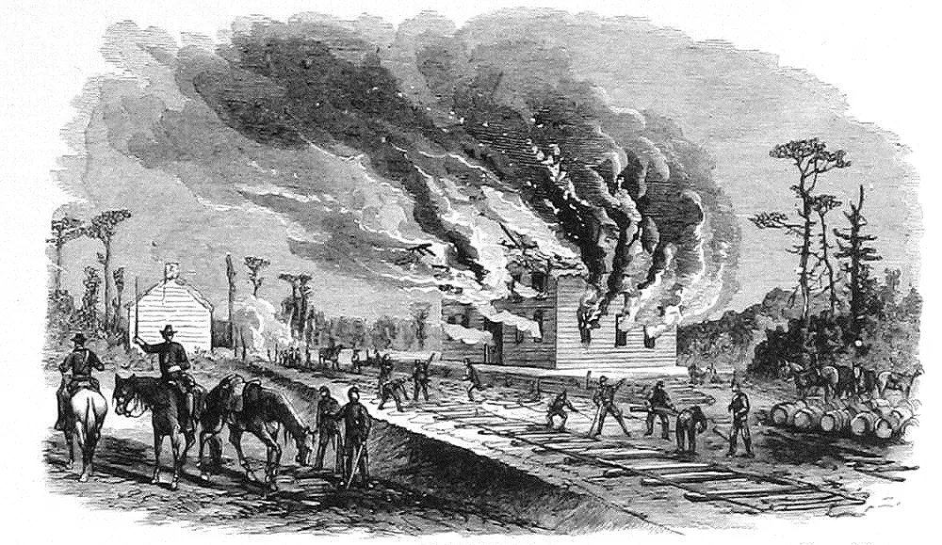
Changing Nature of Warfare
Trench Warfare
Used early in the war, but to a limited extent
Rifle pits, abatis, long interconnected systems of trenches
Petersburg front: 292 days, over 40 miles
Sieges
If directly assaulting and capturing a city was impossible
Cut off and starved out a city or garrison until they surrendered
Notable examples: Vicksburg, Atlanta, Petersburg
Total War
Citizens became increasingly affected by food and supply shortages
Civilians' property was initially off limits, but that changed the longer the war went on
Ie: Scorched Earth policy and Sherman's March to the Sea
Scale of Battles
Man-power vastly increased on the Union side
Northern armies in 1864 vastly outnumbered their armies in 1861-62
More men meant larger battles and more casualties
Notes:
Glossary of Fortification Terms: https://www.battlefields.org/learn/articles/glossary-fortification-terms

Slide 8
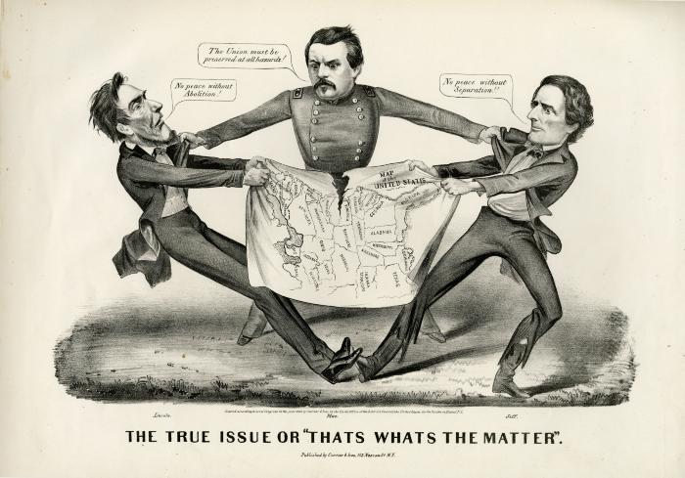
An Election at Stake
November 1864: US Presidential Election
Abraham Lincoln versus Democratic challenge George McClellan (Yes! His former general)
Platforms:
Republican: continue the war to the end, emancipation remains as a war aim
Democratic: sue for peace, rescind emancipation
Dependent upon military successes
Importance of soldiers' vote
Notes:
Video: The Election of 1864 https://www.battlefields.org/learn/videos/election-1864

Slide 9
Prepare to experience the Civil War, 1864...
In the Trenches | The Attack! | On Patrol | The Union Hospital

