Slide 1
Perspectives: The Chesapeake Campaign
The War of 1812 Curriculum

Slide 2
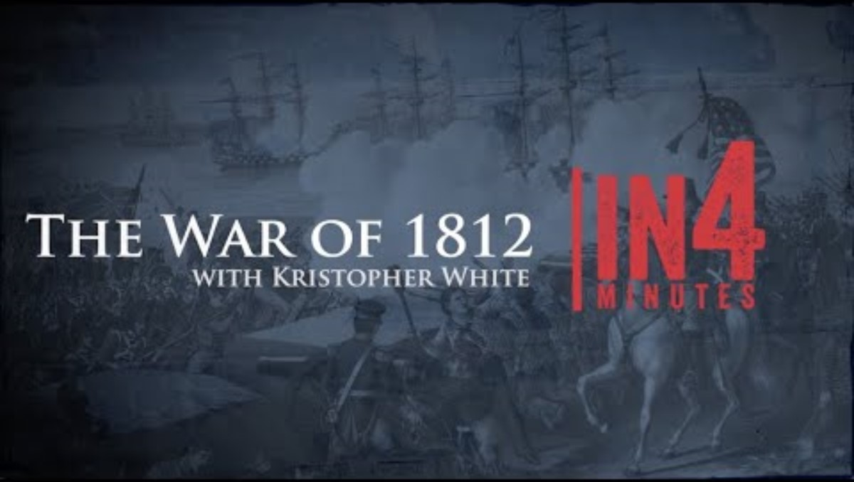
War of 1812 in 4 Minutes
Notes:
YouTube Video Link: https://youtu.be/elp6ZktpQ1c?si=ZZSlCGYmQ00qROSm
Website Video Link: https://www.battlefields.org/learn/videos/war-1812

Slide 3
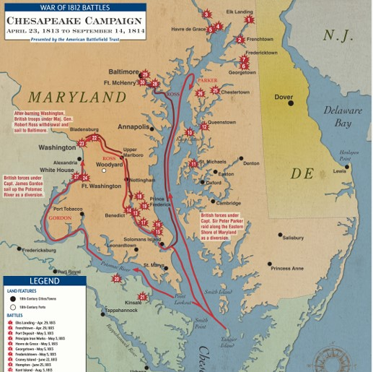
Map of the Chesapeake Campaign
Notes:
Print copies and examine this map: https://www.battlefields.org/learn/maps/chesapeake-campaign-apr-23-1813-sep-14-1814

Slide 4
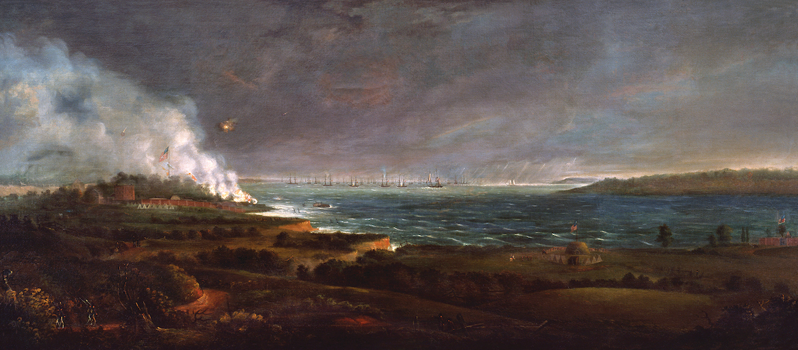
1813-1814: Chesapeake Campaign
Ships from the British navy targeted the Chesapeake Bay and the towns along the shore during 1813-1814.
By 1814, the British targeted larger cities like Washington and Baltimore, which will be the focus of this study.
Notes:
Extra Resources:
Let It Rain Militia: The Critical Battle for the Chesapeake: https://www.battlefields.org/learn/articles/let-it-rain-militia-critical-battle-chesapeake
England’s war strategy for 1814 drifted southward from the Canadian frontier to the Chesapeake Bay region. America’s largest estuary was the nation’s heart of farming, commerce, ship-building and government, making it a high prize of war. In March 1814, a British squadron arrived to enforce the admiralty’s blockade declaration of the Chesapeake and Delaware Bays, making use of extensive surveys conducted of those waterways by the Royal Navy during the Revolutionary War.
On April 28, 1814, British Vice Admiral Alexander Cochrane directed Rear Admiral Cockburn to begin a devastating naval attack on the Chesapeake.
“Their Sea Port Towns laid in Ashes & the Country wasted will be some sort of a retaliation for their savage Conduct in Canada [at York].... [I]t is ... therefore but just, that Retaliation shall be made near to the Seat of their Government from whence those Orders emanated, you may depend upon my most cordial Support in whatever you may undertake against the Enemy.” The offensive was driven by more than vengeance. The global geopolitical game had fundamentally changed. Following his disastrous 1812 Russian campaign and resounding loss at the October 1813 Battle of Leipzig, Napoleon had surrendered in Paris to the allied coalition on March 31, a capitulation so complete that the emperor was forced into exile on the isle of Elba. England found itself able to focus upon a final campaign with renewed strength to chastise the Americans into submission once and for all.
Change was palpable to the Americans as well. Former Maryland Congressman Joseph H. Nicholson wrote to U.S. Naval Secretary William Jones, “We should have to fight hereafter, not for free trade and sailor’s rights,’ not for the conquest of the Canadas, but for our national existence.”
In the summer of 1814, after 18 months of British occupation and raids against port towns, the British campaign against the American mid-Atlantic was building to a climax, with Baltimore in the cross-hairs. “The Clouds of war gather Fast and Heavy in the East,” wrote American Marine Captain George Stiles that July, “and all Hands are called.”

Slide 5
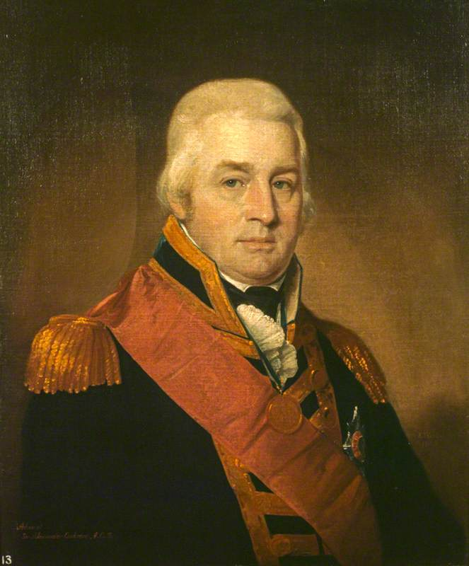
The British Fleet & Army
Admiral Alexander Cochrane (pictured) commanded part of the British fleet in the Chesapeake in 1814; he agreed to land soldiers to attack Washington and oversaw the bombardment of Fort McHenry at Baltimore.
General Robert Ross commanded British infantry during some of the inland attack.
Notes:
Extra Resources:
Admiral Alexander Cochrane: https://www.battlefields.org/learn/biographies/alexander-cochrane
General Robert Ross: https://www.battlefields.org/learn/biographies/robert-ross

Slide 6
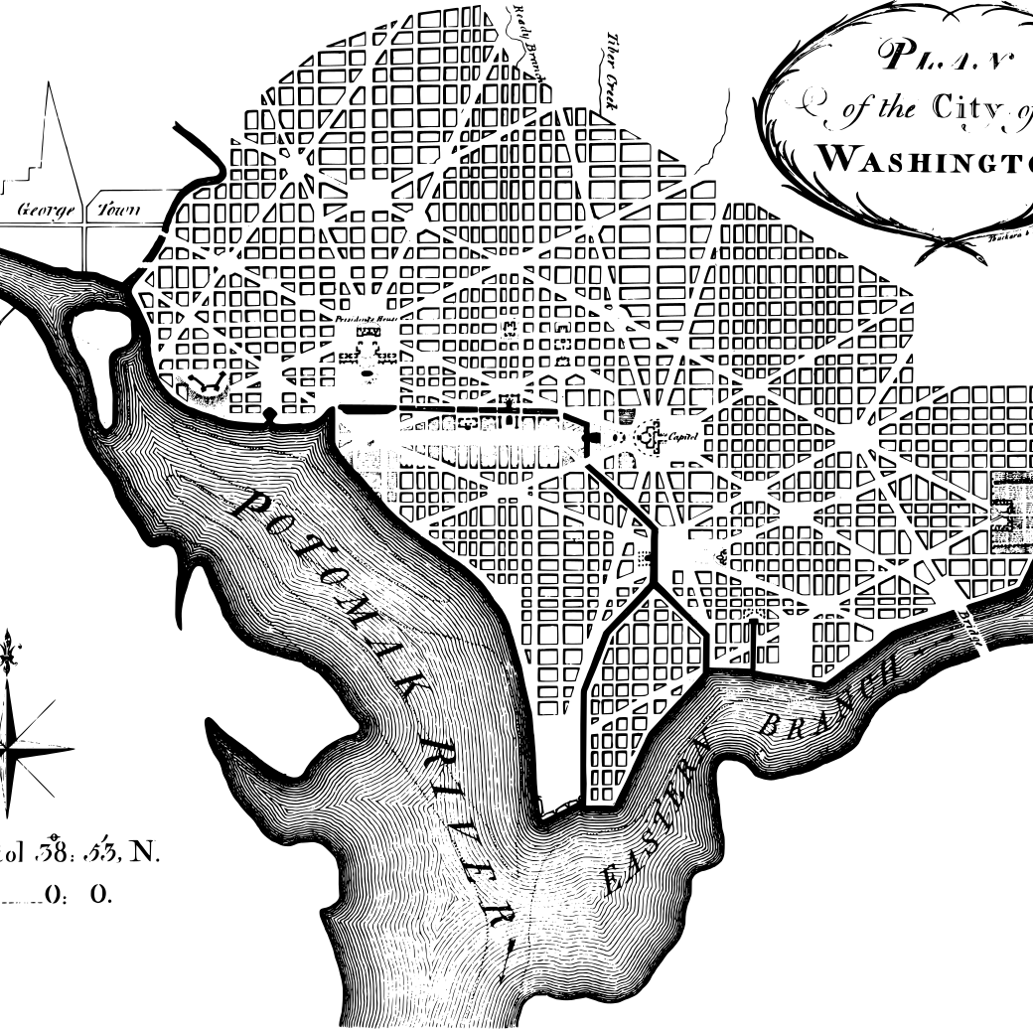
Washington City
1800 – seat of the federal government was moved to the newly-named Washington City
Pierre Charles L'Enfant laid out a design plan for the city.
The White House and U.S. Capitol buildings dominated the city.
The city was known for being swampy, muddy, and unpleasant in the early 19th Century.
Notes:
Originally designed by Pierre Charles L’Enfant after his home city of Paris, France, Washington, D.C., was to be a visionary metropolis. Washington, D.C., was one of the first major American cities to be constructed in a grid system, Philadelphia being the first. Washington was a city with a small population that housed mostly government officials at the beginning of the war. Washington was constructed upon a wetland area and experienced sweltering summer days and unrelenting winters.

Slide 7
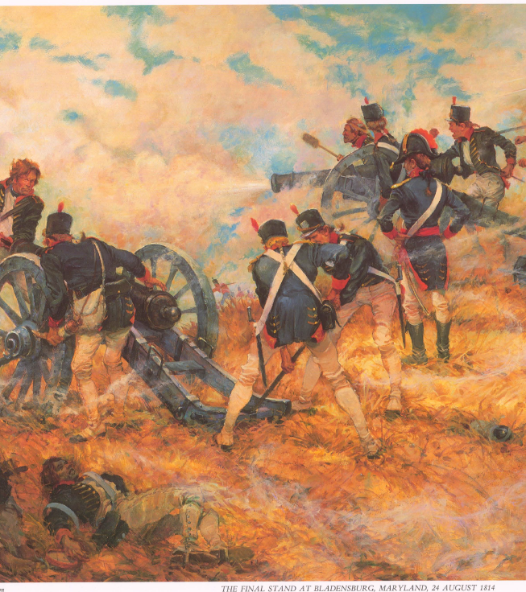
Battle of Bladensburg
Fought on August 24, 1814.
This Maryland battle was a British victory and opened their road to Washington City.
General William Winder led American troops.
General Robert Ross commanded the British force and inland expedition.
Notes:
Extra Resources:
Battle of Bladensburg: https://www.battlefields.org/learn/war-1812/battles/bladensburg
Bladensburg: Before the British Could Torch the Capital of the United States https://www.battlefields.org/learn/articles/bladensburg-british-could-torch-capital-united-states
Bladensburg Battlefield: https://www.battlefields.org/visit/battlefields/bladensburg-battlefield
Bladensburg Historic Map: https://www.battlefields.org/learn/maps/battle-bladensburg
Bladensburg Map: https://www.battlefields.org/learn/maps/bladensburg-august-24-1814
American General William Winder organized his forces, believing that Washington, D.C. and Baltimore would need to be defended. Because Bladensburg, just northeast of D.C., was key to both Washington and Baltimore’s defense, Winder deployed across the roads that led into the young nation’s capital. Though Winder had around 6,500 men at his disposal, most of his men at Bladensburg were poorly trained militia and their resolve would crumble in the face of the war-weary British.
Though Americans positioned themselves well against an attack with artillery covering a bridge over the eastern branch of the Anacostia River, they were overwhelmed when British attacked at noon on August 24th. Fording the river above the bridge and beating back troops who defended the bridge, British General Ross’ 4,500 men steadily advanced against American artillery and rifle fire, gaining control of the west bank. Under heavy British pressure, the left flank of the American line of defense crumbled. As the left flank was enveloped, Americans fled the scene. Their general, Winder, had not prepared a plan for American retreat and his panicked men ran from the battle instead of maneuvering in a controlled retreat to defend Washington D.C. against impending attack. With American forces scattered, the road to America’s capital was now wide open.
As the British marched into Washington in 1814, they held in their memory the bitter date of April 27th1813—the day Americans had burned of the Canadian capital, York. They carried vengeful appetites as they entered Washington, D.C. the evening of August 24th 1814.

Slide 8
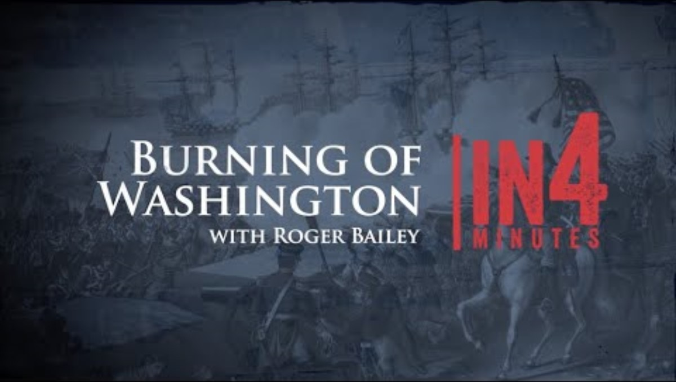
Burning of Washington City in 4 Minutes
Notes:
YouTube Video Link: https://youtu.be/zk8c9DARWiI?si=JmrZSr5_Knu8bqBo
Website Video Link: https://www.battlefields.org/learn/videos/burning-washington-dc

Slide 9
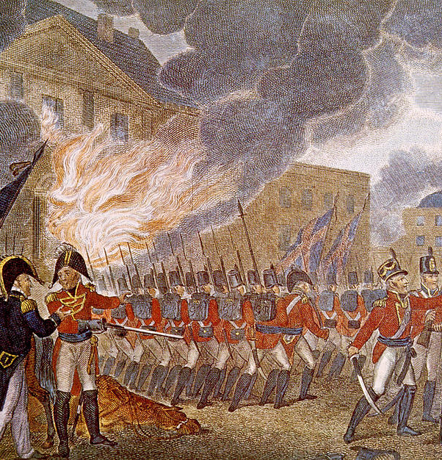
Burning of Washington City
August 24-25, 1814
The British burned government buildings in retaliation for the Americans burning York (Toronto) in Canada in 1813.
Political leaders fled the city.
Significantly, the U.S. Capitol building, the White House, and Library of Congress, and Treasury Building were burned.
A rainstorm helped to extinguish some of the fires.
Notes:
Extra Resources:
Untold Story: The Burning of Washington (Video): https://www.battlefields.org/learn/videos/untold/burning-washington
The Capture and Burning of Washington: https://www.battlefields.org/learn/articles/burning-washington-dc
War of 1812: "The city was left a prey to the invaders": https://www.battlefields.org/learn/primary-sources/war-1812-city-was-left-prey-invaders
War of 1812: "To the Inhabitants of Washington...A Night of Terror and Dismay": https://www.battlefields.org/learn/primary-sources/war-1812-inhabitants-washington-night-terror-and-dismay
As the British marched into Washington in 1814, they held in their memory the bitter date of April 27th1813—the day Americans had burned of the Canadian capital, York. They carried vengeful appetites as they entered Washington, D.C. the evening of August 24th 1814.
President Madison and his cabinet had fled the city, Dolly Madison and White House slave Paul Jennings famously saving critical relics of their new republic, among them a portrait of George Washington. It was a good thing that the first lady and Jennings saved these symbols of American democracy as British forces wasted no time in setting the presidential mansion, the Capitol, the Treasury and the War Office ablaze in the evening of August 24th. The burning of Washington went down in history as the only foreign attack on the nation’s capital until the terrorist attacks on September 11, 2001.

Slide 10
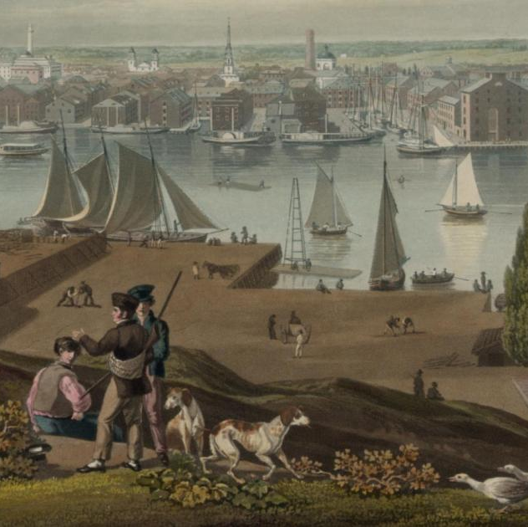
Baltimore, Maryland
Founded in 1729
By 1812, Baltimore was the 3rd largest city in the United States
Deep harbor and maritime trades/economy
Home port for 122 Privateers, ships that raided British merchant ships
Protected by Fort McHenry
Notes:
Extra Resources:
Baltimore during the War of 1812: https://www.battlefields.org/learn/articles/baltimore-during-war-1812
By 1812, the port city of Baltimore had solidified its place in the young United States as a burgeoning economic metropolis. Although it was founded in 1729, markedly later than its peripheral east coast cities, Baltimore with its 47,000 residents was by 1812 the third-largest city in America. Recently emigrated Europeans, a majority being Irish, German, and French refugees escaping British rule in Nova Scotia and increasingly hostile conditions in Haiti made up much of Baltimore’s booming population. To these immigrants, Baltimore offered an attractive and ideal livelihood full of economic promise. Indeed, Baltimore’s location on the Patapsco River with easy access to the Chesapeake Bay and the Atlantic, and with a well-protected, deep harbor, enjoyed economic prosperity through its maritime activities--trade, shipbuilding, and privateering. Although Baltimore became a chief exporter of grain on the east coast and built warships such as the frigate the U.S.S. Constellation, the city was best known for the vast privateering network of militarized private sailors to which it provided haven.

Slide 11
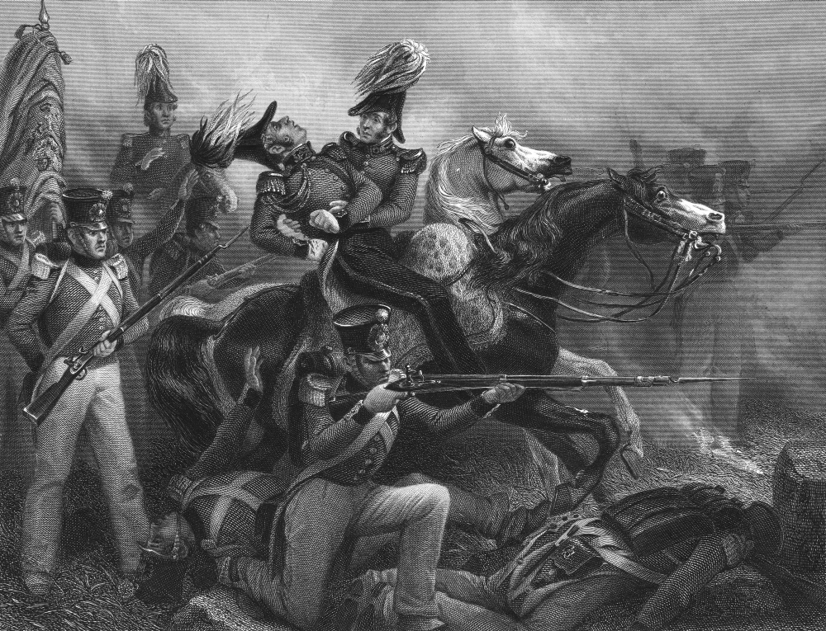
Battle of North Point
Fought on September 12, 1814
This Maryland battle was an American victory, preventing the British from attacking Baltimore by land.
General John Strickler commanded American troops.
General Robert Ross commanded the British soldiers and was killed during the battle.
Turned back on land, the British planned to bombard Fort McHenry which guarded the approach to Baltimore by water.
Notes:
Extra Resources:
Battle of North Point: https://www.battlefields.org/learn/war-1812/battles/north-point
North Point Map: https://www.battlefields.org/learn/maps/north-point-sep-12-1814
War of 1812: "Undaunted we marched out": https://www.battlefields.org/learn/primary-sources/war-1812-undaunted-we-marched-out
War of 1812: "She was at the Battle of North Point": https://www.battlefields.org/learn/primary-sources/war-1812-she-was-battle-north-point
General Robert Ross: https://www.battlefields.org/learn/biographies/robert-ross
Following the burning of Washington, D.C, the British forces in the Chesapeake Bay area next set their sights on the port city of Baltimore, Maryland. On September 12, 1814, some 4,500 British soldiers and marines landed on the peninsula created by the Back and Patapsco Rivers. This force was commanded by the veteran Maj. Gen. Robert Ross. To meet this threat, a force of 3,200 Americans commanded by General John Stricker marched out to intercept Ross' forces. Utilizing the streams, hills, and swamps to the area to protect his line, Stricker advanced a force of American rifleman toward the British camps, in hopes of drawing the enemy into battle on ground of his choosing. The Americans were met with early success, and they even managed to fell Ross. Mortally wounded, the British commander turned command over to Col. Arthur Brooke.
Brooke advanced on the American position near 3 PM. He launched frontal assaults to hold Stricker's men in place, while he sent a force around the American flank to drive them from the field. Although the frontal attack was met with fierce resistance and heavy casualties, the British flanking column succeeded in dislodging the Americans, who fell back to a new defensive position on high ground closer to Baltimore.

Slide 12
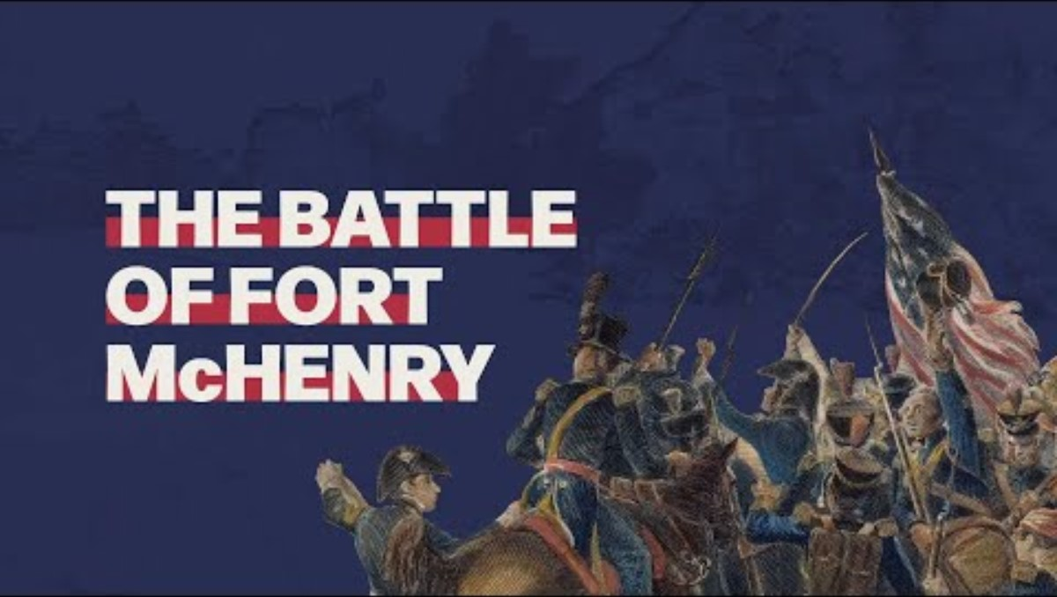
Fort McHenry Video
Notes:
YouTube Video Link: https://youtu.be/N20k3ix_RLI?si=rXumsEc2xSdfhfFG
Website Video Link: https://www.battlefields.org/learn/videos/untold/battle-fort-mchenry

Slide 13
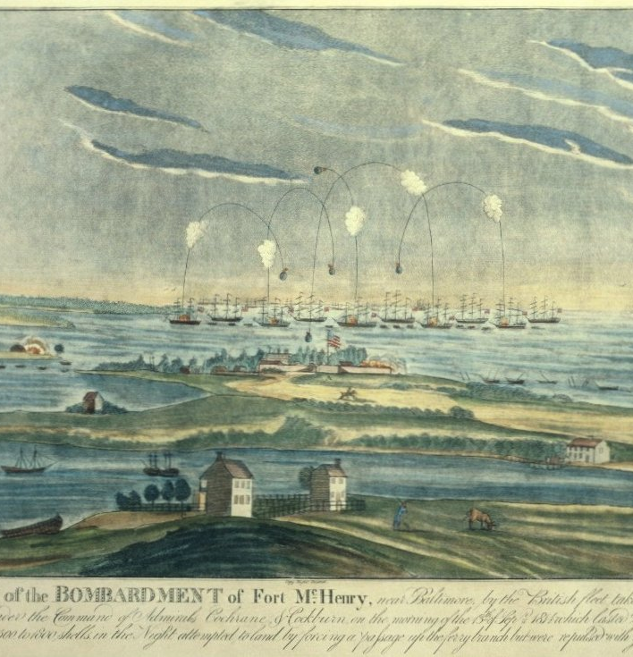
Bombardment of Fort McHenry
Fought on September 13-14, 1814
Despite a heavy bombardment from the British ships, Americans held Fort McHenry, preventing the British from reaching Baltimore.
Major George Armistead commanded American soldiers at Fort McHenry.
Admiral Alexander Cochrane commanded the British fleet attacking Fort McHenry.
Unable to capture or destroy Fort McHenry, the British fleet retreated, and Baltimore remained in American control.
The Battle of Fort McHenry marks the end of the Chesapeake Campaign. British ships and troops would try to capture New Orleans, Louisiana, before news of the Treaty of Ghent ended the War of 1812.
Notes:
Extra Resources:
Battle of Fort McHenry: https://www.battlefields.org/learn/articles/battle-fort-mchenry
War of 1812: "The enemy's fleet arranged...before Fort McHenry": https://www.battlefields.org/learn/primary-sources/war-1812-enemys-fleet-arrangedbefore-fort-mchenry
Fort McHenry Map: https://www.battlefields.org/learn/maps/bombardment-fort-mchenry-sep-13-14-1814
Fort McHenry National Monument: https://www.battlefields.org/visit/battlefields/fort-mchenry-battlefield
American forces resisted the dramatic British bombardment of Fort McHenry and proved they could stand up to a great world power. The exploding shells and rocket fire from British warships inspired Francis Scott Key to pen the lyrics to the “Star-Spangled Banner.” Seeing no way to penetrate American defenses, the British withdrew their troops and gave up their Chesapeake Campaign.

Slide 14
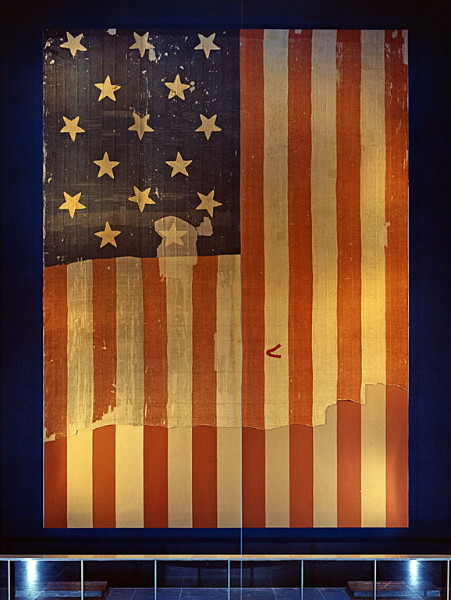
"The Star-Spangled Banner"
The morning after the British bombardment, Major Armistead ordered a large American flag to be raised over Fort McHenry to visually announce that the Americans still held the fort and had repulsed assaults.
Baltimore resident Francis Scott Key penned a poem, inspired by the sight of a large American flag still flying over Fort McHenry.
The poem was set to music and became a popular song, celebrating the American victory at Fort McHenry. Decades later, the song was adopted as the United States National Anthem.
Notes:
Extra Resources:
War of 1812: "The Star-Spangled Banner": https://www.battlefields.org/learn/primary-sources/war-1812-star-spangled-banner
Short History of The Star Spangled Banner: https://www.battlefields.org/learn/articles/star-spangled-banner
The Star-Spangled Garrison Banner: https://www.battlefields.org/learn/articles/star-spangled-garrison-banner
Francis Scott Key: https://www.battlefields.org/learn/biographies/francis-scott-key
Mary Pickersgill: https://www.battlefields.org/learn/biographies/mary-young-pickersgill
In the morning after the British bombardment of Fort McHenry, Armistead raised a thirty by forty-two-foot United States Flag over the fort. Customarily, this garrison flag was raised every morning at reveille, but after a night of fighting this action took on a new meaning. The British, equally fatigued after the long fight and running low on ammunition, noted that they could not overtake the fortifications of Fort McHenry. Beanes, Key, and Stuart were sent back to the Maryland shore and the British retreated and set off for New Orleans.
Throughout this battle, Key was in the harbor hearing cannon fire and the booms of explosives. After the hours of bombardment and the fear that the British could overtake the fort and head to Baltimore, Key awoke to a proud display of American patriotism and a symbol that they were not going to stop fighting. That morning he wrote notes for a future poem about this event. Later that week, he finished the poem “Defence of Fort M’Henry.” On September 20, the Baltimore Patriot published “Defence of Fort M’Henry.” Francis Scott Key’s brother-in-law set the poem to music, and the combined poem and music were published under the name “The Star-Spangled Banner.”
After it was published, “The Star-Spangled Banner” became one of the many patriotic songs sung throughout the country. After 1889, it accompanied the flag raisings by the Navy. President Woodrow Wilson adopted the song as a de facto “national anthem” in 1916 but did not codify this ruling. In 1929, “House Resolution 14” was presented to Congress to name “The Star-Spangled Banner” as the official national anthem to the United States. There were many objections to this resolution.

Slide 15
Primary Sources
Campaign:
Alexander Cochrane's Proclamation
Washington:
"The city was left a prey to the invaders"
"To the Inhabitants of Washington...A Night of Terror and Dismay"
North Point:
"She was at the Battle of North Point"
"Undaunted we marched out"
Fort McHenry:
"The bombardment...lasted 25 hours"
"The enemy's fleet arranged...before Fort McHenry"
"The Star-Spangled Banner"
Notes:
View the Lesson Plan Teaching Guide for links to these Primary Sources, worksheets, and discussion suggestions.

Slide 16
Notes:
Always more FREE resources at www.battlefields.org

