Slide 1
War of 1812: Battles
The War of 1812 Curriculum

Slide 2
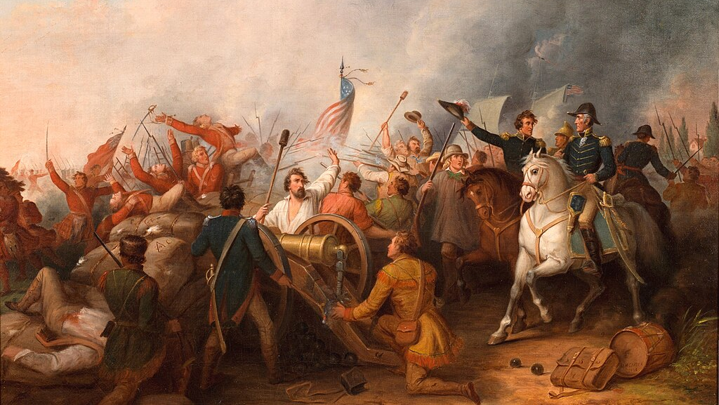
Essential Question
What were some of the significant battles of the War of 1812?
Notes:
Extra Resources:
"Chesapeake vs. Leopard, June 21, 1807" painting https://www.humanitiestexas.org/archives/digital-repository/bevan-chesapeake-vs-leopard-june-21-1807
Encourage students to think about what makes a battle significant in the timeline of history. Outcome? Losses? Strategic location?

Slide 3
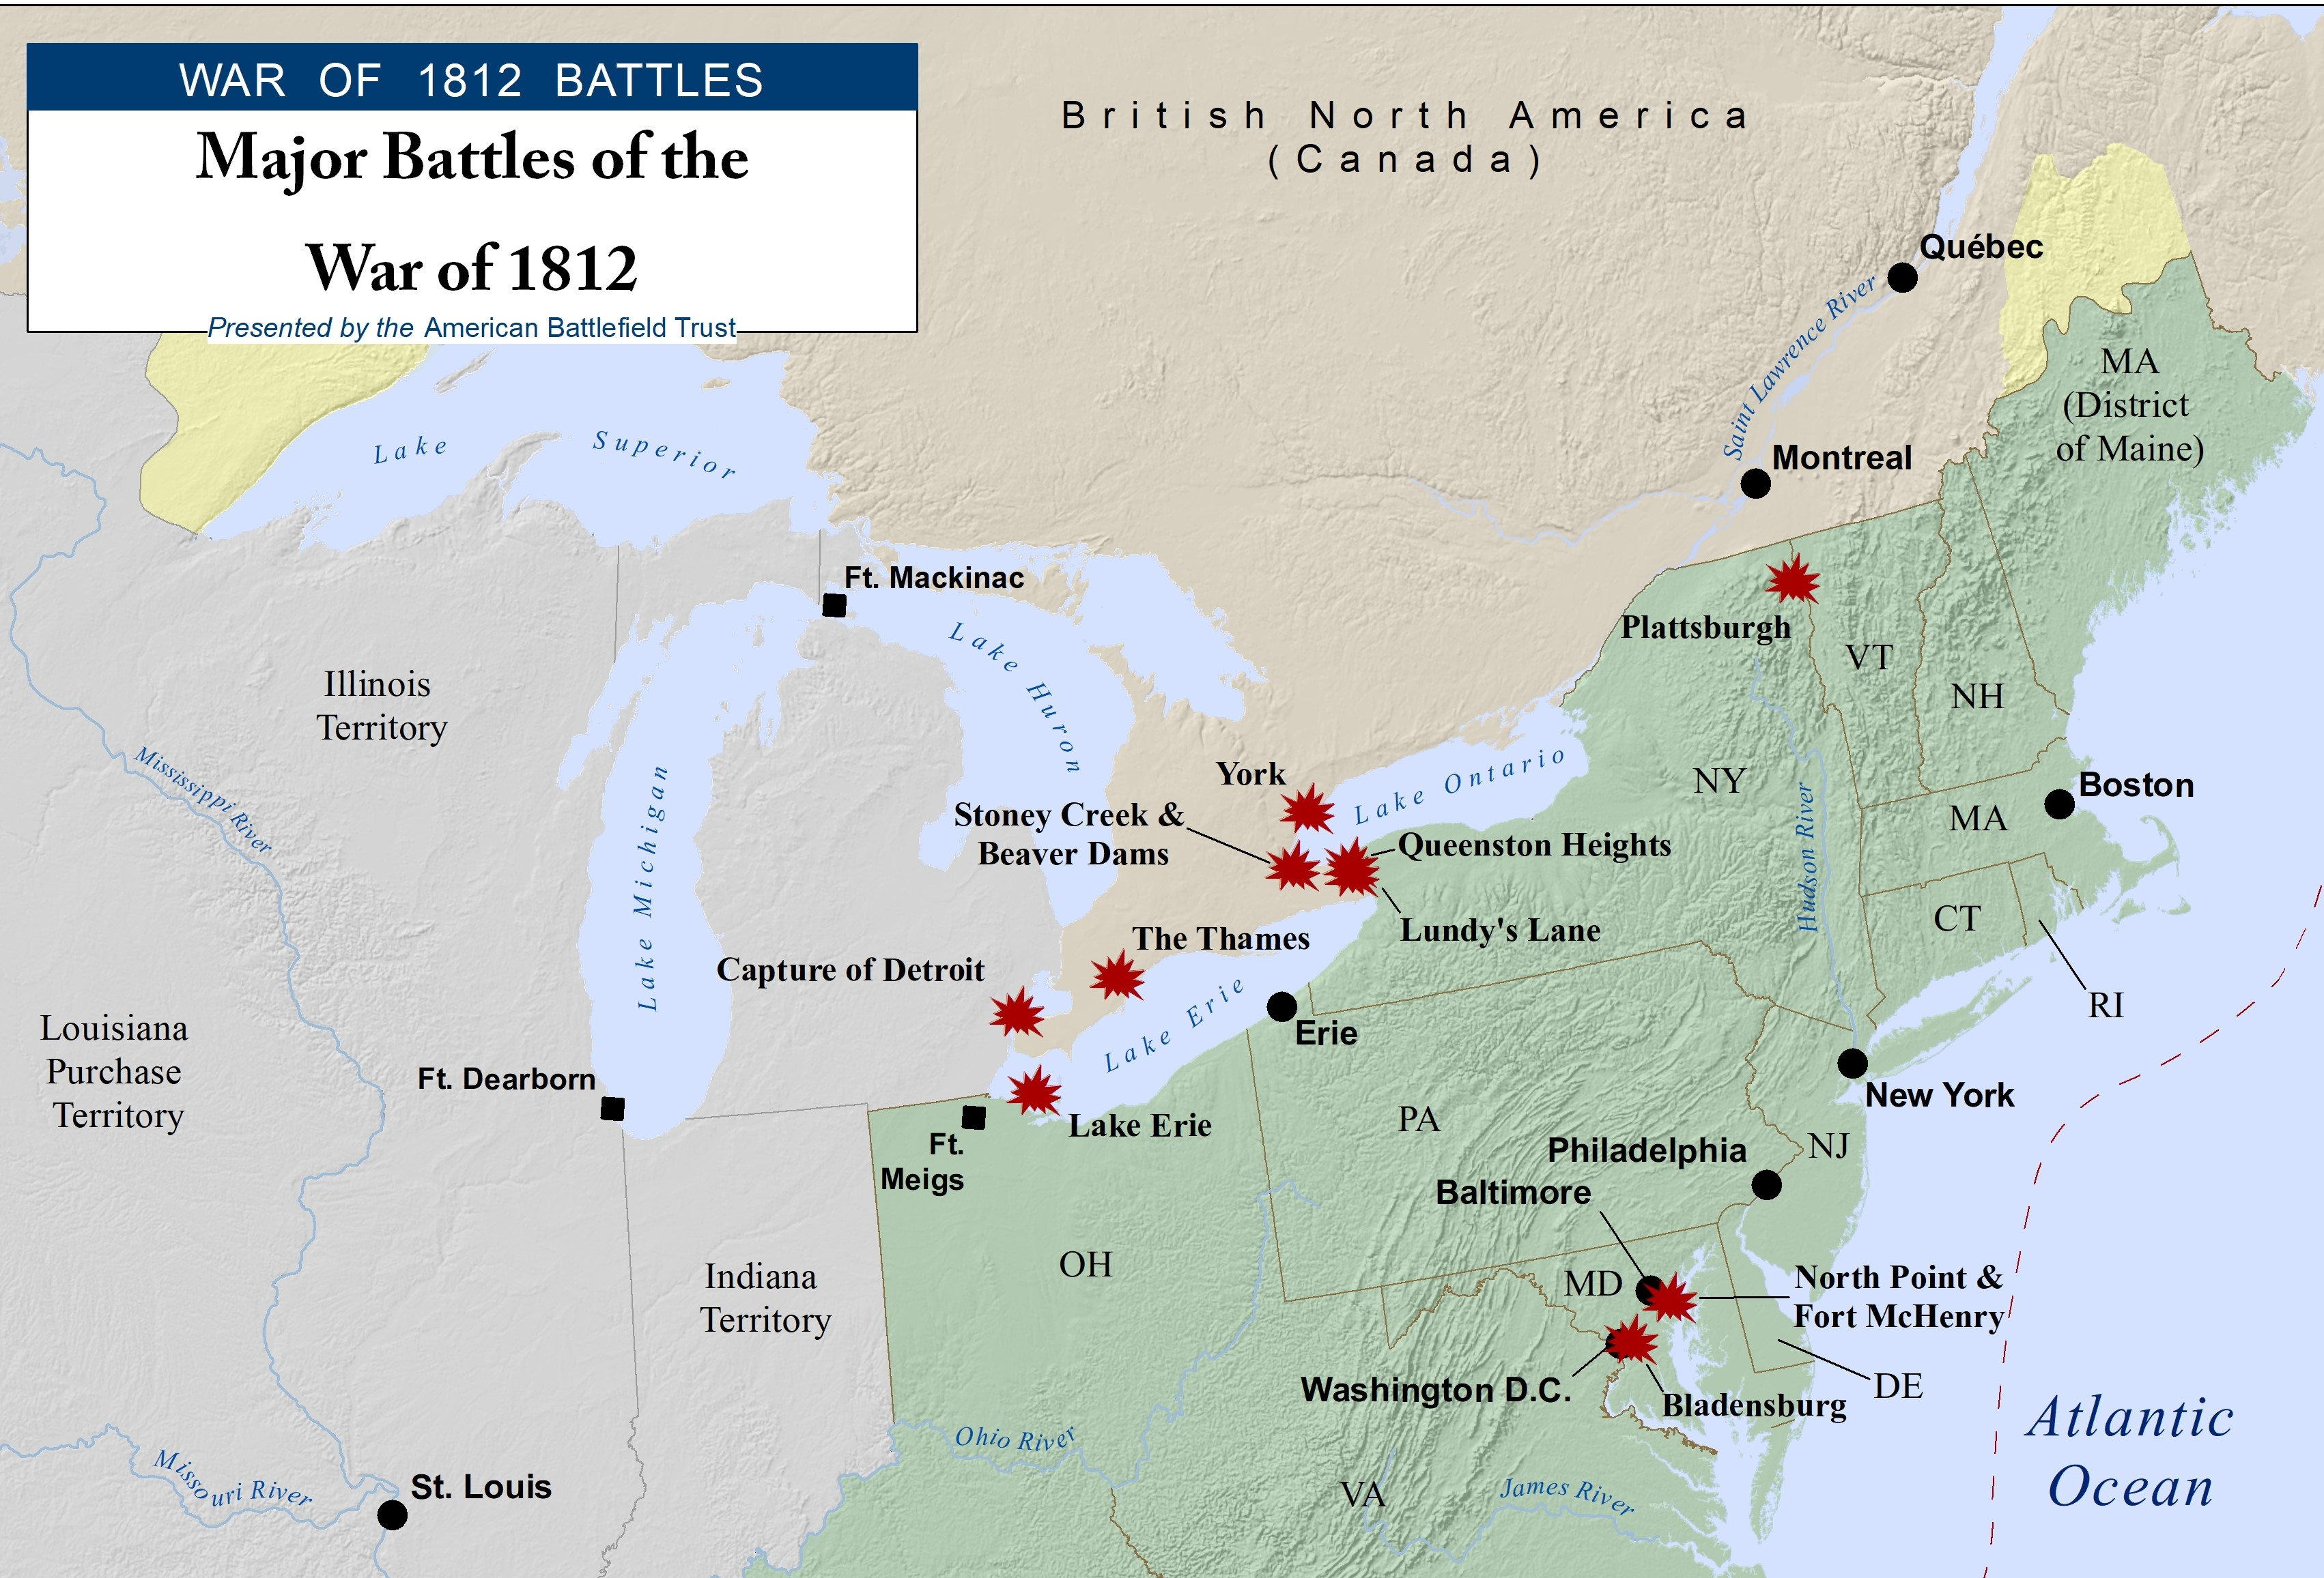
Notes:
Here's a timeline of battles and events during the War of 1812 https://www.battlefields.org/learn/articles/war-1812-timeline

Slide 4
U.S.S. Constitution vs. Guerriere
Battle of Bladensburg, Burning of Washington, Battle of Baltimore
Battle of New Orleans
Battle of Frenchtown, Battle of Horseshoe Bend
1812 1813 1814 1815
Battle of Queenston Heights
Treaty of Ghent signed
Battle of Lake Erie, Battle of the Thames
Notes:
Extra Resources:
Overview of the War of 1812: https://www.battlefields.org/learn/articles/brief-overview-war-1812
War of 1812 Timeline: https://www.battlefields.org/learn/articles/war-1812-timeline

Slide 5
The Invasion of Canada
British Victory
Americans sought a speedy victory to end the war by invading Canada on July 12, 1812.
The poorly-coordinated invasion soon faltered, and Fort Detroit was surrendered to the British on August 16, 1812.
Despite American hopes, most Canadians and Native Americans sided with the British.
Notes:
Extra Resources:
Battle of Queenston Heights: https://www.battlefields.org/learn/war-1812/battles/battle-queenston-heights
Battle of Hull's Trace: https://www.battlefields.org/visit/heritage-sites/hulls-trace
Four months after the American declaration of war against the United Kingdom the first major battle of the war took place. The American strategy was to undertake a four-pronged attack and invasion of Canada to bring a quick and decisive victory for American forces. The defeat of the Americans at the hands of the combined British and Canadian forces undermined American morale throughout the United States.

Slide 6
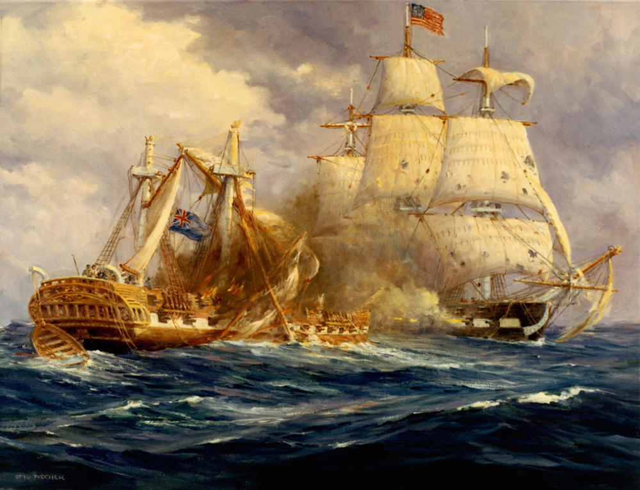
The U.S.S. Constitution
On August 19, 1812, the frigate the U.S.S. Constitution defeated the British warship the H.M.S. Guerriere and took her crew prisoner.
The ship earned her nickname "Old Ironsides" when British cannonballs failed to damage her hull.
The American victory boosted national morale and proved the young country could win against the powerful British navy.
Notes:
During the war, the USS Constitution defeated four British warships and earned its nickname "Old Ironsides" because of the seemingly impenetrable sides.
Extra Resources:
USS Constitution Video: https://www.battlefields.org/learn/videos/uss-constitution
"Old Ironsides": https://www.battlefields.org/learn/articles/old-iron-sides

Slide 7
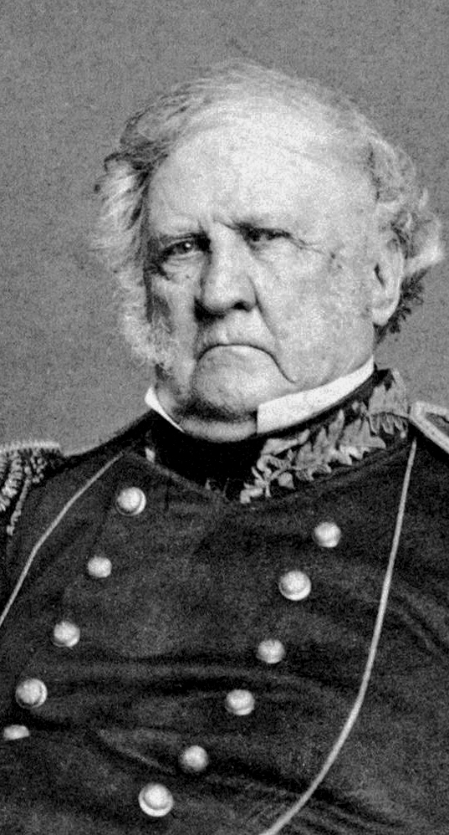
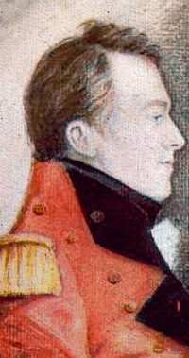
On October 13, 1812, the Americans suffered a major setback when they were driven out of Queenston Heights in Canada.
Lieutenant Colonel Winfield Scott was forced to surrender an American landing party and was taken prisoner by the British. He lived to serve as a general in the American Civil War.
British General Isaac Brock led his men to victory but was killed in the battle. He became a national hero in Canada.
Notes:
Extra Resources:
Battle of Queenston Heights: https://www.battlefields.org/learn/war-1812/battles/battle-queenston-heights
Queenston Heights Battlefield: https://www.battlefields.org/visit/battlefields/queenston-heights-battlefield
Winfield Scott during the War of 1812: https://www.battlefields.org/learn/articles/winfield-scott-war-1812
The defeat of the Americans at the hands of the combined British and Canadian forces undermined American morale throughout the United States. The defeat at Queenston Heights led General Dearborn to hesitate and ultimately reject his plans of invading Canada. Additionally, American General Van Rensselaer, the general tasked with taking Queenston, resigned his post in the military in disgrace. However, this battle proved vital in cementing British General Isaac Brock’s memory in Canadian history as a heroic officer who died personally leading his men to help preserve Canadian sovereignty.

Slide 8
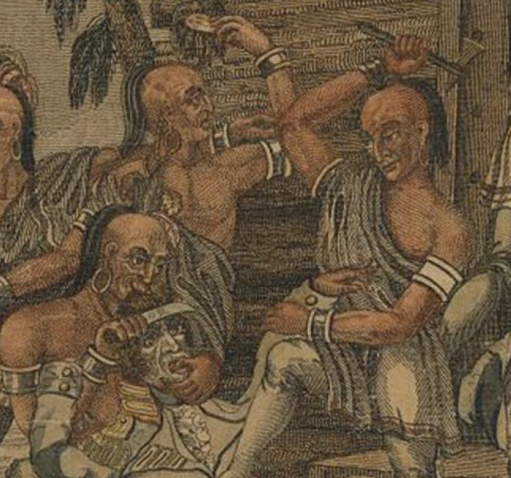

The Battle of Frenchtown
January 22, 1813: British Victory
After defeats in Canada and at Fort Detroit, General William Henry Harrison was charged with securing the Northwest.
A small American force occupied Frenchtown on January 18, 1813.
Four days later, the Americans were driven out by a larger British and Native American force and retreated to the Raisin River before surrendering.
Between 30-50 prisoners of war were killed by Native American warriors because they were too wounded to evacuate. This became known as the River Raisin Massacre and "Remember the Raisin" became an American battle cry.
Notes:
Extra Resources:
The Detroit Frontier in the War of 1812: https://www.battlefields.org/learn/articles/detroit-frontier-war-1812
Battle of River Raisin: https://www.battlefields.org/learn/war-1812/battles/river-raisin
"Remember the Raisin": https://www.battlefields.org/learn/articles/remember-raisin
Native American Involvement in the War of 1812: https://www.battlefields.org/learn/articles/native-american-involvement-war-1812
In January 1813, American troops under the command of General James Winchester advanced from the Maumee Rapids against a British force at Frenchtown, south of Detroit. Winchester engaged a British and Native force there under Col. Henry Procter on January 22 which resulted in a rout of the American force. In the engagement’s aftermath, hundreds of Americans were captured, with a number of wounded prisoners killed by the Native warriors. British Victory. After surrendering most of his troops, Winchester and what remained of his army marched towards British-held Detroit, leaving behind wounded who could not walk. The day after the battle, Native American warriors returned to Frenchtown began killing many of the mortally wounded. The Michigan Territory became a focal point shortly after war broke out between the young United States and Great Britain in June 1812. U.S. forces set their eyes on the capture of Upper Canada. However, the war effort received a major blow when General William Hull surrendered the Northwestern Army and Fort Detroit to General Isaac Brock on August 16, 1812.
The following month, President James Madison appointed the former governor of the Indiana Territory and current brigadier general in the Kentucky militia, William Henry Harrison, the new commander in the Old Northwest. Madison charged Harrison with rebuilding the American army and the capture of Fort Detroit.

Slide 9
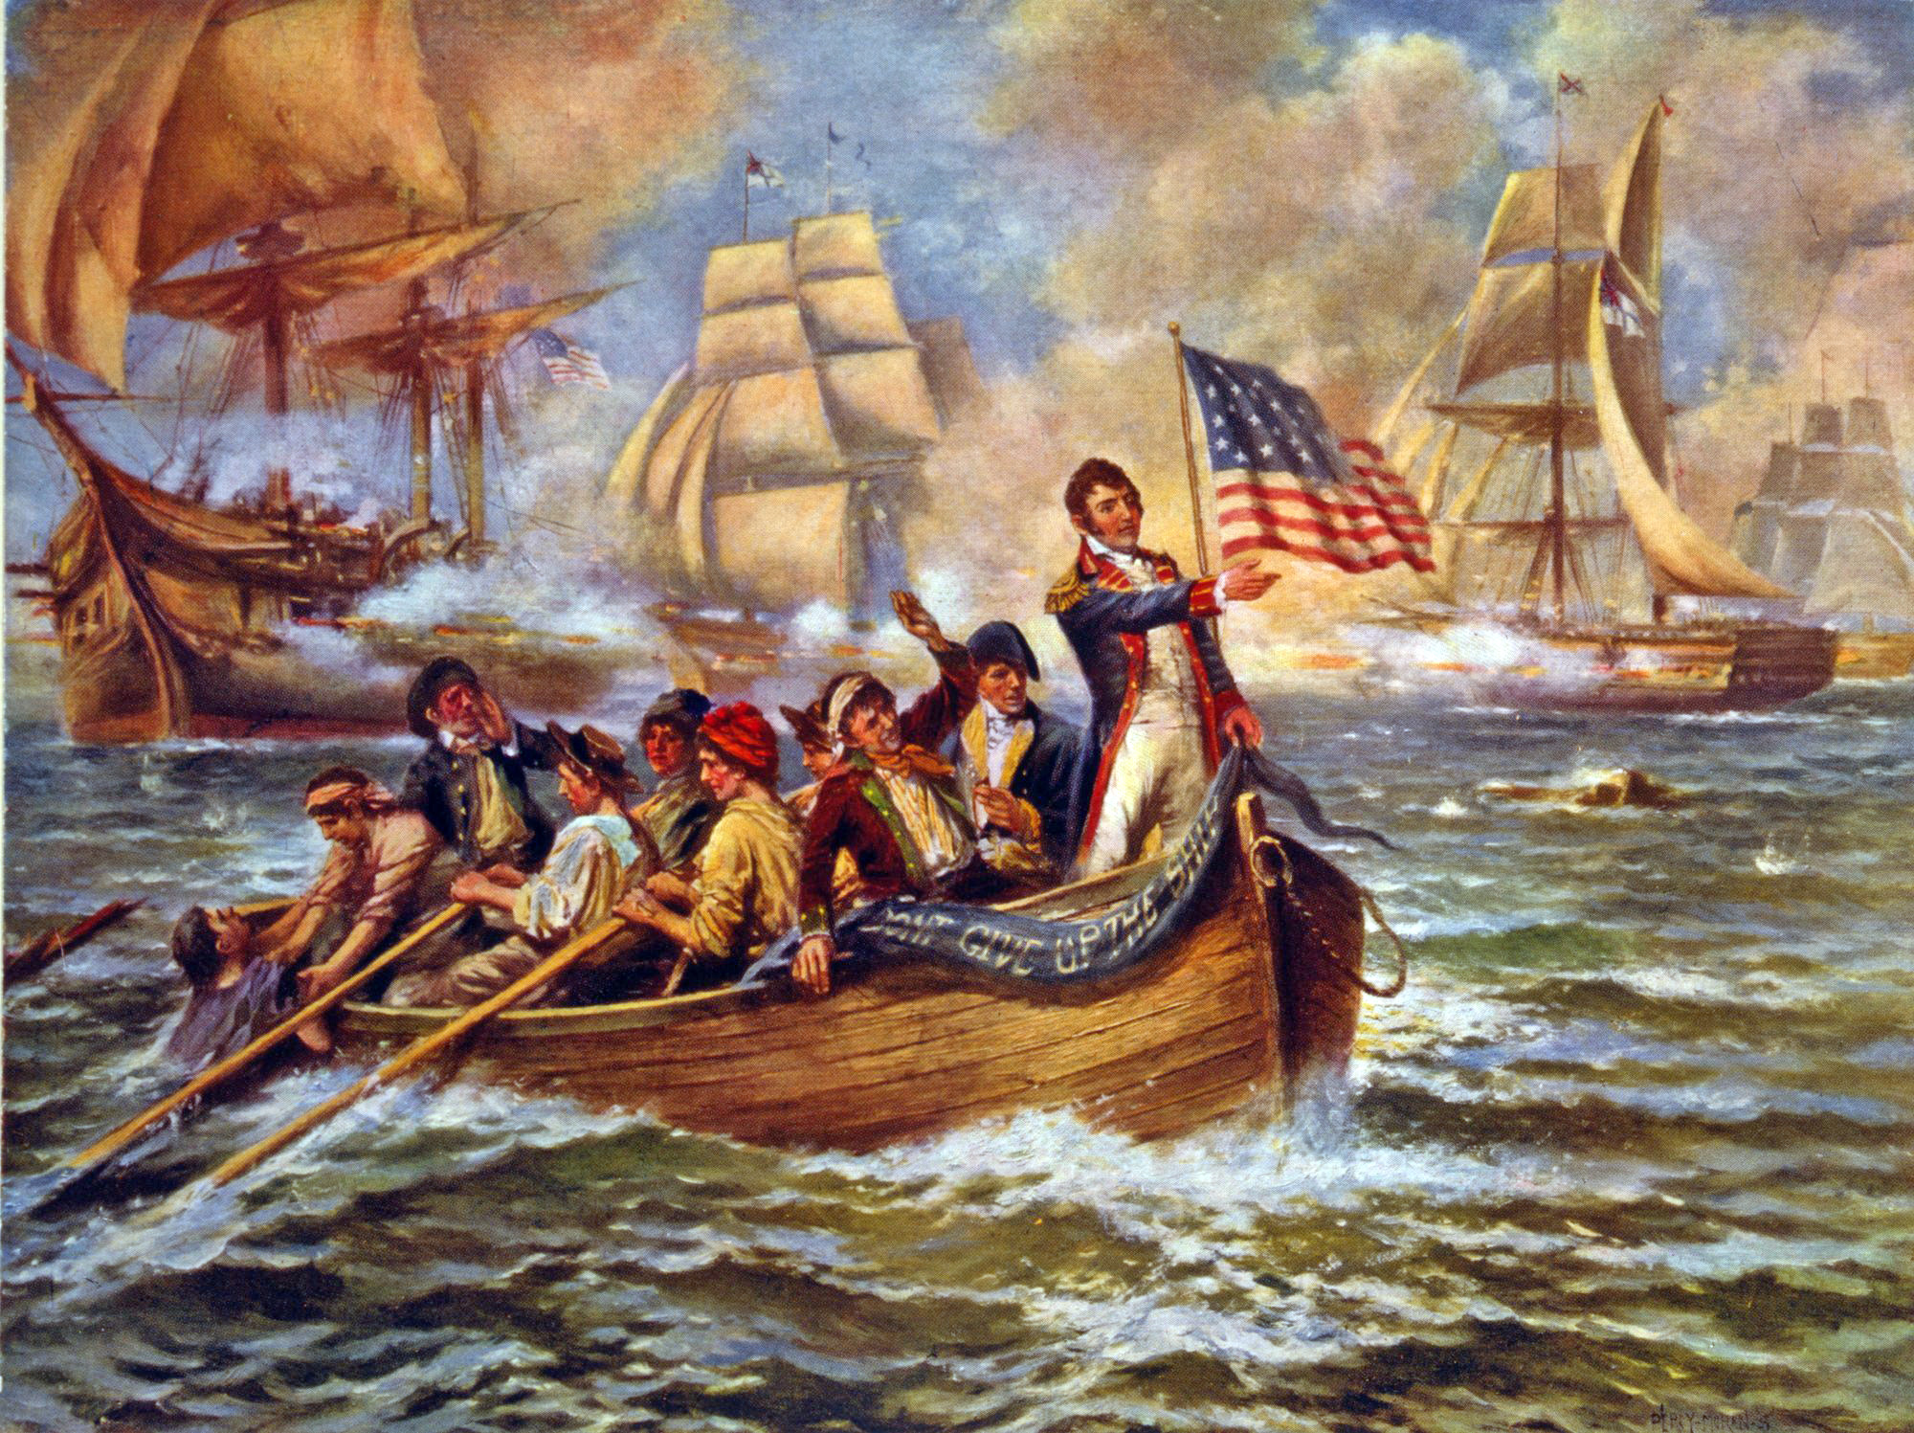
The Battle of Lake Erie
On September 10, 1813, an American squadron of ships defeated a British flotilla on Lake Erie.
American captain Oliver Hazard Perry refused to retreat even when his flagship, the Lawrence, was destroyed. His remaining ships decimated the British force with superior firepower.
The American victory secured control of the lake and the British were forced to evacuate Fort Detroit.
Perry's personal flag, shown in Edward Moran's painting The Battle of Lake Erie, bore the now-famous motto "Don't Give Up the Ship."
Library of Congress
Notes:
Extra Resources:
Battle of Lake Erie: https://www.battlefields.org/learn/war-1812/battles/battle-lake-erie
Standing Tall on Lake Erie: https://www.battlefields.org/learn/articles/standing-tall-lake-erie
War of 1812: " A Minute and Interesting Account of the Naval Conflict on Lake Erie": https://www.battlefields.org/learn/primary-sources/war-1812-minute-and-interesting-account-naval-conflict-lake-erie
On September 10, 1813, American Naval forces under the command of Oliver H. Perry attacked Robert H. Barclay’s British fleet in Lake Erie. In the resulting action, Perry’s forces gained a victory and claimed supremacy over the lake, causing the British to evacuate Fort Detroit. After breaching the British lines with his flagship, the USS Niagara, Perry’s force managed to break the will of the British navy and ultimately forced a wounded Robert H. Barclay to surrender. After the victory, the American navy along Lake Erie maintained control over the region for the rest of the war and forced British forces in Upper Canada to consolidate their forces.

Slide 10
The Battle of Horseshoe Bend
March 27, 1814: American Victory
By July 1813, the United States was entangled in the Creek Civil War. Upper Creeks, also known as Red Sticks, opposed American expansion and allied themselves with the British. Lower Creeks, along with their Cherokee and Choctaw allies, were pro-American.
Major General Andrew Jackson led a combined force of regulars, militia, and Native Americans against a fortified Upper Creek village, destroying the village and killing the majority of the Red Stick warriors.
Notes:
Extra Resources:
Battle of Horseshoe Bend: https://www.battlefields.org/learn/war-1812/battles/horseshoe-bend
By the summer of 1813, the violence had grown from minor infighting amongst the Creeks, into all-out civil war. In reaction to the chaos, Colonel James Caller of the Mississippi territorial militia mustered 180 men to ambush a band of Upper Creek sympathizing Red Sticks returning from Pensacola with British firearms and ammunition. The ensuing conflict came to be known as the Battle of Burnt Corn Creek. The event sparked a tinder box of retaliatory attacks by the Upper Creeks, triggering large-scale American involvement in the war and eventually the battle of Horseshoe Bend.
On the night of March 26, 1814, Major General Andrew Jackson and a contingent of 3,300 regulars, militiamen, Cherokees and Lower Creek camped six miles north of Horseshoe Bend. The Red Sticks, under direction of Chief Menawa, had fortified their village, Tehopeka, located on the peninsula created by the bend. The daunting log and mud breastwork at the neck of the peninsula made a frontal assault on Tehopeka virtually impossible. An impressed Jackson later described the fortification favorably, “It is impossible to conceive a situation more eligible for defense than the one they had chosen and the skill which they manifested in their breastwork was really astonishing.”
In the morning Jackson launched a two-pronged attack on Tehopeka. Knowing that he couldn’t assault the breastwork head on, he divided his force, sending his second in command General John Coffee and 1,300 militiamen, Lower Creeks and Cherokee on a wide flanking maneuver that would cross the Tallapoosa and surround the Red Sticks. Jackson commenced an ineffective artillery barrage at 10:30 a.m. while Coffee’s men positioned themselves across from Tehopeka.
Once organized on the adjacent banks of the river, Coffee ordered a small contingent to swim across the Tallapoosa and steal the Red Stick’s canoes. Once the canoes were secured, Coffee ordered Colonel Gideon Morgan’s Cherokee Regiment to traverse the river and attack the town itself.
Jackson, who was bombarding the breastwork on the opposite side of the bend, began hearing small arms fire and seeing smoke rising from Tehopeka. Coffee’s men had served as the diversion Jackson needed. Without hesitation he ordered the 39th U.S. Infantry, his most elite unit, to initiate a bayonet charge. Colonel John Williams led the assault accompanied by a young Sam Houston, the future patriarch of Texas. As soon as the 39th scaled the fortification the violence turned from a battle into a slaughter. Women and children were not exempt from the carnage and more than 200 fleeing Red Stick warriors were killed while swimming across the Tallapoosa to safety.
The battle of Horseshoe Bend was a disaster for the Red Sticks, with more than 800 of their 1,000 warriors killed in the fray. Even more significant, the Upper Creek nation had lost its last substantial fighting force. Chief Menawa was wounded seven times during the battle but miraculously escaped after playing dead until nightfall, crawling into a canoe and floating away on the Tallapoosa.
Following the defeat at Horseshoe Bend, the remaining warriors signed the Treaty of Fort Jackson, which ended hostilities and forced the Upper Creeks to cede over 20 million acres to the United States government, virtually half of what is today Alabama. Over the next 15 years, Alabama’s population exploded, growing from a sparsely populated wilderness with under 10,000 inhabitants in 1810, to one of the South’s most vital economic engines by 1830 with a population over 300,000. The Creek would never be able to regain their tribal autonomy and in 1830 with the signing of the “Indian Removal Act” by President Andrew Jackson, the remaining Creeks were forced onto reservations in Oklahoma on the “Trail of Tears.”

Slide 11
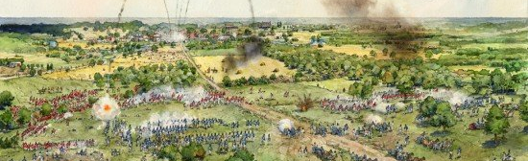
The Battle of Bladensburg
Richard Schlecht
When the Napoleonic Wars ended, Britain suddenly had more resources and men to dedicate to the War of 1812.
On August 24, 1814, British veterans defeated an inexperienced American force at Bladensburg, leaving both Baltimore and Washington, D.C. vulnerable to invasion.
Notes:
Extra Resources:
Battle of Bladensburg: https://www.battlefields.org/learn/war-1812/battles/bladensburg
The Capture and Burning of Washington DC: https://www.battlefields.org/learn/articles/burning-washington-dc
War of 1812: "To the Inhabitants of Washington...A Night of Terror and Dismay": https://www.battlefields.org/learn/primary-sources/war-1812-inhabitants-washington-night-terror-and-dismay
War of 1812: "The city was left a prey to the invaders": https://www.battlefields.org/learn/primary-sources/war-1812-city-was-left-prey-invaders
The Battle of Bladensburg was fought in Maryland on August 24, 1814 and this British victory left Washington D.C. perilously open to British invasion. The embarrassing defeat of American forces under General William Winder allowed British Army Officer Robert Ross’ men to subsequently march into nearby Washington D.C. and set fire to public buildings, including the presidential mansion (later to be rebuilt and renamed as the White House) over August 24th and 25th. Devastating American morale by destroying the very symbols of American democracy and spirit, the British sought to swiftly end an increasingly unpopular war.
Though neither side had gained a clear advantage in the first two years of the War of 1812, that changed in the spring of 1814 when Britain was able to disentangle itself from fighting France in the Napoleonic Wars. After Napoleon’s exile in April 1814, British forces could be replenished with thousands of veterans. These soldiers were different than the soldiers Americans had faced in Upper Canada; these men had fought against Napoleon and his Imperial Guard and wanted a quick end to this war against a young country.
British military leaders drew up a plan to decisively end the war, crafting a strategy to take control of the New England states and focus an attack on New Orleans, thereby separating north and south by cutting off critical transportation routes in both regions. In addition to destroying American trade, the British also planned to degrade American morale by arranging attacks on coastal cities such as Washington, Baltimore, Charleston and Savannah.
With this in mind, General Robert Ross arrived in Maryland, fresh from the Napoleonic Wars. Despite having recently been wounded in February at the Battle of Orthes, Ross returned to take charge of British troops on the east cost. Ross marched his 4,500 men from Benedict, Maryland towards Washington, D.C. with a goal of weakening American resolve.
American General William Winder organized his forces, believing that Washington, D.C. and Baltimore would need to be defended. Because Bladensburg, just northeast of D.C., was key to both Washington and Baltimore’s defense, Winder deployed across the roads that led into the young nation’s capital. Though Winder had around 6,500 men at his disposal, most of his men at Bladensburg were poorly trained militia and their resolve would crumble in the face of the war-weary British.
Though Americans positioned themselves well against an attack with artillery covering a bridge over the eastern branch of the Anacostia River, they were overwhelmed when British attacked at noon on August 24th. Fording the river above the bridge and beating back troops who defended the bridge, British General Ross’ 4,500 men steadily advanced against American artillery and rifle fire, gaining control of the west bank. Under heavy British pressure, the left flank of the American line of defense crumbled. As the left flank was enveloped, Americans fled the scene. Their general, Winder, had not prepared a plan for American retreat and his panicked men ran from the battle instead of maneuvering in a controlled retreat to defend Washington D.C. against impending attack. With American forces scattered, the road to America’s capital was now wide open.
As the British marched into Washington in 1814, they held in their memory the bitter date of April 27th1813—the day Americans had burned of the Canadian capital, York. They carried vengeful appetites as they entered Washington, D.C. the evening of August 24th 1814.
President Madison and his cabinet had fled the city, Dolly Madison and White House slave Paul Jennings famously saving critical relics of their new republic, among them a portrait of George Washington. It was a good thing that the first lady and Jennings saved these symbols of American democracy as British forces wasted no time in setting the presidential mansion, the Capitol, the Treasury and the War Office ablaze in the evening of August 24th. The burning of Washington went down in history as the only foreign attack on the nation’s capital until the terrorist attacks on September 11, 2001.
The embarrassing defeat at Bladensburg, coupled with the destruction of Washington, D.C., depleted American morale. For both sides, the Battle of Bladensburg helped usher in a conclusion to a costly and frustrating war.

Slide 12
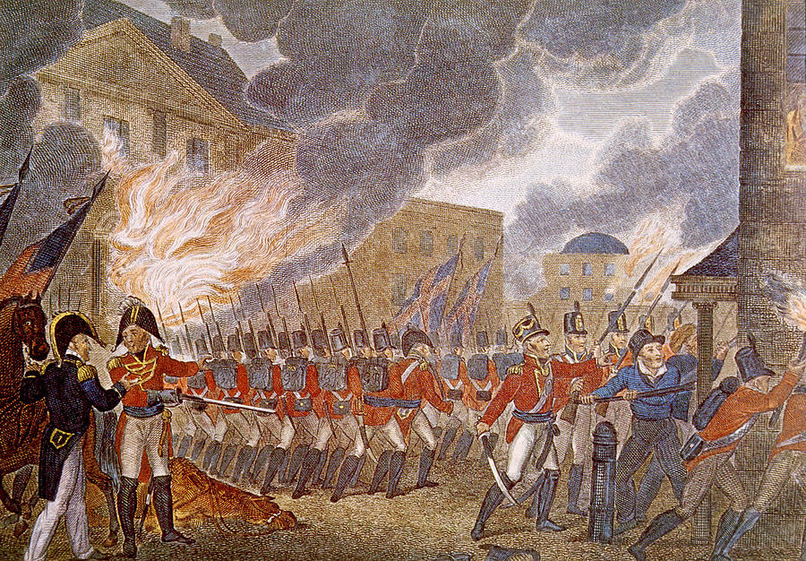
The Burning of Washington
American forces scattered after the defeat at Bladensburg.
The British entered Washington, D.C., and burned many public buildings, including the White House and the Capitol on August 24, 1814.
One of the only public buildings to survive was the Patent Building. Superintendent of Patents William Thornton successfully convinced the British that it contained private property and knowledge which was valuable to the whole world.
Some documents and items were safely taken out of the city before the British arrived, including the Declaration of Independence, the Bill of Rights, and the portrait of George Washington, famously saved by Dolley Madison.
Notes:
Extra Resources:
"Untold: The Burning of Washington" Video https://www.battlefields.org/learn/videos/untold/burning-washington
"In4Minutes: The Burning of Washington" Video https://www.battlefields.org/learn/videos/burning-washington-dc
The Capture and Burning of Washington DC: https://www.battlefields.org/learn/articles/burning-washington-dc
War of 1812: "To the Inhabitants of Washington...A Night of Terror and Dismay": https://www.battlefields.org/learn/primary-sources/war-1812-inhabitants-washington-night-terror-and-dismay
War of 1812: "The city was left a prey to the invaders": https://www.battlefields.org/learn/primary-sources/war-1812-city-was-left-prey-invaders
On August 24th evening, British soldiers moved on Washington holding bitter resentment for the American burning of the Canadian capital of York (present-day Toronto) in 1813. When entering Washington, the British and Canadian soldiers had unfettered access to the capital and began burning the city. Government officials were forced to flee the city. President James Madison and First Lady Dolley Madison both fled the White House. Before leaving, Dolley Madison had a portrait of President George Washington, and many other irreplaceable artifacts from the founding of the nation secured. Dolley had the artifacts taken for safekeeping from the flames. Washington’s naval yard was ordered to be set ablaze to prevent warships from being taken into British hands. British Admiral George Cockburn ordered his men to burn the White House, Capitol Building, the Library of Congress (located in the Capitol Building at the time), the Treasury, and other government buildings. However, Cockburn instructed his men to not destroy private residences, and they even spared the Patent Office due to the head administrator convincing the British that inside the building contained private property. The administrator argued that if the inventions within the Patent Office were burned that it would be a loss to humanity.
The following day on August 25th, a storm rolled into Washington and put out the fires. Unfortunately, during the storm, a tornado erupted and tore through the city. While the British had spared the private residences, the tornado did not express such mercy to private residences and destroyed some in the city. After the burning of Washington, there was widespread looting throughout the city, and many of the looters were American citizens. Shortly after the British were finished with burning Washington, they left almost immediately towards Baltimore as the British did not intend to occupy Washington.
The burning of Washington did not achieve the effect that the British had hoped that it would cause. Instead of demoralizing Americans, it gave Americans a cause to rally behind in defeating the British once again. The burning of Washington negatively impacted the British, because when the British arrived in Baltimore, Maryland, on September 13th, 1814, the British navy was met with a well-defended city. The Battle of Fort McHenry ensued and resulted in an American victory. While the battle was raging, a Baltimore lawyer by the name of Francis Scott Key was held aboard a British warship and watched the battle unfold. He wrote a poem called the Defense of Fort McHenry, which later became the Star-Spangled Banner, America’s national anthem. The United States’ victory at Fort McHenry led to the eventual end of the war, with Washington left to rebuild from the fires.
The burning of Washington was not a large embarrassment as it was originally thought to be. Washington was quickly rebuilt, with the White House becoming operational in 1817 and the Capitol Building was operational by 1819. Overall, the burning of Washington symbolized that the young nation that was built upon democracy and freedom was able to take a major world power head-on and come out victorious. Thomas Law, a foreign visitor who went to Washington, described the city after the war like a phoenix rising from the fires stronger than ever before. The War of 1812 showed the world that America was a force to be reckoned with and would continue to be perpetual.

Slide 13
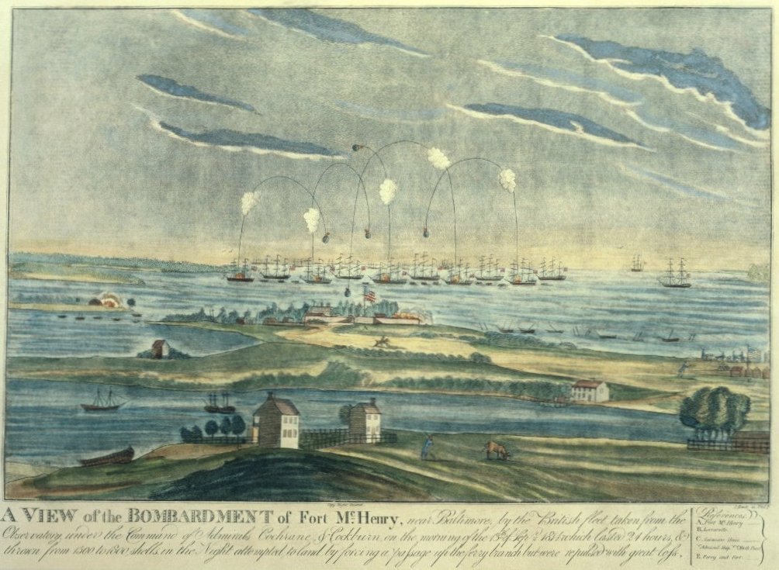
Battle of Baltimore
American Victory
Francis Scott Key was inspired by the fort's survival to write "The Star-Spangled Banner" in honor of the American flag.
A second British victory after that at Washington would cripple the American war effort.
On September 13, 1814, British ships began a bombardment of Fort McHenry and Baltimore Harbor which would last 27 hours.
Fort McHenry withstood the bombardment, making further attempts on Baltimore impossible.
Wikimedia Commons
Notes:
Extra Resources:
The Battle of Fort McHenry Video: https://www.battlefields.org/learn/videos/untold/battle-fort-mchenry
Battle of Fort McHenry: https://www.battlefields.org/learn/war-1812/battles/fort-mchenry
Baltimore during the War of 1812: https://www.battlefields.org/learn/articles/baltimore-during-war-1812
War of 1812: "Undaunted we marched out": https://www.battlefields.org/learn/primary-sources/war-1812-undaunted-we-marched-out
Initially, the British strategy during the War of 1812 had been defensive. The British were more concerned with defeating Napoleon in Europe than fighting a minor war with the United States. This changed on April 6, 1814, with the defeat and abdication of Napoleon, which freed up veteran troops for a more aggressive strategy. Major General Robert Ross was sent to command all British forces on the East Coast of the United States, with Vice Admiral Alexander Cochrane leading a fleet of warships.
Encouraged by their victory at Bladensburg on August 24, 1814, and the subsequent burning of Washington, D.C., the British turned north, intent on capturing the major port city of Baltimore, Maryland. Militarily, Baltimore was a far more important city than Washington because of its thriving port and strategic location. The British hoped the loss of both Washington and Baltimore would cripple the American war effort and force peace. However, the citizens and militia of Baltimore had been preparing for such an assault for more than a year. The imposing Fort McHenry, at the mouth of the inner harbor, provided the linchpin for the American defenses.
American forces resisted the dramatic British bombardment of Fort McHenry and proved they could stand up to a great world power. The exploding shells and rocket fire from British warships inspired Francis Scott Key to pen the lyrics to the “Star-Spangled Banner.” Seeing no way to penetrate American defenses, the British withdrew their troops and gave up their Chesapeake Campaign.

Slide 14
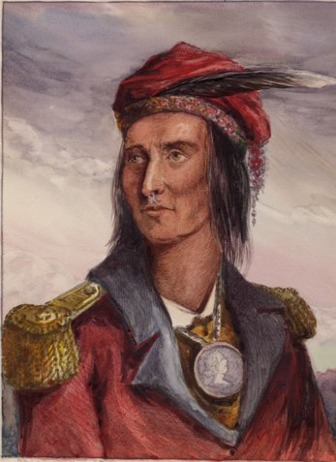
The Battle of the Thames
American Victory
After Perry's victory, the British retreated into Canada, and Harrison's army pursued them to the Thames River.
The British's local allies, a broad confederacy of Native American nations under Tecumseh, saw the retreat as a betrayal and wanted to stay and fight.
The outnumbered and exhausted British and Native Americans were defeated at the Thames River on Oct 5, 1813. Tecumseh was killed in the fighting and his confederacy dissolved.
Notes:
Extra Resources:
Battle of the Thames: https://www.battlefields.org/learn/war-1812/battles/battle-thames
Tecumseh: https://www.battlefields.org/learn/biographies/tecumseh
William Henry Harrison: https://www.battlefields.org/learn/biographies/william-henry-harrison
During the fall of 1813, American forces in the Western frontier began an offensive to reclaim the lost territory in the Great Lakes and Detroit front. After gaining a victory in the Battle of Lake Erie in September of that same year, American forces under the command of William H. Harrison were free to move on to British-held Fort Detroit. After capturing the fort, Harrison then pursued the fleeing British army into Canada in hopes of trying to destroy them completely. On October 5, 1813, American forces under the command of William H. Harrison defeated British forces and their allies in the Battle of the Thames, resulting in the death of the famed Native American leader Tecumseh and the end of his Confederacy. After attacking the British line and forcing a general rout, Harrison’s soldiers moved towards the last pocket of resistance led by Native American leader Tecumseh. After some initial brutal fighting ensued, Tecumseh was killed and what remained of his Native American army retreated, ending the battle.

Slide 15
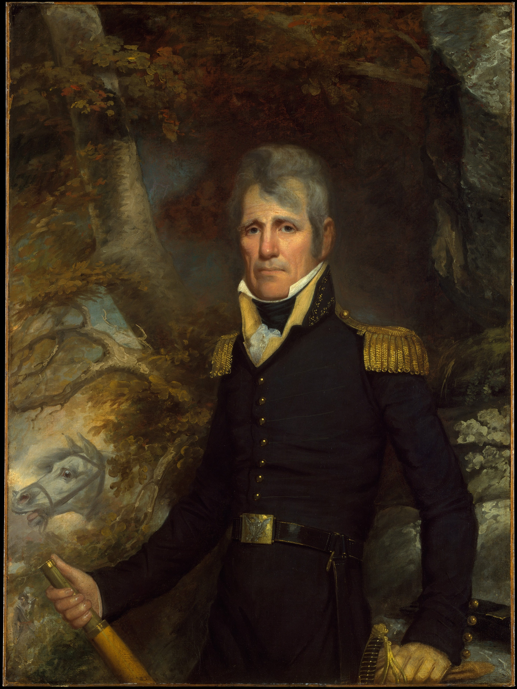
The Battle of New Orleans
January 8, 1815: American Victory
The Treaty of Ghent was signed in December 1814, restoring pre-war borders.
Before word could reach the U.S., future president General Andrew Jackson defeated a larger British force at the port city of New Orleans.
The victory catapulted Jackson to fame and established the young United States as a formidable world power.
Metropolitan Museum of Art
Notes:
Extra Resources:
"Untold: The Battle of New Orleans" https://www.battlefields.org/learn/videos/untold/battle-new-orleans
"In4Minutes: The Battle of New Orleans" https://www.battlefields.org/learn/videos/battle-new-orleans
The Battle of New Orleans: https://www.battlefields.org/learn/war-1812/battles/new-orleans
Battle of New Orleans: The Last Battle of the War of 1812: https://www.battlefields.org/learn/articles/battle-new-orleans-last-battle-war-1812
Battle of New Orleans 1812 Virtual Tour: https://www.battlefields.org/visit/virtual-tours/battle-new-orleans-1812-virtual-tour
After Napoleon’s defeat in the spring of 1814, the British were free to concentrate on their war in America. With a strategic focus on coastal regions and American trade and transportation, the British army attacked and burned Washington in August 1814. Although unable to take Baltimore the following month, the British nonetheless moved ahead with a plan to attack New Orleans.
Apprised of a possible invasion on the Gulf Coast, the commander of the U.S. Seventh Military District, Andrew Jackson, left Mobile, Alabama, for New Orleans on November 22. Recently promoted to Major General in the Regular Army for his successful campaign against the Creek Indians, Jackson reached the city on December 1 and began the task of assembling an army, which eventually consisted of Tennessee and Kentucky frontiersmen, Louisiana militia, New Orleans businessmen, Free Men of Color, Choctaw Indians, smuggler Jean Lafitte and his privateers, sailors, marines, and United States troops.
On January 8, 1815, Maj. Gen. Andrew Jackson's hastily assembled army won the day against a battle-hardened and numerically superior British force. The resounding American victory at the Battle of New Orleans soon became a symbol of American democracy triumphing over the old European ideas of aristocracy and entitlement. The battle was the last major armed engagement between the United States and Britain.

Slide 16
Notes:
Always more FREE resources at www.battlefields.org

