Slide 1
American Revolution Experience
The American Battlefield Trust

Slide 2
1775-1783
The American Revolution began with the Battles of Lexington and Concord in 1775.
It ended with the Treaty of Paris in 1783.
Outcome: Independence for the United States
Check out a Revolutionary War Timeline here!

Slide 3
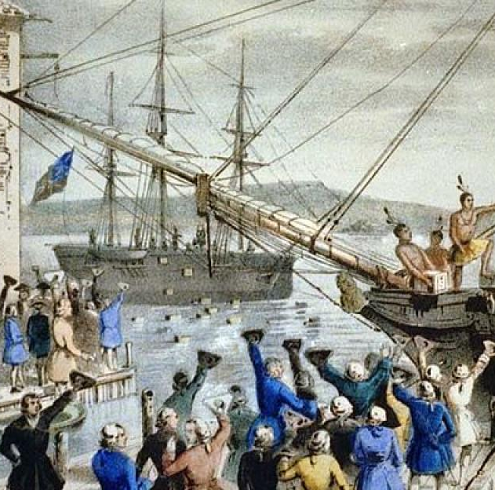
Toward Revolution
After their French and Indian War victory, Britain instituted changes within the colonies
  No westward movement (Proclamation of 1763)
    Purpose: avoid future conflicts between colonists and American Indians and to pay off debt
  Taxes (Stamp Act of 1765, Tea Act, Sugar Act)
    Purpose: pay off war debt created by British fighting on behalf of the colonies
"Patriots" protested these taxes
  Boston Tea Party
Notes:
Extra Resources:
"The French and Indian War (1754-1763): Its Consequences" article https://www.battlefields.org/learn/articles/french-and-indian-war-1754-1763-its-consequences
Royal Proclamation of 1763 primary source
Stamp Act of 1765 primary source https://www.battlefields.org/learn/primary-sources/stamp-act-1765
Tea Act primary source https://www.battlefields.org/learn/primary-sources/tea-act
Sugar Act primary source https://www.battlefields.org/learn/primary-sources/sugar-act
"'Boston a Teapot Tonight!'" article https://www.battlefields.org/learn/articles/boston-teapot-tonight
After the end of the French and Indian War, the victorious Britain gained a large swath of French territory in North America. Now burdened with the task of governing such a large area, King George III issued this proclamation to forbid European settlement west of the Appalachian Mountains and reserved this land for use by Native Americans. It also created new colonies in North America and the Caribbean. This was the first of a string of British measures intended to tighten their control on the colonies and would factor into the breakdown of relations between Britain and her American colonies. Taxes imposed to pay for a massive national debt, a constant struggle with Native Americans over borders and territories, and the prohibition of expansion to the west fueled an ever-increasing “American” identity.
Possible discussion question: why might the colonists be upset about the taxes and restrictions?

Slide 4
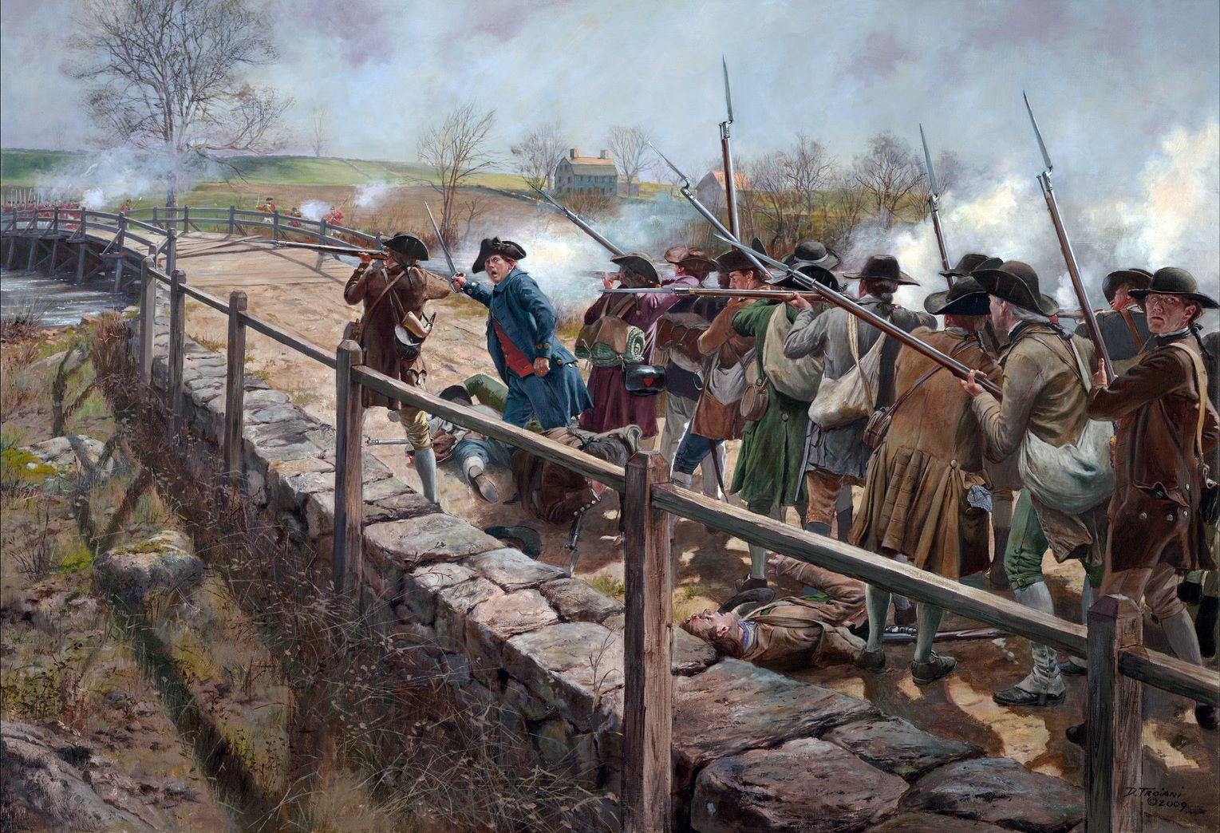
Lexington and Concord: The First Battle of the Revolution
April 19, 1775
British troops marched into Lexington at about 5:00 a.m. and faced by a militia company of more 70 men led by Capt. John Parker.
The British rushed toward the militia across the town green and Parker immediately ordered his company to disperse
  But, one single shot rang out, causing the British to fire a volley
The British moved onto Concord to secure the North Bridge across the Concord River
400 militia from the Concord area gather on the high ground, where they mistakenly assumed the British were torching the town, so they advanced
The British were intimidated by the militia, so they retreated to the opposite shore
When the militia came within range, the British opened fire and the minutemen responded
Don Troiani​
Notes:
Extra Resources:
"Lexington and Concord" In 4 Minutes video https://youtu.be/jQtkw2tCLyU
"Ten Facts: The Battles of Lexington and Concord" article https://www.battlefields.org/learn/articles/ten-facts-battles-lexington-and-concord
"Lexington and Concord: The Shot Heard 'Round the World" article https://www.battlefields.org/learn/articles/lexington-and-concord-shot-heard-round-world
The battle ended in an American victory. The British marched into Lexington and Concord intending to suppress the possibility of rebellion by seizing weapons from the colonists. Instead, their actions sparked the first battle of the Revolutionary War. The colonists’ intricate alarm system summoned local militia companies, enabling them to successfully counter the British threat.
Possible discussion question:

Slide 5
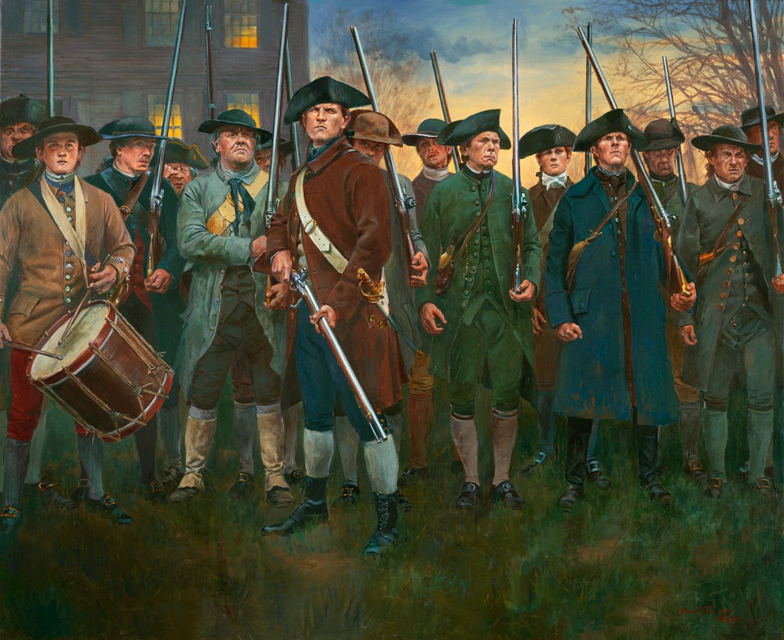
Forming the Continental Army
June 14, 1775
The Continental Army— a regular standing army to oppose the British— was created with George Washington as its commander.
Washington saw the Continental Army as the best way to mold a new nation.
  A national army could remove sectional differences
Continental Army contained soldiers from all colonies
militia:
Males 16-60 years old who were citizen soldiers.
minuteman:
One subset of the Massachusetts or New England militia that was prepared to fight at a moment's notice.
Don Troiani​
Notes:
Extra Resources:
"Militia, Minutemen, and Continentals: The American Military Force in the American Revolution" article https://www.battlefields.org/learn/articles/militia-minutemen-and-continentals-american-military-force-american-revolution
"Continental Congress: Unprepared for War" article https://www.battlefields.org/learn/articles/continental-congress-unprepared-war
After Lexington and Concord in April 1775, thousands of militia from around New England and some mid-Atlantic states surrounded the British in Boston. Many in the Continental Congress such as John Adams called for the “nationalization” of the military forces around Boston. After some debate, on June 14, 1775, the Continental Army was created with Washington as commander. This was a major step for the colonies, as it now looked to create a regular standing army to oppose the British. In the beginning, Congressional leaders believed a force of approximately 20,000 men in 26 battalions would be sufficient. Quickly military and political leaders realized they would need more units and authorized more units including cavalry and artillery. Congress continued to revise and reorganize the Continental Army. One of the most significant changes were the terms of service. At the beginning of the war, terms were very short with an average of one year but as the war drew on, three years or duration of the war was required. Congress expected states to furnish “levies” as well to supplement the Continental ranks. These numbers were based on the size of the state, and many had a difficult time filling their quotas. It is difficult to determine the number of men that served as many reenlisted in the army once their terms were up. Widely accepted estimates include nearly 231,000 men served in the Continental Army, with the largest year being 1776. The army was fully integrated with nearly 6,600 people of color serving, many earning freedom from enslavement.
Possible discussion question: how was the Continental Army different than what you know about the military today?

Slide 6
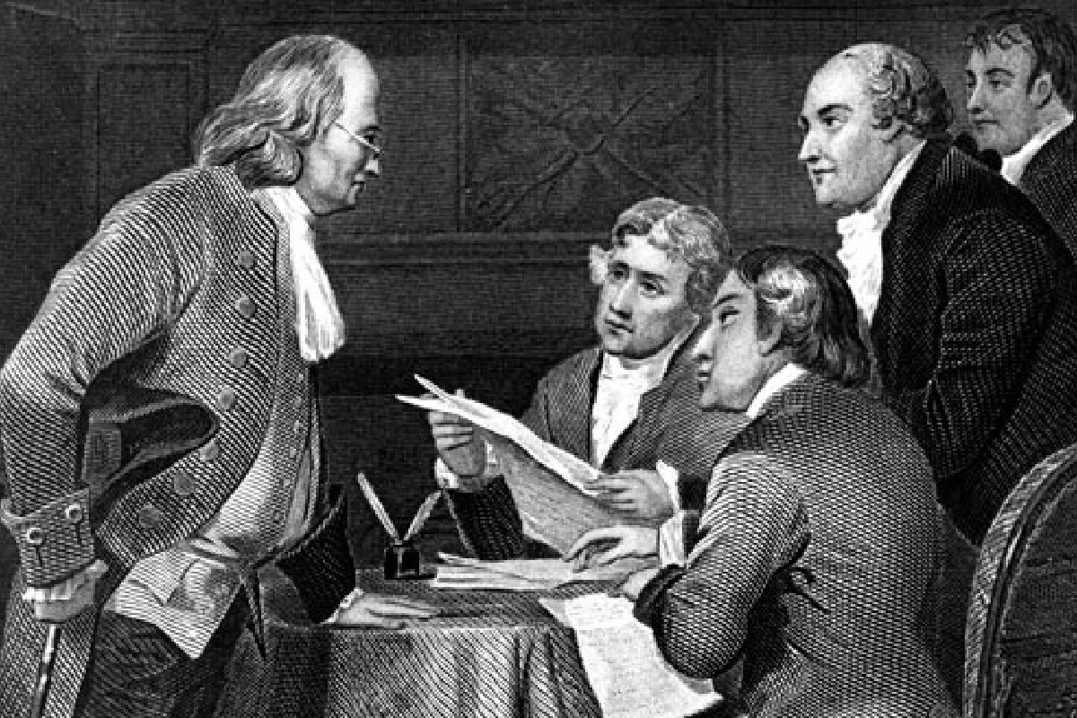
The Declaration of Independence
July 4, 1776
Declared independence from Great Britain
56 men signed the Declaration of Independence
Formed the United States as a separate nation.
Notes:
Extra Resources:
The Declaration of Independence primary source https://www.battlefields.org/learn/primary-sources/declaration-independence
"The Declaration of Independence" article https://www.battlefields.org/learn/articles/declaration-independence
"Independence Hall: The Birthplace of America" video https://youtu.be/CePiy1oRyYE
On June 28, after making some changes as a group, the Committee of Five presented Jefferson’s version of the declaration to Congress. Congress took the draft and made some significant changes to it, rearranging sentence structures, shortening the length, and significantly, removing a clause the blamed King George III for the slave trade in the colonies. The powerful ideas echoing throughout the Declaration were intended for a wide audience. The Declaration was not only meant to reach Americans and the King, but the general world as well. The document was meant to reach foreign allies and announce to the world that the colonies were now a new country.
Possible discussion question: What were the different purposes of the Declaration of Independence?
Photo source: https://www.politico.com/story/2018/07/04/declaration-of-independence-adopted-by-continental-congress-july-4-1776-692467

Slide 7
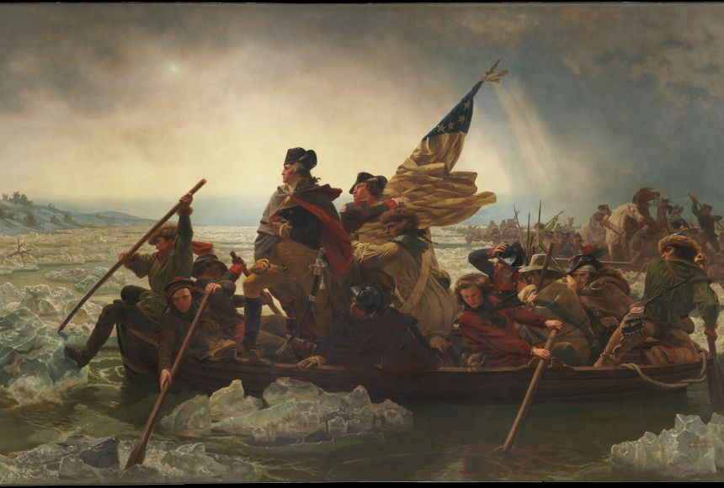
“Victory or Death”
With morale running low by the end of 1776 with the loss of New York City, Washington recognized the need to make a bold offensive move to alter the course of the war.
On Christmas night 1776, Washington decided to cross the icy Delaware River back into New Jersey and launch a surprise attack on Hessian soldiers stationed at Trenton under the command of Colonel Rall.
Over "The 10 Crucial Days," Washington won victories and Trenton and Princeton which kept his army together and the Revolution alive.
Painting by Emanual Leutze
Notes:
https://www.battlefields.org/learn/biographies/john-glover
While Washington's decision to cross the Delaware River demonstrated his leadership and courageous decision-making, he also had to rely on others in his army to successfully cross the river and attack Trenton. One man in particular that aided Washington during the crossing was John Glover. As leader of the 14th Continental Regiment, which Washington deemed men "bred to the sea," John Glover and his men valiantly led the Continental Army across the Delaware River in icy waters and blizzard conditions. Without the support of Glover and the 14th Continental Regiment, Washington may have been unsuccessful in his crossing which likely would have led to defeat for the patriots in the war.
Photo Credit:
https://www.mountvernon.org/library/digitalhistory/digital-encyclopedia/article/crossing-of-the-delaware/

Slide 8
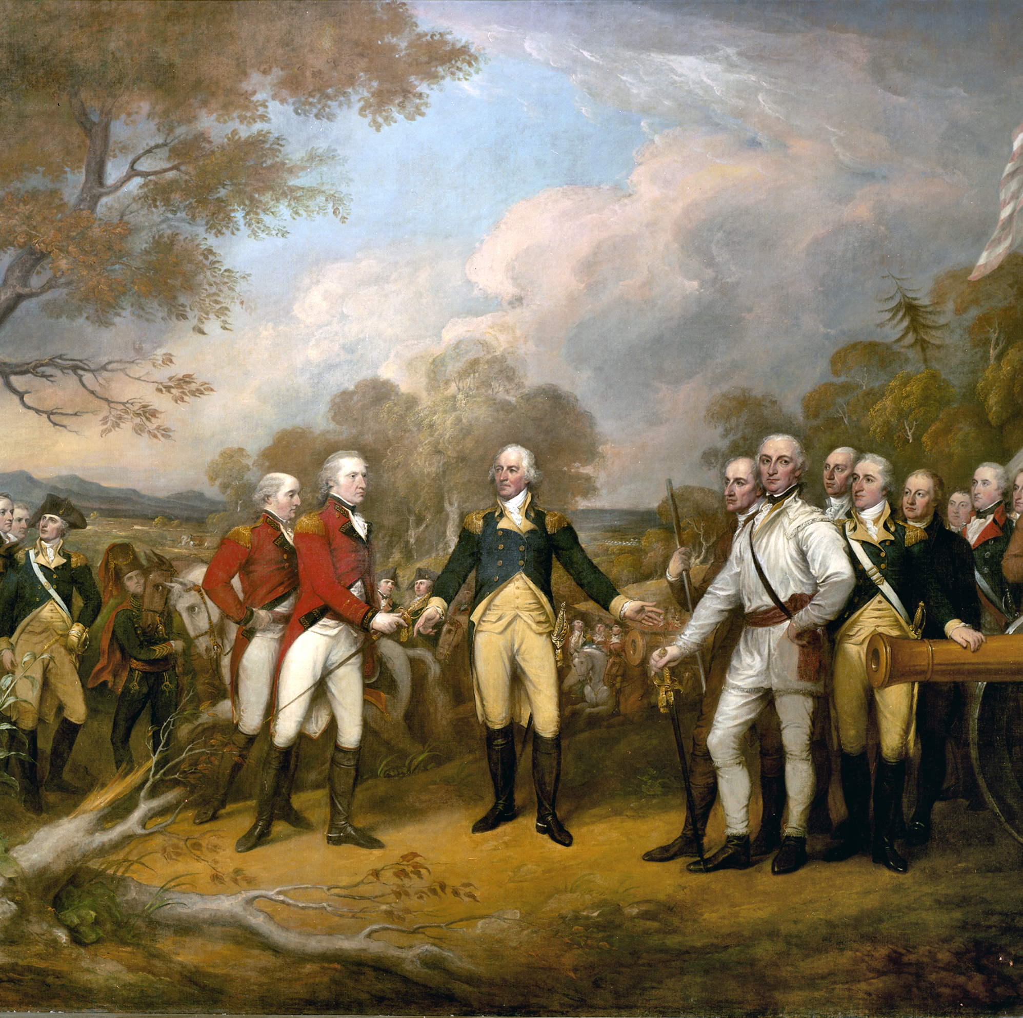
The Battles of Saratoga
American General Horatio Gates fought and trapped Burgoyne at Saratoga, New York, preventing the British armies from uniting and forcing Burgoyne to surrender on October 17, 1777.
The surrender of Burgoyne's 5,000-man army was key in gaining international support for the American cause.
Discuss: Why would countries like France and Spain be more likely to support the United States after the victory at Saratoga?
Notes:
The Battle of Saratoga was a turning point in the Revolutionary War. The American defeat of the superior British army lifted patriot morale, furthered the hope for independence, and helped to secure the foreign support needed to win the war.
How it ended
American victory. One of the most decisive American battles of the Revolutionary War, Saratoga ended British general John Burgoyne's attempt to control the Hudson River Valley. The outcome convinced the Court of King Louis XVI that the Americans could hold their own against the British Army, sealing the alliance between America and France. American general Benedict Arnold was hailed as a hero for his bravery on the battlefield, a reputation lost with his later betrayal and defection to the Royalists.
In context
In 1777, British strategy called for a three-pronged attack on New York, with three separate armies converging near Albany. For British general John Burgoyne, moving south from Canada with 7,500 men, the Hudson River Valley became the critical route for the invasion. By August, Burgoyne had captured Fort Ticonderoga, defeated fleeing American troops at Hubbardton (Vermont), and occupied Fort Edward, on the edge of the Hudson River. After a contingent of Burgoyne’s troops was defeated in the Battle of Bennington, his reduced forces marched south toward Saratoga in early September.
General Horatio Gates and his American soldiers had built formidable defenses on Bemis Heights, just south of Saratoga overlooking the Hudson. The two armies engaged in combat at Freeman’s Farm on September 19. While the British held off the Americans, their losses were great. Burgoyne’s battered forces dug trenches and waited for reinforcements, but none came. Burgoyne launched a second, unsuccessful attack on the Americans at Bemis Heights on October 7. With no means of escape, Burgoyne eventually surrendered to Gates on October 17. The victory persuaded France to sign a treaty with the United States against Britain. France’s financial and military support contributed to Washington’s victory at Yorktown in 1781, which effectively ended America’s War for Independence.
https://www.battlefields.org/learn/revolutionary-war/battles/saratoga
https://www.battlefields.org/learn/articles/ten-facts-battle-saratoga

Slide 9
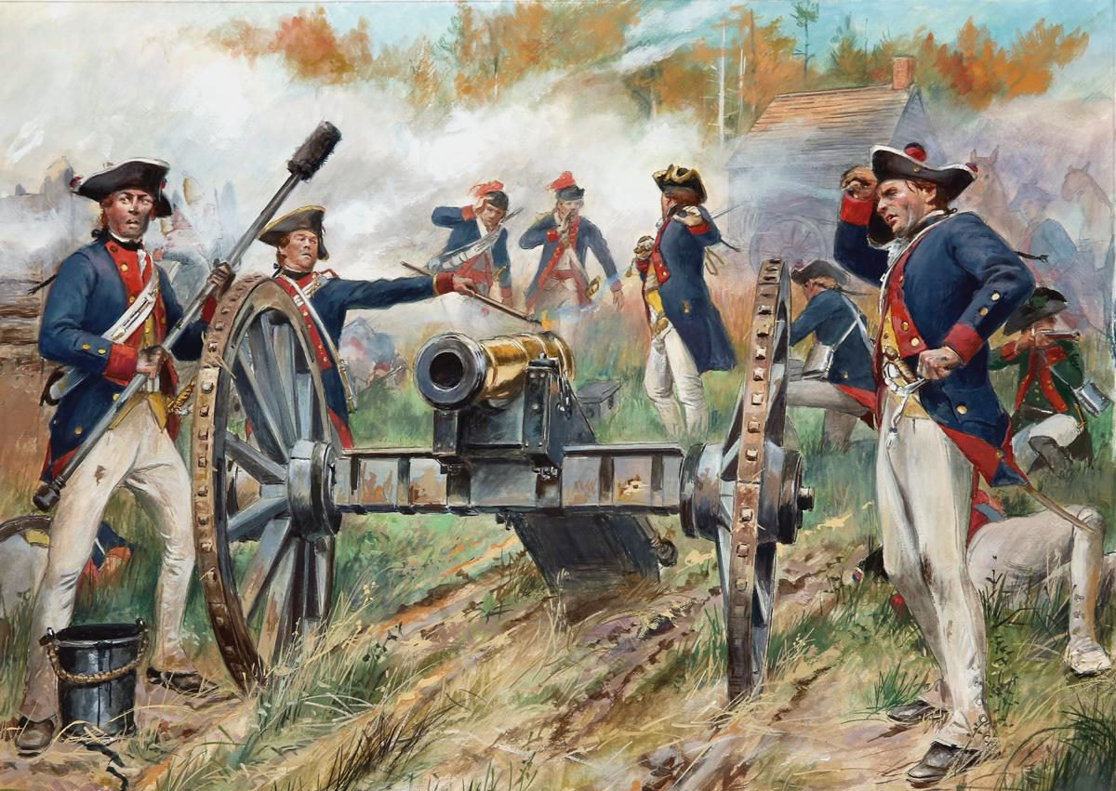
The Birth of an Alliance
Early in 1776, France began secretly providing support to the Americans, including gunpowder and arms.
France had a long history of war with Great Britain and hoped to regain some of the territory it lost in 1763.
The victory at Saratoga, along with Benjamin Franklin's skillful diplomacy, convinced France to support the United States openly.
Don Troiani
Notes:
https://www.battlefields.org/learn/videos/untold/revolutionary-diplomats-franklin-and-adams
https://www.battlefields.org/learn/articles/10-facts-benjamin-franklin
Throughout 1777, the Continental Army achieved victories, causing the French monarchy to take more interest in the conflict. The Marquis de Lafayette proved highly beneficial to the army and persuaded American leaders that an official alliance between the colonies and France would create mutual benefit. The French monarchy still needed a decisive victory before officially agreeing to a treaty of alliance. In the autumn of 1777, an American army, under the command of Horatio Gates, participated in one of the most decisive combats of the American Revolution: The Battles of Saratoga. The American troops successfully prevented British General John Burgoyne’s force from taking the Hudson River Valley. On October 17, after negotiations, Burgoyne's army surrendered. Impressed by the Patriots’ resistance to Britain, France agreed to sign a formal Treaty of Alliance with the Americans. On December 3, Benjamin Franklin arrived in France to join Silas Deane and Arthur Lee to negotiate and write the official alliance treaties.
In early 1778, Benjamin Franklin, Silas Deane, and Arthur Lee began negotiations with the French government's Conrad Alexandre Gérard de Rayneval. The Franco-American Alliance Treaty agreed that neither country would stop fighting with Great Britain until independence was granted. In addition to the alliance, France signed the Treaty of Amity and Commerce, creating an official trade network with the colonies. Due to a previous alliance treaty with France, the American colonies now had Spain as an ally in the American Revolution.

Slide 10
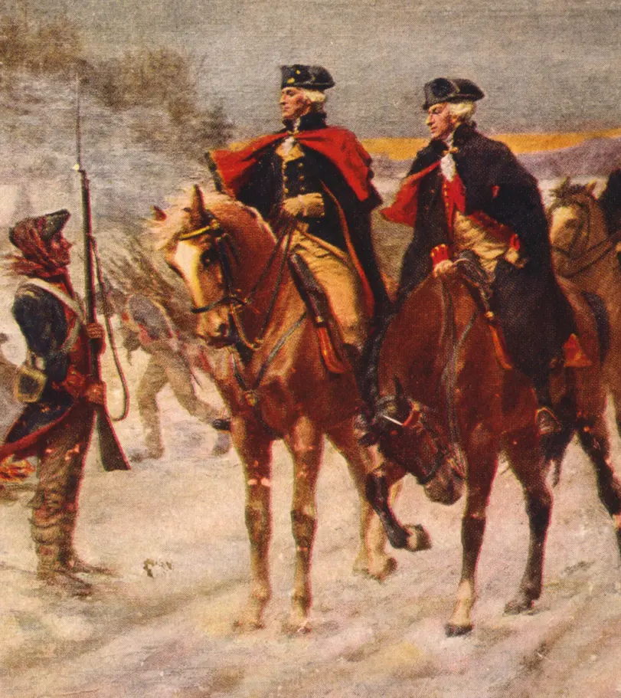
Valley Forge
Washington exhibited his leadership and was able to turn the British capture of Philadelphia to his favor.
With the help of men such as Baron von Steuben, Marquis de Lafayette, and Alexander Hamilton, Washington utilized Valley Forge as a place to regroup and train his soldiers.
Despite the significant loss of life due to the harsh winter, the time spent at Valley Forge turned out to be largely successful as a result of the training and regrouping endeavors that took place.
Notes:
https://www.battlefields.org/learn/articles/ten-facts-valley-forge
https://www.battlefields.org/learn/biographies/marquis-de-Lafayette
https://www.battlefields.org/learn/biographies/alexander-hamilton
One of the most significant figures that camped at Valley Forge and helped the Continental Army was Baron von Steuben who acted as an inspecting general. He was instrumental in instructing soldiers the rudiments of military drill and in turn created a system of training. Additionally, Washington's aide-de-camps, Marquis de Lafayette and Alexander Hamilton, also resided at Valley Forge during the winter and aided Washington by giving him advice and support. Hamilton helped support Washington and the Continental Army at Valley Forge by writing letters to political leaders (i.e., governors and congressmen) requesting provisions. Meanwhile, Lafayette provided assistance to the encampment by distributing uniforms and muskets to men who were lacking them.
Photo Credit:
https://www.loc.gov/resource/cph.3g06877/

Slide 11
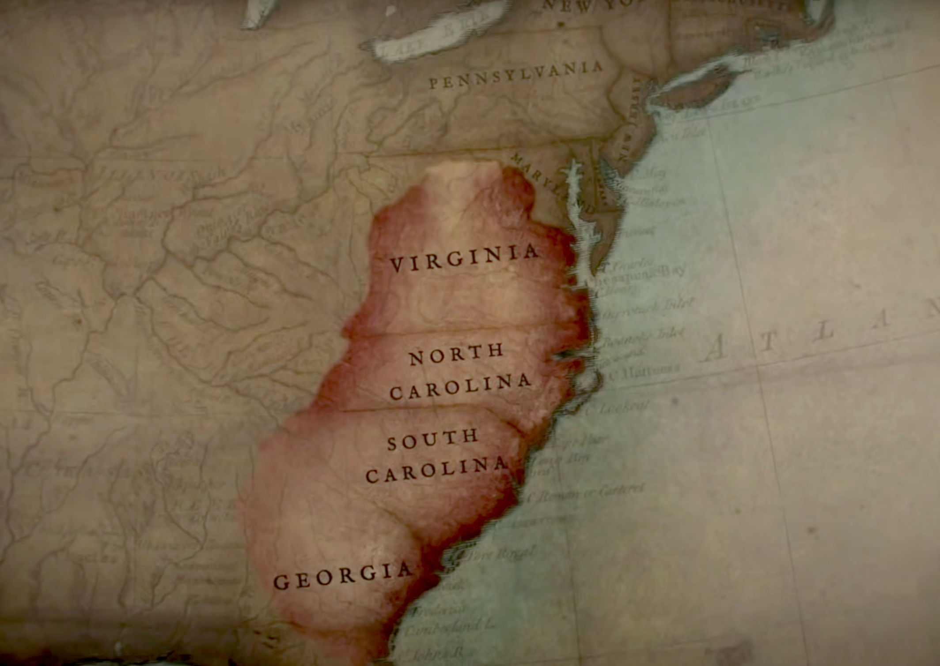
Southern Focus
Stalemate gripped the North
By the end of 1778, British concentrate efforts in southern colonies
Cash crops in the South a valuable resource to keep in the British empire.
By securing the South, British hoped to cut the colonies in two
  Leave the North, control the prosperous South
British southern victories
  Captured Savannah, Georgia (December 1778)
  Victories in 1779 at Briar Creek, Stono Ferry
Notes:
Extra Resources:
"The Southern Campaign: The Revolutionary War in Four Minutes" In 4 Minutes video https://www.youtube.com/watch?v=S0eg6TDNVQ4&t=1s
"The Southern Theater of the American Revolution" article https://www.battlefields.org/learn/articles/southern-theater-american-revolution
In the South, where the split between Patriots and Loyalists was much more even, both militias recruited heavily. The years of 1775-1777 were dominated by small skirmishes and the British need for a deep-water port to support their southern campaign. In June 1776, British Major General Sir Henry Clinton and Commodore Sir Peter Parker attempted to capture Charleston, the most critical port in the South, but were unable to reduce Fort Sullivan (which would become Fort Moultrie, named for the commander who led the successful defense) and take the city.
Possible discussion question: What do you think could be advantages and disadvantages of Britain's decision to focus on the south?

Slide 12
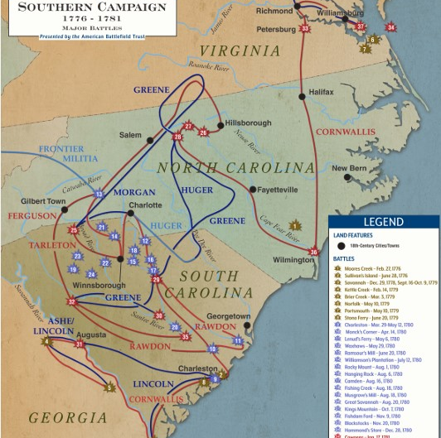
Communities at War
In the Southern Campaigns, some battles were fought "traditionally," but many other conflicts happened as partisan skirmishes.
Communities divided between Loyalists and Whigs (patriots), and sometimes neighbors fought each other in short combats or surprise attacks.
Organized partisan forces attacked British supply lines or Whig-supporting settlements.
Because of this viciousness, these final years left a bitter impact in the memory of the survivors and their descendants.
Definition:
Whig – a political party associated with support for American Independence during the Revolutionary War Era.
Notes:
https://www.battlefields.org/learn/articles/bloody-ban-backcountry
Of all the colonies that suffered during the War for Independence, few endured the brunt of the constant bloodshed in its final years as South Carolina. Contrary to popular convention, much of the fighting in the Revolutionary War was conducted in much the same manner as most conventional 18th century warfare: strictly organized and disciplined armies, utilizing linear tactics, taking part in pitched battles on the open field, with the Continental Army quickly transitioning from a ragtag militia to a fully professional force. As the war moved South however, the terrain in the backcountry gave way to a sustained guerilla campaign in addition to the traditional Continental forces. Current estimates suggest that over 1,000 Americans died in the fighting here, almost one-fifth of those that died in battle throughout the entire war. This, of course, says nothing about those who died of disease or starvation, as well as the destruction of private and public property by forces attempting to root out the partisans. Because of this viciousness, these final years left a bitter impact in the memory of the survivors and their descendants. In fact, there seems to have been a unique set of circumstances that set the War in the Backcountry apart from the other Theaters.

Slide 13
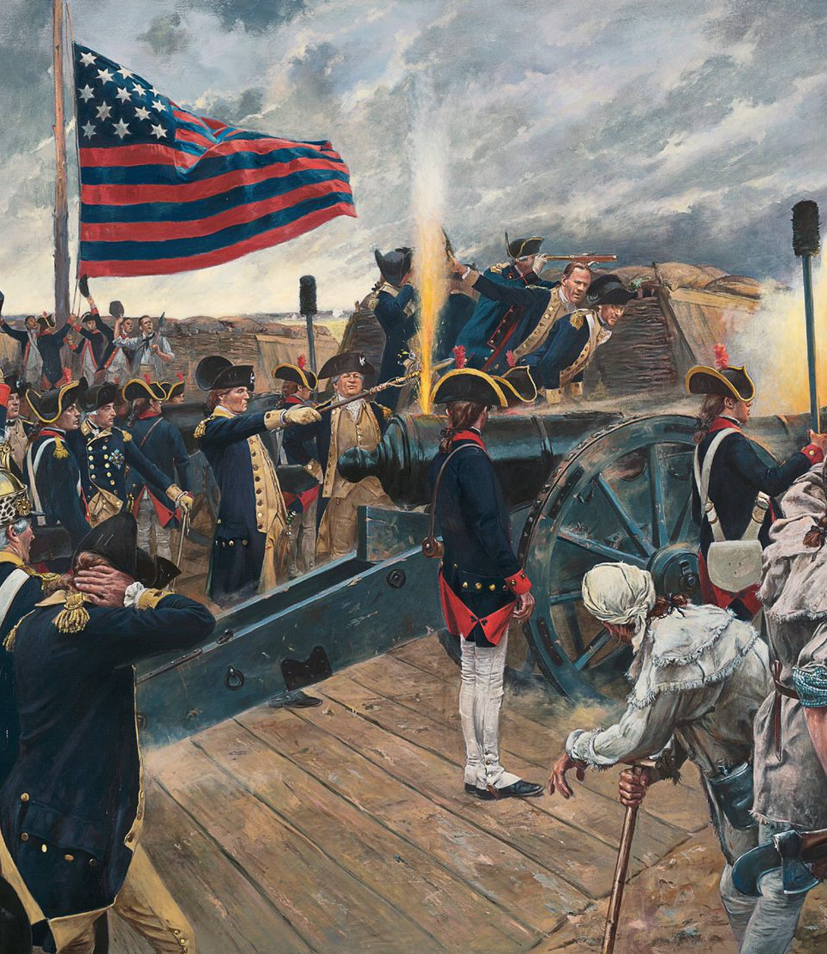
Yorktown
September 28 - October 19, 1781
Cornwallis entered Virginia and captured Virginian cities.
Sept 1781- Cornwallis camped near Yorktown, hoping to be resupplied by the British navy.
General Washington rushed to Virginia to lock British in from land
French locked them in from sea
After 3 weeks of siege operations, Cornwallis surrendered on October 19, 1781
The War continued for 2 more years, but the major fighting was over
Treaty of Paris ended the Revolution on September 3, 1783
Don Troiani
Notes:
Extra Resources:
Yorktown 360° Virtual Tour https://www.battlefields.org/visit/virtual-tours/yorktown-virtual-tour
Battle of Yorktown article https://www.battlefields.org/learn/revolutionary-war/battles/yorktown
After six years of war, both the British and Continental armies were exhausted. The British, in hostile territory, held only a few coastal areas in America. On the other side of the Atlantic, Britain was also waging a global war with France and Spain. The American conflict was unpopular and divisive, and there was no end in sight. For the colonies, the long struggle for independence was leading to enormous debt, food shortages, and a lack of morale among the soldiers. Both sides were desperately seeking a definitive victory.
General George Washington and his Continental Army had a decision to make in the spring of 1781. They could strike a decisive blow to the British in New York City or aim for the south, in Yorktown, Virginia, where Gen. Charles Lord Cornwallis’s troops were garrisoned. Washington and his French ally, Lt. Gen. Comte de Rochambeau, bet on the south, where they were assured critical naval support from a French fleet commanded by Adm. Comte de Grasse. The Allied armies marched hundreds of miles from their headquarters north of New York City to Yorktown, making theirs the largest troop movement of the American Revolution. They surprised the British in a siege that turned the tide toward an American victory in the War for Independence. The Battle of Yorktown proved to be the decisive engagement of the American Revolution. The British surrender forecast the end of British rule in the colonies and the birth of a new nation—the United States of America. American victory. Outnumbered and outfought during a three-week siege in which they sustained great losses, British troops surrendered to the Continental Army and their French allies. This last major land battle of the American Revolution led to negotiations for peace with the British and the signing of the Treaty of Paris in 1783.
Possible discussion question: What techniques did the Americans and French use to close in on the British at Yorktown?

Slide 14
Experiences...
While the American Revolution has a large place in U.S. History and led to our nation's independence from Britain, the conflict was fought, argued over, and waged by common people in extraordinary times.
The American Revolution Experience helps to explore the lives of lesser-known historical figures.
Enjoy the exhibit and choose a historical figure to learn more about through primary and secondary sources!

