Slide 1
George Washington's Leadership
The American Battlefield Trust

Slide 2
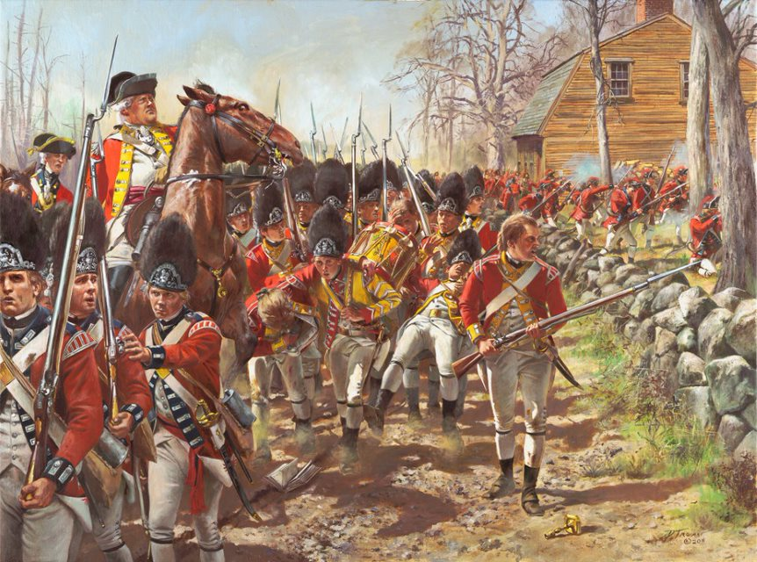
Origins of the War
The "Shot heard round the world" is fired at Concord beginning the Revolutionary War on April 19, 1775.
Boosted by victories at Lexington & Concord, Fort Ticonderoga, and a resilient stand at Bunker Hill despite defeat, the Continental Congress formed the Continental Army under George Washington's leadership.
Aided by patriot Henry Knox and artillery from Fort Ticonderoga, Washington forces Britain out of Boston securing an early victory for the patriot cause.
This victory is the beginning of a long and brutal war.
Did You Know?
Artillery is a term for larger weapons such as cannons and mortar guns.
Don Troiani
Notes:
https://www.battlefields.org/learn/articles/fighting-man-continental-army
Most of the men fighting in this war were between the ages of 15-30 consisting mainly of merchants, mechanics, and farmers. By 1780, nearly 30,000 men were serving in the Continental Army. On January 10, 1776, (two months before Britain evacuated Boston), Thomas Paine’s Common Sense was published. This pamphlet argued for independence from Britain and was a crucial work that further ignited the fire of freedom in the hearts of colonists. Subsequently, a mere six months after the release of Common Sense, Congress adopted the Declaration of Independence and officially declared independence from Britain.

Slide 3
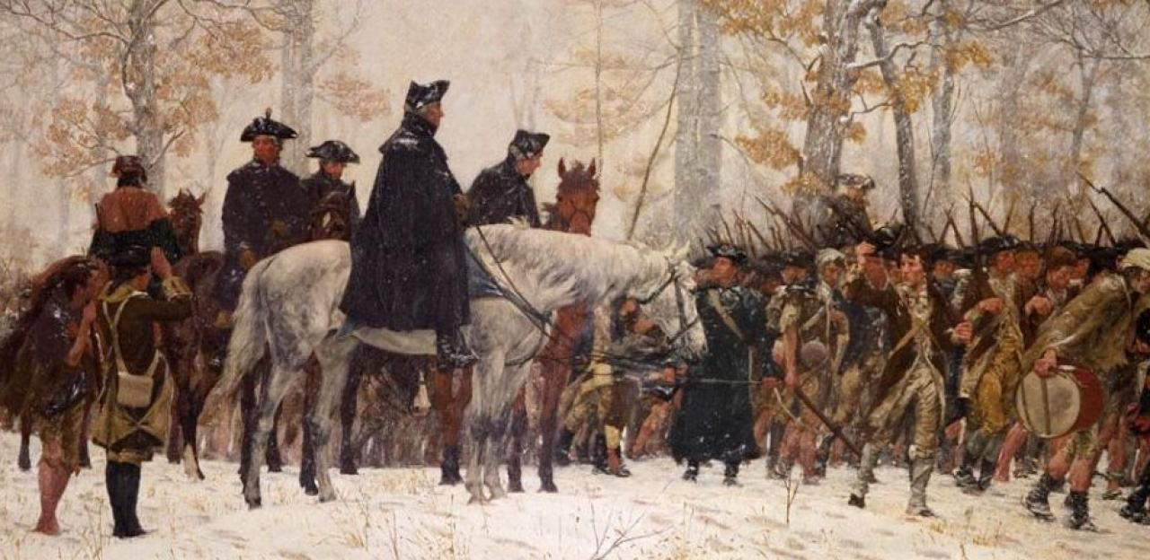
How Did George Washington's Leadership Shape the Revolutionary War?
Inquiry Question:
Notes:
Photo Credit:
https://www.nps.gov/vafo/planyourvisit/images/marchtovalleyforge_trego_1883_ARC2.jpg

Slide 4
George Washington
Humble leader that valued advice from his officers.
Experienced military officer before Revolutionary War (French and Indian War).
Fearless in battle.
Had an "unwillingness to depart" from his wife and used "every endeavor" to avoid being appointed leader of the Continental Army.
Driven by a profound sense of "destiny," he accepted the position, solidifying his role as the future "Father of His Country."
Notes:
https://www.battlefields.org/learn/primary-sources/george-washington-martha-washington
https://www.battlefields.org/learn/articles/george-washingtons-military-leadership
https://www.battlefields.org/learn/articles/george-washingtons-rise-rebellion
Some of the men that Washington listened to intently and highly valued were Alexander Hamilton, John Laurens, and Baron von Steuben. These men pushed, prodded, and created dialogue that Washington absorbed and synthesized to evolve as a leader. The humility of being able to learn from various sources, put ego aside for the cause, and never lose the ultimate goal was a major strength of Washington’s character. Due to his notable role in the French and Indian War, Washington had a robust military resume. Some of his experiences in the war helped him learn how to train and discipline troops and fight skillfully in battles. While he was fearless in battle, he also had an innate ability to recognize momentary defeat and retreat in a skillful manner. In this way, Washington symbolized the famous saying, “One can lose a battle, but win a war.” Despite his love for his wife, Washington simply could not decline the offer as leader of the Continental Army due to his commitment and belief in the patriot's cause.
Photo Credit:
https://www.loc.gov/resource/cph.3b19847/

Slide 5
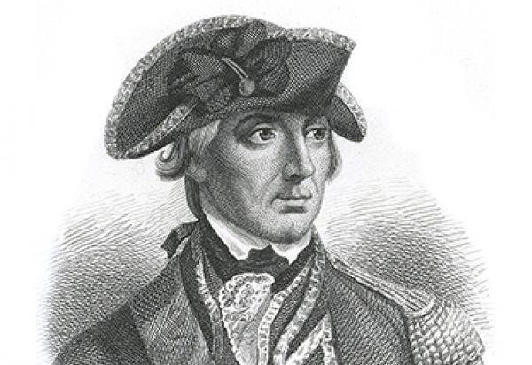
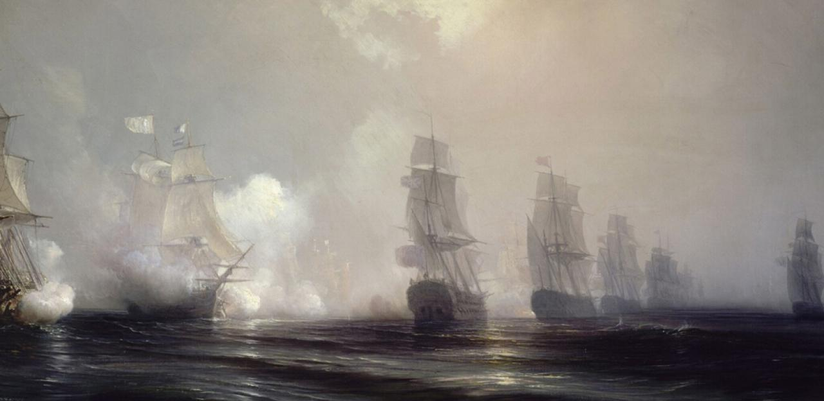
"All of London is Afloat"
Following the patriots' victory in Boston, Britain returned to America with vengeance (132 ships) docking in Long Island, New York under the command of William Howe (depicted).
Howe achieved a decisive victory over Washington's troops at the Battle of Brooklyn and later forced them to retreat from Harlem Heights.
Washington, after numerous difficult defeats, withdrew to Pennsylvania with his weary soldiers in December 1776.
Did You Know?
A retreat is when soldiers withdraw from a battle or enemy territory to protect themselves and reassess their strategy.
Notes:
https://www.battlefields.org/learn/biographies/william-howe
During the New York Campaign, Howe repeatedly defeated Washington in several battles. As a result, Washington was continually retreating from Howe which eventually forced him to fall back to Pennsylvania leaving Howe, at the time, victorious in the New York area. However, Howe’s failure to completely destroy Washington and the Continental Army kept the hope of independence alive in the hearts of patriots. Furthermore, Howe's decision to not pursue Washington into Pennsylvania proved to be a catastrophic mistake for Howe and Britain's conquest to squash the rebellious colonists.
Photo Credit:
https://upload.wikimedia.org/wikipedia/commons/5/5c/Combat_naval_devant_la_Chesapeake%2C_3_septembre_1781.jpg

Slide 6
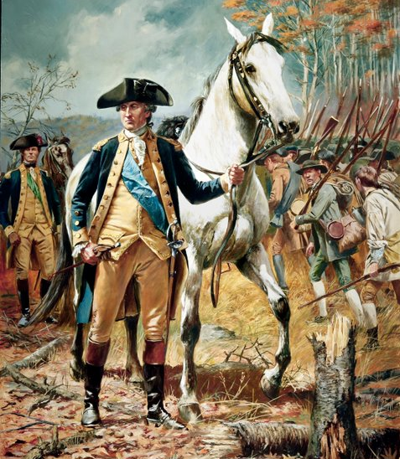
Courage in the Face of Defeat
During the New York Campaign, Washington exhibited remarkable courage and maneuvered his troops in strategic retreats, preserving the spirit of freedom.
His ability to evade potentially war-ending battles was a key ingredient in America ultimately winning the war.
Amidst his retreat into Pennsylvania, Washington's leadership emerged as he embarked on one of the most pivotal campaigns in the Revolution, famously known as the "Ten Crucial Days."
Don Troiani
Notes:
https://www.battlefields.org/learn/biographies/nathan-hale
After Washington withdrew from New York to Pennsylvania, he needed brave volunteers to remain in New York to spy and report on British movements. One of the most known men to stay behind and gather intelligence was Nathan Hale. When Hale entered a British controlled city in September 1776, he disguised himself as a teacher looking for work (this disguise was appropriate for him as he had been a teacher prior to his enlistment in the army). Unfortunately for Hale, he was caught shortly thereafter and hung on the 21st of September 1776. Before his hanging, Hale infamously stated the words, "I only regret, that I have but one life to lose for my country." While Washington's courage and bravery should be praised, he also had to rely on brave men to risk their lives in dangerous missions for the hope of freedom which is exactly what Nathan Hale embodied.

Slide 7
Ten Crucial Days
Notes:
The video is embedded in the slide, but here is the link: https://www.battlefields.org/learn/videos/untold/ten-crucial-days

Slide 8
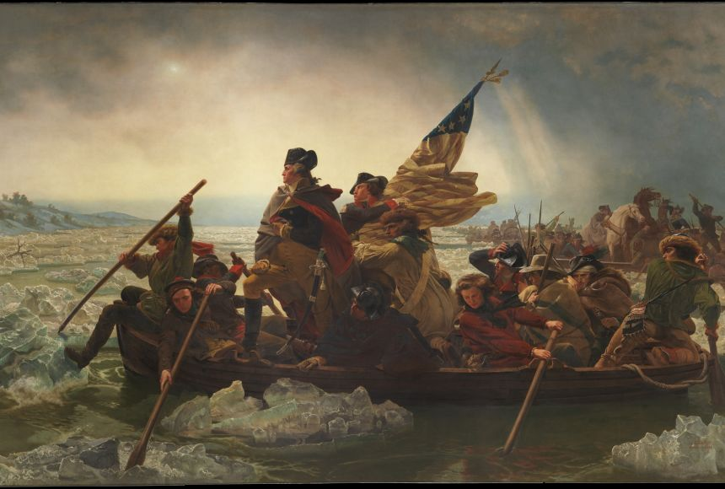
“Victory or Death”
With morale running low, Washington recognized the need to make a bold offensive move to alter the course of the war.
On Christmas night 1776, Washington decided to cross the icy Delaware River back into New Jersey and launch a surprise attack on Hessian soldiers stationed at Trenton under the command of Colonel Rall.
As temperatures plummeted below freezing during the river crossing, Washington's leadership shone through as he encouraged his men in "a deep and solemn voice."
Did You Know?
Hessians were professional soldiers from the German land of Hesse hired by the British to fight in America.
Painting by Emanual Leutze
Notes:
https://www.battlefields.org/learn/biographies/john-glover
While Washington's decision to cross the Delaware River demonstrated his leadership and courageous decision-making, he also had to rely on others in his army to successfully cross the river and attack Trenton. One man in particular that aided Washington during the crossing was John Glover. As leader of the 14th Continental Regiment, which Washington deemed men "bred to the sea," John Glover and his men valiantly led the Continental Army across the Delaware River in icy waters and blizzard conditions. Without the support of Glover and the 14th Continental Regiment, Washington may have been unsuccessful in his crossing which likely would have led to defeat for the patriots in the war.
Photo Credit:
https://www.mountvernon.org/library/digitalhistory/digital-encyclopedia/article/crossing-of-the-delaware/

Slide 9
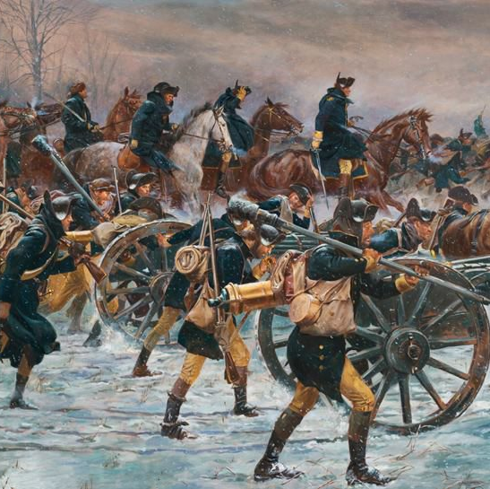
Trenton
After a long trek through the night, the Continental Army attacked Trenton at 8:00 am with Washington ordering, "Advance and charge!"
Washington, along with Nathanael Greene and John Sullivan, led the attack on Trenton from nearly every side of the garrison.
The Hessians were overwhelmed as Colonel Rall attempted to execute a counterattack but was quickly and decisively defeated by Washington.
Did You Know?
A garrison is a group of soldiers stationed at a military post.
Don Troiani
Notes:
Prior to this battle, Colonel Rall was not particularly concerned that the patriots would attack despite his vulnerable defensive position at Trenton. Indeed, Rall is known to have scoffed at the patriots by stating, "Let them come … we will simply fall on them and rout them." This overconfidence certainly did not help him and his men when the patriots charged Trenton. On the patriots' side, both Greene and Sullivan were particularly important leading troops and enabling their victory. Notably, under the leadership of Sullivan, the strategic crossing point south of Trenton (the bridge spanning the Assunpink Creek) was secured, effectively eliminating any avenue of escape for the Hessian soldiers.

Slide 10
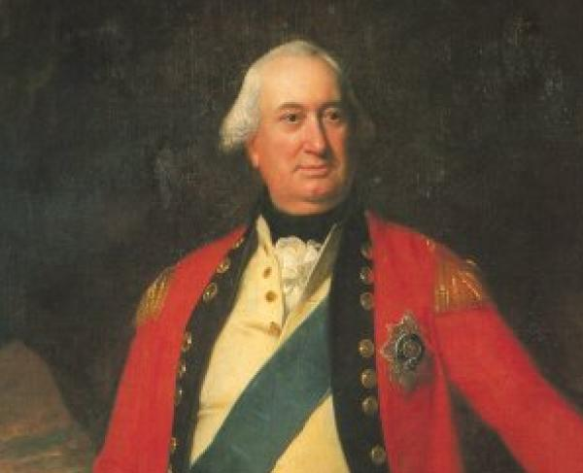
Assunpink Creek (Second Battle at Trenton)
Washington withdrew his men following his victory at Trenton back across the Delaware.
British troops under the command of Charles Cornwallis (pictured) attacked and pushed patriots back into Trenton and to the Assunpink Bridge where Washington resiliently and fiercely fought and repelled British efforts.
The skirmish ended leaving Cornwallis frustrated as he had no choice but to wait until the next morning, eagerly believing it would finally be his opportunity to "bag" the "Old Fox (Washington)."
Notes:
Washington was certain of a British response after his victory at Trenton which is why he stationed a delay force in-between Trenton and Princeton. Washington hoped that this delay force would afford him some time to fend off the British attack and allow him to better organize his defensive position. Despite the battle being intense and dangerous, Washington stood firm at the bridge and ensured that each one of his men were safely across. His fearlessness and unequivocal confidence kept morale high in the patriots' camp which aided in his subsequent fight the following day at the Battle of Princeton.
Photo Credit:
https://www.nps.gov/people/charles-cornwallis.htm

Slide 11
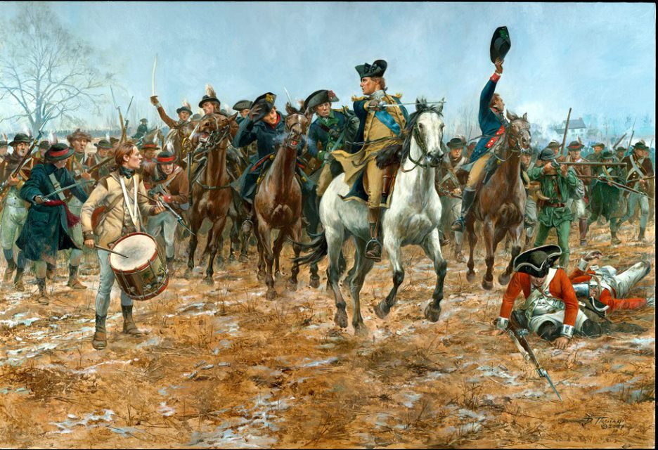
Princeton
With Cornwallis prepared to attack in the morning and end the patriots fight once and for all, Washington executed another daring and impressive maneuver.
He quietly flanked Cornwallis and attacked a strong British stronghold at Princeton.
The battle resulted in a patriot victory officially ending the Ten Crucial Days that entirely shifted the momentum of the war.
Did You Know?
A flank is to move around and gain the side of an enemy position, avoiding a frontal assault.
Don Troiani
Notes:
https://www.battlefields.org/visit/virtual-tours/princeton-virtual-tour
Nathanael Greene initially led the attack on Princeton which was commanded by Lt. Col. Charles Mawhood. Impressively, Mawhood combatted this attack by stabilizing his lines and launching a counter-attack that pushed back the patriots. Washington, seeing that the battle was starting to not go in his favor, rushed to the battlefield and rallied his men. Courageously, he formulated a battle line coming within 30 yards of British guns and opened fire upon them. Despite this line being particularly dangerous, Washington stood firm with his men and did not back down in the heat of the firing. One of Washington's officers, behind the battle line, covered his eyes because he believed that Washington was going to be shot and killed atop his charger and he refused to witness it. Nonetheless, after the smoke cleared, Washington remained on his charger unscathed and attacked the now retreating British Army shouting that this is going to be a "fox chase." The British shortly thereafter surrendered securing Washington's momentous victory at Princeton.

Slide 12
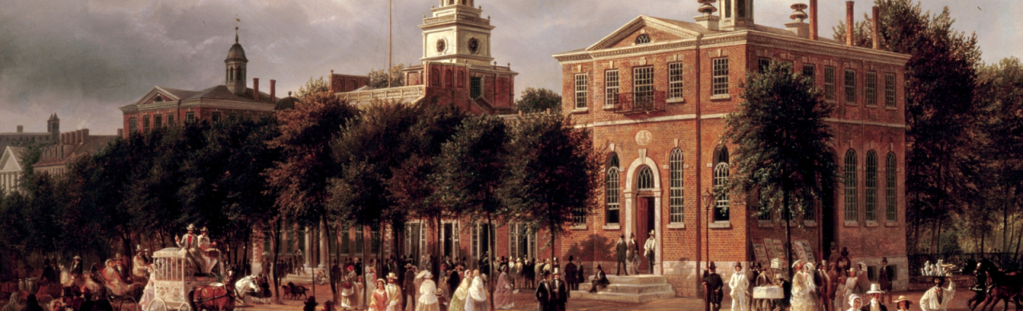
Chaos in Philadelphia
Less than a year after the results of the Ten Crucial Days, Washington and the Continental Army suffered setbacks, including losses at the Battle of Brandywine and the Battle of Paoli, as well as the surrender of Fort Mifflin and Mercer to British forces.
General William Howe utilized this momentum to capture Philadelphia, the largest city in America.
Washington attempted to recapture Philadelphia in the Battle of Germantown but was unsuccessful forcing him to retreat to a location nearly 20 miles away called Valley Forge.
Notes:
https://www.battlefields.org/learn/articles/10-facts-philadelphia-campaign
Shortly after his victorious capture of New York, Howe set his sights on capturing Philadelphia. Instead of directly attacking it, he was patient and sacked Philadelphia from the south after sailing to Maryland and up the Chesapeake Bay. Philadelphia was the home of the Continental Congress and Howe believed this capture would be a critical blow to the patriots. However, prior to the city being captured, Congress had fled to York. Still, this capture did not please the patriots as shown by Washington's failed attempt to conquer Howe at Germantown. This loss resulted in him retreating to Valley Forge exhausted. Yet, in times that "try men's souls," as Thomas Paine eloquently stated, George Washington thrived as demonstrated by his time at Valley Forge.
Photo Credit:
https://www.senate.gov/about/resources/graphics/xlarge/congress-hall-exterior.jpg

Slide 13
Valley Forge
Notes:
The video is embedded in the slide, but here is the link: https://www.battlefields.org/learn/videos/valley-forge

Slide 14
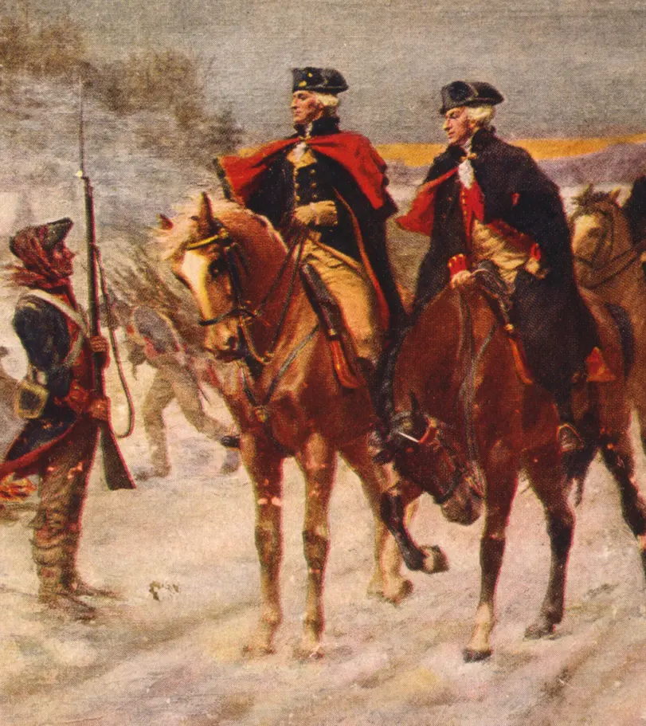
Valley Forge
Washington exhibited his leadership and was able to turn the British capture of Philadelphia to his favor.
With the help of men such as Baron von Steuben, Marquis de Lafayette, and Alexander Hamilton, Washington utilized Valley Forge as a place to regroup and train his soldiers.
Despite the significant loss of life due to the harsh winter, the time spent at Valley Forge turned out to be largely successful as a result of the training and regrouping endeavors that took place.
Notes:
https://www.battlefields.org/learn/articles/ten-facts-valley-forge
https://www.battlefields.org/learn/biographies/marquis-de-Lafayette
https://www.battlefields.org/learn/biographies/alexander-hamilton
One of the most significant figures that camped at Valley Forge and helped the Continental Army was Baron von Steuben who acted as an inspecting general. He was instrumental in instructing soldiers the rudiments of military drill and in turn created a system of training. Additionally, Washington's aide-de-camps, Marquis de Lafayette and Alexander Hamilton, also resided at Valley Forge during the winter and aided Washington by giving him advice and support. Hamilton helped support Washington and the Continental Army at Valley Forge by writing letters to political leaders (i.e., governors and congressmen) requesting provisions. Meanwhile, Lafayette provided assistance to the encampment by distributing uniforms and muskets to men who were lacking them.
Photo Credit:
https://www.loc.gov/resource/cph.3g06877/

