Slide 1
War Within a War
The American Battlefield Trust

Slide 2
Inquiry Question:
How did citizens choose sides and participate or avoid the tension and conflict during the Southern Campaigns?
Notes:
Ask students to create a hypothesis of the answer to this question. Have students either discuss in groups their ideas or as a class. Ask students how they produced those hypotheses.

Slide 3
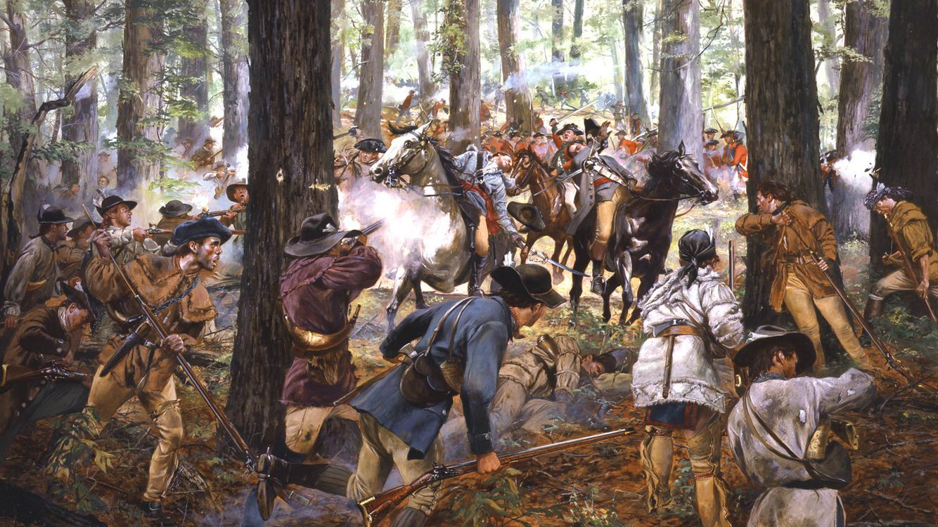
What did life look like during the Southern Campaigns?
As the American Revolution spread to the South, the conflict became more and more a civil war.
Don Troiani
Notes:
Discuss in what ways the American Revolution could be considered a civil war, particularly in the Southern states as neighbors joined opposing militias or fought guerilla warfare.
By definition a civil war is "a war between citizens of the same country."

Slide 4
Communities at War
In the Southern Campaigns, some battles were fought "traditionally," but many other conflicts happened as partisan skirmishes.
Communities divided between Loyalists and Whigs (patriots), and sometimes neighbors fought each other in short combats or surprise attacks.
Organized partisan forces attacked British supply lines or Whig-supporting settlements.
Because of this viciousness, these final years left a bitter impact in the memory of the survivors and their descendants.
Definition:
Whig – a political party associated with support for American Independence during the Revolutionary War Era.
Notes:
https://www.battlefields.org/learn/articles/bloody-ban-backcountry
Of all the colonies that suffered during the War for Independence, few endured the brunt of the constant bloodshed in its final years as South Carolina. Contrary to popular convention, much of the fighting in the Revolutionary War was conducted in much the same manner as most conventional 18th century warfare: strictly organized and disciplined armies, utilizing linear tactics, taking part in pitched battles on the open field, with the Continental Army quickly transitioning from a ragtag militia to a fully professional force. As the war moved South however, the terrain in the backcountry gave way to a sustained guerilla campaign in addition to the traditional Continental forces. Current estimates suggest that over 1,000 Americans died in the fighting here, almost one-fifth of those that died in battle throughout the entire war. This, of course, says nothing about those who died of disease or starvation, as well as the destruction of private and public property by forces attempting to root out the partisans. Because of this viciousness, these final years left a bitter impact in the memory of the survivors and their descendants. In fact, there seems to have been a unique set of circumstances that set the War in the Backcountry apart from the other Theaters.

Slide 5
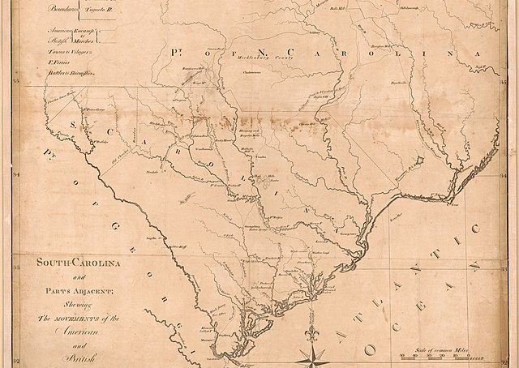
Life for Soldiers
British supply lines now stretched from Ireland to forces fighting hundreds of miles inland from the Southern coast. Their vulnerability motivated attacks by French fleets on the seas and patriot partisans on land.
Outnumbered American forces often resorted to raids on British supply lines while avoiding traditional battles.
Today, we call this style of fighting guerrilla warfare.
Notes:
Define partisan as a member of a body of detached light troops harassing an enemy, often behind enemy lines.
https://www.battlefields.org/learn/articles/british-supply-chain-south
One of the constant challenges for Great Britain in the American Revolution was maintaining a reliable, sustainable and safe supply line to support their men in the field. Of course, the biggest challenge was the 3,000 mile ocean separating Great Britain from the American colonies. The British over-relied on resources from their homeland, which strained their supply lines and hampered troops in the field. Successfully established supply lines became targets for Patriot partisans' constant actions. These groups, usually residing locally, had stronger knowledge of roads, farms and geography compared to the British. Though partisans existed throughout the United States, their activities in the South had the most impact on the outcome of the war. A combination of misaligned British strategy, the inability to manage their logistics and an active Patriot partisan war on the British supply lines led directly to the British defeat in the South in 1781 and the ultimate end of the war with Cornwallis’s surrender in Yorktown, Virginia.

Slide 6
Francis Marion, a patriot commander, was nicknamed the "Swamp Fox" for his daring use of guerrilla warfare.
He attacked British supply routes and forts.
Notes:
Video Link:
Francis Marion: The Swamp Fox
https://www.battlefields.org/learn/biographies/francis-marion
The American army retreated and was almost nonexistent in South Carolina after the fall of Charleston. Partisan and militia groups shouldered the responsibility of carrying on the fight against the advancing British. Francis took command of a militia unit and had quick success, leading fifty militiamen in a guerilla-style raid on the British in the Carolina backcountry. The unit hid in dense forest, just as the Cherokee Indians had, surprising the British encampment and rescuing 150 American Prisoners. Though his force was almost always smaller than his opponents, Francis used this to his advantage, making the British split their forces to search for him and always moving quicker than his opponents. He made South Carolina inhospitable for the British.
Even British Lieutenant Colonel Banastre Tarleton, known for his speed and ruthlessness, could not find Francis. In fact, Tarleton gave Francis Marion the nickname that remains to this day. In November 1780, Tarleton learned about Marion’s position and moved with his cavalry to intercept. However, Francis evaded the British cavalrymen for near seven hours and twenty-six miles, eventually escaping into the Carolina swamp. Tarleton gave up the pursuit saying, “as for this damned old fox, the Devil himself could not catch him.” This story traveled around the South, and Francis Marion earned the name the "Swamp Fox."

Slide 7
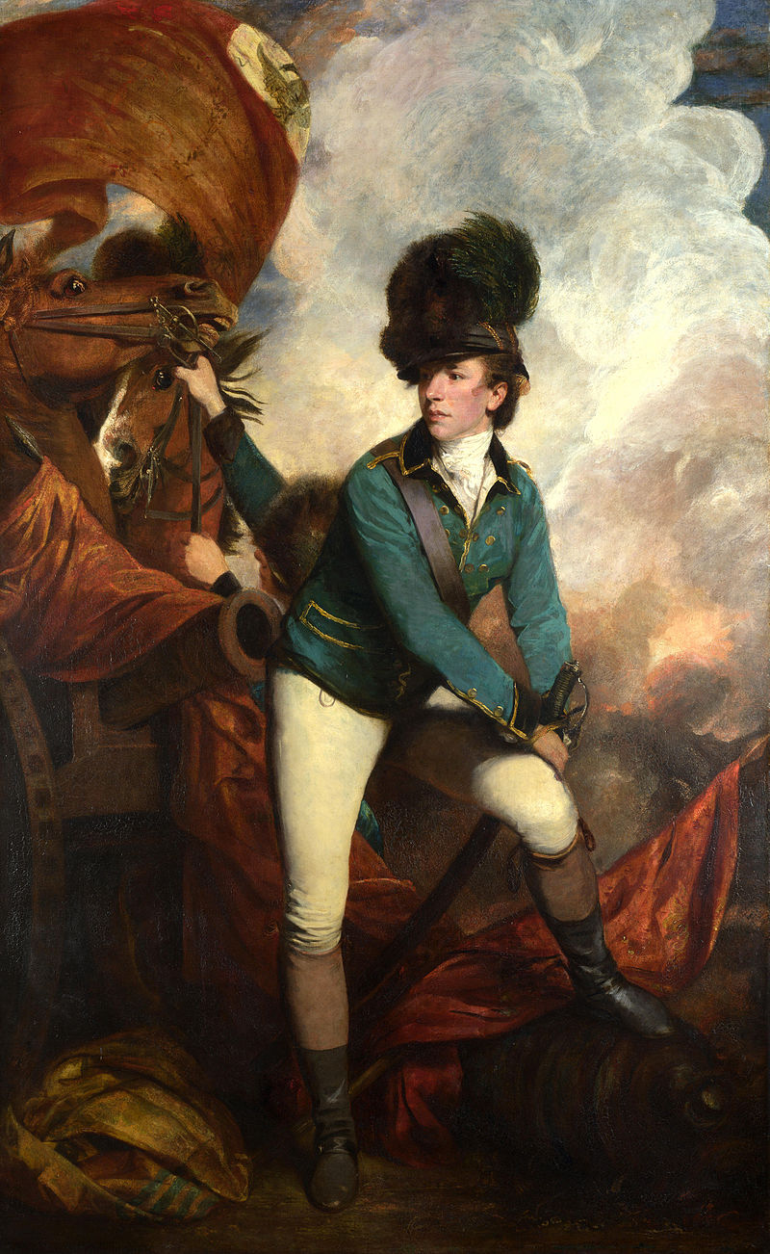
One of the most infamous British officers was Banastre Tarleton, accused of allowing his men to kill Patriots trying to surrender after his victory at the Battle of Waxhaws.
The stories of his harsh actions fueled division and American resistance.
Notes:
Explore the 360° Virtual Tour of Waxhaws Battlefield.
Link:
Waxhaws Virtual Tour
https://www.battlefields.org/learn/biographies/banastre-tarleton
Tarleton fought in Lord Charles, Cornwallis's army in the Southern Campaign. He played an active role in the battles of Monck’s Corner, Charleston, Waxhaws, Camden, Fishing Creek and Blackstock's. At the Battle of Waxhaws on May 29, 1780, Continental soldiers accused his dragoons of disregarding a Patriot surrender by attacking the Americans after they laid down their arms. Afterward, Americans ascribed the moniker “butcher” to Tarleton and the “Waxhaws Massacre” or “Tarleton’s quarter” to the Battle of Waxhaws, shouting the latter as a rallying cry at the ensuing Battle of Cowpens. On January 17, 1781, at the Battle of Cowpens, Daniel Morgan took advantage of Tarleton's aggressiveness. Morgan employed tactics that deceived Tarleton who believed the Americans were in full retreat. Once Tarleton committed his entire force, Morgan’s men turned around to counterattack and the British were routed off the field. The engagement devastated Tarleton’s force—100 killed, 229 wounded, 600 captured—and marked the beginning of the end of the British plan to re-annex the South.

Slide 8
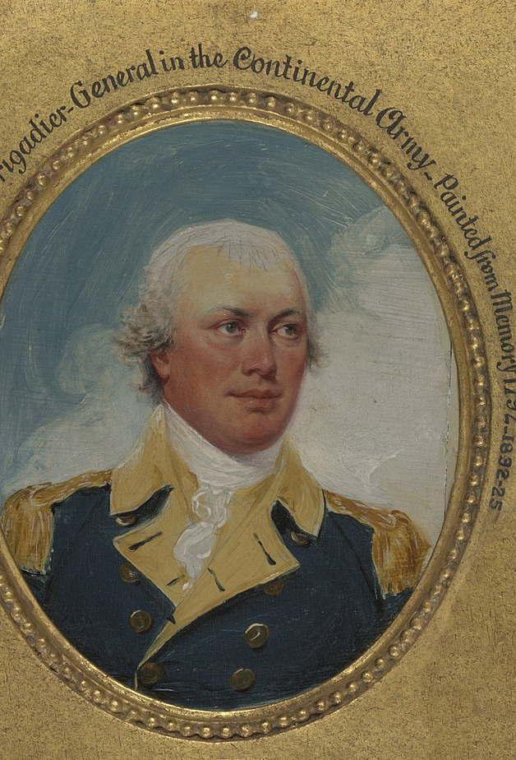
Soldiers on both sides worried about family members back home.
Compare this letter by Patriot General Nathanael Greene and this one by Loyalist officer Stephen de Lancey. What concerns do they share? How are their situations different?
Notes:
Links:
Nathanael Greene letter
Stephen de Lancey letter

Slide 9
Prisoners of War
Prisoners of war on both sides were often poorly treated and lived in harsh conditions. American and British leadership would sometimes organize prisoner exchanges, while civilians might provide charity and relief.
Sometimes the legal status of prisoners was unclear. After the Battle of Kettle Creek, South Carolina tried Loyalist prisoners of war as criminals and sentenced them to death.
Discuss: What can their story tell us about how prisoners were supposed to be treated? Did the conflict's status as a civil war change how prisoners were treated?
Notes:
Link:
The Loyalist Prisoners from Kettle Creek

Slide 10
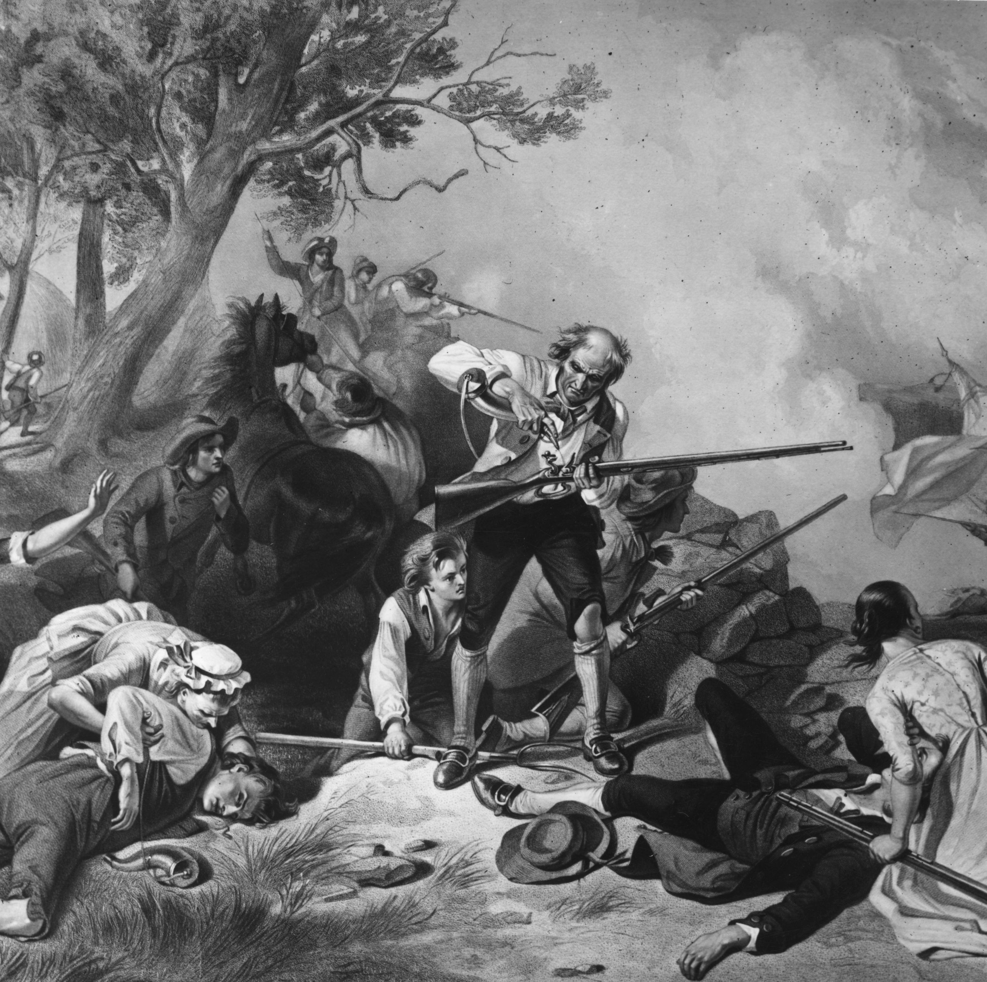
Life for Civilians
Patriot, American, Loyalist, and British forces all sometimes harassed the local population for supplies, making conditions worse for civilians.
Other times civilians were attacked for their support of a cause or the civilian were simply trapped in harm's way.
Compare these accounts from Eliza Wilkinson and the town of Salem, North Carolina: What do they have in common? Where do they differ?
Notes:
Links:
Eliza Wilkinson
Salem

Slide 11
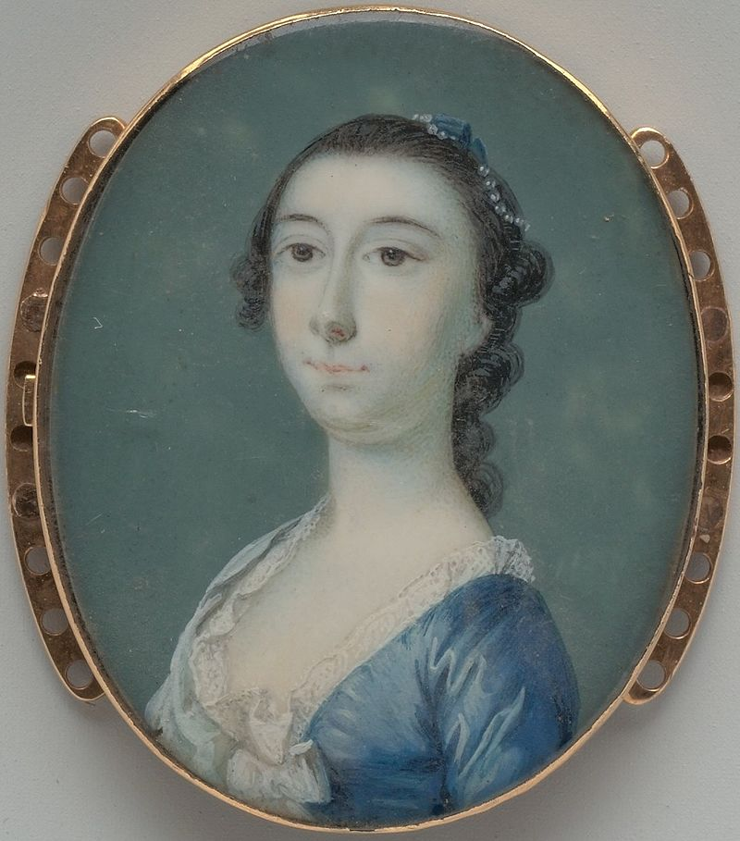
What roles did women play?
Women ran households, farms, and businesses while men were away.
Women navigated the shifts in power between British and Continental forces, quartering troops, providing supplies, or passing along intelligence.
Rebecca Motte, a patriot plantation owner, supplied American forces and even helped destroy her own home to prevent its use by the British.
Notes:
Define quartering as providing lodgings for soldiers.
https://www.battlefields.org/learn/articles/women-american-revolution
https://www.battlefields.org/learn/biographies/rebecca-motte

Slide 12
According to Legend...
Nancy Hart, a Georgia frontierswoman, served as Patriot spy gathering information from British camps. She defeated six British soldiers who entered her home with only the help of her twelve-year-old daughter, Sukey.
(We know some of this story is true... and six skeletons have been found on Nancy's land.)
Notes:
https://www.battlefields.org/learn/biographies/nancy-hart
As the Revolution moved into the Southern colonies, Nancy played an important role fighting against Tories in the Georgia backcountry. Hart succeeded in outsmarting British opponents on multiple occasions, frequently disguising herself as a “crazy man” and wandering through British camps to procure information for the Patriots. When one of Hart’s children discovered a British soldier spying on the Hart home, Nancy doused the man with boiling water that she was using to make soap before tying him up and turning him over to Patriot forces. Some accounts hold that in addition to her more covert operations, Hart was also present for the Battle of Kettle Creek, which took place in Georgia on February 14, 1779.
Though Hart gained recognition after the war for a variety of exploits, one of the most popular stories involved her capture of several British soldiers.

Slide 13
"It is beneath the character of the independent State of North Carolina to war with women and children. The authors of our ill treatment are the proper subject of our own and the resentment of the public. Does their resentment barbarity strike us with abhorrence? Let us blush to imitate it; not justify by our own practice what we so justly condemn in others."
Petition to Governor Martin from the "Ladies of Wilmington"
Notes:
Patriot women in Wilmington, North Carolina, petitioned the governor and his council in 1782, protesting an order expelling Loyalist civilians from the town in revenge for an earlier British occupation.
Discuss: What motivated some participants on both sides to advocate for fairer treatment of civilians? How could the authors' status as women affect their argument? What political agency did women have?
Link:
Petition from the Ladies of Wilmington

Slide 14
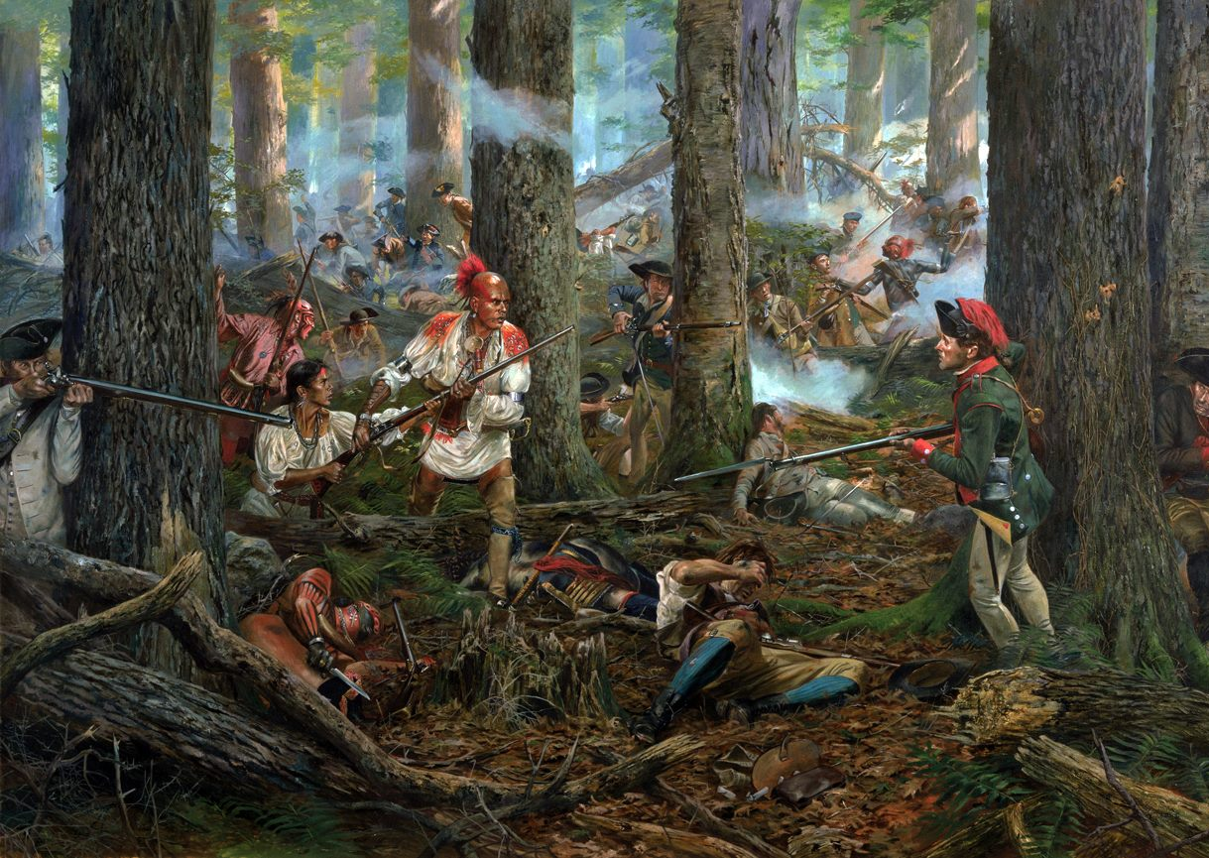
Choosing sides
The American Revolution provided unique opportunities and risks to African Americans and Native Americans.
Many fought on both sides because they believed in the cause as well as to protect their own freedom and land.
Don Troiani
Notes:
https://www.battlefields.org/learn/articles/roles-native-americans-during-revolution
https://www.battlefields.org/learn/articles/native-american-impact-british-war-strategy-southern-campaign
The Revolutionary War did not only determine the future of the American colonies, but it also shaped the future of the Native peoples who lived in and around them. Native Americans were not passive observers in the conflict. While most Native communities tried to remain neutral in the fighting between the Crown and its colonists, as the war continued many of them had to make difficult decisions about how and when to support one side or the other.

Slide 15
What roles did Native Americans play?
More Native Americans aligned with the British and Loyalists than with the Patriots, because the British promised protection of their lands.
The Choctaw, Chickasaw, and Cherokee all aligned with the British. The Catawba, however, aligned with the Patriots.
From 1776-1777, the Cherokee War was fought between Patriot settlements and most Cherokee tribes along the western border of the southern states.
Many Native Americans remained neutral throughout the conflict.
Notes:
Discuss the personal and political reasons Native Americans may have had for supporting the Patriot or Loyalist cause or for staying neutral. Ask students to share what their own choice would have been.

Slide 16
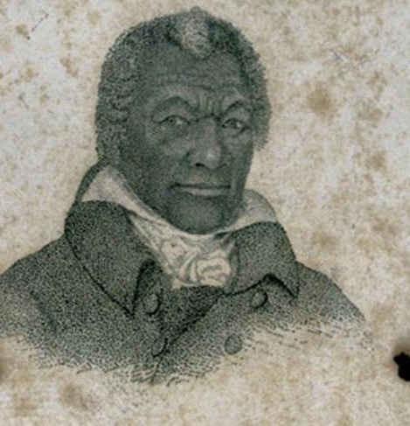
James Armistead Lafayette
While many enslaved African Americans won their freedom by joining British forces, many served the Patriot cause as well. James Armistead, an enslaved Virginian, pretended to pass information to British General Cornwallis but instead acted as a double agent for General Washington.
Armistead remained enslaved until 1787 when he received his manumission from Congress with the help of the Marquis de Lafayette. He changed his name in Lafayette's honor.
Notes:
Define manumission as legal release from slavery.
https://www.battlefields.org/learn/biographies/james-armistead-lafayette

