Slide 1
Solutions or Revolt?
The American Battlefield Trust

Slide 2
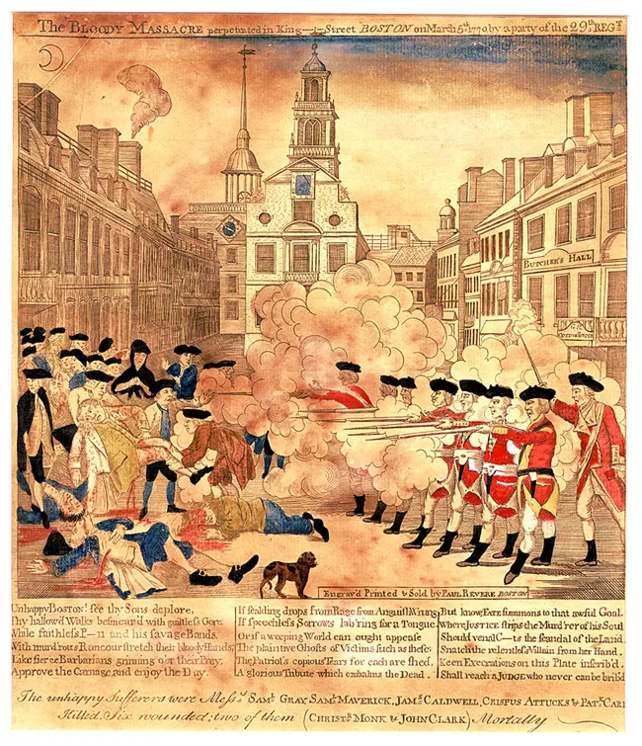
Previous Events
Following the French and Indian War, Britain expected colonists to contribute to war expenses leading to the enactment of the Sugar and Stamp Acts.
The colonists strongly opposed these acts, sparking widespread protests against British rule with organizations like the Sons of Liberty taking the lead.
The tensions escalated on March 5, 1770, in the Boston Massacre, which resulted in the death of five colonists.
The Boston Massacre became a rallying cry for colonists fueling their determination to resist British oppression.
Notes:
https://www.battlefields.org/learn/biographies/paul-revere
While Britain believed that the colonists needed to contribute to the war expenses of the French and Indian War, most of the colonists did not agree. This is due to the fact that many of them served in the war itself. Heroes of the American Revolution such as George Washington, Daniel Morgan, and Horatio Gates all served in the French and Indian War; consequently, many colonists felt they had already paid their fair share of the war by serving in it. One individual who was particularly vocal against the Sugar and Stamp Acts was Paul Revere. Indeed, Revere began his involvement in political matters due to these acts and became a known illustrator of anti-British paintings (the depiction of the massacre on this slide was engraved by Paul Revere and is entitled "The Bloody Massacre in King-Street"). He was also a member of the Sons of Liberty, a secret society dedicated to opposing British rule and advocating for colonial rights.
Photo Credits:
https://www.nps.gov/articles/250th-anniversary-of-the-boston-massacre.htm

Slide 3
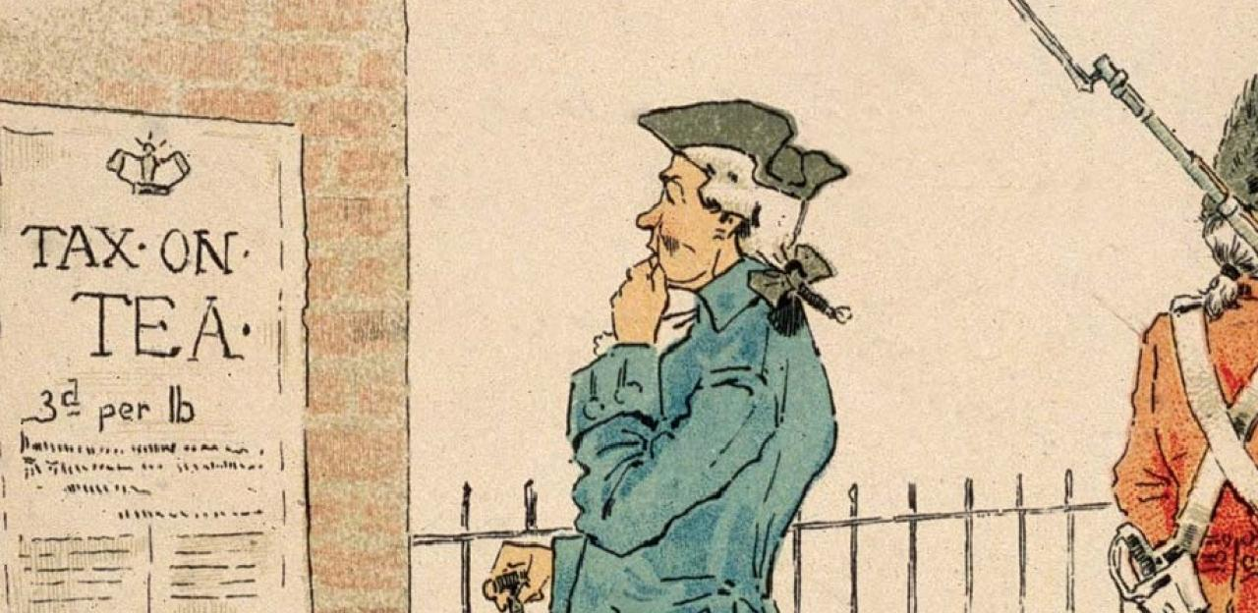
Inquiry Question:
What were some of the final attempts for a solution or escalations of conflict leading to the Revolutionary War?
Notes:
An inquiry question to use in this lesson plan.

Slide 4
Start of the Revolution?
Notes:
The video is embedded in the slide, but here's a link: https://www.battlefields.org/learn/videos/untold/burning-gaspee-spark-lit-revolution

Slide 5
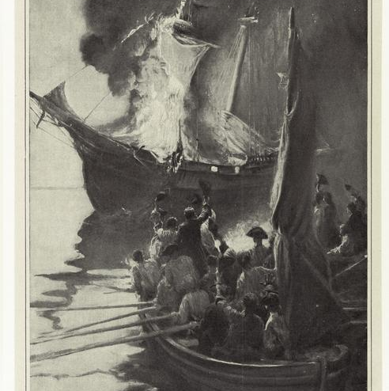
Start of the Revolution?
Commander William Duddingston of the HMS Gaspee aggressively enforced the Navigation Acts and conducted numerous searches on colonial ships without clear justification.
On June 9, 1772, the Sons of Liberty, in response to Duddingston's actions, attacked the Gaspee after it ran aground due to low tide.
The men took control of the Gaspee, removed its crew, and ultimately set it on fire.
Notes:
This incident further fueled anti-British sentiment among the American colonists by serving as a rallying point for those who opposed British authority. Notably, no witnesses came forward to identify any of the attackers, despite the attack occurring close to shore. This silence demonstrated the colonists' collective determination to protect and support each other in their defiance of British enforcement and perceived taxation without representation. The incident served as a clear signal that the colonies were becoming more cohesive in their opposition, laying the groundwork for future acts of resistance and eventually the American Revolution.
Photo Credits:
https://images.nypl.org/index.php?id=808451&t=w

Slide 6
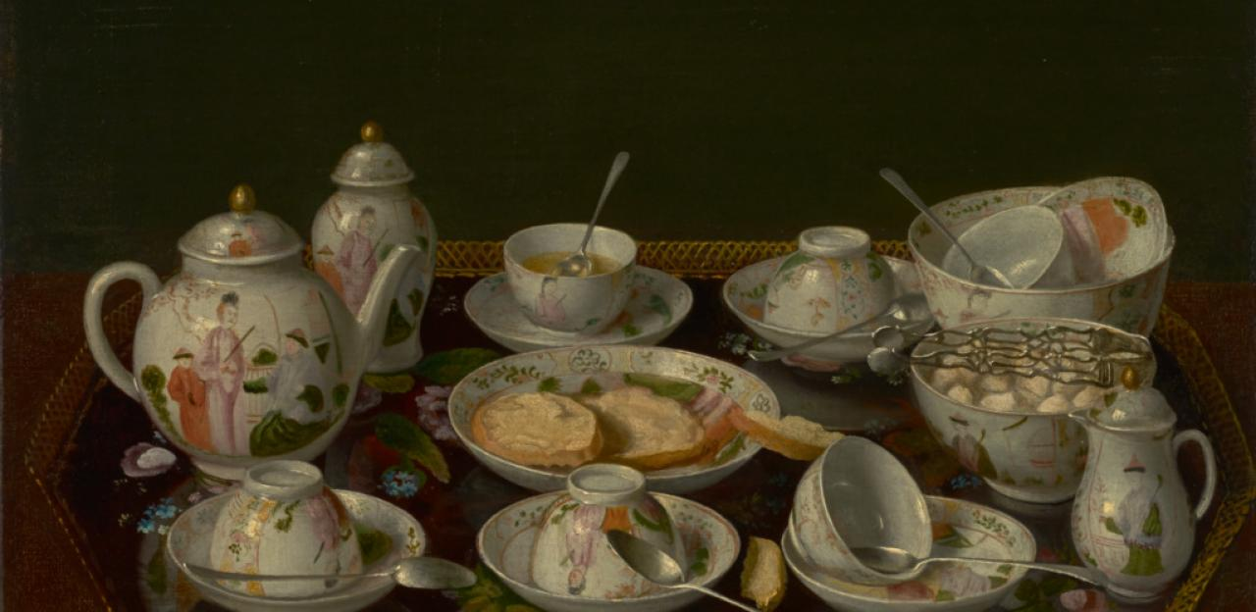
Tea Act
Before the Tea Act of 1773, Britain had implemented several acts that the colonists deemed as unjust taxation.
After the passage of the Tea Act which compelled colonists to purchase taxed tea exclusively from the East India Company, a momentous protest unfolded.
This protest, which further ignited the fire of freedom in the hearts of colonists, is known as the Boston Tea Party.
Notes:
https://www.battlefields.org/learn/primary-sources/tea-act
The Tea Act stands out as one of the most pivotal and contentious policies serving as the catalyst for one of the most renowned protests in America's history, the Boston Tea Party. In response to colonial resistance against other taxes, the Tea Act of 1773 was designed to bail out the financially struggling British East India Company. The Act granted the company a monopoly on tea sales in the American colonies, effectively eliminating competition and allowing it to sell tea directly to colonial merchants. This move not only angered the American colonists but also threatened the livelihood of local merchants who could no longer import tea themselves.

Slide 7
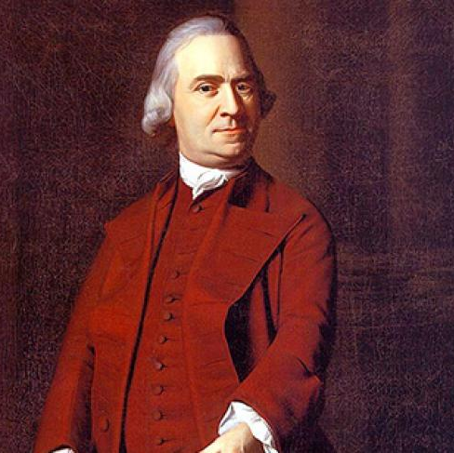
Tensions Rising
By December 15, 1773, three British ships (Dartmouth, Beaver, and Eleanor) carrying tea were docked in the Boston harbor.
Prominent Boston Whigs such as Samuel Adams (pictured) delivered impassioned speeches, urging the governor to grant permission for the ships to sail back to England.
However, he refused commencing (unknowingly) the Boston Tea Party.
Notes:
https://www.battlefields.org/learn/articles/boston-teapot-tonight
Due to the Governor of Massachusetts's (Hutchinson) refusal to let the ships return to England without payment of duties, and the colonists' adamant rejection of the tea, the vessels were trapped in the harbor. Interestingly, Hutchinson's decision illustrated his frustration with those who had rejected Royal authority over the years. Furthermore, the Tea Act was a way for Britain to flex its power over the colonies and force submission which Hutchison was not against. Many colonists simply wanted to resist the Tea Act peacefully and send the tea back to England. Nevertheless, with Hutchison's decision, many brave men decided that overtaking the ships and casting the tea into the harbor was their only option.

Slide 8
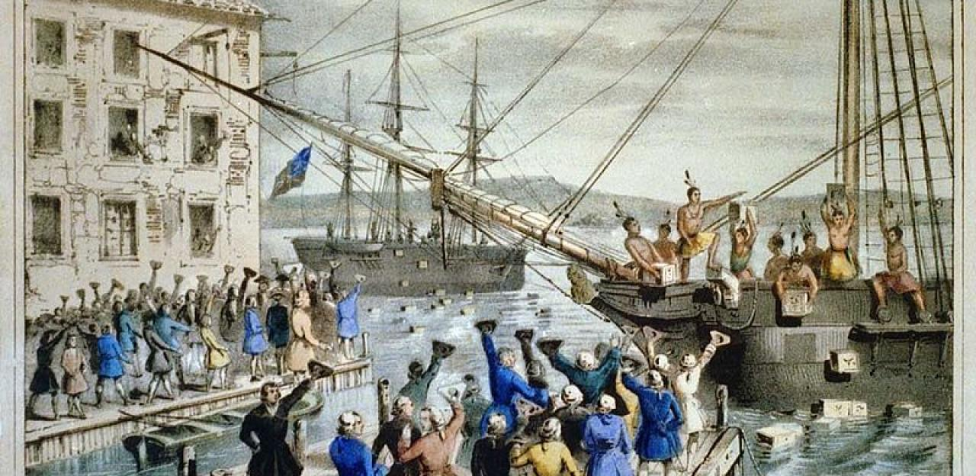
The Boston Tea Party
With the assistance of Sarah Bradlee Fulton, on the night of December 16, 1773, a group of men disguised themselves as Indians and boarded the ships to dispose of the tea.
Despite the opportunity to destroy other cargo, the men focused solely on seizing the tea and casting it into the harbor.
This bold act of defiance against Britain's Tea Act symbolized the colonists' resolute resistance, much to the dismay of the Crown.
Notes:
https://www.battlefields.org/learn/biographies/sarah-bradlee-fulton
https://www.battlefields.org/learn/articles/boston-teapot-tonight
https://www.battlefields.org/learn/biographies/paul-revere
Sarah Bradlee Fulton's home also served as the protestors' escape house. After the tea was cast into the harbor, the men raced to her house where she removed the disguises which kept them from being discovered by the British. Additionally, one of the most influential patriots involved in this protest was Paul Revere. When the merchant ship Dartmouth came into Boston Harbor carrying East India Company Tea in 1773, Revere and Joseph Warren organized a watch over the ship so that it could not be unloaded. During the Boston Tea Party, he was one of the ring leaders when colonists boarded the ships in the harbor to dump the tea. There were multiple other patriots that fateful night that helped to send a resounding message to Britain. Nevertheless, Fulton and Revere were two of the most influential colonists that night, playing strategic roles in the success and legacy of the Boston Tea Party.

Slide 9
Britain's Response
In response to the "Tea Party", Britain enforced the Boston Port Act which punished the city by ending its business until the tea was paid for.
Attempting to illustrate their control over the colonists, this was one of four acts that Britain passed due to the turmoil in Boston (and other colonies).
Colonists came to call them the "Intolerable Acts."
Notes:
https://www.battlefields.org/learn/primary-sources/boston-port-act-1774
https://www.battlefields.org/learn/biographies/thomas-gage
https://www.battlefields.org/learn/articles/british-army-boston
In addition to the passage of the Boston Port Act and the other Intolerable Acts, Britain also named Thomas Gage the new Governor of Massachusetts, replacing Hutchison. Previously serving as the commander in chief of the British military in North America for over 10 years, Gage was not unfamiliar with the upheaval happening in Boston. Indeed, Gage contributed to the Boston Massacre after he pulled British troops from the frontier and placed them in Boston and New York. Due to this incident and other events, Gage became a fervent believer that democracy was a threat in North America which made him the obvious choice to replace Hutchison as governor.

Slide 10
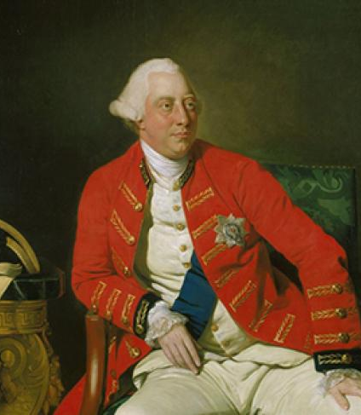
Intolerable Acts
The Intolerable Acts (officially called the Coercive Acts by Britain) were the:
Boston Port Act which closed the port of Boston.
Massachusetts Government Act which gave Great Britain direct control over the colony.
Administration of Justice Act which ended the colonists' authority to hold trials of British officials.
Quartering Act which authorized royal governors (not colonial legislatures) to find places for British soldiers to stay.
George III
Notes:
https://www.battlefields.org/learn/articles/intolerable-acts
Each of these acts had a devastating affect on the colonists. The Boston Port Act had severe economic consequences for the people of Boston as it disrupted trade and commerce and caused widespread hardship for the city's residents. The Massachusetts Government Act essentially stripped the colonies of their ability to self-govern, therefore removing the peoples ability to have a say in their local governmental decisions. The Administration of Justice Act enabled (in the eyes of the colonists) British soldiers to not have accountability for their actions. Because this act allowed British officials and soldiers accused of crimes in Massachusetts to be tried in Britain, the colonists believed that British soldiers would do as they please without fear of being prosecuted. Finally, the Quartering Act, although not a new law, underwent strengthening in response to colonial resistance, further intensifying the colonists' discontentment. They viewed the presence of British troops as a violation of their rights and felt burdened by its enforcement.

Slide 11
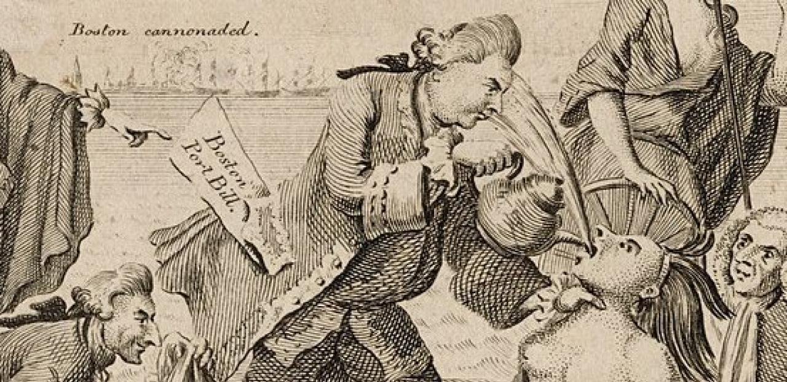
Rallying Cry
Britian believed that these acts would provoke fear in the colonists and end their rebellion.
However, they actually produced a countereffect on the colonists by unifying them in an unprecedented fashion.
This resulted in the first meeting of the Continental Congress signifying the unification of the colonies.
Notes:
https://www.battlefields.org/learn/articles/colonial-responses-intolerable-acts
The Intolerable Acts varied significantly compared to previous British acts that caused discontent in the colonies. This time the acts directly repealed how the colonists ruled themselves. This not only impacted those in Boston and coastal cities, but everyone in the colony. Instead of submitting to Britain out of fear, these acts further encouraged the colonies to rebellion due to the overbearingness of Britain. In this way, the acts united the colonies against British oppression bringing a sense of collective identity and solidarity among the colonies, leading to the convening of the First Continental Congress in 1774. This gathering marked a significant step toward unity and the pursuit of a common cause—defending their rights and liberties against British "tyranny."

Slide 12
Continental Congress
12 of the 13 colonies met on September 5th, 1774, to determine what their response would be to the mother country.
Their initial resolution was to boycott British goods and urge King George III to repeal the Intolerable Acts.
The King did not respond and a mere 7 months later, "the shot heard round the world" was fired commencing the Revolutionary War on April 19, 1775.
On May 10, 1775, the Continental Congress convened again with war on their mind, not resolution.
Notes:
https://www.battlefields.org/learn/biographies/peyton-randolph
https://www.battlefields.org/learn/articles/continental-congress
https://www.battlefields.org/learn/primary-sources/declaration-and-resolves-first-continental-congress#:~:text=The%20First%20Continental%20Congress%20issued,a%20petition%20to%20the%20king
https://www.battlefields.org/learn/primary-sources/olive-branch-petition
The First Continental Congress was held in Philadelphia in September, 1774, with a primary purpose to address grievances against British policies (namely, the Intolerable Acts). Georgia was the lone colony that was not present for the meeting. Peyton Randolph served as the first president of Congress, presiding over the proceedings. Randolph was unanimously selected and well-liked as demonstrated by South Carolina's Thomas Lynch calling him "a Gentleman present who had presided with great Dignity over a very respectable Society, greatly to the Advantage of America." During this first meeting, Congress passed the Continental Association which planned to boycott all British goods in solidarity with Massachusetts. If the Acts were not repealed within the year, Congress threatened to cease all exports of American goods to Britain. Shortly thereafter, on May 10th, Congress convened for a second time with concerns of war on their mind as the battles of Lexington and Concord had occurred less than one month prior. In a last attempt to settle the dispute peacefully, Congress drafted the Olive Branch Petition in which they expressed their loyalty to the Crown and emphasis on their rights as British citizens. However, the king did not read the petition which solidified the commencement of the Revolutionary War.
Photo Credits:
https://www.bostonteapartyship.com/continental-congress

