Slide 1
Shifting British Strategy
The American Battlefield Trust

Slide 2
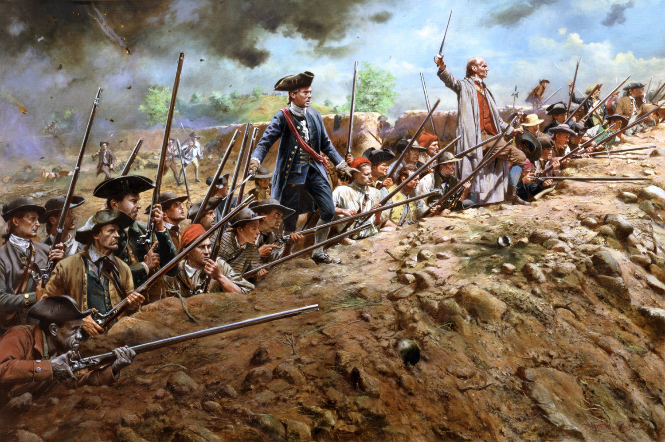
The War so Far (1775-77)
The "Shot heard round the world" was fired at Concord on April 19, 1775,​ beginning the Revolutionary War.
The patriots faced resounding defeat during the New York Campaign (1776) but were saved by Washington's daring endeavors during his "Ten Crucial Days" from December 25, 1776, to January 3, 1777.
After a victory at Saratoga, the newly formed United States become more appealing to France and an alliance was signed.
Following this victory, the war slowed in the north to nearly a stalemate.
Accordingly, Britain adjusted its strategy and began focusing their military actions in the Southern States.
Don Troiani
Notes:
Lexington and Concord: https://www.battlefields.org/learn/articles/lexington-and-concord-shot-heard-round-world
New York Campaign/Battle of Brooklyn: https://www.battlefields.org/learn/videos/battle-brooklyn
Ten Crucial Days: https://www.battlefields.org/learn/articles/audacity-george-washington-and-crucial-days-saved-american-revolution
Saratoga: https://www.battlefields.org/learn/articles/10-facts-battle-saratoga
French-American Alliance: https://www.battlefields.org/learn/articles/timeline-franco-american-alliance

Slide 3
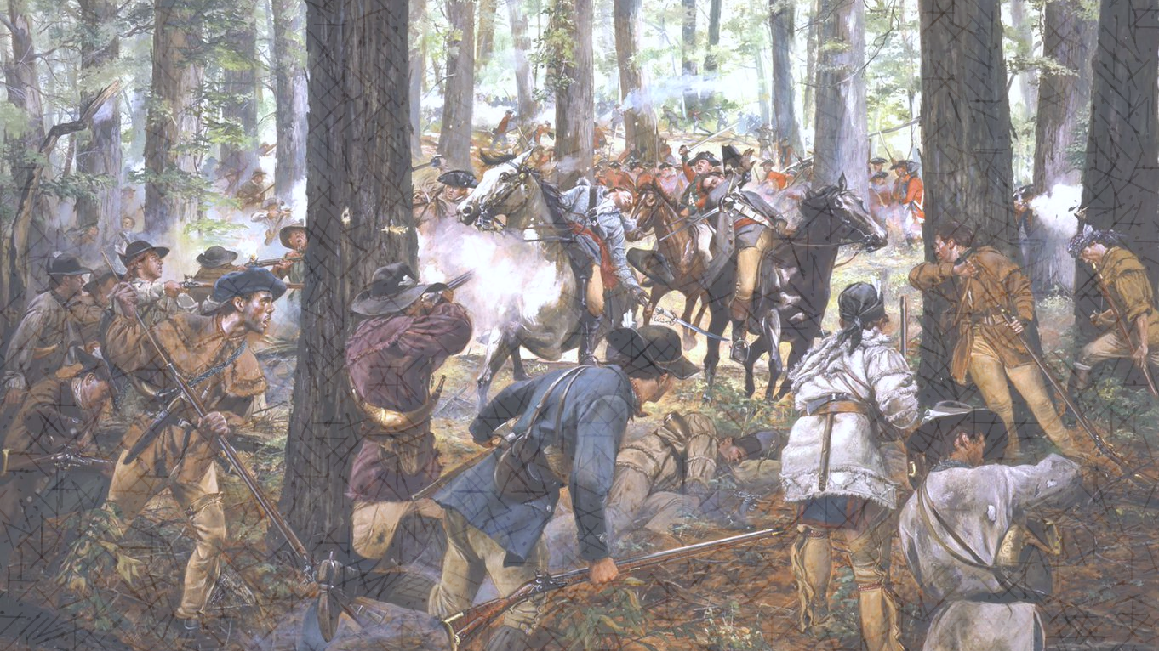
Inquiry Question:
Why did the British shift their military campaigns to the Southern States?
Don Troiani

Slide 4
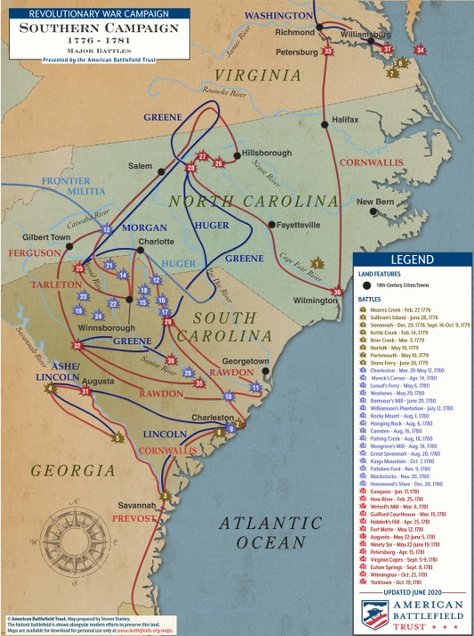
Georgia, South Carolina, North Carolina, Virginia
By the fall of 1779, General George Washington had fought the British to a standstill.
To revive British fortunes, Sir Henry Clinton set out to conquer the South.
With the capture of Georgia, the Carolinas and Virginia, the British believed that the other colonies would surrender or negotiate.
Notes:
Map: https://www.battlefields.org/learn/maps/southern-campaign-1776-1781
10 Facts: https://www.battlefields.org/learn/articles/10-facts-southern-campaign
For the first four years of the American Revolution, British efforts were focused primarily on the Middle Colonies and Northern Colonies. Crown leadership believed that isolating New England, the hotbed of the Patriot fervor, from its sister colonies would bring a quick end to the conflict. The British captured New York City in 1776 and the American capital of Philadelphia in 1777. Despite these advances, a British army surrendered at Saratoga and Sir William Howe and Sir Henry Clinton had been unable to destroy Gen. George Washington’s Continental Army. By the fall of 1779, Washington had fought the British to a standstill. To revive British fortunes, Clinton set out to conquer the South. With the capture of Georgia, the Carolinas and Virginia, the British believed that the other colonies would capitulate.

Slide 5
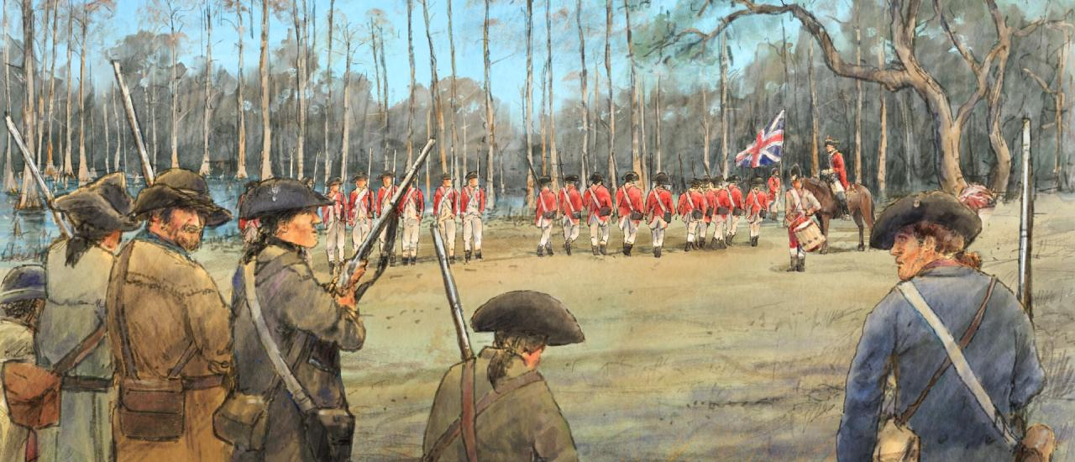
The British Look South
Dale Watson
Due to Britain's lack of progress in the Northern states, they shifted their focus to the Southern states in late 1778.
Prior to this, the South had seen minimal action aside from small skirmishes between Patriot and Tory militias.
After the British failure to capture Charleston, South Carolina, in 1776, the South had been mostly left alone until 1778.

Slide 6
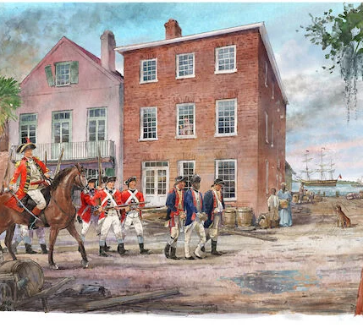
Why Take the South?
Britain had three key reasons to focus on the south.
Economic prosperity.
Strong southern sympathy.
Isolation of the North from the South.
Notes:
https://www.battlefields.org/learn/articles/conflicting-british-strategies-executing-american-revolution
Charles Jenkinson, an undersecretary in the British Treasury, suggested that the war effort be shifted from New England to the south. Why did he propose this new “Southern Strategy?” Simply put, economics. The New England colonies produced many of the same products and goods as the British Isles, but the Southern colonies were a different story. Rice, indigo, tobacco, and other cash crops abounded. Crops that could not be produced in other parts of the Empire. The institution of chattel slavery helped to keep the wholesale prices of these products low, and British mercantilism could profit from cornering the market and selling the goods for substantial profits. The undersecretary and others in London also felt that the Southern people supported Toryism, and by default were more apt to take up arms as Loyalists. These Loyalist forces could be relied upon to bolster the British war effort lending manpower to an army that had been at war with their own colonists since 1775, while having to maintain a vast empire abroad. If the Crown forces could subdue the South, and isolate it from their sister colonies, the Empire would have a powerful bargaining chip when it came to peace negotiations. From a coldly economic standpoint, if the New England colonies became independent, that was not as great of a loss to Britain financially as the loss of their Southern colonies.
As usual, the powers that be in London were out of touch with the war on the ground in North America.

Slide 7
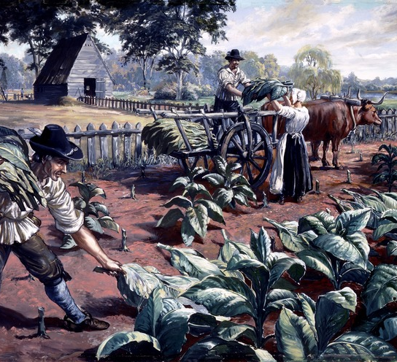
Southern Economy
The main economic drive in the southern colonies was agriculture.
By the 1740s, slavery existed in every British North American Colony, but the Southern agricultural plantations relied heavily on enslaved labor.
Many of the farms focused on growing cash crops (tobacco, rice, and indigo).
If Britain had to reach a peace agreement, they preferred to have control of the South instead of the North due to the south's impressive wealth.
Tobacco farm in Virginia colony, National Park Service
Notes:
https://www.battlefields.org/learn/articles/glimpse-everyday-life-southern-colonies-1763-1774
https://www.battlefields.org/learn/articles/slavery-in-the-colonies
In the South, the main economy was structured around the tobacco trade. Between frequent droughts, market instability, and depletion of fertile soil, Virginia, in particular, faced economic uncertainty in the 1760s. To make matters worse, many of the planter class became accustomed to living on credit with foreign banks and creditors. While they borrowed handsomely to enrich their estates with the newest European furnishings, they expected to export tobacco at a price that would bring them high returns. Instead, the price of and demand for tobacco plummeted in the 1760s as Britain faced a recession because of the financial ruin its credit was in from years of over-extension and mismanagement. Couple these events with creditors who began calling in their loans to the Southern gentry class at the same time Parliament issued the Sugar and Stamp Acts, and one can see how the sudden demand for hard money (many wealthy planters did not have much in hard money — land ownership provided their wealth) that would trigger a reaction like it did. This is not to suggest that economic reasons were the primary motives for Southern radicals and residents to protest British taxation; plenty of argument and defense of liberty and freedom were equally afoot in petitions and grievances. But unlike the merchant class of Boston and New England, new British taxation threatened to squeeze Southern interests and the economy further than it wanted. Unable and unwilling to denounce slavery, despite many complaining of its economic burden, the Southern economy forged ahead while elected officials attached themselves to protest movements in the northern colonies, no doubt to show solidarity for liberty, even if their motives were slightly different for doing so.

Slide 8
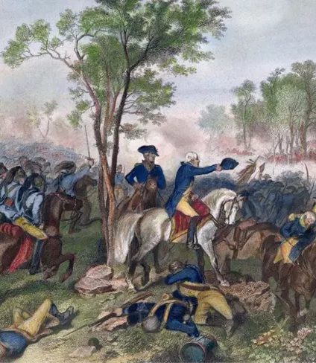
British Sympathy & Support
Britain believed that there were strong loyalist forces in the south.
James Simpson, the attorney general for South Carolina, reported on the loyalists stating, "… whenever the King's Troops move to Carolina they will be assisted by very considerable number of the inhabitants."
John Adams wrote that he believed one-third of the American population were loyal to the Crown.
Notes:
The idea that most colonial subjects were loyal to King George III pervaded the British government and high command throughout the war. It was believed a strong Loyalist enclave existed in South Carolina. Crown authorities felt the loyalists only needed the support of a British army in the field to rise, suppress the rebellion and restore Royal authority. In order to support this anticipated movement, the British appointed an inspector of militia, Major Patrick Ferguson, to recruit and organize Loyalist elements in the Carolinas.
https://www.battlefields.org/learn/primary-sources/southern-strategy-whenever-kings-troops-move-carolina

Slide 9
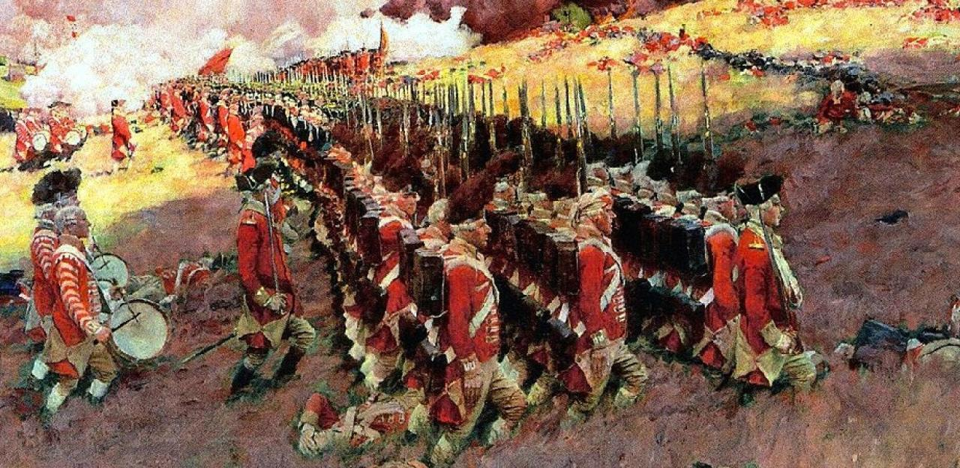
Isolation
Britain initially wanted to isolate Massachusetts from the rest of the colonies to halt the rebellion from where it started.
The Redcoats soon discovered that the rebellion was more widespread than originally believed, pushing them to attempt to isolate all of New England.
Finally, in 1777, Britain realized that their best course of action was to shift from isolating New England to isolating the south, slicing the country in half.
Notes:
Strategy is what dictates the tactics used to achieve a combatant's objectives. Though the initial British strategy was to isolate New England from the remainder of the colonies by way of seizing the Hudson River Valley, as the war evolved, it became clear this approach was failing. Thus, the British set their sights on the southern colonies of Virginia, North Carolina, South Carolina, and Georgia. It was hoped that by isolating the rich southern colonies, the British could sue for peace and walk away with at least a portion of their rebelling colonies. Leaders overestimated the resolve of the Loyalists in the region, which morphed into a brutal civil war. The British high command also made the mistake of not destroying the true heart of the American Revolution, Washington's Army, and convinced themselves that tactical battlefield victories equaled strategic success. They did not. Their overconfidence in relying on what had won them battles in the past was not effectively winning them the current war.

Slide 10
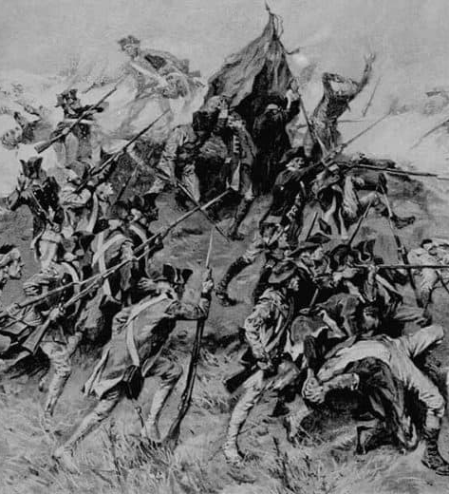
The Campaign Begins at Savannah, Georgia
The British, under General Sir Henry Clinton, leave New York in late November 1778 with the intent of capturing Savannah with around 3,100 men.
The British are successful and capture Savannah on December 29.
This victory sparks loyalist enthusiasm as many make their way to the city to support the British.
Revolutionarywar.us
Notes:
In 1778, British policymakers and strategists decided to refocus their efforts on the southern colonies, where they believed the crown would enjoy the support of a large Loyalist population. As part of that effort, a British army under Lieutenant Colonel Archibald Campbell captured the city of Savannah, Georgia on December 29, 1778.
(In the fall of 1779, the Americans were determined to take the city back.)

Slide 11
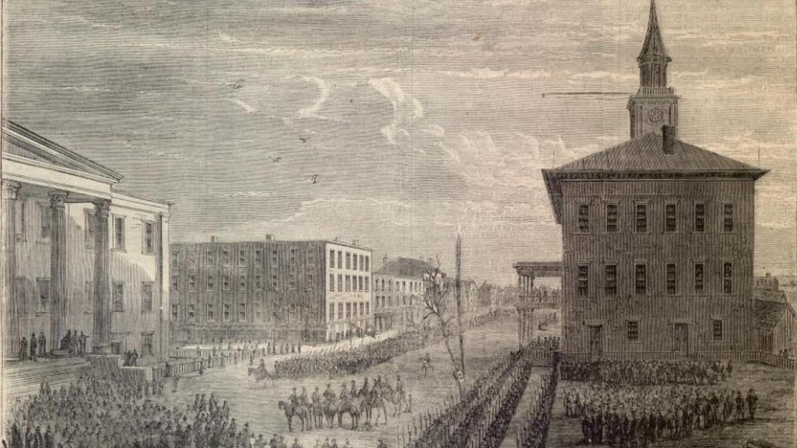
Savannah Under Siege
In late 1779, American and French forces of 5,000 attempted to retake Savannah.
On October 9, the forces launched a major assault on the Spring Hill Redoubt; a fortification defending the city.
This ended in disaster resulting in 1,000 casualties for the attackers versus 150 of the British.
The patriots abandon the siege on October 18 and the British remain in control of Savannah for the rest of the war.
Notes:
https://www.battlefields.org/learn/revolutionary-war/battles/savannah
In the fall of 1779, the Americans were determined to take the city back.
American forces in the region, numbering between 5,000 and 7,000 men, were based in Charleston, South Carolina, under the command of General Benjamin Lincoln. Lincoln recognized that to recapture Savannah, he would need assistance from the French military. On September 3, he learned that Charles Hector, Comte d’Estaing, was en-route to Savannah, bringing with him a fleet of warships and 4,000 French soldiers.
On September 11, Lincoln left Charleston with a force of his own, intent on linking up with d’Estaing. Arriving first, d’Estaing began offensive operations against the city on September 16. When fully assembled, the Allied force numbered over 5,000 men. Defending Savannah was a force of more than 3,000 men under the command of General Augustine Prevost.
On the morning of October 9, the Franco-American Allies launched a major assault. Fog shrouded the battlefield, impeding forward progress. Troops became lost in the swamps fronting the Spring Hill Redoubt, the Allied objective. d’Estaing had selected the Spring Hill Redoubt under the mistaken impression that it was lightly defended by local Loyalist militia. In reality, the Loyalist militia was backed by battle-hardened British Regulars. When the fog lifted, the French lines were fully exposed, crumbling in the face of a withering and incessant fire from the redoubt’s defenders. d’Estaing himself was wounded twice while personally leading the attack. Mortally wounded in the assault was the Polish cavalry mastermind, Casimir Pulaski, who had done much to shape the mounted forces of the Continental Army. He was shot while trying to lead his horseman through a temporary breach in the British line. During the attack on the Spring Hill Redoubt, the Allies lost roughly 1,000 men. The British suffered only 150 casualties.
An hour after leading his forces forward, d’Estaing called off the attack, recognizing its futility. A week later the French commander sailed away, leaving Lincoln behind and the Franco-American Alliance strained.
On October 18, Lincoln lifted the siege. Savannah would remain in British hands until the end of the war.
Photo Credit:
https://visitsavannah.com/sites/default/files/styles/hero/public/photo_courtesy_of_lakeside_press.jpg?itok=1o9m1YV1

Slide 12
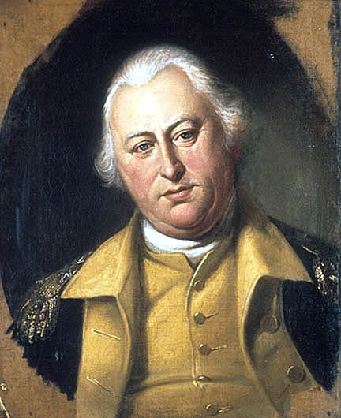
The Fall of Charleston, South Carolina
With Savannah still in British hands, Sir Henry Clinton looked to consolidate his gains laying siege to Charleston in April 1780.
American General Benjamin Lincoln (pictured) attempted to protect the city with a mere 5,000 defenders and a handful of Continental Navy ships versus the Redcoat's 14,000.
Lincoln, due to insurmountable difficulties, surrendered the city on May 12, 1780, solidifying the worst American defeat of the war.
Notes:
https://www.battlefields.org/learn/articles/10-facts-charleston-revolutionary-war
https://www.battlefields.org/learn/biographies/benjamin-lincoln
After failed offensives in New England and the Middle Colonies, the British shifted their attention to the Southern Colonies. In February 1780, the British fleet anchored on the Savannah River, and General Sir Henry Clinton marched an army within 30 miles of Charleston. Between March 29 and May 12, Clinton cut off the city’s supplies and denied a request by American commander Benjamin Lincoln to negotiate. Lincoln offered to surrender if his men were allowed to leave unharmed, but Clinton insisted on unconditional terms. British warships successfully passed the guns of Fort Moultrie in Charleston Harbor, which further isolated Lincoln’s position and closed off any means of escape. Over the next two weeks, the British moved to within a few yards from the American defenses. After Benjamin Lincoln refused Clinton’s demands for an unconditional surrender, the British general ordered a bombardment of Charleston. With Charleston in flames, Lincoln finally ended the siege by surrendering his army of 5,000 men on May 12, 1780. It was the largest surrender of American forces until the Siege of Harper's Ferry in September of 1862.

Slide 13
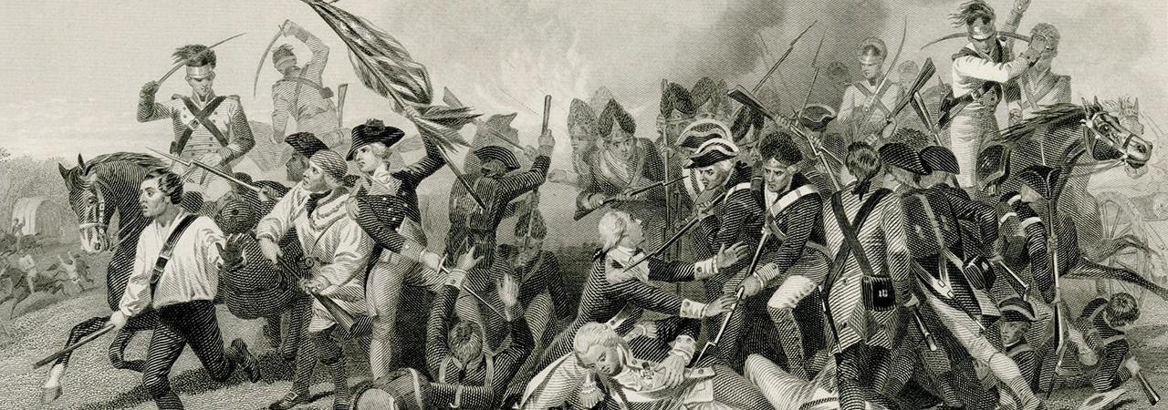
Success for the British?
After the fall of Charleston, more loyalists joined the British in their conquest of the southern colonies.
It quickly became apparent to many in the British command that their plan was working.
In April 1780, Clinton returned to New York and Lord Cornwallis took command of the south.
But the Americans would fight back, and the Southern Loyalists were not as prominent or successful as the British had hoped.
Notes:
https://www.battlefields.org/learn/articles/10-facts-charleston-revolutionary-war
https://www.battlefields.org/learn/articles/10-facts-southern-campaign
To continue the history of the Southern Campaign, please refer to the next Lesson Plan in the Southern Campaigns Module. If you do not have time to continue with the lesson plans, we suggest watching the Southern Campaigns Animated Map: https://www.battlefields.org/learn/maps/southern-campaign-animated-map

