Slide 1
Revolutionary Turning Points
The American Battlefield Trust

Slide 2
Inquiry Question:
What were some key turning points of the American Revolution and how did people feel about them?

Slide 3
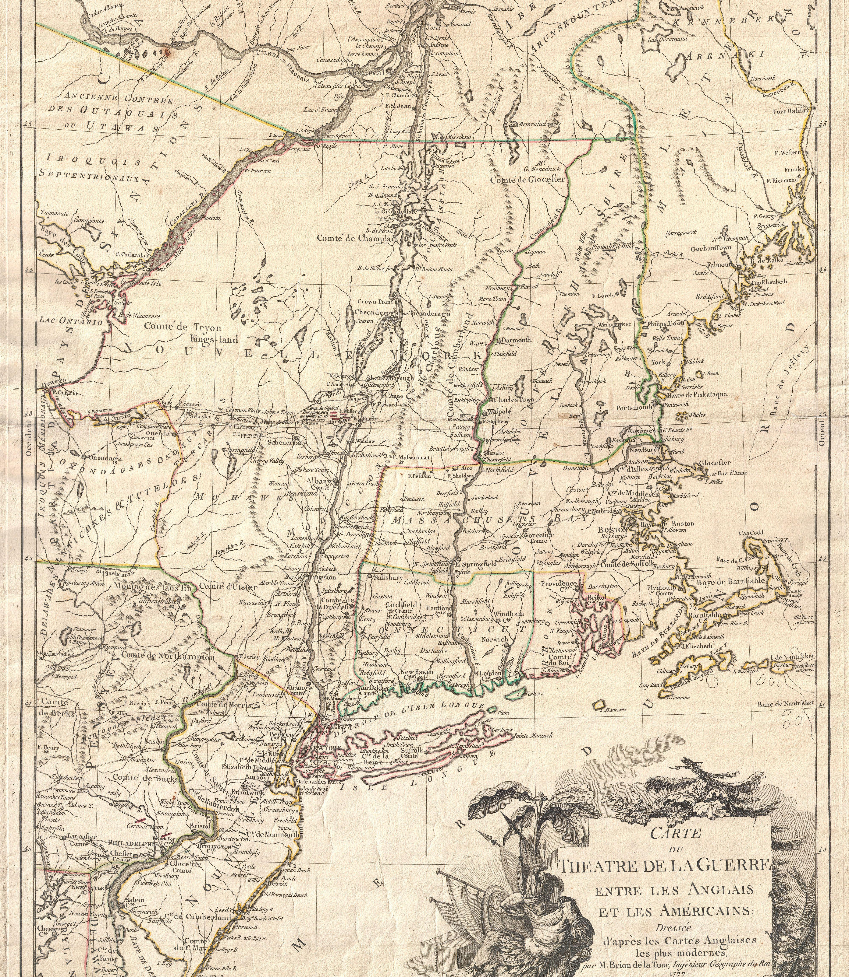
The War in 1777
Washington's victories at Trenton and Princeton had saved the Continental Army, but British advances threatened the American capital, Philadelphia.
The British held Canada and New York City, while the Americans controlled New England in between.
Notes:
The American Continental Army almost dissolved at the end of 1776 as enlistments ended and a year of defeats in New York concluded. However, General Washington launched the Ten Crucial Days Campaign, convincing soldiers to stay and fight and winning two significant victories at Trenton and Princeton.
https://www.battlefields.org/learn/articles/audacity-george-washington-and-crucial-days-saved-american-revolution
The British decided on a new strategy in 1777, attempting to unite strong military forces and cut the New England states off from the rest of the colonies by campaigning through New York.

Slide 4
The War in 1777
British General John Burgoyne proposed an attack on Albany, New York. A British victory would cut the rebelling colonies in half and isolate New England.
In June 1777, British forces began to move.
Notes:
British General John Burgoyne planned to advance into New York from Canada as part of the effort to isolate the rebellious New England States. Other British forces would keep General Washington occupied in Pennsylvania, according to the British plan.
Burgoyne's advance is known as the Saratoga Campaign.
https://www.battlefields.org/learn/articles/saratoga-campaign
https://www.battlefields.org/learn/biographies/john-burgoyne
https://www.battlefields.org/learn/videos/untold/john-burgoyne-gentleman-general

Slide 5
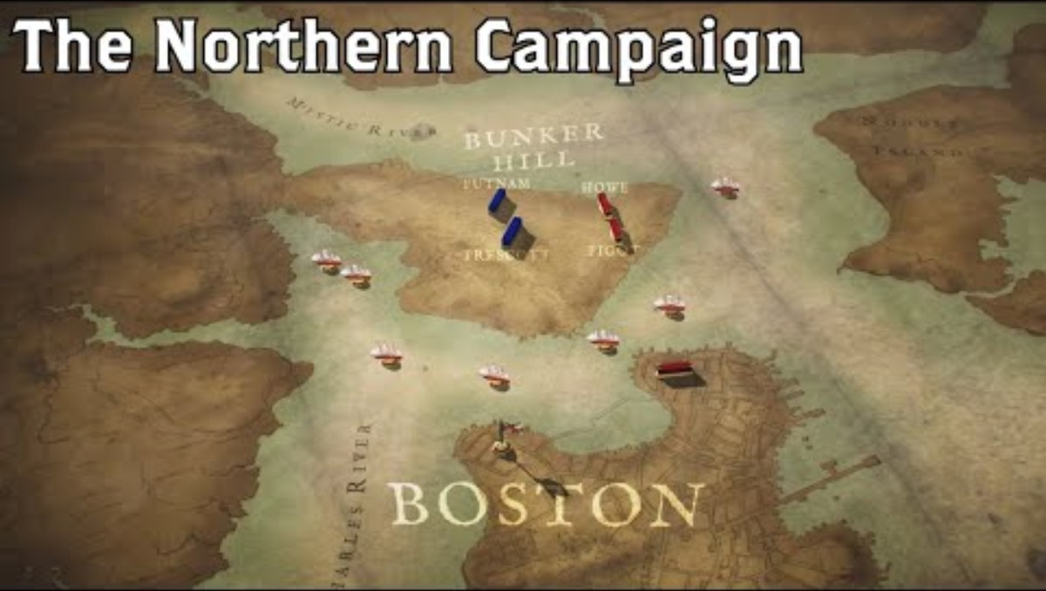
Animated Map
Notes:
The 1777 Campaign begins around the 12:30 minute mark; we recommend starting there and watching to the end (about 6 minutes total) if you are short on time.
The video is embedded in the slide, but here is the link: https://www.battlefields.org/learn/videos/northern-campaign-animated-map

Slide 6
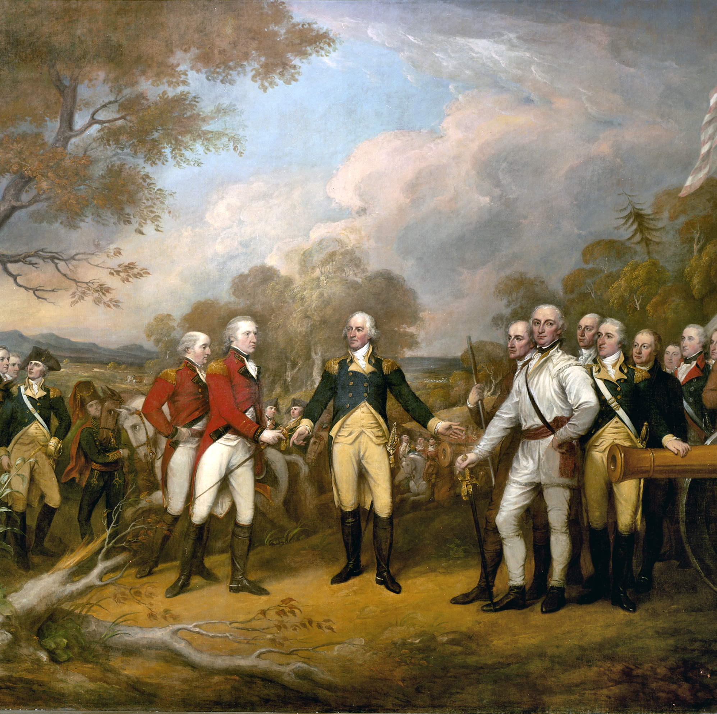
The Battles of Saratoga
American General Horatio Gates fought and trapped Burgoyne at Saratoga, New York, preventing the British armies from uniting and forcing Burgoyne to surrender on October 17, 1777.
The surrender of Burgoyne's 5,000-man army was key in gaining international support for the American cause.
Discuss: Why would countries like France and Spain be more likely to support the United States after the victory at Saratoga?
Notes:
The Battle of Saratoga was a turning point in the Revolutionary War. The American defeat of the superior British army lifted patriot morale, furthered the hope for independence, and helped to secure the foreign support needed to win the war.
How it ended
American victory. One of the most decisive American battles of the Revolutionary War, Saratoga ended British general John Burgoyne's attempt to control the Hudson River Valley. The outcome convinced the Court of King Louis XVI that the Americans could hold their own against the British Army, sealing the alliance between America and France. American general Benedict Arnold was hailed as a hero for his bravery on the battlefield, a reputation lost with his later betrayal and defection to the Royalists.
In context
In 1777, British strategy called for a three-pronged attack on New York, with three separate armies converging near Albany. For British general John Burgoyne, moving south from Canada with 7,500 men, the Hudson River Valley became the critical route for the invasion. By August, Burgoyne had captured Fort Ticonderoga, defeated fleeing American troops at Hubbardton (Vermont), and occupied Fort Edward, on the edge of the Hudson River. After a contingent of Burgoyne’s troops was defeated in the Battle of Bennington, his reduced forces marched south toward Saratoga in early September.
General Horatio Gates and his American soldiers had built formidable defenses on Bemis Heights, just south of Saratoga overlooking the Hudson. The two armies engaged in combat at Freeman’s Farm on September 19. While the British held off the Americans, their losses were great. Burgoyne’s battered forces dug trenches and waited for reinforcements, but none came. Burgoyne launched a second, unsuccessful attack on the Americans at Bemis Heights on October 7. With no means of escape, Burgoyne eventually surrendered to Gates on October 17. The victory persuaded France to sign a treaty with the United States against Britain. France’s financial and military support contributed to Washington’s victory at Yorktown in 1781, which effectively ended America’s War for Independence.
https://www.battlefields.org/learn/revolutionary-war/battles/saratoga
https://www.battlefields.org/learn/articles/ten-facts-battle-saratoga

Slide 7
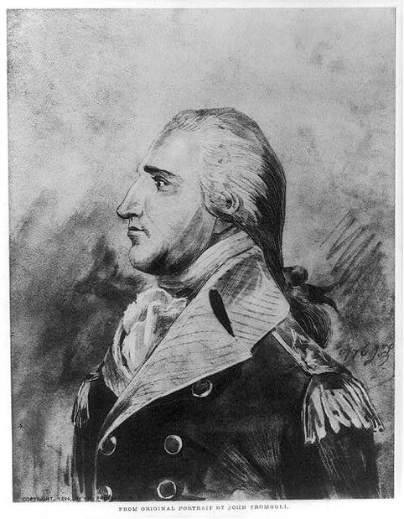
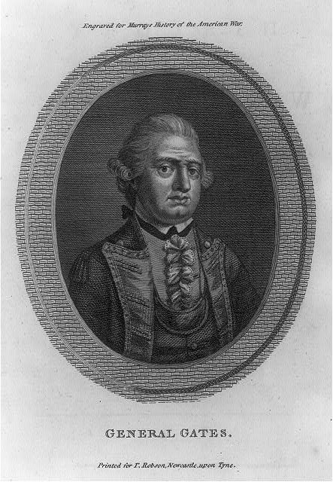
Benedict Arnold: American Hero in 1777
General Benedict Arnold's courage in the fighting at Saratoga at Freeman's Farm and Breymann Redoubt was key to the American victory.
Arnold almost lost his left leg to a musket ball wound, and his mobility was permanently damaged.
At the same time, Arnold resented a lack of recognition by his commander, General Horatio Gates, and by the Continental Congress. This would lead to his treason
Notes:
SEE SLIDE 13 for the rest of Benedict Arnold's biography and treason.
General Benedict Arnold (L) https://www.battlefields.org/learn/biographies/benedict-arnold
General Horatio Gates [R] https://www.battlefields.org/learn/biographies/horatio-gates
https://www.battlefields.org/learn/articles/10-facts-benedict-arnold-and-peggy-shippen
Since the beginning of the conflict, Benedict Arnold was seemingly always in the thick of the fighting and found himself at the forefront of many of the War’s early heroic moments. He rose in the ranks from colonel to major general, albeit a much slower rise than he deserved. Arnold assisted in the capture of Fort Ticonderoga and Lake Champlain in 1775, was wounded during the epic assault on Quebec City, slowed down an invading British army from Canada at Valcour Island in 1776, and resisted an enemy raiding party at Ridgefield, Connecticut, earning a strategic victory for the Patriots in the spring of 1777. Later that year, he valiantly led troops at the Battles of Saratoga, and without a command, successfully delivered the knockout blow against John Burgoyne’s army during the second of those engagements. On multiple occasions, Arnold received little to no recognition for his heroism and exploits, and instead, watched as others with less experience and capabilities were constantly promoted instead of him.

Slide 8
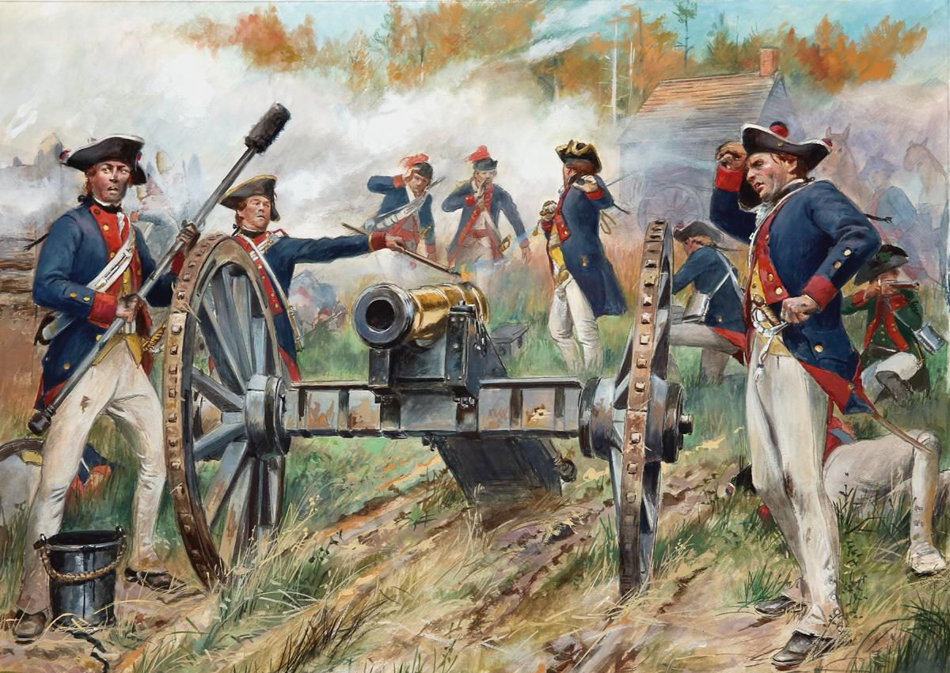
The Birth of an Alliance
Early in 1776, France began secretly providing support to the Americans, including gunpowder and arms.
France had a long history of war with Great Britain and hoped to regain some of the territory it lost in 1763.
The victory at Saratoga, along with Benjamin Franklin's skillful diplomacy, convinced France to support the United States openly.
Don Troiani
Notes:
https://www.battlefields.org/learn/videos/untold/revolutionary-diplomats-franklin-and-adams
https://www.battlefields.org/learn/articles/10-facts-benjamin-franklin
Throughout 1777, the Continental Army achieved victories, causing the French monarchy to take more interest in the conflict. The Marquis de Lafayette proved highly beneficial to the army and persuaded American leaders that an official alliance between the colonies and France would create mutual benefit. The French monarchy still needed a decisive victory before officially agreeing to a treaty of alliance. In the autumn of 1777, an American army, under the command of Horatio Gates, participated in one of the most decisive combats of the American Revolution: The Battles of Saratoga. The American troops successfully prevented British General John Burgoyne’s force from taking the Hudson River Valley. On October 17, after negotiations, Burgoyne's army surrendered. Impressed by the Patriots’ resistance to Britain, France agreed to sign a formal Treaty of Alliance with the Americans. On December 3, Benjamin Franklin arrived in France to join Silas Deane and Arthur Lee to negotiate and write the official alliance treaties.
In early 1778, Benjamin Franklin, Silas Deane, and Arthur Lee began negotiations with the French government's Conrad Alexandre Gérard de Rayneval. The Franco-American Alliance Treaty agreed that neither country would stop fighting with Great Britain until independence was granted. In addition to the alliance, France signed the Treaty of Amity and Commerce, creating an official trade network with the colonies. Due to a previous alliance treaty with France, the American colonies now had Spain as an ally in the American Revolution.

Slide 9
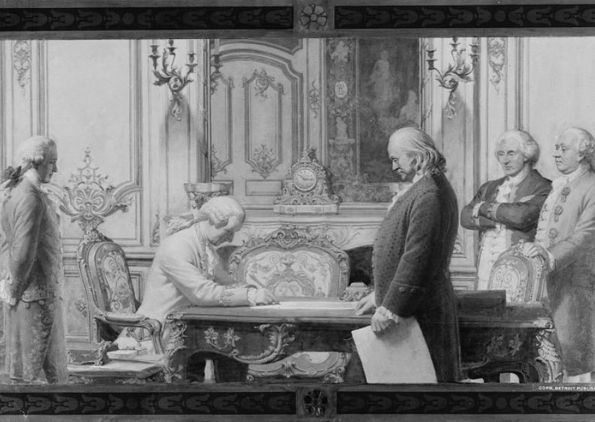
A Treaty of Amity and Commerce
Read The Treaty of Alliance with France
Discuss: What does France promise in the treaty? What does the United States promise?
Notes:
Read the Alliance here:https://www.battlefields.org/learn/primary-sources/treaty-alliance-france

Slide 10
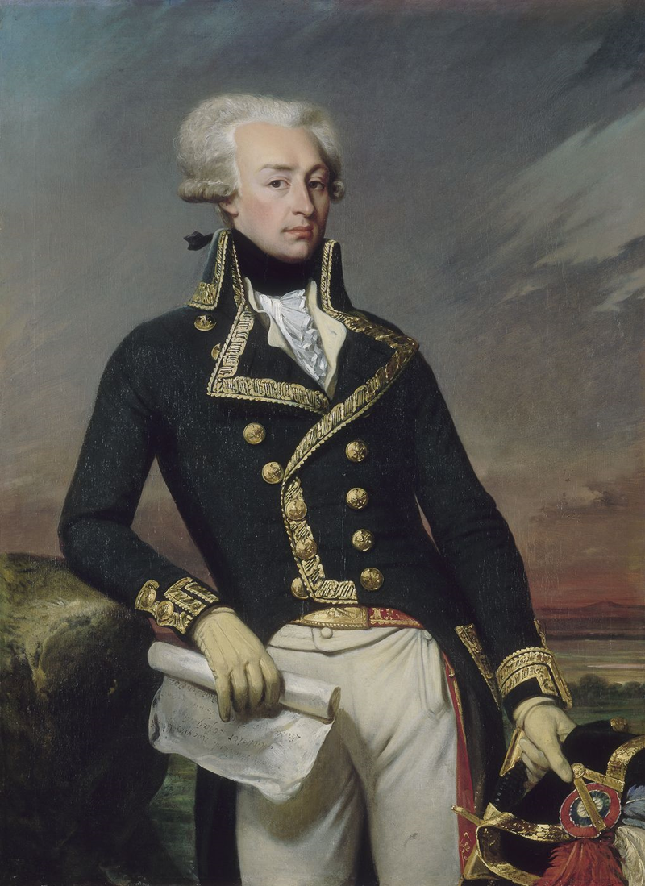
Marquis de Lafayette
Gilbert du Motier, Marquis de Lafayette, better known simply as the Marquis de Lafayette, had a fascination with the colonial conflict brewing in the Americas.
In April 1777, Lafayette sailed to North America, desperate to serve as a military leader in the Revolution, despite a royal decree prohibiting French officers from serving there at that time.
Shortly after arriving, the Continental Congress commissioned him a major general and he became a member of George Washington’s staff.
Lafayette hoped and worked for an alliance between France and America.
Notes:
Primary Source: https://www.battlefields.org/learn/primary-sources/alliance-america-most-impatiently-expecting-us-declare-her
Biography: https://www.battlefields.org/learn/biographies/marquis-de-lafayette

Slide 11
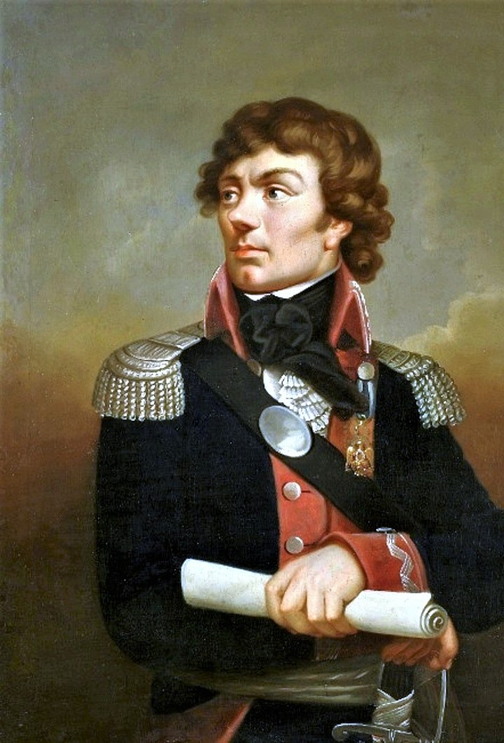
Tadeusz Kosciuszko
Andrej Tadeusz Bonawentura Kosciuszko was a Polish nobleman who sympathized with the American cause.
He served as Brevet Brigadier General and Engineer, and his defenses helped win the Battle of Saratoga.
After the war, he led a failed uprising against Russian rule in Poland.
Notes:
https://www.battlefields.org/learn/videos/untold/tadeusz-kosciuszko-engineer-revolution
https://www.battlefields.org/learn/biographies/andrzej-tadeusz-bonawentura-kosciuszko
https://www.battlefields.org/learn/articles/foreign-fighters-american-cause-independence
In many respects the American Revolution was the progeny of the Enlightenment, that 17th century intellectual movement in Europe that sparked new ideas about humanity, science, government, and reason. The most influential European philosopher on the American Revolution was Englishman John Locke, who at the end of the 17th century expanded the notion of the social contract between those governed and those governing. Locke’s philosophy of the “social contract” greatly influenced Thomas Jefferson and its themes can be found throughout the Declaration of Independence.
But Locke’s philosophy and the works of other Enlightenment thinkers also influenced many noblemen and men of privilege living in Europe in 1776. Including individuals with a military pedigree who were excited and energized at the possibilities for humankind that the new United States offered to the world. Many of them wanted to be part of the historical moment. Representing the United States abroad to foreign governments from Paris, was the wily and savvy Benjamin Franklin. Franklin would be the portal through which many of these foreign fighters found their way to the new United States. The lure of a high rank in the nascent American Continental Army played a role as well yet to view these men simply as bounty hunters is a disservice to their memory. The zeal of freedom was firmly entrenched in their hearts and minds.

Slide 12
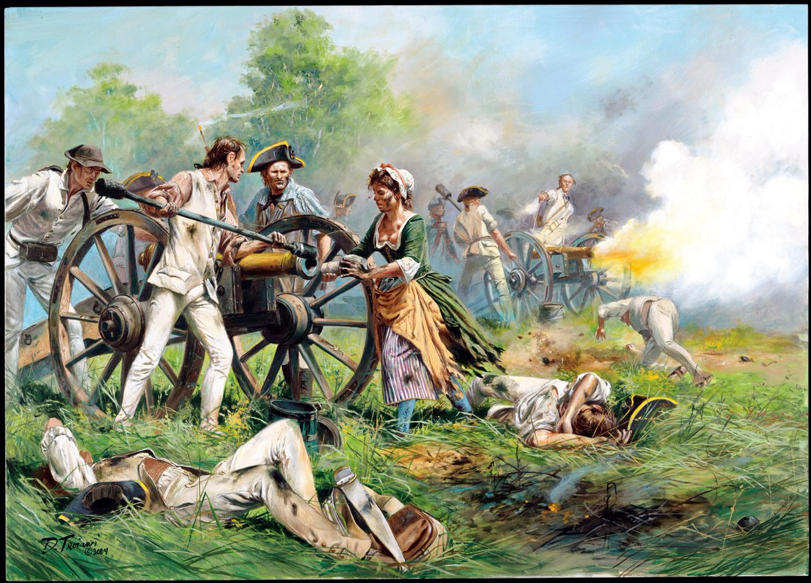
Molly Pitcher
Mary Ludwig Hays, the wife of a Continental artilleryman, earned her nickname at the Battle of Monmouth on June 28, 1778 serving with the gunners.
Legend states that she ran water and ammunition to the men and even helped fire the guns.
Don Troiani
Notes:
https://www.battlefields.org/learn/articles/molly-pitcher-and-battle-monmouth
https://www.battlefields.org/learn/biographies/molly-pitcher
Women often followed their husbands in the Continental Army. These women, known as camp followers, often tended to the domestic side of army organization, washing, cooking, mending clothes, and providing medical help when necessary. Sometimes they were flung into the vortex of battle. Such was the case of Mary Ludwig Hays, better known as Molly Pitcher, who earned fame at the Battle of Monmouth in 1778. Hays first brought soldiers water from a local well to quench their thirst on an extremely hot and humid day and then replaced her wounded husband at his artillery piece, firing at the oncoming British. In a similar vein, Margaret Corbin was severely wounded during the British assault on Fort Washington in November 1776 and left for dead alongside her husband, also an artilleryman, until she was attended by a physician. She lived, though her wounds left her permanently disabled. History recalls her as the first American female to receive a soldier’s lifetime pension after the war.

Slide 13
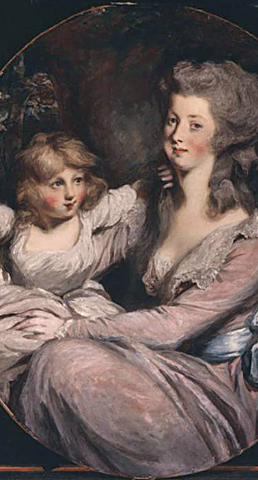
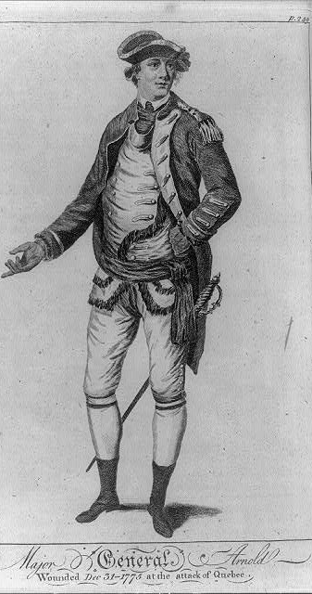
Benedict Arnold: American Traitor in 1779
Still resentful over a lack of promotion and a court-martial that accused him of abuses of power, Arnold offered his services to the British in 1779.
With the help of his wife Peggy, Arnold communicated secretly with British Major John André.
Arnold devised a plan to turn over the defenses of West Point to the British but was discovered when Major André was captured. The Arnolds successfully escaped capture, but André was hung for espionage.
Notes:
https://www.battlefields.org/learn/articles/10-facts-benedict-arnold-and-peggy-shippen
https://www.battlefields.org/learn/videos/benedict-arnold
https://www.battlefields.org/learn/biographies/benedict-arnold
https://www.battlefields.org/learn/biographies/john-andr%C3%A9
https://www.battlefields.org/learn/biographies/peggy-shippen

Slide 14
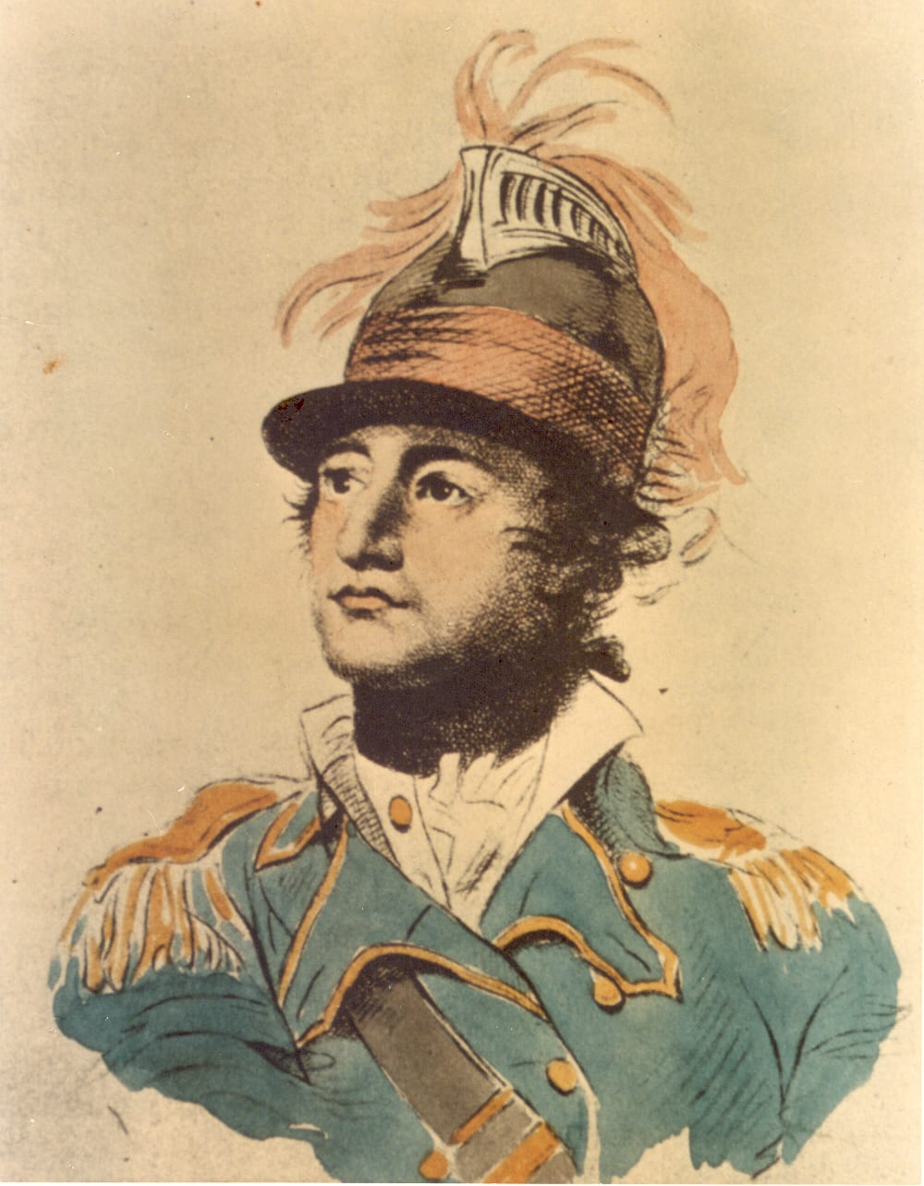
The Culper Ring
A key figure in uncovering Arnold's betrayal was Major Benjamin Tallmadge, who led an American intelligence group known as the Culper Ring, named for the code name of one of its members.
The Culper Ring successfully conveyed information about General Clinton's British force stationed in New York to Washington and the Continental Army.
Participants included Abraham Woodhull, Caleb Brewster, Robert Townsend, Anna Strong, Austin Roe, and an Agent 355.
Notes:
https://www.battlefields.org/learn/articles/spies-revolutionary-war
https://www.battlefields.org/learn/videos/untold/culper-ring-spying-revolution
https://www.battlefields.org/learn/biographies/benjamin-tallmadge
https://www.battlefields.org/learn/articles/black-spies-american-revolution
Many spy rings were active during the American Revolution, but perhaps the most famous is the Culper Spy Ring, comprised of a group of civilian and military officials working together to gather intelligence for Washington while the British army occupied New York. Under the direction of Benjamin Tallmadge, agents Abraham Woodhull, Caleb Brewster, Anna Strong, Austin Roe, and others spied on the British beginning in 1778 and for the duration of the war. The agents choose pseudonyms—Tallmadge was known as “John Bolton,” while Woodhull became known as Samuel Culper, the namesake of the group. Tallmadge also devised a numerical substitution system, with numbers standing in for words, locations, and important names (for example, Washington’s numerical code was 711). The spy ring employed systematic tactics of dead drops, codes were hidden in plain sight (a petticoat hanging from Anna Strong’s clothesline could indicate the location of a meeting or that a message was available at a dead drop), and even messages written in invisible ink with ciphers and coded letters. Washington himself was active in directing the agents’ secret communications. From his headquarters at West Point in September 1779, Washington wrote to Tallmadge instructing agents to write messages with invisible ink on pocketbooks, almanacs, or pamphlets, which British agents were less likely to search than common letters. The Culper Ring was extremely successful and is responsible for uncovering a British plan to bombard the French fleet off the coast of Rhode Island.
Historians also credit the Culper Ring with uncovering Benedict Arnold’s treasonous turn to the British and, indirectly, exposing Major John André, Arnold’s British accomplice and head of the British secret service in America. After rendezvousing with Arnold regarding plans for the British to capture West Point André, dressed in civilian attire, was stopped and questioned by three patriot militiamen. André aroused the men’s suspicions and upon searching his person, the militiamen found a map of West Point and other incriminating papers hidden in André’s boot.

Slide 15
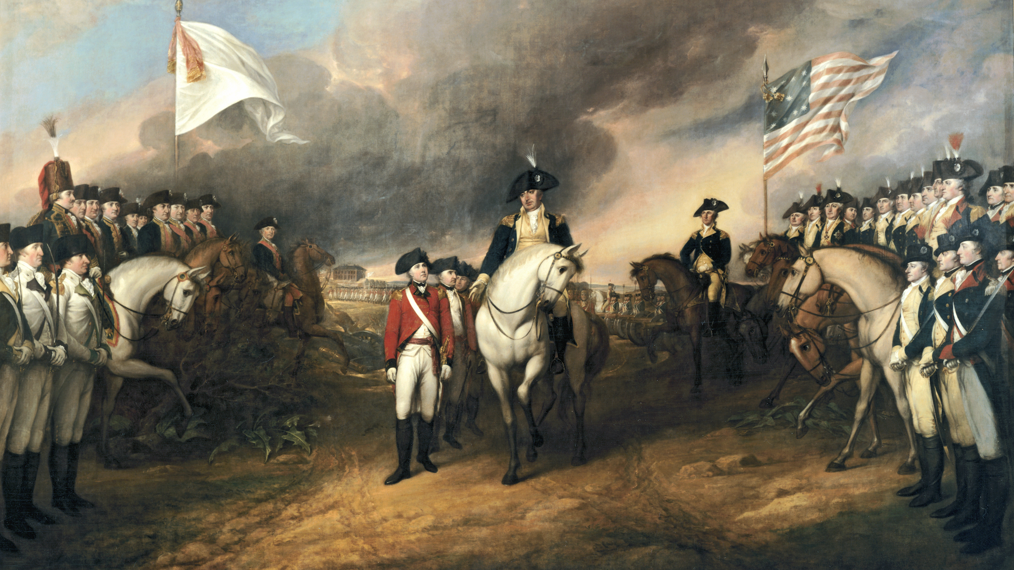
A Shared Victory
In 1780, the Count of Rochambeau, Jean-Baptiste Donatien de Vimeur, landed with over 5,000 French soldiers.
The combined forces of Washington, Rochambeau, and Lafayette surrounded British General Lord Cornwallis's 8,000-man army at Yorktown, Virginia.
A French fleet defeated the British in the Battle of the Capes, forcing the British fleet to retreat to New York and leave Cornwallis's army trapped on land.
After the monthlong Siege of Yorktown, Cornwallis was forced to surrender in October 1781. Peace followed in 1783.
Notes:
https://www.battlefields.org/learn/articles/how-france-helped-win-american-revolution
https://www.battlefields.org/learn/articles/france-american-revolution
https://www.battlefields.org/learn/revolutionary-war/battles/yorktown
France provided the money, troops, armament, military leadership and naval support that tipped the balance of military power in favor of the United States and paved the way for the Continental army’s ultimate victory. When British General Charles Cornwallis surrendered at Yorktown on October 19, 1781, his vanquished troops marched through a corridor formed by the victorious forces. On one side were the Americans; on the other side stood the French.

Slide 16
Inquiry Question:
What were some key turning points of the American Revolution and how did people feel about them?

