Slide 1
Rebellion Begins—1775
The American Battlefield Trust

Slide 2
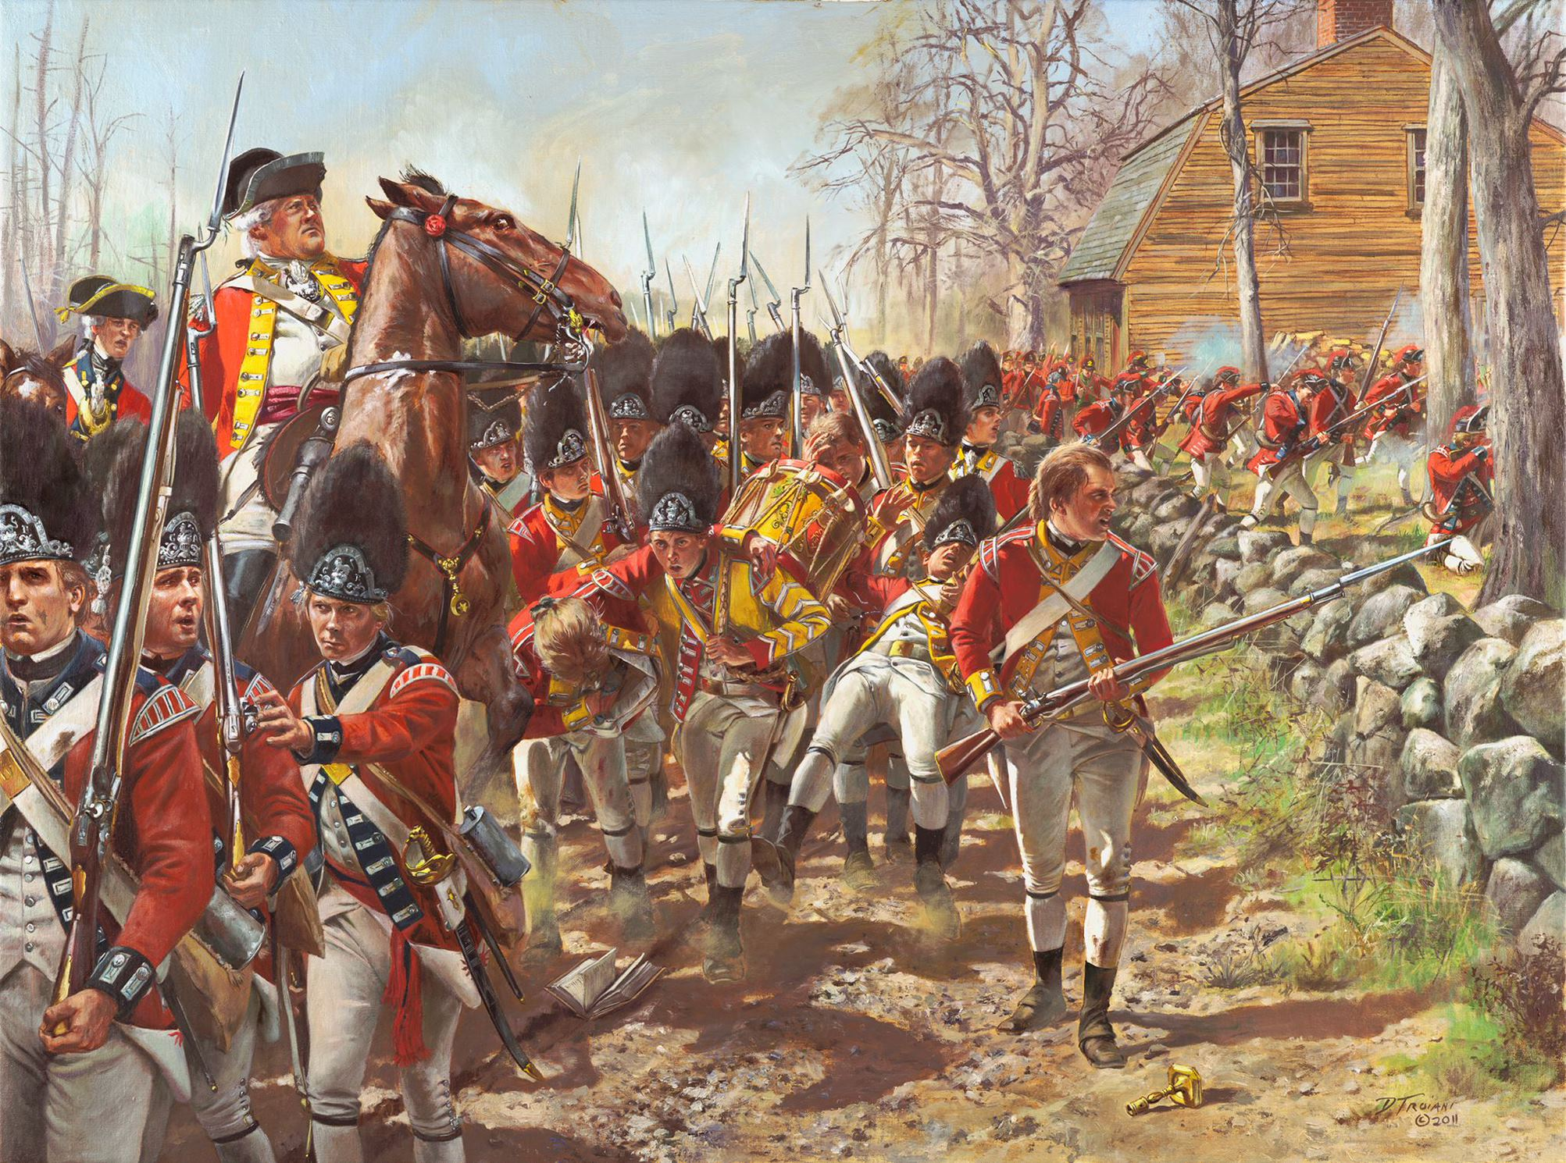
Essential Question
What happened and how did people respond at the beginning of the American Revolution?
Don Troiani
Notes:
Encourage students to think about how after these events, the revolution was more than a localized rebellion starts in Massachusetts- it had a global effect.
Possible discussion question: what happened and how did people respond at the beginning of the American Revolution?

Slide 3
Context
After their French and Indian War victory, Britain instituted changes within the colonies
No westward movement (Proclamation of 1763)
Purpose: avoid future conflicts between colonists and American Indians and to pay off debt
Taxes (Stamp Act of 1765, Tea Act, Sugar Act)
Purpose: pay off war debt created by British fighting on behalf of the colonies
"Patriots" protested these taxes
Boston Tea Party
Notes:
Extra Resources:
"The French and Indian War (1754-1763): Its Consequences" article https://www.battlefields.org/learn/articles/french-and-indian-war-1754-1763-its-consequences
Royal Proclamation of 1763 primary source
Stamp Act of 1765 primary source https://www.battlefields.org/learn/primary-sources/stamp-act-1765
Tea Act primary source https://www.battlefields.org/learn/primary-sources/tea-act
Sugar Act primary source https://www.battlefields.org/learn/primary-sources/sugar-act
"'Boston a Teapot Tonight!'" article https://www.battlefields.org/learn/articles/boston-teapot-tonight
After the end of the French and Indian War, the victorious Britain gained a large swath of French territory in North America. Now burdened with the task of governing such a large area, King George III issued this proclamation to forbid European settlement west of the Appalachian Mountains and reserved this land for use by Native Americans. It also created new colonies in North America and the Caribbean. This was the first of a string of British measures intended to tighten their control on the colonies and would factor into the breakdown of relations between Britain and her American colonies. Taxes imposed to pay for a massive national debt, a constant struggle with Native Americans over borders and territories, and the prohibition of expansion to the west fueled an ever-increasing “American” identity.
Possible discussion question: why might the colonists be upset about the taxes and restrictions?

Slide 4
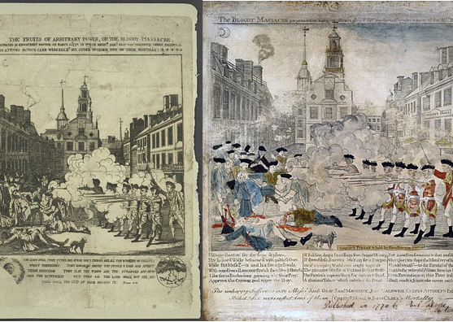
Heightened Tensions
After Patriots attack royal commissioners, British General Thomas Gage ordered British troops to Boston
Quartering Act of 1765
Tensions between soldiers and Patriots resulted in the Boston Massacre
Colonial dissatisfaction with British expansion of power fueled an ever-increasing “American” identity
Do you think the colonists had a right to be angry? Do you think Britain had a right to levy taxes?
Notes:
Extra Resources:
Quartering Act of 1765 primary resource https://www.battlefields.org/learn/primary-sources/quartering-act-1765
"The Boston Massacre" article https://www.battlefields.org/learn/articles/boston-massacre
The Boston Massacre marked the moment when political tensions between British soldiers and American colonists turned deadly. Patriots argued the event was the massacre of civilians perpetrated by the British Army, while loyalists argued that it was an unfortunate accident, the result of self-defense of the British soldiers from a threatening and dangerous mob. Regardless of what actually happened, the event fanned the flames of political discord and ignited a series of events that would eventually lead to American independence. John Adams believed that “on that night, the foundation of American independence was laid.”
Possible discussion question: do you think the colonists had a right to be angry? Do you think Britain had a right to levy taxes?

Slide 5
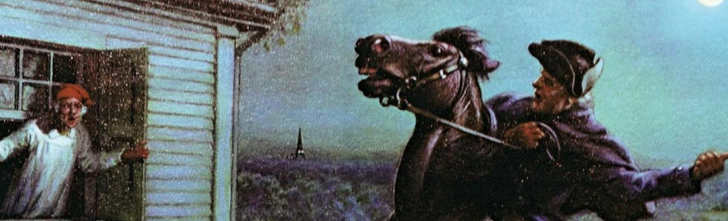
Paul Revere's Ride
Anti-British intelligence discovered a British plan to remove arms and supplies from Concord
Gage planned this to prevent violent rebellion by seizing these weapons
Paul Revere and William Dawes left to alert the countryside to the coming threat
Revere passed the message of "the Regulars are coming out"
More alarm riders rode out
Signal guns fired and church bells rang
Soldiers grabbed their weapons and headed for town greens
April 18, 1775
Notes:
Extra Resources:
"Paul Revere's Ride" video https://youtu.be/h7ug7Zny_yo
"Paul Revere's Ride in Legend" article https://www.battlefields.org/learn/articles/paul-reveres-ride-legends-myths-and-realities
Paul Revere's role in the events of April 18-19, 1775 is well documented in modern American literature. Revere, along with William Dawes, rode from Boston to Lexington to warn of the British Regulars march west. Many falsely believed the soldiers were on a mission to capture John Hancock and Samuel Adams. As Revere and Dawes rode towards Lexington, they handed off their message to other riders in the towns they rode through. Soon, dozens of riders were spreading the word as far away as New Hampshire and Connecticut by the end of the day. The network of information sharing was astounding and showed that colonial leaders were well organized. Though Revere is by far the most well-known rider that night, he was by far not the only one out that night spreading the word.
Possible discussion question: how do you think the soldiers felt when they heard the alarm?

Slide 6
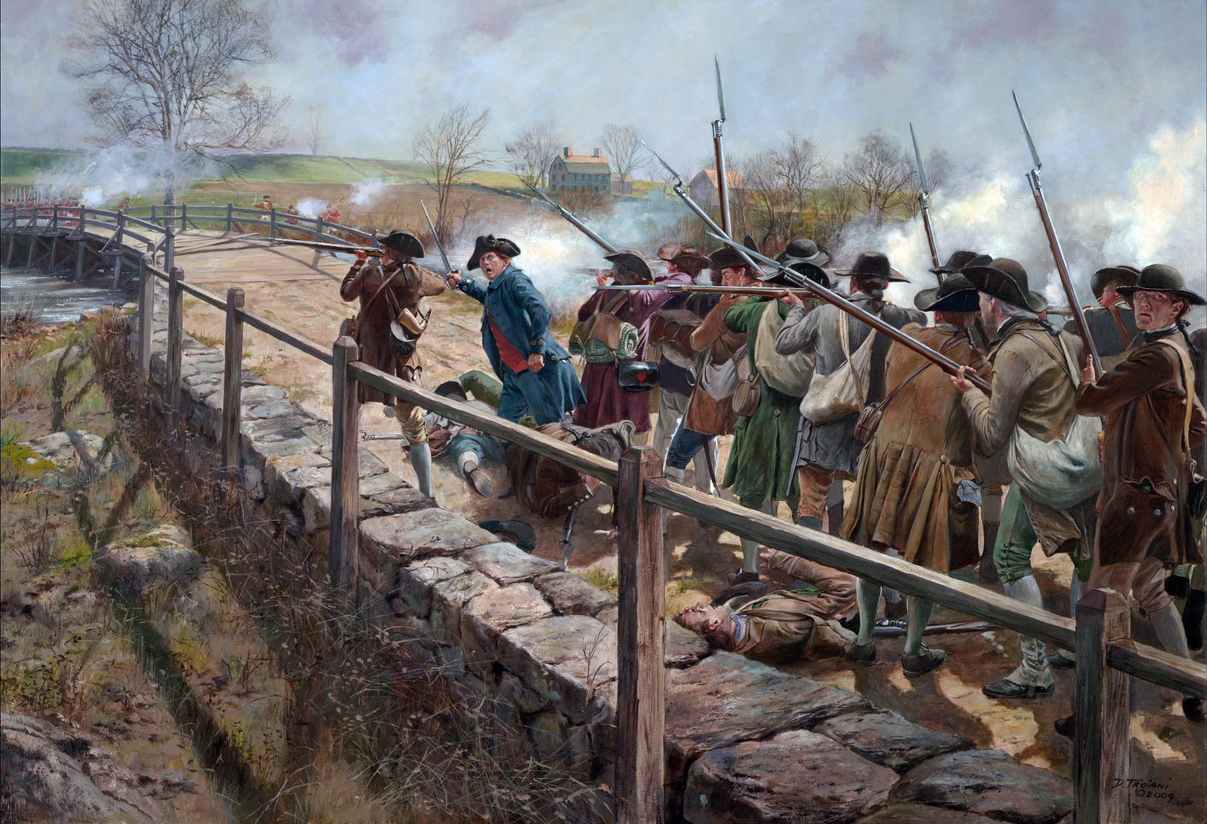
Lexington and Concord: The First Battle of the Revolution
April 19, 1775
British troops marched into Lexington at about 5:00 a.m. and faced by a militia company of more 70 men led by Capt. John Parker.
The British rushed toward the militia across the town green and Parker immediately ordered his company to disperse
But, one single shot rang out, causing the British to fire a volley
The British moved onto Concord to secure the North Bridge across the Concord River
400 militia from the Concord area gather on the high ground, where they mistakenly assumed the British were torching the town, so they advanced
The British were intimidated by the militia, so they retreated to the opposite shore
When the militia came within range, the British opened fire and the minutemen responded
Don Troiani​
Notes:
Extra Resources:
"Lexington and Concord" In 4 Minutes video https://youtu.be/jQtkw2tCLyU
"Ten Facts: The Battles of Lexington and Concord" article https://www.battlefields.org/learn/articles/ten-facts-battles-lexington-and-concord
"Lexington and Concord: The Shot Heard 'Round the World" article https://www.battlefields.org/learn/articles/lexington-and-concord-shot-heard-round-world
The battle ended in an American victory. The British marched into Lexington and Concord intending to suppress the possibility of rebellion by seizing weapons from the colonists. Instead, their actions sparked the first battle of the Revolutionary War. The colonists’ intricate alarm system summoned local militia companies, enabling them to successfully counter the British threat.
Possible discussion question:

Slide 7
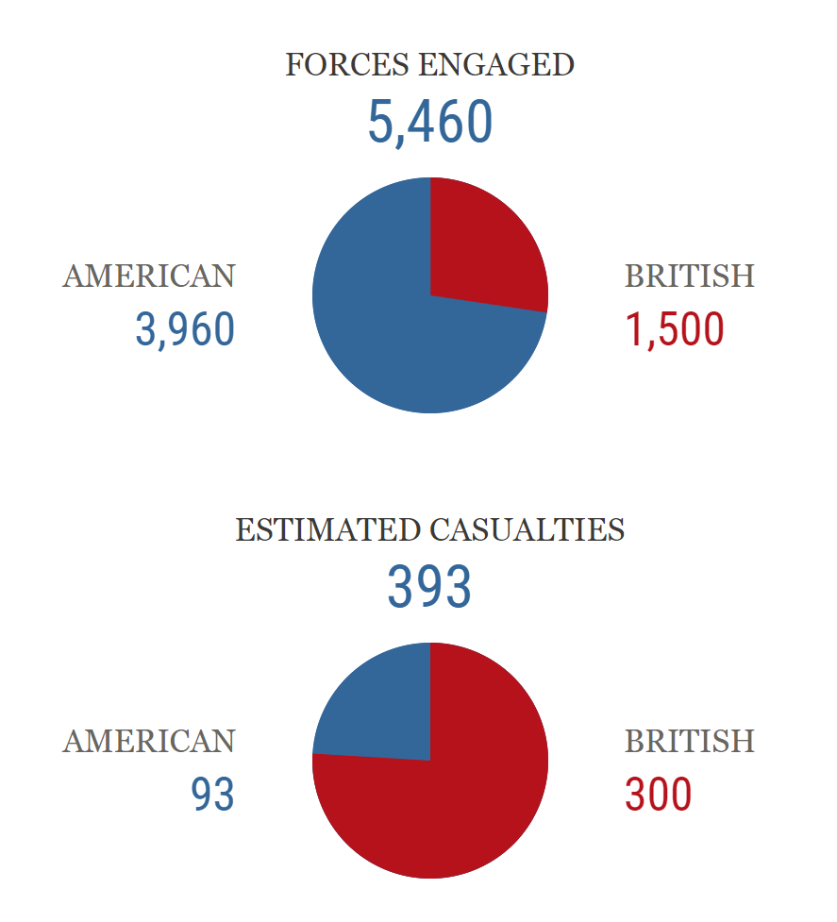
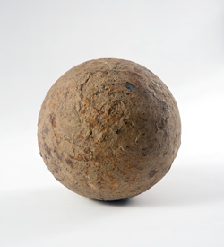
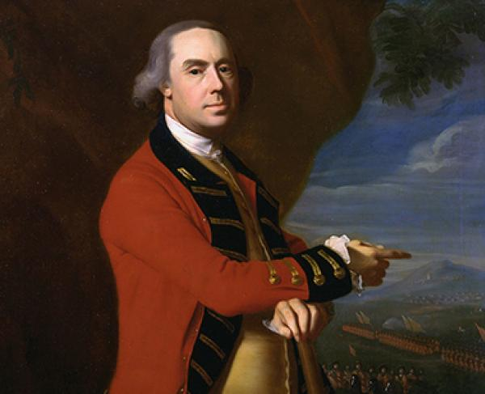
Battle Facts
The Lexington militia did not intend to fight the British Regulars— they only wanted to show their willingness to the British
Nobody knows who fired the first shot
The volley on the Concord Bridge is considered “the shot heard 'round the world”
Cannonball from the battle
Thomas Gage
volley:
A number of bullets or other projectiles discharged at the same time to increase firepower and effects on the target. Military units used volley fire due to the inaccuracy of aimed fire by smoothbore muskets.
Notes:
Extra Resources:
"Thomas Gage: The Two-Faced Governor?" video https://youtu.be/JRpXlAqQWWs
If needed, the American Battlefield Trust has a glossary of Revolutionary War terms, including military terminology: https://www.battlefields.org/glossary-revolutionary-war-terms
Thomas Gage
Gage left Montreal to take over the position of commander-in-chief of North America. During his administration, tension between Colonists and British rule started to rise.
Gage began pulling back British troops from the frontier to place them in cities such as New York and Boston. This led to more tension and eventually the Boston Massacre. Gage became a fervent believer that democracy was a threat in North America. In April 1775, Gage had become governor of Massachusetts and received orders from London to take action against the Patriots. This led to Gage giving the orders to seize militia supplies at Concord. Gage continued command through the Battle of Bunker Hill and the Siege of Boston, before being recalled to England.

Slide 8
Fight back to Boston
The British retreated and were continually ambushed by Minute Men shooting from behind trees, rock walls, and buildings.
The British conducted a running fight until they could reach the cover of British guns on ships anchored in the waterways surrounding Boston.
The Patriots chased them but, having no clear orders, ultimately let them escape.
Don Troiani​
Notes:
Extra Resources:
Map of the British retreat back to Boston https://www.battlefields.org/learn/maps/battle-lexington-and-concord-british-retreat-april-18-19-1775
Smith and Pitcairn ordered a return to Boston, which devolves into a rout as the British are attacked from all sides by swarms of angry Minute Men along what is now known as Battle Road. When they reach Lexington, Parker’s men take their revenge for the violence suffered that morning, firing on the British regulars from behind cover. For the next 12 miles, the British are continually ambushed by Minute Men shooting from behind trees, rock walls, and buildings. British reinforcements reach Smith and Pitcairn’s men on the eastern outskirts of Lexington, but the Minute Men pursue them as they retreat back to Boston.
Possible discussion question: how do you think this victory affected colonial morale? What about British morale?

Slide 9
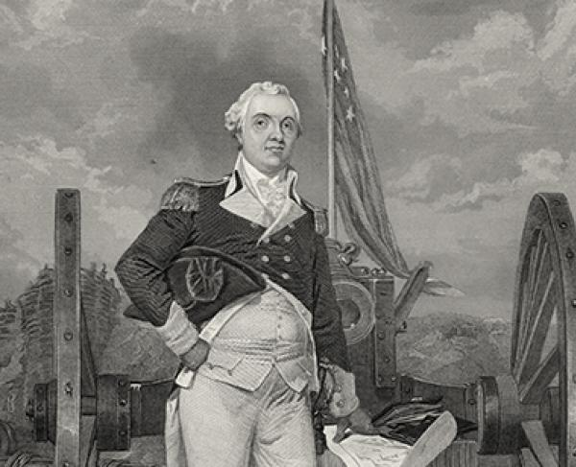
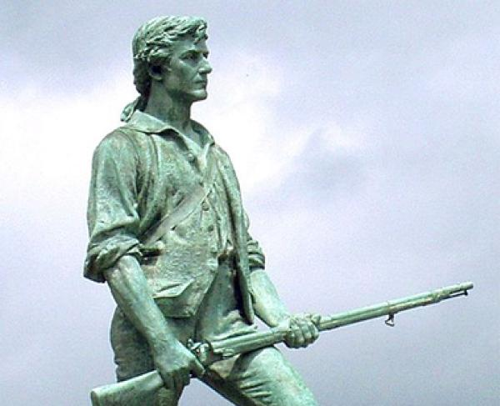
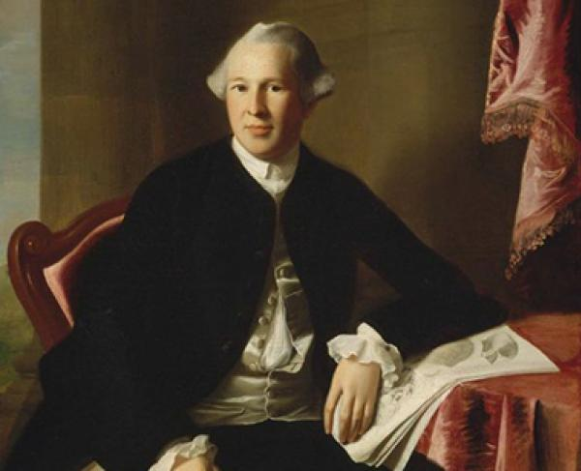
Notable Patriots
Henry Knox​
John Parker
Joseph Warren
“Stand your ground. Don’t fire unless fired upon, but if they mean to have a war,
let it begin here.”
Notes:
Extra Resources:
Henry Knox biography https://www.battlefields.org/learn/biographies/henry-knox
John Parker biography https://www.battlefields.org/learn/biographies/john-parker
Joseph Warren biography https://www.battlefields.org/learn/biographies/joseph-warren
Henry Knox
Knox's command of artillery impressed Washington in July of 1775. Though only about twenty five years old, Knox received a commission as a colonel who oversaw artillery and tasked with bringing cannons from the recently captured Fort Ticonderoga in New York state to Boston in the middle of winter. He and his men successfully brought sixty tons of cannon packed on sleds pulled by oxen over 300 miles of snow, ice covered rivers, and mountains to the Boston camps without losing a single cannon. Knox remained the highest-ranking artillery officer under General Washington, who refused to give anyone a command higher than Knox. His leadership shown during the New York and New Jersey campaigns of 1776-77 when he oversaw the logistics for recrossing the Delaware River to surprise the Hessians at Trenton and another victory at Princeton a week later. Knox received a promotion to brigadier general for these feats. Washington recommended promotion for his actions during the Siege of Yorktown, and in March 1782, Knox became the army’s youngest major general.
John Parker
By the time word arrived in Lexington about the incoming British troops, John Parker was forty-six years old, suffering from tuberculosis and on his death bed. On the morning of the April 19, he mustered his strength and walked two miles to Lexington Green to take command of the seventy or so militiamen awaiting the British regulars. Here, Parker is said to have told his men, “Stand your ground. Don’t fire unless fired upon, but if they mean to have a war, let it begin here.” Later, during the British retreat back to Boston, the Lexington militia under Parker hid behind rocks and trees, ready to ambush the British column in what is called Parker’s Revenge. The Lexington militia fired in a single group of attacks along the road that would inflict heavy casualties on the British as they retreated.
Joseph Warren
Joseph practiced medicine and surgery in Boston, and he started to become active in politics, which led him to associate with other leaders such as John Hancock and Samuel Adams. After the Boston Massacre, Warren became chairman of the Committee of Safety. He played a first-hand role in the raising of militias in and around Boston. While Sam Adams was away in 1774, Warren assumed the role of raising militias and the procurement of gunpowder, arms, and other supplies. When Adams and Hancock returned to Boston, they had learned a bounty was placed on their heads by the British crown. Joseph Warren directed Paul Revere and William Dawes to warn the leaders that the British were coming for them on the night of April 18, 1775 in Lexington, where Hancock and Adams were hiding. With the events of Lexington and Concord, Warren left Boston to rally the militia for the battles to come. He spent six weeks doing so and was elected second general in command of Massachusetts forces by the Provincial Congress on June 14. He commanded troops at the Battle of Bunker Hill on June 17 where legend says he joined the battle line as a regular volunteer. Whether this legend is true or not, on the third British assault, Warren was shot and instantly killed.
Possible discussion question: what similarities and differences exist between these three people?

Slide 10
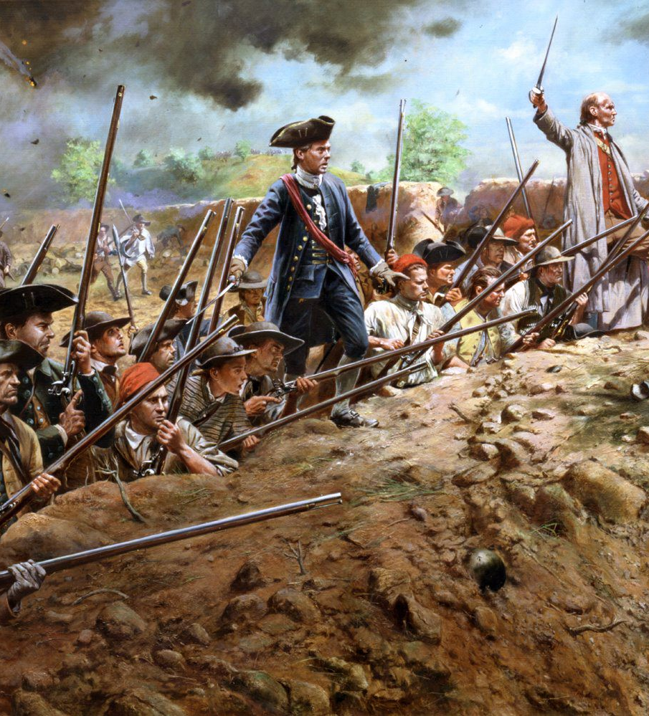
The Battle of Bunker Hill
June 17, 1775
In the wake of Lexington and Concord, 20,000 soldiers arrived to Boston from throughout New England
The British were intimidated by the sheer number of militiamen gathered outside the city
The patriots moved forward to Breed’s Hill and prepared a fortified position
One patriot general had an idea to assemble a makeshift split rail barricade to blunt any flanking action employed by the British.
British are stunned and Gage ordered British soldiers to assault the militiamen
British troops climbed Breed’s Hill in perfect battle formation.
Don Troiani​
Notes:
Extra Resources:
"Bunker Hill" In 4 Minutes video https://youtu.be/mgeq7uqqmn8
"Bunker Hill: Proving Ground of the Patriots" video https://youtu.be/xodPA_cR-SU
"Bunker Hill/Breed's Hill" article https://www.battlefields.org/learn/revolutionary-war/battles/bunker-hill
The sheer number of militiamen gathered on the hills outside of Boston deeply troubles Gen. Thomas Gage and his newly arrived subordinates, Gens. William Howe, Henry Clinton, and John Burgoyne. On June 15 and June 16, the Patriots move forward to Breed’s Hill on the Charlestown peninsula, where they prepare a fortified position that all but invites a British response. General John Stark from New Hampshire recognizes that the left flank of the fortified position is exposed along the south bank of the Mystic River. He and his men assemble a makeshift split rail barricade to blunt any flanking action employed by the British. When the British officers look out at what has been erected in the short span of one evening they are stunned. Gage knows he has to take action.

Slide 11
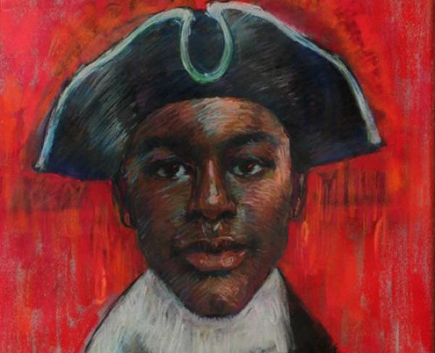
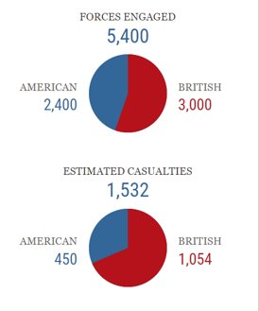
British Victory, but American Strength
Legend has it that as they advanced, American officer William Prescott cautioned his men not to waste their powder, exclaiming “don’t fire until you see the whites of their eyes.”
The Patriots unleashed a strong, deadly volley on the British when they approached
The British broke through the patriot works on their third attempt up the hill
Though defeated, the Patriots are not demoralized. Those who choose to stay and keep the British bottled up in Boston become the nucleus of the Continental Army.
Peter Salem fought and may have killed British Maj. John Pitcairn, the officer despised for allegedly ordering his men to fire on patriots during the battle of Lexington and Concord weeks earlier.
Notes:
Extra Resources:
Peter Salem biography https://www.battlefields.org/learn/biographies/peter-salem
John Pitcairn biography https://www.battlefields.org/learn/biographies/john-pitcairn
On this hot and humid afternoon, Gage and his commanders order British regulars and grenadiers to move across Boston Harbor and disembark in lower Charlestown, where Gage will force the rabble’s hand with an assault. As the British move into position, the fatigued but spirited defenders are on the alert inside their hastily built fortifications. Led by Gen. William Howe, King George’s troops climb Breed’s Hill in perfect battle formation. Legend has it that as they advance, American officer William Prescott cautions his men not to waste their powder, exclaiming “don’t fire until you see the whites of their eyes.” When British troops near the redoubt, the patriots unleash a withering volley, creating an absolute slaughter. Once more the British push up the hill, stepping over the bodies of their dead and wounded comrades who lay “as thick as sheep in a fold,” and again they receive another patriot volley. Finally, on the third try –and just when the patriots run out of powder and shot—the British succeed in breaking through the patriot works. Intense hand-to-hand fighting occurs inside the fortification. The British are victorious but at a cost. At some point in the struggle, a “black soldier named Salem” is credited with killing British Maj. John Pitcairn, the officer despised for allegedly ordering his men to fire on patriots during the battle of Lexington and Concord weeks earlier. British General Sir Henry Clinton is appalled at the carnage, calling it “a dear bought victory.” Badly depleted, the British abandon plans to seize another high point near the city and ultimately evacuate Boston.
Peter Salem
Salem was emancipated Salem so that he could enlist in the patriot militia and serve as a minuteman. During the Battle of Bunker Hill, he was credited with mortally wounding British Major John Pitcairn with a shot through the chest. However, this claim is often disputed. Most American accounts of the battle note that a single shooter shot Major Pitcairn, while many British accounts note that Pitcairn was shot four times by four unique shooters. In addition, the American version of the story recounts that Pitcairn was shot at the top of a redoubt, while the British version places him at the bottom of the British fortification.
John Pitcairn
Bostonians regarded Pitcairn as one of the more tempered British officers sent to resolve the conflict. Two months later the British attempted to break out of Boston at the Battle of Bunker Hill. Major Pitcairn commanded the British reserve force; his son Thomas served under his command as a junior officer. On June 17, 1775, the marines landed at the south end of Charlestown to feint an attack on the American position. After the first assaults failed, Pitcairn led his men forward up the hill in a bayonet charge. The attack succeeded, and the marines drove the Americans from their redoubt. Pitcairn, already wounded twice, personally led the marines over the defenses.
As the major descended the rebel works, four bullets struck him—the last of which allegedly fired by former slave and militiaman Peter Salem. Pitcairn fell into the arms of his son Thomas who exclaimed, “I have lost my father!” British troops carried Pitcairn back to Boston where he died several hours later. They laid him to rest at the Old North Church in Boston, while the soldiers under his command proclaimed they all “lost a father" in their major.

Slide 12
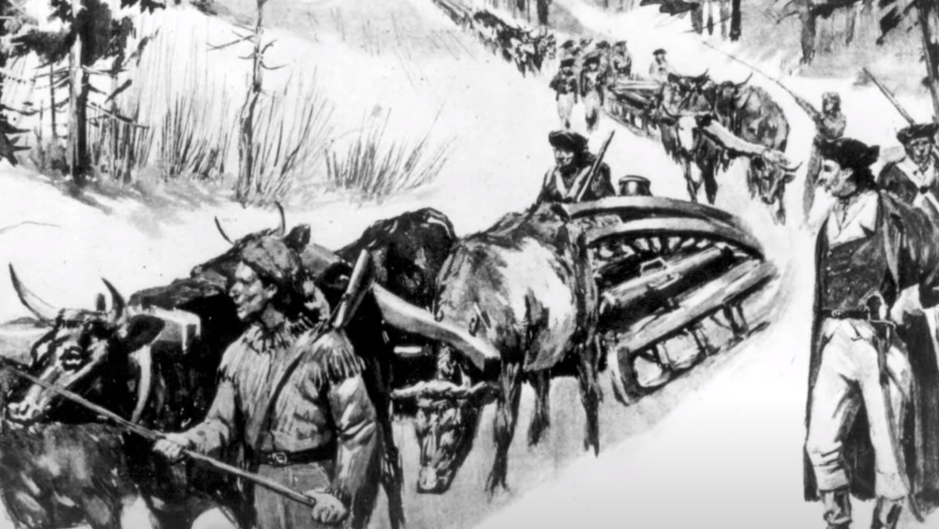
Fort Ticonderoga and the Siege of Boston
April 19, 1775 – March 19, 1776
After Lexington and Concord, 20,000 soldiers arrived from throughout New England to fight
Efforts to improve the army
Henry Knox and Nathanael Greene would try to organize the camp, improve sanitation, and get the British out of Boston
Need supplies to fortify the hills outside Boston with artillery
Henry Knox picked out 58 artillery pieces from Fort Ticonderoga and his team dragged the weaponry on sleds all the way to Boston, arriving in mid-January
"Impossible task" in a blizzard, traveling over 180 miles
artillery:
Cannon or other large caliber firearms; a branch of the army armed with cannon
Notes:
Extra Resources:
"Fort Ticonderoga: The Revolutionary War" In 4 Minutes video https://www.youtube.com/watch?v=94_qdS3n__Y
"Fort Ticonderoga: Key to the Continent" video https://www.youtube.com/watch?v=UCSVvX1pEmE
"The Guns of Ticonderoga" article https://www.battlefields.org/learn/articles/guns-ticonderoga
"Siege of Boston" article https://www.battlefields.org/learn/articles/siege-boston
The Green Mountain Boys had captured Ft. Ticonderoga and took possession of two hundred cannons. With a commission as a colonel in the Continental Army, Knox went to Washington and confidently predicted that once the cannons had been taken by boat from Fort Ticonderoga to the southern end of Lake George, it would take fewer than twenty days to move them overland to Boston. Henry Knox left for Fort Ticonderoga on November 16, 1775. Once he arrived at the fort, he selected 58 pieces of artillery to take back to Boston. Most of artillery pieces were “12-pounder” or “18-pounder” cannons (depending on the weight of the cannonball they fired). Knox also brought one massive 24-pounder cannon, nicknamed “Old Sow,” that weighed more than 5,000 pounds and several high-arching mortar guns that weighed one ton each. In total, Henry Knox’s “noble train of artillery” weighed 120,000 pounds, or 60 tons. Three boats loaded with artillery traveled forty miles down the ice-covered Lake George, and after eight days, Knox and others used more than one-half mile of rope to secure the guns to 42 sleds. Hauling the heaviest guns required eight horses and sometimes additional oxen as well. The journey on land required crossing the frozen Hudson River four times. The leader of each sled team carried an axe, so that if a cannon fell through the ice they could cut the lines before it dragged the horses underwater as well. Henry Knox himself nearly froze to death while trying to walk through three feet of snow in a blizzard. In a letter to Washington, he wrote that “it is not easy to conceive the difficulties we have had,” but not a single cannon was lost. Henry Knox and his noble train of artillery arrived at the Continental Army camp outside Boston in late January 1776.
Possible discussion question: what does Henry Knox's actions reveal about the commitment of the patriots?

Slide 13
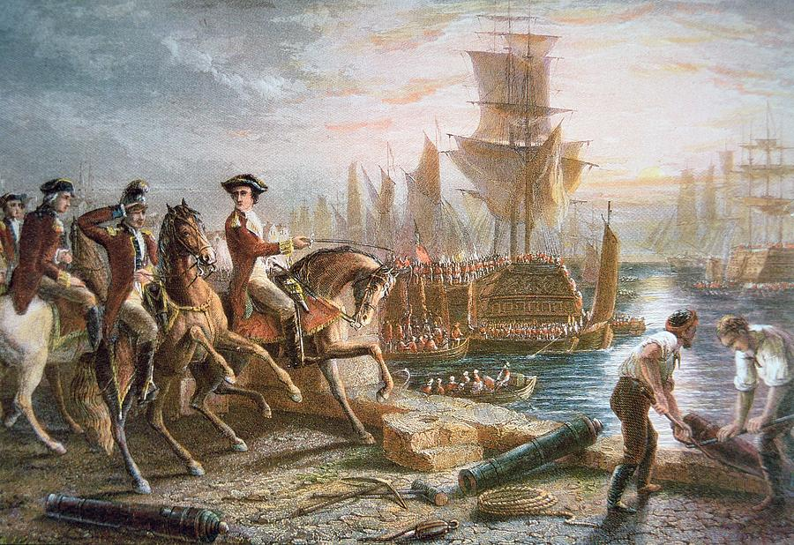
British evacuate Boston
March 17, 1776
British were weak and running out of food
Artillery was put in place surrounding Boston
Washington was prepared to bombard the city
British decided to evacuate and surrender Boston to Washington
No shots fired
What could this evacuation mean for the rest of the war?
Historical Digression
Notes:
On the night of March 4, the cannons were moved into position on Dorchester Heights, overlooking the city and the harbor. On March 5, when General Howe learned what the colonists had done, he exclaimed that “these fellows have done more work in one night than I could make my army do in three months.” On March 6, 1776, he gave the order to prepare for evacuation and not engage the Americans. Overnight, a torrential storm blew in, possibly a hurricane, that upended any further chances of an impending battle. On March 8, Howe sent a letter to the American lines, asking Washington for a truce: Howe would not burn Boston to the ground if the Americans allowed him and the British to sail unmolested out of the harbor. The wish was granted, and nearly eleven thousand people boarded the British ships and transports where they departed on March 17. On Saint Patrick’s Day 1776, 120 ships carried 9,000 British soldiers, 1,200 dependents, and 1,100 Loyalists out of Boston. On the deck of one ship, the merchant George Erving told other Loyalists, “Gentlemen, not one of you will ever see that place again.”
Possible discussion question: what could this evacuation mean for the rest of the war?

Slide 14
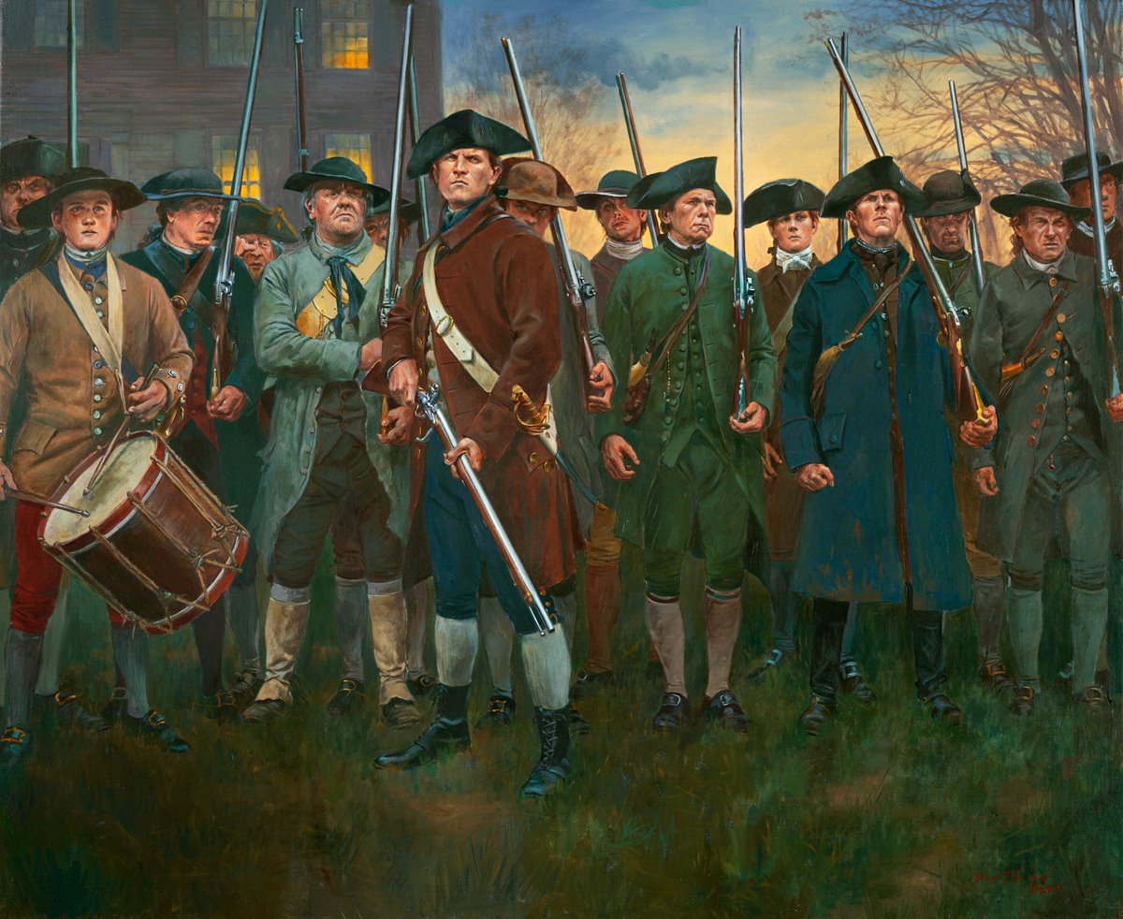
Forming the Continental Army
June 14, 1775
The Continental Army— a regular standing army to oppose the British— was created with George Washington as its commander.
Washington saw the Continental Army as the best way to mold a new nation.
A national army could remove sectional differences
Continental Army contained soldiers from all colonies
militia:
Males 16-60 years old who were citizen soldiers.
minuteman:
One subset of the Massachusetts or New England militia that was prepared to fight at a moment's notice.
Don Troiani​
Notes:
Extra Resources:
"Militia, Minutemen, and Continentals: The American Military Force in the American Revolution" article https://www.battlefields.org/learn/articles/militia-minutemen-and-continentals-american-military-force-american-revolution
"Continental Congress: Unprepared for War" article https://www.battlefields.org/learn/articles/continental-congress-unprepared-war
After Lexington and Concord in April 1775, thousands of militia from around New England and some mid-Atlantic states surrounded the British in Boston. Many in the Continental Congress such as John Adams called for the “nationalization” of the military forces around Boston. After some debate, on June 14, 1775, the Continental Army was created with Washington as commander. This was a major step for the colonies, as it now looked to create a regular standing army to oppose the British. In the beginning, Congressional leaders believed a force of approximately 20,000 men in 26 battalions would be sufficient. Quickly military and political leaders realized they would need more units and authorized more units including cavalry and artillery. Congress continued to revise and reorganize the Continental Army. One of the most significant changes were the terms of service. At the beginning of the war, terms were very short with an average of one year but as the war drew on, three years or duration of the war was required. Congress expected states to furnish “levies” as well to supplement the Continental ranks. These numbers were based on the size of the state, and many had a difficult time filling their quotas. It is difficult to determine the number of men that served as many reenlisted in the army once their terms were up. Widely accepted estimates include nearly 231,000 men served in the Continental Army, with the largest year being 1776. The army was fully integrated with nearly 6,600 people of color serving, many earning freedom from enslavement.
Possible discussion question: how was the Continental Army different than what you know about the military today?

Slide 15
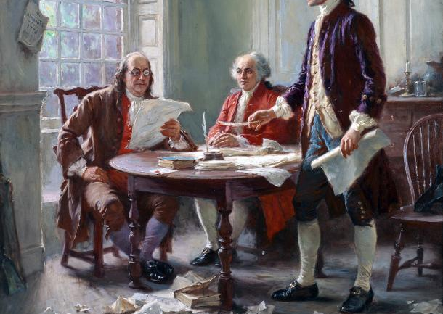
Expanding War
Washington knew the British would return, but when?
Patriots needed foreign support to win the war
To garner more French support, the Continental Congress published the Declaration of Independence to show their commitment to victory
Jean Leon Gerome Ferris, Virginia Museum of History and Culture
Notes:
Patriot military strategy relied heavily on soliciting Britain’s old foes, France and Spain, too willing to take back lost ground against Britain, as allies in their own struggle. Their combined ability to expand what was once a regional conflict to a global war in the Mediterranean, Caribbean and Indian Ocean greatly reduced Britain’s ability to project it’s full military power onto North America, saving the cause of Independence from what could have been a swift and gristly end.
Possible discussion question: what do you know about the Declaration of Independence? What do you think it could also mean, in addition to the reason discussed in this slide?

Slide 16
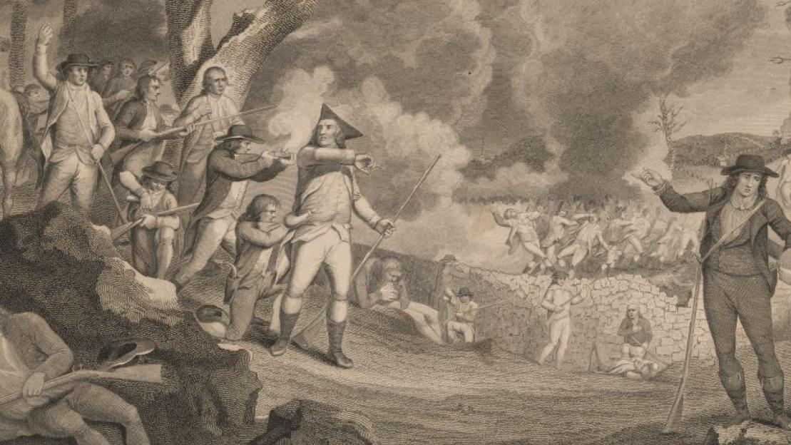
"Shot Heard 'Round the World"
No one knows who fired the first shot at Lexington, but it created a movement reaching far beyond the scope of Massachusetts.
How might this colonial victory affect how other countries viewed the colonists and their desire for independence?
Notes:
Although not uttered at the time of the engagement in April 1775, the “shot” marked the turning point of the disputes between the American Colonies and Great Britain. With shots fired, there was no turning back, and that evening the British found themselves trapped in Boston.
After this lecture, you could watch the "Was the Revolution a World War?" video to look at how other countries got involved after the events discussed in this slideshow.
https://youtu.be/Si7rduXcPbg
Possible discussion question: how might this colonial victory affect how other countries viewed the colonies and their desire for independence?

Slide 17
Special Thanks
Thank you to historical artist Don Troiani for allowing American Battlefield Trust to share his artwork for educational purposes.
In the order that they appeared in this PowerPoint:
"Concord-Concord Bridge" (Slide 6)
"Lexington & Concord-British Retreat" (Slide 8)
"Bunker and Breed's Hill-British and Dr Joseph Warren" (Slide 13)
"Lexington- soldiers with guns" (Slide 18)

