Slide 1
Liberty & The Age of Enlightenment
The American Battlefield Trust

Slide 2
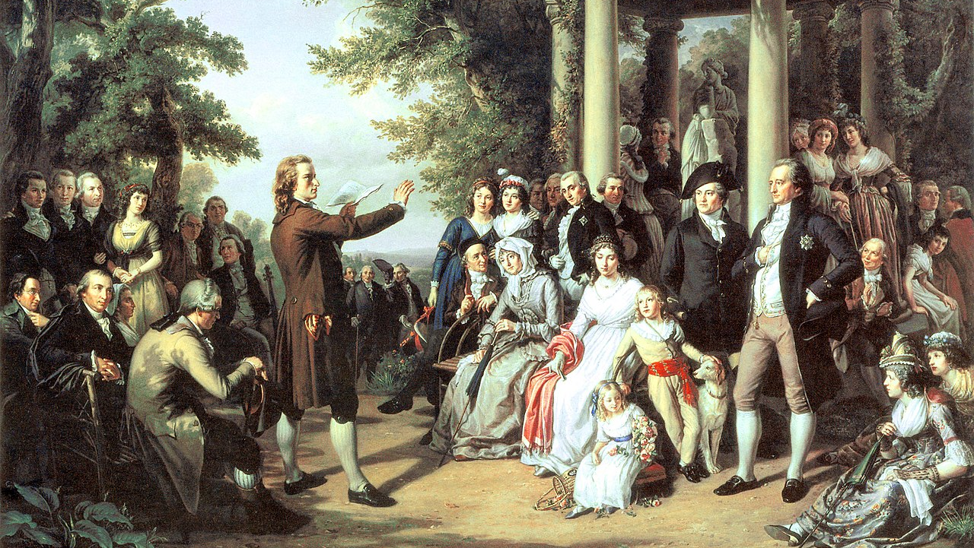
Essential Question
How did the philosophies of the Enlightenment influence American thought and the Revolutionary War?
Notes:
Encourage students to think about the periods of history before the Age of Enlightenment and how the new ideas (or revisiting ancient ideals) shaped this period of history.

Slide 3
The Enlightenment
A period of history stretching from the late 17th century through the end of the Napoleonic Wars in 1815.
Ideals such as natural law, liberty, progress, constitutional government, and separation of church and state became byproducts of the workings of the great minds that lived during the Age of Enlightenment.
This range of ideas and values sparked an outpouring of discussion, debate, and publication that set in motion the ideas that lead to revolutions and rebellions.
Notes:
Extra Resources:
Age of Enlightenment: https://www.battlefields.org/learn/articles/age-enlightenment
Ironically, out of a period of chaos came an age of reason. Better known in history as the Age of Enlightenment or the Age of Reason, this was a period stretching from the late 17th century through the end of the Napoleonic Wars in 1815. From the restoration of the monarchy following the English Civil War, “a rigorous scientific, political, and philosophical discourse” emerged in Europe and journeyed across the Atlantic Ocean to enlighten the minds of British colonists. Ideals such as natural law, liberty, progress, constitutional government, and separation of church and state became byproducts of the workings of the great minds that lived during the Age of Enlightenment. This range of ideas and values sparked an outpouring of discussion, debate, and publication that set in motion the ideas that lead to revolutions and rebellions.
Preceding, and to some historians a natural connection to, the Enlightenment was the Scientific Revolution. There is some overlap as historians debate where these two monumental ages begin and end. There is a disagreement of 50 years, with some arguing that the beginning of the Enlightenment was 1637 when Rene Descartes published his Discourse of Method. However, others mark the publication of Isaac Newton’s Principia Mathematica in 1687 as the end of the Scientific Revolution and the kick-off of the Age of Enlightenment. Regardless of when these two eras began, ended, or overlapped, historians do agree that this time frame began the emergence of the modern world. Custom and tradition, mainstays for centuries, were overtaken by exploration, individualism, and developments in industry and the world of politics.

Slide 4
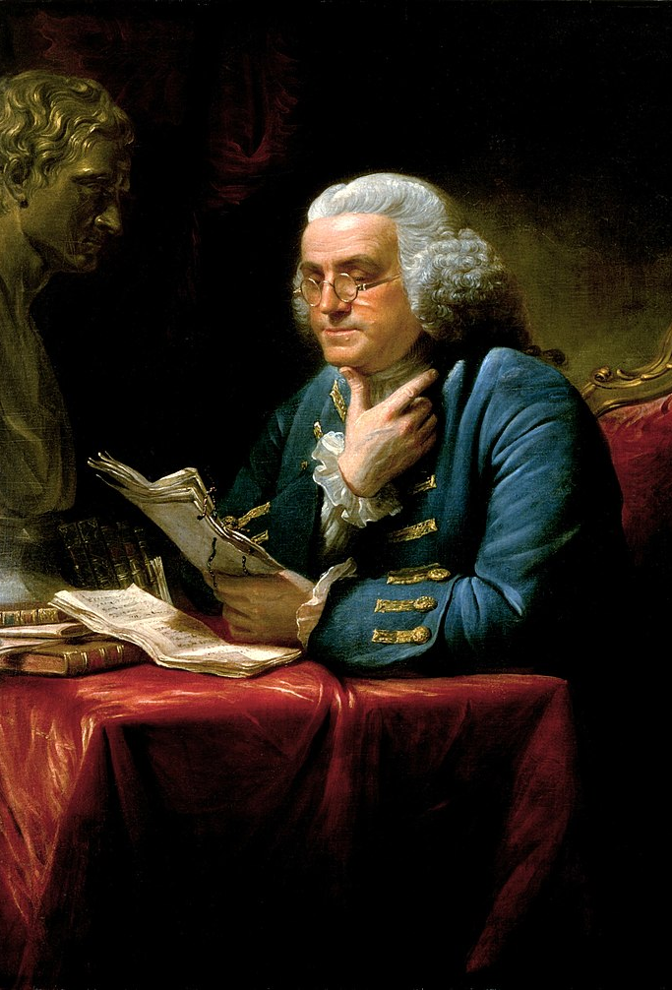
Patterns of Thought
Natural law
Liberty
Progress
Toleration
Fraternity
Constitutional government
Separation of church and state
Value of human happiness
The pursuit of knowledge obtained by means of reason and the evidence of the senses
Notes:
Age of Enlightenment: https://www.battlefields.org/learn/articles/age-enlightenment
By the end of the Age of Enlightenment a “new sphere” of political debate was evident in Europe and a sense of individualism among the populace prevailed. The explosion of literacy and culture of reading and debate in society also increased. This fueled notions of the concept of liberty and freedom. Science, industrialization and economic growth of the 18th century were propelled by the ideology that emanated from the Age of Enlightenment. These ideas though did not remain on just one side of the Atlantic Ocean.

Slide 5
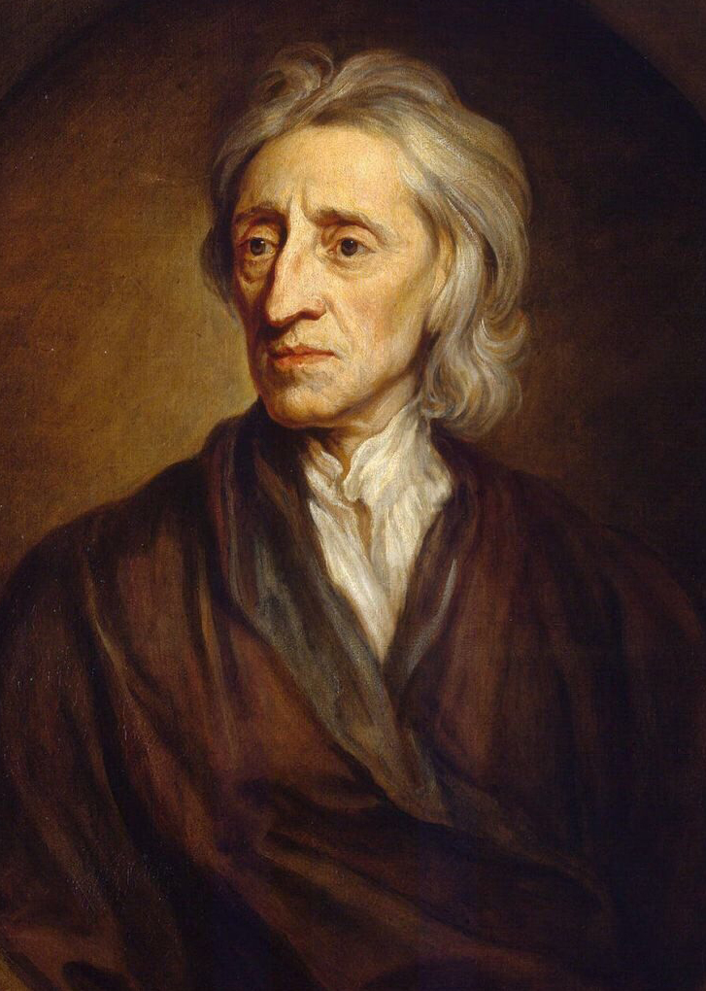
John Locke
English; born 1632, died 1704
The idea of a social contract in which individuals consent to surrendering some of their rights in exchange for protection and order.
American Revolutionaries adopted this notion and others, particularly in the Declaration of Independence.
Following the Revolution, John Locke’s political ideas continued to influence American government during the framing of the United States Constitution.
Locke's promotion of separation of powers and theory that a government’s authority is derived from the consent of the governed laid the groundwork for such principles in the Constitution.
Notes:
John Locke: https://www.battlefields.org/learn/biographies/john-locke
Hobbes, Locke, and Social Contract: https://www.battlefields.org/learn/articles/hobbes-locke-and-social-contract
Excerpts from Second Treatise on Government: https://www.battlefields.org/learn/primary-sources/john-locke-excerpts-second-treatise-government
Locke’s revolutionary views got him into trouble. In 1683, he fled England under accusations of his connection to a conspiracy to assassinate King Charles II known as the Rye House Plot. Though his involvement in the plot was never proven, Locke spent his exile in Netherlands until after the Glorious Revolution. When he returned to England following the ascension of Mary II, he published his three major works of political philosophy: Essay Concerning Human Understanding, the Two Treatises on Government, and A Letter Concerning Toleration. Locke’s fame grew as a result of his publications, and he soon became a renowned intellectual among the Whig party. He died in 1704 at the age of seventy-two, a lifelong bachelor.
Locke based his Two Treatises around the idea of a social contract in which individuals consent to surrendering some of their rights in exchange for protection and order. American Revolutionaries adopted this notion and others, particularly in the Declaration of Independence. In fact, Jefferson likely found inspiration for his phrase, “Life, Liberty and the pursuit of Happiness,” and other language of the Declaration in Locke’s Second Treatise. The Declaration of Independence also espouses Locke’s theory that revolution is not only a right of the people but an obligation in some cases. Following the Revolution, John Locke’s political ideas continued to influence American government during the framing of the United States Constitution. His promotion of separation of powers and theory that a government’s authority is derived from the consent of the governed laid the groundwork for such principles in the Constitution.

Slide 6
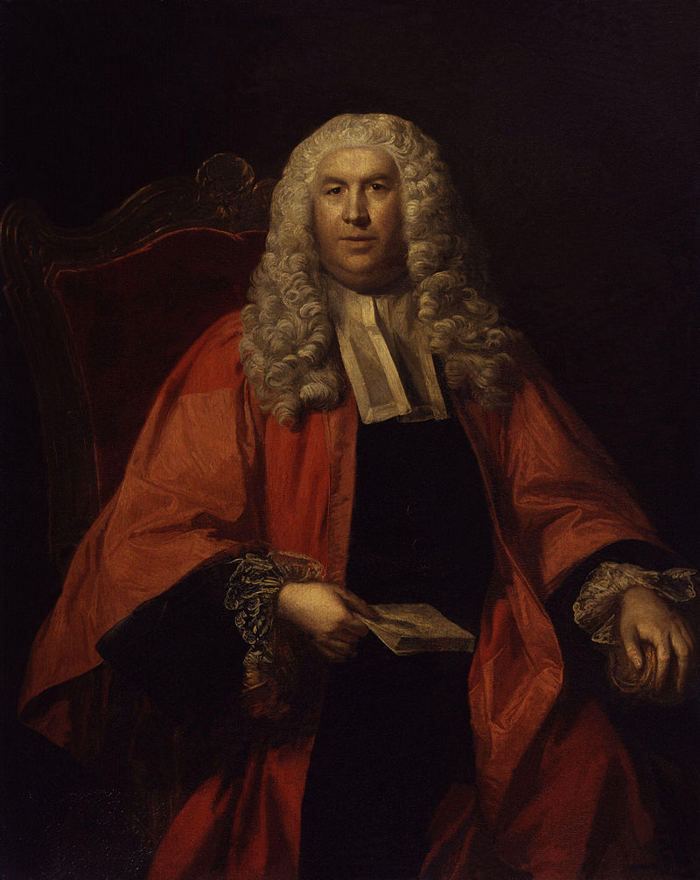
Sir William Blackstone
English; born 1723, died 1780
In the 1760s, Blackstone published a multi-volume study, Commentaries on the Laws of England.
The Commentaries were republished 5 times during the 1770s and more than 1000 copies were sold in the American Colonies.
Blackstone’s legacy as a political philosopher greatly influenced the Revolutionary generation of the United States. Even after the Revolution, William Blackstone’s philosophies continued to impact American government into the nineteenth and twentieth centuries.
Notes:
Sir William Blackstone: https://www.battlefields.org/learn/biographies/william-blackstone
In 1753, Blackstone resigned his position as a barrister and entered the lecture circuit. He gave some of the first speeches on English law and garnered a small fortune. The success of his lectures led him to write his first full legal commentary, An Analysis of the Laws of England, which received tremendous acclaim and helped build the foundation of Blackstone’s future writing and career. Six years later in 1759, he accepted a position as the first Vinerian Professor of English Law at Oxford, established by English jurist Charles Viner before his death. The young philosopher's newfound fame, however, allowed him to return to the bar and secure election as a Tory member of Parliament in 1761.
By 1765, he published another treatise called Discourse on the Study of Law and the first volume of Commentaries on the Laws of England which is considered to be his seminal work. The next three volumes followed in 1766, 1768, and 1769, heralded by both scholars and commoners alike. Blackstone’s Commentaries were republished five times in the 1770s and sold over 1,000 copies in the American colonies. Following his crowning achievement, the philosopher received an appointment as a Justice of the Court of King’s Bench in 1770 but abandoned that position to fill a vacancy in the Court of Common Pleas later that year. He remained in that position until his death on February 14, 1780.
Blackstone’s legacy as a political philosopher greatly influenced the Revolutionary generation of the United States. Individuals like John Adams, Alexander Hamilton, John Jay, and John Marshall drew inspiration from his works. Though Thomas Jefferson criticized some parts of the Commentaries, he acknowledged that Blackstone accomplished "more towards the suppression of the liberties of man, than all the millions of men in arms of Bonaparte.” In fact, Jefferson probably found inspiration for the language of the Declaration of Independence in the philosopher's description of the rights of Englishmen under the British Constitution. Even after the Revolution, William Blackstone’s philosophies continued to impact American government into the nineteenth and twentieth centuries. The Commentaries profoundly impacted the legal career of Abraham Lincoln, and justices cited them in numerous Supreme Court decisions.

Slide 7
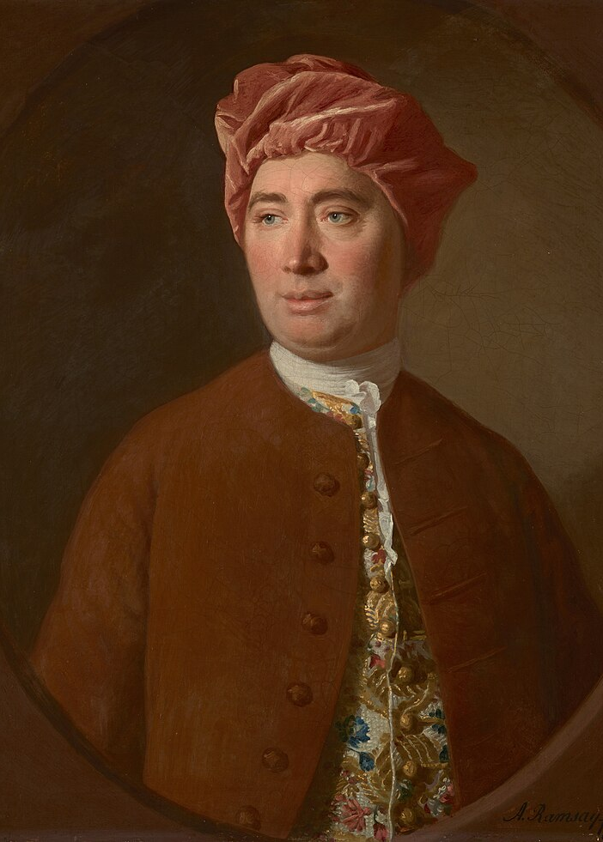
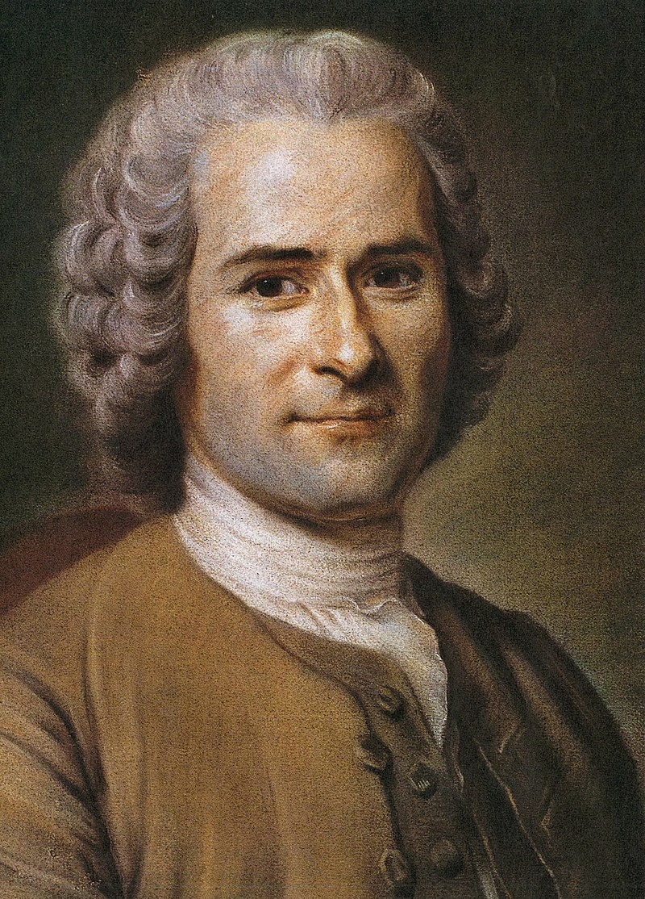
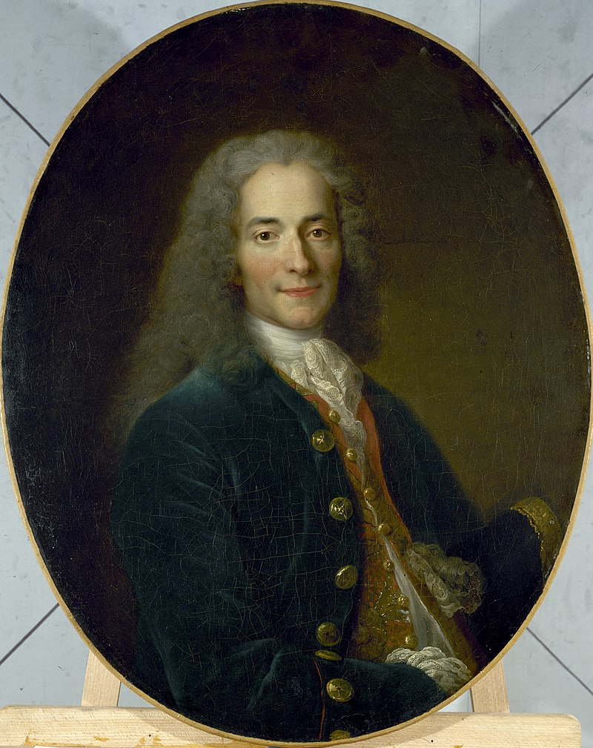
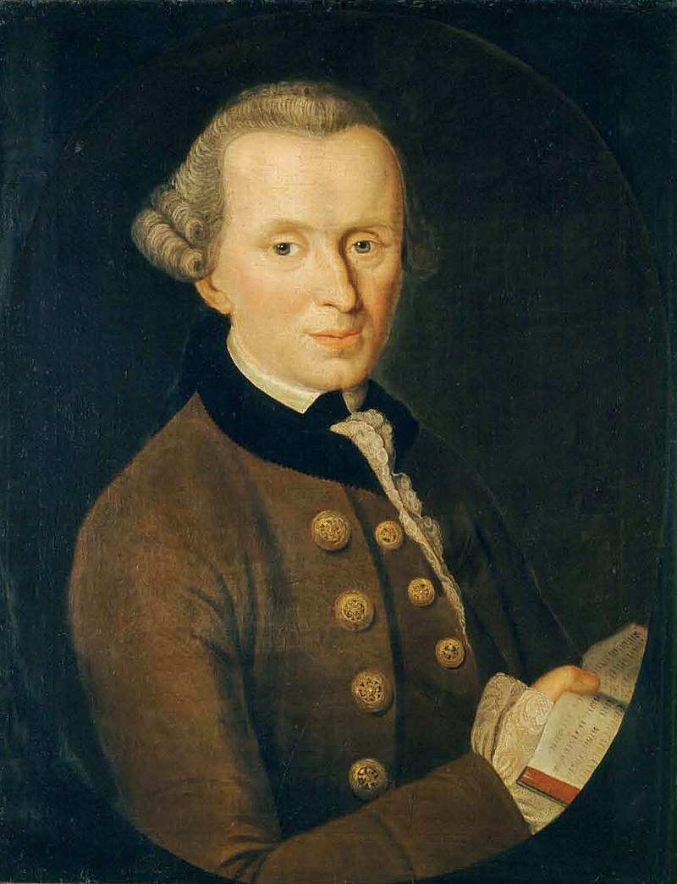
Other European Enlightenment Philosophers
David Hume Jean-Jacques Rousseau Voltaire Immanuel Kant Adam Smith
Notes:
Other great Enlightenment era thinkers included Adam Smith, David Hume, Immanuel Kant and Jean-Jacques Rousseau, to name a few. Smith’s influential work, published in 1776, was entitled An Inquiry into the Nature and Causes of the Wealth of Nations. A central point of the work is the idea that the individual need to fulfill self-interest resulted in a benefit of the society as a whole. Smith advocated for no government interference in the market and that the three basic tenets of a government were to protect national borders, enforce civil laws, and engage in public works.
Hume—a philosopher, historian, economist and essayist—was another Enlightenment era thinker who had a direct impact on the ideology of the Founding Father generation. As early as 1771, Hume foresaw the fissure erupting between Great Britain and the American colonies, writing that the “union with America…in the nature of things, cannot long subsist." He continued to be a proponent of American independence throughout the early part of the 1770s. Even after American independence, Hume’s views continued to shape the burgeoning political narrative of the United States. One example with a direction connection is his view that no high office holder in the government should draw a salary impacted Benjamin Franklin’s thinking, leading that luminary of early America to propose the same clause at the Constitutional Convention in 1787.
Immanuel Kant’s views on freedom of speech were embodied in the United States with the passage of the First Amendment along with the freedom to practice religion. Kant advocated for freedom of speech in the press, in public, where “one’s reason is all that matters.” Not only did Kant’s work have an effect in the fledgling United States, but also in the German principalities well into the 20th century.
Jean-Jacques Rousseau—a Genevan philosopher and writer—explored political philosophy, and his writings formed foundational pieces on modern social and political thought. He believed that people would give up unlimited freedom for the security provided by government, yet it was the people of the state that held the ultimate power throughout. An elected body of government protected the rights of the people, and all people deserved the right to freedom, freedom of speech and religion. These ideas may have influenced Thomas Jefferson as he drafted the Declaration of Independence. Rousseau’s ideas also shaped some of the narrative of the beliefs held by French revolutionaries as well.

Slide 8
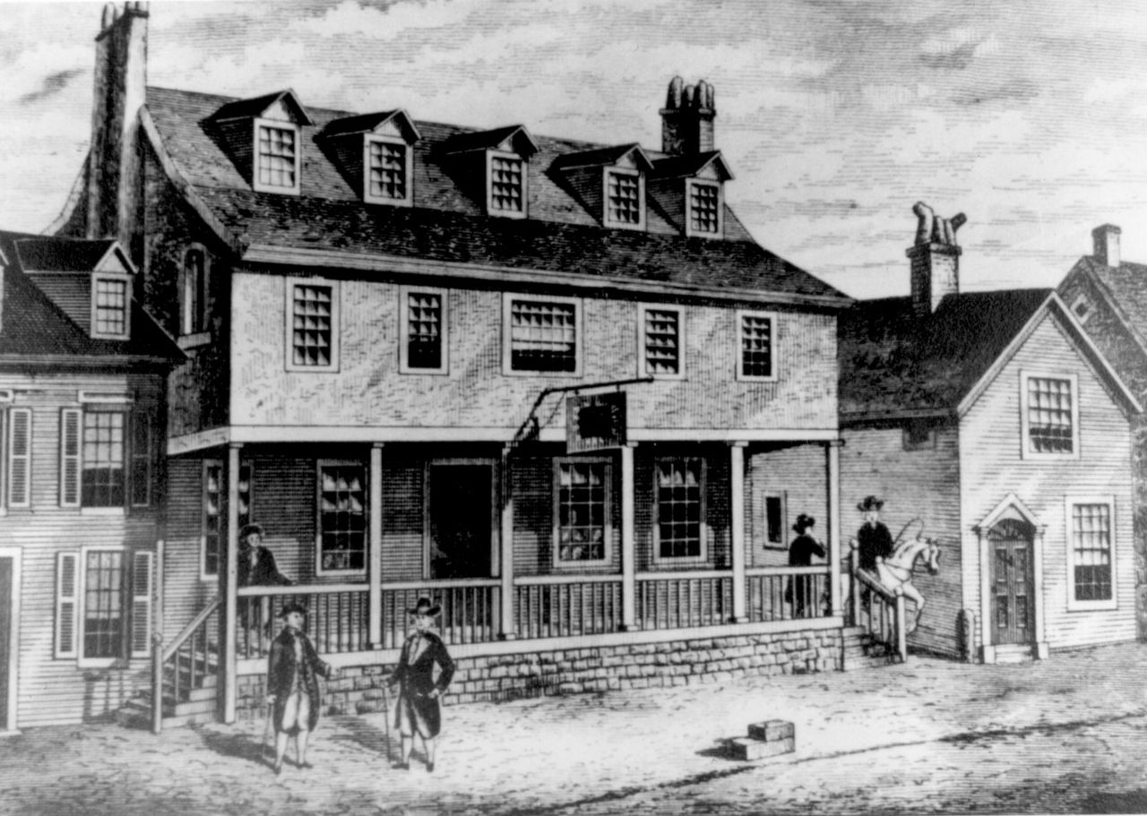
Enlightenment in the American Colonies
As the 18th century progressed, colonists in North America were fond of newspapers, books, coffee shops, salons, and taverns.
This led to further debate and expression of ideas, and burgeoning movements sprung up about individual liberty.
Education efforts and colleges were founded in the American Colonies which encouraged political, religious, and social thought.
Notes:
Revolutionary Colleges: https://www.battlefields.org/learn/articles/revolutionary-colleges
In many respects, the American Revolution and subsequent War for Independence were a product of the Enlightenment, the 17th-century intellectual movement in Europe that sparked new ideas about humanity, science, government, human rights and reason combined with a sense of liberal nationalism. The most influential European philosopher on the American Revolution was Englishman John Locke, who at the end of the 17th century expanded the notion of the social contract between those governed and those governing. Locke’s philosophy of the “social contract” greatly influenced Thomas Jefferson and its influence runs throughout the Declaration of Independence.

Slide 9
Enlightenment and the Revolution
Enlightenment concepts, philosophies, and theories influenced the American Revolution.
The idea that people could change governments (rebel) if a social contract was broken was at the political forefront of the Revolution.
Creating a new nation built on the Laws of Nature, Social Contract, and the concept of Liberty.
“We hold these truths to be self-evident, that all men are created equal, that they are endowed by their Creator with certain unalienable Rights, that among these are, Life, Liberty and the Pursuit of Happiness.” (Declaration of Independence)
Notes:
In 1689, John Locke published Two Treatises of Government advocating a separation of church and state, religious toleration, and certain inalienable rights of the individual, among other premises. These sacrosanct or natural rights were God-given and cannot be given or taken away, and Locke narrowed them down to three: “life, liberty, and property.” Thomas Jefferson, writing 87 years later, echoed Locke when he penned the Declaration of Independence.
“We hold these truths to be self-evident, that all men are created equal, that they are endowed
by their Creator with certain unalienable Rights, that among these are, Life, Liberty and the Pursuit of Happiness.”
The echoes of the Age of Enlightenment did not end with Locke’s influence on Jefferson and the seminal document of the United States. Francis Bacon advocated the scientific method, careful and repetitive experiments that could be replicated and logical thinking over theological synthesis and philosophical speculation. This provided the basis for the laws of reason.

Slide 10
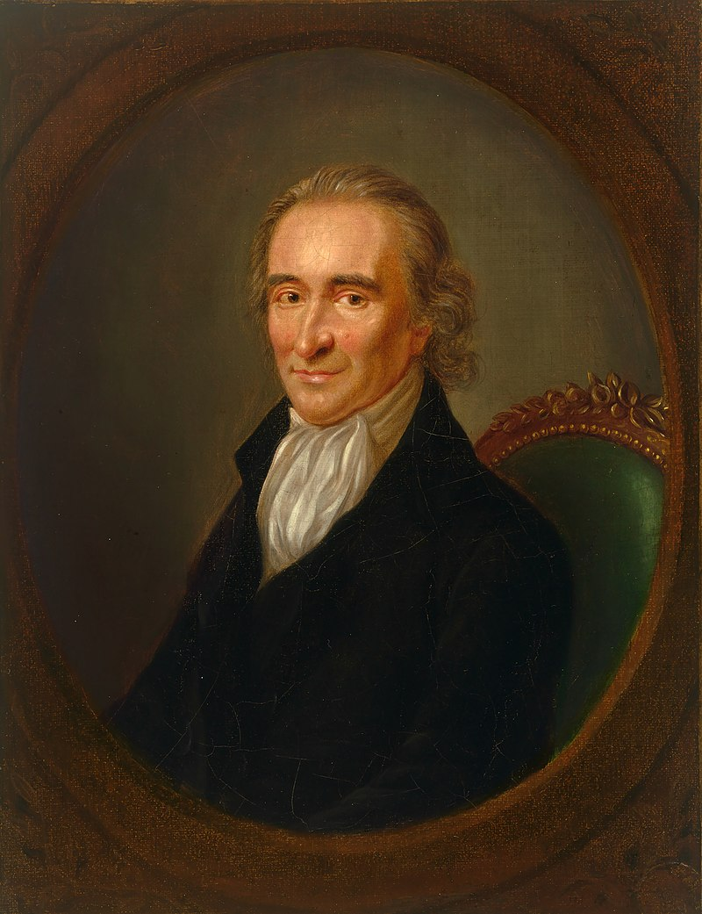
Thomas Paine
English/American Philosopher; born 1737, died 1809
Wrote Common Sense, one of the most widely read documents in America and a foundational document for persuading colonists to support independence from Britain.
Wrote American Crisis which inspired Americans during some of the darkest days of the Revolutionary War.
Notes:
Thomas Paine: https://www.battlefields.org/learn/biographies/thomas-paine
Common Sense: https://www.battlefields.org/learn/primary-sources/common-sense
American Crisis: https://www.battlefields.org/learn/primary-sources/american-crisis-0
Thomas Paine’s pamphlet, Common Sense, published in 1776, influenced the drafters of the Declaration of Independence. Paine argued in succinct terms that ordinary people had the capacity to govern themselves and did not need to be led by a crowned official. This argument alone made the American Revolution a turning point in history. Common Sense inspired many Members of Congress and American colonists alike. the pamphlet became a sensation and bestseller throughout the thirteen colonies. The Declaration articulated Paine’s ideas in a more formal manner, declaring separation between England and her American colonies.

Slide 11
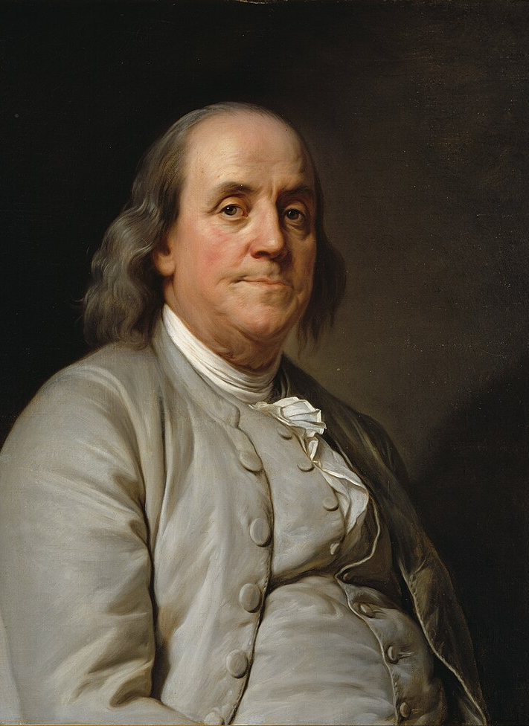
Benjamin Franklin
American Philosopher/Statesman; born 1706, died 1790
One of the better-known disciples of Enlightenment principles in America
In his writings, Franklin reflected on the way people view their own responsibility, how they are better themselves as individuals, and scientific experimentation.
His scientific, political, and social experiments were famous on both sides of the Atlantic.
Notes:
Benjamin Franklin: https://www.battlefields.org/learn/biographies/benjamin-franklin
In 1743, he founded the American Philosophical Society and began researching electricity. During his lifetime, Franklin continued to study science, including oceanography, engineering, meteorology, and physics. While studying, he created experiments, including the kite experiment, and invent products like the lighting rod based on his research. In addition to science, Franklin was interested in education and caring for society. Due to his wealth, Franklin organized the Pennsylvania militia and founded the first hospital in the colonies. Under Franklin's influence, the city streets were clean, and colonists in Philadelphia had homeowners' insurance. Franklin's popularity grew when he aided in founding the Academy of Philadelphia, later known as the University of Pennsylvania.
In 1751, Franklin was elected to represent the Pennsylvania assembly in the British parliament in London. He made connections in England with parliament officials and worked to settle disputes between the colonies and Britain. Franklin temporarily returned home until he was sent back to London in 1765 to testify against the Stamp Act. During Franklin's second mission to England in 1775, the British fired upon colonists at Lexington and Concord, officially beginning the American Revolution.
Upon hearing the news, Franklin returned to the colonies. He arrived in Philadelphia in May of 1775, and the Pennsylvania Assembly elected Franklin to the Second Continental Congress. The congress met to discuss the revolution's goals and plan the next steps for the colonies. While serving as a delegate for Pennsylvania, Franklin served as the United States' first postmaster general, suffered from gout, and missed most of the delegations. In early 1776, he was elected to the "Committee of Five," alongside Thomas Jefferson, John Adams, Robert Livingston, and Rodger Sherman was assigned to write the Declaration of Independence. Although Thomas Jefferson wrote most of the declaration, Franklin made "small but important changes." On July 4, the Declaration of Independence was signed, and the colonies readied to take the next step toward independence. In October 1776, Franklin was assigned the duty of Ambassador to France. To beat the British, the colonist needed European aid, and it was Franklin's mission to convince France to help the United States.

Slide 12
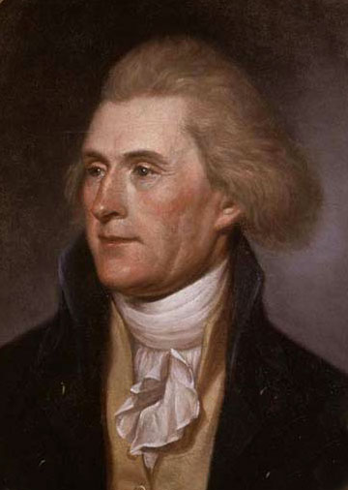
Thomas Jefferson
American Philosopher/Statesman; born 1743, died 1826.
Authored most of the Declaration of Independence which was based on Enlightenment theories for social contract, government, and liberty.
Later, he supported the early efforts of the French Revolution.
Notes:
Thomas Jefferson: https://www.battlefields.org/learn/biographies/thomas-jefferson
Declaration of Independence: https://www.battlefields.org/learn/primary-sources/declaration-independence-primary-source-questions
Jefferson’s growing reputation for politics earned him a chance to represent Virginia at the Second Continental Congress in 1776. Jefferson was the youngest member of the Continental Congress at only thirty-three years old. Despite Jefferson's younger age, John Adams wrote that Jefferson brought with him "a reputation for literature, science and a happy talent for composition." Jefferson’s fellow representatives called upon this “happy talent” selecting him to compose the Declaration of Independence. Jefferson brought together his knowledge of literature and philosophy drawing from the works of George Mason and John Locke to compose what Jefferson called an "expression of the American mind." Jefferson submitted a rough draft of his Declaration on June 28. The Declaration was debated and edited extensively by the Continental Congress until on July 2 Congress adopted a resolution of Independence and on July 4 adopted the Declaration of Independence. The Declaration was published widely and spread through word of mouth—gaining support for resistance against Great Britain across the collection of colonies.
However, Jefferson’s Declaration of Independence did not just help inspire the initial refusal of British rule, the Declaration of Independence helped to construct an American identity. The Declaration was more than just an elaboration on independence but rather a treatise on the American identity. The Declaration identified the colonies, not as individual entities but rather a unified “united states.” Jefferson constructed an American political identity based on democracy rather than monarchism, arguing that to secure natural rights required a government that derived its power from “powers from the consent of the governed.” And perhaps most important to American identity is Jefferson’s bold claim that “all men are created equal.”

Slide 13
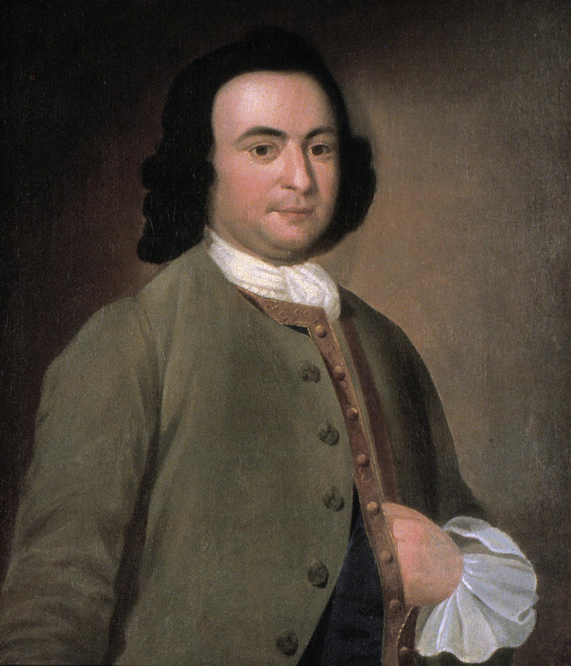
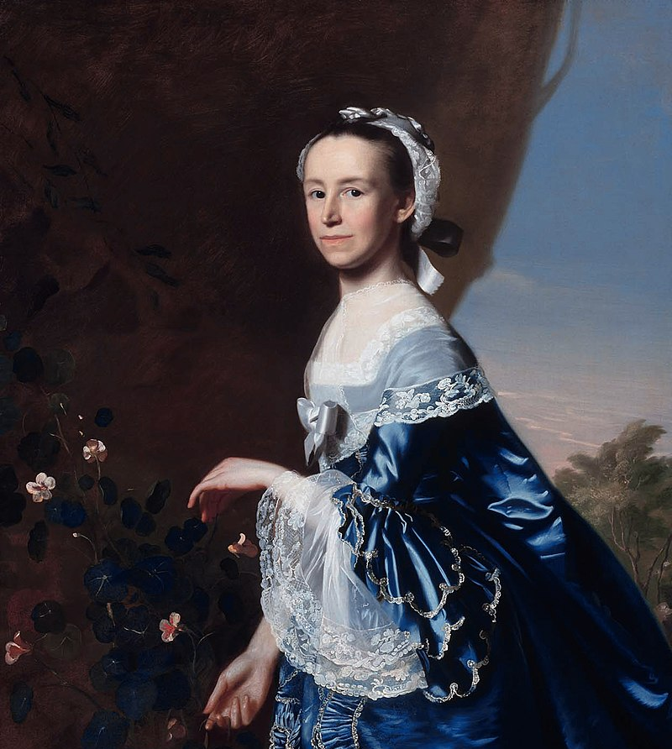
American Philosophers
Many of the American Founding Fathers studied Enlightenment ideas and debated or practiced them to some extent. Here are a few other American Philosophers particularly noted for their ties to Enlightenment theories.
Images: George Mason (upper left), Mercy Otis Warren (upper right), George Wythe
Notes:
George Mason: https://www.battlefields.org/learn/biographies/george-mason
Mercy Otis Warren: https://www.battlefields.org/learn/biographies/mercy-otis-warren
George Wythe: https://www.battlefields.org/learn/biographies/george-wythe

Slide 14
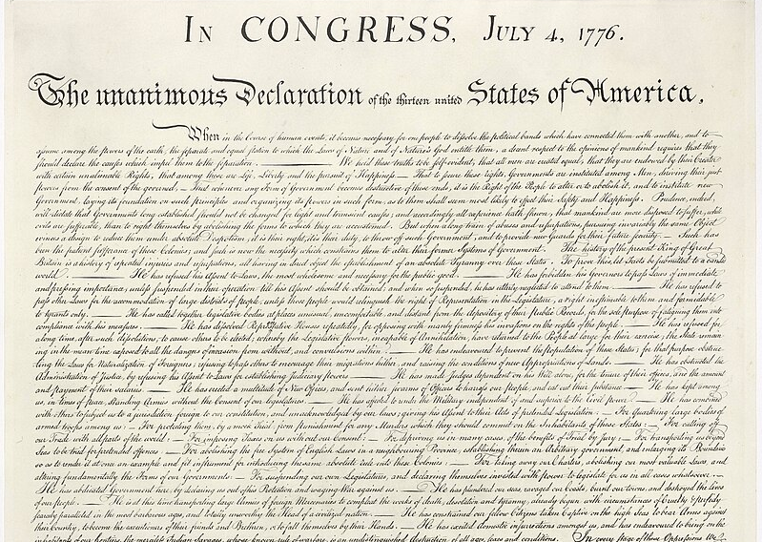
A Great Experiment
In many ways, the Declaration of Independence and, later, the United States Constitution and Bill of Rights were products of Enlightenment theory.
The new nation and government were a "great experiment" in these ideals of liberty.
In many ways, the experiment of liberty continues to this day with new challenges and successes for each generation.
Notes:
From the Declaration to the Constitution: https://www.battlefields.org/learn/articles/declaration-constitution
The Declaration of Independence and the Constitution of the United States of America form the bedrock of the American Charters of Freedom, a group of documents which also includes the Bill of Rights. All three are enshrined in the Rotunda of the National Archives in an altar-like setting. Abraham Lincoln referred to these documents, particularly the Declaration of Independence, as American scripture, even using the phrase "American civil religion" when he invoked the Declaration’s place in American memory.
We tend to take the Charters of Freedom for granted and hardly recognize that the Constitution was deliberately written in the present tense to make it a “living document.” While these documents are all related, they each have a unique history which helps us to understand their importance and meaning. Together they establish the United States' guiding principles on which people are not bound by tribe, race, religion, or language.

