Slide 1
Southern Campaigns: Decisive Moments
The American Battlefield Trust

Slide 2
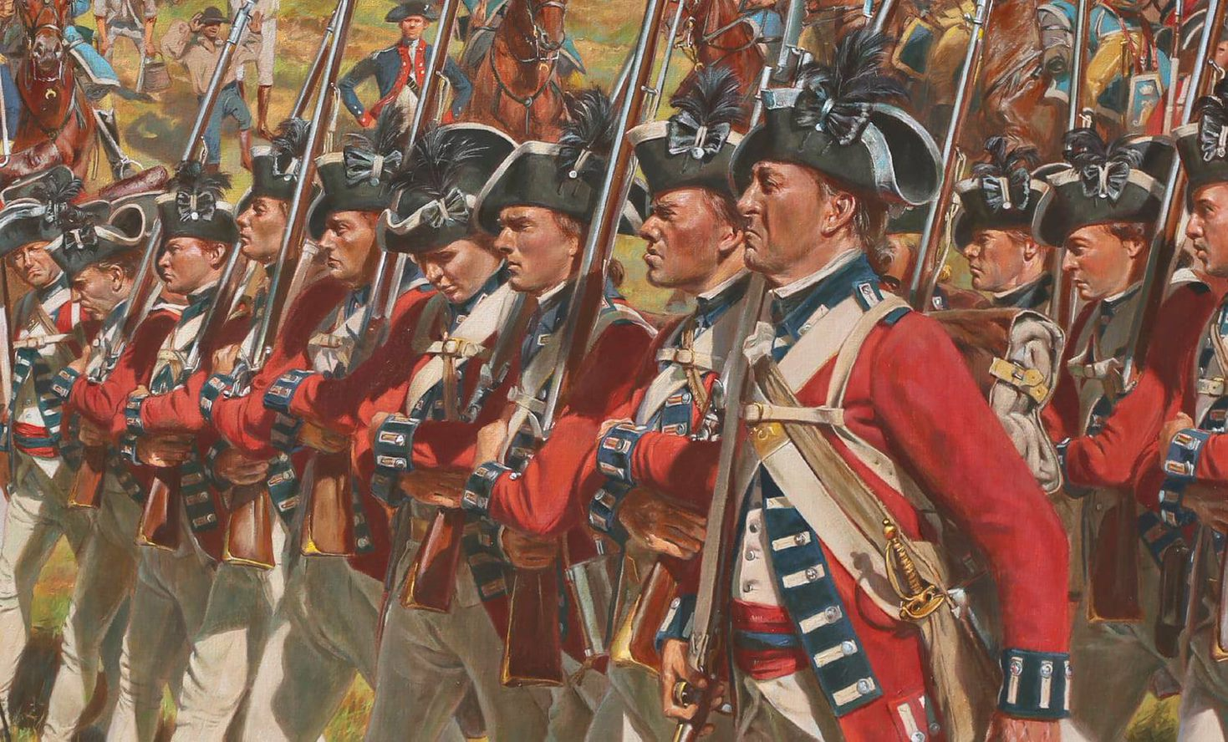
Essential Question
What were some important battles of the Southern Campaign and how did they shape America's fight for independence?
Don Troiani
Notes:
Encourage students to think about how more battles fought in the state of South Carolina than in all of the other colonies combined.
Possible discussion question: What were some important battles of the Southern Campaign and how did they shape America's fight for independence?

Slide 3
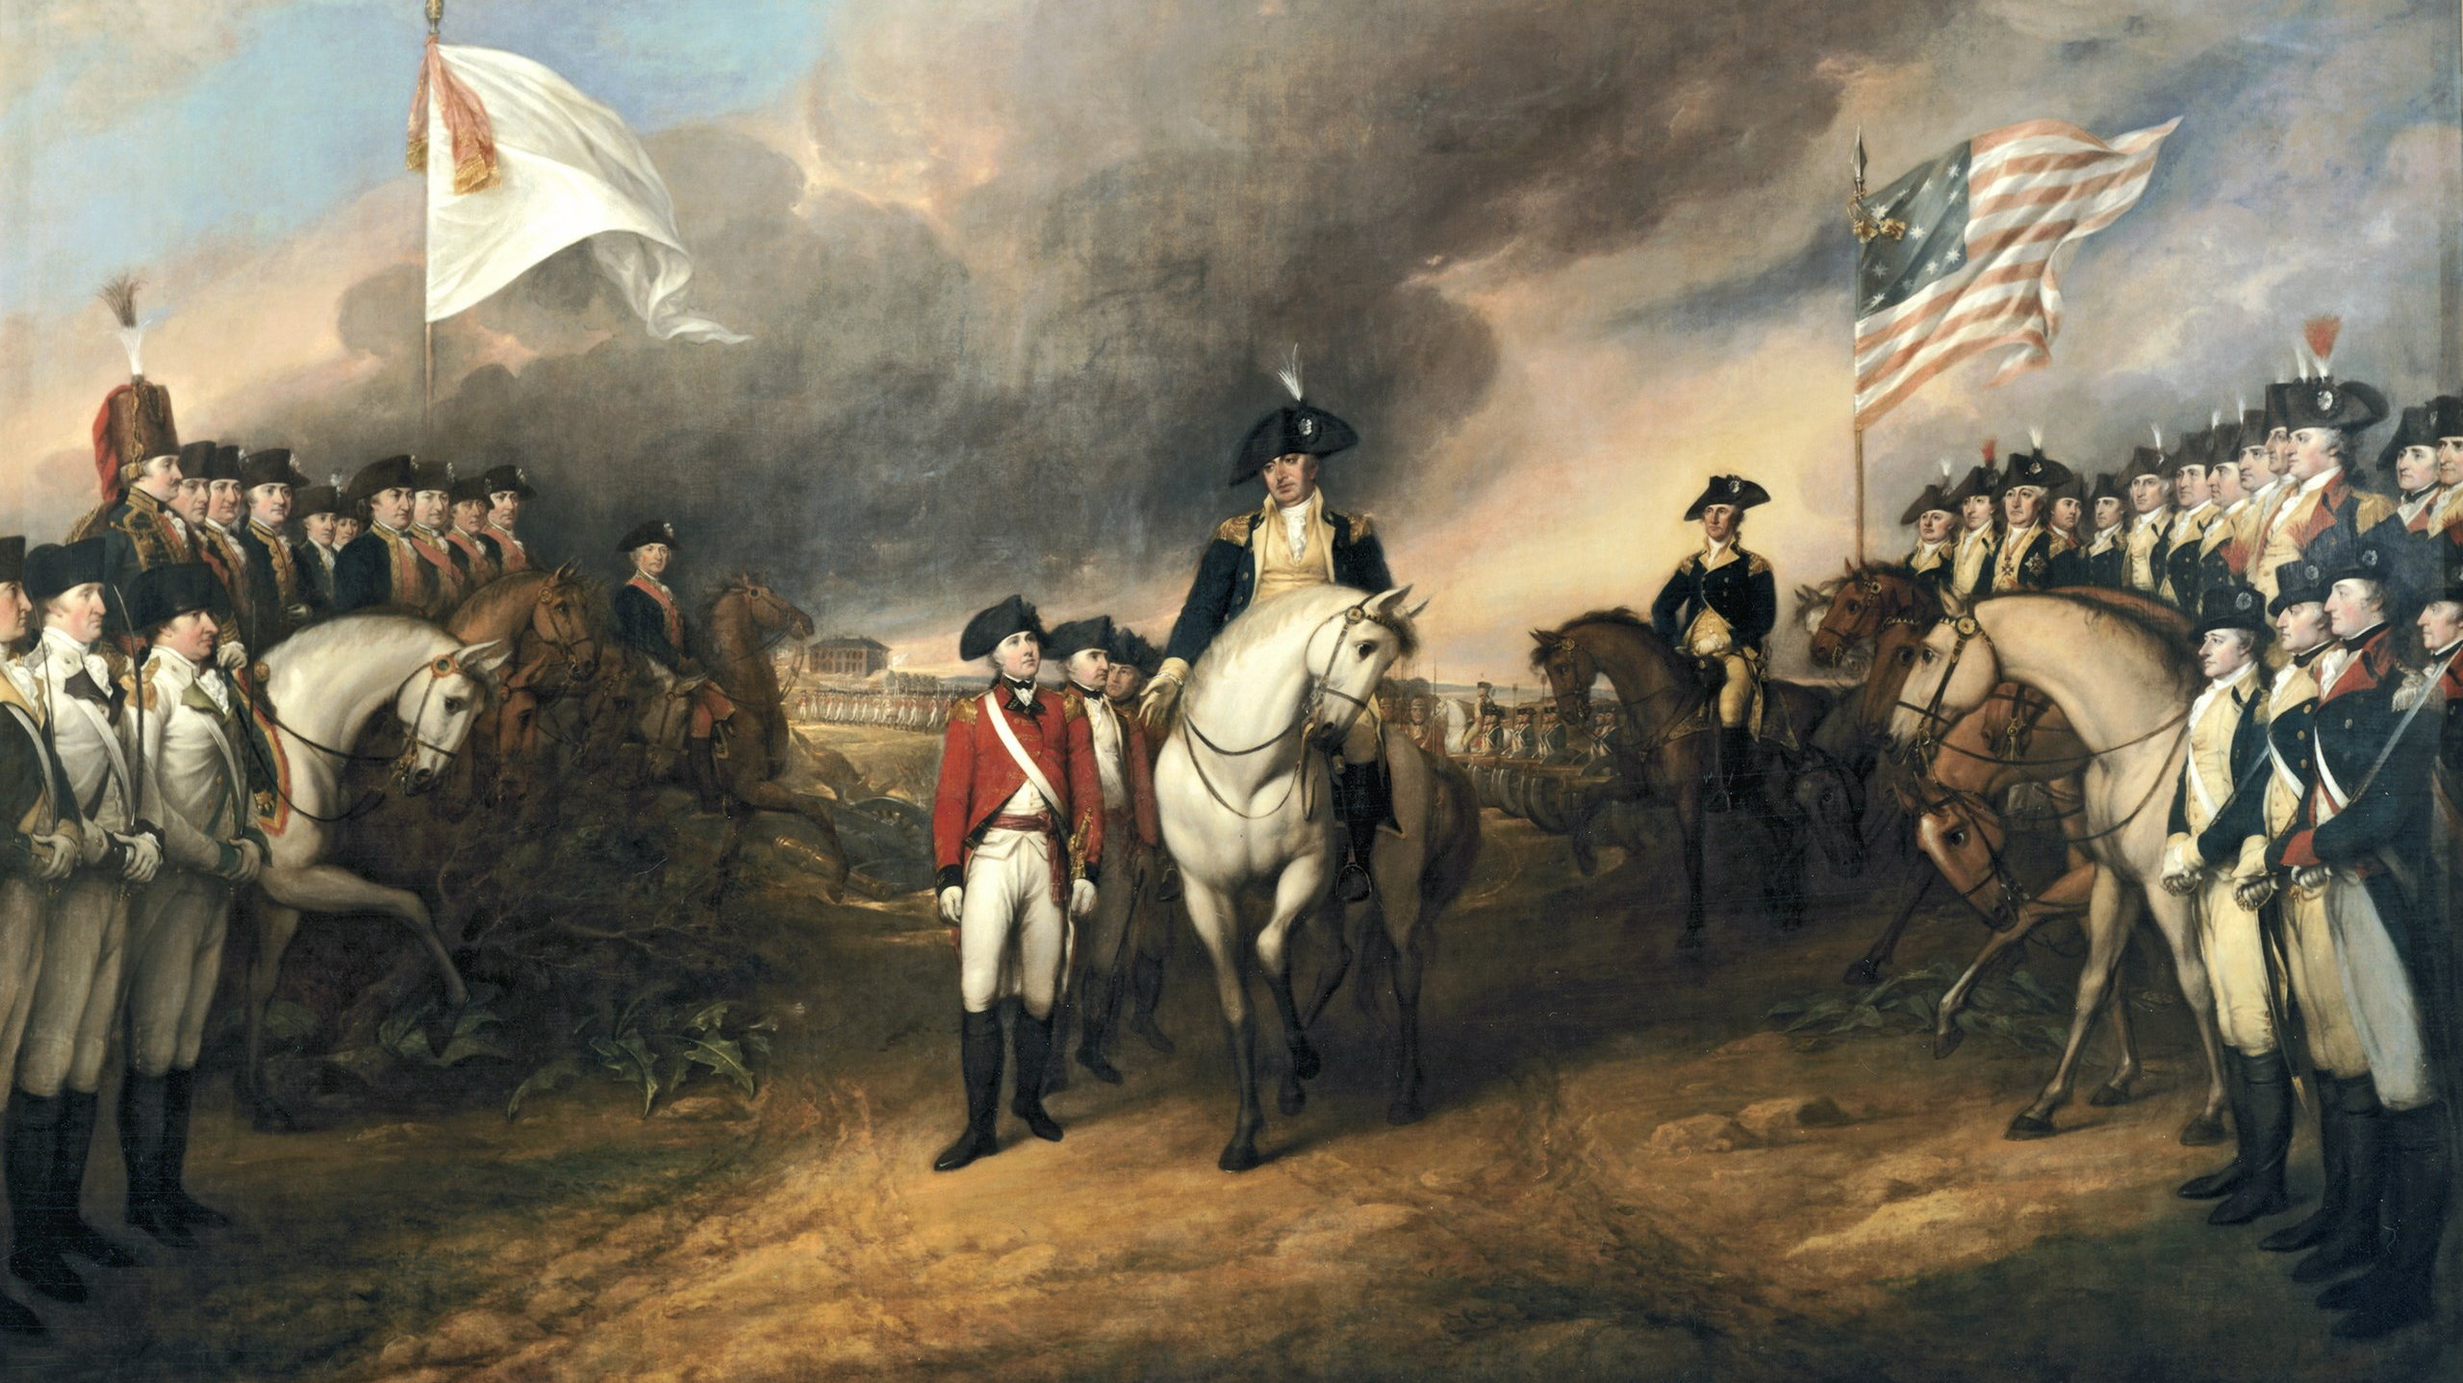
decisive:
having the power or quality of deciding; putting an end to controversy; crucial or most important
What do you think a "decisive moment" in war might look like?
Notes:
Extra Resources:
Definition: https://www.dictionary.com/browse/decisive
Possible discussion question: What do you think a "decisive moment" in war might look like?
Photo source: https://en.wikipedia.org/wiki/Surrender_of_Lord_Cornwallis#/media/File:Surrender_of_Lord_Cornwallis.jpg

Slide 4
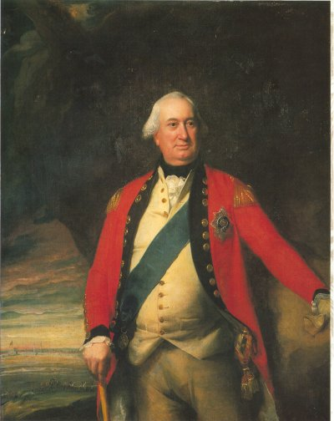
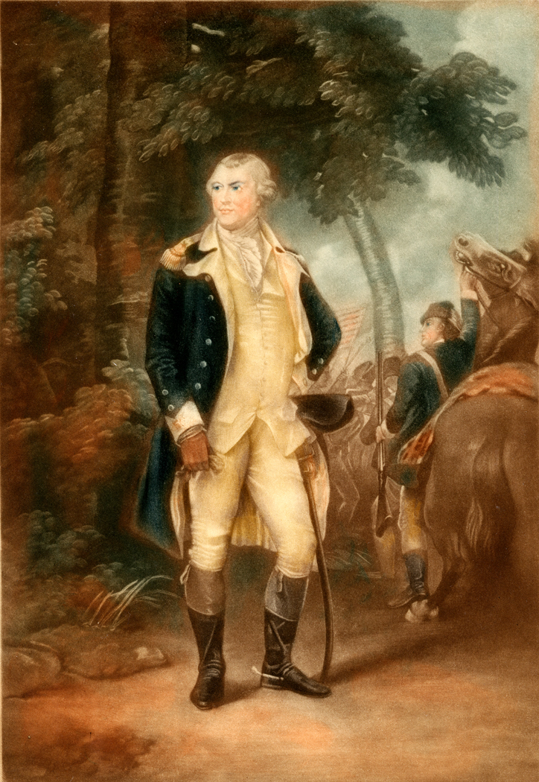
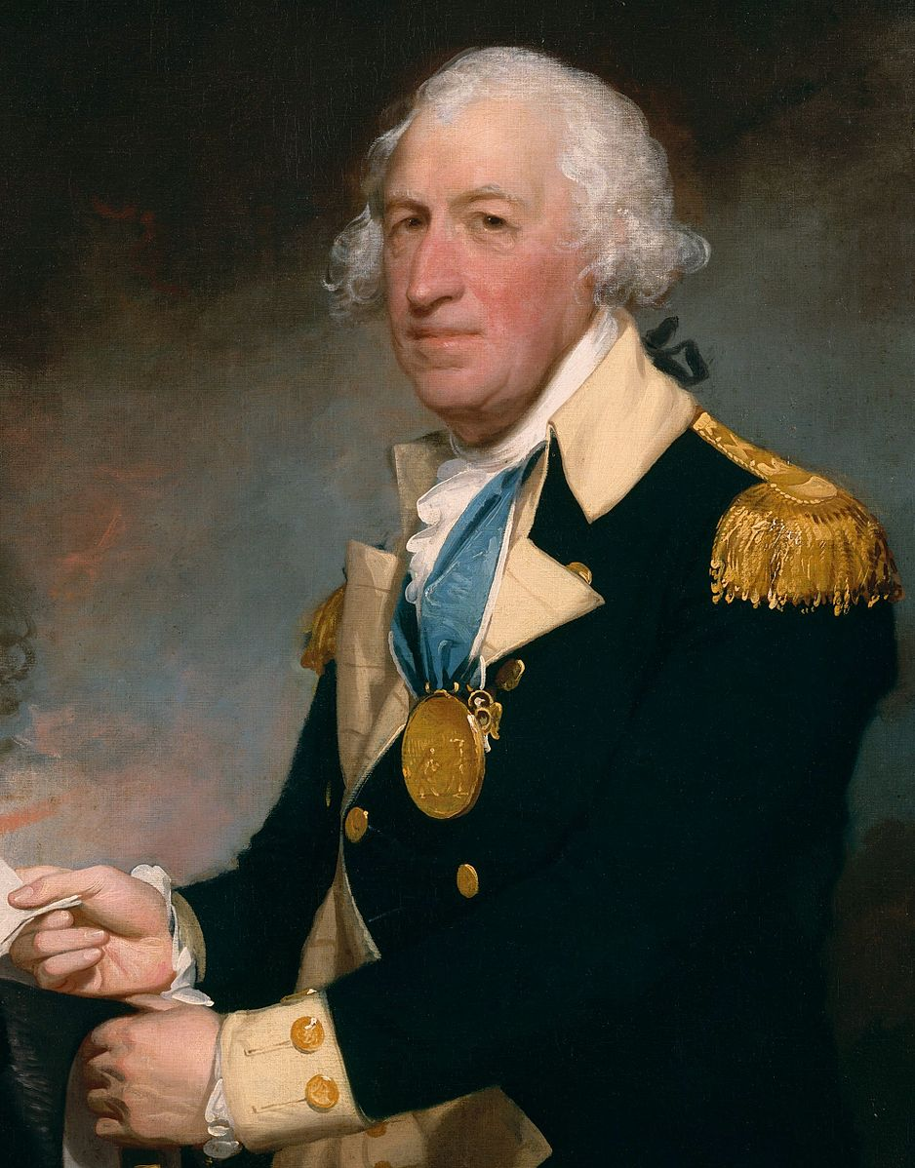
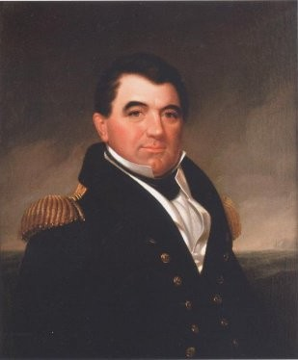
Notable People
Nathanael Greene
Charles Cornwallis
Horatio Gates
Jorge Farragut
Notes:
Extra Resources:
Charles Cornwallis biography https://www.battlefields.org/learn/biographies/charles-cornwallis
Nathanel Greene biography https://www.battlefields.org/learn/biographies/nathanael-greene
Horatio Gates biography https://www.battlefields.org/learn/biographies/horatio-gates
Jorge Farragut biography https://www.battlefields.org/learn/biographies/jorge-farragut
"Cornwallis: A Great British General" video https://www.youtube.com/watch?v=SzOxYFuDP2M
Charles Cornwallis
Charles Cornwallis was born on New Years’ Eve to an English ruling class family. Cornwallis began his military career in earnest during the Seven Years’ War. During the first few years of his earldom, tensions between American colonists and the British crown rose to a boiling point. Cornwallis sympathized with the colonists and voted to repeal the Stamp Act; he was one of only five members to vote for this motion. Colonial sympathies did not prevent him from serving the crown in the Revolution. In December 1775, following the Battle of Lexington and Concord, Cornwallis received a promotion to the rank of lieutenant general and departed for America. He participated in the first British expedition against Charleston and fought in the New York and Philadelphia Campaigns. In 1779, after a stalemate in the north, Cornwallis went south as second in command to Sir Henry Clinton. Clinton captured Charleston in May 1780. He soon returned to New York, leaving Cornwallis to secure South Carolina. Cornwallis pressed on to defeat General Horatio Gates at Camden, South Carolina, on August 16, 1780.
Nathanael Greene
Nathanael Greene’s rise to prominence as one of the most skilled and celebrated generals of the American Revolution appears unlikely based upon his early life. Greene was born to a devout Quaker family in Rhode Island in August of 1742. Greene’s early military career insured that the Continental Congress never regretted its decision to promote him. After the Siege of Boston in 1776, Greene proved to be an able commander when he took command of the city upon the British retreat. However, the young general’s career was not without blemish: during the New York Campaign, he lost Forts Washington and Lee. Although racked by guilt for these loses, Greene subsequently led a column of troops to victory at the Battle of Trenton and the Battle of Princeton. Following the Battle of Brandywine and the Battle of Germantown in the Pennsylvania campaign in 1777, the Continental Congress appointed him Quartermaster General under the condition that he retain the right to command troops in the field. Greene’s most notable appointment came in October 1780 when Washington with the power to appointed Greene as the new southern commander.
Greene’s martial skills shone brightest as commander of the southern theater. Soon after he took command, the tide of war began to turn in favor of the Patriots. Greene decided to divide his troops in the hopes that the British would be forced to follow suit. The tactic worked as Greene's subordinate, Brig. Gen. Daniel Morgan won a victory at Cowpens early in 1781. After the British victory over at Greene at the Battle of Guilford Courthouse, the much depleted British force under Charles Cornwallis withdrew to Wilmington while Greene and his men turned south to reconquer the South Carolina backcountry. Throughout 1781, Greene steadily drove the British back to an isolated position at Charleston, which they abandoned the following December. George Washington trusted Greene immensely, and that trust only grew over the course of the war. Greene’s legacy endures. He is one of the most celebrated generals of the Revolution for his crucial role in wresting the southern theater from the British and securing a revolutionary Patriot victory.
Horatio Gates
Horatio Gates was born July 26, 1727, in Maldon, Essex County, England. Gates got his first military experience when he obtained a commission in the British Army and fought in Germany during the War of Austrian Succession. He later sailed to Halifax, Nova Scotia, under Edward Cornwallis, who was the uncle of Charles Cornwallis. When the American Revolution began, Gates travelled to Mount Vernon to offer his services to his friend, George Washington. The Continental Congress gave Gates the rank of brigadier general in June 1775. His first acts of the war used his administrative skills. By June 1776, he was promoted again to major general and given command of the Canadian Department.
Gates had always believed that he should lead the Continental Army, rather than Washington. This came to fruition in the Conway Cabal in 1777-78, where it became public that Gates was slandering Washington in letters. Although many in Congress supported Gates to take over command, Washington’s supporters were stronger than previously thought.
Gates’s final battlefield command took place in the Southern Department. After Benjamin Lincoln’s surrender at Charleston, Gates travelled south to take command of a new Continental Army in May 1780. At the Battle of Camden on August 16th, British General Lord Cornwallis routed Gates's army and captured nearly 1,000 men, including their supplies, baggage, and artillery. There was no organized retreat, and Gates rode near 170 miles north in three days to flee. It destroyed his reputation and his new southern army. He did not rejoin the army until they camped at Newburgh, New York.
Jorge Farragut
Born on September 29, 1755, Jordi Ferragut Mesquida, better known as Jorge Farragut, was the only known Spanish volunteer who fought under the American flag in the Revolutionary War. Farragut first stepped foot in New Orleans in 1775, and it was here that Farragut learned of the imminent American Revolution. Farragut was moved by the plights of colonials and their struggle in achieving independence from Great Britain, and he soon declared his allegiance to the patriot cause. To show his dedication, Farragut anglicized his name from Jordi Ferragut Mesquida to George Farragut. It was not until 1780 that Farragut made the switch from naval officer to a foot soldier. At the Battle of Charleston, Farragut commanded a battery in an effort to protect Charleston from British occupation. Despite putting up a valiant effort, Farragut was captured by the British and transported to Philadelphia, while Charleston fell under British rule. One year later, Farragut was released in a prisoner exchange, and he immediately returned to the forefront of Revolutionary War engagements at Cowpens and Wilmington. Farragut notably raised a volunteer company of cavalry at Wilmington in order to capture stragglers from General Charles Cornwallis’ army as they pushed north towards Virginia. His valiant efforts earned him the promotion to a major in the cavalry by the Revolutionary War’s end.
Possible discussion question: What similarities and differences do you see between the experiences of these two generals?
Charles Cornwallis photo source: https://commons.wikimedia.org/wiki/File:First_Marquis_of_Cornwallis.jpg
Nathanael Greene photo source: https://allthingsliberty.com/2020/11/general-nathanael-greene-intelligence-manager/
Horatio Gates photo source: https://commons.wikimedia.org/wiki/File:HoratioGatesByStuart_crop.jpg
Jorge Farragut photo source: https://commons.wikimedia.org/wiki/File:Jordi_Farragut.jpg

Slide 5
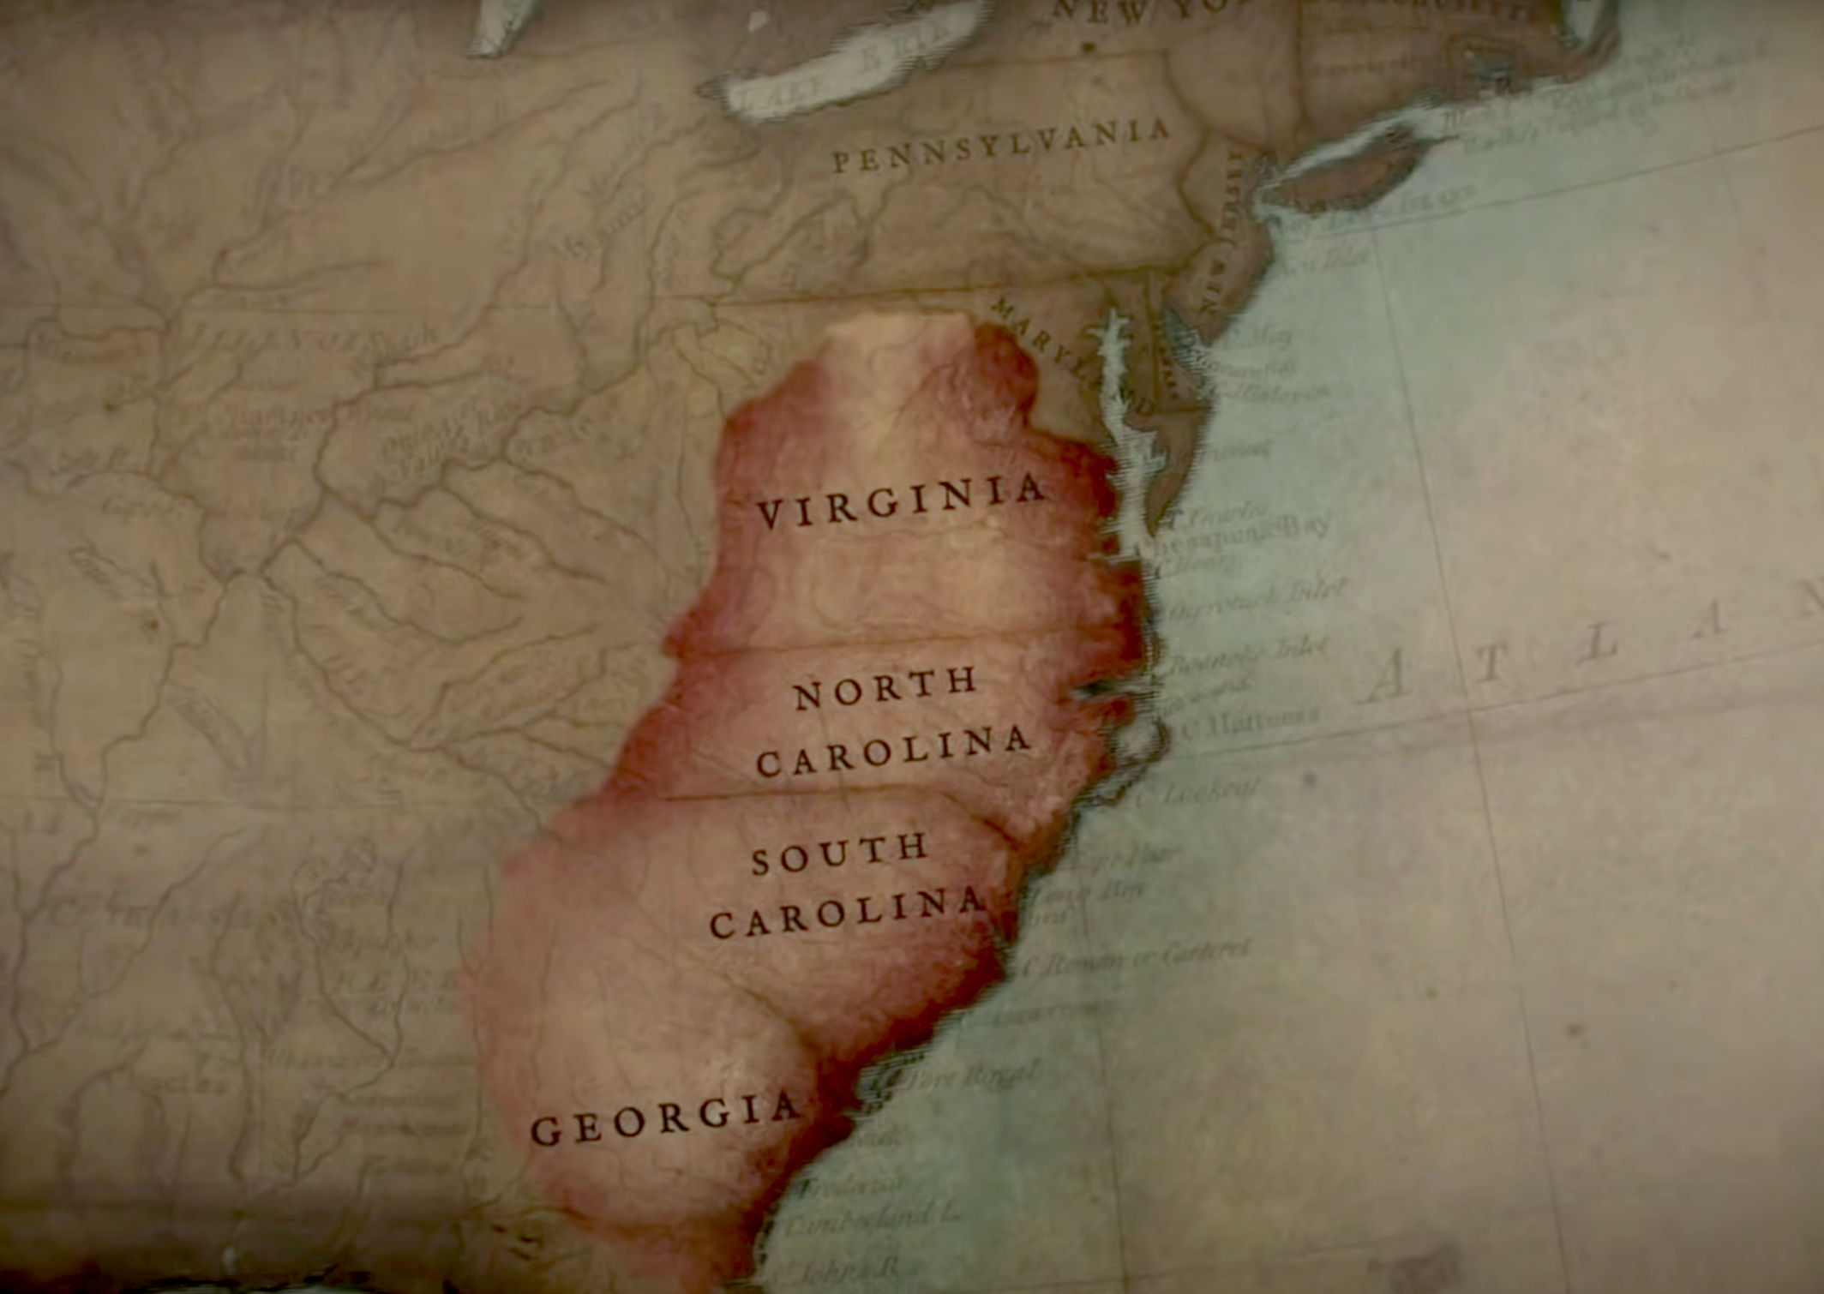
Southern Focus
Stalemate gripped the North
By the end of 1778, British concentrate efforts in southern colonies
Cash crops in the South a valuable resource to keep in the British empire.
By securing the South, British hoped to cut the colonies in two
Leave the North, control the prosperous South
British southern victories
Captured Savannah, Georgia (December 1778)
Victories in 1779 at Briar Creek, Stono Ferry
Notes:
Extra Resources:
"The Southern Campaign: The Revolutionary War in Four Minutes" In 4 Minutes video https://www.youtube.com/watch?v=S0eg6TDNVQ4&t=1s
"The Southern Theater of the American Revolution" article https://www.battlefields.org/learn/articles/southern-theater-american-revolution
In the South, where the split between Patriots and Loyalists was much more even, both militias recruited heavily. The years of 1775-1777 were dominated by small skirmishes and the British need for a deep-water port to support their southern campaign. In June 1776, British Major General Sir Henry Clinton and Commodore Sir Peter Parker attempted to capture Charleston, the most critical port in the South, but were unable to reduce Fort Sullivan (which would become Fort Moultrie, named for the commander who led the successful defense) and take the city.
Possible discussion question: What do you think could be advantages and disadvantages of Britain's decision to focus on the south?

Slide 6
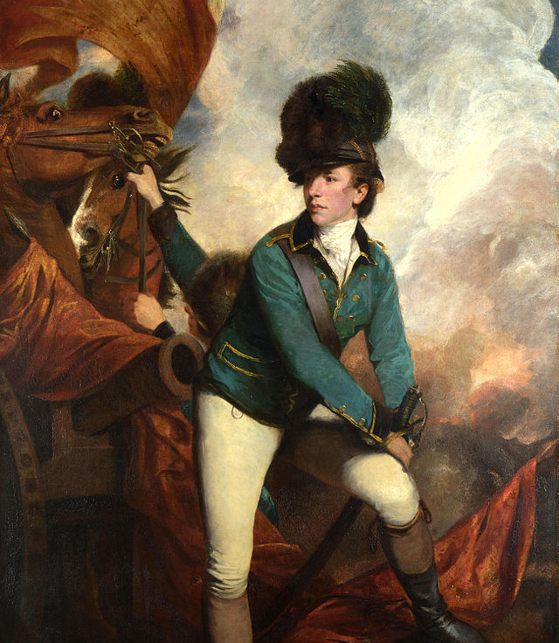
Patriot Struggles
British tried to capture try Charleston, South Carolina again
By April 1780, the British had laid siege and the city surrendered on May 12
Largest American surrender in the war
Colonel Banastre Tarleton – British commander with a reputation for harsh tactics
Continental Army command structure in tatters in the South after surrender at Charleston
Patriots had no regular army in the south, just motivated patriot militias
militia:
Militia frequently came and went as they pleased with no set length of service unlike State Troops or the Continental Army.
Notes:
Extra Resources:
Banastre Tarleton biography https://www.battlefields.org/learn/biographies/banastre-tarleton
Banastre Tarleton
Tarleton participated in the 1776 Charleston Campaign as well as the capture of American General Charles Lee in New Jersey later in the year. Eventually commissioned a Lieutenant Colonel, he took command of a unit made up of Loyalists known as the British Legion. Tarleton fought in Lord Charles, Cornwallis's army in the Southern Campaign. At the Battle of Waxhaws on May 29, 1780, Continental soldiers accused his dragoons of disregarding a Patriot surrender by attacking the Americans after they laid down their arms. Afterward, Americans ascribed the moniker “butcher” to Tarleton and the “Waxhaws Massacre” or “Tarleton’s quarter” to the Battle of Waxhaws, shouting the latter as a rallying cry at the ensuing Battle of Cowpens. Tarleton’s rash behavior in battle strained his relationship with his superiors who believed he was too reckless and lacked “military maturity.” After Cornwallis’s surrender at Yorktown, when Patriot leaders invited British leaders to dine with them. Tarleton was not included. The Americans made it clear that the omission was a deliberate censure for his ruthless treatment of Continental soldiers.
Possible discussion question: What problems do you think the American's lack of a regular army created?
Photo source: https://commons.wikimedia.org/wiki/File:Banastre-Tarleton-by-Joshua-Reynolds.jpg

Slide 7
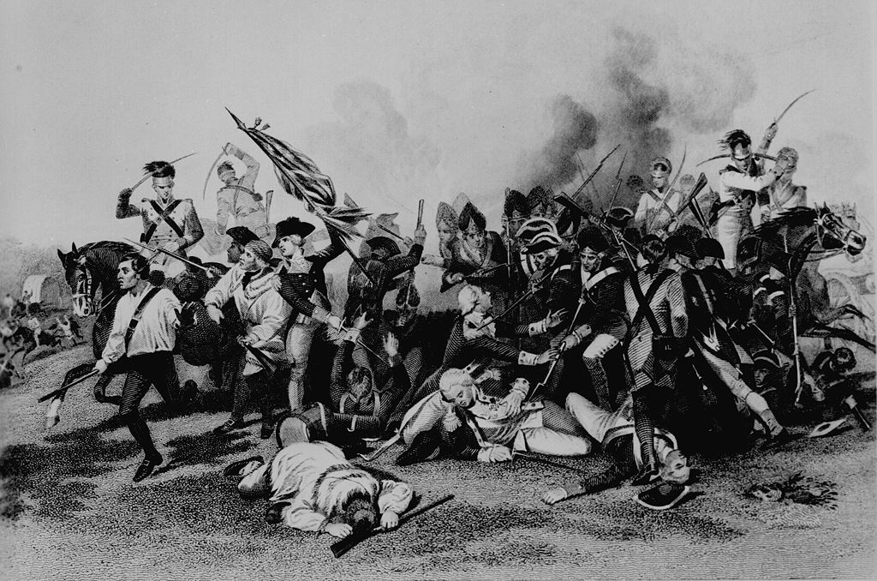
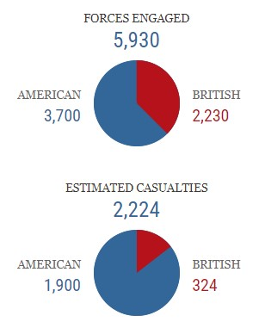
Camden
August 16, 1780
Lord Cornwallis led the British advanced inland through South Carolina.
American soldiers arrived with General Horatio Gates to oppose the movement.
The Battle of Camden ended in an American defeat and opened the route for the British to advance to North Carolina.
The British established a series of supply bases throughout South Carolina
George Washington sent General Nathanael Greene to replace General Gates
Notes:
https://www.battlefields.org/learn/revolutionary-war/battles/camden
The Battle of Camden was one of several devastating defeats suffered by the Americans in the early stages of the British military offensive in the South. After capturing Charleston in May 1780, British forces under General Charles Lord Cornwallis established a supply depot and garrison at Camden as part of their effort to secure control of the South Carolina backcountry.
In July, American Maj. Gen. Horatio Gates marched his army into South Carolina, intent on liberating the state from British control. As Gates neared Camden, word of his movement reached Cornwallis at his headquarters in Charleston. The British commander immediately left the city to take the field against Gates. The armies approached one another north of Camden early on the morning of August 16, 1780. The battle ended in defeat for the Americans.
Gates's defeat cleared South Carolina of organized American resistance and opened the way for Cornwallis to invade North Carolina. Approximately two months after Camden, Maj. Gen. Nathanael Greene accepted the command of the Southern Department and replaced the one time hero of Saratoga. Greene went on to play a critical role in the Carolinas, directing operations that eventually led to the American victory.

Slide 8
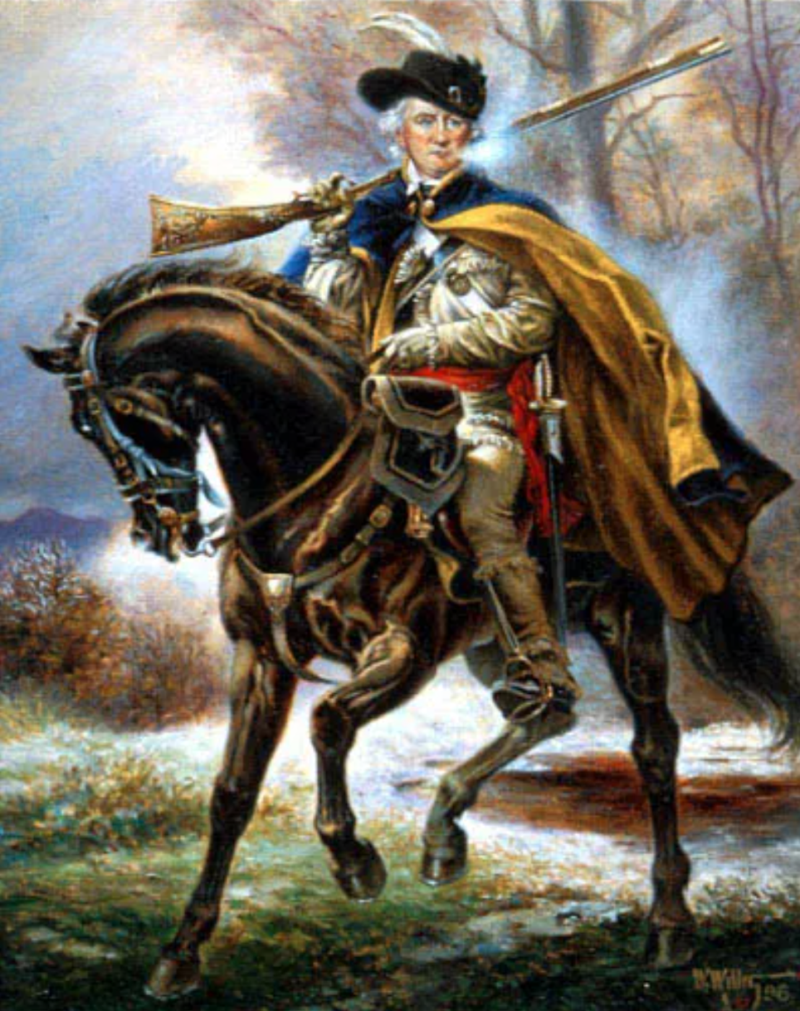
Changes
Washington appointed Nathanael Greene to lead of the army in the southern department
Greene sent Daniel Morgan west to raise spirits and protect that region
Cornwallis is forced to split the army, sends Tarleton west to protect the Ninety-Six district and Star Fort
Notes:
Extra Resources:
Daniel Morgan biography https://www.battlefields.org/learn/biographies/daniel-morgan
Daniel Morgan
Daniel Morgan's teamster career drew him into the French and Indian War, during which he helped to supply the British Army. He soon became known as the “Old Wagoner.” After the outbreak of the American Revolution, Morgan led a force of riflemen to reinforce the patriots laying siege to Boston in 1775. His company, known as “Morgan’s riflemen” marched from Virginia to Boston in 21 days. These Southerners and frontiersmen quickly gained a reputation for their hard fighting ways and the incredible accuracy of their rifles. They also distinguished themselves through their dress. Morgan and his men wore hunting shirts, a distinctly American garment that soon struck fear in the British Army because of the known accuracy of the American riflemen, and soon became a common uniform item in the Continental Army. Later in 1775, Morgan participated American expedition to invade Canada organized by General Benedict Arnold. During the Battle of Quebec, Arnold suffered a wound to his leg, forcing command of the American forces on Morgan. The combat, however, resulted in his capture along with 400 other Americans. His release several months later was followed by his promotion to colonel of the 11th Virginia Regiment.
One of Morgan’s most valuable qualities as a commander was his ability to think beyond the confines of the accepted standards of warfare. Not long after becoming colonel, he was placed in charge of a corps of light infantry made up of Virginians, Pennsylvanians, and Marylanders and he began to employ tactics designed to disturb the disciplined Royal troops. He and his men wore Indian disguises and used hit-and-run maneuvers against the British in New York and New Jersey throughout 1777.Morgan’s main adversary was British Lieutenant Colonel Banastre Tarleton. Tarleton and Morgan’s forces faced each other at Cowpens in South Carolina on January 17, 1781. Morgan emerged victorious and secured his reputation as a skilled military tactician. Utilizing knowledge of his enemy’s aggressive and impulsive behavior, Morgan lured Tarleton into a trap with a fake retreat. Tarleton charged, only to be surprised when Morgan’s infantry turned to fire and a hidden cavalry force joined the conflict. The victory was complete and was a turning point in the war in the South.
Possible discussion question: What was unique about Daniel Morgan's approach to warfare?
Photo source: https://thehistoryjunkie.com/daniel-morgan/

Slide 9
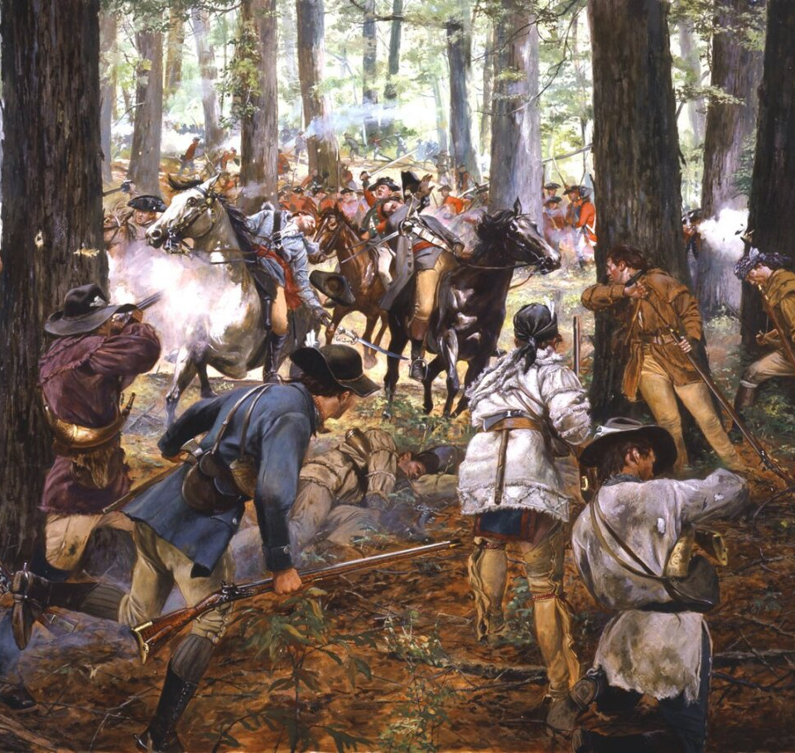
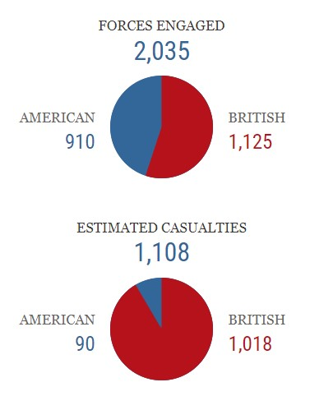
King's Mountain
October 7, 1780
Loyalist (British) militias led by Major Patrick Ferguson were supposed to recruit additional volunteers and protect Cornwallis's army as it marched toward North Carolina.
American "Overmountain men" from the Carolina Backcountry and regions of Tennessee and Kentucky surrounded Ferguson at King's Mountain.
Ferguson was killed, and 8 loyalists were hanged.
American victory at King's Mountain delayed the British invasion of North Carolina and proved that the British did not have guaranteed support in the South.
Thomas Jefferson called this battle "The turn of the tide of success"
Don Troiani
Notes:
Extra Resources:
https://www.battlefields.org/learn/revolutionary-war/battles/kings-mountain
The siege of Charleston in May 1780 was one of the worst American defeats of the Revolutionary War. Another British victory, in the Battle of Camden, followed in August 1780. British general Charles Lord Cornwallis dispatched Major Patrick Ferguson to North Carolina in early September 1780. Ferguson had two tasks: recruit members to fight for the Loyalist militia and protect the Cornwallis’s left flank as he attempted to move through the Carolinas.
Nicknamed Bull Dog by his men, Ferguson soon came up against the Overmountain men, residents of the Carolina Backcountry and the Appalachian mountain range, and from places that would later become the states of Tennessee and Kentucky. American cavalry commander “Light Horse” Harry Lee called them, “A race of hardy men who were familiar with the use of the horse and the rifle, stout, active, patient under privation, and brave.” To the British, however, they were “more savage than the Indians.” From the start Ferguson miscalculated his potential foes, brazenly issuing a proclamation for the local patriots to “desist from their opposition to British arms” or he would “march over the mountains, hang their leaders, and lay their country to waste with fire and sword.” His scare tactics backfired.
On October 7, 1780, Ferguson and the Overmountain men met in a small but significant battle in the War for Independence. It took place on a rocky hilltop in Western South Carolina called Kings Mountain. The rout of the Loyalists there was the first major setback for Britain's southern strategy and started a chain of events that culminated in Cornwallis's surrender at Yorktown.

Slide 10
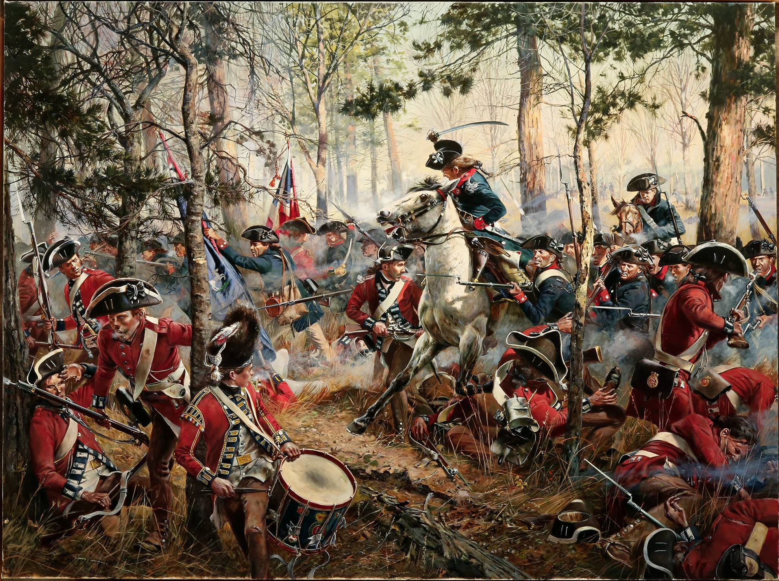
Cowpens
January 17, 1781
American General Daniel Morgan set up a deceptive tactic to get British Colonel Banastre Tarleton to attack.
The Battle of Cowpens, fought on January 17, 1781, was a much-needed American victory.
The British give up trying to fight in South Carolina and move their main army into North Carolina.
Don Troiani
Notes:
Extra Resources:
Cowpens 360° Virtual Tour https://www.battlefields.org/visit/virtual-tours/cowpens-virtual-tour
Cowpens article https://www.battlefields.org/learn/revolutionary-war/battles/cowpens
On January 17, 1781, at the Battle of Cowpens, Daniel Morgan took advantage of Tarleton's aggressiveness. Morgan employed tactics that deceived Tarleton who believed the Americans were in full retreat. Once Tarleton committed his entire force, Morgan’s men turned around to counterattack and the British were routed off the field. The engagement devastated Tarleton’s force—100 killed, 229 wounded, 600 captured—and marked the beginning of the end of the British plan to re-annex the South. A stunning example of military prowess and skilled leadership, the Battle of Cowpens near Chesnee, South Carolina, was a critical American victory in the Revolutionary War. This engagement further weakened British attempts to wrest the southern colonies from American control. This battle ended in American victory. After a string of bad luck in the Southern Campaign, the American army demonstrated its worth in a swift struggle that decisively hindered British forces in the South.

Slide 11
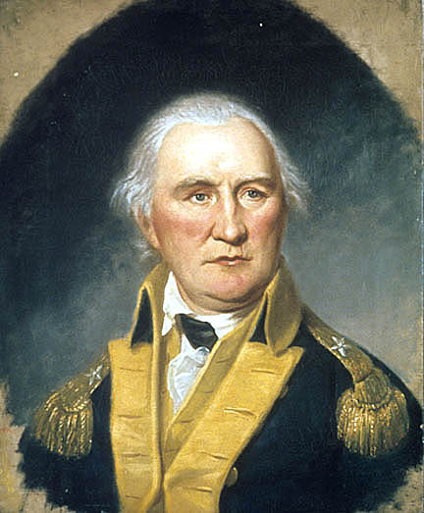
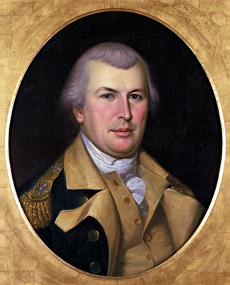
Letter from Daniel Morgan to Nathanael Greene
"Altho’ they have waged the most cruel Warfare, not a man was killed, wounded or even insulted after he surrendered. Had not Britons during this Contest received so many Lessons of Humanity, I should flatter myself that this might teach them a little, but I fear they are incorrigible."
January 19, 1781
Notes:
Link to primary source letter: https://teachingamericanhistory.org/document/letter-to-nathanael-greene/
Possible discussion question: What do you think about Morgan's perspective? Do you see any generalizations in his words?
Portrait of Morgan: https://www.nps.gov/museum/exhibits/revwar/image_gal/indeimg/morgan.html
Portrait of Greene: https://commons.wikimedia.org/wiki/File:Greene_portrait.jpg

Slide 12
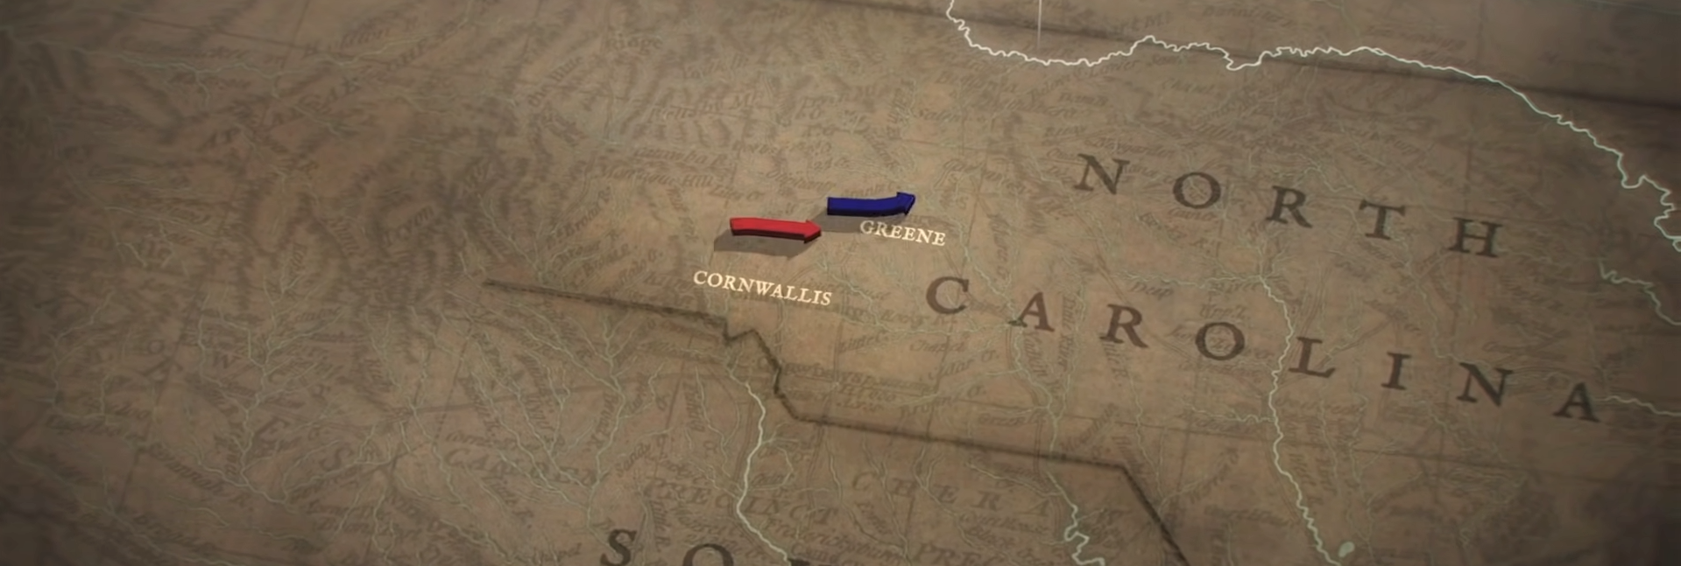
Race to the Dan River
Following the American victory at the Battle of Cowpens, General Morgan needed to reunite with General Nathanael Greene.
For six weeks, the American forces retreated toward the Dan River in North Carolina in a strategy retreat to save their soldiers and pull the British further north.
Greene adopted strategy of exhaustion
Moved toward the Dan River, pulls them away from their supply race
Greene's army escaped across the river
Greene's revitalized army recrosses the Dan in pursuit
January –March 1781
Notes:
Extra Resources:
"Divide and Conquer: Race to the Dan and the Battle of Guilford Courthouse" article https://www.battlefields.org/learn/articles/divide-and-conquer
"The Revolutionary War in the South: Animated Battle Map" video https://www.youtube.com/watch?v=M3jNh3D57gQ
To execute the maneuver known to history as the “Race to the Dan,” Greene employed a ruse to help keep the British off his tail, splitting his army again. On February 10, Greene led the main body northeast toward Virginia from Guilford Courthouse, while a smaller rearguard detachment of dragoons and light troops, commanded by Colonel Otho Holland Williams of the Maryland Continentals, fooled Cornwallis into following their march for Dix’s Ferry. For the next four days, Redcoats chased the rebels across a largely unsettled Piedmont region of sandy roads and tall pines. Often, Tarleton, leading his dragoons in the British pursuit, closed within a hundred yards of the fatigued Americans, who were subsisting on less than three hours sleep and little time to eat their bacon and ground corn. Early on the morning of the 14th, Greene ordered Williams to shift his route to the main body’s path as the army approached the ferry sites. Although Cornwallis doggedly chased his prey, Greene and his troops managed to cross the Dan River on boats collected there weeks before, just hours in advance of the British appearing on the south bank. Williams called the “race” one of Greene’s most “masterly and fortunate maneuvers.”
Possible discussion question: In what ways was this event a decisive moment in the southern campaign?

Slide 13
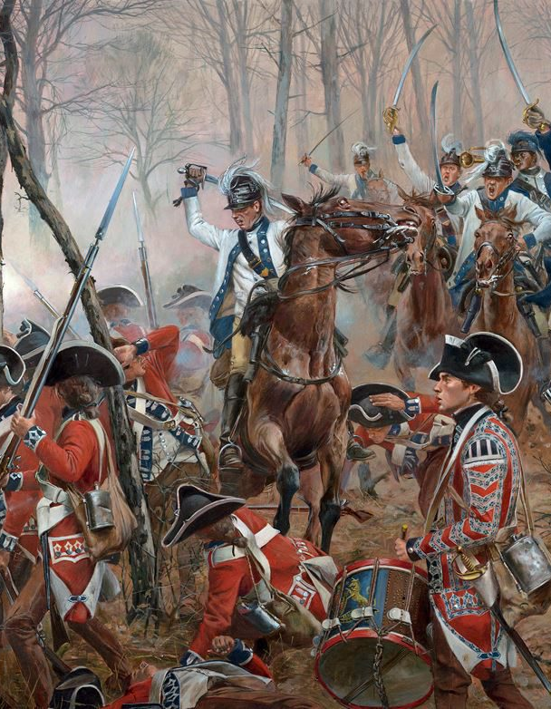
Guilford Courthouse
March 15, 1781
During the Retreat to the Dan, Cornwallis's British troops caught up with the rebels at Guilford Courthouse
Greene retreated- the British were victorious
"Americans fought like demons" during the battle
Cornwallis lost many soldiers, lost the chance of dominating the south with numbers
In parliament, James Fox said that another such victory would destroy the British army
Would you consider the battle at Guilford Courthouse a "decisive moment?" Why or why not?
Don Troiani
Notes:
Extra Resources:
Guilford Courthouse 360° Virtual Tour https://www.battlefields.org/visit/virtual-tours/guilford-courthouse-virtual-tour
Guilford Courthouse article https://www.battlefields.org/learn/revolutionary-war/battles/guilford-court-house
"Guilford Courthouse: Defeat for Both Sides?" Video https://www.youtube.com/watch?v=sqRJGappZWY
On March 15, 1781, British General Charles Lord Cornwallis’s army of 2,100 men engaged a Continental army under Major General Nathanael Greene at Guilford Court House, near present-day Greensboro, North Carolina. Adopting a tactic utilized by Daniel Morgan at the Battle of Cowpens, Greene formed his roughly 4,500 men into three lines. The concept, known as a defense in depth, was for the first two lines to exhaust the enemy's advance and inflict as many casualties as possible in the hopes of delivering a decisive blow at the third line. Forming his men on both sides of the Great Salisbury Road, Cornwallis sent his men forward at 1:30 p.m. When the British got within 150 yards of Greene’s men, the Americans opened fire. The British pressed on, returning fire only when they got within range. On command, the British surged forward. The North Carolinians fired one more time and then retreated into the woods to their rear, abandoning their equipment as they fled. Guilford Courthouse was a pyrrhic victory for Cornwallis. Despite besting the American army, he had lost 25% of his men and was in no position to pursue Greene. Cornwallis decided to withdraw to his supply base at Wilmington to rest and refit. With his army still not in condition to engage Greene by the middle of April, Cornwallis decided to shift his operations to Virginia, a decision that would contribute to the independence of the United States.
Possible discussion question: Would you consider the battle at Guilford Courthouse a "decisive moment?" Why or why not?

Slide 14
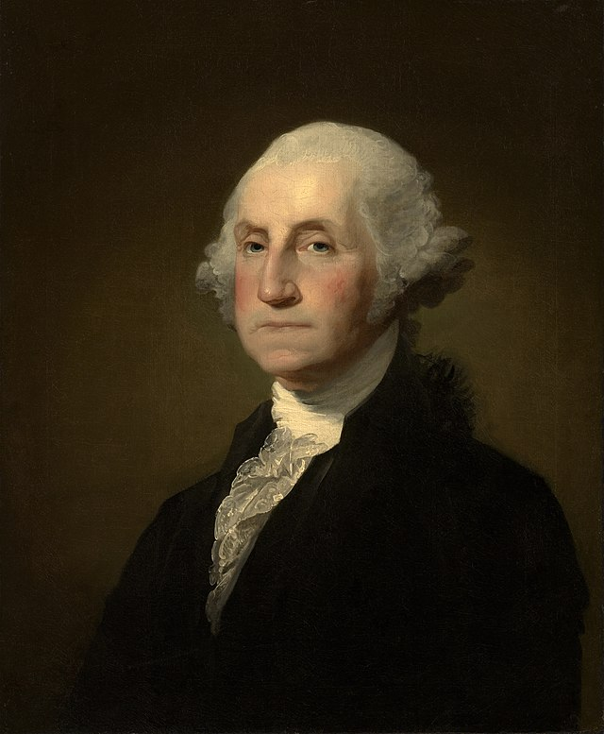
Letter from Nathanael Greene​ to George Washington
"We fight get beat and fight again. We have so much to do and so little to do it with, that I am much afraid these States must fall never to rise again; and what is more I am perswaded they will lay a train to sap the foundation of all the rest."
May 1, 1781
Notes:
Link to primary source letter: https://rotunda.upress.virginia.edu/founders/default.xqy?keys=FOEA-print-01-01-02-5589
Possible discussion question: How do you interpret the meaning of this quote?
Portrait of Greene: https://commons.wikimedia.org/wiki/File:Greene_portrait.jpg
Portrait of Washington: https://commons.wikimedia.org/wiki/File:Gilbert_Stuart_Williamstown_Portrait_of_George_Washington.jpg

Slide 15
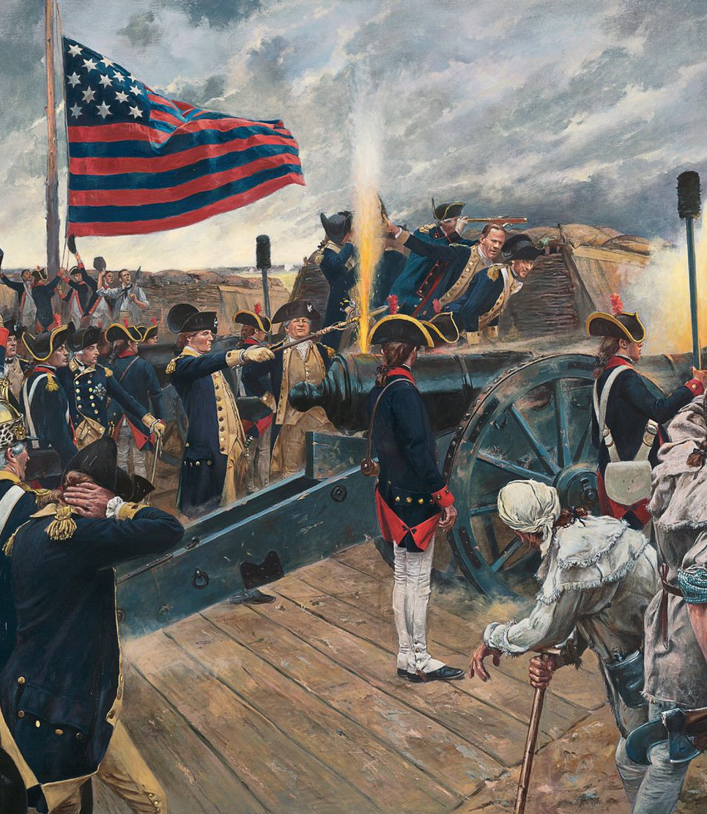
Yorktown
September 28 - October 19, 1781
Cornwallis entered Virginia and captured Virginian cities.
Sept 1781- Cornwallis camped near Yorktown, hoping to be resupplied by the British navy.
General Washington rushed to Virginia to lock British in from land
French locked them in from sea
After 3 weeks of siege operations, Cornwallis surrendered on October 19, 1781
The War continued for 2 more years, but the major fighting was over
Treaty of Paris ended the Revolution on September 3, 1783
"We fight, get beat, rise, and fight again."
Don Troiani
Notes:
Extra Resources:
Yorktown 360° Virtual Tour https://www.battlefields.org/visit/virtual-tours/yorktown-virtual-tour
Battle of Yorktown article https://www.battlefields.org/learn/revolutionary-war/battles/yorktown
After six years of war, both the British and Continental armies were exhausted. The British, in hostile territory, held only a few coastal areas in America. On the other side of the Atlantic, Britain was also waging a global war with France and Spain. The American conflict was unpopular and divisive, and there was no end in sight. For the colonies, the long struggle for independence was leading to enormous debt, food shortages, and a lack of morale among the soldiers. Both sides were desperately seeking a definitive victory.
General George Washington and his Continental Army had a decision to make in the spring of 1781. They could strike a decisive blow to the British in New York City or aim for the south, in Yorktown, Virginia, where Gen. Charles Lord Cornwallis’s troops were garrisoned. Washington and his French ally, Lt. Gen. Comte de Rochambeau, bet on the south, where they were assured critical naval support from a French fleet commanded by Adm. Comte de Grasse. The Allied armies marched hundreds of miles from their headquarters north of New York City to Yorktown, making theirs the largest troop movement of the American Revolution. They surprised the British in a siege that turned the tide toward an American victory in the War for Independence. The Battle of Yorktown proved to be the decisive engagement of the American Revolution. The British surrender forecast the end of British rule in the colonies and the birth of a new nation—the United States of America. American victory. Outnumbered and outfought during a three-week siege in which they sustained great losses, British troops surrendered to the Continental Army and their French allies. This last major land battle of the American Revolution led to negotiations for peace with the British and the signing of the Treaty of Paris in 1783.
Possible discussion question: What techniques did the Americans and French use to close in on the British at Yorktown?

Slide 16
General George Washington Issues Orders For the Siege of Yorktown
"I wish you to be exceedingly watchful upon the Motions of the Enemy on your Side, & to prevent, as much as possible, without risquing too much, the Enemy’s gaining Provisions or Supplies from the Country."
September 23, 1781
Notes:
Link to primary source letter: https://teachingamericanhistory.org/document/letter-to-nathanael-greene/
Possible discussion question: What does this quote reveal about Washington's leadership?

Slide 17
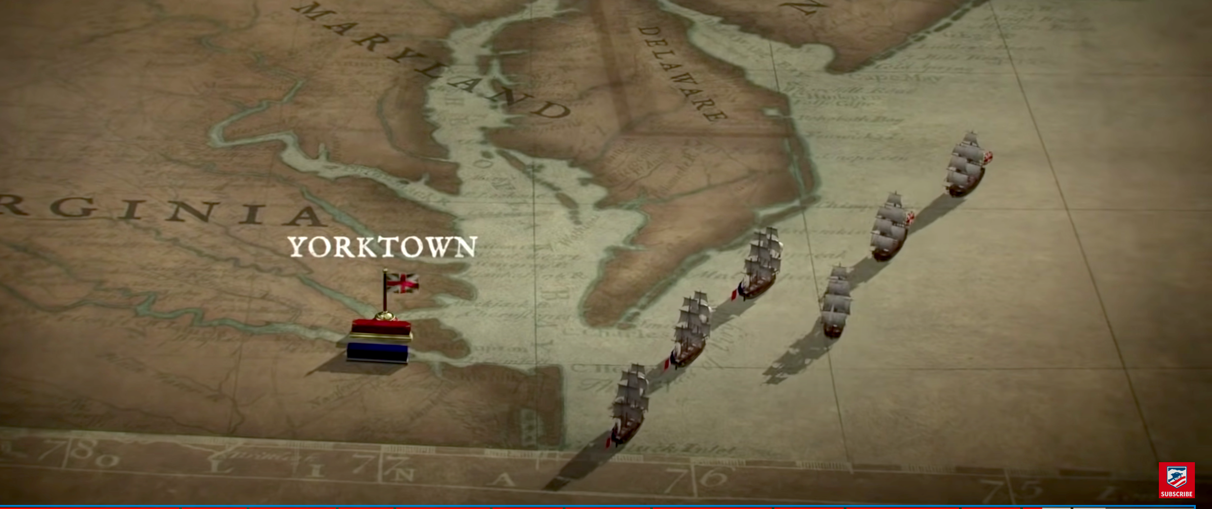
"It is all over."
On March 5, 1782, Parliament passed a bill authorizing the government to make peace with America
Two more years of diplomacy to formally secure American independence
Treaty of Paris ended the Revolution on September 3, 1783
War was won with the British defeat at Yorktown
Notes:
When news of Cornwallis’s surrender reaches London on November 25, the Prime Minister, Lord North, declares, “Oh God. It is all over. It is all over.” On March 5, 1782, Parliament passes a bill authorizing the government to make peace with America. Lord North resigns 15 days later. Although it takes the Americans two more years of skillful diplomacy to formally secure their independence through the Treaty of Paris, the war is won with the British defeat at Yorktown.
Possible discussion question: In what ways was the battle of Yorktown a "decisive moment?"

Slide 18
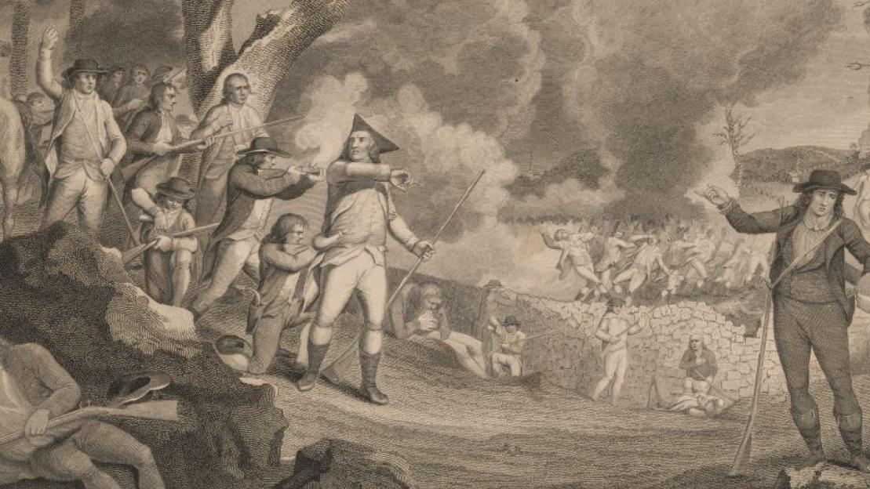
Decisive Moments Lead to Victory
The battles at Camden, King's Mountain, Cowpens, Guilford Courthouse, and Yorktown are among "decisive moments" in the southern campaigns of the American Revolution.
What made these battles "decisive moments?"
Notes:
Reinforce the overall theme that in the final years of the war, following the fall of Charleston to the British in May 1780, the South became the principal theater of the Revolutionary War. In addition to regular fighting between the armies, a civil war erupted between Patriots and Loyalists, with many small battles between militias raging throughout the countryside. This era of the Revolutionary War, like all wars, is full of decisive moments that add up to create the story of the war as is recognized today.
Possible discussion question: What made these battles "decisive moments?"

Slide 19
Special Thanks
Thank you to historical artist Don Troiani for allowing American Battlefield Trust to share his artwork for educational purposes.
In the order that they appeared in this PowerPoint:
"Yorktown-lined soldier" (Slide 2)
"Cowpens-Marylanders overrun British" (Slide 7)
"Guildford Courthouse- Dragoons vs British Foot Guards" (Slide 12)
"Yorktown Siege-George Washington" (Slide 13)

