Slide 1
Conflict in the Colonies
The American Battlefield Trust

Slide 2
Inquiry Question:
How did life in the American colonies and
the French & Indian War lead toward
colonial unity and discontent?
Notes:
Ask students to create a hypothesis of the answer to this question. Have students either discuss in groups their ideas or as a class. Ask students how they produced those hypotheses.

Slide 3
Mercantilism
Britain's American colonies became part of a mercantilist economic system.
Mercantilism - the wealth of the colonies benefits the mother country which is obligated to protect those colonies.
The colonies provided natural resources and agricultural products to Britain and served as a market for British manufactured goods.
Through the Triangular trade, enslaved people crossed the Atlantic from West Africa.
Notes:
https://www.battlefields.org/learn/articles/everyday-life-colonial-america
https://www.battlefields.org/learn/articles/triangular-trade
The economic theory of Mercantilism, which in its simplest terms advocated the accumulation and circulation of precious metals (or bullion) within a single country’s market but taken to its logical extreme believed that countries should maximize exports and minimize imports under the assumption of international trade as a zero-sum game. Using policies such as high tariffs on imported finished products, and sometimes simple bans on certain exports, the European powers saw any gain their neighbors made in trade to be their loss, and they applied this principle to their colonies as well. Most European colonies in the New World, especially cash crop producers, were completely banned from trading with either their colonial neighbors or European ports that did not belong to their mother countries. In Britain, this was done through legislation such as the Navigation Acts of 1660, which completely banned foreign merchants from purchasing or selling goods in any English port. Customers gained access (legally) to foreign products solely through English merchants setting forth and purchasing those items themselves.

Slide 4
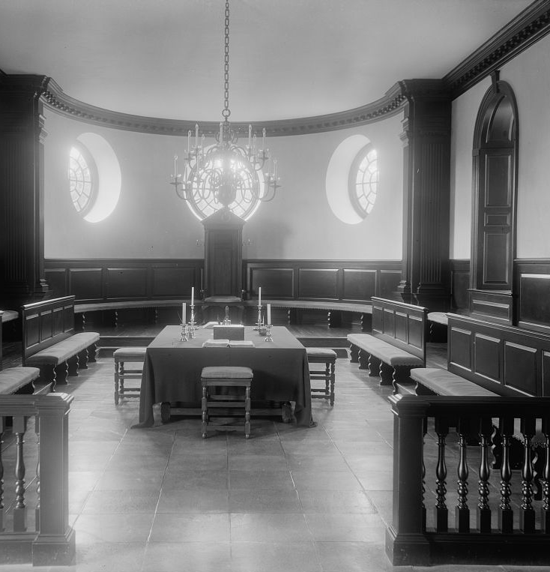
Colonial Government
As colonial subjects, the American colonies were supposed to owe their loyalty to Britain as well as the economic benefits of their natural resources. In return, they were promised the rights of British citizens and the protection of the British military.
However, the distance and difficulty of travel between Britain and the colonies encouraged the growth of local self-government.
Some colonies had colony assemblies who ruled or advised the royal governor.
Notes:
https://www.battlefields.org/learn/articles/ruling-colonial-america
Every colony was different in how its government was structured and functioned. Some, such as Massachusetts, Rhode Island, and Connecticut, were much more localized and less concentrated to a central governing power. Colonial assemblies, and sometimes governor’s councils, presided over government duties while local court systems served at the pleasure of the Royal Governor, who was appointed directly by the King. Other colonies, such as Virginia, held more centralized assemblies, like the House of Burgesses, that reflected the plantation gentry who would become the first American aristocracies. Their responsibilities all varied depending on how the colony’s government was structured; however, ultimate authority was vested in the governor’s hands because they were a direct line to the British Crown. In times of war or unrest, it was the colonial governors who effectively served as the chief executives (think the role of the president) to marshal a militia or issue proclamations that would call on the citizenry to respond.

Slide 5
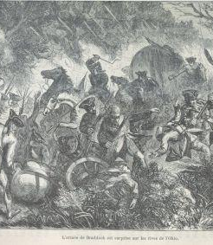
French & Indian-War, 1754-1763
The war was fought in French and British colonies around the world, and globally was known as the Seven Years' War.
The war began when a 22-year-old George Washington, then an officer in the British army, ambushed a small French force in Pennsylvania as part of an ongoing conflict over territory in the Ohio River Valley.
This global conflict witnessed the emergence of the British empire but also sowed the seeds of revolution and the foundation of the United States as the American colonies saw the limits of British protection and the effects of mercantilism.
Notes:
https://www.battlefields.org/learn/articles/10-facts-french-and-indian-war
The French and Indian War refers to the North American theater of the overarching global war known as the Seven Years' War in Europe. The French and Indian War was fought between Great Britain and France and their colonists, as well as Native American tribes. They fought over territories and expansion throughout North America.
The French and Indian War and its consequences were instrumental in causing a divide between Great Britain and its British colonists. After Great Britain ceded control of western land to the Native Americans, the colonists were outraged that they were now prevented from settling in the western region, causing a rift between the colonists and their mother country. Furthermore, due to the war, Great Britain was in massive debt, causing them to levy extreme taxes on the colonists to earn back their monetary losses from the war. The taxes that followed, such as the Stamp Act, the Tea Act, and others, led to the anger among the colonists. Both the Royal Proclamation of 1763 and the absurd taxes that the colonists were forced to pay created outrage among the colonists and led in part to the American Revolution.

Slide 6
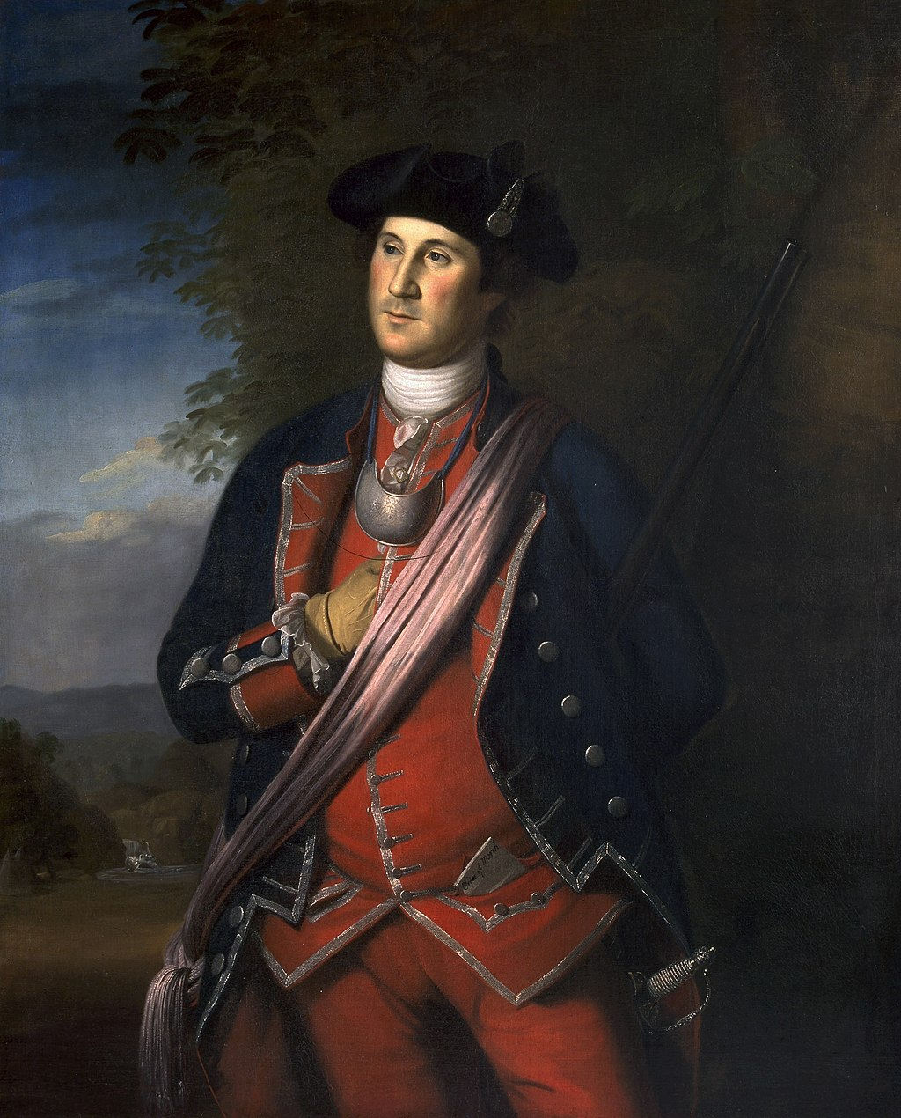
George Washington
The war brought fame and respect to the young George Washington, preparing him for his later role as commander-in-chief of the Continental Army.
Like many other Americans, though, Washington resented what he saw as poor British treatment of colonial troops.
"We can't conceive that being Americans should deprive us of the benefit of British Subjects."
Notes:
https://www.battlefields.org/learn/biographies/george-washington
Washington was the son of a wealthy Virginian land speculator. He was born on February 22, 1732, and received little formal education in his youth. After his father’s death in 1743, he inherited a large farm, with ten slaves to work the property, and became a land surveyor. In 1750, he resigned his position to devote himself to farming and acquiring new farmland. Two years later, inspired by his recently deceased brother Lawrence’s military service, Washington joined the Virginian Militia. He was given the rank of major and appointed to command one of the four militia districts in Virginia. His enlistment occurred as tensions between France and England ignited. British officials ordered Washington to force the French army off “British" land and Washington impressed his superiors by making a treacherous winter round-trip 77-day trek to the French Fort Le Boeuf to inform France of these commands. When France refused to comply, Washington was given the honor to force their hand. Unfortunately, he attacked the French during the Battle of Jumonville Glen, also known as the Jumonville affair, and the French commander Joseph Coulon de Jumonville died. A month later, South Carolinian militia joined Washington and the militia again tried to attack French fortifications but were unsuccessful. This incident led to the French and Indian War, also known as the Seven Years’ War. In response, Washington surrendered his troops and resigned his commission with essential military knowledge that proved vital later in his career.

Slide 7
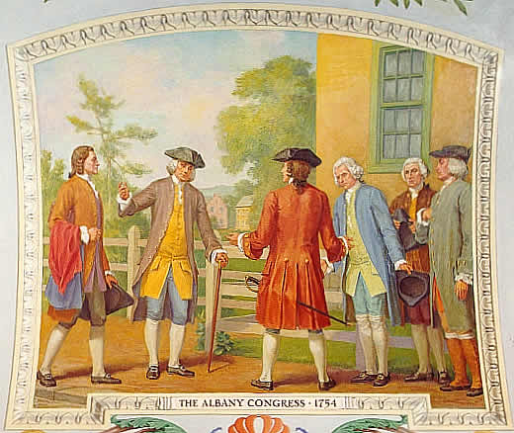
The Albany Plan
Facing a common military threat, representatives from seven of the colonies met in Albany, New York to plan their defense.
Benjamin Franklin, a representative from Pennsylvania, suggested the Albany Plan of Union.
Although Parliament rejected the plan, it would have formed "one general government" for the colonies, including a President-General and a House of Representatives.
Notes:
As the French and Indian War erupted, the Albany Congress was called in Albany, New York. This Congress consisted of twenty representatives from the American colonies to plan how the colonies could defend themselves. Benjamin Franklin, a senior member of the Congress, suggested the Albany Plan of Union unite the colonies to assist in the colonies’ defense. British Parliament rejected the Plan.
https://www.battlefields.org/learn/primary-sources/albany-plan-union-1754

Slide 8
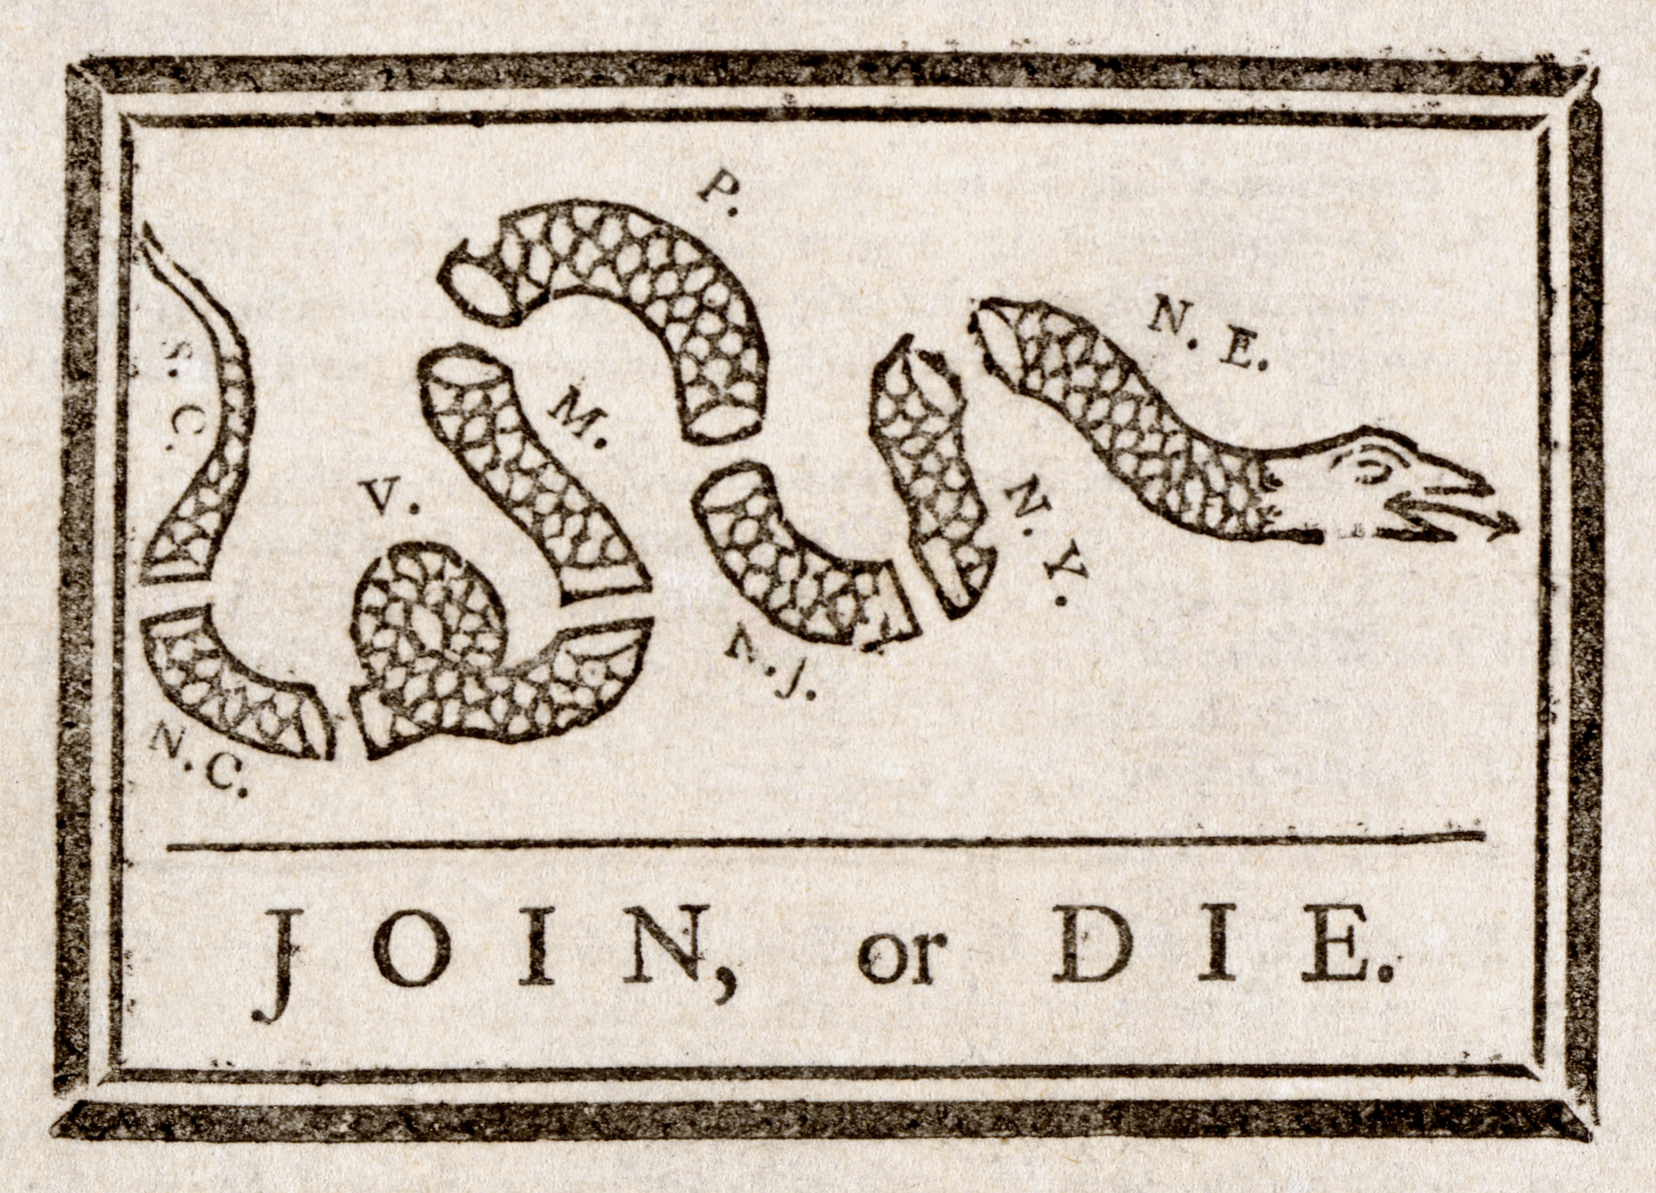
"Join or Die"
This image, created by Benjamin Franklin, illustrated the importance of the colonies to unite for common defense against the French.
Although not a symbol of colonial independence at the time, the concept of uniting for a common cause and avoid defeat by division laid a foundation for American thought that would be crucial during the coming resistance to taxation and the war for independence.
Notes:
Benjamin Franklin was looking to find a way to unite the American colonies as early as the French and Indian War. He created a famous cartoon of a snake divided with the phrase “Join or Die.”
https://www.battlefields.org/learn/articles/10-facts-benjamin-franklin

Slide 9
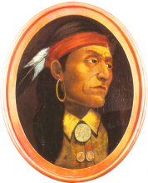
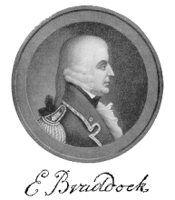
Leaders of the French and Indian War
Edward Braddock commanded all British troops in North America until his death at the Battle of Monangahela in 1755.
Louis-Joseph de Montcalm won major victories over the British at Forts Oswego and Carillon but was defeated at the Battle of the Plains of Abraham.
Pontiac, leading the Ottawa, allied with France until its defeat. He later led an uprising against British rule.
Notes:
Braddock: https://www.battlefields.org/learn/biographies/edward-braddock
Battle of the Monangahela: https://www.battlefields.org/learn/articles/battle-monongahela-july-9-1755
Montcalm: https://www.battlefields.org/learn/biographies/louis-joseph-de-montcalm
Conquering a Continent: https://www.battlefields.org/learn/articles/conquering-continent-battle-quebec
Pontiac: https://www.battlefields.org/learn/biographies/pontiac

Slide 10
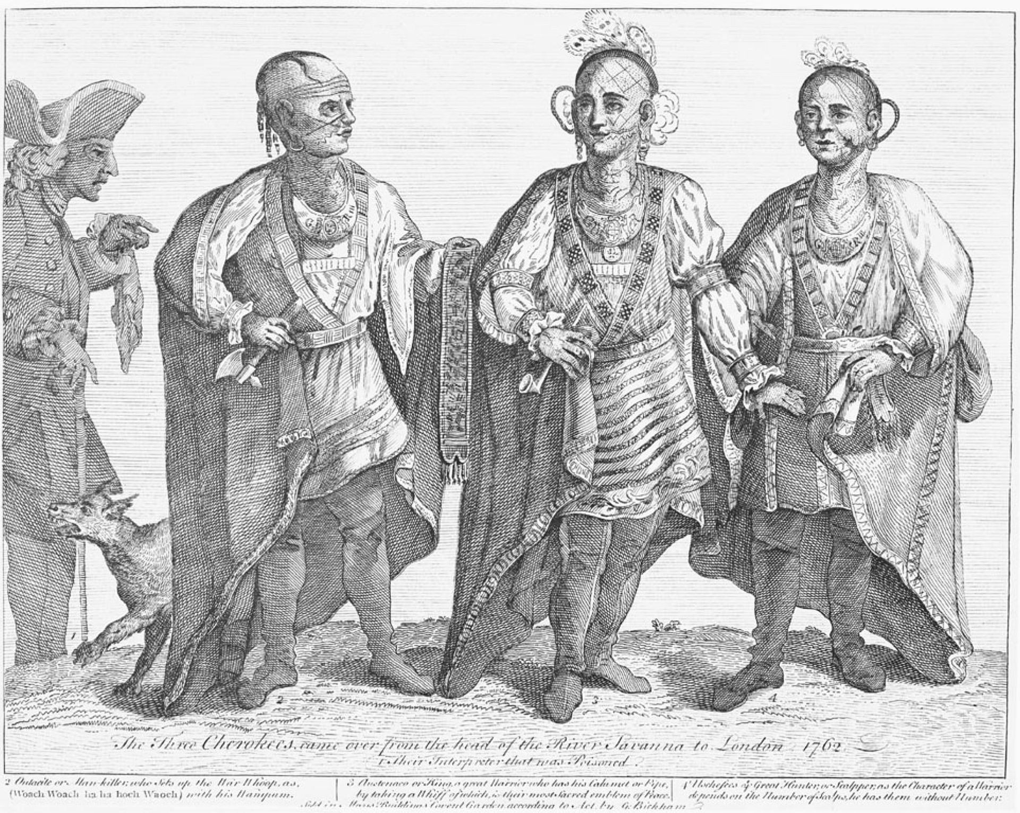
Native Americans in the French and Indian War
Native Americans fought on both sides of the conflict, but most groups stayed neutral or allied with the French.
The conflict heightened tensions over land between colonists and Native Americans. British settlers continued to push west into already-inhabited territory.
Notes:
https://www.battlefields.org/learn/articles/people-involved-french-and-indian-war
Native Americans found themselves caught between these two competing world powers. Rather than a single group of people, there were dozens of different American Indian tribes, and they viewed each other as different people with different desires in the conflict. They also had dissention among themselves and would occasionally change sides depending who was winning the war.
Most of the Indian tribes supported France in the war. French Catholic missionaries had been converting large numbers of Indians to Catholicism since they first arrived in the New World. The French were also less interested in displacing the Indians, but rather claimed them as a protectorate. In this role, the Indian tribes could retain their autonomy while still being French territory. They frequently traded with the French and lived in relative peace.
The Algonquin-speaking people largely supported the French, including the Wabanaki Confederacy, the Mi'kmaq, the Abenakis, the Ojibwa, the Lenape, the Ottawa, and the Shawnee among many others. The Innu and Wyandot tribes also sided with the Algonquins and French. However, some Indian tribes allied with the British, including the Iroquois Confederacy (made up of the Mohawk, Oneida, Onondaga, Cayuga, Seneca, and Tuscarora people) along with some other tribes.

Slide 11
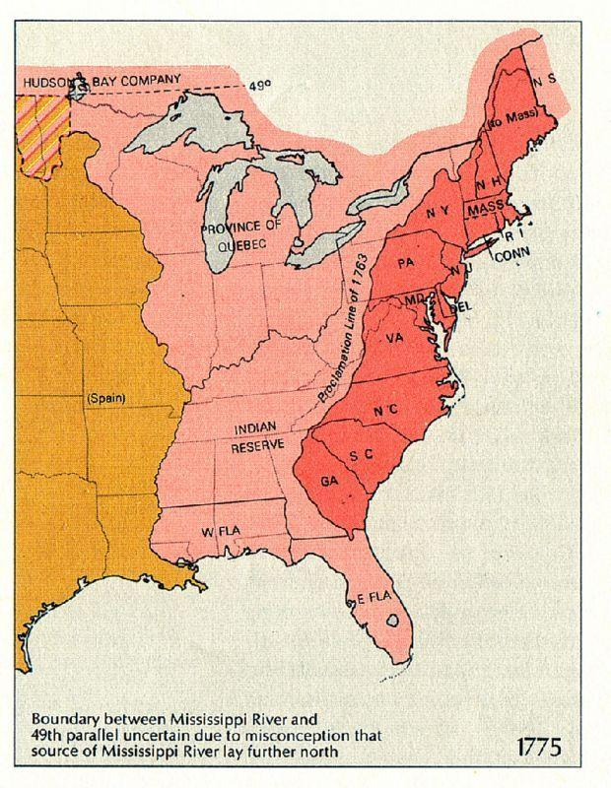
The Treaty of Paris
After intense fighting in Europe, involving Russia, Prussia, Austria, and Portugal, Britain won a decisive victory over France.
The Treaty of Paris was signed in 1763 and transferred most of France's territory in North America to the British Empire.
The Proclamation Line of 1763 was supposed to establish territory for Native tribes to the west of the seaboard colonies.
Notes:
https://www.battlefields.org/learn/articles/french-and-indian-war-1754-1763-its-consequences
On February 10, 1763, over two years after the fighting had ended in North America, hostilities officially ceased with the signing of the Treaty of Paris between Britain, France, and Spain. The fate of America’s future had been placed on a new trajectory, and as famously asserted by 19th century historian, Francis Parkman, “half the continent had changed hands at the scratch of a pen.” France’s North American empire had vanished.
The treaty granted Britain Canada and all of France’s claims east of the Mississippi River. This did not, however, include New Orleans, which France was allowed to retain. British subjects were guaranteed free rights of navigation on the Mississippi as well. In Nova Scotia, Fortress Louisbourg remained in Britain’s hands. A colonial provincial expeditionary force had captured the stronghold in 1745 during King George’s War, and much to their chagrin, it was returned to the French as a provision of the Treaty of Aix-la-Chappelle (1748). That would not be the case this time around. In the Caribbean, the islands of Saint Vincent, Dominica, Tobago, Grenada, and the Grenadines would remain in British hands. Another bug acquisition for His Majesty’s North American empire came from Spain in the form of Florida. In return, Havana was given back to the Spanish. This gave Britain total control of the Atlantic Seaboard from Newfoundland all the way down to the Mississippi Delta.
The loss of Canada, economically, did not greatly harm France. It had proved to be a money hole that cost the country more to maintain than it actually returned in profit. The sugar islands in the West Indies were much more lucrative, and to France’s pleasure, Britain returned Martinique and Guadeloupe. Although His Most Christian Majesty’s influence in North America had receded, France did retain a tiny foothold in Newfoundland for fishing. Britain allowed the French to keep its rights to cod in the Grand Banks, as well as the islands of Saint Pierre and Miquelon off the southern coast.
The inhabitants of the British colonies in North America were jubilant upon hearing the results of the Treaty of Paris. For nearly a century they had lived in fear of the French colonists and their Native American allies to the north and west. Now France’s influence on the continent had been expelled and they could hope to live out their lives in peace and autonomously without relying on Britain’s protection.
https://www.battlefields.org/learn/articles/french-and-indian-war-1754-1763-its-consequences
The Proclamation of 1763 was issued. The French settlements north of New York and New England were consolidated into the colony of Quebec, and Florida was divided into two separate colonies. Any land that did not fall within the boundaries of these colonies, which would be governed by English Law, was granted to the Native Americans. Pontiac’s Rebellion eventually came to an end.
The Royal Proclamation of 1763 further alienated the British colonists. Many sought to settle the west, and even Pennsylvania and Virginia had already claimed lands in the region. The proclamation prohibited the colonies from further issuing any grants. Only representatives of the Crown could negotiate land purchases with the Native Americans. Just as France had boxed the colonies into a stretch along the east coast, now George III was doing the same.

Slide 12
Consequences
The expense of fighting a global war caused the British national debt to nearly double.
The colonists were expected to help cover the debt and were soon forced to pay higher taxes.
The British Empire expanded tremendously in North America and the Caribbean.
This led to increased conflict with Native Americans, especially where the thirteen colonies pushed west into already populated areas.
Notes:
https://www.battlefields.org/learn/articles/french-and-indian-war-1754-1763-its-consequences
The consequences of the French and Indian War would do more to drive a wedge in between Britain and her colonists more so than any other event up to that point in history. During the Seven Years’ War, Britain’s national debt nearly doubled, and the colonies would shoulder a good portion of the burden of paying it off. In the years that followed, taxes were imposed on necessities that the colonists considered part of everyday life—tea, molasses, paper products, etc.... Though proud Englishmen, the colonists viewed themselves as partners in the British Empire, not subjects. King George III did not see it this way. These measures were met with various degrees of opposition and served as the kindling that would eventually contribute to igniting the fires of revolution.

Slide 13
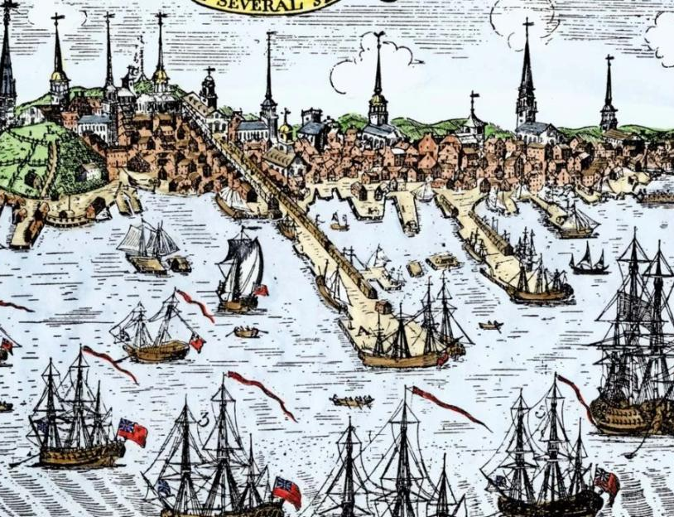
Consequences
The colonies united in a common cause for the first time. The colonists gained military experience.
Resentment against the British treatment of the colonies grew. Many felt the British Empire was not fulfilling its obligations to the American colonists.
Notes:
https://www.battlefields.org/learn/articles/french-and-indian-war-1754-1763-its-consequences
The French and Indian War had initially been a major success for the thirteen colonies, but its consequences soured the victory. Taxes imposed to pay for a massive national debt, a constant struggle with Native Americans over borders and territories, and the prohibition of expansion to the west fueled an ever-increasing “American” identity. As the years following the French and Indian War drug on, the colonists—already 3,000 miles away from Britain—grew further and further apart from the mother country.

