Slide 1
Colonial Taxes & Disputes
The American Battlefield Trust

Slide 2
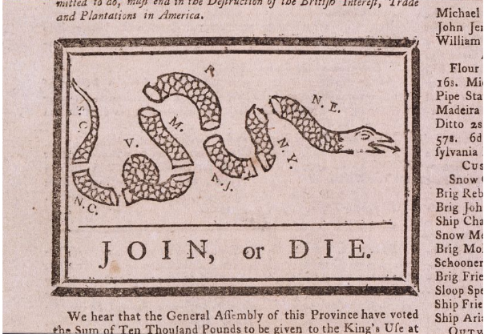
Essential Question
How did British Parliament and the Colonies clash over their ideas of government and liberty?
Notes:
Encourage students to think about how various between 1763 and 1770 disputes led to the revolution. These disputes were over topics such as taxation, troops, and autonomy.
Possible discussion question: how did British Parliament and the Colonies clash over their ideas of government and liberty?
Photo: https://www.loc.gov/resource/cph.3g05315/

Slide 3
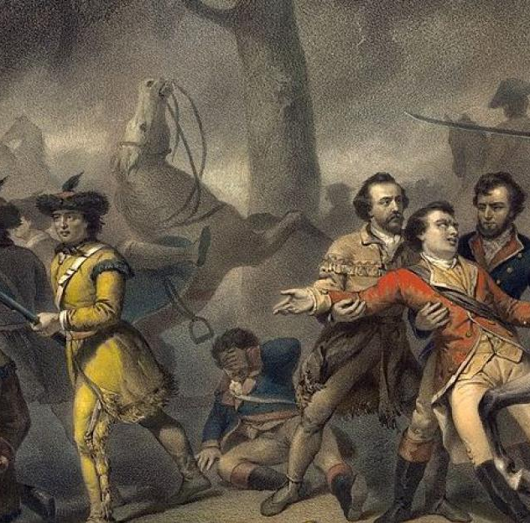
Context
Royal decrees and charters set up the American colonies, each its own distinct entity with its own legislature and colonial governor
During the French and Indian War, Britain’s national debt nearly doubled and British decided to tax the colonies since the war was won on their behalf
Parliament imposed taxes on necessities that the colonists considered part of everyday life
Though proud English citizens, the colonists viewed themselves as partners in the British Empire, not subjects.
What does "taxation without representation" mean to you?
Notes:
Extra Resources:
"An Emerging Identity: Ruling Colonial America" article https://www.battlefields.org/learn/articles/ruling-colonial-america
"10 Facts: The French and Indian War" article https://www.battlefields.org/learn/articles/10-facts-french-and-indian-war
"The French and Indian War (1754-1763): Its Consequences" article https://www.battlefields.org/learn/articles/french-and-indian-war-1754-1763-its-consequences
"No Taxation Without Representation" article https://www.battlefields.org/learn/articles/no-taxation-without-representation
The French and Indian War
The consequences of the French and Indian War would do more to drive a wedge in between Britain and her colonists more so than any other event up to that point in history. During the Seven Years’ War, Britain’s national debt nearly doubled, and the colonies would shoulder a good portion of the burden of paying it off. In the years that followed, taxes were imposed on necessities that the colonists considered part of everyday life—tea, molasses, paper products, etc.... Though proud Englishmen, the colonists viewed themselves as partners in the British Empire, not subjects. King George III did not see it this way. These measures were met with various degrees of opposition and served as the kindling that would eventually contribute to igniting the fires of revolution.
"Taxation without Representation"
In 1768, the catchphrase of “No taxation without representation” first appeared in a London newspaper. As debate continued throughout the 1760s and 1770s over whether the Crown had the right to tax the colonial subjects, the phrase grew more and more popular. It provided an ideological argument in a short and powerful way against many of the subsequent taxes, such as the Townshend Acts in 1767 and 1768 and the Tea Act in 1773.
Possible discussion question: what does "taxation without representation" mean to you?

Slide 4
Stamp Act
March 22, 1765
British parliament enacted the Stamp Act, which taxes stamps used on most paper goods
Bigger impact than the Sugar Act and Townshend Revenue Acts
Massachusetts Lieutenant governor Thomas Hutchinson opposed the act but had to enforce it
Notes:
Extra Resources:
"Stamp Act of 1765" primary source https://www.battlefields.org/learn/primary-sources/stamp-act-1765
"Thomas Hutchinson: Governor of a Rebellious Colony" In 4 Minutes video https://www.youtube.com/watch?v=7V4qGVNMaWs
The Stamp Act, created by the British government, placed a tax on stamps that would be used on most paper goods including legal documents, newspapers, pamphlets, etc.
Possible discussion question: what reasoning did British parliament have for enacting the Stamp Act?
Photo source: https://www.loc.gov/item/2004672606/

Slide 5
Read the Acts!
"For every... sheet or piece of paper, on which shall be... written or printed... in America, a stamp duty of three pence. "
"The members of this congress... make the following declarations... respecting the most essential rights and liberties of the colonists, and of the grievances under which they labor, by reason of several late acts of Parliament.
"We hear that the merchants and friends to America in England, were determined to use their utmost endeavours the next session of Parliament, in order to get the stamp act repealed."
Stamp Act
No Stamped Paper to be Had
Stamp Act Congress
March 22, 1765
November 7, 1765
October 19, 1765
Notes:
The primary sources are linked in the subheadings, but here are the links again:
Stamp Act: https://www.battlefields.org/learn/primary-sources/stamp-act-1765
No Stamped Paper to be Had: https://www.battlefields.org/learn/primary-sources/no-stamped-paper-be-had
Stamp Act Congress: https://www.battlefields.org/learn/primary-sources/resolutions-stamp-act-congress
Possible discussion question: how might the authors of these different primary sources affect how we interpret the writing?

Slide 6
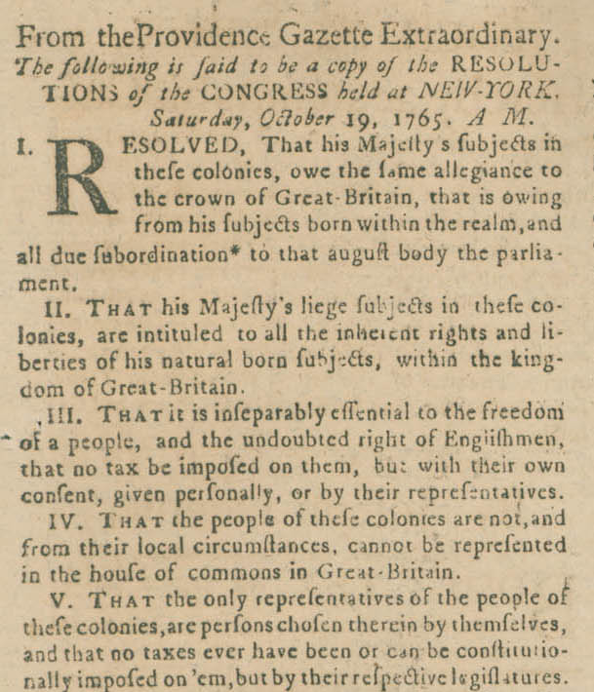
Stamp Act Congress
October 7-24, 1765
In response to the Stamp Act, nine colonial assemblies rallied to file petitions of grievance to London
The Declaration of Rights and Grievances laid out that the colonies would remain subordinate to Parliament but they expected the liberties understood within the English Constitution to be afforded to them too.
Resolutions were adopted on October 14, but quickly floundered as some leading delegated refused to sign them
British authorities were shocked, bewildered, and anxious
The Congress dissolved on October 24, and on November 1 when the Stamp Act was to become law, several bands of Sons of Liberty throughout port towns staged mock funerals showcasing liberty dying by the new taxes.
Notes:
Extra Resources:
"What Was the Stamp Act Congress and Why Did It Matter" article https://www.battlefields.org/learn/articles/what-was-stamp-act-congress
The Stamp Act Congress
After the Stamp Act caused colonies assemblies to file petitions of grievance against British Parliament, eight colonies who followed Virginia’s lead in assembling a coordinated response to the Stamp Act, which has become known as the Stamp Act Congress. Held at Federal Hall between October 7 and 24. None of the delegates there were advocating for American independence. In fact, they were specifically arguing that in order to remain loyal, obedient subjects, Parliament had to understand that taxing them in this matter would actually create more issues for both sides. The final version of what became known as the Declaration of Rights and Grievances, a series of fourteen points that went beyond addressing the Stamp Act, laid out that while intending to remain subordinate to Parliamentary authority, the colonies expected the liberties understood within the English Constitution to be afforded to them too.
What is true is that the Stamp Act Congress was only the second time in British colonial history that the individual colonies banded together to address a situation that threatened them all. It’s important for us to understand that the Stamp Act crisis of 1765 was the first line drawn in the sand and that neither side backed off insinuating the first crack in the foundation that was colonial loyalty to the British monarchy.
Possible discussion question: What does this meeting say about the colonies' willingness to work together?
Photo source: https://www.masshist.org/database/293

Slide 7
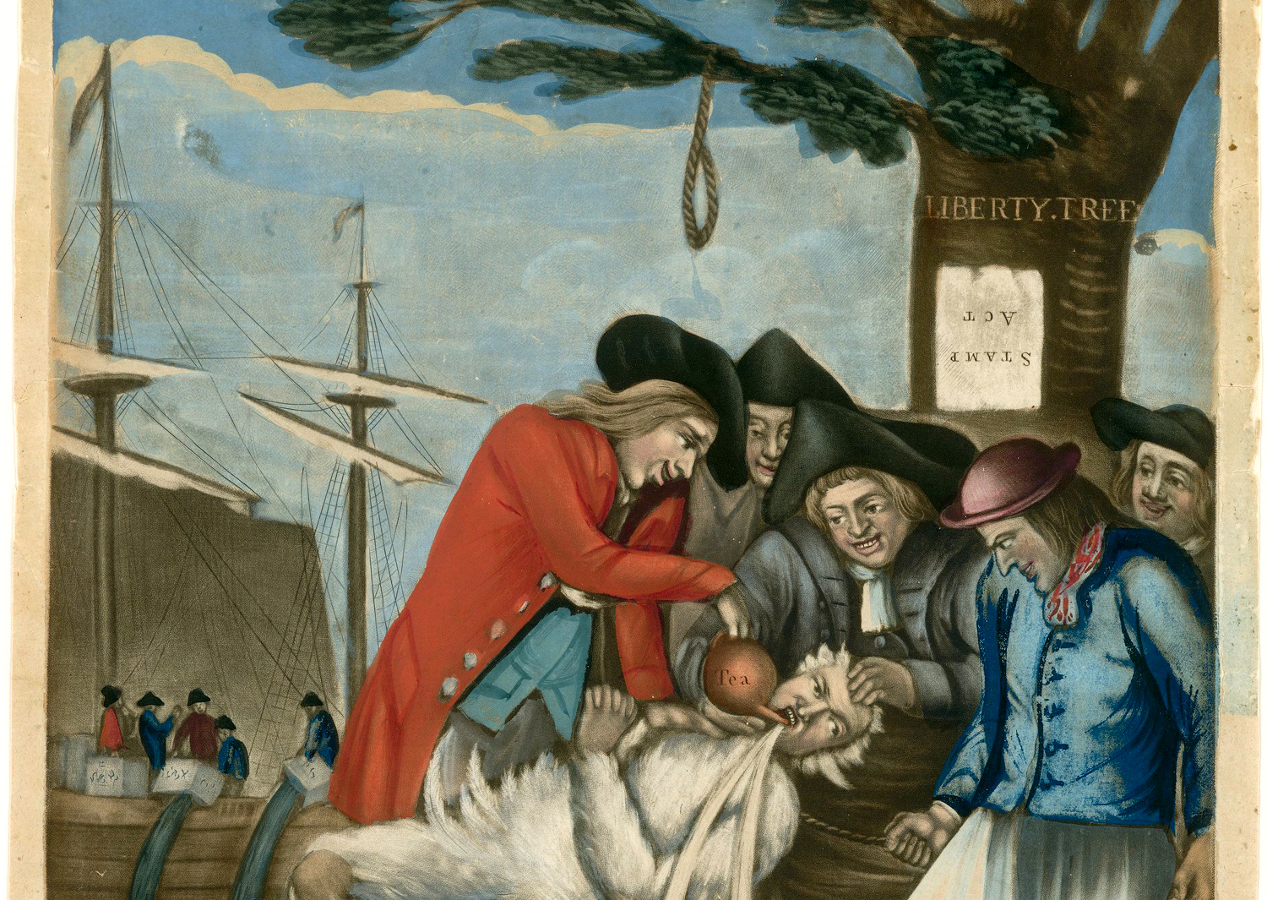
Sons of Liberty
In Massachusetts, merchants and dockworkers formed the Sons of Liberty in anticipation of fending off British tax collectors and enforcement.
The Sons of Liberty instigated riots, destroyed property, and attacked colonial officials in Boston
What was originally organized in Boston by a local brewer turned politician, Samuel Adams, quickly snowballed into a larger network of resistance to the British Crown.
What similarities/differences do you see between the Stamp Act Congress and the Sons of Liberty?
Notes:
Extra Resources:
"Tarring and Feathering" article https://www.battlefields.org/learn/articles/tarring-and-feathering
The Sons of Liberty
The Sons of Liberty was a secret underground society created due to the social and political fallout of the French and Indian War. Because the British, quite literally, found a way to tax almost every aspect of colonial life, the Sons of Liberty instigated riots throughout Boston, Massachusetts. Once the Stamp Act had passed, a secret group called the Loyal Nine, the precursor to the Sons of Liberty, gathered crowds around the famous Liberty Tree in Boston. These riots targeted the taxable goods and the tax collectors, which put many colonial officials at risk of being tarred and feathered or even killed. The rioters also destroyed an immeasurable amount of property. The Loyal Nine, having sparked resistance, turned to publishing patriotic ideas in the Boston Gazette. Eventually, the Loyal Nine began signing their political dissent as ‘The Sons of Liberty’ thus establishing a much larger resistance group. What was originally organized in Boston by a local brewer turned politician, Samuel Adams, quickly snowballed into a larger network of resistance to the British Crown. With the coordination of various Sons of Liberty chapters, the Stamp Act was repealed within one year of it being enacted.
Possible discussion question: what similarities and differences do you see between the Stamp Act Congress and the Sons of Liberty?
Photo source: John Carter Brown Library, Brown University, https://allthingsliberty.com/2019/12/the-sons-of-liberty-and-mob-terror/

Slide 8
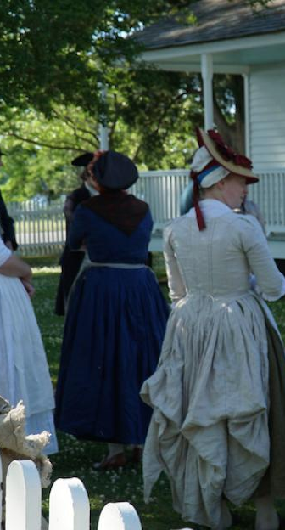
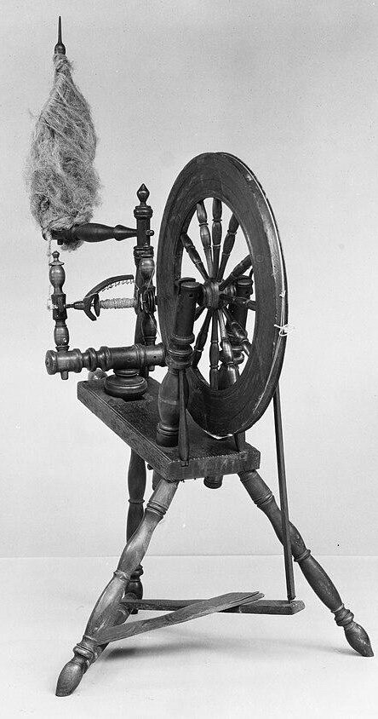
“With ladies on our side, we can make every Tory tremble.”
Women formed the Daughters of Liberty in 1766 to formalize their political agency during the Stamp Act crisis.
  Often supported the Sons of Liberty
Popularized the idea of boycotting stamps and taxed goods
  Lead to the repeal of the Stamp Act
In response to the Townshend Acts, the Daughters of Liberty organized wide-spread nonimportant movements, encouraging women and men to sign nonimportation agreements and circular letters.
Gave women a political arena in which to support patriotic movements without necessarily stepping outside of their normal gender roles.
"Spinning bees" to make their own clothes and boycott British imports
Notes:
Extra Resources:
"The Daughters of Liberty" article https://www.battlefields.org/learn/articles/daughters-liberty
The Daughters of Liberty
Women formed the Daughters of Liberty in 1766 to formalize their political agency during the Stamp Act crisis. They often provided support to the Sons of Liberty. The Stamp Act (1765) placed a tax on cards and dice, as well as mortgages and deeds, wills, newspapers, and pamphlets which women purchased. The Stamp Act also placed taxes on liquor licenses—women being many of the tavern owners in the colonies. The Daughters of Liberty popularized the idea of boycotting the stamps and taxed goods, effectively leading to the repeal of the Stamp Act altogether. Importantly, the Daughters of Liberty gave women a political arena in which to support patriotic movements without necessarily stepping outside of their normal gender roles. Women could translate traditional activities like into decidedly political ones which were widely celebrated and nonthreatening to the status quo. In addition to spinning and boycotting tea, by their dress, consumption, and purchasing power, women could translate their participation in the local and global economies into political action. Some Daughters of Liberty expressed that they “would not even admit the addresses of any gentlemen” who did not also oppose British taxation without representation. Though most active in New England on the eve of the Revolution in the late 1760s, the activities of the Daughters of Liberty set the stage for women’s political involvement and agency during the American Revolution, providing a solid foundation for more women to support the patriot cause in socially acceptable ways.
Possible discussion question: in what ways did the Daughters of Liberty change the way women participated in politics?
Photo source: Spinning wheel https://www.metmuseum.org/art/collection/search/7748

Slide 9
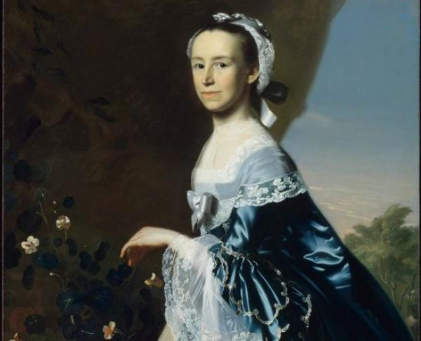
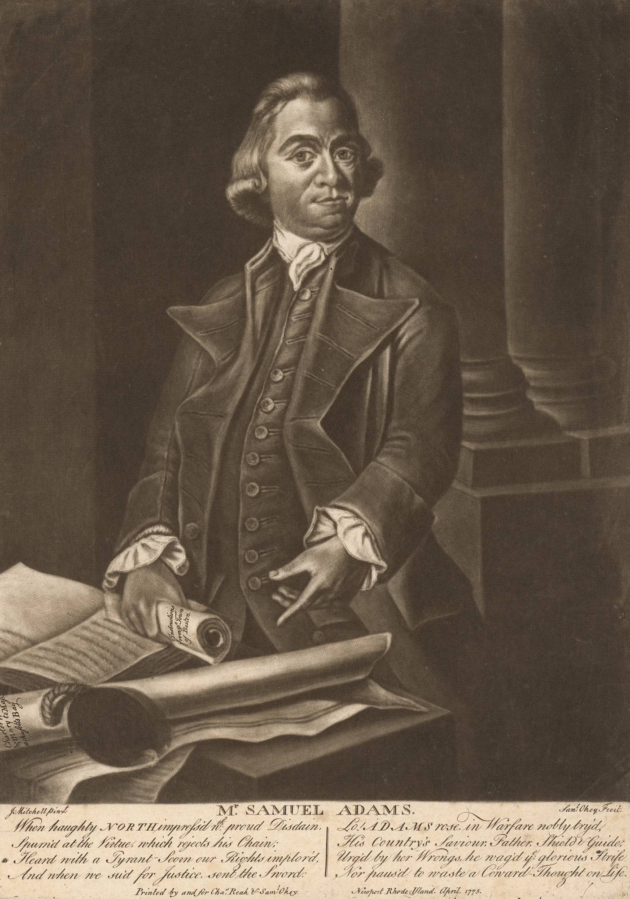
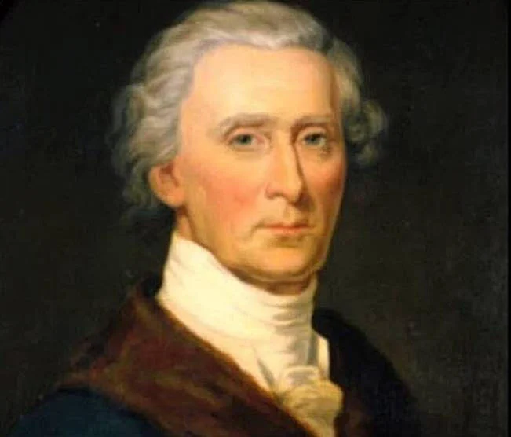
Notable People
Mercy Otis Warren
Samuel Adams
Hercules Mulligan
Notes:
Extra Resources:
Mercy Otis Warren biography https://www.battlefields.org/learn/biographies/mercy-otis-warren
Samuel Adams biography https://www.battlefields.org/learn/biographies/samuel-adams
Hercules Mulligan biography https://www.battlefields.org/learn/biographies/hercules-mulligan
Mercy Otis Warren
Warren was born on September 14, 1728, in West Barnstable, Massachusetts as the first daughter and third of thirteen children of prominent parents. As a young woman, Mercy learned all the subjects available to women in colonial-era America that women were expected to learn. When Mercy turned nine, with her father’s permission, she began to attend classes with her brothers. A merchant and farmer with similar ideals, Mercy married James Warren on November 14, 1754. He would eventually become sheriff, a member of the Massachusetts House of Representatives, and Speaker of the House of the Massachusetts Provincial Congress, allowing Mercy access into the politics of the Revolution. Mercy was well attuned to the changing political climate as the revolution drew near. Mercy corresponded with several notable revolutionaries including George and Martha Washington, Abigail and John Adams, Hannah Winthrop, Patrick Henry, and Catharine Macaulay to which she wrote regularly. In one letter, she wrote, “every domestic enjoyment depends on the unimpaired possession of civil and religious liberty.”
In 1814, Mercy Otis Warren died at age eighty-six in her home in Plymouth, Massachusetts, and is buried at Burial Hill Cemetery. In an era where women were not able to be at the forefront of politics and public action, she broke through the barriers with her publications. These publications reflected her beliefs and political ideologies and inspired others to join the cause of the Revolution. They cemented her place in history as she was one of the first women to publish a nonfiction history of the American Revolution under her own name, as well as the third woman to publish a book of poetry. Her efforts established a precedent for forwarding female thinking that women would continue to follow for centuries.
Samuel Adams
Born as the son of a church deacon in 1722, Samuel Adams understood from a young age the authority private citizens could hold over politics once properly mobilized. Adams acquired something of a historical reputation—in his own time no less—as a rabble-rouser and propagandist for the independence movement, especially in comparison to his second cousin John, the future president. At the age of fourteen, Adams entered Harvard, ostensibly to study theology and later take up his father's career, but life in college also exposed him to the ideas of the Enlightenment philosophers like John Locke, who held that certain rights and liberties were inherent to humanity, and that government should reflect that truth. He took up a public writing career very early on as a public writer.
Adams' real first foray of active resistance came in 1773, when Parliament passed the Tea Act. In response, an enormous group of disgruntled townsfolk gathered in Boston's Old South Meeting House, where Adams began organizing vigilante groups charged with preventing the tea shipments from ever reaching the docks. According to him in a letter to one Arthur Lee, these meetings were "conducted with decency, unanimity, and spirit." One of these groups, about 100 strong, decided to take even further action by dressing up as Mohawk warriors, sneaking aboard the ships and then dumping the tea into Boston Harbor, an act which became the famous Boston Tea Party. Similar events also occurred in Philadelphia and Annapolis. It is difficult to assess if Adams was personally involved in the protest, but he certainly celebrated it immediately afterwards, writing, "Our Enemies must acknowledge that these people have acted upon pure and upright Principle."
As tensions between Britain and the colonies spilled over into armed rebellion, Adams remained on the forefront of political affairs. As a delegate to the Continental Congress, Adams acted as both a signer of the Declaration of Independence as well as a framer of the Articles of Confederation, the governing laws of America before the Constitution. After the war, Adams went home to Boston and again flirted between business, writing and politics as a career. After serving as Lieutenant, then Acting Governor for John Hancock, Adams was elected 4th Governor of Massachusetts in 1794. Though elected for four years, he decided to retire early in '97 on account of his health, which also caused the end of his writing career. Samuel Adams passed away in 1803 and remains to this day in the Granary Burying Ground in Boston.
Hercules Mulligan
Born in 1740 in Coleraine Ireland, he emigrated to New York City with his family at six years old. Quite irrespective of his wife’s British background, Mulligan was a staunch patriot. During the 1770s, Mulligan lived with his close friend Alexander Hamilton and was able to impart some of his flag-waving notions onto the young scholar. In 1774, Mulligan became a tailor and opened a storefront in New York that was frequented by the upper echelons of society. Even high-ranking British officers became regulars at his shop. Successful enough to afford assistance, Mulligan instead preferred to work personally with each of his clients, cultivating genuine relationships with both Americans and Brtitish alike. Despite fraternizing with British officers, the young patriot ensconced himself in treasonous affairs. He was one of the first colonists to join the Sons of Liberty.
When war broke out in 1775, Hercules Mulligan did his part to help the cause. Still in New York, he joined a volunteer militia that stole British cannons and helped lead the Sons of Liberty tear down a statue of King George III in Bowling Green. Once Washington retreated from New York, however, Mulligan was forced to remain in the city and return to his clothing emporium. Mulligan was invited to be a spy for the Continental Army. Throughout the war, Mulligan performed his new role perfectly. By outfitting verbose British officers, appealing to their egos, and asking the right questions, Mulligan gained valuable insight into the enemy’s movements. He could oftentimes deduce the British Army’s next move by inquiring when the officers needed their uniforms back. After gaining such intelligence, Mulligan dispatched his slave, Cato, to ride out to Washington’s headquarters with the news. In 1785, Mulligan continued to fight for democratic ideals and co-founded the New York Manumission Society. He died in 1825 at age 80 and is buried next to Alexander Hamilton in Trinity Church.
Possible discussion question: compare and contrast the ways in these three people were activists for independence.
Photo sources:
Samuel Adams: https://npg.si.edu/object/npg_NPG.76.9?destination=node/63231%3Fedan_q%3Dsamuel%2520adams
Hercules Mulligan: https://allthatsinteresting.com/hercules-mulligan

Slide 10
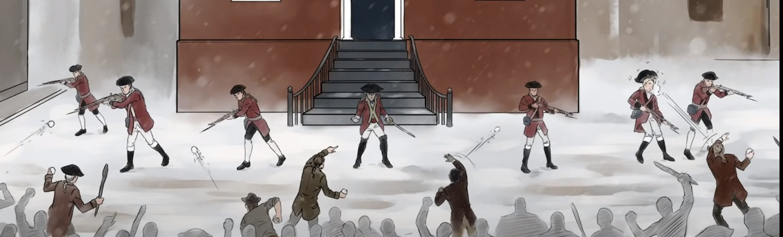
Boston Massacre
In October of 1768, British soldiers arrived in Boston to preserve the peace, which enraged colonists, who now felt they were being occupied by a foreign army.
British soldiers faced numerous insults and taunting. Fights became commonplace.
One altercation between a provocative civilian and a British sentry caused a large mob of 300-400 people to gather, as well as seven British soldiers coming to the rescue.
At one point a club or stick was thrown at the soldiers and struck one of the British soldiers. The soldier fell to the ground. He stood back up, shouted, and fired his musket into the crowd.
The other British soldiers fired into the crowd. Eleven people were hit, five men were killed and six were wounded.
April 18, 1775
Notes:
Extra Resources:
"The Boston Massacre" article https://www.battlefields.org/learn/articles/boston-massacre
"The British Army in Boston" article https://www.battlefields.org/learn/articles/british-army-boston
"Who Was Crispus Attucks?" video https://youtu.be/3CmSQqrqyBk
The Boston Massacre marked the moment when political tensions between British soldiers and American colonists turned deadly. Patriots argued the event was the massacre of civilians perpetrated by the British Army, while loyalists argued that it was an unfortunate accident, the result of self-defense of the British soldiers from a threatening and dangerous mob. Regardless of what actually happened, the event fanned the flames of political discord and ignited a series of events that would eventually lead to American independence. John Adams believed that “on that night, the foundation of American independence was laid.”
In an attempt to use an excessive amount of force to crack down on these upstart colonials, Great Britain passed the Townshend Acts in 1767 and dispatched the British Army to restore order in Boston. On October 1, 1768, the British fleet arrived, and hundreds of British soldiers marched into the hostile city. Rather than restore order, this maneuver proved to only worsen relations between the British and Americans. The presence of British regular troops in the streets of Boston enraged colonists, who now felt they were being occupied by a foreign army. British soldiers faced numerous insults and taunting as they patrolled the streets. Angry mobs would frequently protest British soldiers or American loyalists who supported the British policies. Private Hugh White of the 29th Regiment of Foot took up a sentry post outside of the Customs House on King Street, the symbolic center of British taxation. A protesting colonist and Private White engaged in a heated conversation and then Private White swung his musket at Garrick, hitting him on the side of the head. Word traveled through the streets about the altercation and a large mob began to descend on the lone British sentry at the Custom House. Seven British soldiers marched to the sentry’s defense with fixed bayonets. As the nine British soldiers stood guard near the steps to the Custom House, passions enflamed and dozens of more people joined the crowd surrounding the soldiers. Bells began ringing in the city and more people came out of their homes and into the streets. The crowd was estimated to have grown to as many as 300 or 400 people. They were yelling at the British soldiers and throwing rocks, paddles, and snowballs. Preston’s men loaded their muskets in front of the crowd. The crowd became angrier and angrier. At one point a club or stick was thrown at the soldiers and struck one of the British soldiers. The soldier fell to the ground. He stood back up and yelled, “Damn you, fire!” and fired his musket into the crowd. The musket ball struck Attucks who fell dead to the ground. A few seconds later, the other British soldiers fired into the crowd. Eleven people were hit, five men were killed and six were wounded. After the smoke cleared, Preston ordered his men to cease fire and called out dozens of soldiers to defend the Custom House.
Possible discussion question: What does the Boston Massacre's uncertain start teach us about the importance of examining multiple perspectives in history?

Slide 11
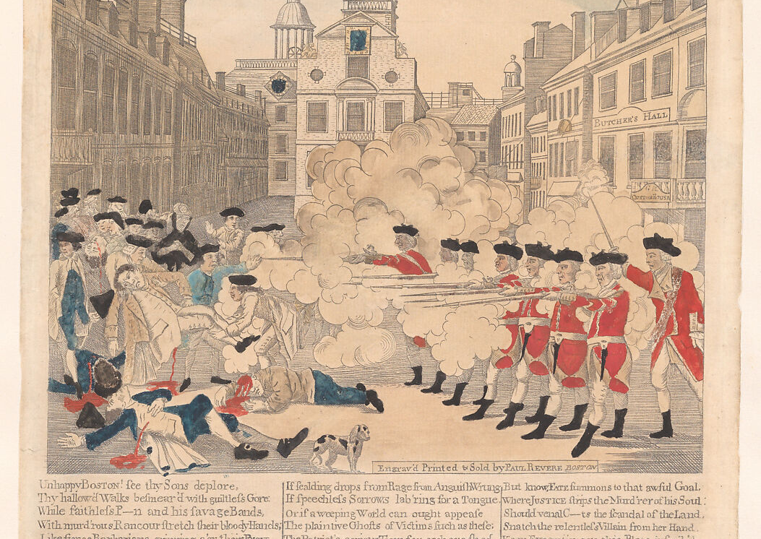
Reactions
Royal governor Thomas Hutchinson promised justice for what had just occurred.
The next day, the soldiers involved were arrested and sent to trial for murder.
Patriot Paul Revere made an engraving based on an illustration by Henry Pelham of the event and labeled it, “The Bloody Massacre.” This provocative image outraged many colonists as the event soon became known as a massacre.
How could images and newspapers affect public opinion? Is it the same today?
Notes:
Extra Resources:
"Thomas Hutchinson: Governor of a Rebellious Colony" In 4 Minutes video https://www.youtube.com/watch?v=7V4qGVNMaWs
Most of the crowd of civilians left the area immediately around the soldiers as others ran to help the wounded. American blood had been spilled at the hands of British soldiers for the first time. Royal governor Thomas Hutchison arrived on the scene and calmed the anxious and angry colonists and promised justice for what had just occurred. The next day Preston and the eight soldiers involved were arrested and sent to trial for murder. Following the event, patriot Paul Revere made an engraving based on an illustration by Henry Pelham of the event and labeled it with the provocative title: “The Bloody Massacre.” The image depicted a line of British soldiers firing in unison on an unarmed crowd in front of the State House. This incendiary image outraged many colonists as the event soon became known as a massacre. Broadsides depicting black coffins for the men killed in the incident appeared in newspapers. The funerals for these victims became large public events where patriots displayed their anger at the occupying soldiers.
Possible discussion question: how could images and newspapers affect public opinion? Is it the same today?
Photo source: https://www.metmuseum.org/art/collection/search/365208

Slide 12
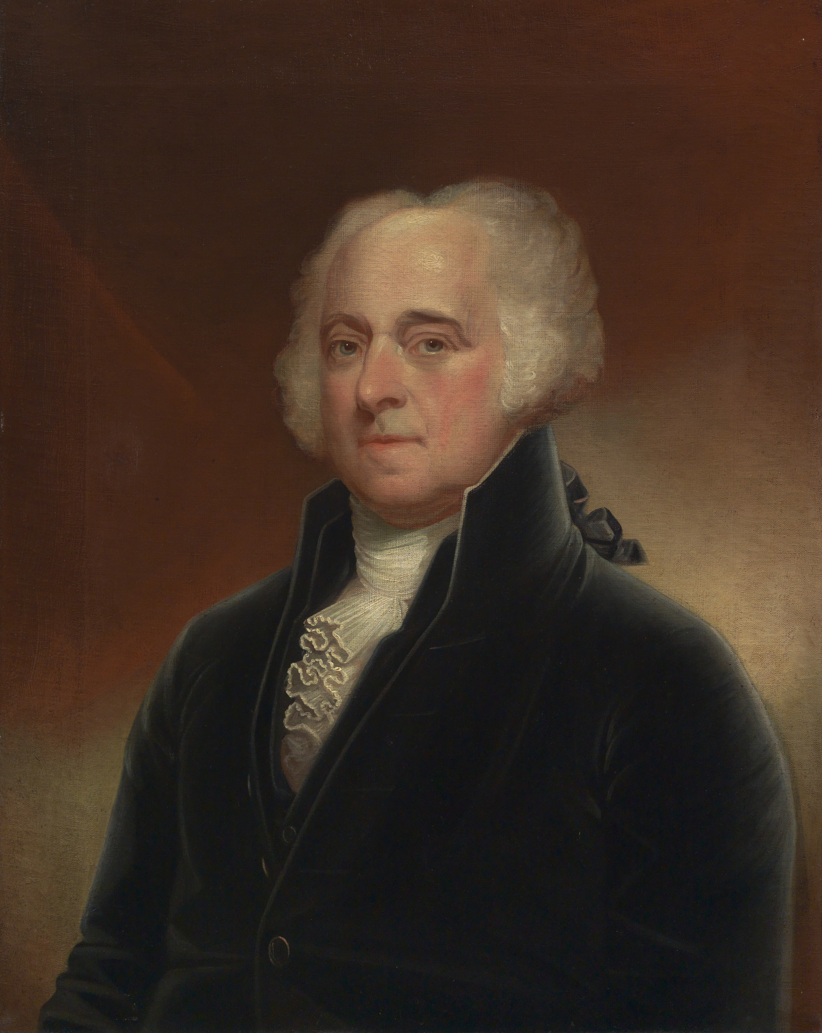
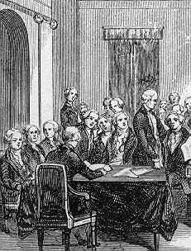
Patriot Defending the British?
John Adams agreed to defend the British soldiers, even though he was a patriot
Despite the public backlash to his defense of the British soldiers, Adams believed it was important to show the British that a fair trial could be held in the colony of Massachusetts, despite the inflamed passions.
After a heated trial, Adams was ultimately victorious in showing the British soldiers were not at fault and had acted in self-defense.
Six soldiers were found not guilty and two were found guilty of the lesser charge of manslaughter.
Bio text
Notes:
Extra Resources:
John Adams biography https://www.battlefields.org/learn/biographies/john-adams
The HBO series John Adams depicts the courtroom scene in which John Adams defends the British.
-John agreeing to take the case https://youtu.be/WRMiTZh6fFg
-Court room scene 1 https://youtu.be/FcM42ZF48lY
-Court room scene 2 https://youtu.be/WRMiTZh6fFg
-Court room scene 3 https://youtu.be/abhKlCqkuVs
-Court room scene 4 https://youtu.be/5oALm4kVWZQ
As public sentiment against the British soldiers grew, Massachusetts placed the soldiers on trial for murder. It became very difficult to find someone who would be willing to publicly defend the British soldiers. Then patriot John Adams agreed to defend them. Despite the public backlash to his defense of the British soldiers, Adams believed it was important to show the British that a fair trial could be held in the colony of Massachusetts, despite the inflamed passions. After a heated trial, Adams was ultimately victorious in showing the British soldiers were not at fault and had acted in self-defense. Six soldiers were found not guilty and two were found guilty of the lesser charge of manslaughter.
Possible discussion question: What were the positives/negatives to John Adams defending the British soldiers in court?
Photo sources:
John Adams photo: https://npg.si.edu/object/npg_NPG.71.4?destination=node/63231%3Fedan_q%3Djohn%2520adams]
Trial: https://www.famous-trials.com/massacre/198-images

Slide 13
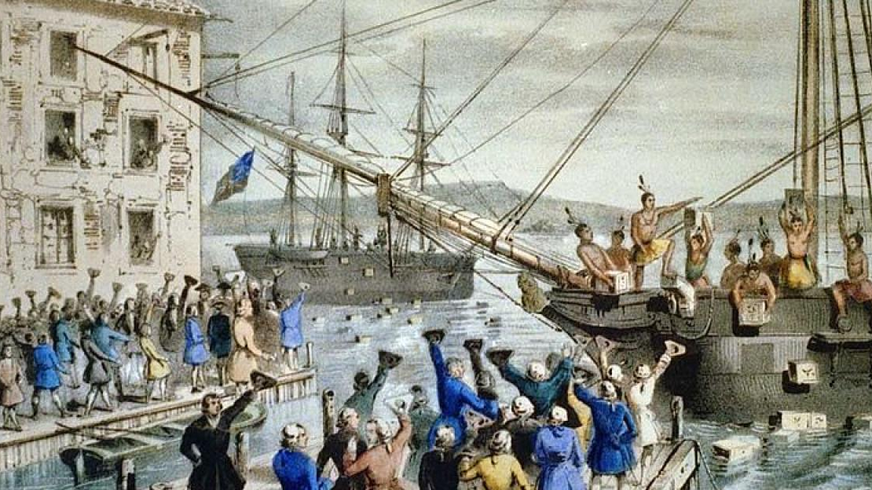
Looking Forward
The Stamp Act was repealed on March 18, 1766, one year later.
With the Tea Act, passed by Parliament on May 10, 1773, Great Britain granted the British East India Company a monopoly on tea sold in the Colonies.
In response to the Tea Act, a group of Bostonians dumped hundreds of crates of British tea on December 16, 1773, into Boston Harbor, rather than pay taxes on them.
Britain reacted by passing the Coercive Acts.
Notes:
Extra Resources:
"Parliament – An Act Repealing the Stamp Act; March 18, 1766" primary source https://www.battlefields.org/learn/primary-sources/parliament-act-repealing-stamp-act-march-18-1766
"The Colonial Responses to the Intolerable Acts" article https://www.battlefields.org/learn/articles/colonial-responses-intolerable-acts
Possible discussion question: how did the colonial response to the Stamp Act affect future responses to different British parliamentary actions?
Photo source: "The Destruction of Tea at Boston Harbor" lithograph

Slide 14
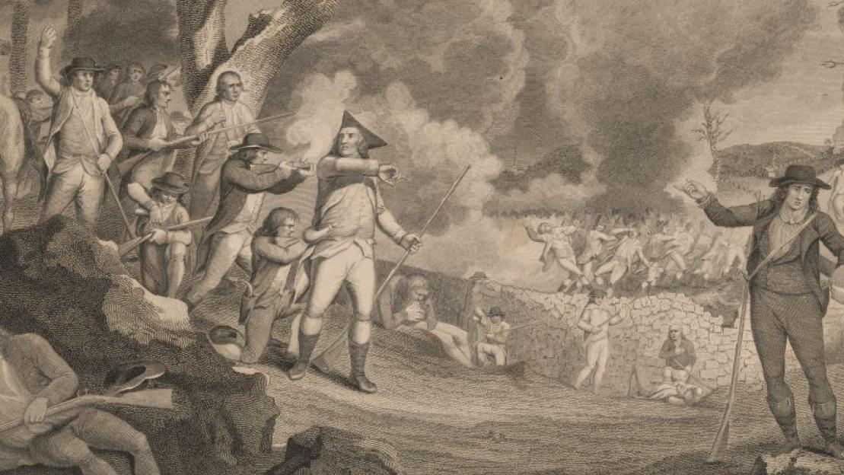
Conflicting Ideas
Between 1763-1770, taxation on goods, British troops stationed in Boston, and impeding British authority on colonial autonomy strained the relationship between the Crown and the colonists.
What do these conflicts reveal about the differences in "American" and British governmental values?
Notes:
Reinforce the overall theme that from 1763 to 1770, the main three causes of colonial-British disputes were taxation, troops, and autonomy.
Possible discussion question: What do these conflicts reveal about the differences in "American" and British governmental values?
Possible discussion question: what do you think "autonomy" means? Why was it important to the revolutionary cause and to the colonists themselves?

