Slide 1
Revolutionary War
Soldiers

Slide 2
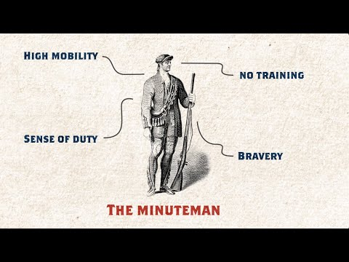
The Revolutionary War
Notes:
This slide offers a quick video overview of the concept of Citizen Soldier.
The Revolutionay War started on April 19, 1775 with the Battles of Lexington and Concord in Massachusetts. The Siege of Yorktown in Virginia in 1781 was a major defeat for the British and led to the Treaty of Paris which officially ended the war in 1783.
Prior to the Revolutionary War, 13 American colonies belonged to Britian. INSERT LINK TO 13 COLONIES ARTICLE THAT IS WAITING TO BE PUBLISHED. Taxation without representation in the British Parliament was one of the many causes of conflict between the colonies and the Britian. After various appeals and attempts at reconciliation without success, and the American colonies united and rebelled, seeking liberty.
At the end of the Revolutionary War, the American colonies won their independence from Britian and became the first 13 states of the United States. The Declaration of Independence backed with the American victory led to the formation of the United States of America.
Also see our "What is a Minuteman? article. https://www.battlefields.org/learn/articles/what-minuteman

Slide 3
ESSENTIAL QUESTION
What was it like to be a soldier during the Revolutionary War?
Notes:
This question sets the tone for today's lesson. The next few slides will provide information, then the uniform items can be explore either on the slides or from the Traveling Trunk.

Slide 4
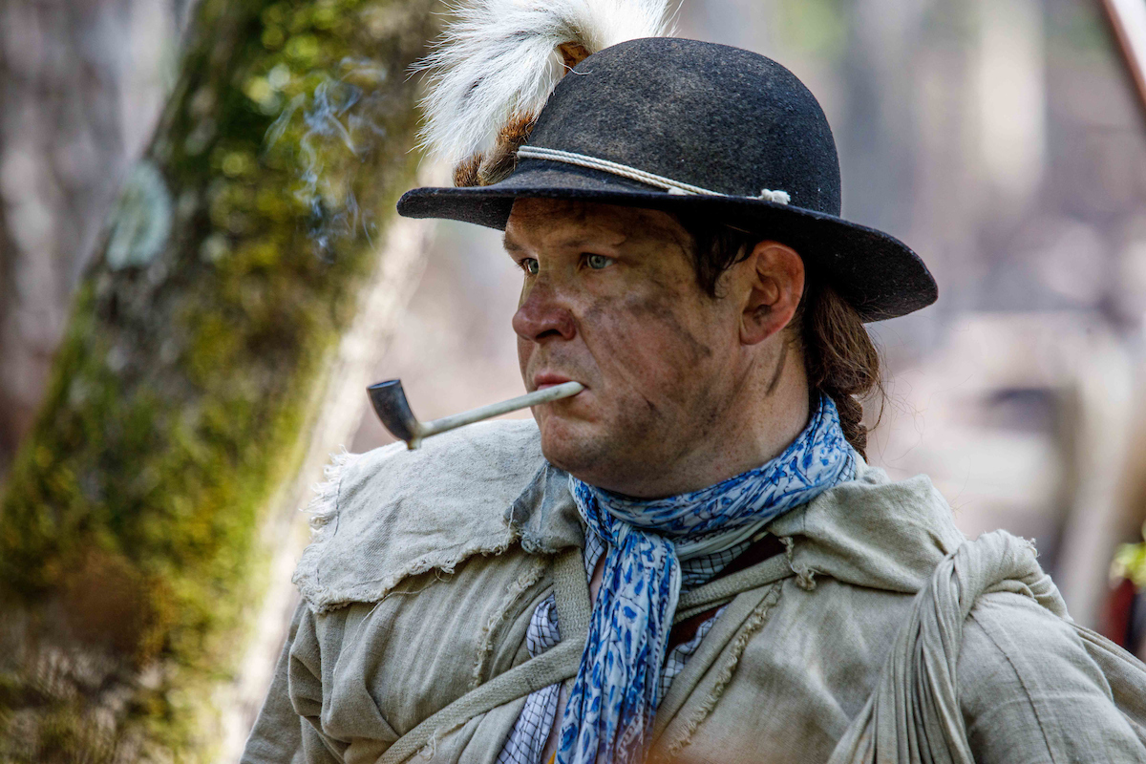
Recruiting Soldiers
State Militias – men enlisted and served for a short period of time. Militiamen had to bring their own weapons and equipment.
Continental Army – after 1776, some men joined General George Washington's army. They enlisted for 3 years or the duration of the war. These soldiers received monthly pay ($6.67 per month), uniforms, weapons, an enlistment bonus, and a parcel of land.
Most American soldiers during the Revolutionary War were between the ages of 16 and 60.
Notes:
You can utilize the "Militia, Minutemen, and Continentals: The American Military Force in the American Revolution," article
https://www.battlefields.org/learn/articles/militia-minutemen-and-continentals-american-military-force-american-revolution

Slide 5
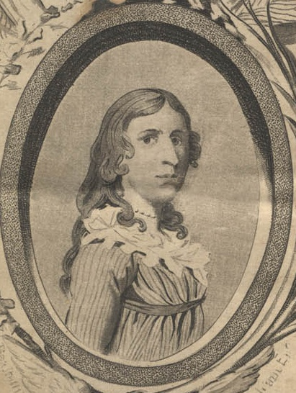
Female Soldiers?
Girls and women were not supposed to enlist as soldiers in the Revolutionary War armies...but a few did.
Deborah Sampson (pictured in female clothes) disguised herself in a uniform, enlisted, fought in numerous battles, was wounded, and eventually honorably discharged from military service. She called herself Robert Shurtleff while in the army and later received a pension.
Notes:
Biography of Deborah Sampson, https://www.battlefields.org/learn/biographies/deborah-sampson
Learn more about "Women in War" https://www.battlefields.org/learn/topics/women-war

Slide 6
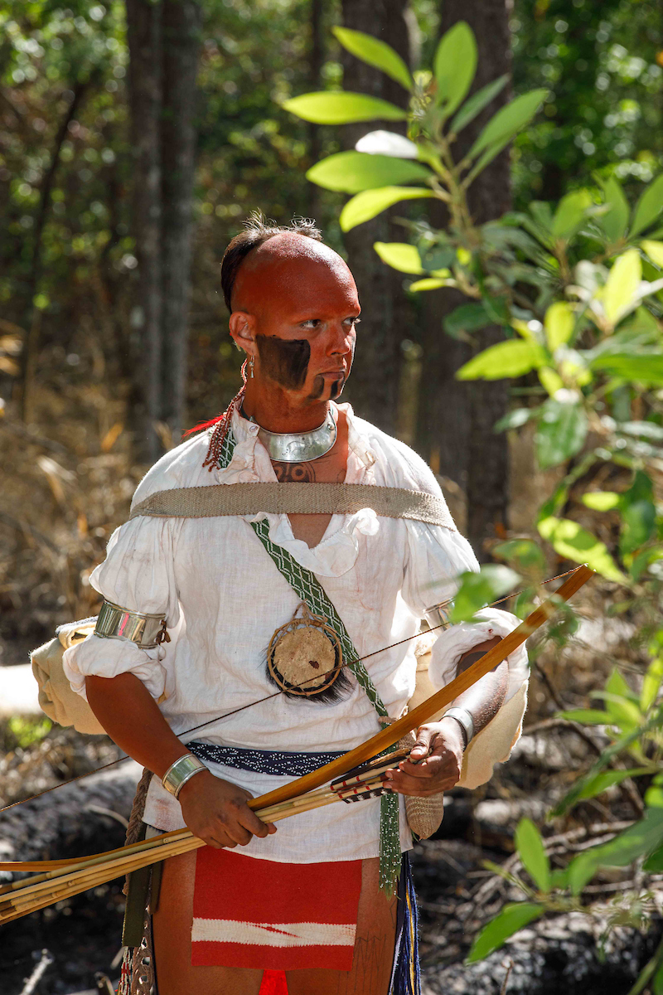
Native American Warriors
In some regions, Native American tribes chose to take part in the Revolutionary War.
Some joined the British while others sided with the Patriots.
Notes:
Students can read on their own, or you can discuss as a class, "10 Facts About Native Americans," https://www.battlefields.org/learn/articles/10-facts-native-americans
For additional information, utilize out Native American education hub. https://www.battlefields.org/learn/topics/here-from-the-start

Slide 7
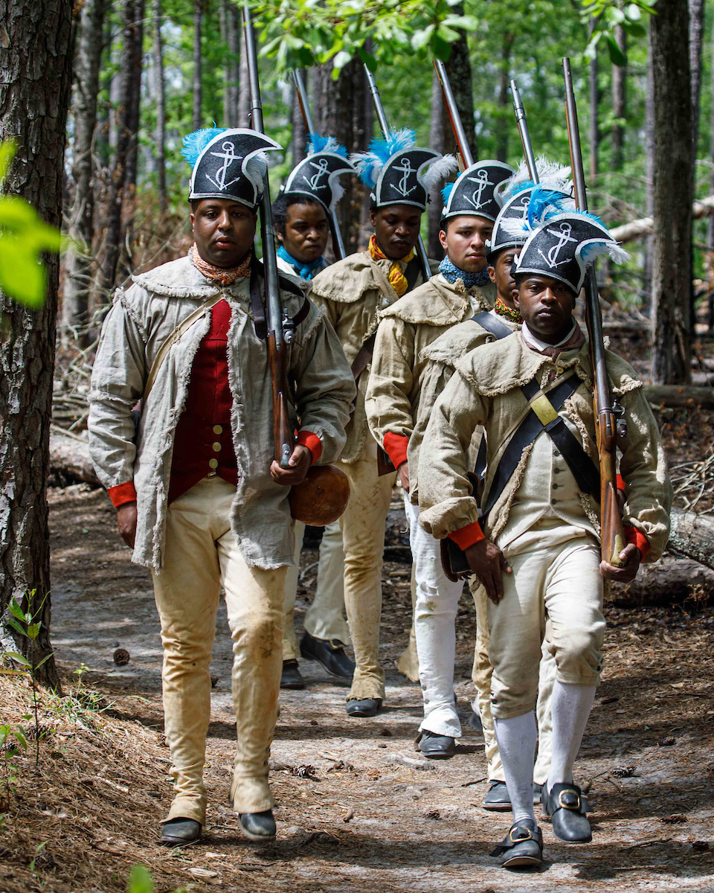
Marches
Most Revolutionary War soldiers marched on foot from battle to battle or camp to camp.
On the march, they hoped their shoes and clothing did not wear out.
They had to carry their gun and other weapons. And their personal items were carried in a knapsack.
Notes:
The Continental Army was an integrated army. Mixed units of white, Native American, free and enslaved Black soldiers were not uncommon. As much as 10% of Washington's army at Valley Forge consisted of Black soldiers. This was the last integrated army until the Korean War in the 1950s.
The picture above are reenactors portraying the 1st Rhode Island Regiment. Starting in January of 1777, free and enslaved Blacks joined the unit. While this is arguably the most famous of all the integrated units, it was not the only integrated unit, nor was it the first.
https://www.battlefields.org/learn/articles/african-americans-armed-forces-timeline
https://www.battlefields.org/learn/articles/10-facts-black-patriots-american-revolution

Slide 8
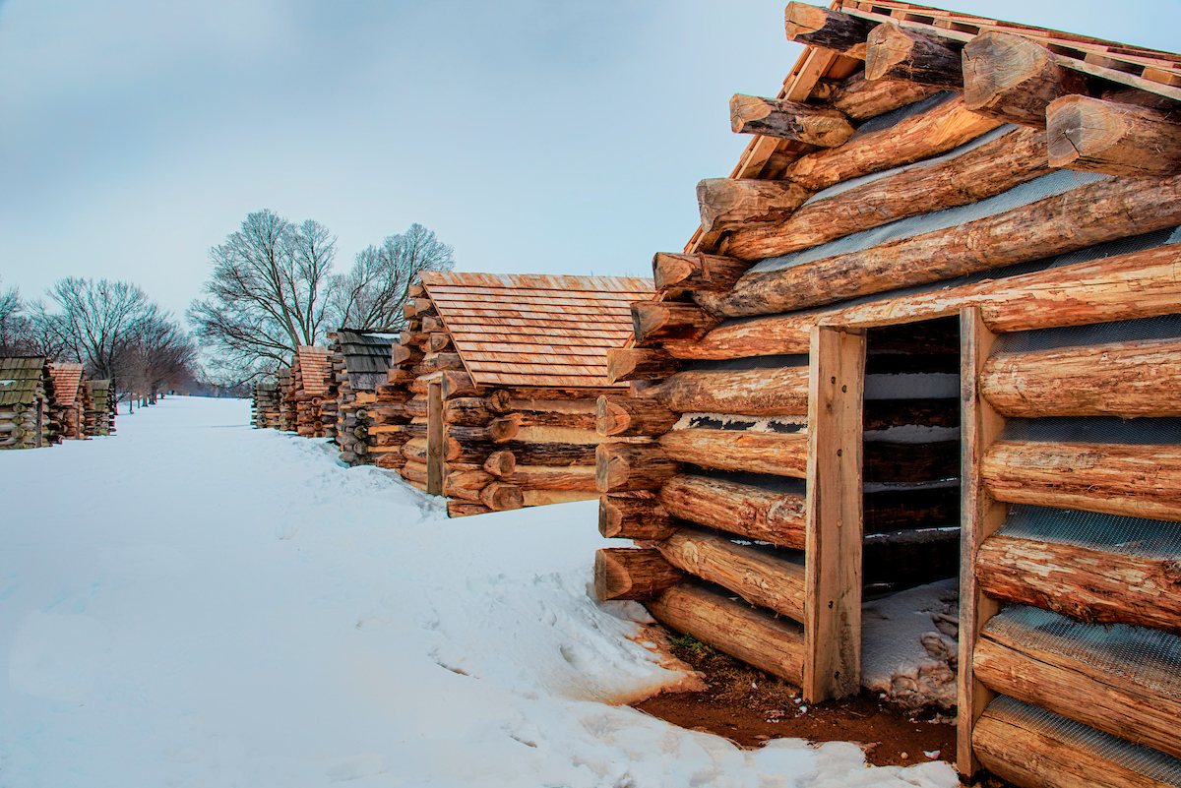
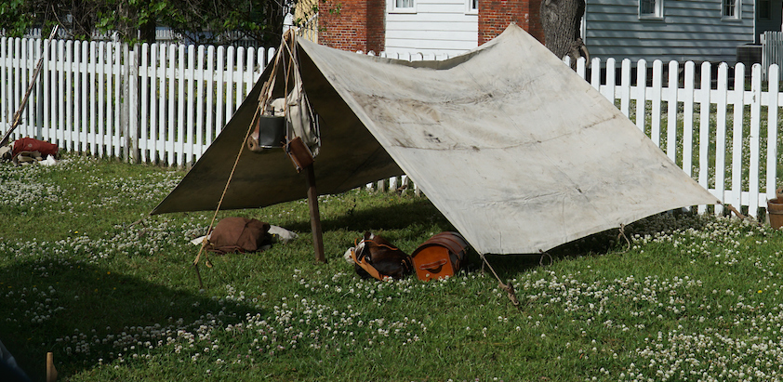
Camps
Photograph by Buddy Secor
Notes:
If the army was moving into more permanent camps, such as during the winter months, they also had to build huts and log houses which became part of their daily life until they were completed. Making sure that temporary campsites, or longer ones like at Valley Forge, did not spread illness and disease, soldiers' daily routine also included keeping the camp and themselves clean. Bathing, acquiring clean linens, shaving, and covering over old sinks (bathroom trenches) and digging new ones were all daily necessities, but some instances depended on supplies available and time to complete.
Extra Resources:
Morristown Winter Encampment (Article) https://www.battlefields.org/learn/articles/morristown-winter-encampment
Valley Forge Encampment (Article) https://www.battlefields.org/learn/articles/valley-forge-encampment
Valley Forge (1 minute Video) https://youtu.be/x3NLLgTVLIA

Slide 9
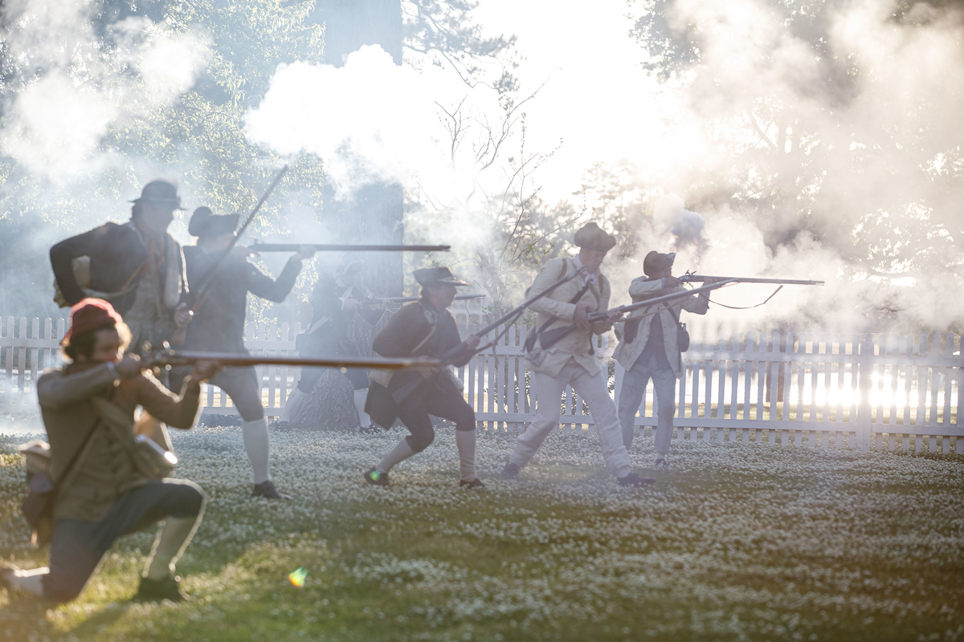
Battles
Lexington & Concord (1775)
Bunker Hill (1775)
Long Island, New York (1776)
Trenton (1776)
Saratoga (1777)
Brandywine (1777)
Charleston (1780)
Camden (1780)
Yorktown (1781)
Notes:
When compared to future American wars, the battles of the Revolutionary War were comparatively small and short engagements. Soldiers spent the vast majority of their time in camps, performing routine duties such as chopping wood, guarding the camp, cooking food, and killing their own boredom.
If time permits, this Animate Map of the Revolutionary gives a good overview of the campaigns and battles (18 minutes): https://youtu.be/0JLvRJzvOic
Extra Resources:
Revolutionary War Timeline: https://www.battlefields.org/learn/articles/american-revolution-timeline
Revolutionary War Strategy (Article): https://www.battlefields.org/learn/articles/revolutionary-war-strategy

Slide 10
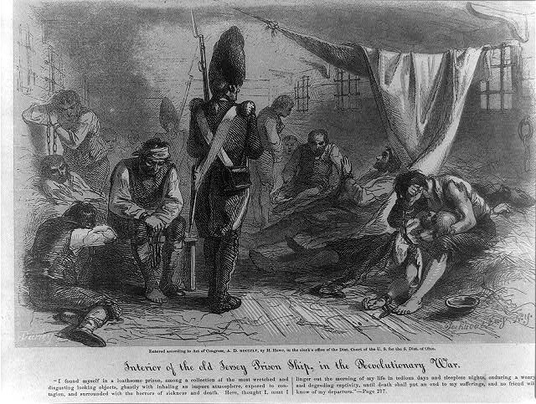
Prisoners of War
Prisoners on both sides during the Revolutionary War had uncertain fates.
The British put some of their prisoners on deadly prison ships (pictured).
Sometimes prisoners were exchanged.
Notes:
Prisoners were treated unevenly during the war. General and high-ranking officers were often invited to dine with prominent enemy soldiers and civilians. They, too, had free reign of cities and were largely housed in private homes or comfortable accommodations. Enlisted men and lower-ranking officers were often treated poorly by their captors. Food rations were poor, accommodations even worse. While prisoner exchanges took place, higher ranking officer tended to be exchanged much more quickly than the common soldier.
Photo Credit: https://commons.wikimedia.org/wiki/File:Interior_HMS_Jersey_1855.jpg
Extra Resources:
ADD CONVENTION ARMY ARTICLE LINK
Chained & Tried: The Fate of Loyalist Prisoners at Kettle Creek (Article): https://www.battlefields.org/learn/articles/chained-and-tried-fate-loyalist-prisoners-kettle-creek

Slide 11
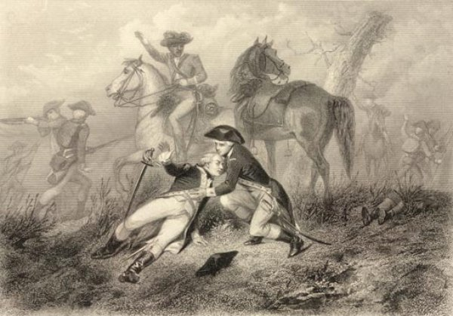
Wounded Soldiers
Many soldiers died of their injuries.
Surgeons tried to treat, operate, and bandage injuries.
Doctors did not understand that germs cause infection and they did not have good medicines or any anesthetics.
Notes:
We are nearly a century removed from the adoption and understanding of germ theory. Disease cost more soldiers their lives than bullets and bayonets. Civilians often assisted wounded soldiers from both sides after a battle. Field hospitals were established after a battle, but these normally consisted of barns, houses, or any other structure that provided shelter. The idea of a hospital as we know it today was vastly different than those of the 18th century.
Photo credit: https://commons.wikimedia.org/wiki/File:Woundedatbrandywine.jpg
Learn more about the medical care of the age.
Medicine in the 1700's (Article): https://www.battlefields.org/learn/articles/medicine-has-scarcely-entered-its-threshold-medicine-1700s

Slide 12
ESSENTIAL QUESTIONS
What did the soldiers need to survive in combat and on the march? What were the uses for each of these items?

Slide 13
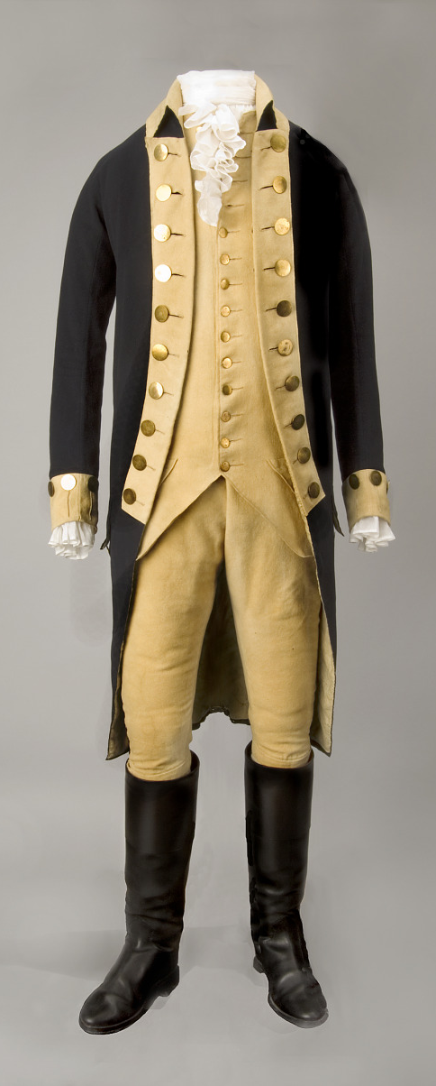
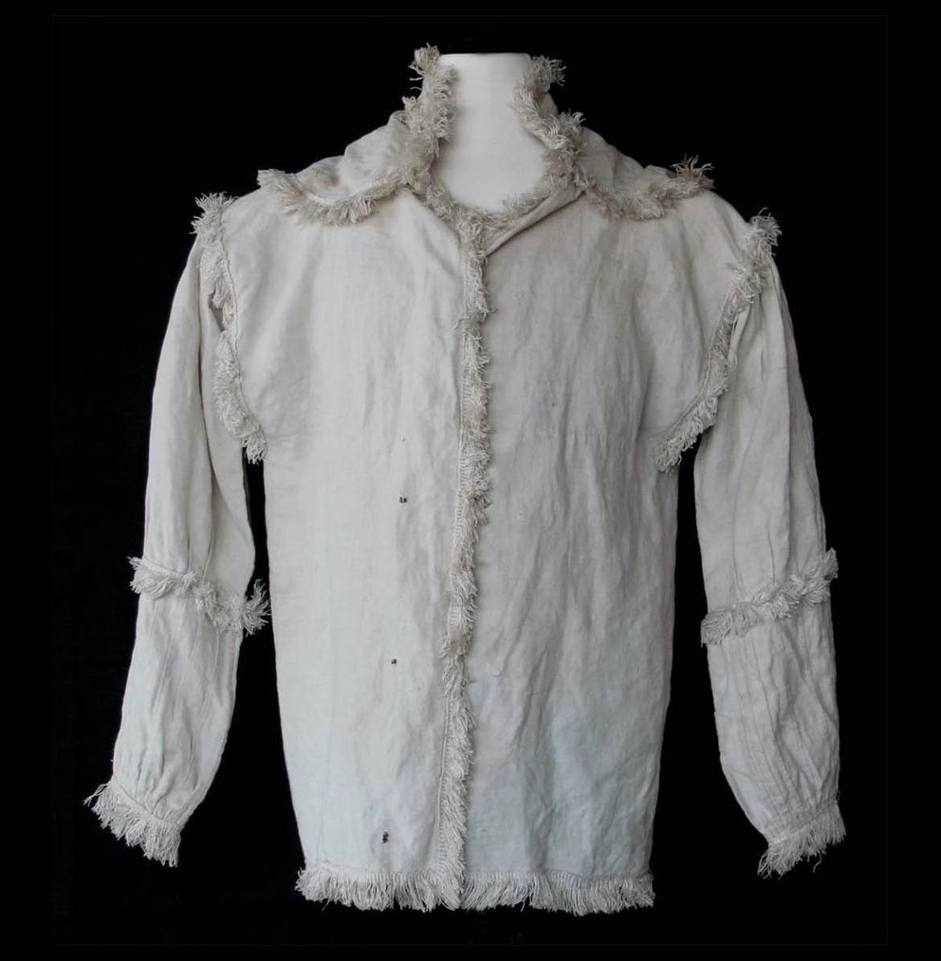
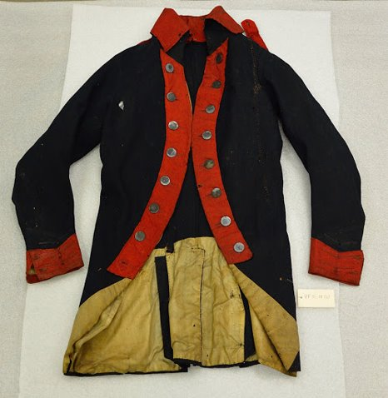
American Uniform Jackets
Notes:
Uniformity in uniforms in the colonial military units varied greatly. Uniform pieces varied from soldier to soldier. Pieces included: hunting shirts, uniform coats, breeches, stockings, overalls, leggings, shoes, and other parts and pieces. The Continental Army tried to create a more standardized uniform which was supposed to provided to the enlisted soldiers. In reality, the uniforms were often delayed and soldiers waited a long time for new clothing.
Left: Hunting Shirt
Middle: Continental Army Uniform
Right: George Washington's Uniform
The State Museum of Pennsylvania, 18 Aug. 2015, statemuseumpa.org/washingtons-army-buttons/
https://www.amrevmuseum.org/collection/linen-hunting-shirt
https://www.si.edu/object/george-washingtons-uniform%3Anmah_434863

Slide 14
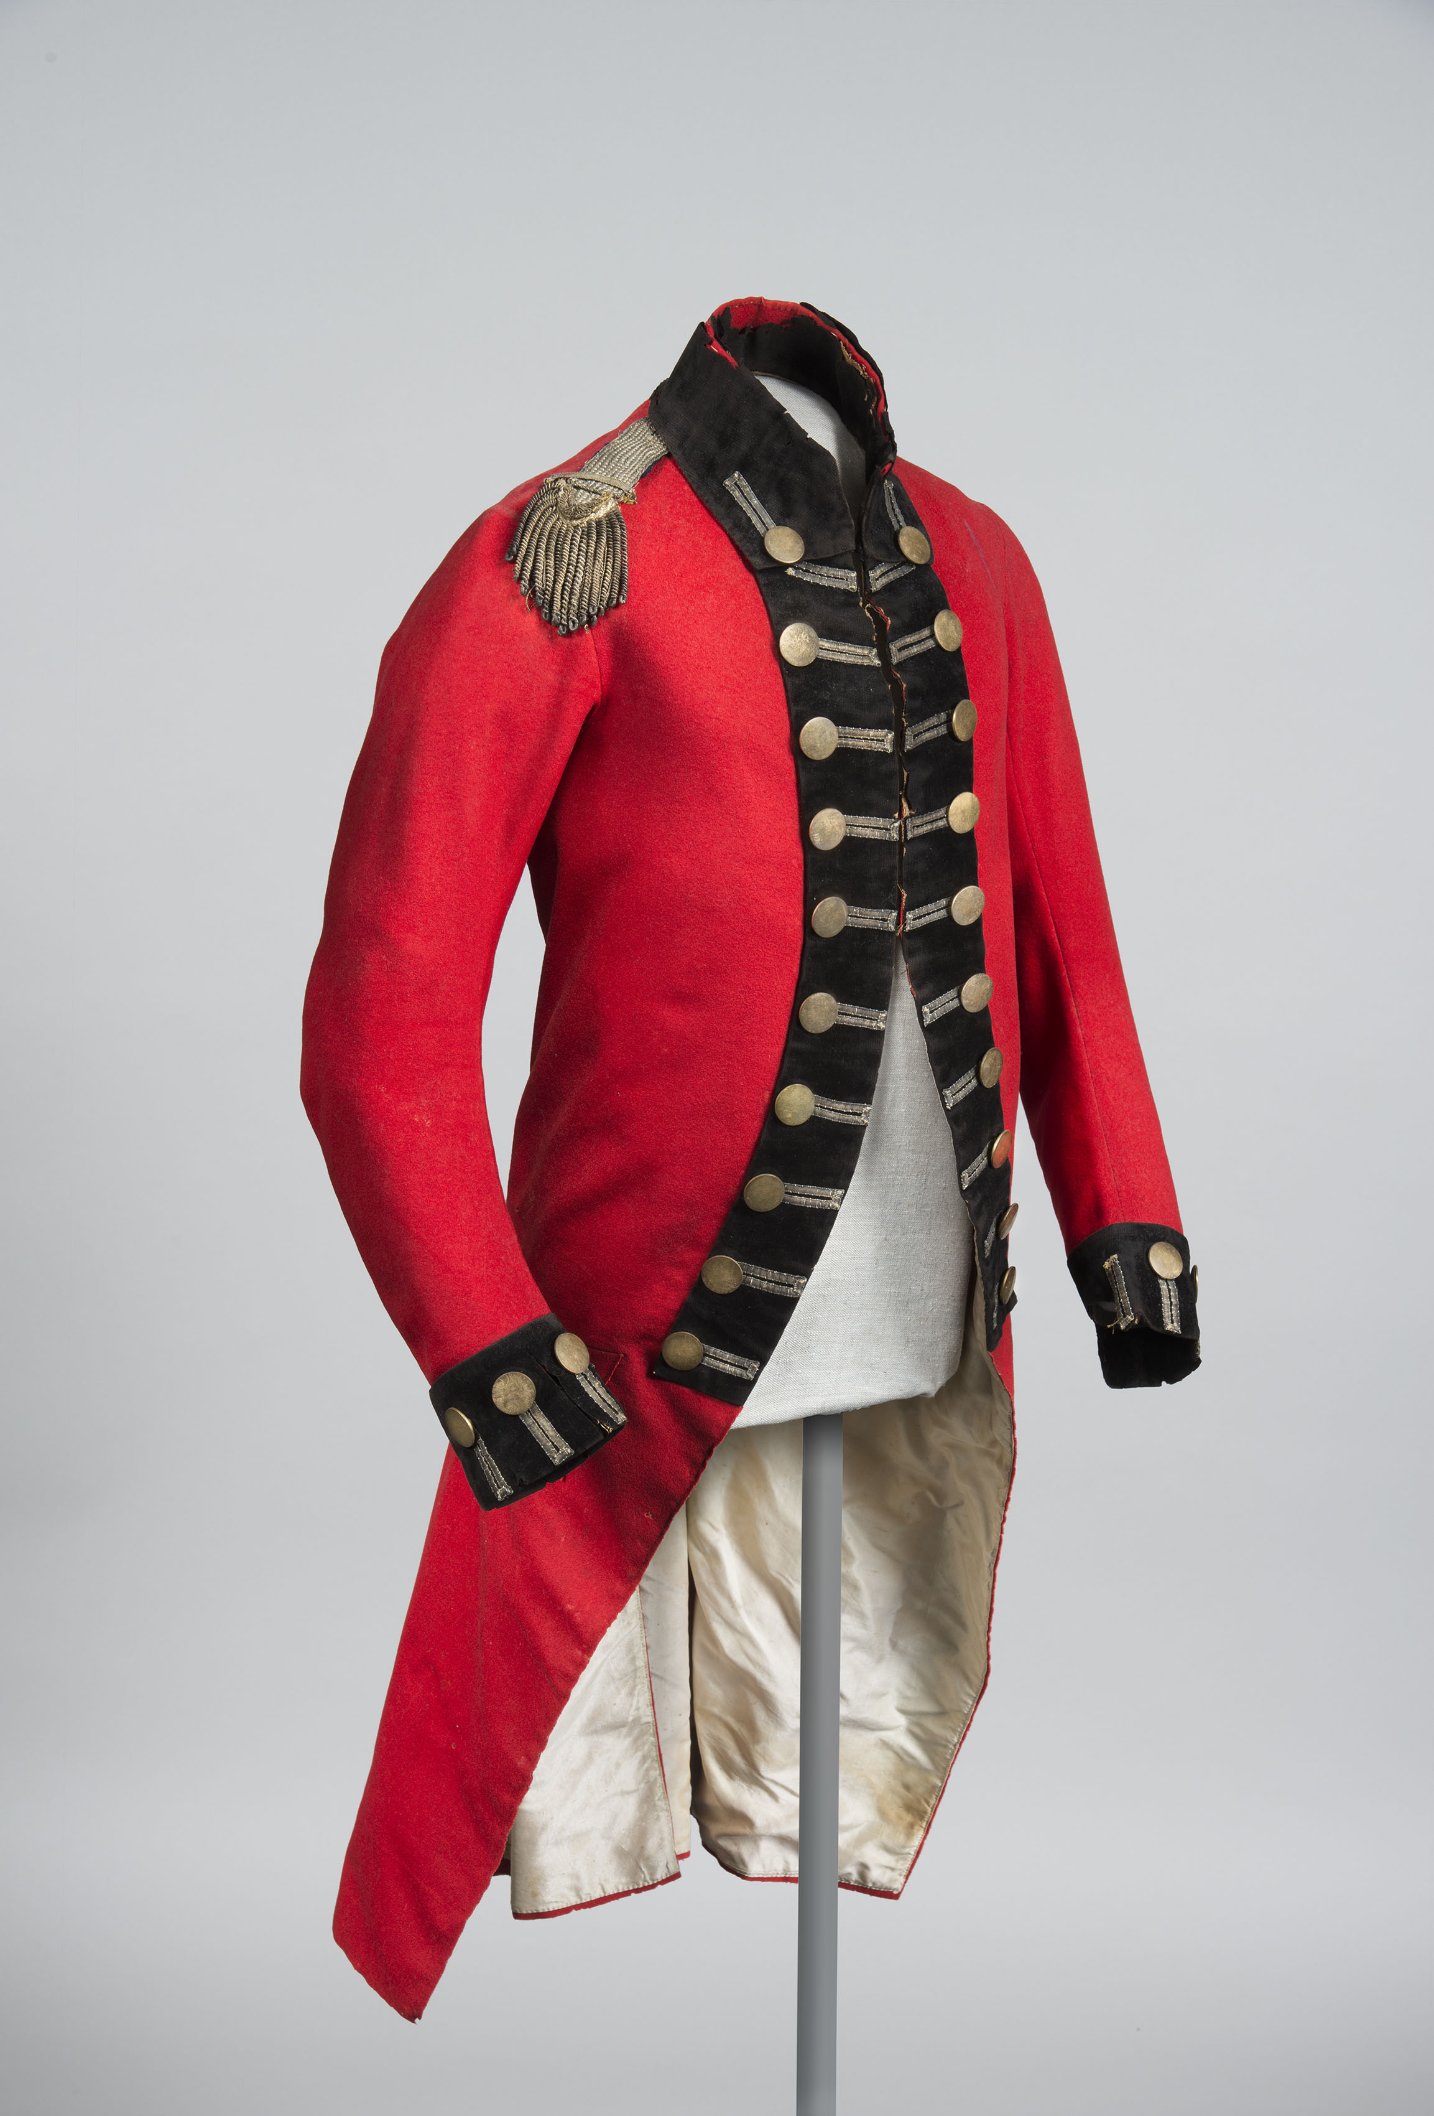
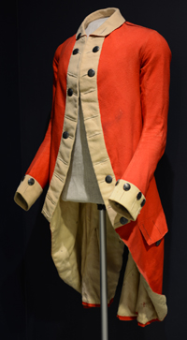
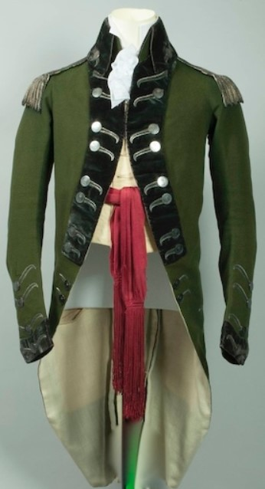
British Uniform Jackets
Notes:
British soldiers and officers had standard uniforms designed for their regiments. They were typically red, though some of the units enlisting Loyalists adopted a green jacket. Some Americans called the British "Lobsterbacks" because of the bright red uniforms. The British also discovered that their red uniforms made them easier targets during an ambush or on a battlefield.
Middle: Governor's Independent Company of Cadets
Right: Uniform of a captain in the Queen's Ranger Dragoons
https://www.georgewashingtoninauguralbuttons.com/1776-1783american-torybritish-crown-loyalist/
https://www.fortticonderoga.org/news/seeing-red/

Slide 15
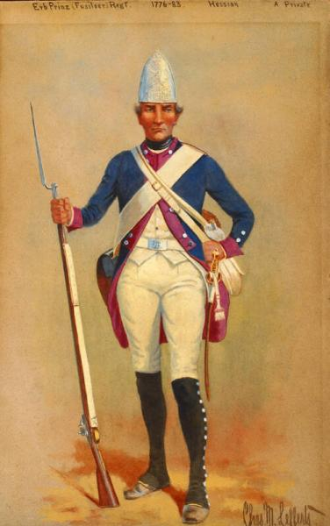

European Uniform Jackets
Notes:
As other European countries became involved in the Revolutionary War, their soldiers arrived in other distinctive uniforms. Similar to the British, these other Europeans tended to have specific uniforms for the regimental soldiers
The image on the left shows the uniform of a Hessian (German) soldier who had been hired to fight with the British.
On the right, a French infantryman stands at attention.
https://emuseum.nyhistory.org/objects/16135/uniforms-of-the-american-revolution-corporal-grenadier-com?ctx=3f012fc2e8bf0b01d21dd862f40bebf4303d2830&idx=1

Slide 16
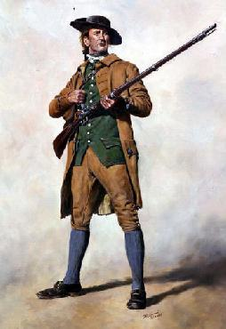
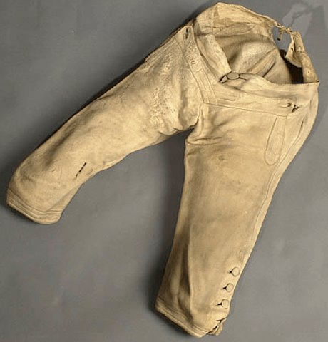
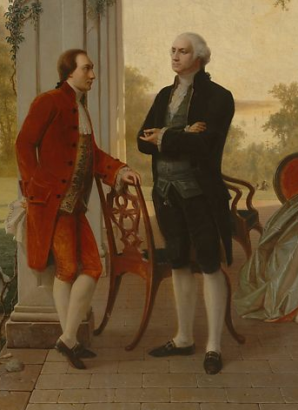
Breeches and Stockings
Notes:
Men's pants during the Revolutionary War period were short, usually just below the knees. They were worn with long stockings. The style came from European fashions and since it was part of everyday clothing, the style was adopted into the uniforms. (Sometimes tall boots would cover the stockings.)
Photo Credit:
https://www.revwartalk.com/buckskin-breeches/

Slide 17
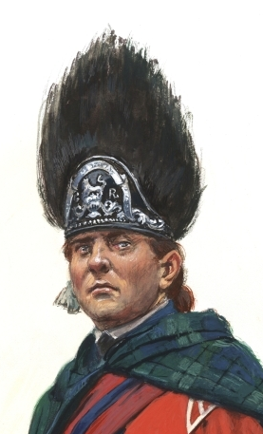
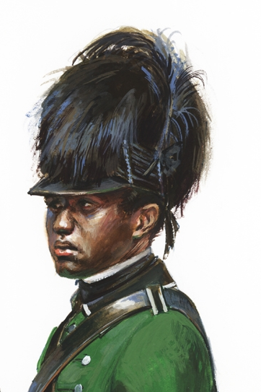
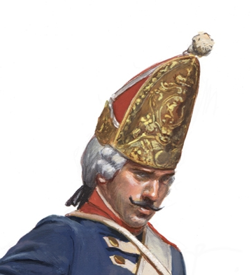
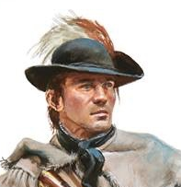
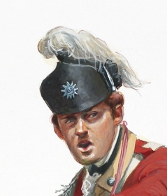
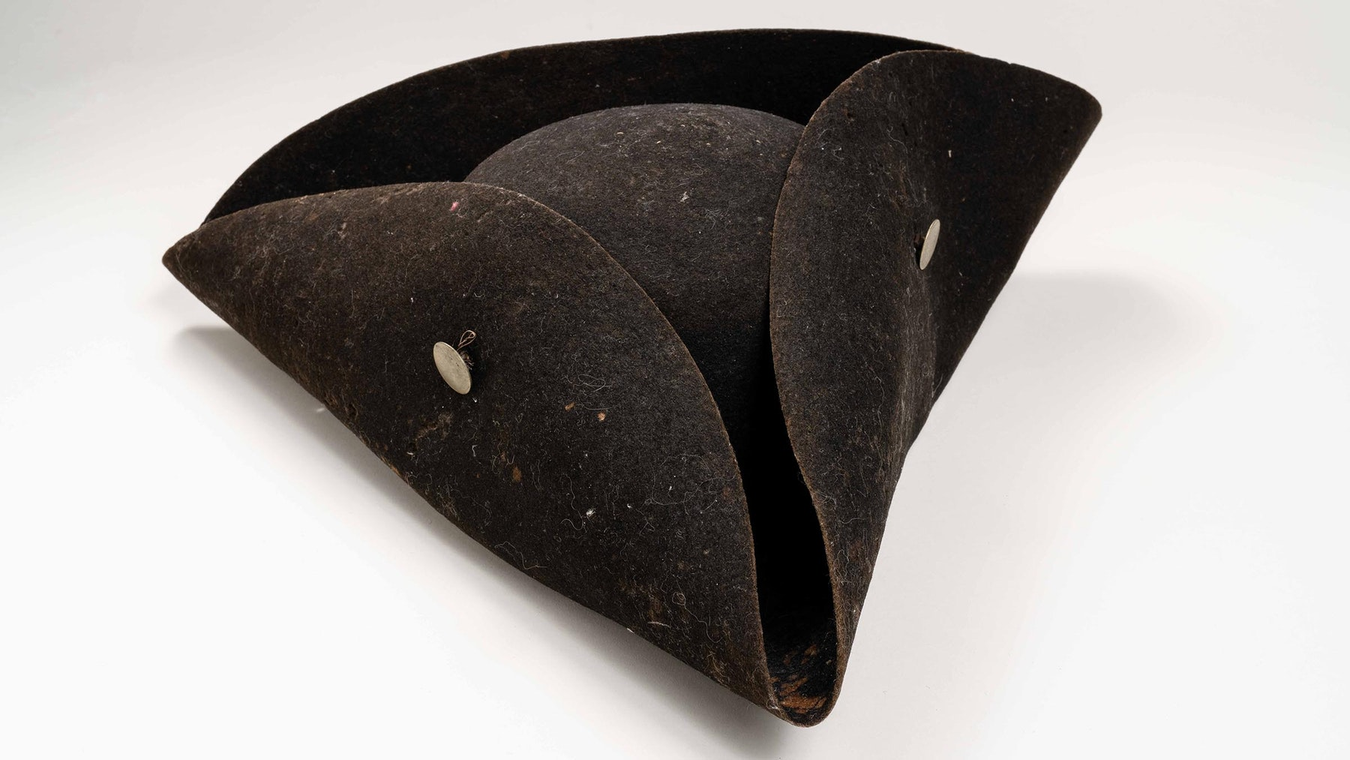
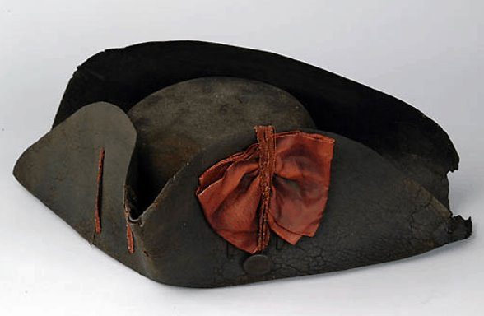
Hats
Notes:
While the Tricorn Hat (two pictures at the bottom) is most associated with the Revolutionary War, soldiers actually wore a variety of hats, helmets, and shakos. For militiamen, it usually depended on what they had at home and chose to wear to war. More structured regiments in the Continental, British, and European ally armies had a style of hat that corresponded with their uniform or matched their battlefield purpose (intimidation, cavalry, artillery, etc.) Notice the lack of brims on the hats. Few of the military issued hats of the day offered much protection for the eyes and face from the sun.
Image Credits:
http://www.cr.nps.gov/museum/exhibits/revwar/image_gal/morrimg/hatcocked.html
https://www.amrevmuseum.org/collection/thomas-noyes-s-cocked-hat
http://dontroiani.com/storage/galleries/March2019/quRLJYyq3EUtExqowMO3.jpg
http://dontroiani.com/storage/galleries/March2019/P9AF8jYzDs9arCoDIlhn.jpg
http://dontroiani.com/storage/galleries/March2019/LcNSeeh9WQotgoEakHdL.jpg
http://dontroiani.com/storage/galleries/March2019/DHma28EBMoUr3LBcP2yd.jpg
Morgan's Ranger Riflemen

Slide 18
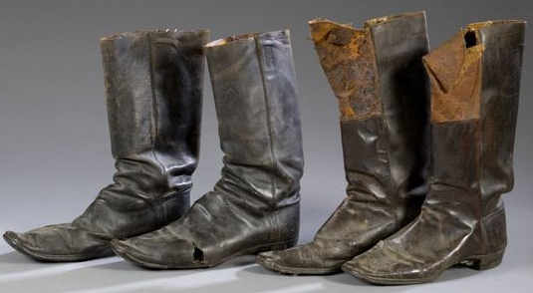
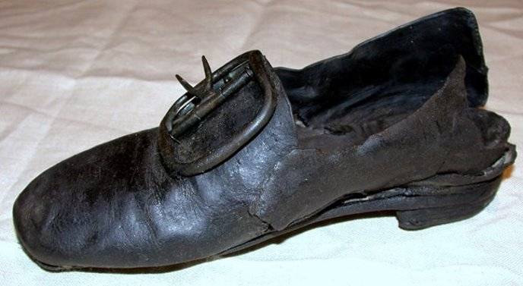
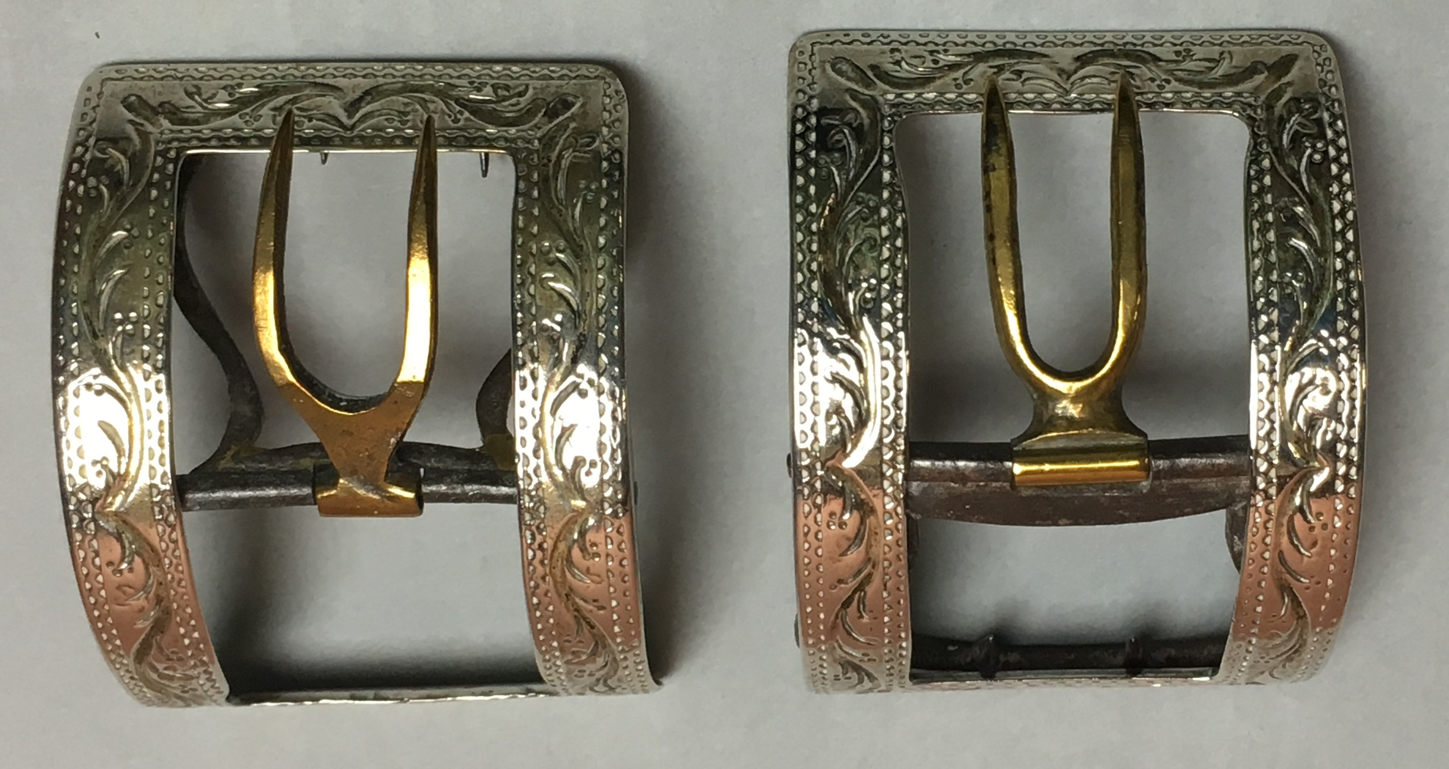
Shoes and Boots
Notes:
Shoes and boots were made by hand from leather and shoes were usually fastened with metal buckles. Footwear was often in short supply for the militias and Continental Army during the Revolutionary War. During several winters, George Washington led his army through cold, and many of his soldiers marched shoeless in the snow.
Photo Credits:
https://www.nps.gov/articles/000/valley-forge-footwear-4.htm
https://collections.dar.org/mDetail.aspx?rID=62.142.A%20%20%20%20%20%20%20%20%20%20%20%20&db=objects&dir=DARCOLL&osearch=shoe%2520buckles&list=res&rname=&rimage=&page=1
https://blog.elmc.co/view-post/the-us-combat-boot

Slide 19
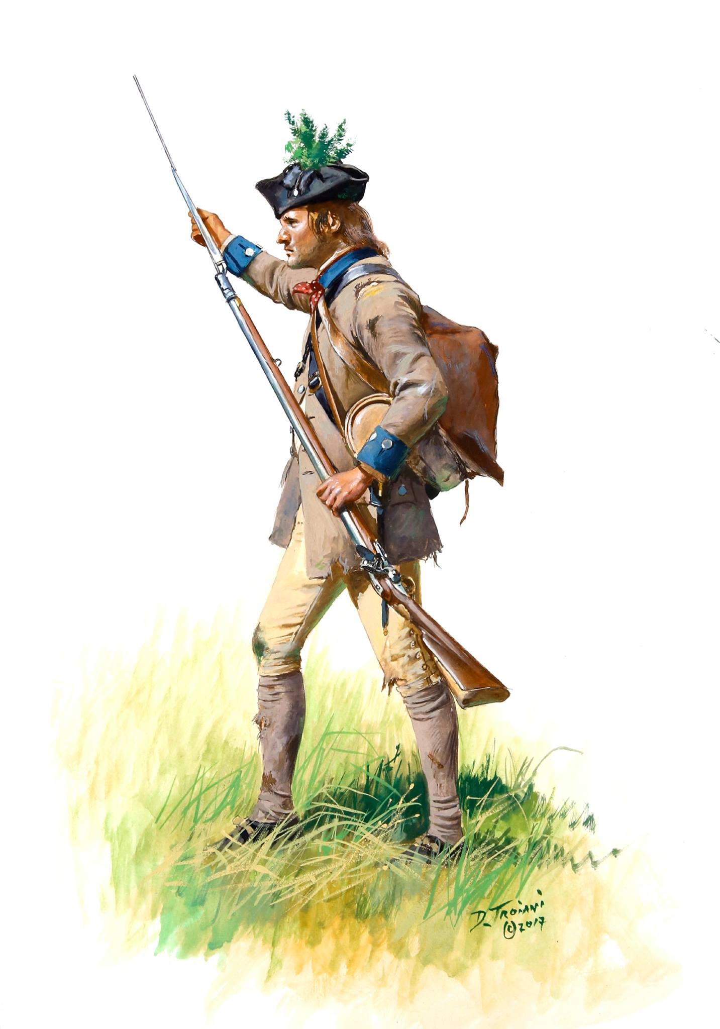
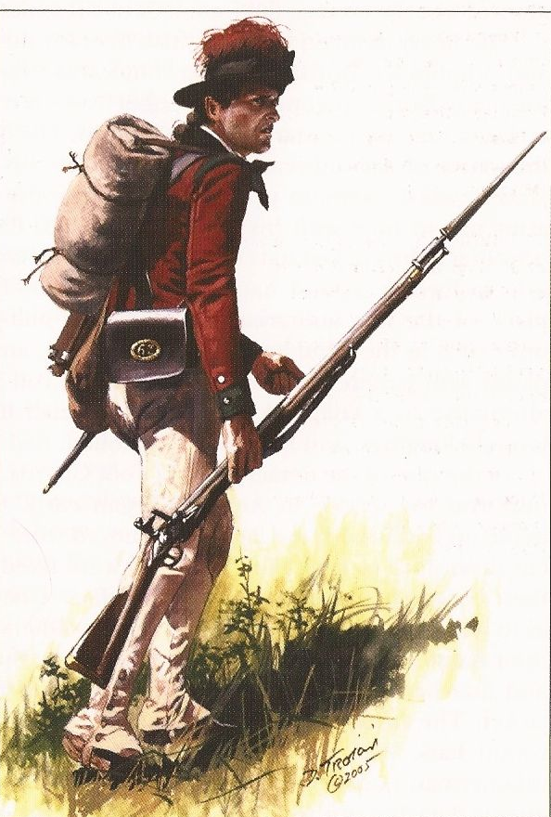
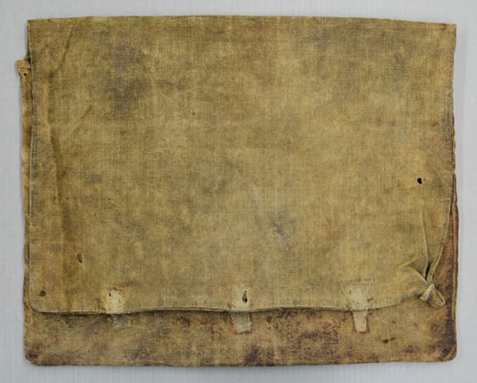
Haversack
Notes:
A soldier carried his personal items, perhaps some extra clothing, and food in his haversack or knapsack. (Knapsacks were usually a little larger than haversacks). What do you think you would carry in your haversack if you were a Revolutionary War soldier?
Photo Credits:
Fox, Christopher D. “The History of Benjamin Warner's Knapsack.” Fort Ticonderoga, 21 June 2019, www.fortticonderoga.org/news/benjamin-warners-knapsack/.
Artwork by Don Troiani

Slide 20
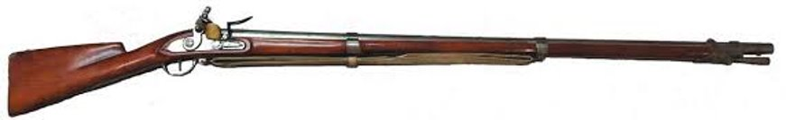
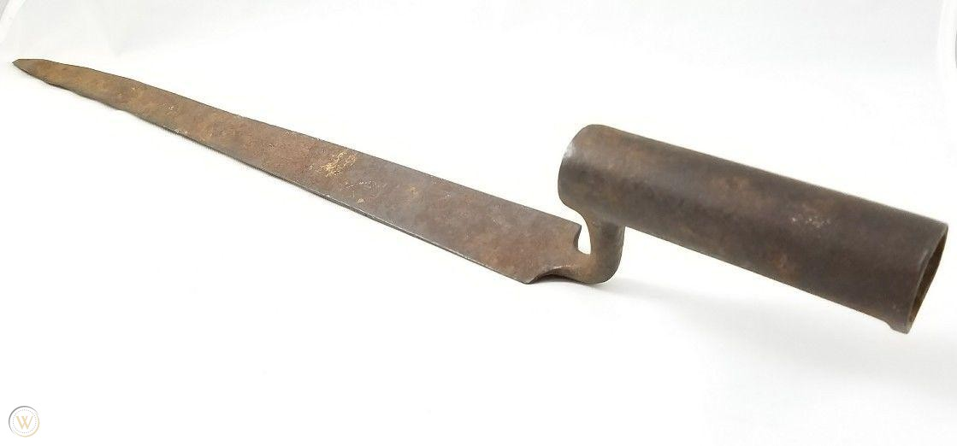
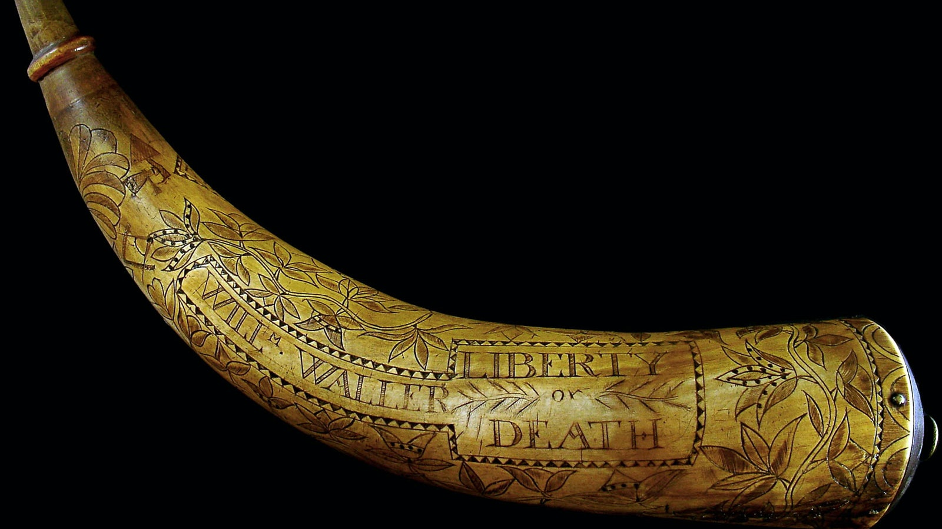
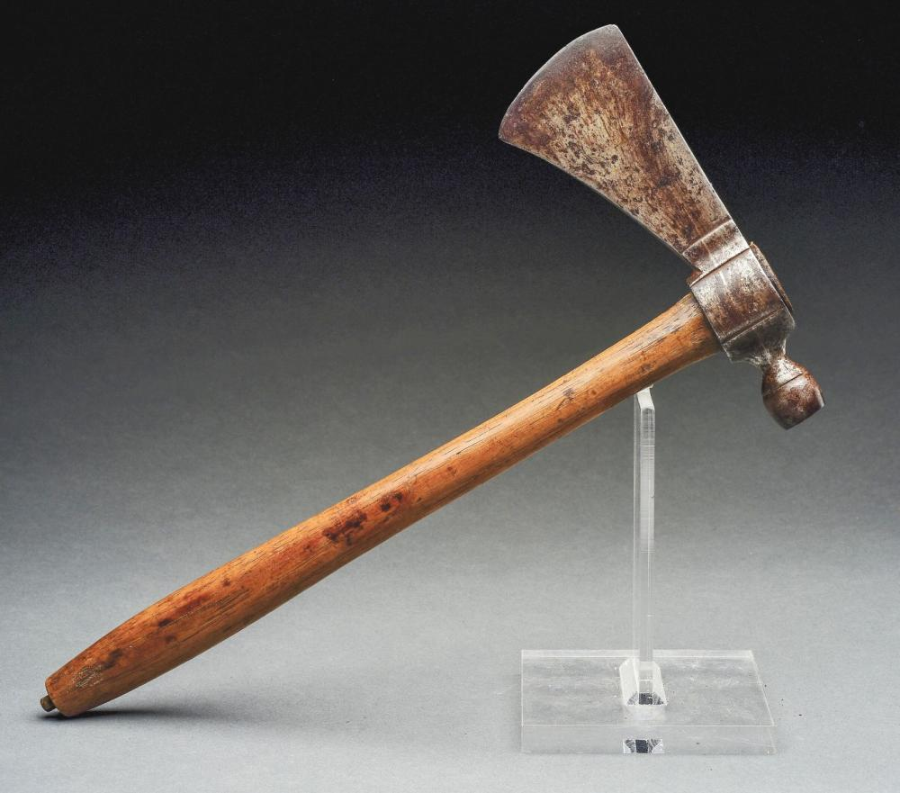
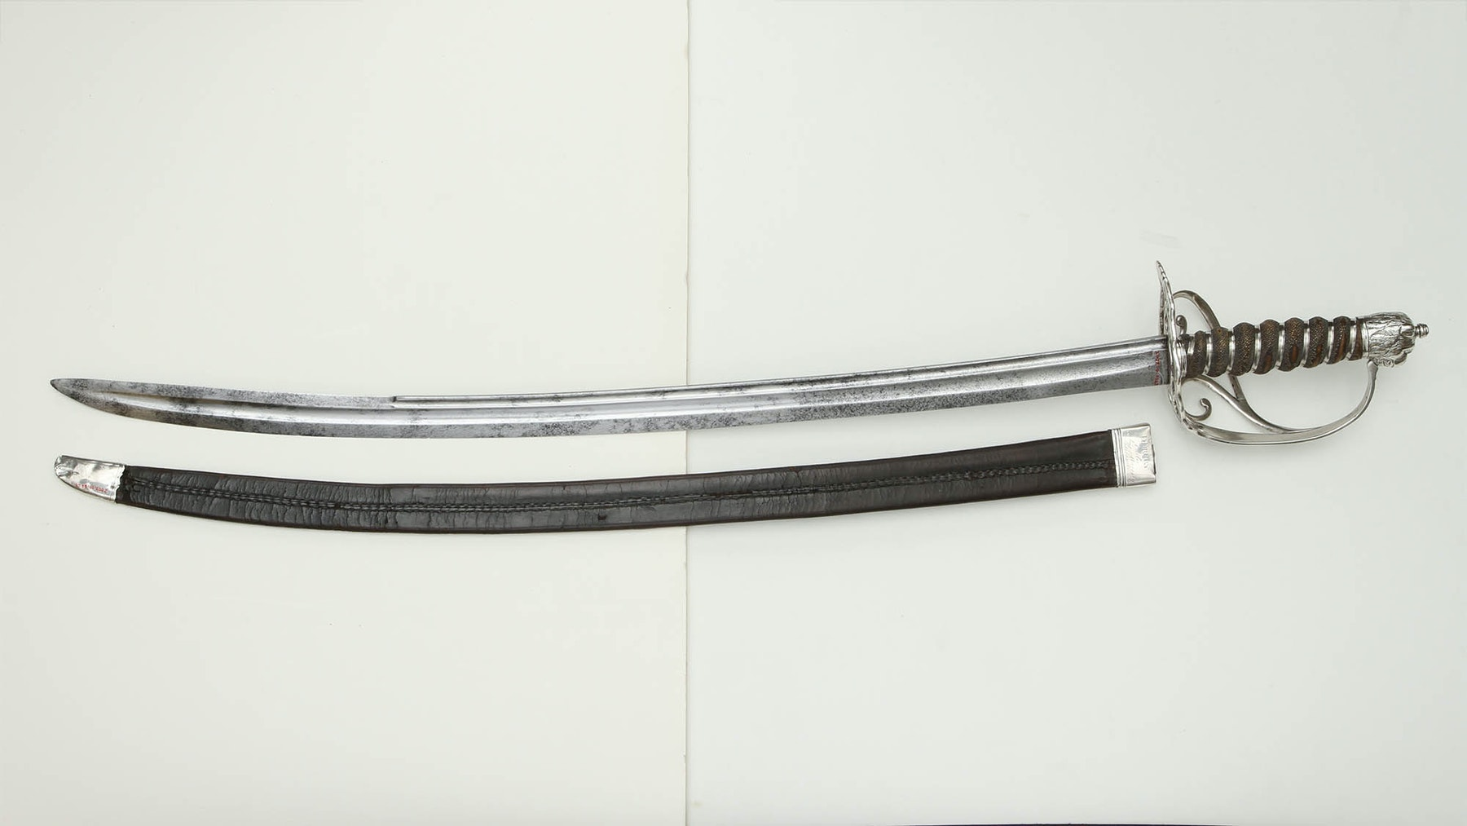
Weapons
Notes:
Revolutionary War soldiers carried and fought with a variety of weapons.
Muskets were the typical firearm of the period. There were some pistols. The firearms were not know for their accuracy and they also had a short range of fire which meant the troops had to get close to fire at the enemy.
Bayonets were attached to the barrel end of the muskets and were used in hand-to-hand combat.
Powder horns carried gunpowder which was essential for making cartridges (paper wadding, musket ball, gunpowder) to shoot out of the musket. Soldiers often spent part of their time in camp making bullets or cartridges.
Officers carried swords both as a weapon and as a symbol of authority. Cavalry (horse-soldiers) used heavy curved swords called sabers.
Tomahawks – a Native American and frontier weapon – were used in hand-to-hand combat.
Extra Resource:
Small Arms Across Three Wars (Article): https://www.battlefields.org/learn/articles/small-arms-across-three-wars
Artillery Across Three Wars (Article): https://www.battlefields.org/learn/articles/artillery-across-three-wars
The Guns of Ticonderoga (Article about cannon): https://www.battlefields.org/learn/articles/guns-ticonderoga
Photo Credits:
https://www.nps.gov/stri/upload/18thCMusketManual2010-01-21.pdf
https://www.worthpoint.com/worthopedia/revolutionary-war-american-bayonet-1863851748
https://www.amrevmuseum.org/collection/british-officer-s-saber
https://www.amrevmuseum.org/collection/william-waller-s-powder-horn
https://www.invaluable.com/auction-lot/revolutionary-war-era-pipe-tomahawk-with-original-1163-c-a1d4fd3891

Slide 21
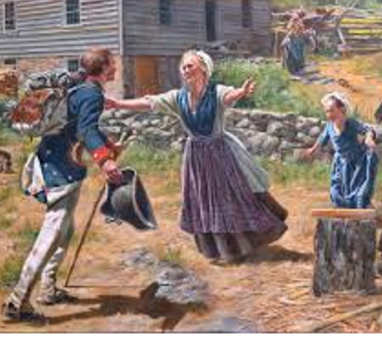
After the War
The Americans won the Revolutionary War.
Many of the American soldiers returned home and worked on their farms or in their trade shops. Some became influential during the formation of the United States government.
British soldiers and many loyalists left in 1783, returning to England or Canada.
Notes:
The Revolutionary War did not end at Yorktown in October of 1781. In fact, it took until November of 1783 for the British to finally evacuate the colonies.
The United States Army in 1783 was vastly different than what we know today. After the conclusion of the Revolutionary War, soldiers returned home, the size of the army shrank at one point to consist of less than 1,000 officers and men. Some of the soldiers participated in local militia units or stayed in a region that they marched or campaigned through, such as many of the Hessian soldiers who stayed in America rather than returning to Europe.
Many soldiers applied for pensions through their state or the United States government. Some enslaved Blacks were freed after their service in the Continental Army, while others were forced back into slavery, having to go to court and petition for their freedom, which was promised in return for their service.
Soldiers and their families sought normality once more, as the politicians met in 1787 to draft the United States Constitution and form the government that we know today.
Extra Resources:

Slide 22
Special Thanks
Thank you to historical artist Don Troiani for allowing American Battlefield Trust to share his artwork for educational purposes.
Featured on Slides: 16, 17, 19, 21
www.dontroiani.com

