Slide 1
Revolutionary War Music
The American Battlefield Trust

Slide 2
The Revolutionary War
1775-1783
Colonial America vs. Britian
Outcome: American Independence from Britian and the beginning of the United States
Notes:
This slide offers a quick overview to the Revolutionary War to give some context to today music lesson.
The Revolutionay War started on April 19, 1775 with the Battles of Lexington and Concord in Massachusetts. The Siege of Yorktown in Virginia in 1781 was a major defeat for the British and led to the Treaty of Paris which officially ended the war in 1783.
Prior to the Revolutionary War, 13 American colonies belonged to Britian. INSERT LINK TO 13 COLONIES ARTICLE THAT IS WAITING TO BE PUBLISHED. Taxation without representation in the British Parliament was one of the many causes of conflict between the colonies and the Britian. After various appeals and attempts at reconciliation without success, and the American colonies united and rebelled, seeking liberty.
At the end of the Revolutionary War, the American colonies won their independence from Britian and became the first 13 states of the United States. The Declaration of Independence backed with the American victory led to the formation of the United States of America.

Slide 3
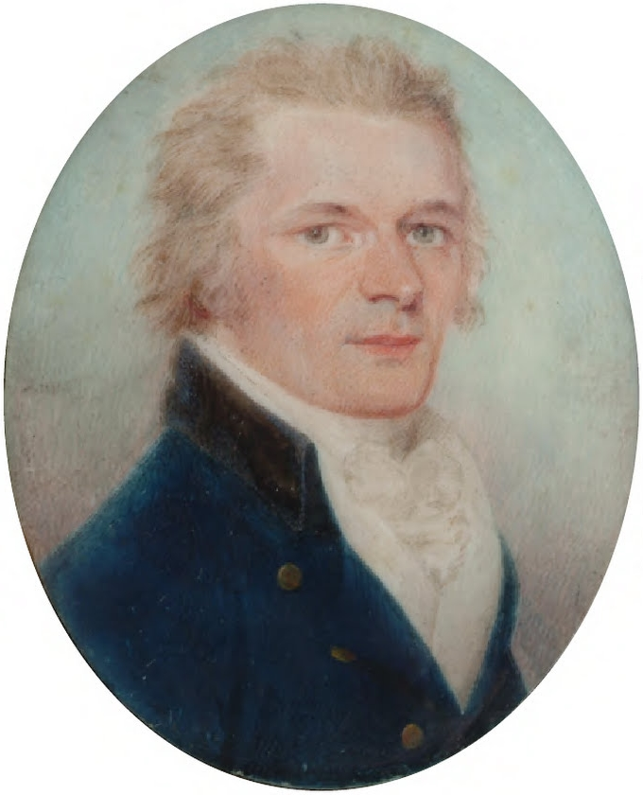
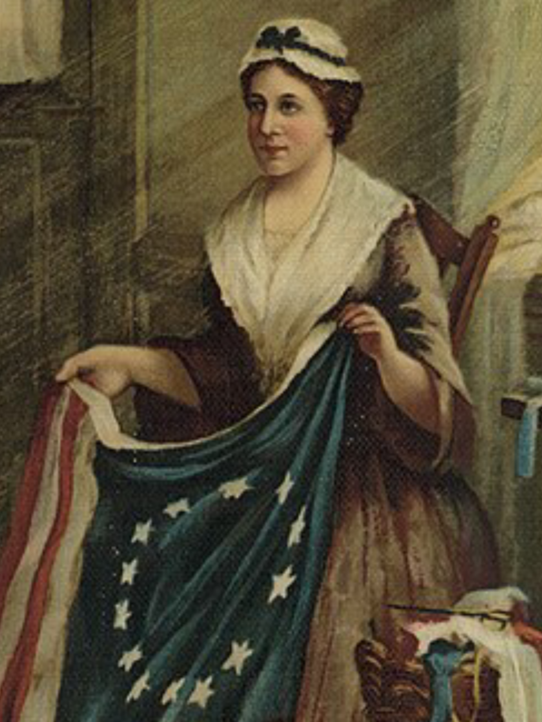
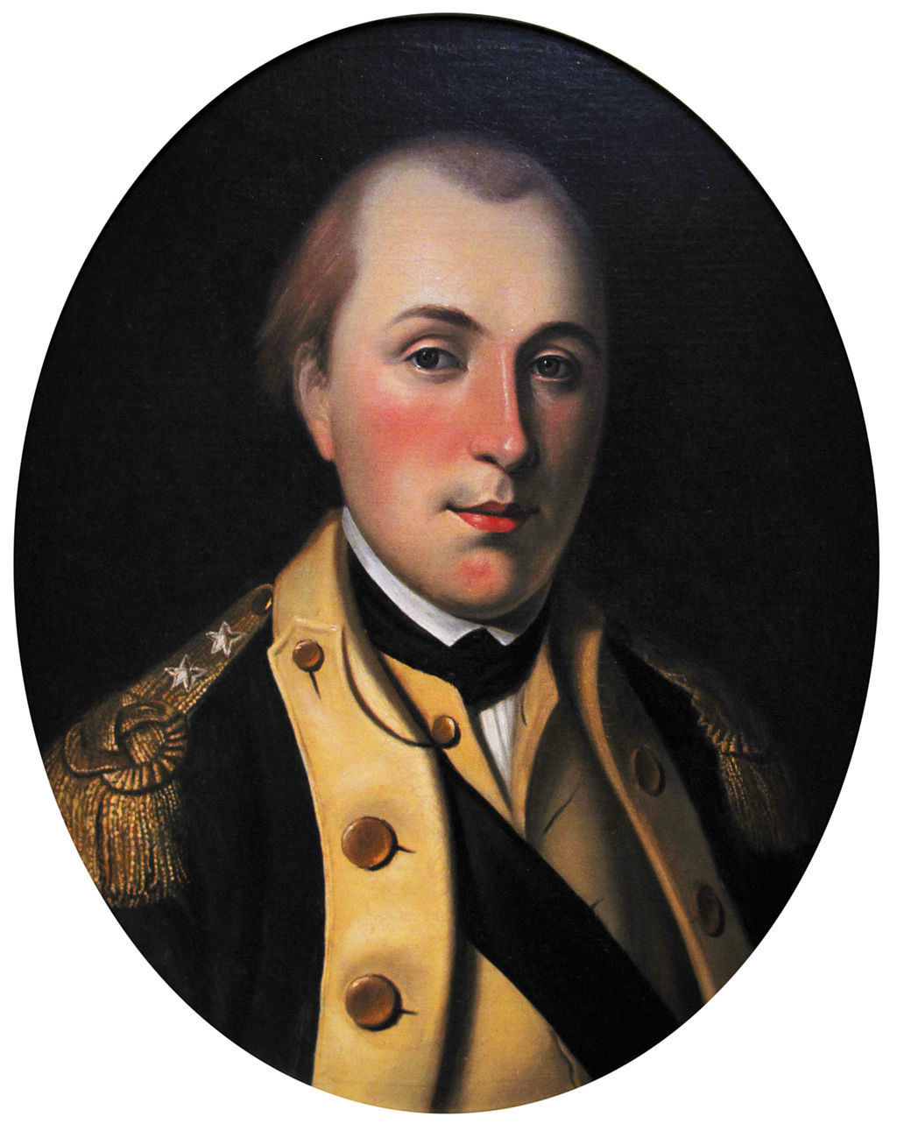
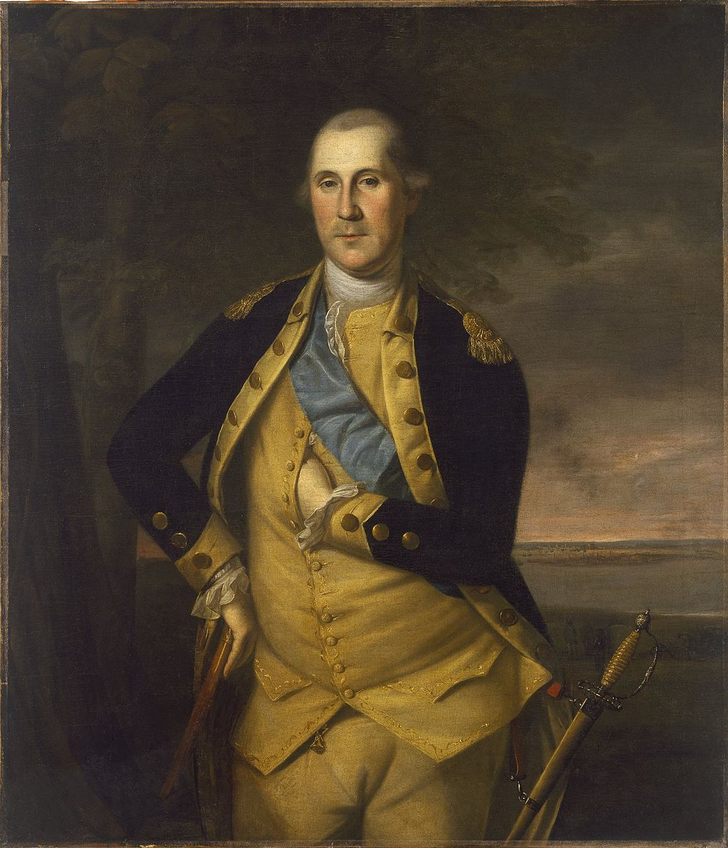
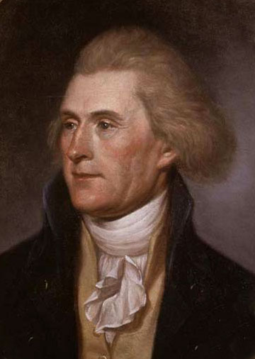
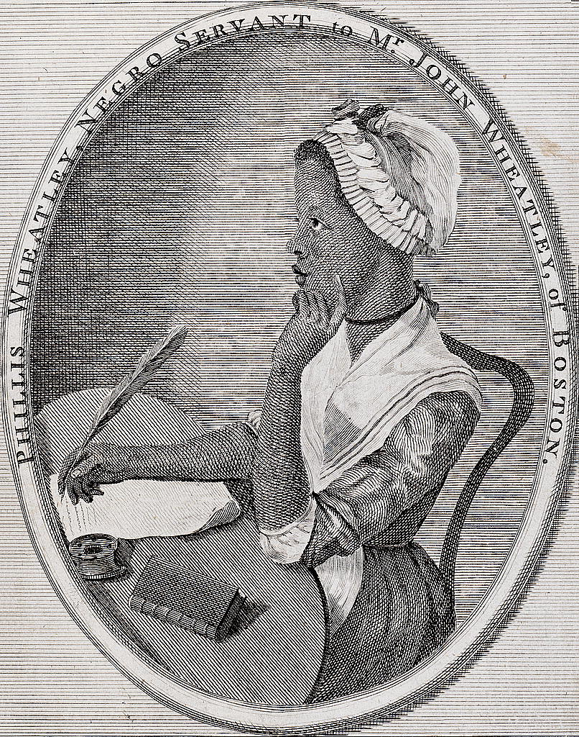
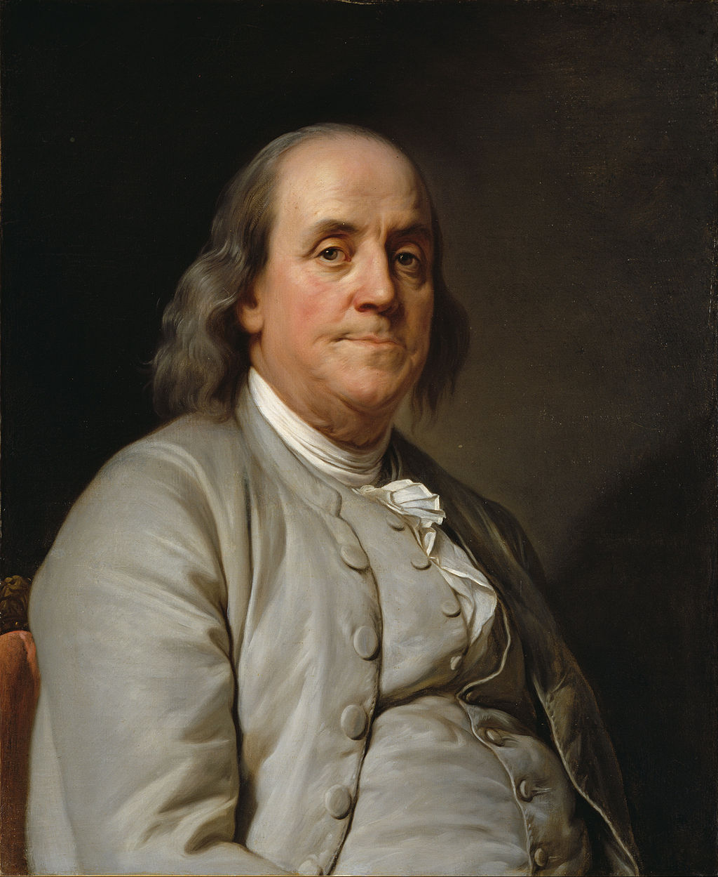
Famous Americans from the Revolutionary War
Betsy Ross
George Washington
Alexander Hamilton
Marquis de Lafayette
Thomas Jefferson
Benjamin Franklin
Phillis Wheatley
Notes:
This slide helps students recognize some of the people of the Revolutionary War era, including a few they might already recognize. Emphasize that these people would have heard the types of music that we are exploring in today's lesson.
Alexander Hamilton - A young officer during the Revolutionary War and one of Washington's miltiary aide-de-camps; he was later instrumental in supporting the U.S. Constitution and establishing the U.S. Treasury. https://www.battlefields.org/learn/biographies/alexander-hamilton
Thomas Jefferson – Helped to write the Declaration of Independence and was influential in Virginia during the Revolutionary War; he later became the 3rd President of the United States. https://www.battlefields.org/learn/biographies/thomas-jefferson
George Washington – Commander of the Continental Army during the Revolutionary War; later, he became the 1st President of the United States https://www.battlefields.org/learn/biographies/george-washington
Betsy Ross – A Philadelphia seamstress credited with sewing the first commissioned flag for the Continental Army https://www.battlefields.org/learn/biographies/betsy-ross
Phillis Wheatley – An enslaved and later freedwoman in Boston who wrote poetry during the Revolutionary War, including a poem that she sent to George Washington https://www.battlefields.org/learn/biographies/phillis-wheatley
Marquis de Lafayette – A young, French nobleman who volunteered with the Americans and became a major general in the Continental Army https://www.battlefields.org/learn/biographies/marquis-de-lafayette
Benjamin Franklin – An American business and diplomat who served as ambassador to France during the Revolutionary War, helping to bring France into the war on the American side. https://www.battlefields.org/learn/biographies/benjamin-franklin

Slide 4
ESSENTIAL QUESTIONS
How did officers communicate their orders above the battle noise?
What musical sounds would a Revolutionary War soldier have heard on the march or in camp?

Slide 5
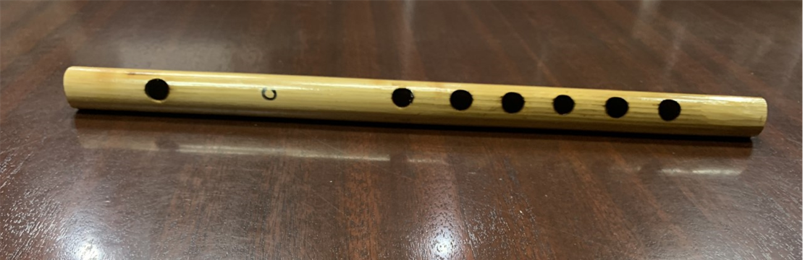
The Fife
Usually made of wood
Usually have six holes
Used since the 12th Century
Small and light wind instrument
Shrill sound
How might these details about the fife have made it popular and helpful for the soldiers?
Notes:
Information on this page corresponds with Handout #1 and the Handout #1 Answer Key

Slide 6
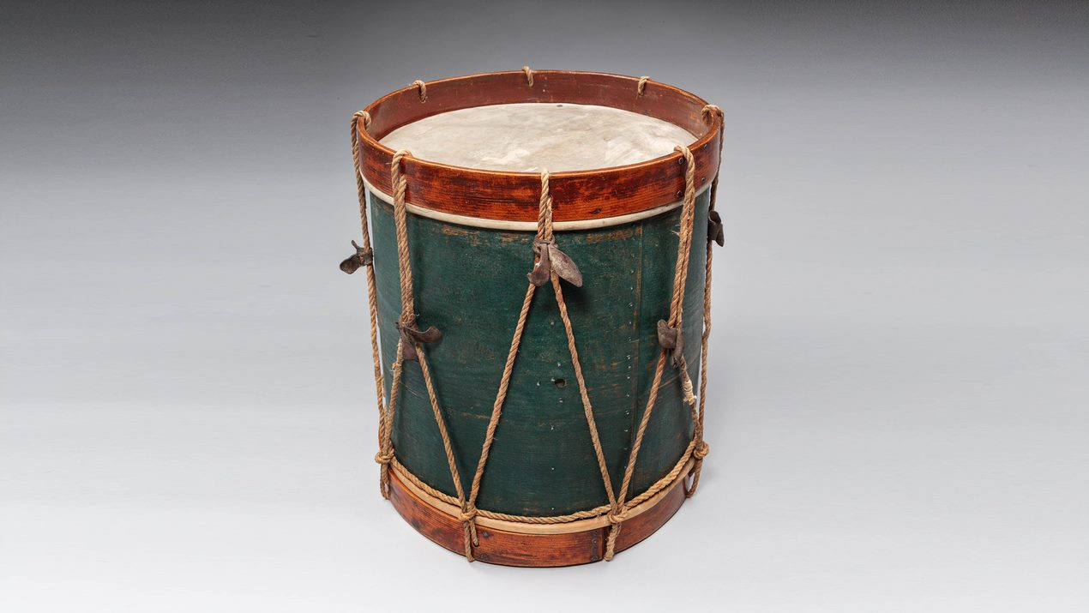
The Drum
Made from wood with sheepskin covering the drum's "head"
Cylindrical, hollow percussion instrument
Ropes along the sides of the drum allowed for tuning and a louder sound.
Played with wooden drumsticks
Creates a deep cadence sound
How might these details about the drum have made it popular and helpful for the soldiers?
Notes:
Information on this page corresponds with Handout #1 and the Handout #1 Answer Key
Drum Artifact photo is from the Museum of the American Revolution.

Slide 7
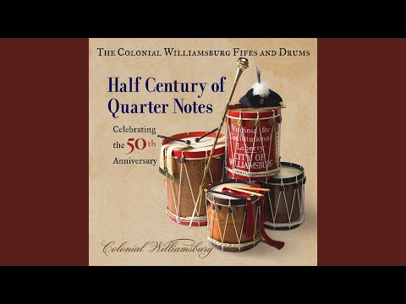
Listen!
This tune is called "Reveille".
It was used to wake the soldiers in the morning and call them to prepare for the day.
Notes:
Video clip is audio from Colonial Williamsburg

Slide 8
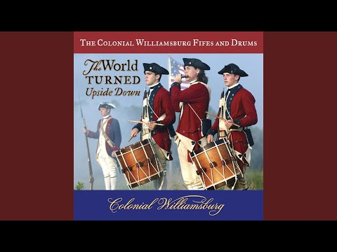
Listen!
This tune is called "The Retreat".
It was used to order soldiers to fall back on the battlefield.
Notes:
Video clip is audio from Colonial Williamsburg

Slide 9
Listen!
This tune is called "Cease Fire".
It was used to order soldiers to stop shooting if the battle was won or the enemy surrendered.

Slide 10
Military Purpose
Fife and drum corps helped officers communicate to their soldiers.
These instruments helped commanders pass their orders to the soldiers.
There were two other main uses of the fife and drum corps.
Can you guess as you listen to the next songs?

Slide 11
Listen!
This tune is called "Rhode Island March."
Notes:
Video clip is audio from Colonial Williamsburg

Slide 12
Listen!
This tune is called "The Hessian Dragoons March."
Hessians were German soldiers fighting with the British during the Revolutionary War.
Dragoons were cavalrymen (horse soldiers).
Notes:
Video clip is audio from Colonial Williamsburg

Slide 13
Military Purpose
Fife and drum corps played marches to help the soldiers keep "in step" as they moved together along a road or into battle.
There was one other main use of the fife and drum corps.
Can you guess as you listen to the next songs?

Slide 14
Listen!
The British called this tune "God Save the King."
Americans called it "God Save Great Washington."
Today, you might recognize it as the tune to a patriotic song "My Country 'Tis of Thee"
Notes:
Video clip is audio from Colonial Williamsburg

Slide 15
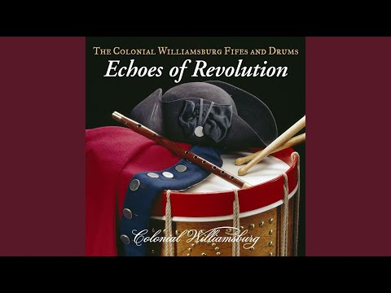
Listen!
This is a collection of popular songs from the Colonial and Revolutionary War era.
"Jigg / Allamande / Reel / Master Linley's Hornpipe"
Notes:
Video clip is audio from Colonial Williamsburg

Slide 16
Military Purpose
Fife and drum corps played popular songs to encourage the soldiers along the march or while they encamped.
Sometimes the songs were political (like "God Save The King").
Other times, the music was popular medleys that the soldiers might have heard at home or in a tavern.
How do these songs make you feel?
Notes:
After the discussion, use the #2 and #3 Handouts

Slide 17
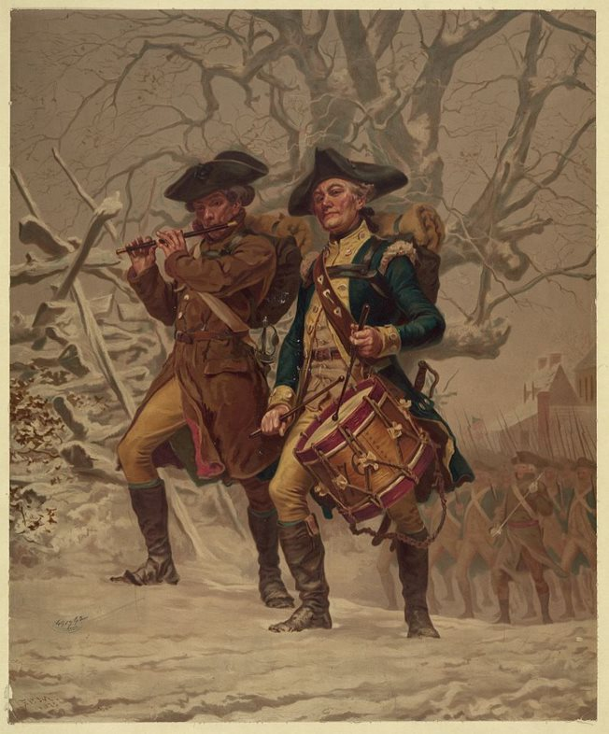
Who Were The Musicians?
Young boys
Older men
Musicians had dedicated roles and they became skilled to play the military calls, marches, and encouraging tunes.
Notes:
Musicians were usually young boys or older men who were not strong enough to handle the heavy muskets.
Many times, young boys went with their fathers or older brothers to the military camps and became musicians.
Whatever their age, the musicians had a lot of courage and skill to perform the officer's commands under fire on the battlefields or the endurance to make the long marches.

Slide 18
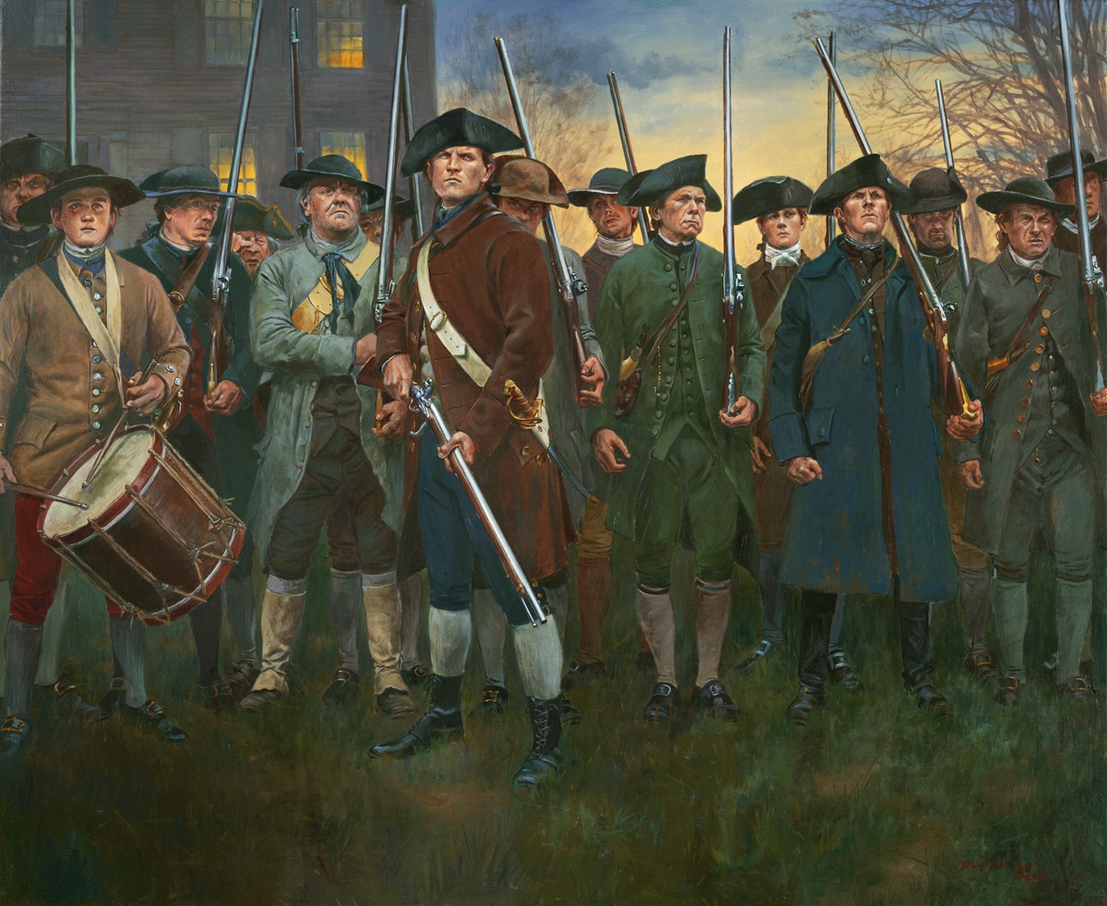
Notes:
Since we don't have photographs from the American Revolution, well-researched art can help us have an idea of what scenes may have looked like. (Painting by Don Troiani)
Here, Minutemen have assembled to oppose the British. Notice the young drummer at the left. Do you think his father or brother might be shouldering a musket elsewhere in the painting?

Slide 19
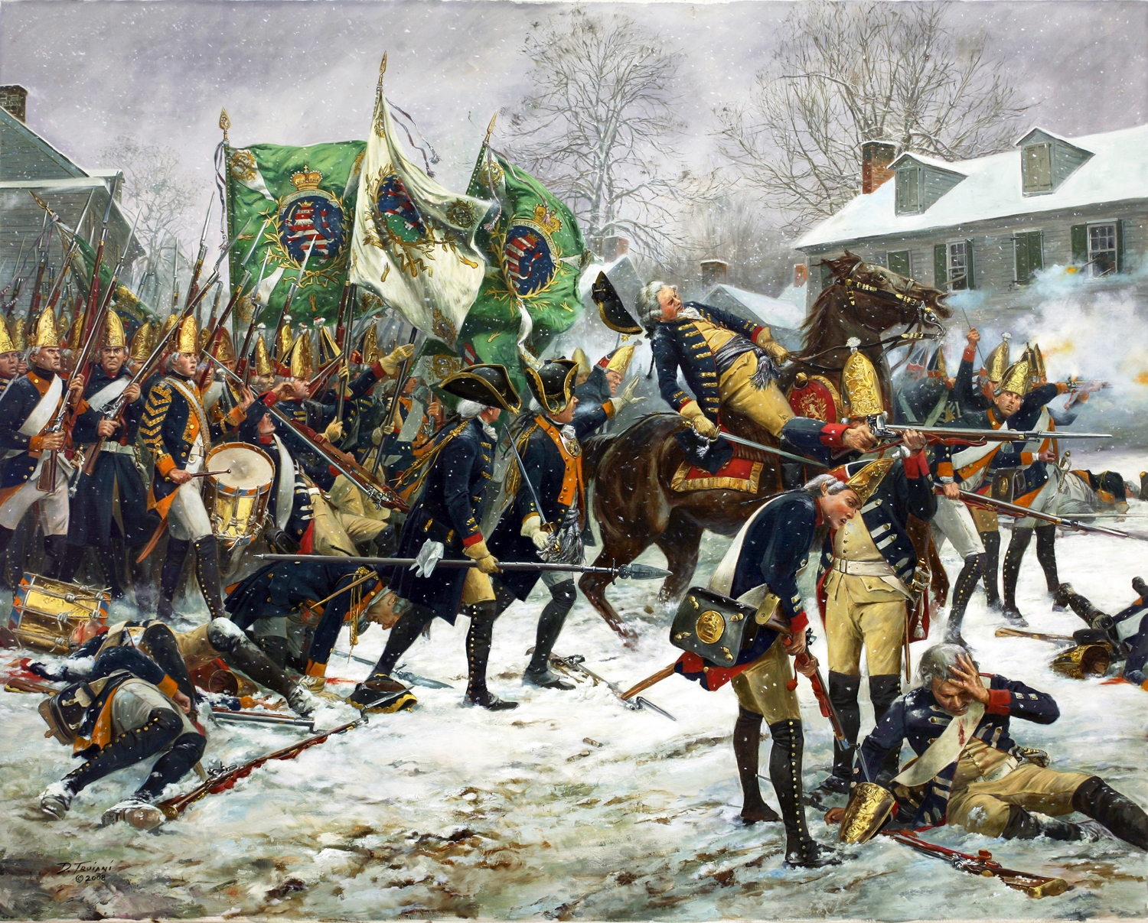
Notes:
Since we don't have photographs from the American Revolution, well-researched art can help us have an idea of what scenes may have looked like. (Painting by Don Troiani)
Here, at the Battle of Trenton, the Hessian commander (German troops hired to fight for the British) has been wounded. Toward the left of the painting stands a Hessian drummer. What musical order do you think he might be preparing to play? The Hessians retreated at this point, eventually leading to the American victory at Trenton.

Slide 20
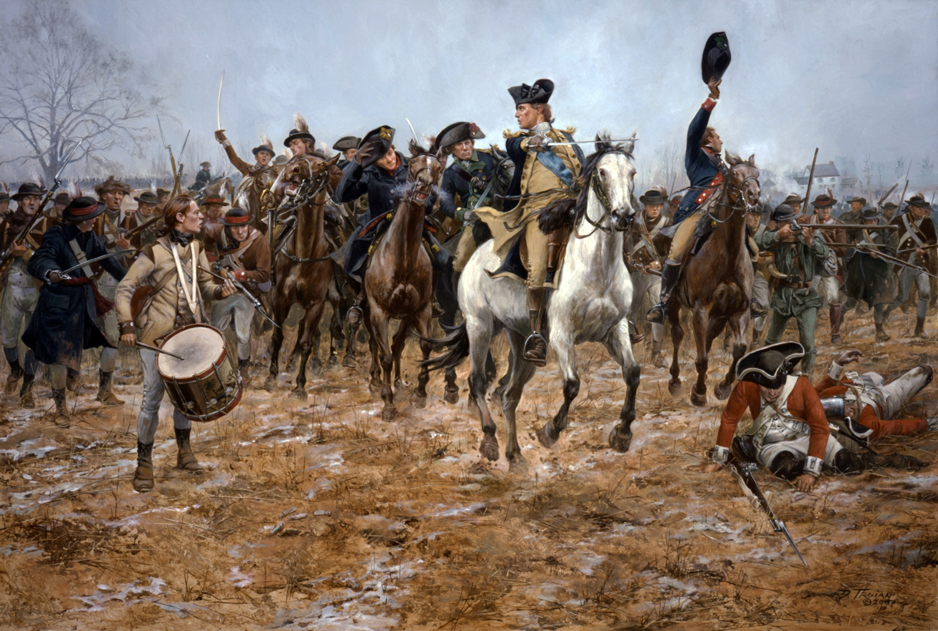
Notes:
Since we don't have photographs from the American Revolution, well-researched art can help us have an idea of what scenes may have looked like. (Painting by Don Troiani)
Here, George Washington orders an advance. Point out the drummer on the left. What might he be playing at this moment?

Slide 21
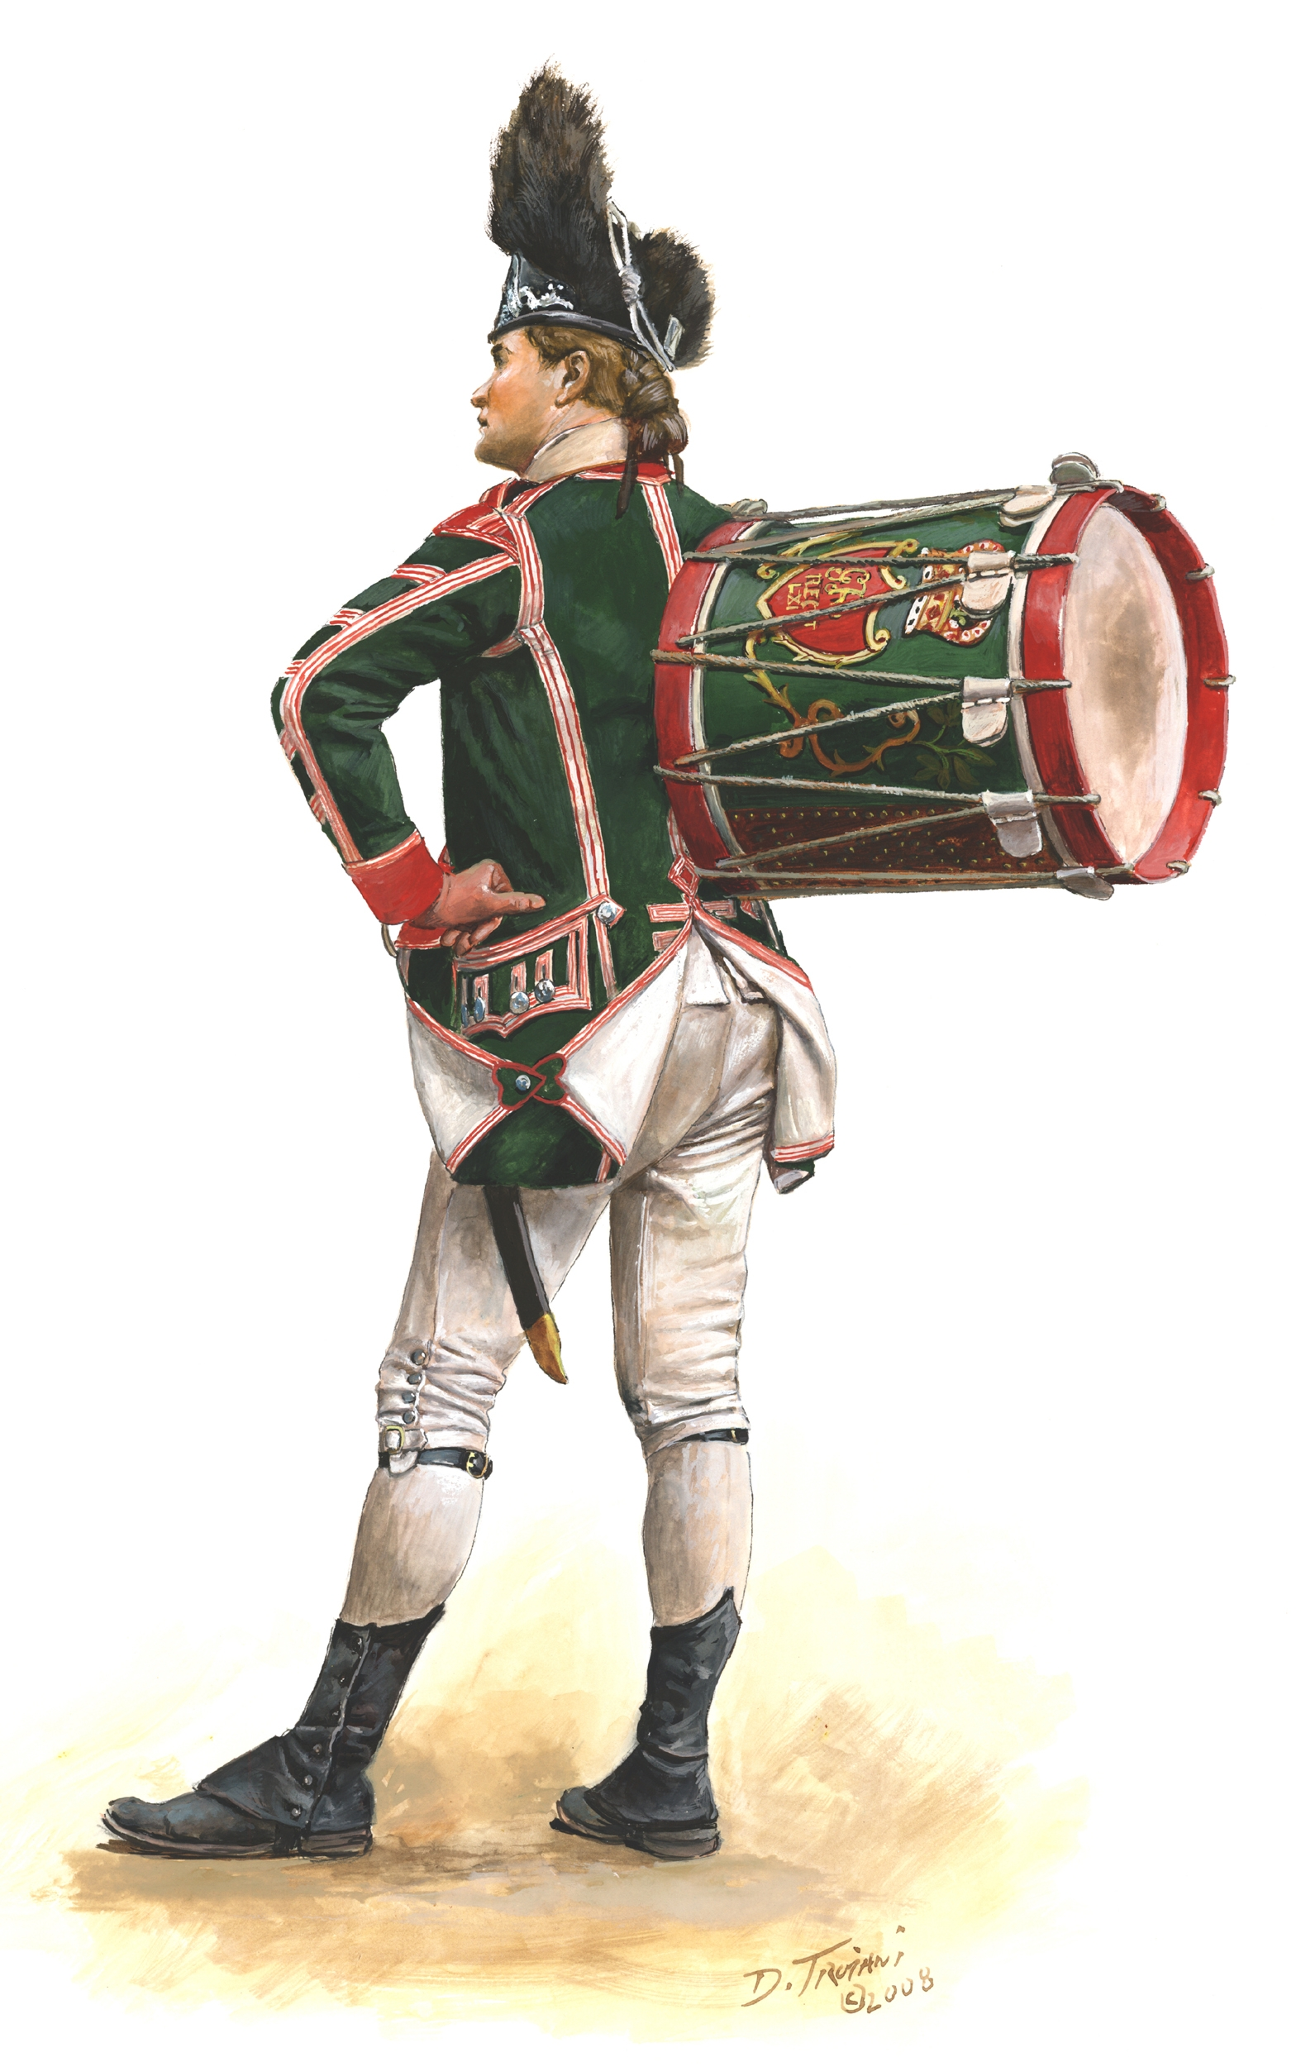
Explore! Traveling Trunk
Fife
Sheet Music
Drumstick
Notes:
Take time to explore the musical items in the Traveling Trunk. We can't send a drum, but there's a good image on this slide and the wooden drumsticks are with the Trunk.
You can end the lesson here and use the #2 and #3 Handouts. If time and interest permits, there are two extra slides with more music to explore!

Slide 22
(Extra) Listen!
This tune is called "The World Turned Upside Down."
The British Army musicians played it as they marched out to surrender to the Americans at Yorktown in 1781.
Notes:
Video clip is audio from Colonial Williamsburg
For more information about Yorktown and the surrender, please visit: https://www.battlefields.org/learn/revolutionary-war/battles/yorktown

Slide 23
(Extra) Listen!
"Yankee Doodle" is a favorite tune that was played by the Americans during the Revolutionary War.
Notes:
Video clip is audio from Colonial Williamsburg; there is a brief introduction and the music begins at the 18 second mark.

Slide 24
Special Thanks
Thank you to historical artist Don Troiani for allowing American Battlefield Trust to share his artwork for educational purposes.
In the order that they appeared in this PowerPoint:
"Lexington Common, April 19, 1775" (Slide 18)
"Battle of Trenton, December 26, 1776" (Slide 19)
"Washington at the Battle of Princeton, 1777" (Slide 20)
"63rd Regiment of Foot, 1776" (Slide 21)

