Slide 1
The Home Front During the American Revolution

Slide 2
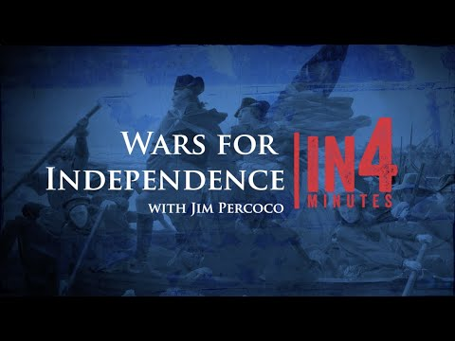
The Revolutionary War
Notes:
This slide offers a quick overview to the Revolutionary War to give some context to today's lesson.
The Revolutionay War started on April 19, 1775 with the Battles of Lexington and Concord in Massachusetts. The Siege of Yorktown in Virginia in 1781 was a major defeat for the British and led to the Treaty of Paris which officially ended the war in 1783.
Prior to the Revolutionary War, 13 American colonies belonged to Britian. INSERT LINK TO 13 COLONIES ARTICLE THAT IS WAITING TO BE PUBLISHED. Taxation without representation in the British Parliament was one of the many causes of conflict between the colonies and the Britian. After various appeals and attempts at reconciliation without success, and the American colonies united and rebelled, seeking liberty.
At the end of the Revolutionary War, the American colonies won their independence from Britian and became the first 13 states of the United States. The Declaration of Independence backed with the American victory led to the formation of the United States of America.

Slide 3
ESSENTIAL QUESTIONS
What is a homefront?
What were some of the experience of people on the homefront of the Revolutionary War?
Notes:
These essential questions can be used for classroom discussion, projects, or student essays.

Slide 4
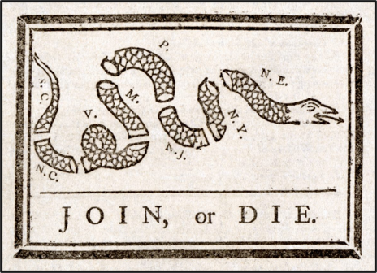
The Homefront
Definition: "the civilian population and activities of a nation whose armed forces are engaged in war abroad."
The American Revolution touched the lives of all people living in the colonies.
Notes:
Definition comes from Oxford Languages (2022)

Slide 5
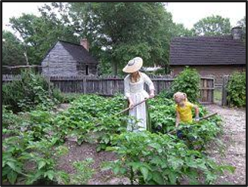
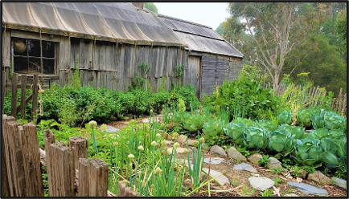
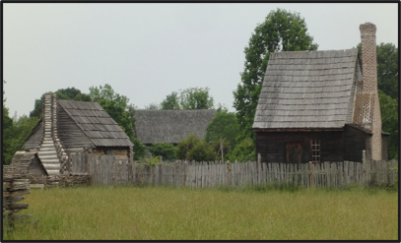
The Role of Those at Home
Tending to the Farm or Family's Business
Not all men enlisted for military service; some stayed on the homefront.
Some civilians sold food or other supplies to the armies.
Women looked after the home and did much of the gardening. They also cared for their children and did most of the sewing for their family.
Do you think you would have wanted to be a soldier or a homefront civilians during the Revolutionary War?
(Images courtesy of NPS &
Jamestown-Yorktown Foundation. )
Notes:
The roles of men and women were also distinct for their time. Men were supposed to provide for the family in which he belonged. Artisan professions were quite common in the major cities and towns. Other men took to the merchant trades or became wanderers on the frontier. A military career might provide fame and notoriety, but it rarely provided a stable income to sustain a family. Women, for the most part, were in charge of the household and child-rearing. Women could receive an education, in that they could learn to read and write in their youths at home for the sole purpose of passing down these skills to her children. Most women had no political rights of any kind. Few held property, and the ones who did had inherited it from their deceased husbands. This may have provided them with more wealth and influence than the majority of women, but it did not allow them to do much of anything but claim their holdings. Male children of wealthy and well-off parents received an education and were expected to enter careers in law, medicine, or the military. Less well-off male children usually found work before their teenage years as artisan apprentices in the trades. Girls were raised to find a suitable husband and prepare for motherhood. For the children of farmers, work usually started at a young age as boys were put to the field while girls were instructed on how to plant crops. Because of the threats of disease and early death, many farming families had large numbers of children to help assist in the daily duties of work. This practice continued well into the twentieth century.
https://www.battlefields.org/learn/articles/life-colonial-america-prior-revolutionary-war

Slide 6
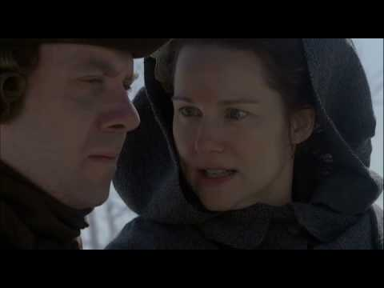
"This War Touches People"
In this video clip from the HBO Series "John Adams" (2008), Abigail Adams explains the difficulties of the war on the family on the homefront.
Notes:
For more information about the John Adams series and teaching Revolutionary War history with film: https://www.battlefields.org/learn/articles/teachers-guide-revolutionary-war-movies
Extra resources about John and Abigail Adams:
https://www.battlefields.org/learn/biographies/john-adams
https://www.battlefields.org/learn/biographies/abigail-adams
https://www.battlefields.org/learn/articles/adams-massachusetts

Slide 7
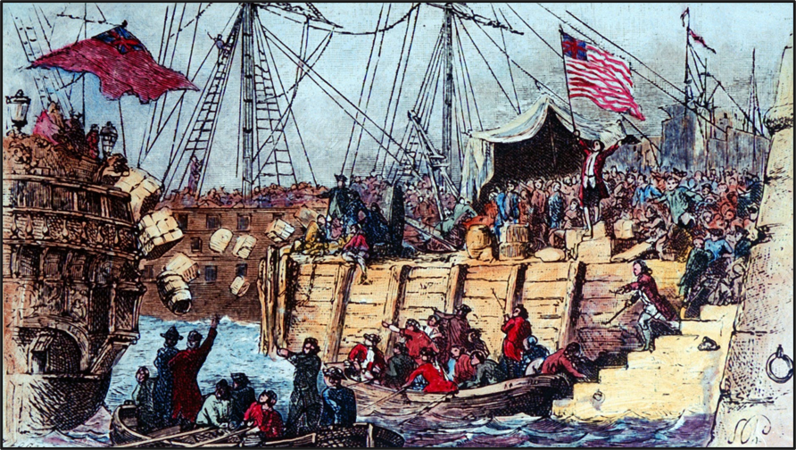
Challenging Times
Britian imposes taxes on the American Colonies in the 1760s and 1770's
The most infamous tax was on tea, a popular drink
The Boston Tea Party occurred on December 17, 1773, when angry Americans dumped tea from the cargo ships into the harbor.
Britian reacted sternly, further escalating the situation and uniting the colonies to protest "no taxation without representation"
(Image courtesy of NPS)
Notes:
Ten years before the North American colonies were in full rebellion against Great Britain, several decisions made by the British Parliament unknowingly chipped the first cracks in the relationship between the Mother Country and Her Subjects in America. Following the expensive Seven Years’ War (French & Indian War) which was fought between 1756-1763, the British Crown was heavily in debt. Parliament decided to enact new taxes on the colonies in order to bring in the needed revenue. But the sudden expectation that the colonists owed taxes to a distant governing body was miscalculated by British officials, and the seeds of discontent were planted, and a road to revolution had suddenly emerged.
King George III came to power in 1760, and unlike his predecessor, he immediately took an interest in Britain’s North American colonies. Whereas British colonial policy had long been lax, and what taxes were on the books were largely ignored or under-enforced, the new king was among those who came to see America as a rich landscape that benefited from British protection. A series of Acts levied taxes starting with the Sugar Act (1764), the Currency Act (1764), the Quartering Act (1765), and the Stamp Act (1765). The Stamp Act’s taxation prompted several colonial assemblies to file petitions of grievance to London and later convene the Stamp Act Congress. Around this time, groups like the “Sons of Liberty” formed to unite like-minded colonists and persuade Britain through written word or startling actions to take notice of the colonists’ feelings.
Over the next years, the British repealed some acts and added others. The Townshend Acts (1767) prompted a new wave of American frustration while the Boston Massacre (1770) and attacks on British troops leveled more restrictions against New England. Other colonies united to support New England, and the hated Tea Act (1773) culminated with the Boston Tea Party when chests of tea were emptied into the harbor rather than pay the tax. To retaliate, the British closed Boston Harbor and added the Coercive Acts (1774). The colonies responded by convening the First Continental Congress to semi-unite their resistance and coordinate their appeals to the king and British Parliament.
By 1775, the colonists and British troops around Boston were primed for an armed conflict, and “the shot heard ‘round the world” was fired on April 19, 1775 at Lexington — starting the American Revolution.
Additional Resources:
Stamp Act Congress: https://www.battlefields.org/learn/articles/what-was-stamp-act-congress
Townshend Act (Article): https://www.battlefields.org/learn/articles/townshend-revenue-act
Intolerable Acts (Article): https://www.battlefields.org/learn/articles/intolerable-acts
Quartering Act (Article): https://www.battlefields.org/learn/articles/quartering-act
Primary Source: https://www.battlefields.org/learn/primary-sources/tea-act
Primary Source: https://www.battlefields.org/learn/primary-sources/boston-port-act

Slide 8
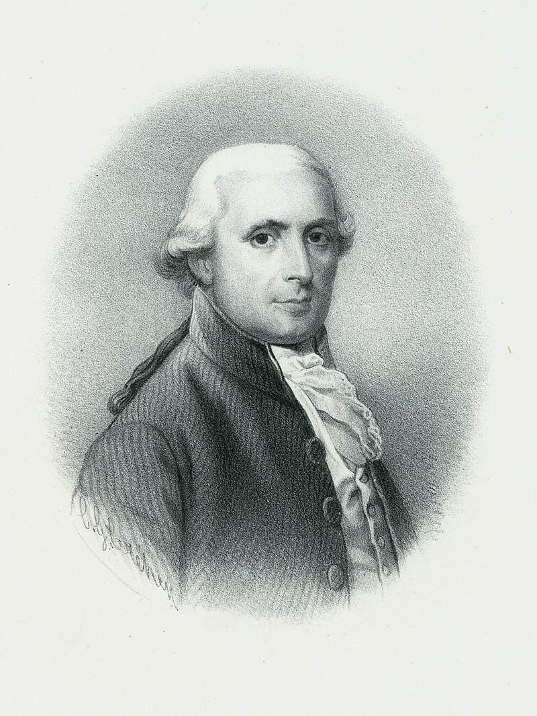
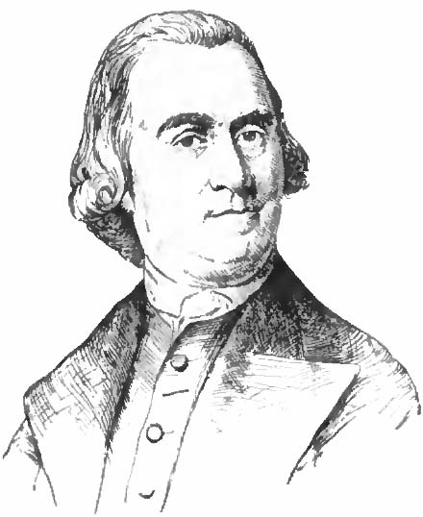
Who's Who?
Loyalist (Tory)
Patriot (Whig)
Lived in the American Colonies/States
Supported Britian
Sometimes abused or hurt by their Patriot neighbors
Welcomed the arrival of British troops
Did not like the Declaration of Independence
Some fought alongside troops from England
Lived in the American Colonies/States
Supported Independence from Britain
Liked the Declaration of Independence
Many organized militias or committees to rebel against Britain
Many fought in militias or the Continental Army
Many supported their cause politically or financially
Do you think you would have been a Loyalist or a Patriot if you lived during the Revolutionary War? Why?
Notes:
Whig and Tory, members of two opposing political parties or factions in England, particularly during the 18th century. Originally “Whig” and “Tory” were terms of abuse introduced in 1679 during the heated struggle over the bill to exclude James, duke of York (afterward James II), from the succession. Whig—whatever its origin in Scottish Gaelic—was a term applied to horse thieves and, later, to Scottish Presbyterians; it connoted nonconformity and rebellion and was applied to those who claimed the power of excluding the heir from the throne. Tory was an Irish term suggesting a papist outlaw and was applied to those who supported the hereditary right of James despite his Roman Catholic faith. From https://www.britannica.com/topic/Whig-Party-England
Photo Credits:
https://en.wikipedia.org/wiki/Richard_Bayley
https://commons.wikimedia.org/wiki/File:Appletons%27_Adams_Samuel.jpg

Slide 9
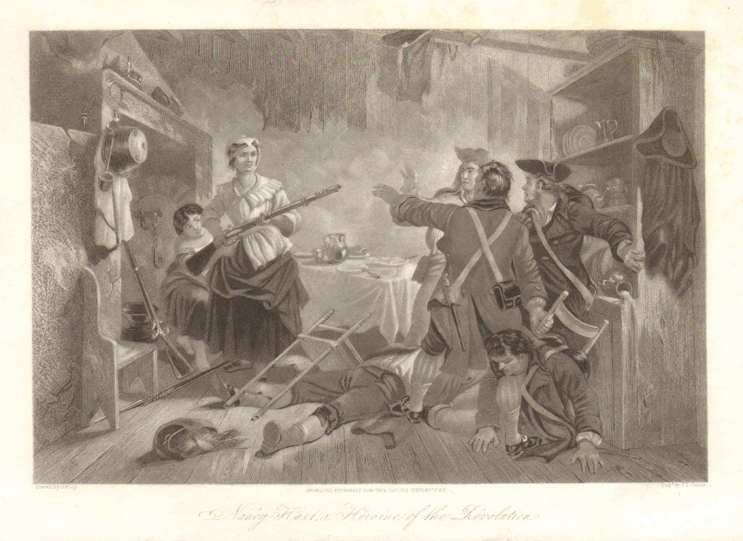
Neighbors Against Neighbors
While the armies fought on the battlefields, civilians on the homefront sometimes came in conflict with each other over their Loyalist or Patriot beliefs.
This strife was particularly bad during the Southern Campaigns in the Carolinas (1779-1782)
Notes:
The American Revolution, while not often called a civil war by modern historians, was referred to as a civil war in its first year, until William Henry Drayton, South Carolina’s chief justice, first used the term "American Revolution" in 1776.
Photo Credits:
https://commons.wikimedia.org/wiki/File:Nancy_Morgan_Hart.gif
https://www.battlefields.org/learn/biographies/nancy-hart

Slide 10
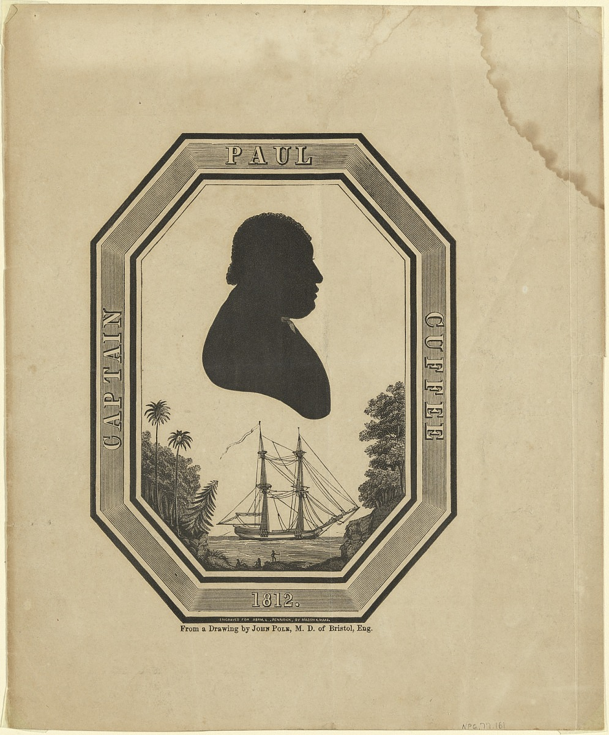
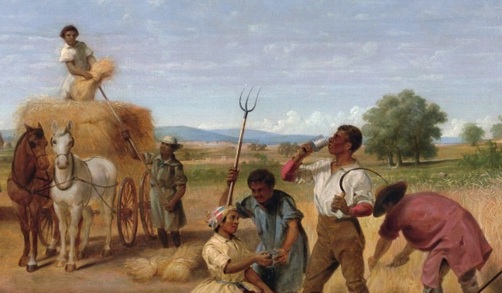
Enslaved and Free Men
Notes:
It is crucial to understand that at the time of the War for Independence the institution of slavery was practiced in all thirteen colonies. As the public opinion in the colonies moved towards Independence, Congress organized the Continental Army. States were expected to supply troops for the new army and regiments were organized and designated by states after Independence was declared in 1776. Almost immediately they questioned whether or not free blacks living in the states could join the Continental Army. In the early phase of the war they could not, but as fighting continued and men were needed in the ranks, things began to change. In some cases, free blacks who enlisted served side by side with white patriots in the same units, but the Army created segregated units later on.
The results of the War for Independence were mixed for African Americans. Many northern states outlawed slavery after the war, with Vermont being the first new state to join the Union whose state constitution prohibited it. In some northern states, free African Americans who lived there were even granted the franchise for a limited time. This did not mean that African-Americans possessed full equality, however. While northern states abolished slavery, black people still could not officially serve in the military. For southern Loyalists who held slaves, when they evacuated America after the war they took their slaves with them, particularly those who chose to resettle in the British colonies in the Caribbean. (https://www.battlefields.org/learn/articles/african-americans-and-war-independence)
Photo Credits:
https://en.wikipedia.org/wiki/Paul_Cuffe
https://npg.si.edu/object/npg_NPG.77.161
https://commons.wikimedia.org/wiki/File:Junius_Brutus_Stearns_-_George_Washington_as_Farmer_at_Mount_Vernon.jpg

Slide 11
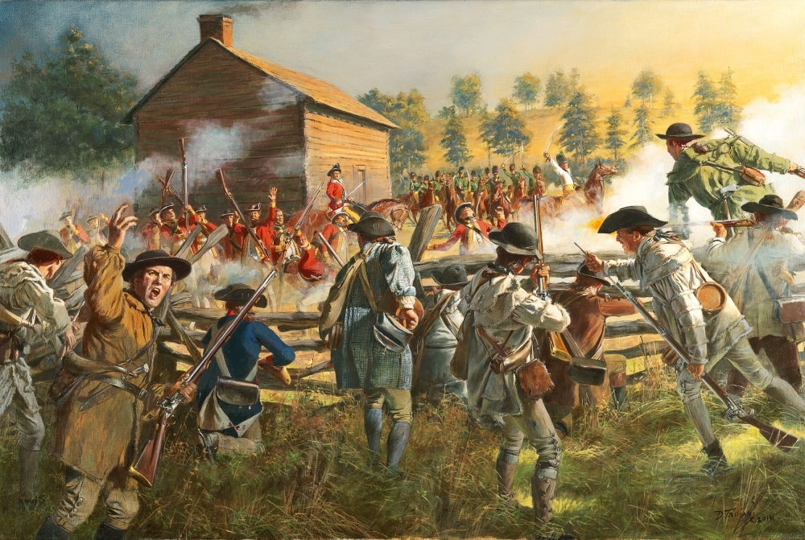
Battle & Soldiers in the Backyard
The battles of the Revolutionary War were not fought on designated fighting fields. Instead, the combat raged across the private & public fields, lanes, farms, and town streets of the homefront.
The damages from the battles along with the wounded and fallen soldiers left behind were often an unexpected consequences to the civilians. Sometimes the destruction forced neutral civilians to choose a side in the war.
Notes:
The Revolutionary War came to cities like Boston, New York, Philadelphia, and Charleston, sometimes with actual battle or other times with military occupation. Many other battles were fought in the countryside, across civilian property or farms. Whether in the cities or countryside, the battles of the Revolutionary War directly impacted civilians and the homefront.
For Example:
Ordinary women also endured the horrors of the battlefield when those fights came to their doorstep. Sally Kellogg of Vermont and her family escaped the gods of War in 1776 when the War for Independence found its way into the northern reaches of upstate New York and Benedict Arnold’s makeshift fleet and the British Navy clashed on Lake Champlain during the Battle of Valcour Island. As the Kellogg family made good its escape by water, Sally’s family “fell in between Arnold’s fleet and the British fleet,” she later recalled. As the family rowed to safety at Fort Ticonderoga, the exchange of gunfire between ships could be seen and heard Sally recalled, “but happy for us the balls went over us. We heard them whis.” Nevertheless, the war continued to follow the Kellogg family. A year later, after having relocated to Bennington, Vermont the Kelloggs were once more forced to be witnesses to carnage and once again upon recollection Sally claimed the results were, “a sight to behold. There was not a house [in Bennington’s vicinity] but was stowed full of wounded. (From https://www.battlefields.org/learn/articles/women-american-revolution)
The largest battles of the Revolutionary War https://www.youtube.com/watch?v=bUjyJgyuIWg&list=PLZrhqv_T1O1tvL3ZSrkcQg68NZOje93dC&index=17

Slide 12
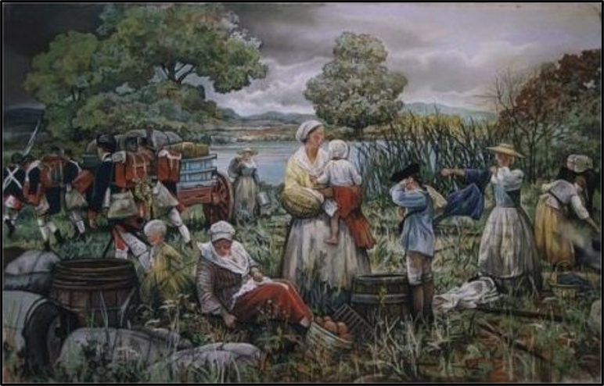
Families & The War
Some families followed their soldiers (both Loyalist and Patriot).
The women and children sometimes felt safer traveling at the back of the army than staying at their home with unfriendly neighbors.
Other times, their homes had been destroyed and they few other choices.
(Image courtesy of revwar75.com )
Notes:
Women often followed their husbands in the Continental Army. These women, known as camp followers, often tended to the domestic side of army organization, washing, cooking, mending clothes, and providing medical help when necessary. Sometimes they were flung into the vortex of battle. (More details about women in battle on the next slide.)
As wives of the common soldier often followed the Continental Army so, too, did the wives of general officers. General Henry Knox, the Continental Army’s Artillery Commander married the vivacious and popular Bostonian Lucy Flucker, the daughter of Bostonian Loyalists. Once she and Henry were married, all ties between her and her family were cut. Henry and Lucy were devoted to one another and she would join him whenever she could while he was on campaign. She endured the bitter encampment at Valley Forge and became fast friends with the wife of General Nathanael Greene, the equally popular Kitty. George Washington’s wife, Martha Custis, spent every winter with her husband wherever the army was camped. In fact, once George Washington left his beloved Mount Vernon estate in 1775 to attend the 2nd Continental Congress in Philadelphia, he did not return to his home until 1781, as the combined American and French Army maneuvered south from the city of New York to Yorktown, Virginia, where the war was eventually won. The wives of generals were as equally helpful in matters of caring and providing compassion to sick and wounded soldiers, as were the wives of the common soldiers. (Text from: https://www.battlefields.org/learn/articles/women-american-revolution )

Slide 13
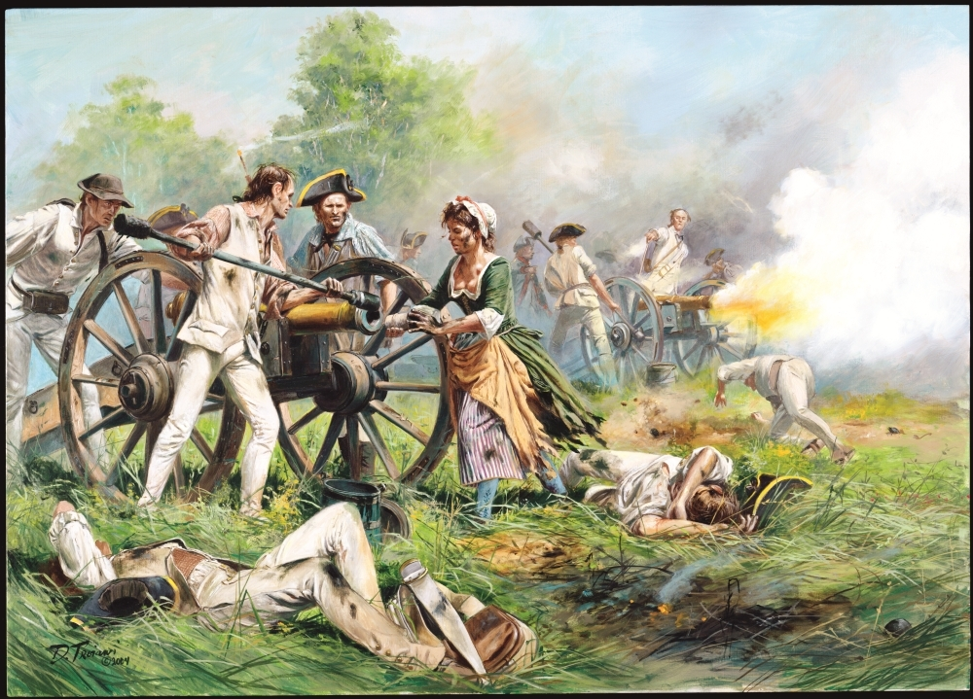
Civilian Women on the Battlefield
Several accounts tell about women who had been traveling with the army who fought on the battlefield.
Several women helped to fire cannons after their husbands had been killed or injured. The most famous of these women was called "Molly Pitcher" since before helping with the cannon she had been carrying water to the soldiers.
Notes:
Mary Ludwig Hays, better known as Molly Pitcher, who earned fame at the Battle of Monmouth in 1778. Hays first brought soldiers water from a local well to quench their thirst on an extremely hot and humid day and then replaced her wounded husband at his artillery piece, firing at the oncoming British. In a similar vein, Margaret Corbin was severely wounded during the British assault on Fort Washington in November 1776 and left for dead alongside her husband, also an artilleryman, until she was attended by a physician. She lived, though her wounds left her permanently disabled. History recalls her as the first American female to receive a soldier’s lifetime pension after the war.
(Some women disguised themselves and enlisted in the army. Deborah Sampson is the best known. However, once they formally enlisted they were no longer civilians.)
Extra Resources:
https://www.battlefields.org/learn/biographies/molly-pitcher
https://www.battlefields.org/learn/articles/molly-pitcher-and-battle-monmouth
https://www.battlefields.org/learn/articles/women-american-revolution

Slide 14
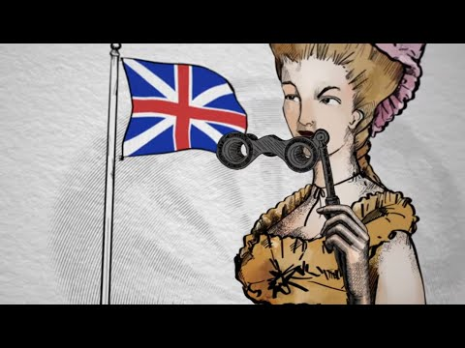
Spies!
Peggy Shippen
Culper Spy Ring
Need to make a short video
Notes:
During the American Revolution, both the British and patriot armies employed spies to gather information about the enemy. Both armies relied on spies to gather information on troop strength and morale, access to and availability of munitions and supplies and intended plans to march or attack. British commanders found intelligence gathered by loyalist sympathizers useful, which often included details about geography and terrain unfamiliar to the British army. Some spies served for long periods or even the duration of the war, while others performed only singular acts of espionage when duty called, or when opportunities presented themselves.
Many spy rings were active during the American Revolution, but perhaps the most famous is the Culper Spy Ring, comprised of a group of civilian and military officials working together to gather intelligence for Washington while the British army occupied New York. Under the direction of Benjamin Tallmadge, agents Abraham Woodhull, Caleb Brewster, Anna Strong, Austin Roe, and others spied on the British beginning in 1778 and for the duration of the war. The agents choose pseudonyms—Tallmadge was known as “John Bolton,” while Woodhull became known as Samuel Culper, the namesake of the group. Tallmadge also devised a numerical substitution system, with numbers standing in for words, locations, and important names (for example, Washington’s numerical code was 711). The spy ring employed systematic tactics of dead drops, codes were hidden in plain sight (a petticoat hanging from Anna Strong’s clothesline could indicate the location of a meeting or that a message was available at a dead drop), and even messages written in invisible ink with ciphers and coded letters. Washington himself was active in directing the agents’ secret communications. From his headquarters at West Point in September 1779, Washington wrote to Tallmadge instructing agents to write messages with invisible ink on pocketbooks, almanacs, or pamphlets, which British agents were less likely to search than common letters. The Culper Ring was extremely successful and is responsible for uncovering a British plan to bombard the French fleet off the coast of Rhode Island. (Text from: https://www.battlefields.org/learn/articles/spies-revolutionary-war )
Extra Resources:
https://www.battlefields.org/learn/biographies/peggy-shippen
https://www.battlefields.org/learn/articles/10-facts-benedict-arnold-and-peggy-shippen
https://www.battlefields.org/learn/articles/spies-revolutionary-war

Slide 15
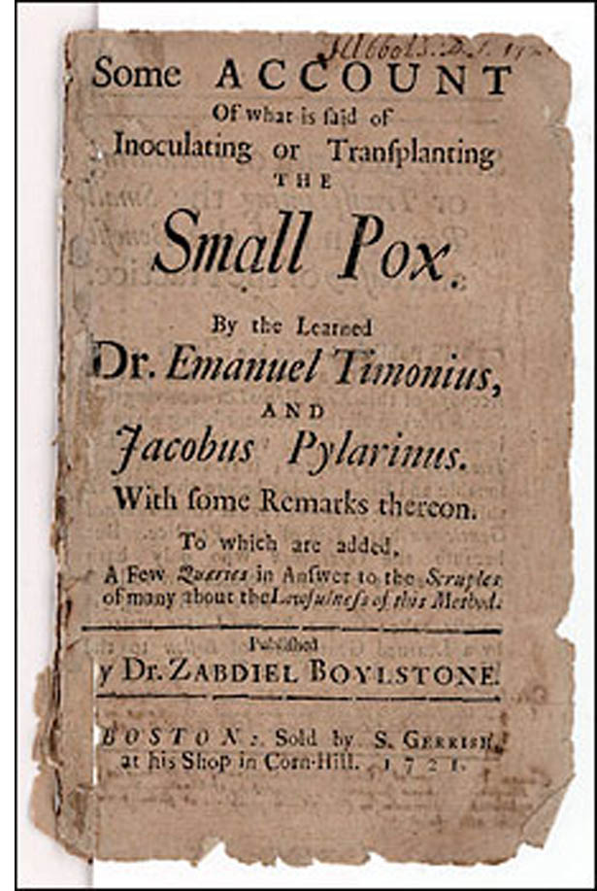
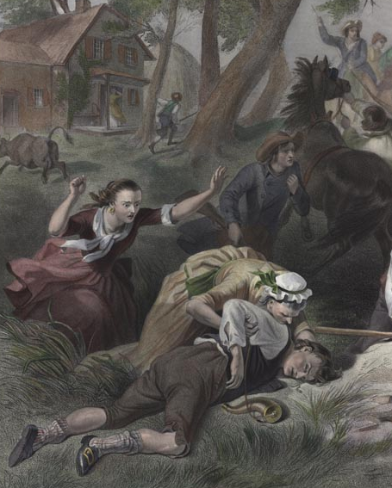
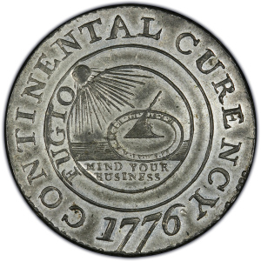
Hardships of War
Food supply
Smallpox
Loss of loved ones
Men away from home
"Valueless" money
Knowing who to trust
Notes:
The homefront in America during the Revolutionary War experienced many difficulties, even if the military didn't come directly to their community. The civilian's food supply could be reduced if the men were away from home and not able to help with the planting and harvesting; also the armies could take or destroy the food. Disease and severe illnesses were very common in the 18th Century, and a smallpox endemic swept through the armies and the homefronts, killing many. Soldiers who died in battle or from disease were mourned by their homefront families and friends. The money issued by states or Continental Congress had very little backing or credit, meaning that the money lacked value or was highly inflated. Communities divided over patriot and loyalist causes, adding uncertainty to family life.
Extra Resources:
https://www.battlefields.org/learn/articles/washington-inoculates-army
Photo Credits:
https://www.brown.edu/Administration/News_Bureau/2002-03/02-017.html
http://oldprintshop.com/product/147513
https://en.wikipedia.org/wiki/Continental_Currency_dollar_coin#/media/File:1776_Continental_Currency_dollar_coin_obverse.jpg

Slide 16
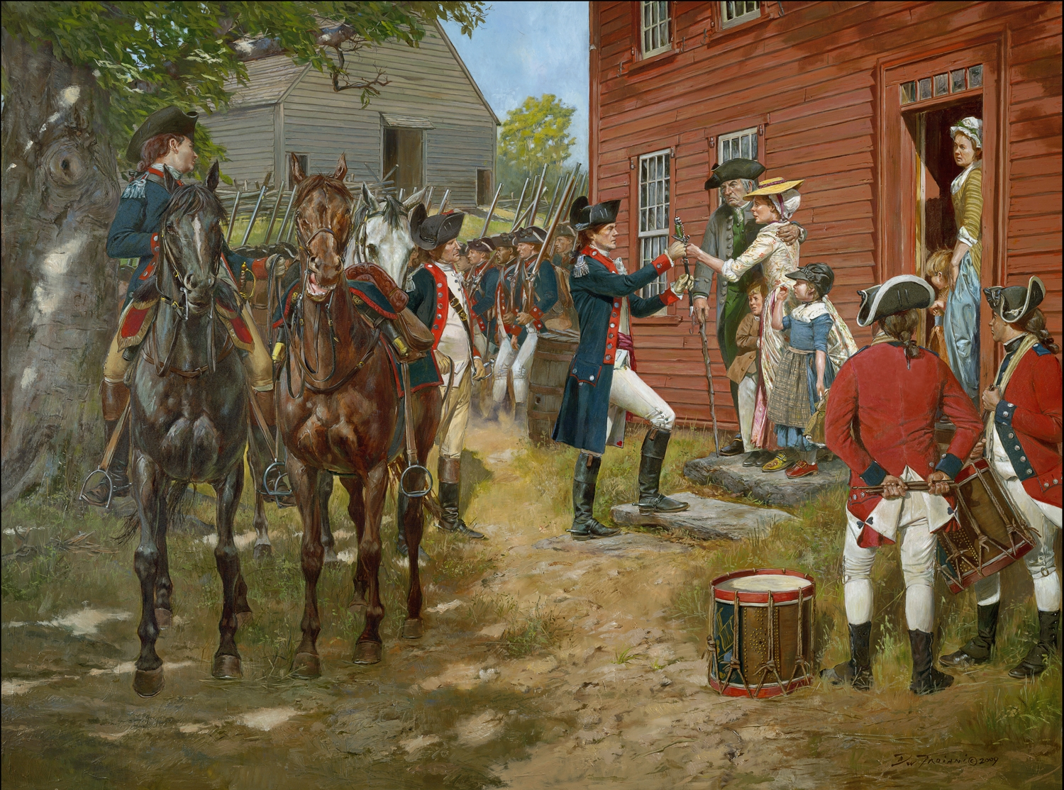
The War Affected Everyone
Everyone in the colonies/states was affected by the Revolutionary War in some way.
The homefront's important role is sometimes forgotten, but they were part of the struggle for liberty and the founding of the United States of America.

Slide 17
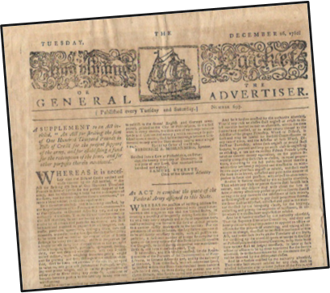
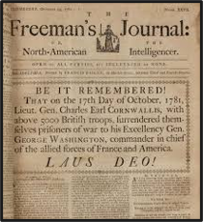
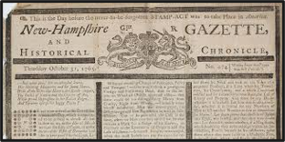
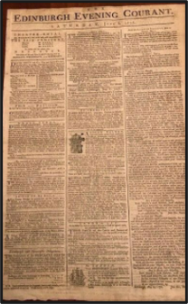
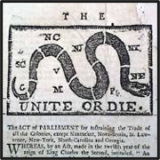
Staying Informed
Notes:
Primary Sources "are immediate, first-hand accounts of a topic, from people who had a direct connection with it." (University of Massachusetts Boston)
Examples: Diaries, Letters, Law or other original legal documents, Newspaper reports by eyewitnesses, Historic photographs, video, or recordings about an event
Newspapers and pamphlets allowed communities share ideas across the states and were very helpful for semi-uniting the Patriots at the beginning of the war and keeping them informed and inspired as the conflict progressed. One of the most famous writers, Thomas Paine, wrote inspirational commentary and essays in favor of the Patriot cause.
Thomas Paine
https://www.battlefields.org/learn/biographies/thomas-paine
(Video) https://www.battlefields.org/learn/videos/thomas-paine
(Short Video about Common Sense by Thomas Paine) https://youtu.be/3dZz5JW3wA4
See Newspapers.com for newspapers from the era. https://www.newspapers.com/topics/american-revolution/

Slide 18
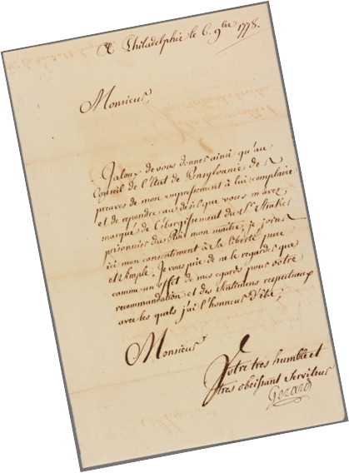
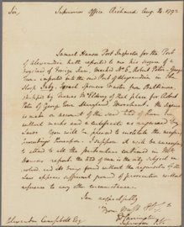
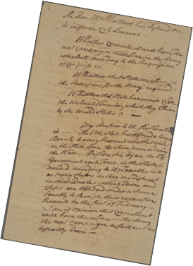
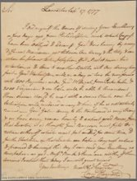
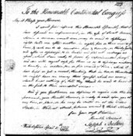
Letters:
Writing about Life & Decisions
Notes:
Letters, an important form of communication in the 18th Century, also created important primary sources for researchers to study. The letters that survived and are preserved in archives, museums, and other collections contain opinions about politics, the war, local communities, families, relationships, hopes, dreams, beliefs, and more. They give insight to the thoughts, feelings, and happenings of famous and common people of the era. Oftentimes, the letters help to explain the decisions that led to the founding of the United States.
Extra Resources:
https://www.battlefields.org/learn/primary-sources/massachusetts-circular-letter-colonial-legislatures-february-11-1768
https://www.battlefields.org/learn/primary-sources/circular-letter-boston-committee-correspondence
Letter from Abigail Adams to John Adams, March 1776: https://www.masshist.org/digitaladams/archive/doc?id=L17760331aa

Slide 19
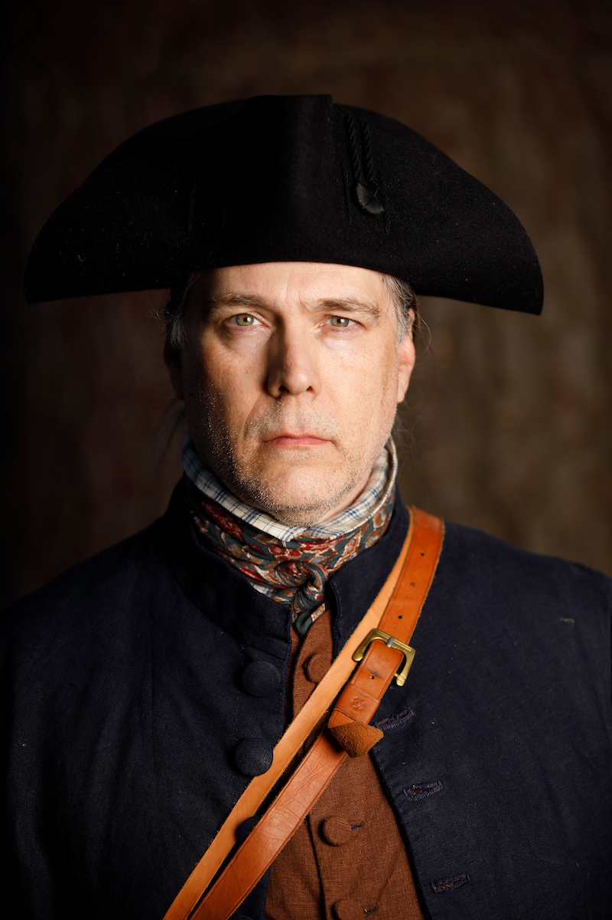
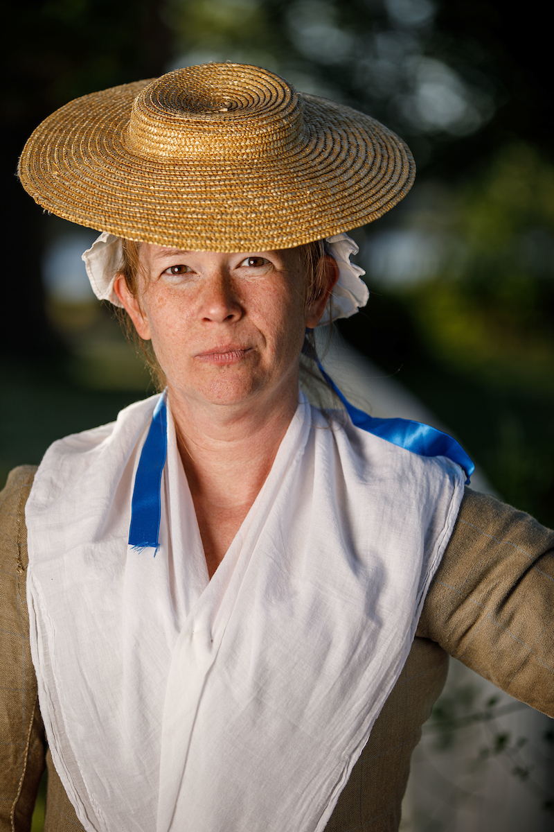
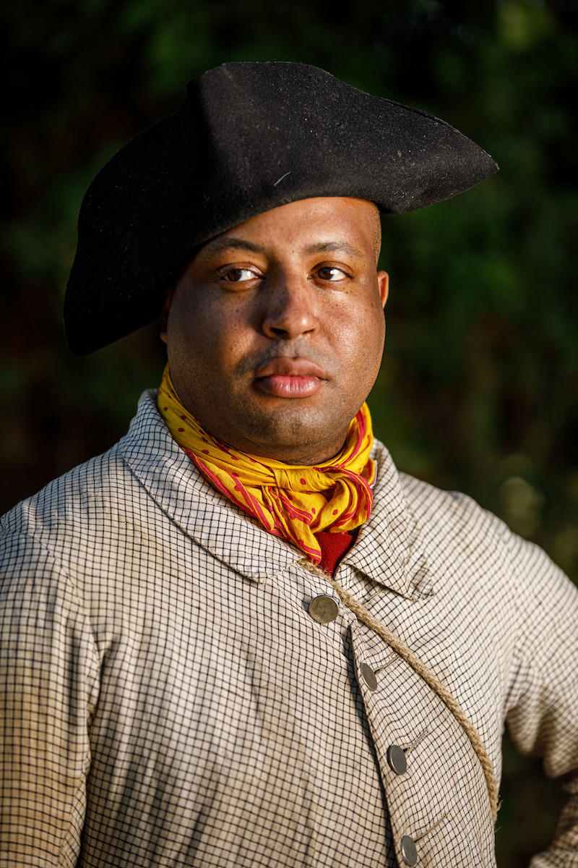
Thinking About Decisions
Notes:
Questions to consider:
What were the roles of non-combatants? Farmers, nurses, merchants, camp followers
What was at stake staying near one of the armies? Risk of catching a disease such as influenza, smallpox, typhoid, etc. The armies could take your livestock, food, or other belongings. Freedom for slaves located close to an army through either enlistment in an army or the emancipation promised by the British army.
What difficult decisions had to be made during the Revolutionary War that particularly affected the homefront?
How do we know about these decisions? Primary Sources
How do you think you might have decided?

Slide 20
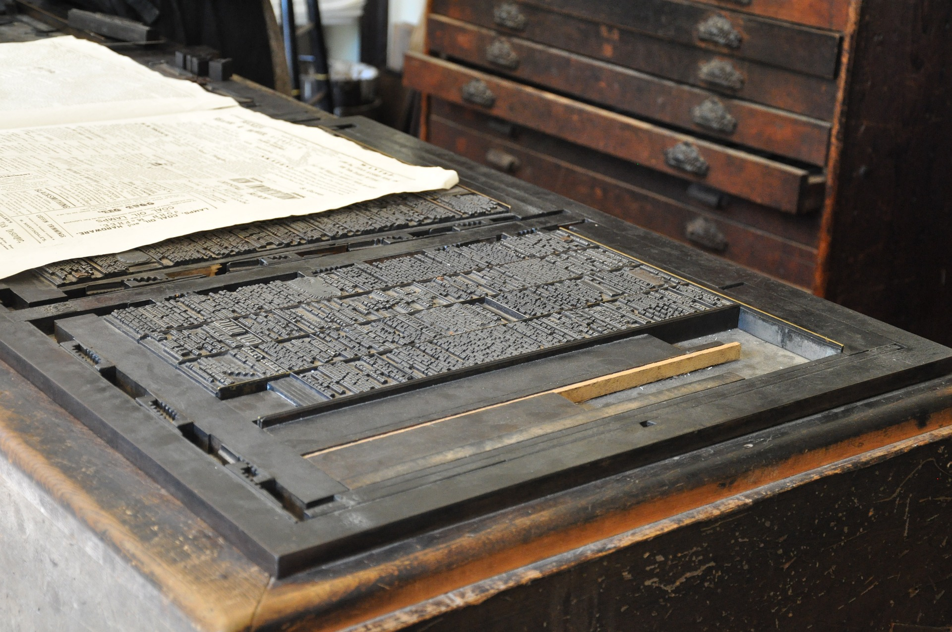
Hand Out #1: Forms of Communication
Notes:
This slide can be displayed while using Hand Out #1. See the Lesson Plan for more details.
(Photograph of a sheet of type for a printing press)

Slide 21
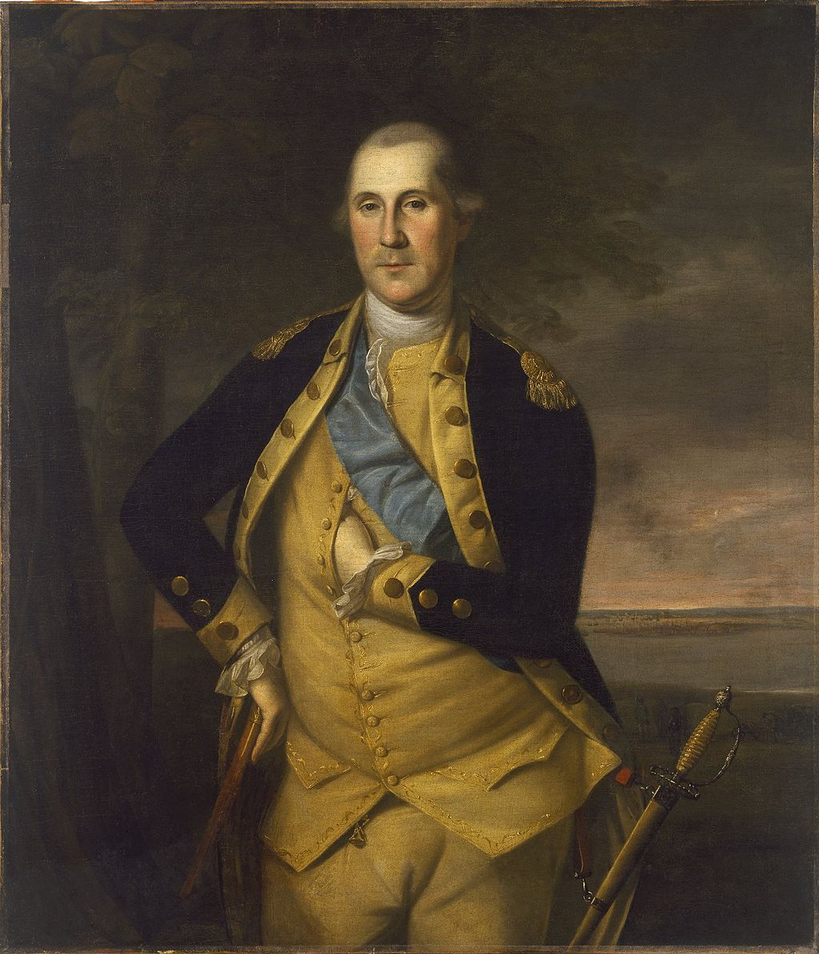
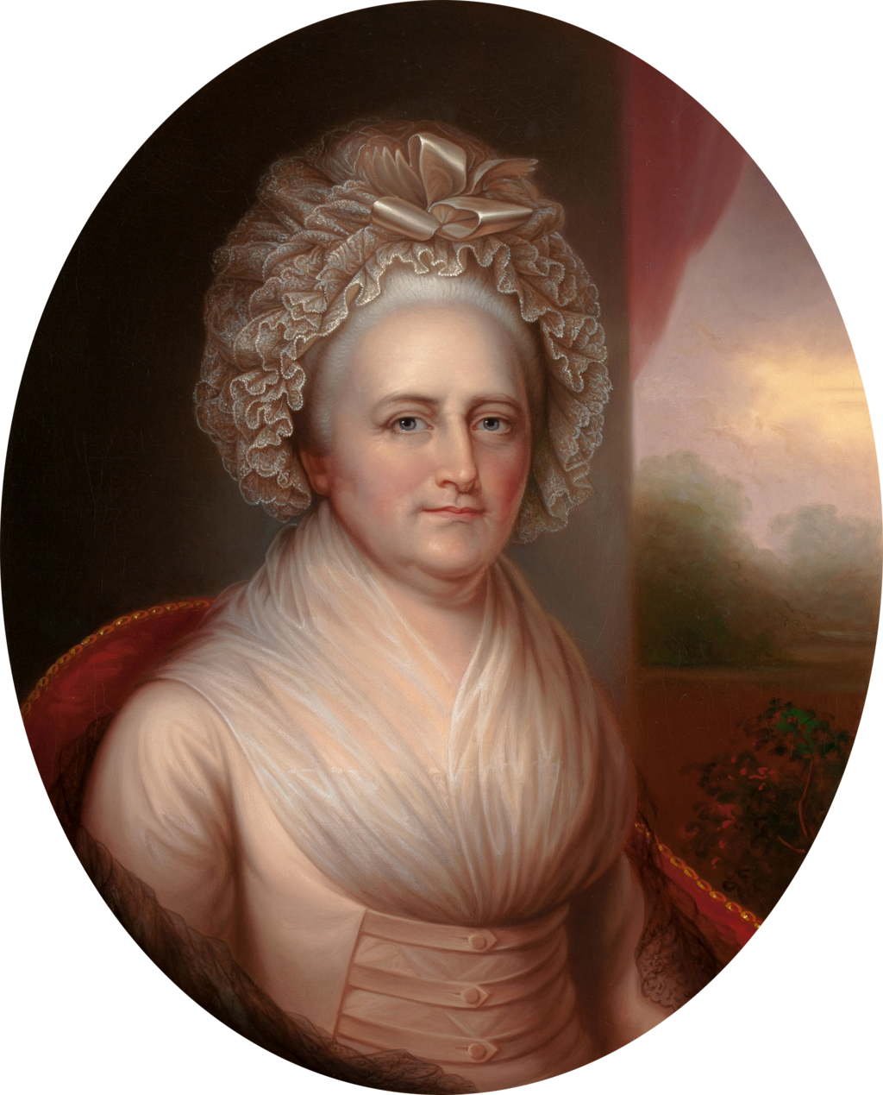
Hand Out #2: Washington Letter
Notes:
This slide can be displayed while using Hand Out #2. See the Lesson Plan for more details.
Extra Resources about George and Martha Washington:
https://www.battlefields.org/learn/biographies/george-washington
https://www.battlefields.org/learn/articles/martha-washington-americas-first-first-lady
https://www.battlefields.org/learn/articles/george-washingtons-rise-rebellion

Slide 22
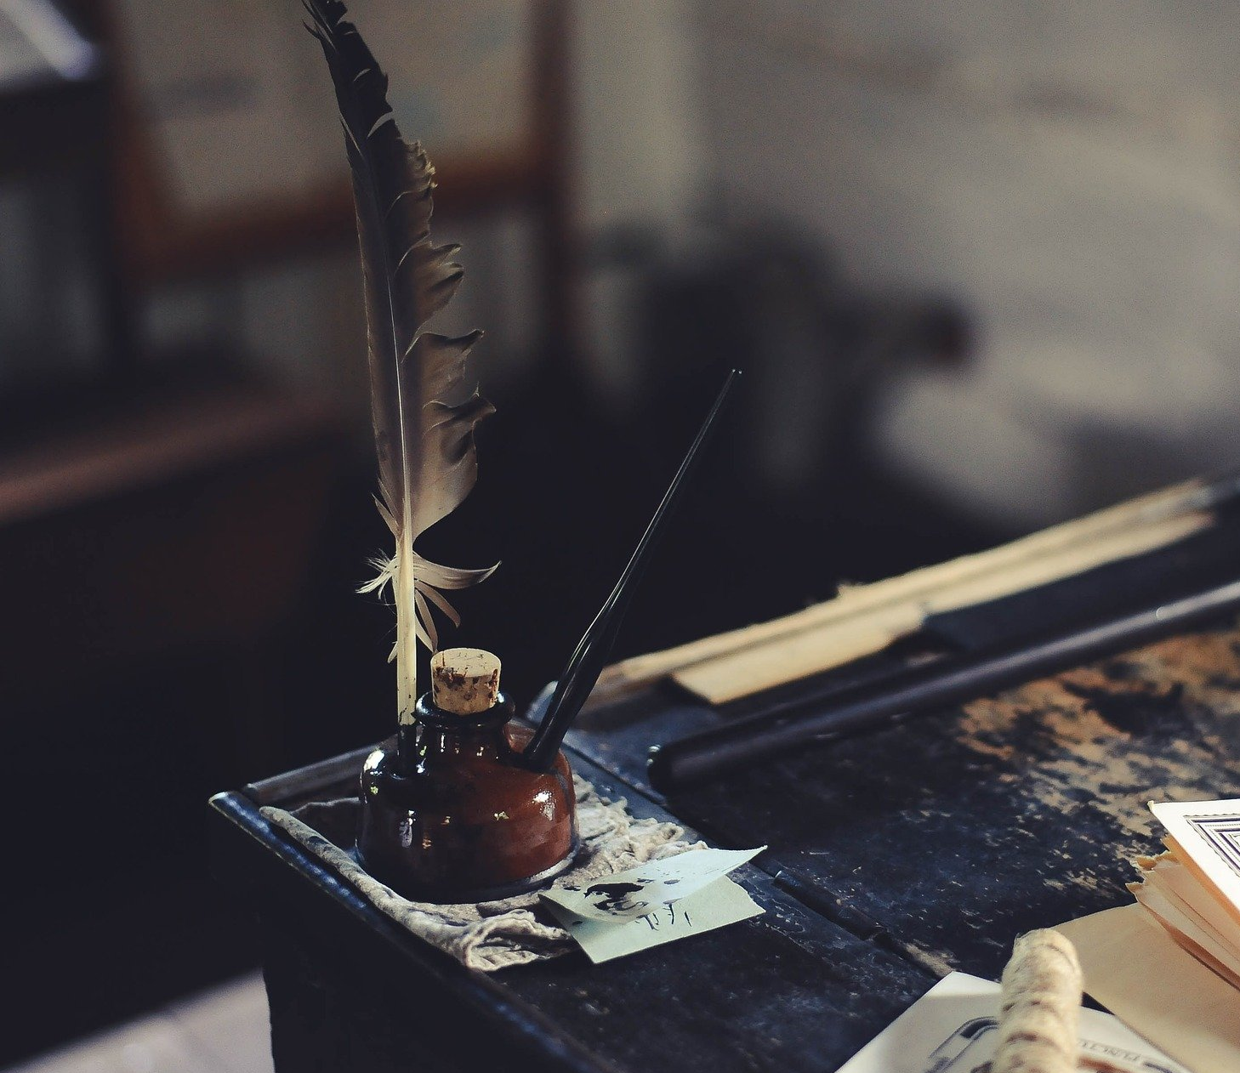
Hand Out #3: Letter Writing
Notes:
This slide can be displayed while using Hand Out #3. See the Lesson Plan for more details.
Extra Resource:
Video about Quill Pens https://youtu.be/bbBd1BJaY7Y

Slide 23
Special Thanks
Thank you to historical artist Don Troiani for allowing American Battlefield Trust to share his artwork for educational purposes.
INSERT CREDITS HERE

