Slide 1
Revolutionary War Camp Life
The American Battlefield Trust

Slide 2
The Revolutionary War
1775-1783
Colonial America vs. Britian
Outcome: American Independence from Britian and the beginning of the United States
Notes:
This slide offers a quick overview to the Revolutionary War to give some context to today music lesson.
The Revolutionay War started on April 19, 1775 with the Battles of Lexington and Concord in Massachusetts. The Siege of Yorktown in Virginia in 1781 was a major defeat for the British and led to the Treaty of Paris which officially ended the war in 1783.
Prior to the Revolutionary War, 13 American colonies belonged to Britian. INSERT LINK TO 13 COLONIES ARTICLE THAT IS WAITING TO BE PUBLISHED. Taxation without representation in the British Parliament was one of the many causes of conflict between the colonies and the Britian. After various appeals and attempts at reconciliation without success, and the American colonies united and rebelled, seeking liberty.
At the end of the Revolutionary War, the American colonies won their independence from Britian and became the first 13 states of the United States. The Declaration of Independence backed with the American victory led to the formation of the United States of America.

Slide 3
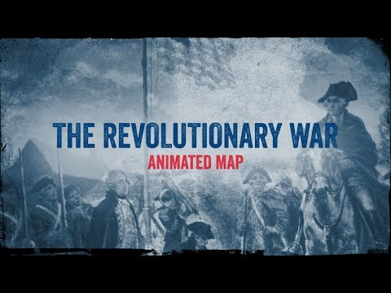
Animated Map
Notes:
The Animated Map is ~19 minutes in length. It can be used as an introduction to the different campaigns and overall war history, if desired.
Here is the link, if the embedded video is not playing: https://youtu.be/0JLvRJzvOic
Extra Resources:
https://www.battlefields.org/learn/articles/overview-american-revolutionary-war
https://www.battlefields.org/learn/articles/american-revolution-faqs
https://www.battlefields.org/learn/articles/american-revolution-timeline

Slide 4
ESSENTIAL QUESTIONS
How did soldiers of both sides during this war pass the time when they were not in combat or on the march?
What was it like to be in winter quarters at Valley Forge or Morristown?

Slide 5
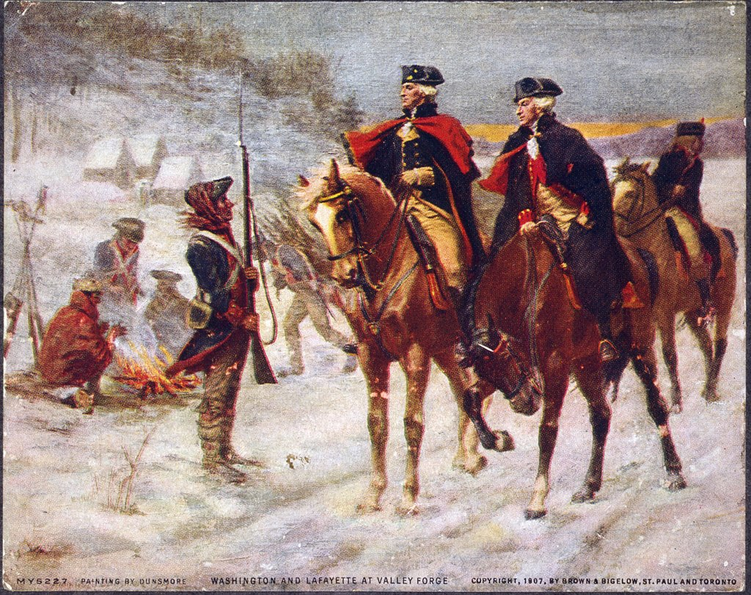
Winter Camps
Did you know?
There were 8 Winters during the Revolutionary War.
The British usually encamped in or near a city while the American tended to choose strategic locations and construct their sheltering camp.
The well-known American winter camps were at Morristown & Valley Forge.
Notes:
Bad weather and impassable roads made the Winter a difficult time for 18th century armies. Military leaders during this period tried to avoid military operations during this trying season. Yet, even when not on active campaign, soldiers struggled against the weather and the boredom of life in winter quarters to try and bring some semblance of home and comfort to the holiday season.
Image Credit:
Washington and Lafayette at Valley Forge, John Ward Dunsmore, 1907. (Public Domain)

Slide 6
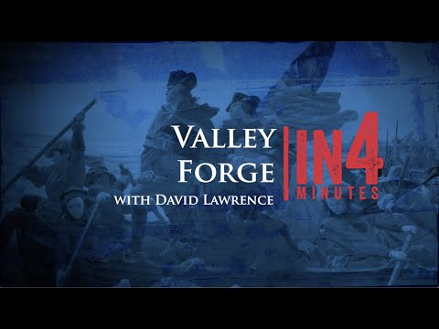
Valley Forge In4Minutes
Notes:
Here is a link in case the embedded video is not playing: https://youtu.be/0pUSiVep0RU
Extra Resource Links for Valley Forge are found in the next slide's notes.

Slide 7
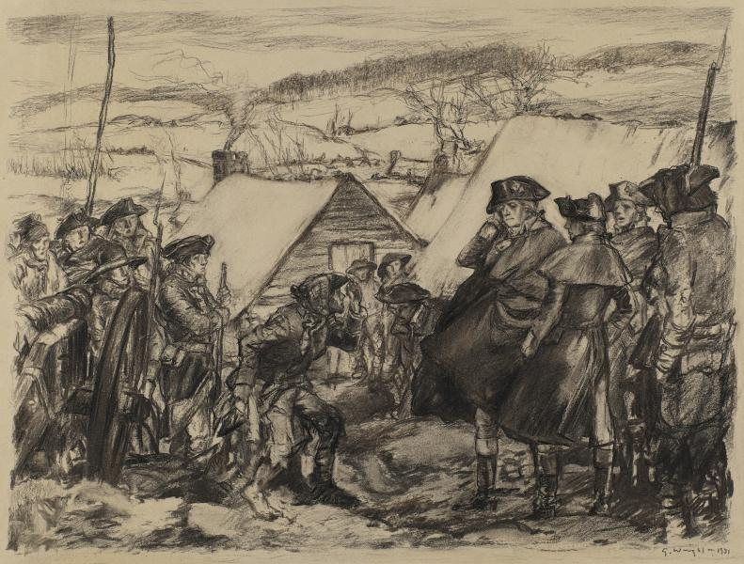
Valley Forge – Winter 1778
The Continental Army spent the winter of 1777-1778 at Valley Forge, Pennsylvania.
Though difficult, this winter became a turning point for the Continental Army as the soldiers transformed into a trained fighting force.
Notes:
In December 1777, General George Washington moved the Continental Army to their winter quarters at Valley Forge. Though Revolutionary forces had secured a pivotal victory at Saratoga in September and October, Washington’s army suffered defeats at Brandywine, Paoli, and Germantown, Pennsylvania. The rebel capital, Philadelphia, fell into British hands.
Only 20 miles from British-occupied Philadelphia, in eastern Pennsylvania, Valley Forge presented a strategic location that allowed Washington's army to stay close to the city while maintaining a defensible position that offered access to clean water and firewood. However, the army’s supply of basic necessities, like food and clothing, ran perpetually short; coupled with the wintertime cold, and the diseases that ran rampant through the camp, this lack of provisions created the infamously miserable conditions at Valley Forge.
Approximately 12,000 Continental soldiers, as well as smaller numbers of African American and Native American soldiers camped at Valley Forge. A number of women and children were also present at Valley Forge, having joined their husbands or family members in the encampment.
While wintering in the camp, soldiers worked together to build huts for shelter, but unsanitary conditions, and shortages of food and blankets contributed to the disease and exhaustion which continually plagued the camp. The lack of clothing alone, including shoes, socks, and coats left as many as 3,000 of Washington's troops unfit for service, creating the image of starving, wearied soldiers leaving bloodied footprints in the snow and ice. Diseases like typhus and smallpox, and a lack of protection from the elements caused the death of more than 2,000 soldiers.
Despite brutal conditions, Valley Forge marked a milestone in the army's military experience. In February 1778, Baron Friedrich von Steuben arrived at Valley Forge and worked to bring uniformity to the continental soldiers, who had seen combat, but lacked the martial training to pose an effective threat to the British. He developed a system of drill for the entire army and taught the men combat maneuvers that equipped them to rival the well-trained British regulars.
News of a French alliance with the Americans came in May 1778, a few weeks before the army’s departure from camp in June of the same year. Valley Forge was significant not only for the reshaping Washington’s army, but for the dedication, endurance, and resilience demonstrated by the Americans in their cause for Independence.
Extra Resources:
https://www.battlefields.org/learn/articles/valley-forge-encampment
https://www.battlefields.org/learn/articles/winter-valley-forge
https://www.battlefields.org/learn/articles/10-facts-valley-forge
https://www.battlefields.org/learn/articles/nathanael-greene-quartermaster-general
https://www.battlefields.org/learn/biographies/polly-cooper
Photo Credit:
https://americanart.si.edu/artwork/washington-valley-forge-28271

Slide 8
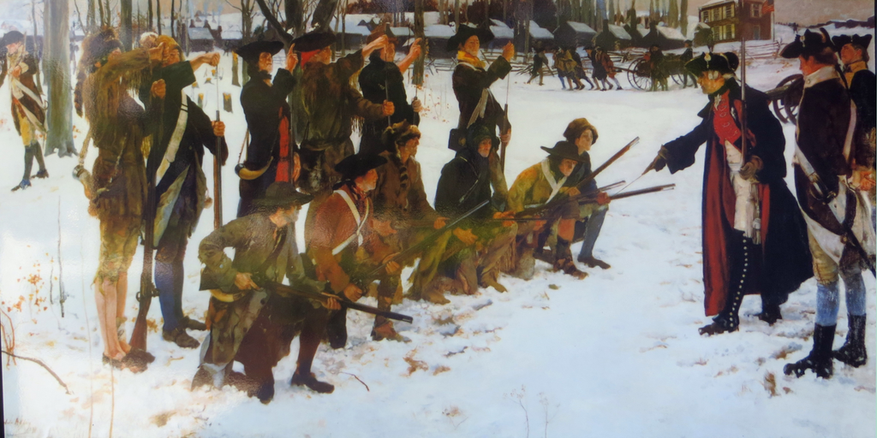
Drilling & Winter Camps
Notes:
Drilling and military training took place in many winter camps during the Revolutionary War, but it is highly associated with the winter of 1777-1778 at Valley Forge. Baron Frederich von Steuben instituted a training program at Valley Forge that helped create a more professional army.
The supposed “baron” arrived during the winter and took the role of acting inspector general until the position became vacant. He was instrumental in training a model company the rudiments of military drill and in turn created a system of training. His lack of English initially did not provide a hindrance. He also recognized the need to amend European regimented training models to fit the psyche of the American volunteer soldier.
Extra Resources:
https://www.battlefields.org/learn/biographies/baron-von-steuben
https://www.battlefields.org/learn/articles/foreign-fighters-american-cause-independence
Image Credit:
An Edwin Austin Abbey painting of Baron Steuben drilling American troops at Valley Forge in 1778 (Public Domain)

Slide 9
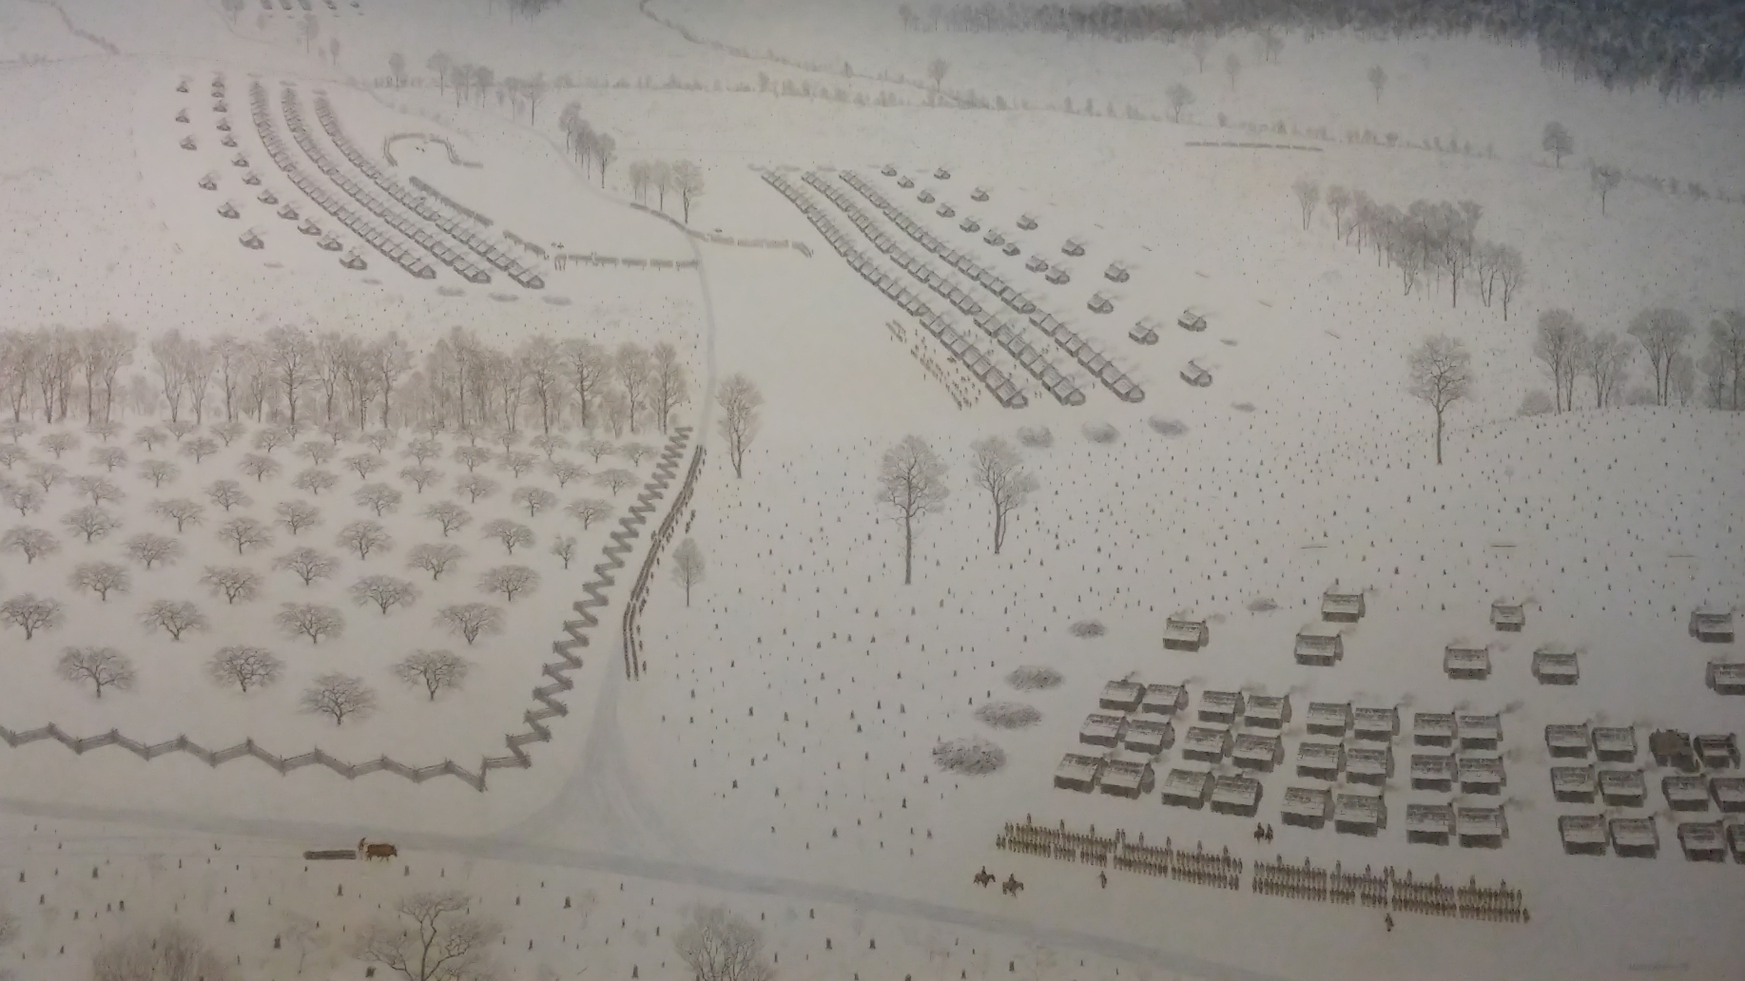
Morristown – 1780 Hard Winter
The Continental Army spent the winters of 1777 and 1780 near Morristown, New Jersey.
The Winter of 1780 was the worst winter that the American army endured during the Revolutionary War.
Notes:
The first time George Washington encamped his army near Morristown (1777), they had just won the Battles of Trenton and Princeton. The general choose the location strategically. Located between Philadelphia and New York City, it allowed the Continental Army to keep watch on the main British Army at New York City while the Watchung Mountains offered some natural defenses for the American camp. Washington also hoped that the local residents and land would provide enough food and supplies for his army. The 1777 Winter Encampment is particular remembered for Washington's efforts to inoculate his army against the dreaded smallpox disease.
The second time the Continental Army returned to Morristown for the winter (1779-1780) is known as the "Hard Winter." After marching into Morristown in December of 1779, Washington’s troops settled in a mountainous region nearby called Jockey Hollow. The Continental soldiers cut down thousands of acres of timber to construct a “log house city” of more than a thousand wooden structures which accommodated about twelve men each. The site also included parade grounds and officers’ quarters. An estimated 10-12,000 soldiers camped at Morristown, although desertions and deaths reduced the number to only about 8,000, and Washington claimed that as many as one third of these troops were unfit for duty.
Extreme cold proved to be one of the army’s greatest trials during the winter at Morristown. Though Valley Forge is remembered for its harsh conditions, that winter in Morristown, Washington’s troops faced even bitterer cold than they had witnessed in Pennsylvania a few years before. Known as “the hard winter,” the season bridging the end of 1779 and early 1780 proved to be one of the coldest on record. Morristown received twenty-eight snowfalls during the Continental Army’s residence there, adding to the miserable conditions the troops faced in the wake of the shortages of food and supplies. Shoes, shirts, and blankets were scarce, making conditions even more bleak as soldiers sought to fend off hunger and cold.
Shortages of food and other provisions also posed a constant challenge for the army at Morristown. The inclement weather added to the difficulty in transporting available supplies to the army. Financial problems presented another source of difficulty for the Continental Army during the winter encampment at Morristown. Many soldiers had not been paid for months, adding to their frustrations and increasing the risk that they would desert or choose not to continue supporting the war effort. In the spring, regiments from the Connecticut Line staged a mutiny in the camp, retaliating against the delayed wages and shortages of basic supplies. Though the small insurrection was quickly put down, it provided a stark reminder of the army’s dissatisfaction and demoralized state.
Much like Valley Forge, the winter encampment at Morristown, New Jersey became an important symbol of patriotism and persistence in the American Revolution. In the winter of 1779-1780, the Continental Army’s perseverance and determination to overcome the challenges they faced prepared them for the final campaigns that would eventually secure American Independence.
Extra Resources:
https://www.battlefields.org/learn/articles/morristown-winter-encampment
https://www.battlefields.org/learn/articles/washingtons-encampment-morristown-new-jersey-and-hard-winter-1779-1780
Image Credit:
Morristown National Historical Park Collection

Slide 10
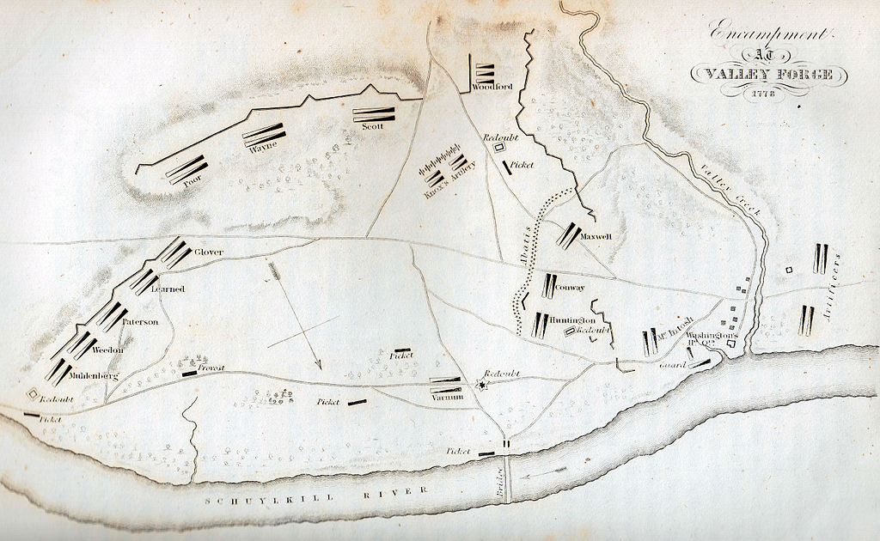
What's Need at a Winter Camp Encampment Site?
Land Space
Good Water
Forest/Wood Supply
Local Provisions for Sale
Notes:
When the good-weather campaign months were over, armies of both sides needed more permanent quarters for the winter months. It was an arduous task, requiring far more work than a camp while on campaign. The first task for a winter camp was finding a location that met the needs of a large army.
A winter campsite needed to have clean, fresh water as well as firewood, both in ample supply. The campsite also needed plenty of space to accommodate the large number of men and animals in the army. (Text from Lesson Plan Overview)
Extra Resources:
https://www.battlefields.org/learn/articles/getting-food-continental-army
Photo Credit
The encampment at Valley Forge in 1778 (1830 engraving by G. Boynton)

Slide 11
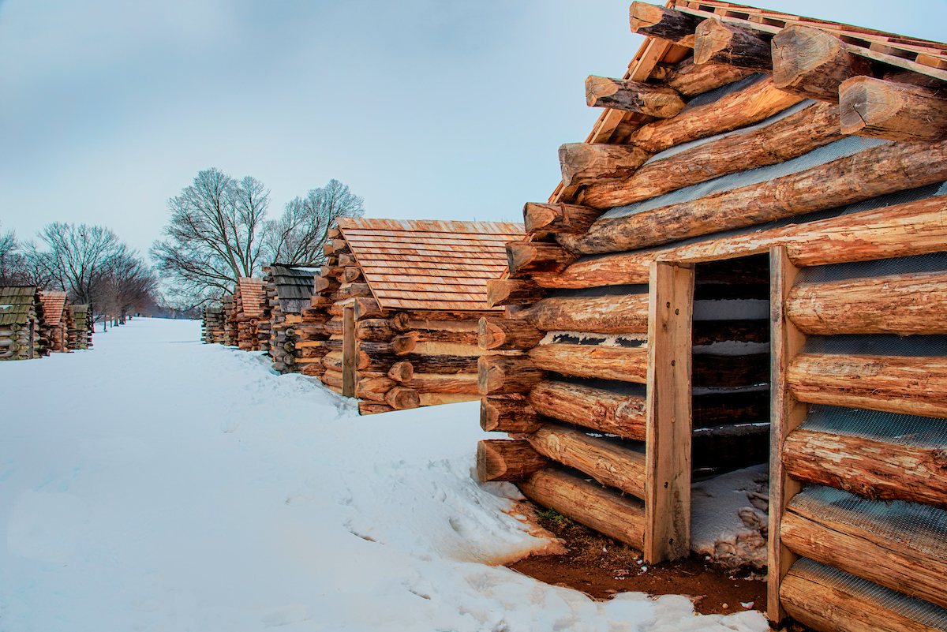
Activity #1: Constructing Huts
Notes:
Start Activity #1 from the Lesson Plan
Photo Credit:
American Battlefield Trust photo collection

Slide 12
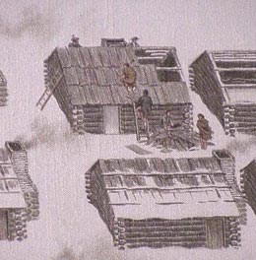
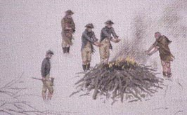
Building Shelter
What could be some added difficulties of building a winter hut?
Notes:
This optional slide can be shown and used for discussion during Activity #1
Photo Credits:
https://www.nps.gov/morr/faqs.htm

Slide 13
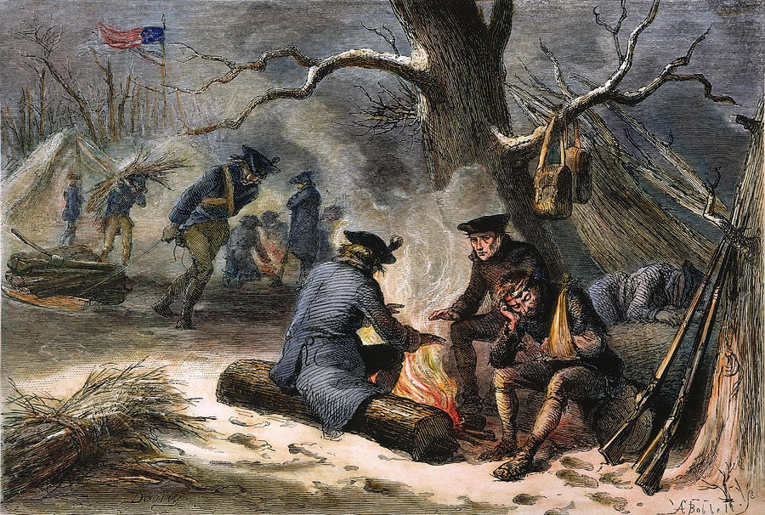
Life in a Winter Camp
  How did soldiers pass the time around the fire and in their huts?
  What games and other pastimes did soldiers partake in?
  What was food prep like while in camp?
Notes:
https://pixels.com/featured/4-valley-forge-winter-1777-granger.html?product=beach-towel

Slide 14
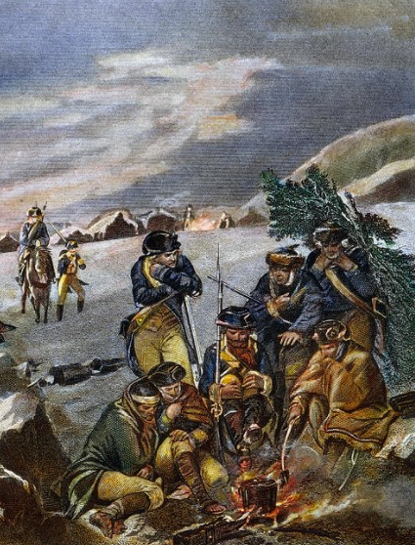
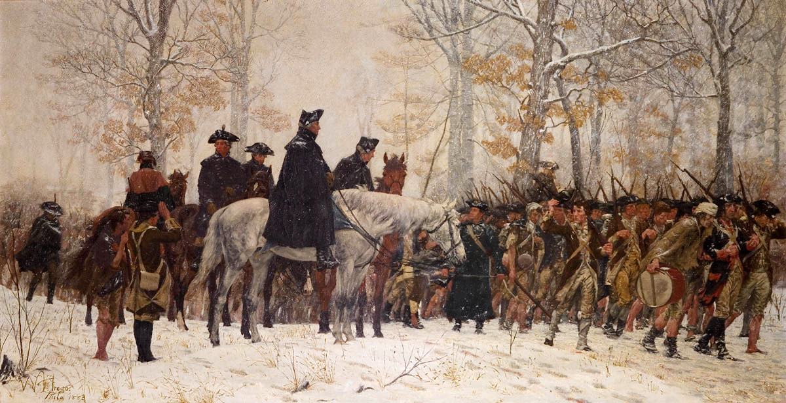
Activity #2: Writing Letters
Notes:
This slide can be used with Handout #2 from the Lesson Plan
Photo Credits:
https://fineartamerica.com/featured/washington-valley-forge-granger.html
The_March_to_Valley_Forge_William_Trego.png

