Slide 1
The Home Front
The Civil War Curriculum

Slide 2
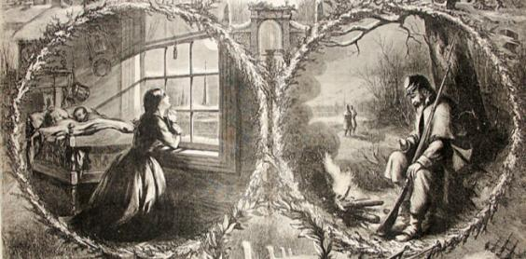
The Home Front
The Civil War touched the lives of every American family,
North and South.
Notes:
Almost every family had a son, husband, sweetheart, brother or father away at war. For those who remained behind, the Civil War changed their lives forever.
Discussion Questions:
What does the kneeling woman symbolize?
What is the soldier doing?
Look at the pictures along the bottom of the slide. Describe the actions taking place.

Slide 3
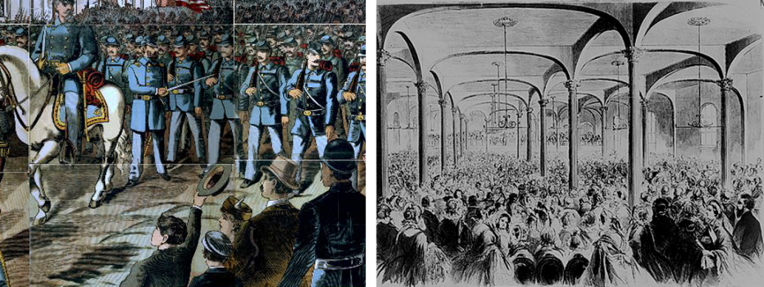
The Home Front
Notes:
Men March to War Across the Divided Nation (left)
Women Mobilize to Support The Army (right)
Picture on Left - Union soldiers and band march through a city in the woodcut “Off to the War.”
Picture on Right - Great meeting of the ladies of New York at the Cooper Institute, on Monday, April 29, 1861, to organize a society to be called "Women's Central Association of Relief," to make clothes, lint bandages, and to furnish nurses for the soldiers of the Northern Army

Slide 4
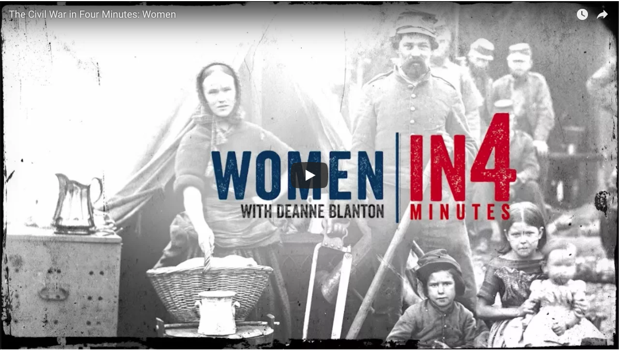

The Role of Women
Activity:
Watch The Role of Women
Notes:
Watch the In4 video on Women in the Civil War https://www.battlefields.org/learn/videos/women-civil-war

Slide 5
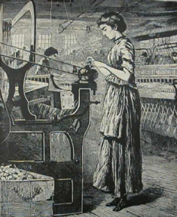
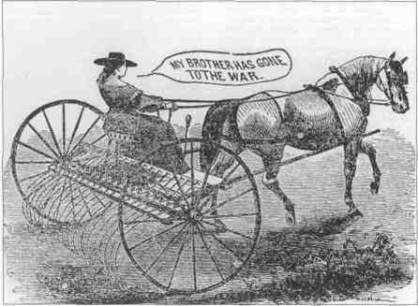
The Role of Women
Life must go on.
Women in the North and South take over men's work.
Notes:
Notes for the Teacher: With so many men at war, women had to take on more responsibility. In the South, women on plantations took charge, serving as plantation mistresses and managing vast numbers of slaves while their husbands were away at war. Most Southern women took on the back-breaking strain of agricultural labor, often doing work that their husbands and sons would normally have done. In the North, women bore the brunt of manufacturing jobs and/or the farm work as well as taking care of the family. Both North and South, women were vital to the war effort to supply the armies with food, clothing, and supplies.
Discussion Question:
What jobs did women take up when the men were called to war?
What jobs or tasks did women continue to do?

Slide 6
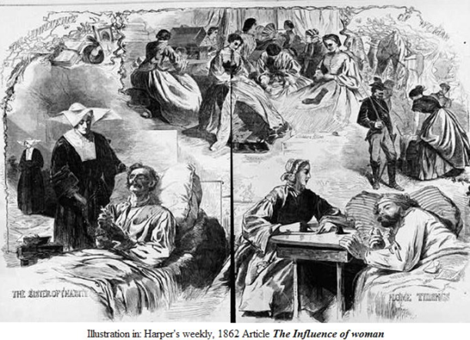
The Role of Women
Notes:
At this point, women had not traditionally been nurses, this had been a man’s job. However, with the Civil War, women marched right out onto the field and into the hospitals insisting that they could and would care for the wounded and dying.
Discussion Question:
What actions are women taking to support the soldiers in the picture?

Slide 7
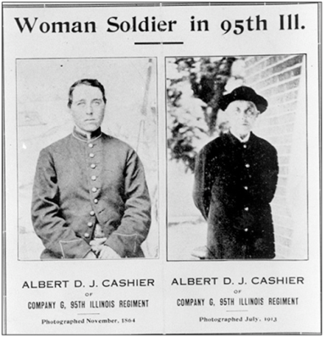
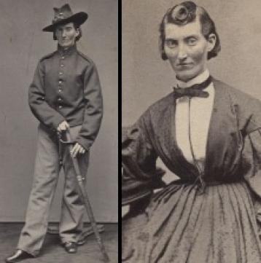
The Role of Women
Some women disguised themselves as men and marched off to war
Notes:
Discussion:
Why do you think a women would disguise herself as a man to join the army and fight in the war?
Notes for the Teacher: Early in the war recruiting examinations were cursory. Later, because of rampant illness and disease, recruits received careful and complete physical examinations. The lax medical examination early in the war allowed some women to sneak through and serve in the army disguised as men. Jenny Hodgers, known during the war as Private Albert Cashier joined the 95th Illinois Infantry in August 1862 and served for more than three years. She participated in many campaigns, including those at Vicksburg, the Red River and Mobile. Hodgers continued to wear men’s clothes until 1911, when a doctor discovered her identity while mending her fractured leg. She continued to receive a soldier’s pension and at her death in 1915 and was buried with full military honors.

Slide 8
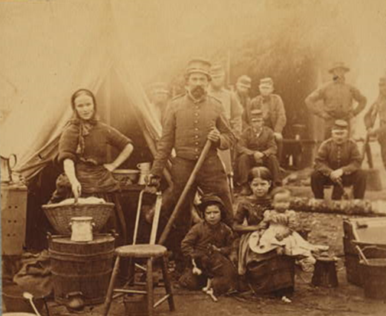
The Role of Family
Notes:
Sometimes families followed soldiers into the army.
Discussion Question:
What do you think life was like for children in camp?

Slide 9
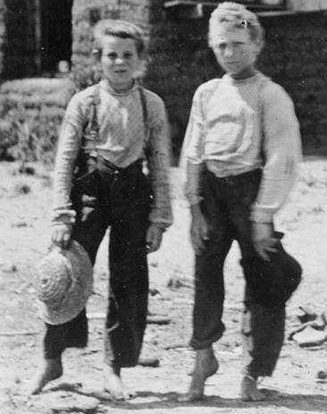
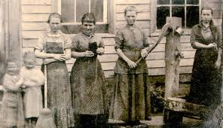
The Role of the Family
Notes:
Children worked the fields for the family while their fathers and older brothers were away at war.
Discussion Question:
Why would the children have to work in the fields more?

Slide 10
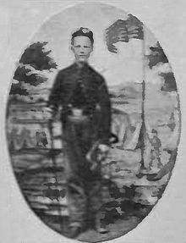
The Role of the Family
Children went to War.
Private Johnny Cook was a bugler with Battery B, 4th U.S. Artillery who was awarded the Medal of Honor for his actions at Antietam when he was only 15 years old.
Just west of the Cornfield
with men down in the battery, he acted as cannoneer under severe fire.
Notes:
Young boys often served as drummers or buglers for the armies.
Discussion:
Why do you think boys did this?
Do you think the boys wanted to do this?
Do you think the boys were in danger in these positions?

Slide 11

The Role of the Family
Tillie Pierce was a 15-year-old teenager on July 1, 1863, when she left Gettysburg with her family to escape the battle. She found herself nursing the wounded at the J. Weikert Farm south of town. Care of wounded soldiers continued upon returning to the family home, and in almost every home and building in Gettysburg for months after the battle. Tillie later wrote about her experiences in an article, “What a Girl Heard and Saw of the Battle.”
Notes:
Discussion:
Do you think that children were often caught in battle?
Were children near battles more in the North or South? (Answer Information: most battles were fought in the South, which directly affected the lives of those on the home front, sometime with battles being fought in their own backyards)

Slide 12
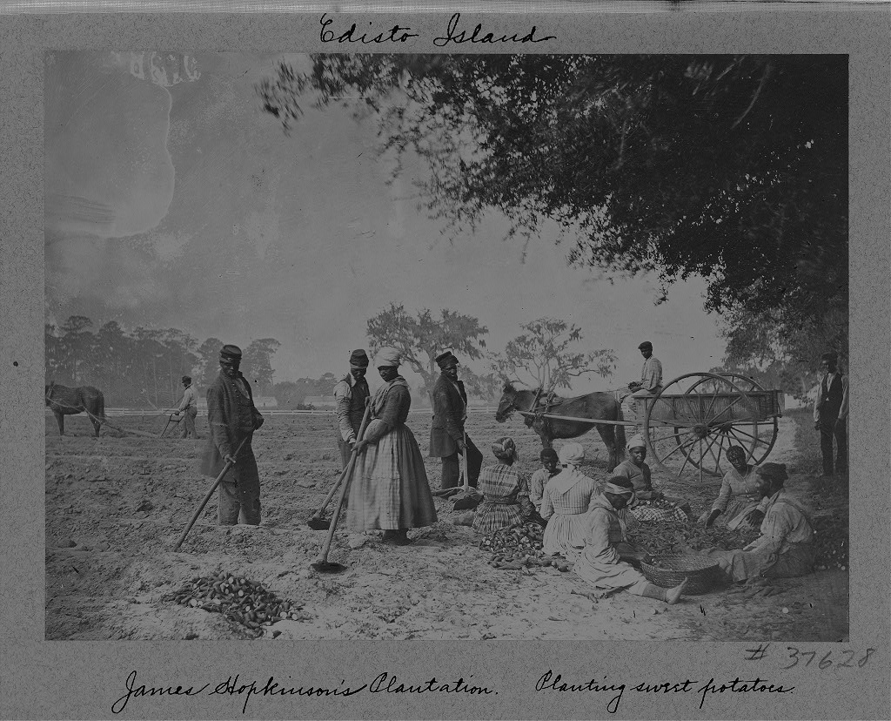
The Role of Slaves
Notes:
In the South, some slaves continued to work for their masters and mistresses, providing for the troops and families for which they worked. However, many left, fleeing to the North in hopes of a better life.
Discussion:
What were two roles or tasks taken on by African Americans during the war?

Slide 13
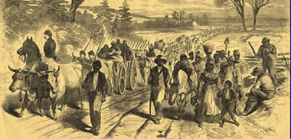
The Role of Slaves
Notes:
Former slaves would travel North or with the army. Some former slaves joined the army while most others took care of their families and tried to find work.

Slide 14
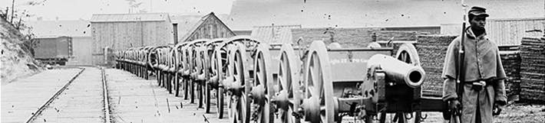
The Role of Slaves
Notes:
Following the Emancipation Proclamation, many of the freed men joined the Union forces.
If you have not done so in another lesson, have the students watch Black Soldiers in the Civil War https://www.battlefields.org/learn/videos/black-soldiers-civil-war

Slide 15
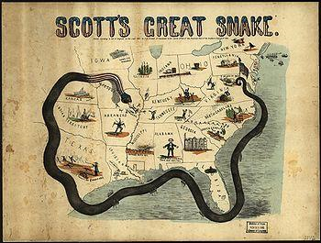
Challenging Times
Notes:
Particularly in the South families faced shortages in raw materials, food, clothing and medical supplies due to the Union Navy blockading Southern ports.
Notes for the Teacher: Above is a cartoon illustration of the “Anaconda plan” a plan developed to block the Southern ports, surround, and essentially disable the Confederacy. This plan was successful in ending the Confederacy, but it hurt civilians.

Slide 16
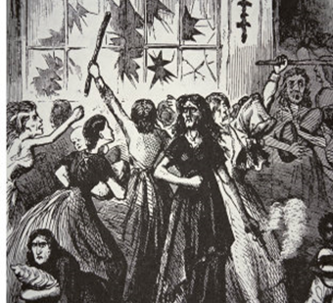
Challenging Times
Shortages became so severe that in 1863 the women of Richmond marched on the government in a “Bread Riot.”
Notes:
Discussion Question:
Why do you think women rioted in Richmond, Virginia? Why do you think it was just women?

Slide 17
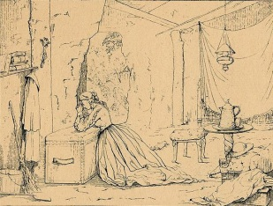
Challenging Times
Civilians in Vicksburg, Mississippi lived through 47 days of Union siege operations against Confederate forces defending the city of Vicksburg. Families lived in caves and trenches to escape the bombardment and many starved in the process.
Notes:
Discussion:
What is a siege? (Answer Information: Surrounding a defended area, cutting the area off from food and supplies.)
Why did the people of Vicksburg have to suffer?
Do you think there were other sieges during the war? (Answer Information: Yes, Petersburg, Fort Donelson, and Port Hudson.)

Slide 18
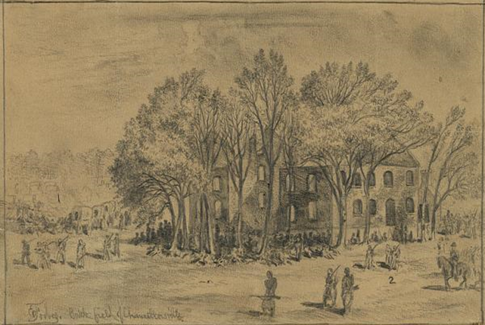
Challenging Times
Civilians who had homes near battles often had their homes destroyed or taken over for use as field hospitals.
The Chancellor family was trapped between the armies in May 1863 when their home became General Hooker’s Headquarters.
Notes:
Image information:
Battlefield of Chancellorsville House after the Battle
Notes:
Sue Chancellor was 16 in May 1863 when her home was between the armies and General Hooker took it for his headquarters. She left a detailed description of the ordeal she faced in company with 15 other women and girls, including relatives, neighbors, and a young abandoned black girl. Water stood shin deep in the basement where they crouched for protection.
“Oh! Such cannonading on all sides,” Sue wrote of May 2, “such shrieks and groans, such commotion of all kinds!”
Her home became a hospital, the grand piano became the amputating table. Arms and legs were thrown out the window. The house caught fire from shelling and burned to the ground. Luckily all the family got out alive.

Slide 19
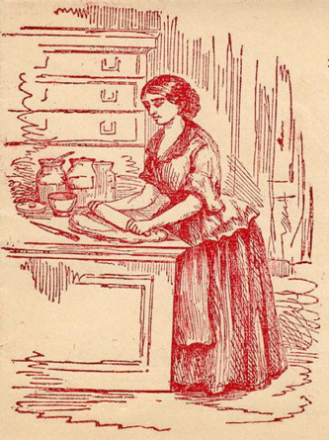
Challenging Times
Those on the home front had to meet the needs of their family as well as support the needs of the army.
Families, mostly in the South, also faced pillaging soldiers.
“When any of the soldiers on either side came thro our place they took anything they could find, the rebels felt that they had a right to it for they were fighting for us. They took our horses and killed our hogs and cows to eat, and took our corn.”
Notes:
The quote is from Mrs. Ernestine Weiss Faudie an interview conducted by the WPA http://www.loc.gov/teachers/classroommaterials/presentationsandactivities/presentations/timeline/civilwar/soldiers/faudie.html

Slide 20
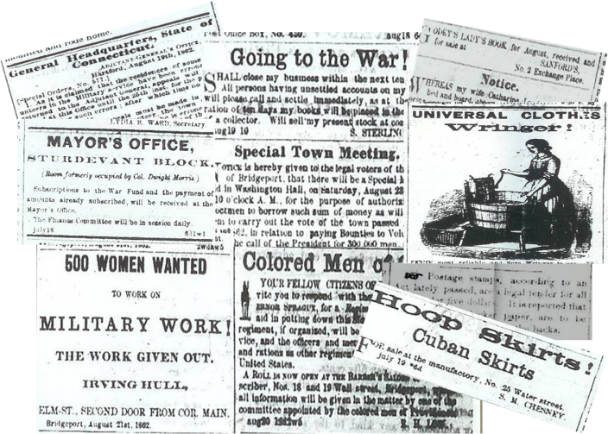
Information
Notes:
Information traveled at a slow rate in the 1800’s, but with the telegraph, newspapers, photography, and the postal service it was moving faster than ever before. Those on the home front were able to learn more about the war and their loved ones during the Civil War than in any previous war. Sometimes the reality of war was a brutal one.
NOTES FOR THE TEACHER: Newspaper reading was at an all time high. Above are clips from a Connecticut newspaper from the summer of 1862.
The newspaper is where people on the home front received most of the news about the war.

Slide 21
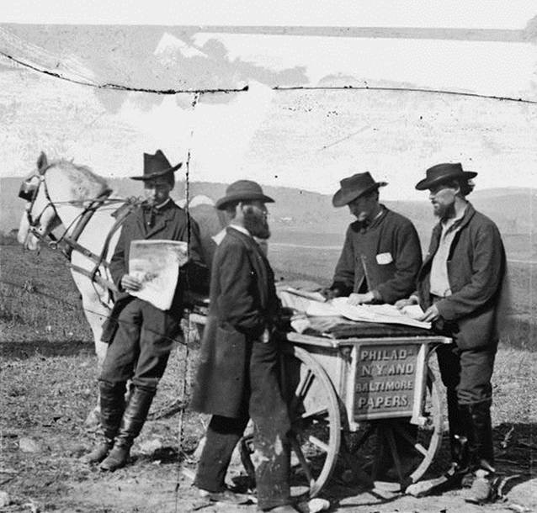
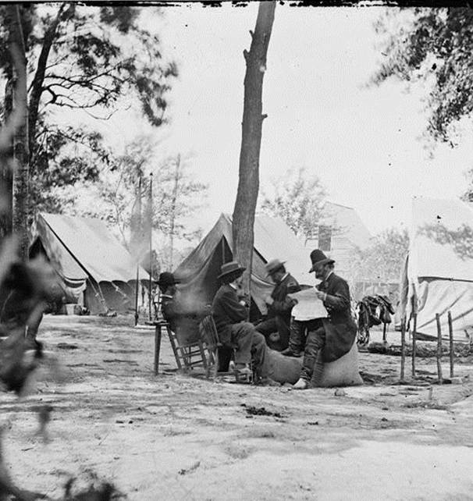
Information
Notes:
Newspaper reading reached an all-time high.
People scanned the newspapers every day for news of the war or their home.

Slide 22
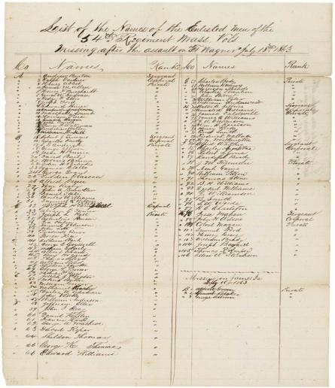
Information
Notes:
Casualty lists were dreaded.
Image information:
Casualty List of the 54th Massachusetts Infantry Regiment from the Assault on Fort Wagner, South Carolina

Slide 23
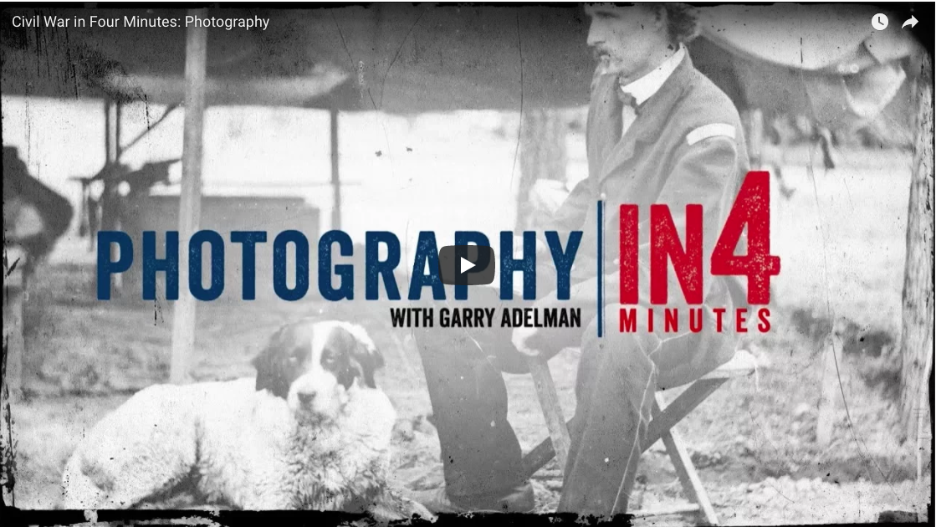
Information
Activity:
Watch Photography
Notes:
Have students watch the Photography In4 video to learn more about photography and photojournalism in the American Civil War.
CAUTION THIS VIDEO CONTAINS GRAPHIC IMAGES
https://www.battlefields.org/learn/videos/photography-and-civil-war

Slide 24
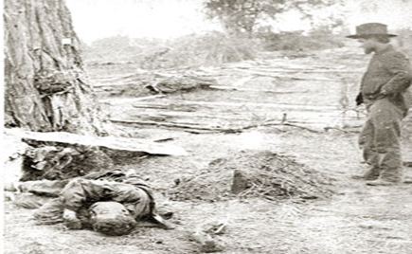
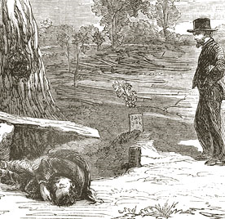
Information
Notes:
The American Civil War gave birth to photojournalism. The US government commissioned photographers to travel with the army and photograph the war. The images that returned home were vastly different from the glorious portrayal of war created by artists up until this time.
Alexander Gardner, working for Matthew Brady, shocked the nation with his photographs of dead on the Antietam Battlefield. Newspapers could not reproduce photographs at the time, but published woodcuts were viewed across the country.
Image Information:
On the Left - Gardner’s image entitled "A Contrast: Federal buried, Confederate unburied, where they fell on the Battlefield of Antietam.“
On the Right - Woodcut created from the Gardner photograph that was reproduced in the newspapers.

Slide 25
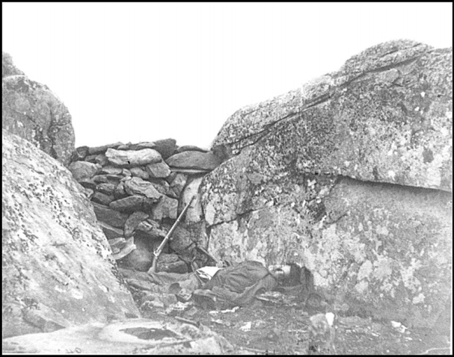
Information
Notes:
Photographs brought the horrors of the war into the home for the first time.
Image Information: Photo of dead soldier at Devil’s Den, Gettysburg.
Discussion Question:
Look at the photograph of the dead soldier at Devil’s Den, Gettysburg. How does this picture make you feel? Think empathetically about the people at the time on the home front, knowing that their loved ones were out fighting in similar conditions. How do you think they were feeling when they saw images like this one?

Slide 26
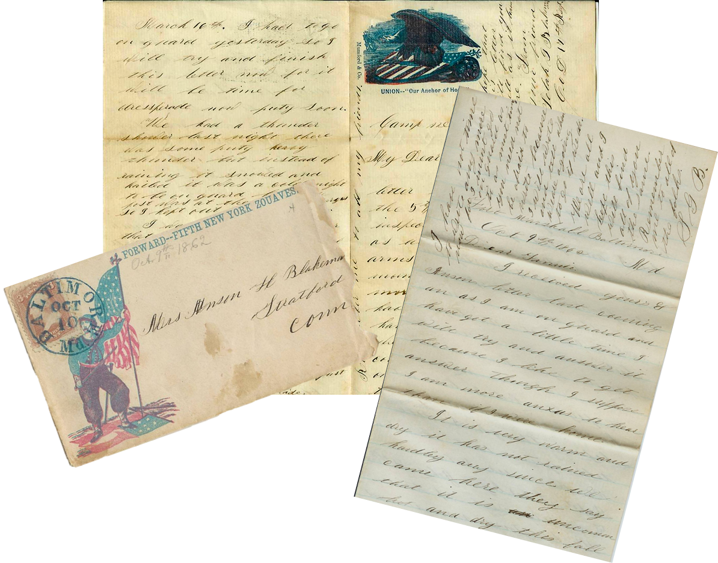

Information
Activity
Read J. Henry Blakeman’s letter
Notes:
Letter writing was the way people kept in touch.
Activity: Read J. Henry Blakeman’s letter
Discussion Question:
How did family members communicate with soldiers away at war?

