Slide 1
Post 1865: Effects of the War
American Battlefield Trust

Slide 2
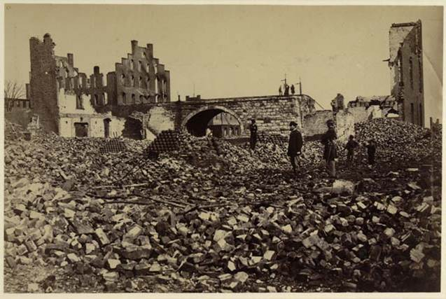
Effects of the War
Notes:
Image information:
Richmond, Virginia in ruins

Slide 3
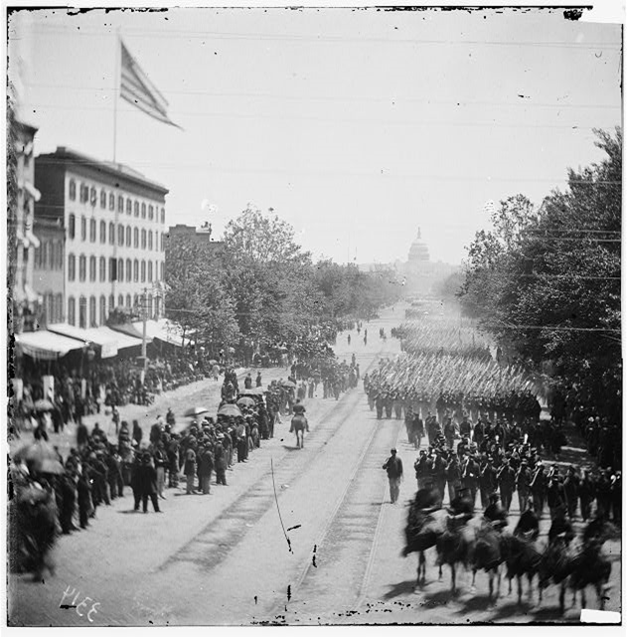
Effects of the War
Notes:
Image information:
Grand Review of the Army – Washington, DC

Slide 4
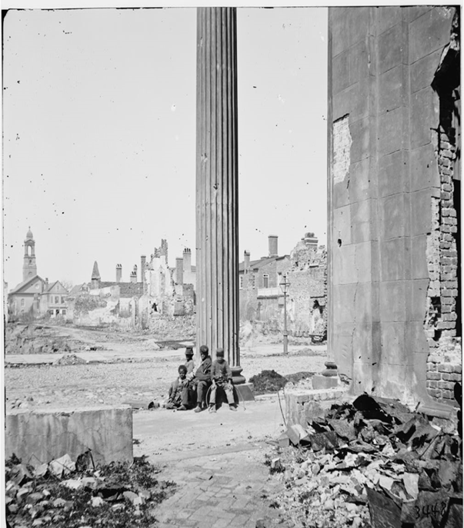
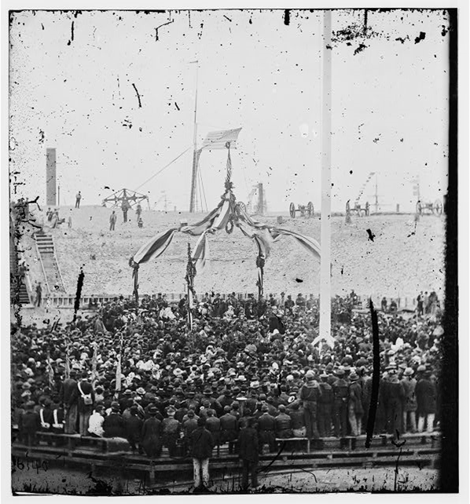
Effects of the War
Notes:
Image information:
Left - Richmond, Virginia
Right – Raising the American flag over Ft. Sumter

Slide 5
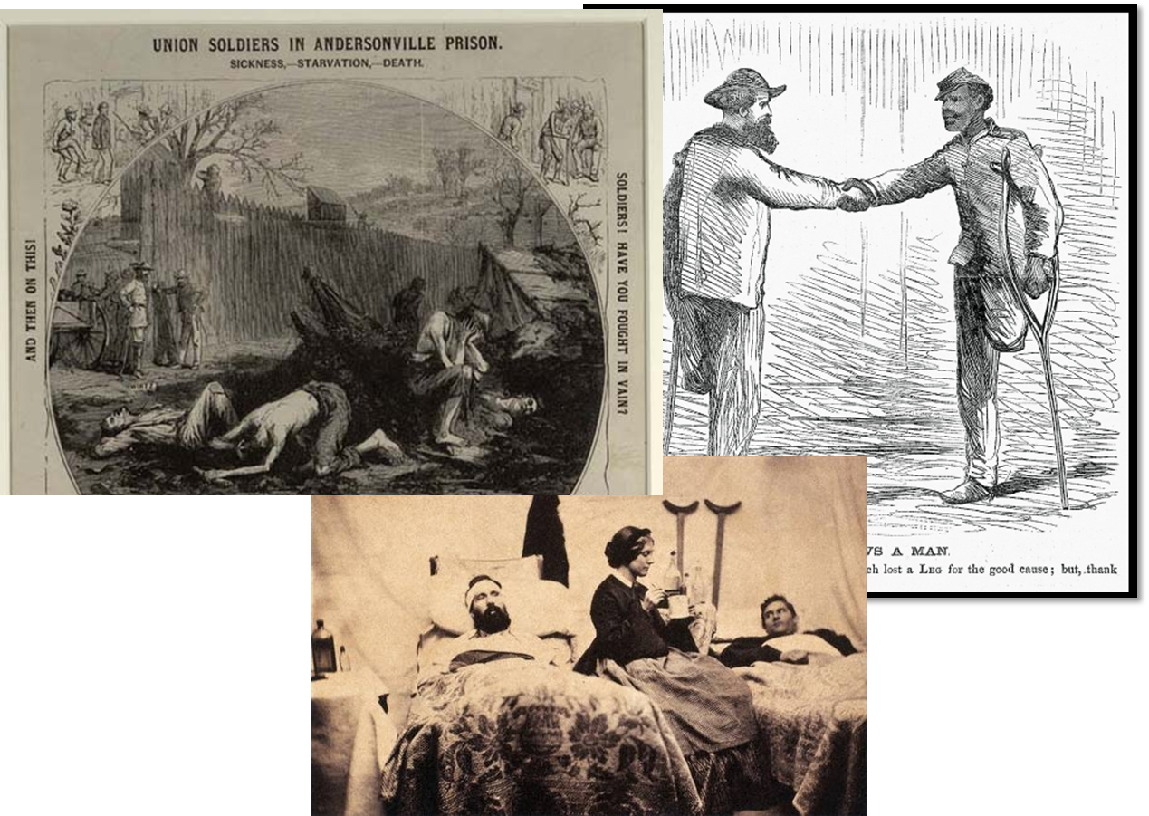
Effects of the War
Notes:
Image information:
Left – illustration, Union soldier’s at Andersonville Prison
Right – soldiers greeting one another after the war
Bottom – civil war hospital

Slide 6
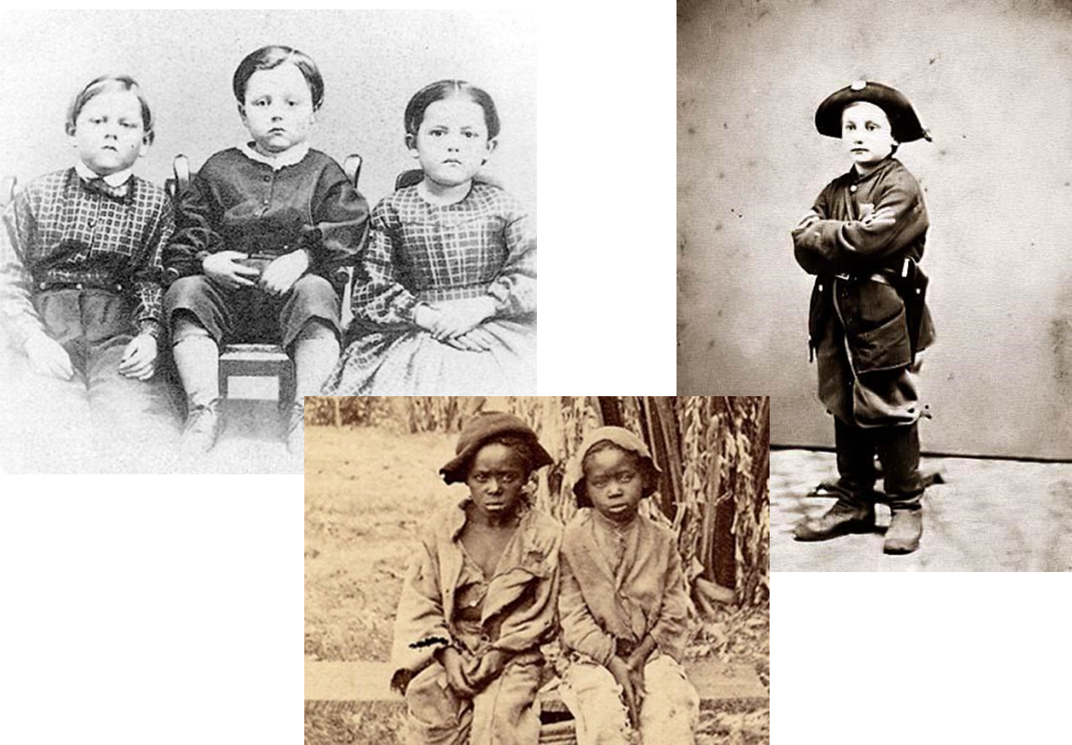
Effects of the War
Notes:
Image information:
Children after the war
Link for two black children: http://abcnews.go.com/US/wireStory?id=10880072 –
Rare Photo of Slave Children Found in NC Attic

Slide 7
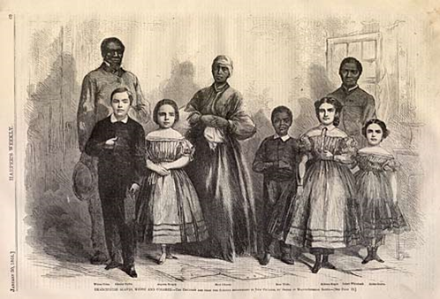
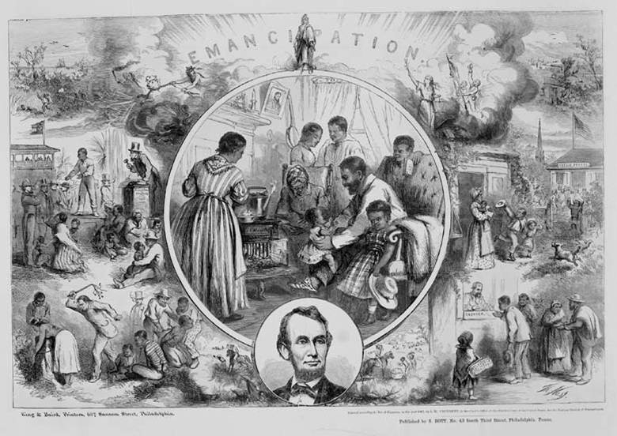
Effects of the War
Notes:
Image information:
Left - Emancipated slaves (both white and black)
Right – Engraving of emancipation

Slide 8
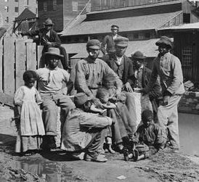
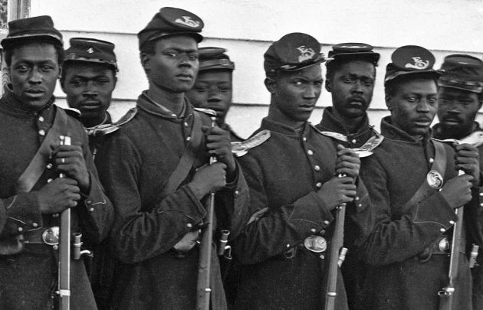
Effects of the War
Notes:
Image information:
Left - Family of freed slaves in Richmond, Virginia
Right - United States Colored Troops

Slide 9
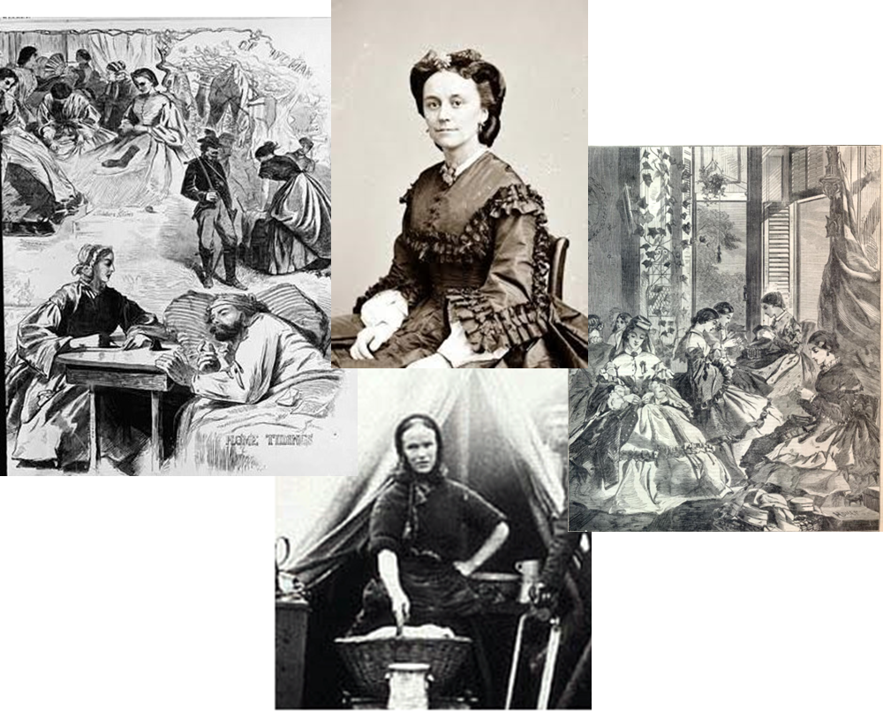
Effects of the War
Notes:
Image information:
Women during the Civil War

Slide 10
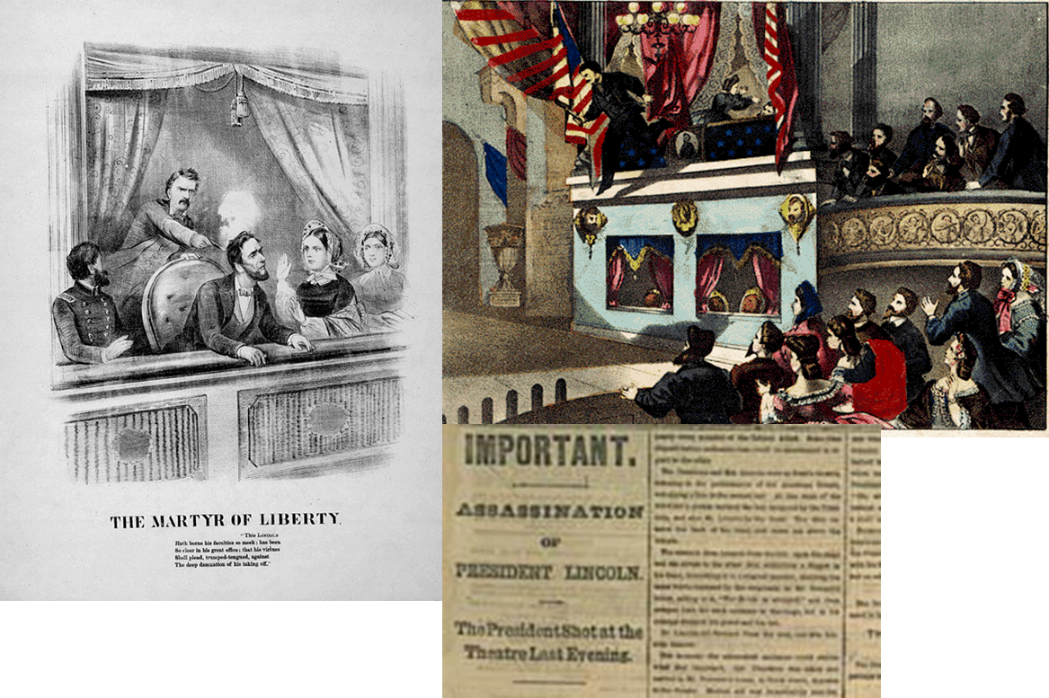
Effects of the War
Notes:
Image information:
Lincoln’s assassination

Slide 11
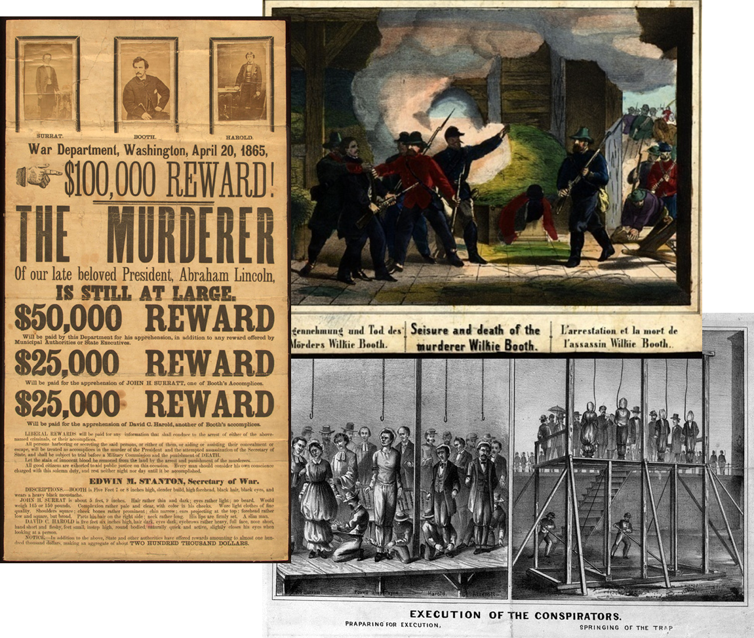
Effects of the War
Notes:
Image information:
Left – wanted poster for John Wilkes Booth and his accomplises
Top Right – illustration of the scene of Booth’s capture
Bottom Right – execution of the Lincoln assassination conspirators

Slide 12
Now what?
What do you think will happen next in the United States? How will the country put itself back together?

Slide 13
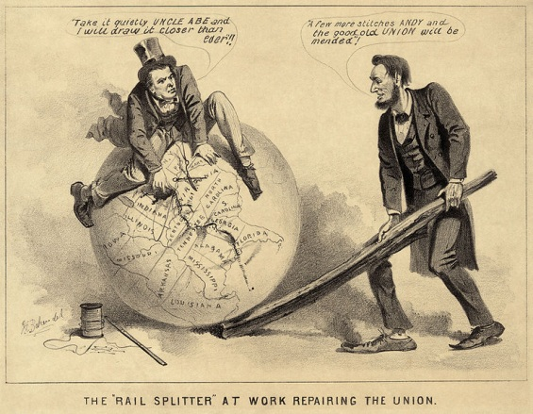
Reconstruction
Notes:
The period following the Civil War in which Congress passed laws designed to rebuild the country and bring the southern states back into the Union.

Slide 14
Reconstruction
1865 Reconstruction Issues
Amending the Constitution to abolish slavery.
Bringing the former Southern states back into the Union.

Slide 15
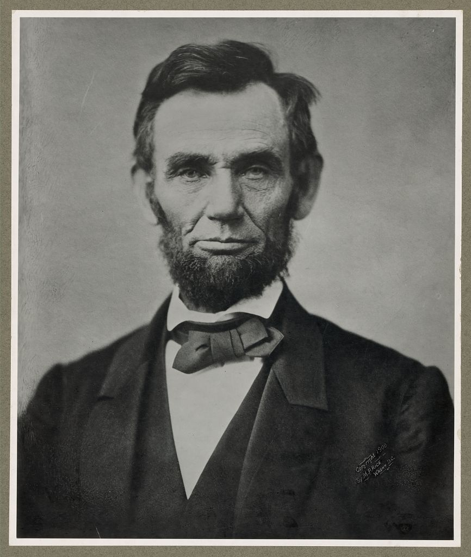
Reconstruction
Notes:
Although Lincoln died before Reconstruction began, he had already started planning for reunification several years before the end of the war.

Slide 16
President Abraham Lincoln
Lincoln wanted the country to come back together peacefully.
Lincoln’s plan was created in 1863, about two years before the end of the war.
At the time of his death, the war was just ending and he was not able to put his ideas into practice.
The Ten Percent Plan
10% of voters in the seceded states must swear
loyalty under oath to the Union.
The seceded states must abolish slavery.

Slide 17
Republican in Congress
Wanted to be more strict with the States that had rebelled.
Wanted a State to re-enter through a slower admission process.
Wade-Davis Bill
The majority of white men from formerly Confederate states must swear loyalty to the United States.
The seceded states must abolish slavery.
Former Confederate soldiers or volunteers cannot hold office or vote.

Slide 18
President Andrew Johnson
Wanted to be strict with the States that had rebelled, but ended up making it relatively easy for them.
Allowed for segregation of the races.
Johnson Plan
The majority of white men from formerly Confederate states must swear loyalty to the United States.
Formerly Confederate states must ratify the 13th Amendment.
Former Confederate officials may hold office and vote.

Slide 19
Radical Republicans
Radical republicans, often abolitionists, represented a large part of Congress.
These Congressmen wanted to be strict with the States that had rebelled.
Reconstruction Act
Formerly Confederate states must disband their state governments.
Formerly Confederate states must write new state constitutions.
Formerly Confederate states must ratify the 14th Amendment
Formerly Confederate states must allow African Americans to vote.

Slide 20
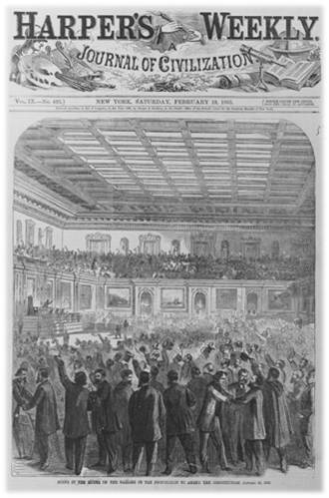
13th Amendment
January 31, 1865
“The final announcement of the vote was the sequel for a whirlwind of applause wholly unprecedented in Congressional annals,” reported the Chicago Tribune. “The galleries led off, giving cheer after cheer. The members on the floor then joined in the shouting, throwing up their hats and clapping their hands.”
Notes:
On this date, the House passed the 13th Amendment to the Constitution, abolishing slavery in the United States. After the House had failed to follow the Senate in mustering the two-thirds majority necessary to amend the Constitution the previous June, Representative James Ashley of Ohio revived the amendment. He noted that “the genius of history with iron pen is waiting to record our verdict…which shall declare America is free.” The 119 to 56 vote sealed victory for abolitionists’ long battle against the “peculiar institution.” Despite rules dictating decorum in the House Chamber, the roll call vote instigated jubilant celebration. “The final announcement of the vote was the sequel for a whirlwind of applause wholly unprecedented in Congressional annals,” reported the Chicago Tribune. “The galleries led off, giving cheer after cheer. The members on the floor then joined in the shouting, throwing up their hats and clapping their hands.” The requisite three-quarters of the states ratified the amendment with the state of Georgia’s approval on December 6, 1865.
http://clerk.house.gov/art_history/highlights.html?action=view&intID=5

Slide 21
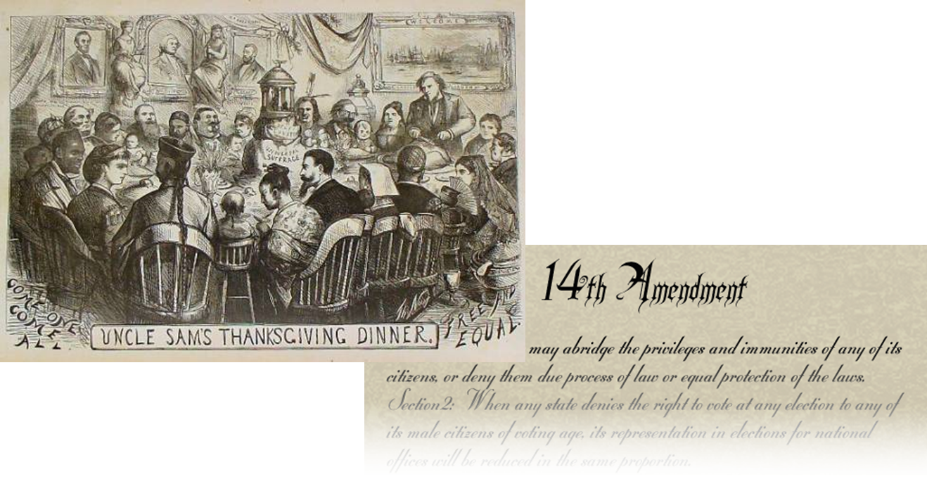
14th Amendment
July 9, 1868
Notes:
Not only did the 14th amendment fail to extend the Bill of Rights to the states; it also failed to protect the rights of Black citizens. One legacy of Reconstruction was the determined struggle of black and white citizens to make the promise of the 14th amendment a reality. Citizens petitioned and initiated court cases, Congress enacted legislation, and the executive branch attempted to enforce measures that would guard all citizens’ rights. While these citizens did not succeed in empowering the 14th amendment during the Reconstruction, they effectively articulated arguments and offered dissenting opinions that would be the basis for change in the 20th century. http://www.ourdocuments.gov/doc.php?flash=old&doc=43

Slide 22
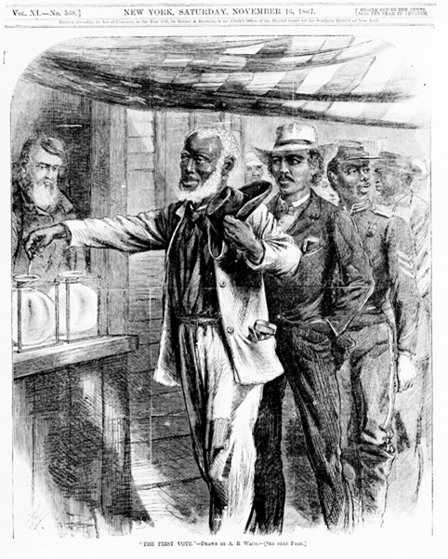
15th Amendment
February 3, 1870
“The right of citizens of the United States to vote shall not be denied or abridged by the United States or by any state on account of race, color, or previous condition of servitude."

Slide 23
What do you think?
Given Lincoln’s plan and the other plans, what plan do you think they will end up choosing (if they choose one at all)?
Where do you think the country is headed?
What do you think will happen with the former Confederate soldiers and leaders?
What will happen to the newly freed African-American population?
When might reconstruction end?
Notes:
Go through the questions, taking notes on the students answers. After your class watches the following 4 minute video, see if their predictions were along the correct path.

Slide 24
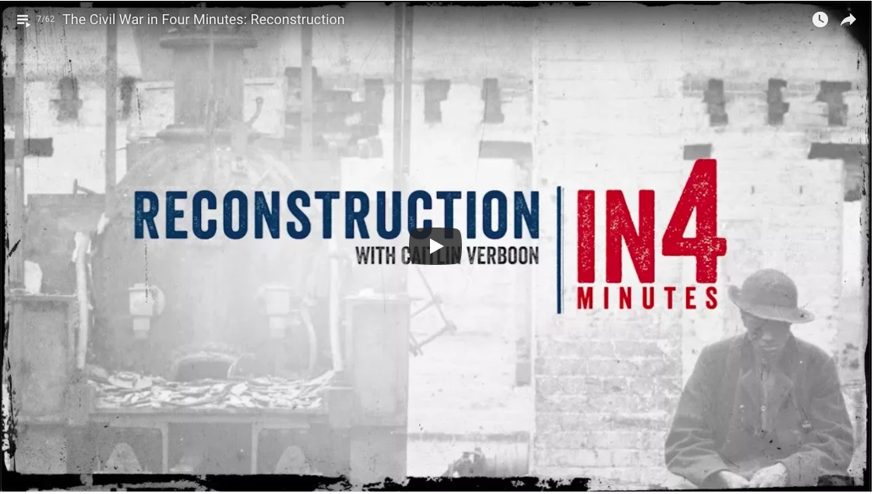
Reconstruction
Notes:
Watch the Reconstruction IN4 video for a quick summary of the reconstruction period https://www.civilwar.org/learn/videos/reconstruction-after-civil-war

