Slide 1
1864-1865: Bringing the War to an End
American Battlefield Trust

Slide 2
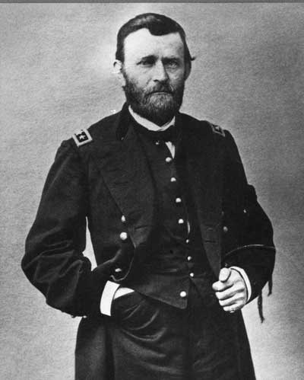
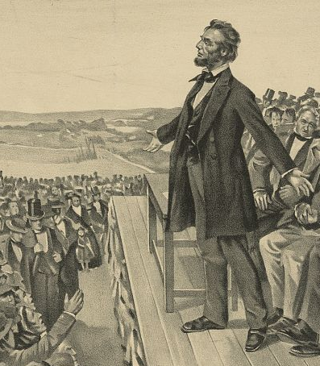
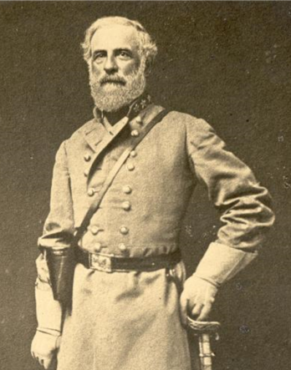
End of 1863
With success at Gettysburg and Vicksburg the war is going in favor of the Union forces, but three years of war has taken its toll on the nation. The upcoming presidential election could determine, more than any battle, the fate of the nation.
Ulysses S. Grant defeats the Confederate defenses of Vicksburg in July 1863.
November 1863, Lincoln gives the Gettysburg Address.
Robert E. Lee retreats from Gettysburg, PA in July 1863 and returned to Virginia.

Slide 3
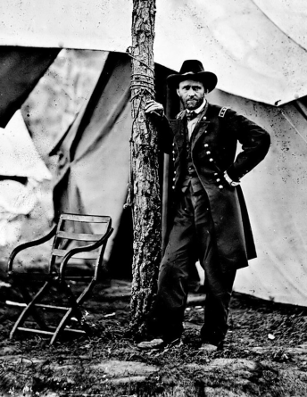
Bringing the War to an End
March 10, 1864
Abraham Lincoln appoints General Ulysses S. Grant as commander of ALL U.S. forces - for the first time one commander will be in charge of the entire Union Army.

Slide 4
Bringing the War to an End
General Grant moves himself to the Eastern front to move on the Confederate capital, Richmond, Virginia.
Union General William T. Sherman will move towards the capture of Atlanta. Atlanta is a railroad hub and a city that manufactures a number of goods for the Confederacy.

Slide 5
Bringing the War to an End
Why would taking control or destroying railroads be important?
  Optional, learn more about the role of railroads in the Civil War, watch the In4 video https://www.battlefields.org/learn/videos/railroads-civil-war
Why is capturing Richmond important?
What will it take to bring the war to an end?

Slide 6

Bringing the War to an End
Date | Name
May-June 1864 | Overland Virginia Campaign
May-Sept, 1864 | Atlanta Campaign
Nov 1864 | Reelection of Abraham Lincoln
Sept - Dec 1864 | Sherman’s March to the Sea
July 1864 – April 1865 | Siege of Petersburg
April 9, 1865 | Lee’s army surrenders
April 14, 1865 | Abraham Lincoln is assassinated
April 26, 1865 | Joseph Johnston’s army surrenders
Activity
Place each of the final events of the Civil War in chronological order on your timeline.

Slide 7
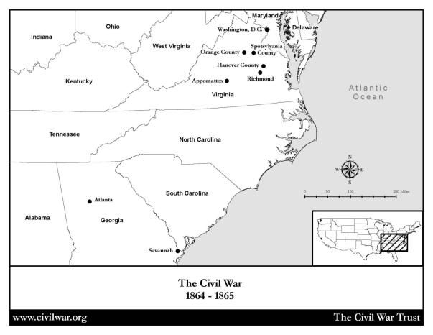
Bringing the War to an End
Activity
Label each of the events and their date on your map.

Slide 8
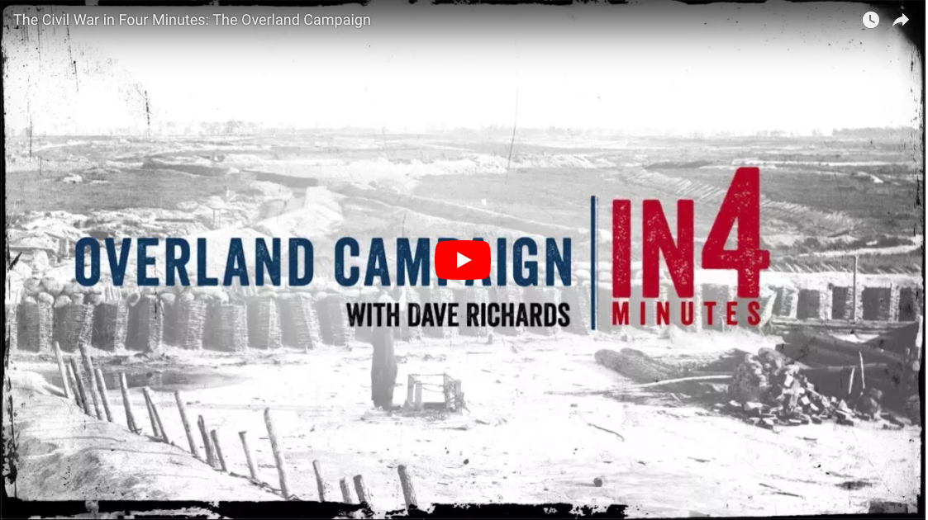
Overland Campaign
Watch The Overland Campaign In4 https://www.civilwar.org/learn/videos/overland-campaign

Slide 9
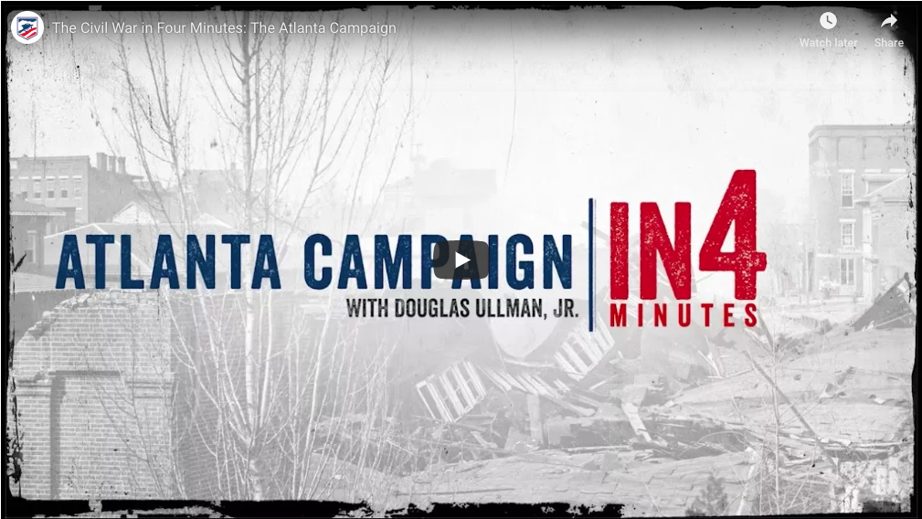
Atlanta Campaign
Watch the Atlanta Campaign In4 https://www.battlefields.org/learn/videos/atlanta-campaign

Slide 10
Bringing the War to an End
While the war rages on and battles are being fought, the presidential election of 1864 is underway.

Slide 11
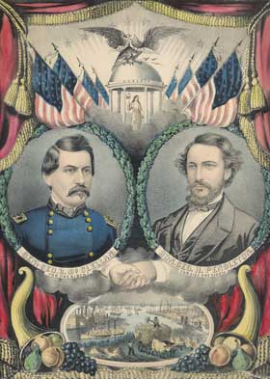
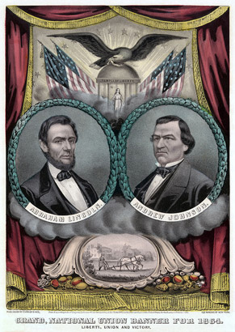
Election of 1864
Abraham Lincoln runs for re-election in his campaign against his former General, George B. McClellan.
A poster of the Democrat ticket.
A poster of the Republican ticket.

Slide 12
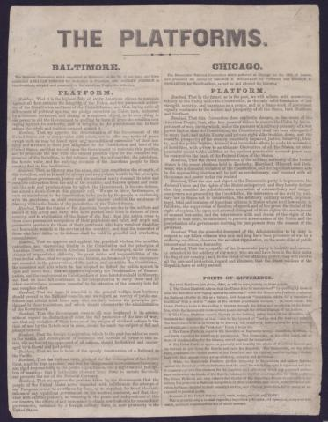
Election of 1864
Activity
As a class read the party platforms. Take notes on the major resolutions for each party, this will help prepare you for the debate.

Slide 13
What do you think?
Should the war go on?
You will now break into two groups.
Lincoln
McClellan
As a group, discuss and formulate answers to your group’s respective questions on the “What Do You Think” worksheet.

Slide 14
What do you Think?
Activity
Debate between the Lincolns and McClellans. Use your notes from the questions to formulate your responses.

Slide 15
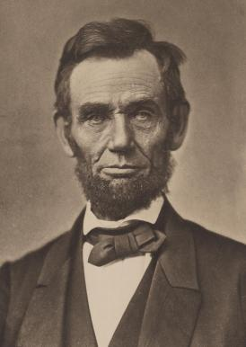
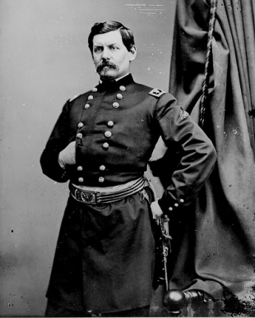
What do you Think?
Raise your hand if you are
voting for Lincoln.
Raise your hand if you are
voting for McClellan.

Slide 16
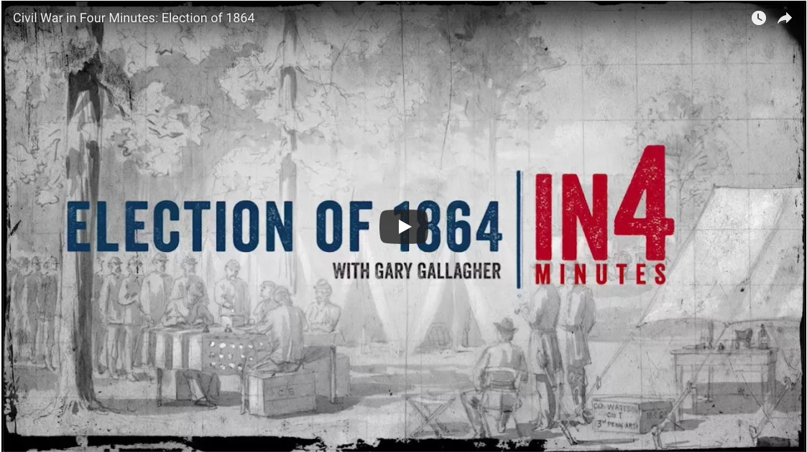
Election of 1864
Watch the Election of 1864 In4 https://www.civilwar.org/learn/videos/election-1864

Slide 17
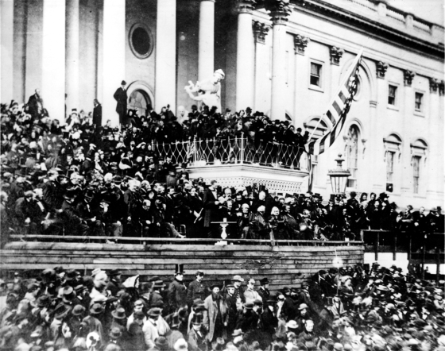
Lincoln Wins the Election
America chose, through the election of Abraham Lincoln, to continue fighting the war.
Lincoln gives his Second Inaugural Address March 4, 1865

Slide 18
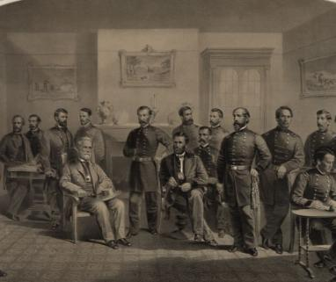
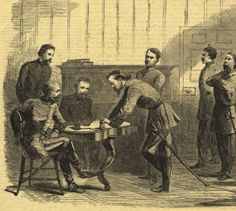
Confederate Surrender
April 2, 1865
Union breaks through the defenses of Petersburg.
April 3, 1865
Union troops take over Richmond, the Confederate capital.
April 9, 1865
Confederate General, Robert E. Lee surrenders at Appomattox, Virginia.
Later in April, on the western front, Confederate General Joseph Johnston surrenders to General William T. Sherman.

Slide 19
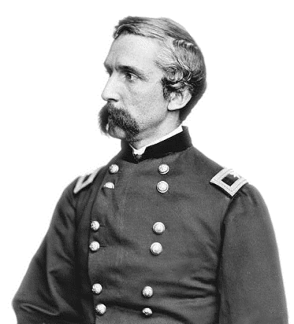
Confederate Surrender
Activity
Let’s read a portion of General Chamberlain’s account as a class and answer the discussion questions

Slide 20
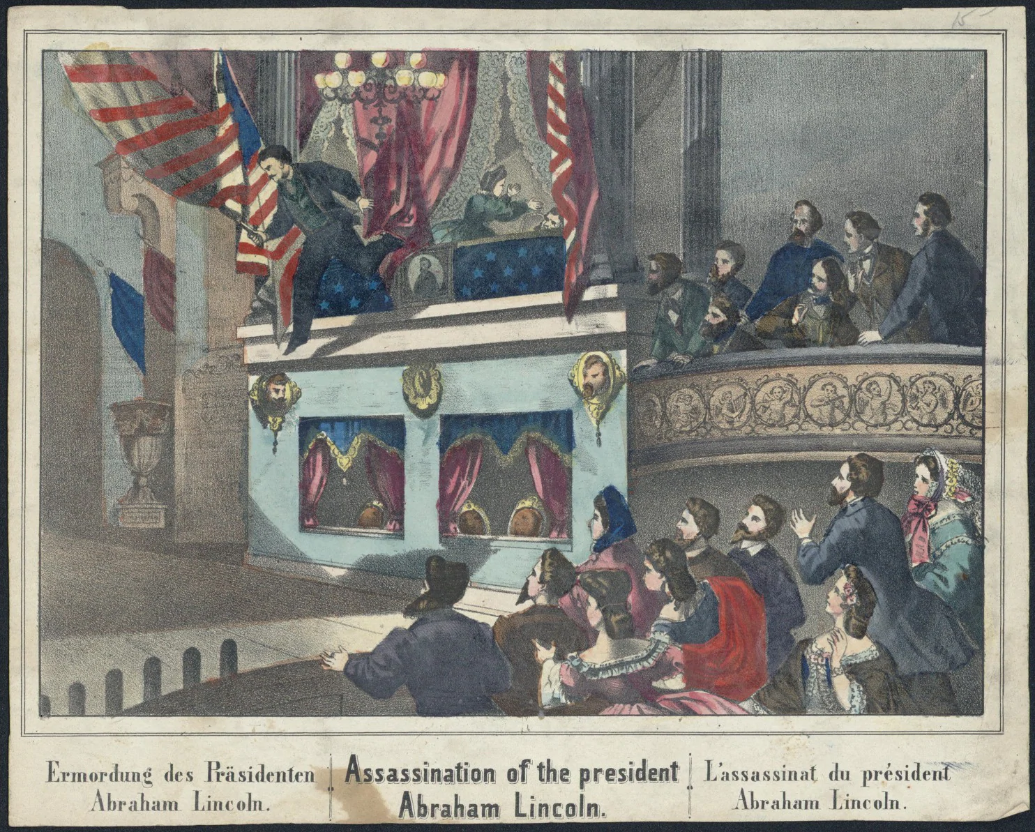
Lincoln is Assassinated
April 14, 1865
Abraham Lincoln is assassinated by Confederate sympathizer, John Wilkes Booth.
The country mourns the loss, and the former Confederacy does not rejoice; rather, they feel the loss as well.

Slide 21
Bringing the War to an End
What did it take to bring the Civil War to an end?

Slide 22
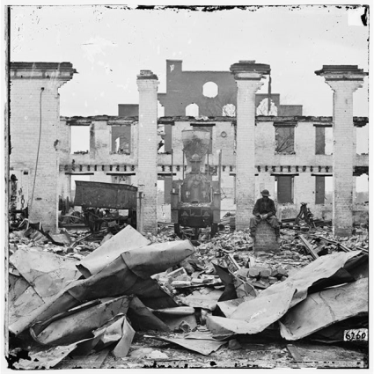
Rebuilding
After the surrender and the assassination of the nation’s leader, the incredibly difficult task of rebuilding and reunifying the country begins.
Richmond in ruins.

Slide 23
Why Does this Matter?
Why does the end of the war matter to us today?
  Consider who won the conflict and the structure of the Union today.
  Consider who lost the conflict and if there are any signs of a lost war in that region.
  Consider the people the war impacted.
  Consider laws and rights that were tested, strengthened, and changed.

